Slide 1
IMAGING OF THE SPINE AND SPINAL CORD
Dr N.M. Kimani
Lecturer DIRM
Level 4: 15th Dec 2016

Slide 2
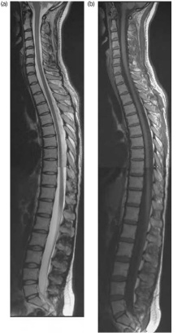
SPINE/SPINAL CORD
Functions
-Protection of spinal canal
-Weight bearing
- Motion
Anatomy
-Vertebrae---24 vertebrae
-Facet joints , discs and ligaments.

Slide 3
Why image?
Trauma
Degenerative disease
Disc herniation
Spinal stenosis
Inflammatory diseases
Spinal tumours
Congenital spinal malformation.
Spinal vascular abnormalities.

Slide 4
Modalities
  Plain radiography
  Computerized tomography
  Myelography
  Magnetic resonance
  Radionuclide imaging
  Ultrasonography
  Miscellaneous -discography

Slide 5
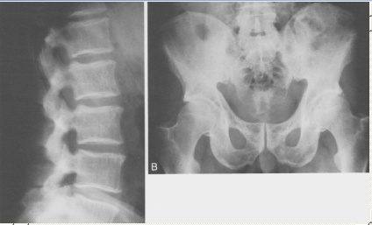
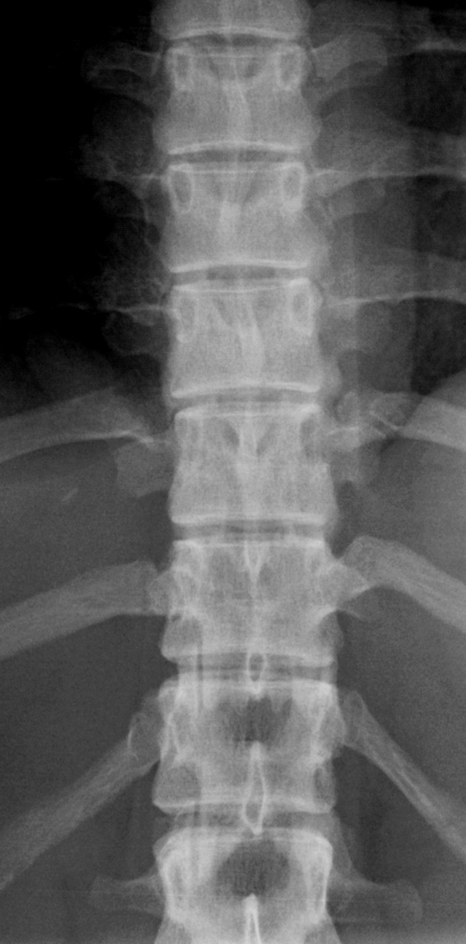
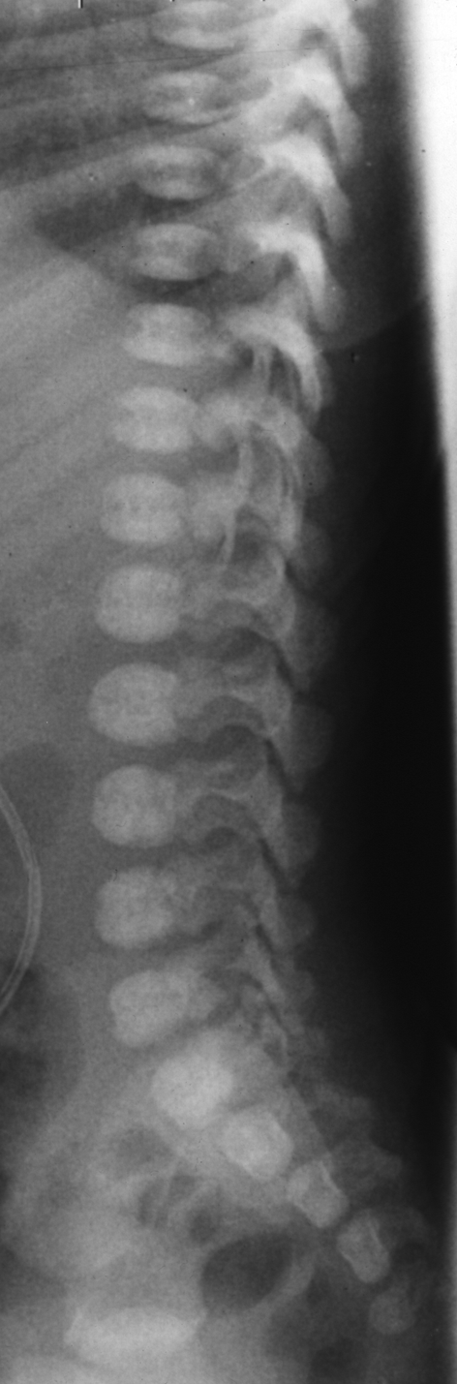
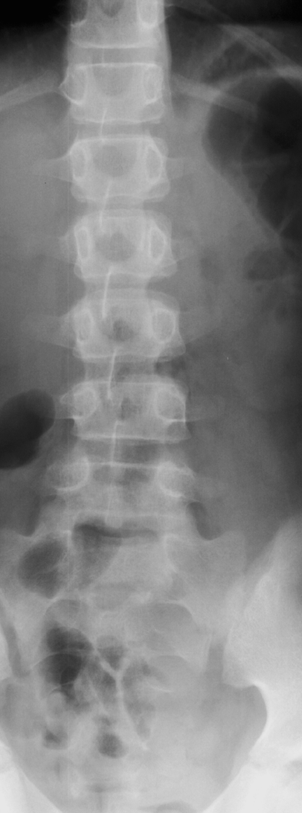
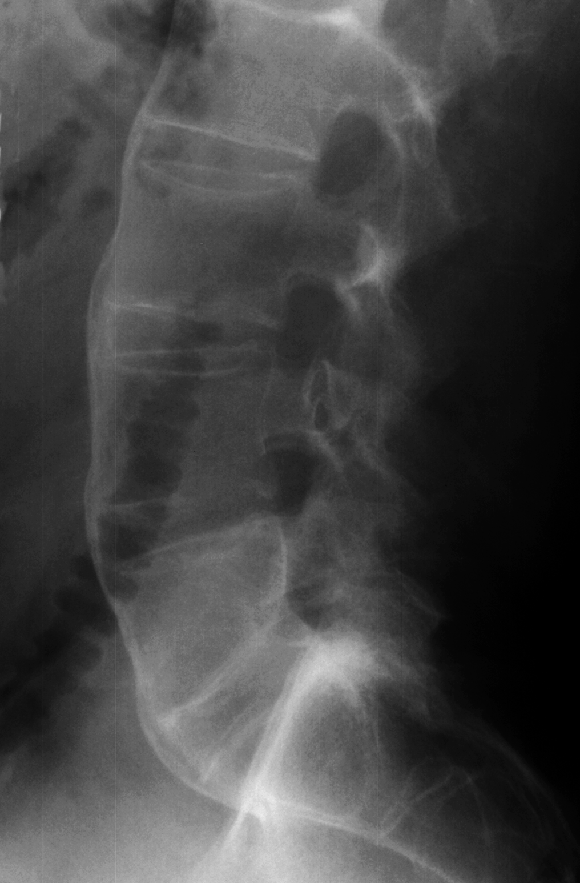
Plain film(X-Ray)
Most important in spinal trauma
-Available in any hospital
-Can be performed without moving the patient
-Gives best information about dislocation.
- Important structures such as facet joints in the cervical spine are well shown.
- Can be performed in provocation allowing
evaluation of instability.

Slide 6
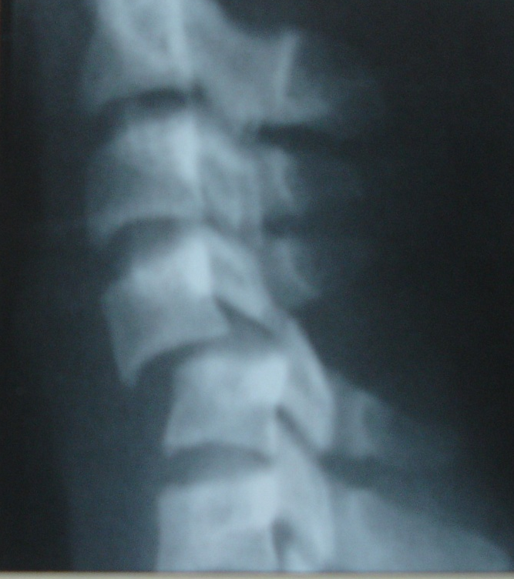
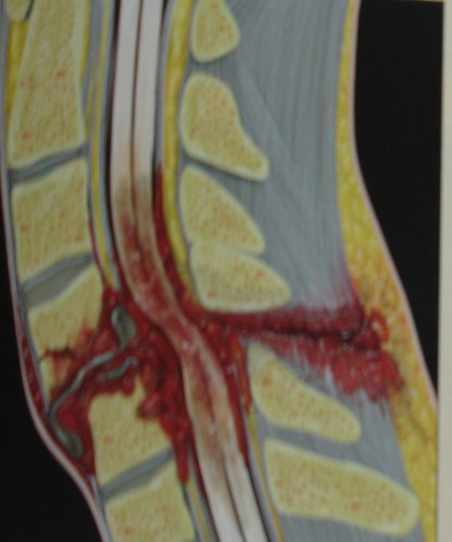
Trauma
Traumatic lesions differ on the kind and extent of trauma
Distinction is drawn from spinal fractures with and without neurological features –important for therapy
Spinal cord injury
-concussion
-Spinal contusion
-Torn spinal cord
Fractures and dislocations with /without neurological symptoms
Hemorrhage
-epidural
- subdural (rare)
Root avulsion injury .

Slide 7
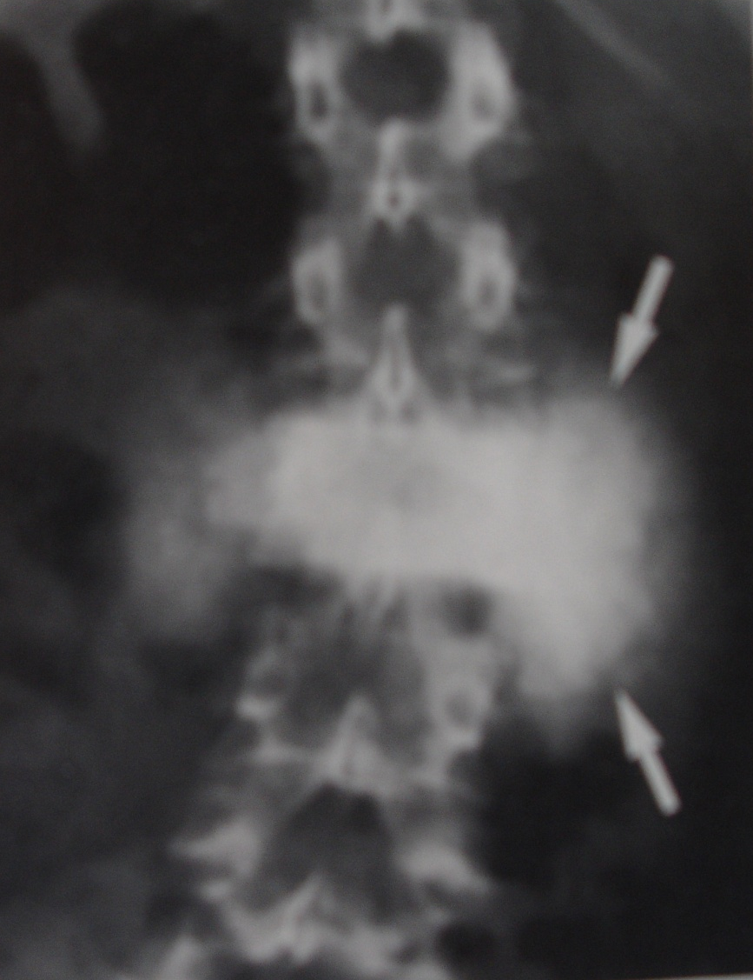
Tumors
Plain film radiograph
-Osteogenic sarcoma
-sunburst tumor
-soft tissue mass

Slide 8
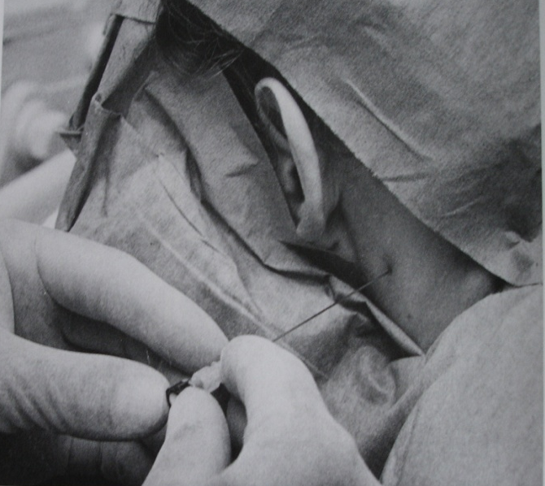
MYELOGRAPHY
C1/C2 puncture

Slide 9
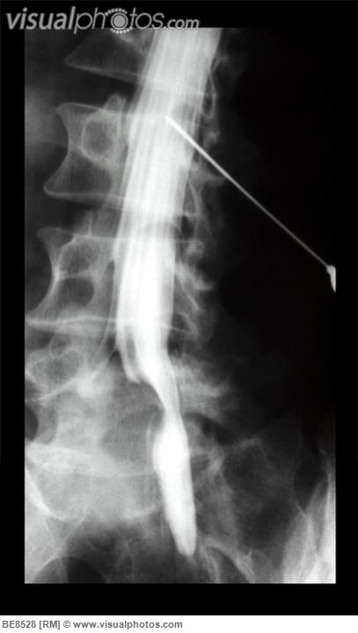
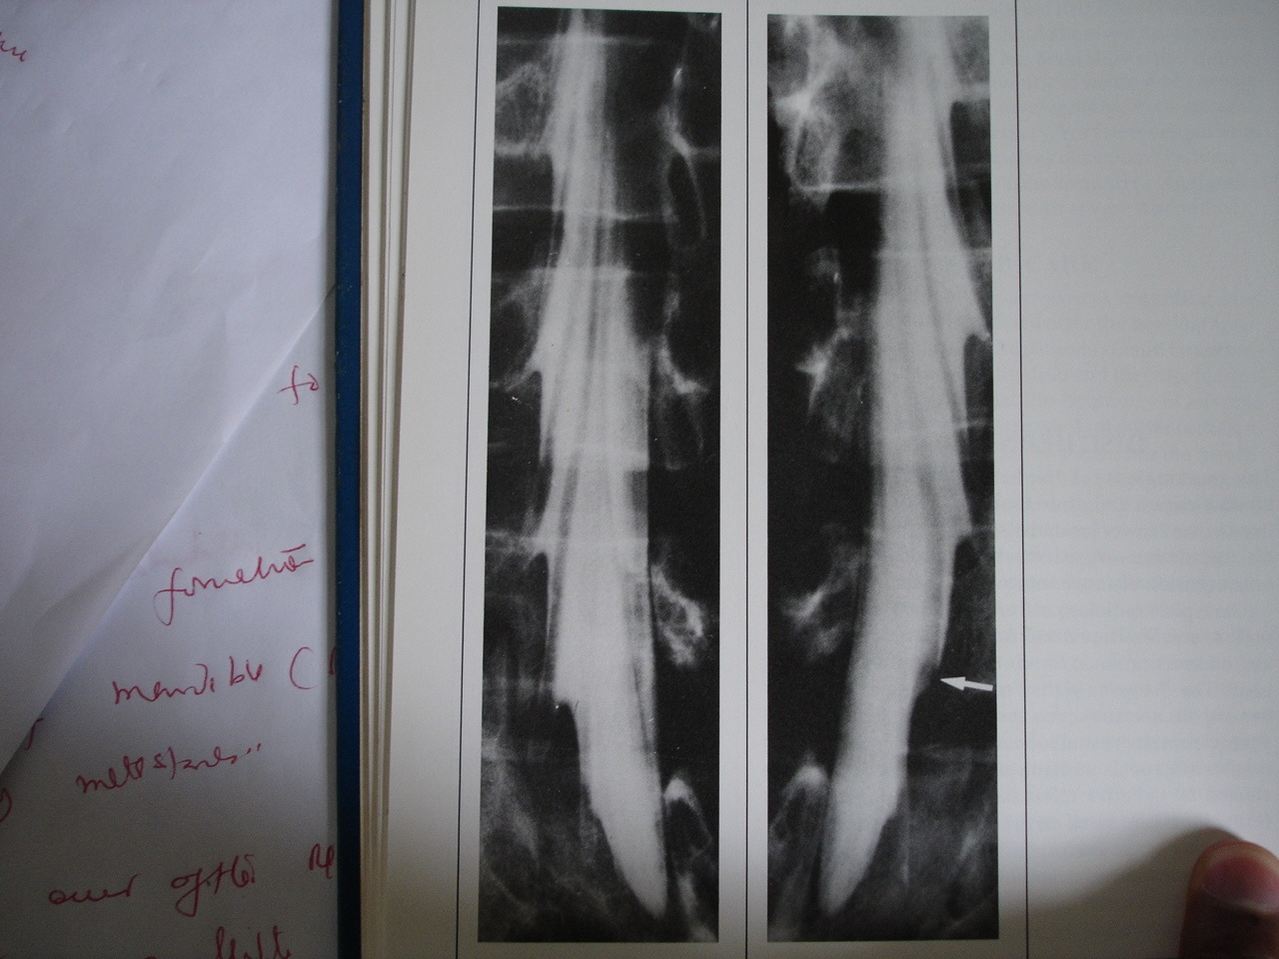
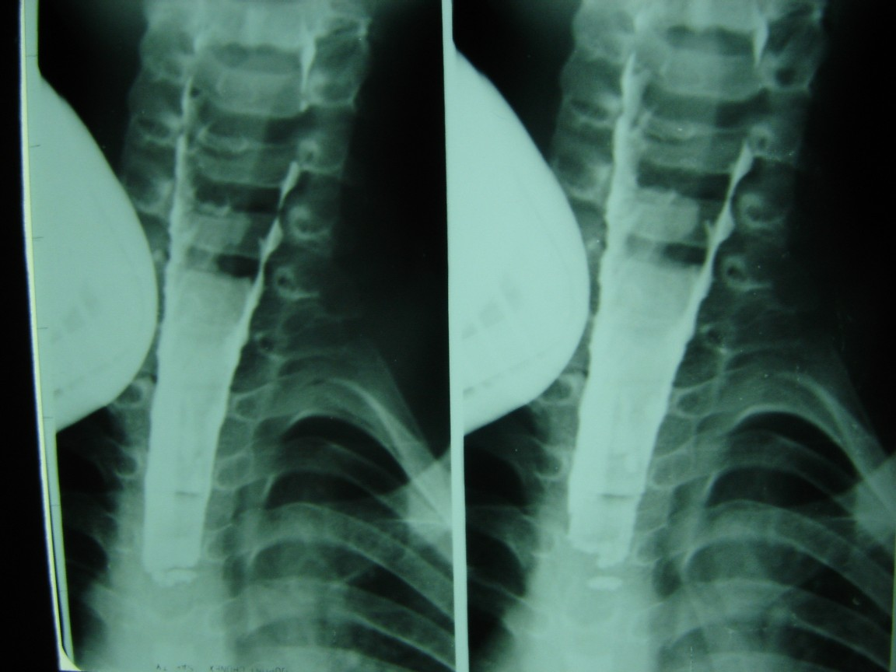
Myelography
C1/C2 puncture

Slide 10
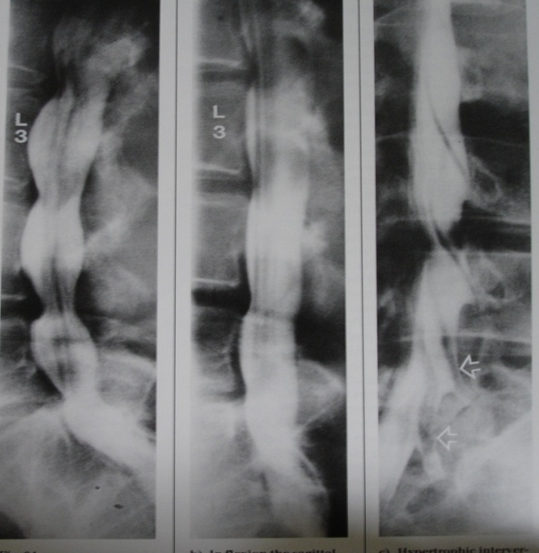
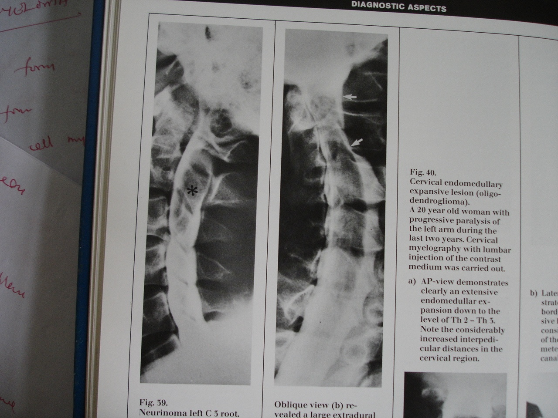
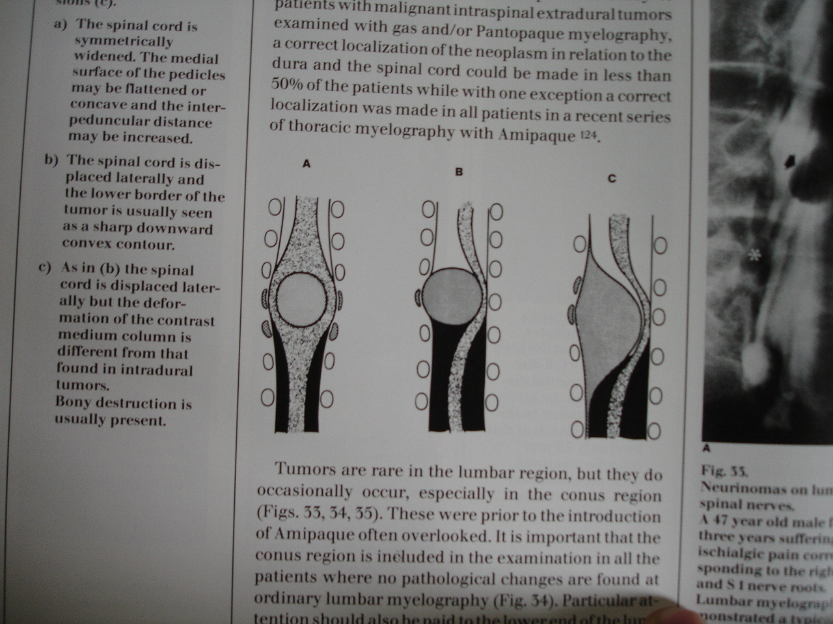
myelography

Slide 11
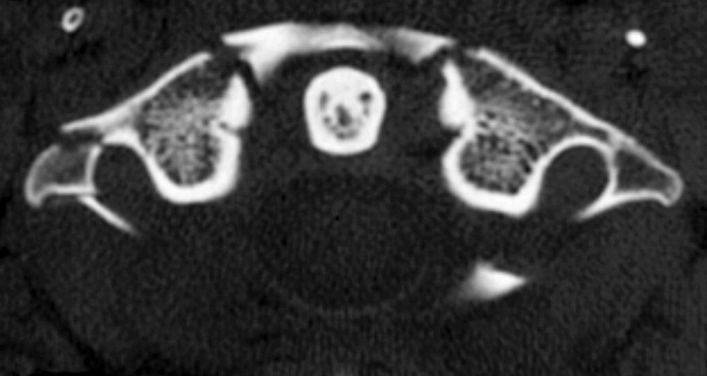
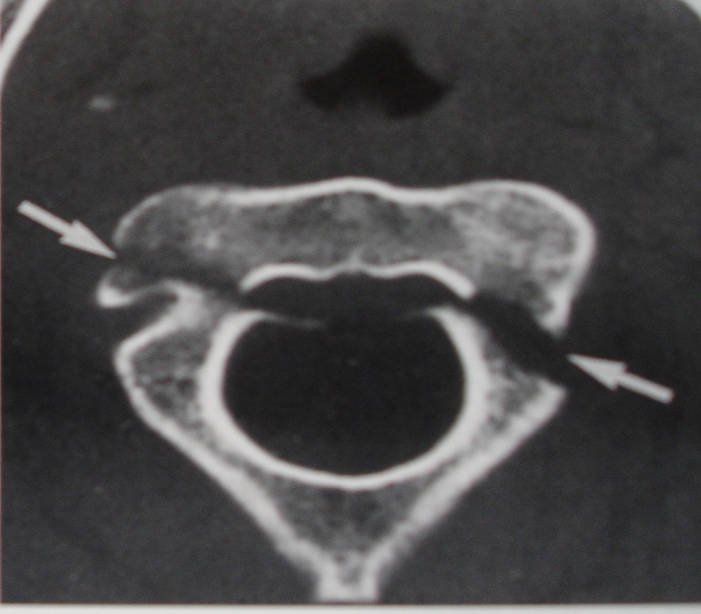
Computerized Tomography(CT)
Gives valuable additional information to plain
film.
special value in identification of fractures
Identification of fractures with bone fragments in
the spinal canal.
Gives best informative about the degree of ligamentous tears and fracture dislocations.
Reformatted images gives valuable information about dislocations

Slide 12
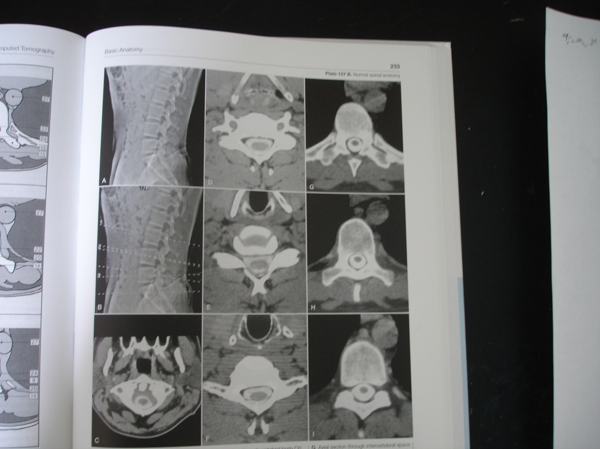
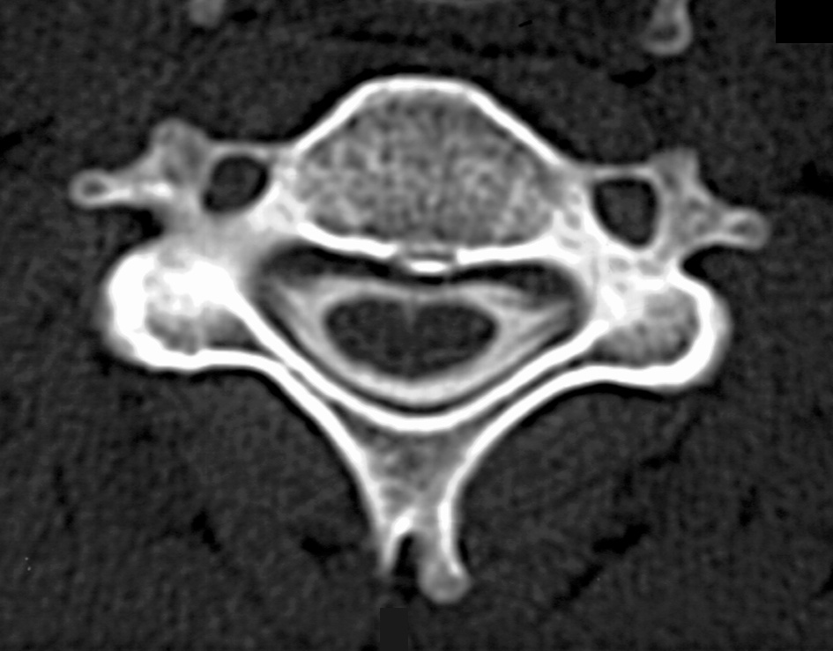
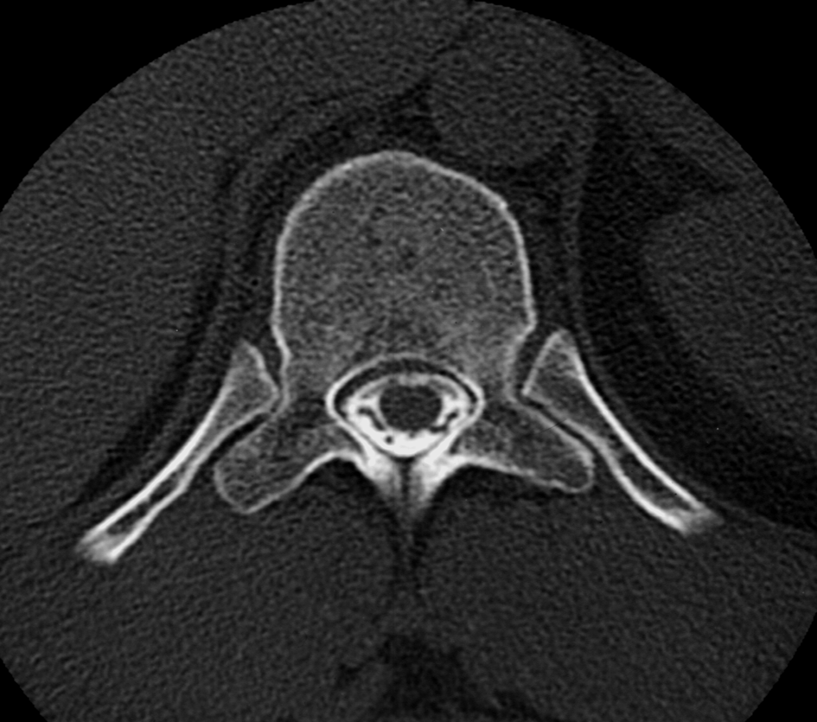
CT Myelogram-Normal
Digital x-ray of the spine –A, B

Slide 13

Traumatic spondylosis
Hangman’s fracture of C2
Anterior displacement of C1-C2 body complex
Axial NECT shows the fracture extends thro the pedicle and inferior C2 body

Slide 14
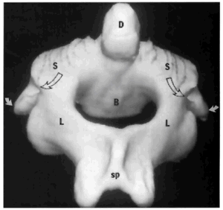
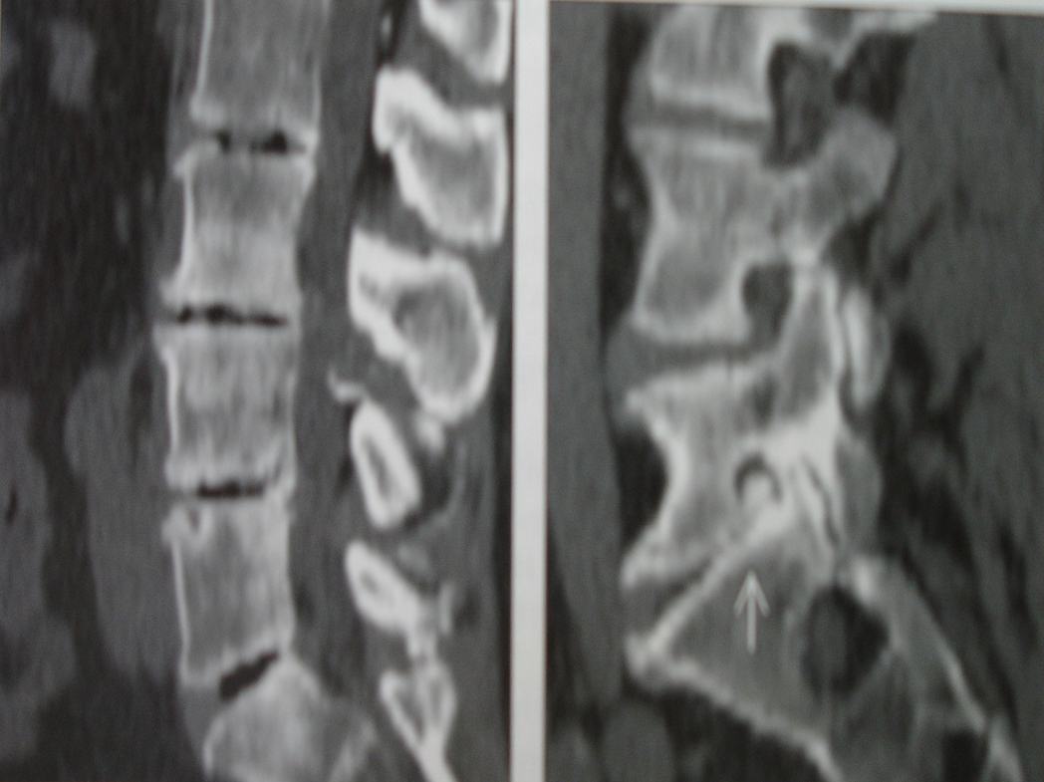
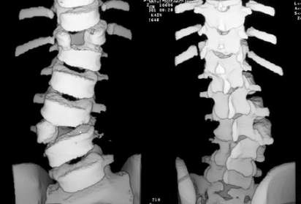
CT Reformats
Degenerative Disc Disease
-Loss of disc height
-Vacuum phenomena
-Osteophytes
-facet subluxation

Slide 15
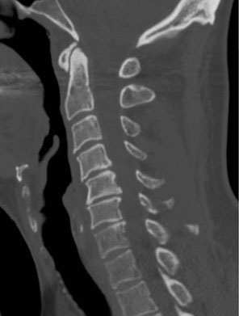

Slide 16
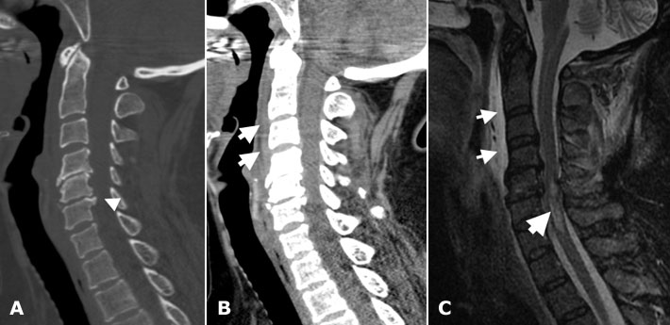
A CT scan-degenerative changes
B subtle prevertebral soft tissue swelling
C. MR prevertebral effusion
spinal cord signal abmormality

Slide 17

Magnetic Resonance Image
-Gives additional information about soft tissue:
-cord contusion
-traumatic disc herniations.
-Evaluation of post traumatic changes
e.g. cyst formation.
-Non-invasive
-gives details about bone marrow.

Slide 18
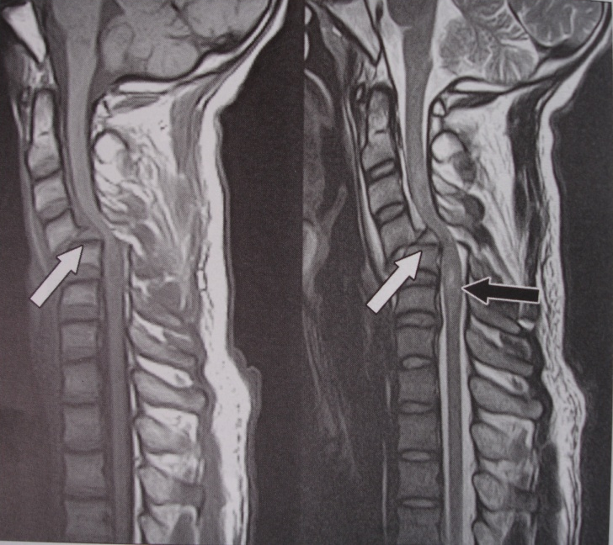
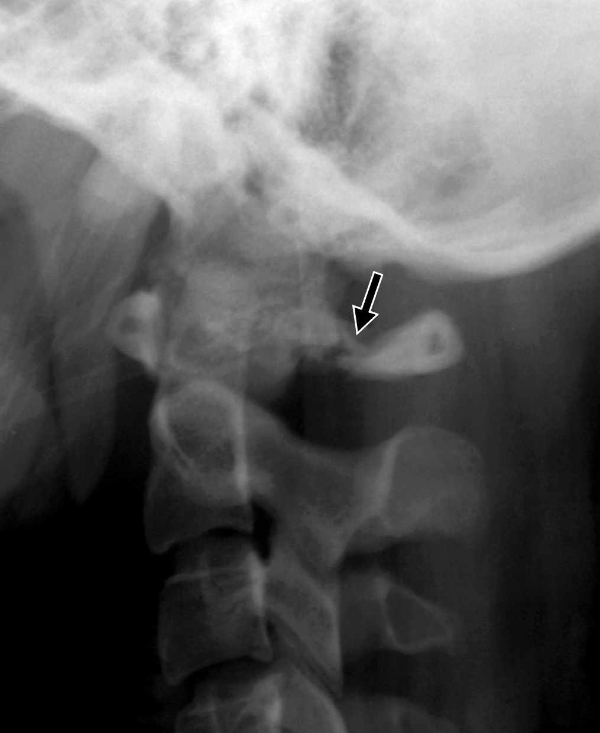
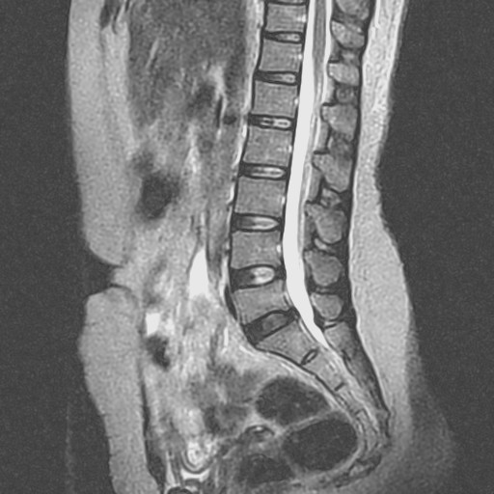

Slide 19
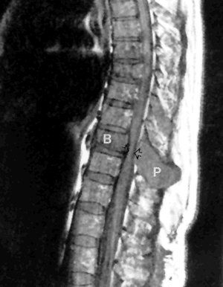
Metastases
Cord compression

Slide 20
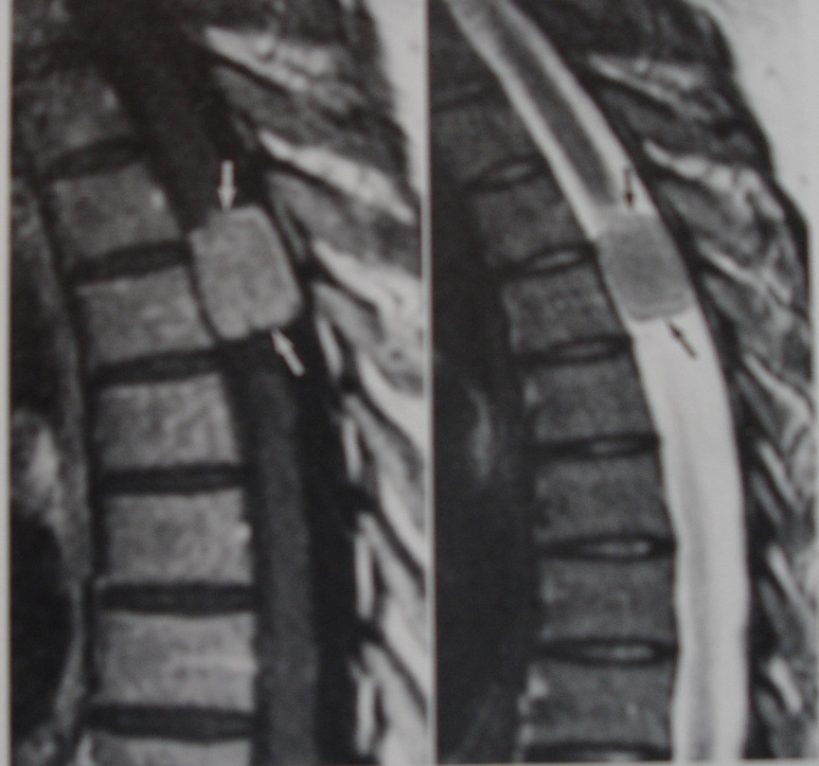
Post contrast T1,T2wi MR
Enhancing well demarcated intradural mass mid thoracic spine
Typical meningioma

Slide 21
Tethered cord

Slide 22

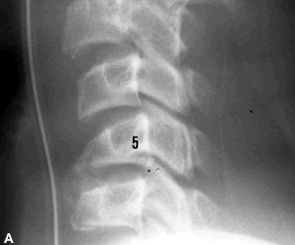
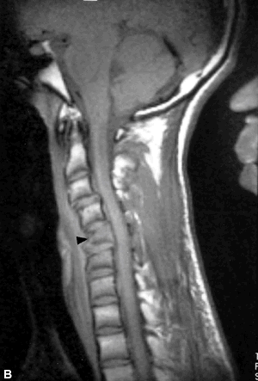
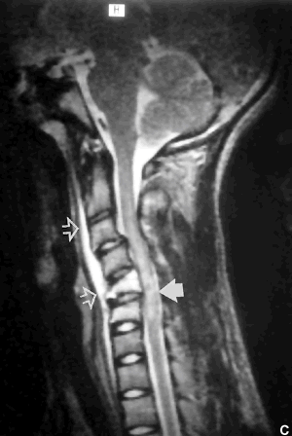
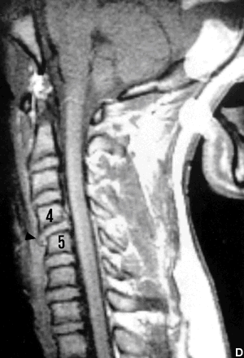
Spinal Trauma-Images
A) Plain radiograph
-Wedge fracture of C5
B) T1WI
-compression fracture of C5 (arrow head)
C6 slightly wedged
-C5, C6 vertebral bodies show low signal intensity (bone marrow edema)
C)T2Wi cervical spine
- Anterior compression fracture of C5
-Prevertebral swelling (open arrows)
-Spinal cord edema
-bone marrow edema- hyper intensities of vertebral bodies C5 C6
D) T1WI midline sagittal
-slight anterior displacement of C4 on C5
-anterior disc herniation
-disruption of anterior longitudinal ligament (arrow head)

Slide 23
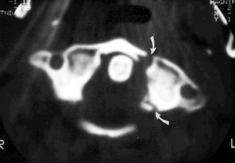
Trans axial CT
Fracture of anterior and posterior arches of C1 --variation of Jefferson fracture

Slide 24
Trans axial CT
Fracture of anterior and posterior arches of C1 --variation of Jefferson fracture

Slide 25
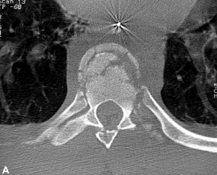
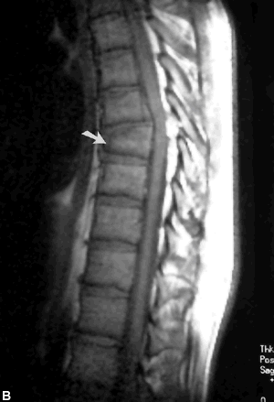
Thoracic spine
Thoracic spine compression #
A) axial CT
-compression # involving the anterior aspect of T7
-posterior margin of the body appears intact
B) T1WI of same patient
-wedged T7
-posterior margin displaced producing spinal cord compression
Thoracic spine stabilized by rid cage, musculature, and steeply oriented facet joints.
-#s uncommon ,occur in severe trauma
- Plain film evaluation difficult due to superimposition of shoulder girdle, ribs
-CT valuable

Slide 26

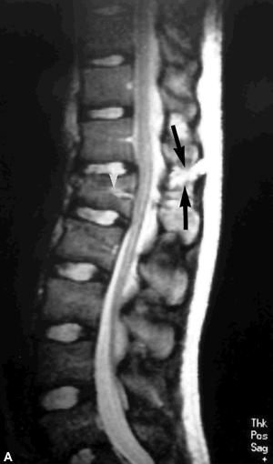
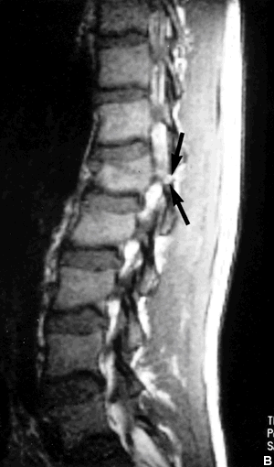
Lumbar spine
T1WI
Facet joint separated
Inhomogeneous marrow signal L1
T2WI
-Disruption of posterior ligament complex
-Widening of Interspinous space
-Disruption of the Interspinous ligament(long arrows)
-Wedging of L1
-

Slide 27

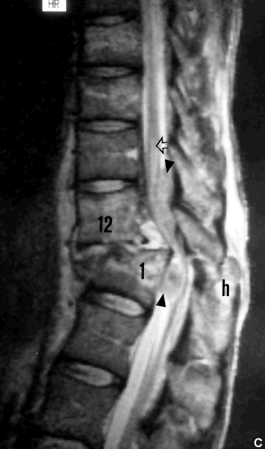
T2WI sagittal
Fracture/dislocation with posterior displacement of L1 on T12
-Interspinous hematoma (h)
-Total disc disruption
-compression of cauda aquina (arrow heads)
Edema of conus medullaris (open arrow)

Slide 28
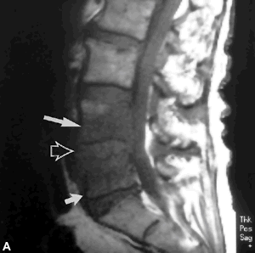
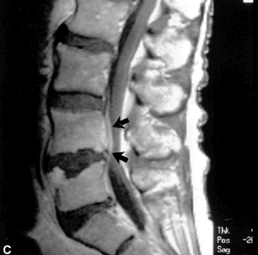
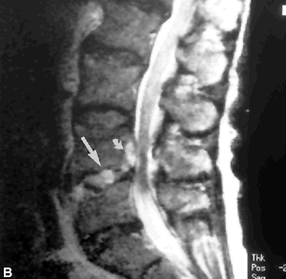
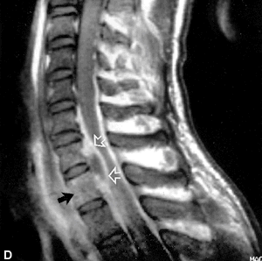
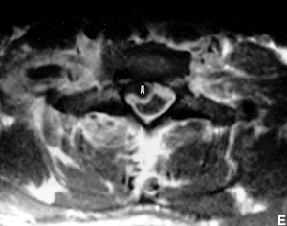
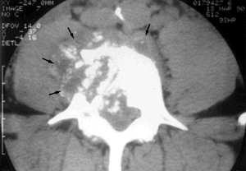
INFECTIONS
A . T1WI
L4/L5 discitis osteomyelitis(staphylococcus)
- Low signal L4,L5
-Indistinct inferior L4 and superior L5 end plates
-Hypo intense L4/L5 disc
B. Spin echo T2WI
- High signal intensity L4/L5 disc .
- High signal intensity epidural abscess (small arrow)
C. T1WI with contrast
-Enhancement of L4,L5 bodies
D. Epidural abscess at C7-T1
-High signal intensity of T1
-Intact disc
E. Axial T1WI
-Abscess.
Axial CT
-TB affecting L1
-destruction of rt side of vertebral body
- extension of abscess into rt psoas muscle and Prevertebral space.
-Erosion of posterior aspect of vertebral body
-Extension of infection into the epidural space
- compression of the thecal sac

Slide 29
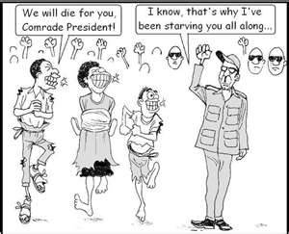

Slide 30
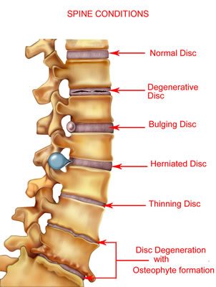
Degenerative disease
Disc
Spondylosis
Spondylolisthesis/spondylosis
Facet joint disease
Spinal stenosis.

Slide 31

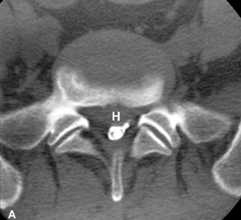




DISC HERNIATION
A. CT myelogram.
-Herniated disc H
-contrast filled thecal sac indented by the herniated disc
-S1 Nerve root compressed
B. T1WI
-Right foraminal/extraforaminal disc herniation at L4/L5
T1WI
-Mid sagittal
-large herniated disc at C4-C5
-No significant indentation of the spinal cord
D.CT myelogram thoracic spine
- partially calcified disc herniation

Slide 32




Spondylolisthesis and spondylolysis
Displacement of a vertebra in relation to an adjacent vertebra
Malalignment of the spinal column
Can be;
-anterior-anterolisthesis
-posterior-retrolisthesis
Can result from
-trauma,
-congenital or acquired fibrous defect of the pars interarticularis
Axial CT at L5
Bilateral lucent defects(arrowheads) involving the pars interarticularis

Slide 33



Facet joint disease
    Synovial cyst
    A. axial CT l4/5
- mass compressing the thecal sac
-degenerated left facet joint
-gas in the facet joint
B. Post contrast T1WI axial
-cyst with peripheral enhancement =>?granulation tissue
C. Mid sagittal T1WI (contrast)
- cyst surrounded by enhancing granulation tissue

Slide 34




Spinal stenosis
  A & B
Ossified posterior longitudinal ligament (OPLL) on CT , MR
Sagittal T2W MR
-ossified PLL C2-C7
-spinal stenosis at C3/4
and C6/7
Axial CT
- heavily calcified ligamentum flavum (F)
-significant narrowing of the spinal canal

Slide 35


Tumors and tumor like lesions----
Vertebral body haemangioma
-high signal intensity rt side
-multiple small areas of low signal—bone trabeculae
Haemangioma
-10% of all autopsies
-predominantly in women
-thoracic/lumbar regions
CT-low attenuation with thick bone striations (polka dot pattern)
-no cortical bone destruction
-calcification of soft tissue extension
MR – High signal on T1 & T2
- ddx focal fatty replacement
Rt parasagittal T1Wi showing the haemangioma

Slide 36

Aneurysmal bone cyst
Axial CT L4
- erosion of vertebral body, pedicle,
transverse process.
-blood/fluid levels
- Well defined margins

Slide 37


Secondary tumors (mets)
Axial CT Bone window
-Sclerotic mets from bronchogenic carcinoid
-narrowed spinal canal
Breast metastasis T1WI
- multiple areas of low signal intensity in the bone marrow
- spinal cord is normal
MR T1WI
-Breast cancer mets mid thoracic vertebra(B)
-Involvement of posterior elements (P)
-spinal cord compression(arrow) by tumor

Slide 38

Avoid bad habits ….
THE END

