Slide 1
GIT IMAGING
Dr. T. Musila Mutala

Slide 2
OBJECTIVES
Describe the modalities available for GIT imaging
Discuss the indications, contraindications and patient preparation for each of the modalities
Highlight the limitations of the described imaging modalities
Present examples of pathological processes as demonstrated in each of the modalities
Bring out a decision making protocol for imaging in acute abdomen setting

Slide 3
ANATOMICAL DIVISIONS
Fore-gut
Oral cavity
Pharynx
Oesophagus
Stomach
Part of duodenum
2. Mid-gut
Part of duodenum
Small bowel – jejunum,ileum
Part of large bowel- caecum, ascending, mid-transverse colon
3. Hind-gut
Mid-transverse, descending , sigmoid colon, rectum, anus
4. Accessory organs/tissues
Salivary glands
Liver
Gall bladder
Pancreas
Vascular structures
Neural structures
Lymphatic system

Slide 4
GIT PATHOLOGY
Congenital anomalies
Inflammation
Obstruction
Neoplasia
Trauma
Motility disorders
Vascular
Metabolic

Slide 5

There are pathological conditions that you cannot see on imaging despite their presence, due to
Wrong imaging modality / technique
Disease is only microscopic and has not induced any visible anatomical change, unless the imaging method is functional.

Slide 6
MODES OF GIT IMAGING
Plain radiography
Contrast radiography
Ultrasound
CT Scan
MRI Scan
Radionuclide imaging (Nuclear Medicine)
Angiography

Slide 7
PLAIN RADIOGRAPHY
Plain radiographs are frequently still the first investigation in the acute abdomen
For non-acute situations, the relatively small yield of information from a plain radiograph does not justify the radiation dose that it entails, unless it is on follow up basis
Plain radiographic findings must corroborate with clinical findings: sometimes even obvious signs can be non-specific generating a plethora of differential diagnoses. A good example is the presence of air-fluid levels which may be benign or a pointer to obstruction

Slide 8
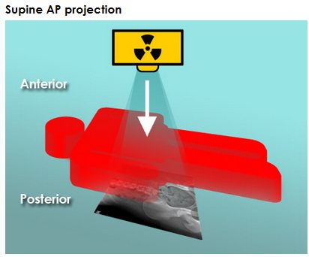
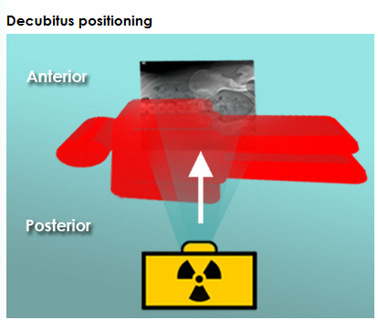
PLAIN RADIOGRAPHY: projections

Slide 9
AXR -The densities
Air
Soft tissues
Fat
Calcified structures

Slide 10
Abdominal x-ray: systematic approach
Check the patient details
Assess quality (including presence of artifacts).
Bowel gas
Soft tissues
Bones
Abnormal calcifications

Slide 11
AXR – Air Distribution
Intra-luminal
Normal
Gastric bubble (erect film)
Large bowel
Very minimal or non-detectable in small bowel
Check for abnormalities
Size
Distribution: peripheral – large bowel, central – small bowel
Extra-luminal
Always abnormal
Key areas to look at
Subdiaphragmatic (erect film)
Bowel wall
Liver – portovenous, biliary.

Slide 12
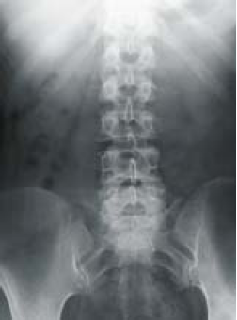
AXR – Air Distribution
Normal findings

Slide 13
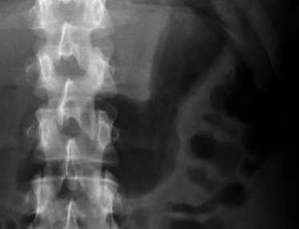
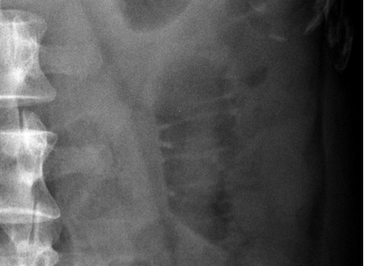
AXR – Air Distribution
Stomach
Small bowel

Slide 14
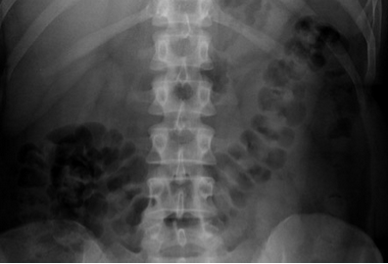
AXR – Air Distribution
Large bowel

Slide 15
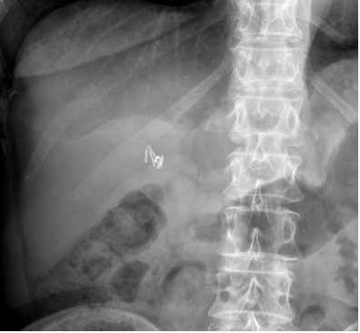
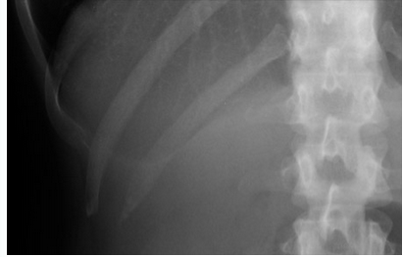
AXR- SOFT TISSUES
Liver: Note the surgical clip within the gall bladder fossa from previous surgery
Lung bases: vascular markings are visible.

Slide 16
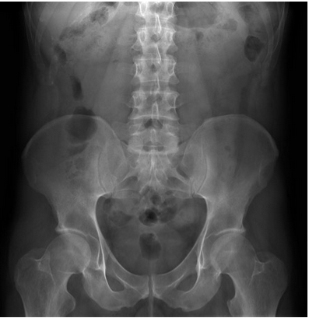
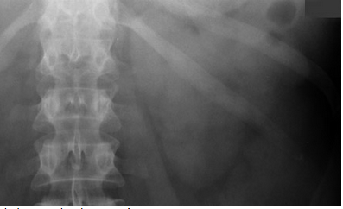
AXR- SOFT TISSUES
Left kidney
Psoas muscles shadows

Slide 17
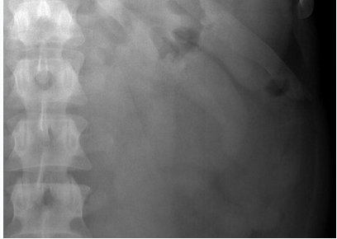
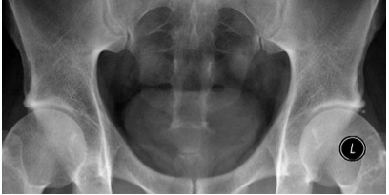
AXR- SOFT TISSUES
Spleen, left kidney and psoas muscle
Urinary bladder

Slide 18
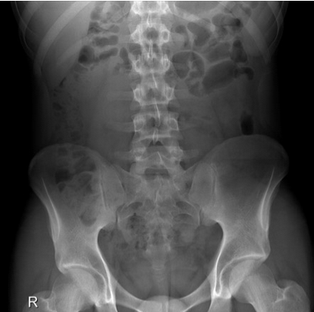
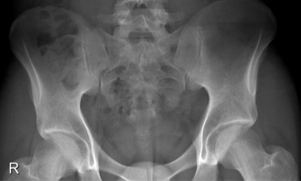
AXR – BONES

Slide 19
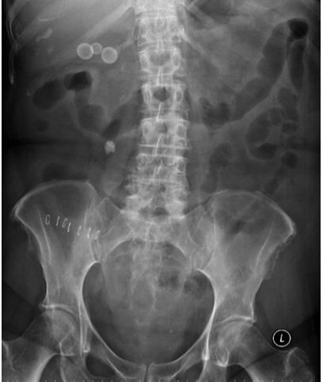
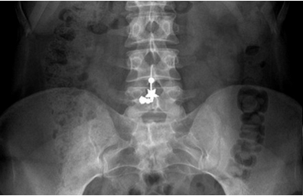
AXR – ARTIFACTS AND CALCIFICATIONS

Slide 20
AXR – abnormal Air Distribution – Intraluminal
Erect
Supine
Small bowel obstruction

Slide 21
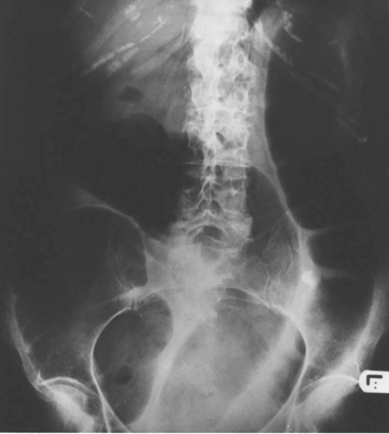
AXR – abnormal Air Distribution -intraluminal
Large bowel obstruction – supine

Slide 22
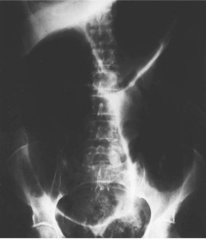
AXR – Air Distribution – intraluminal abnormal
Paralytic ileus
Sigmoid volvulus
meteorism

Slide 23
ABNORMAL INTRALUMINAL AIR PATTERN: LOCALISATION

Slide 24
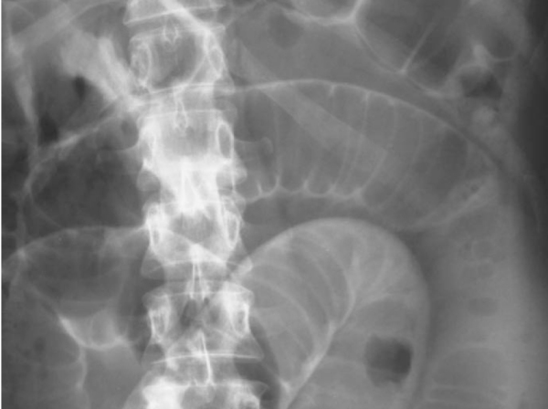
AXR – ABNORMAL Air Distribution - extraluminal
Rigler’s sign – Double wall sign
Air under the diaphragm
Pneumoperitoneum – secondary to perforated gut

Slide 25
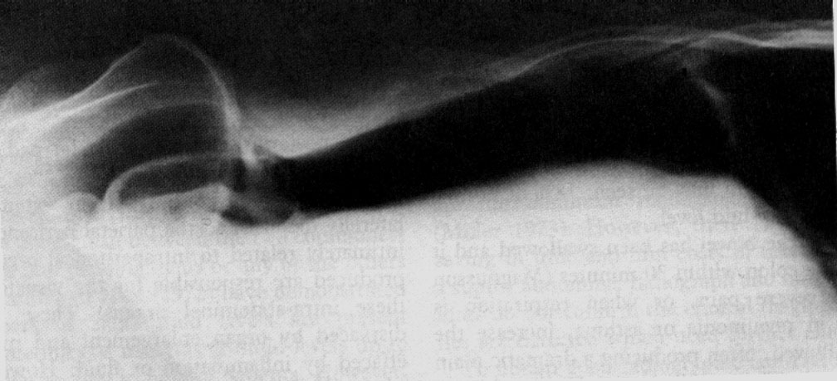
AXR – ABNORMAL Air Distribution - extraluminal
Pneumoperitoneum – Lt lateral decubitus view

Slide 26
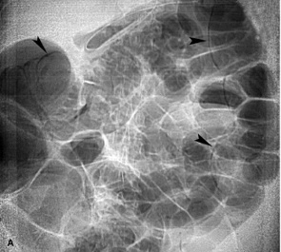
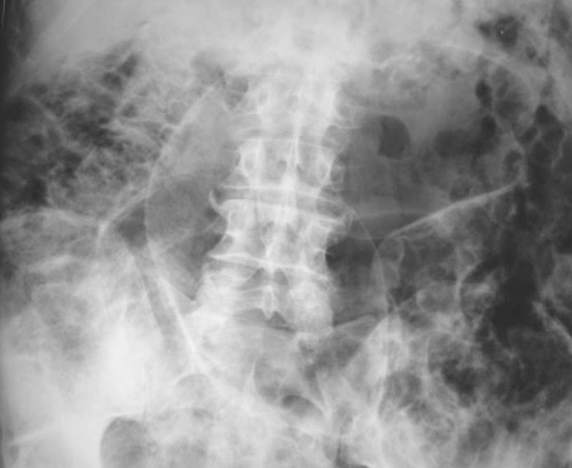
AXR – ABNORMAL Air Distribution – INTRAMURAL
Pneumatosis intestinalis

Slide 27
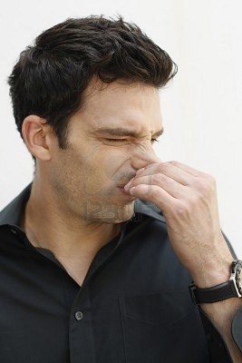
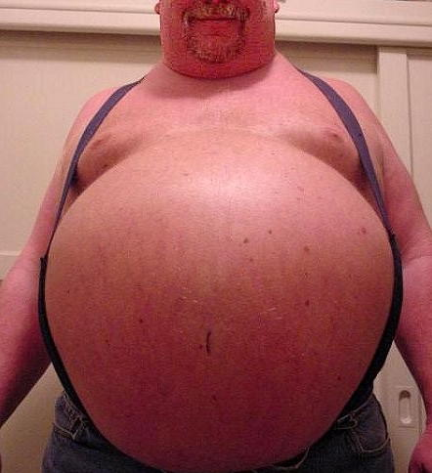
Air shall only be kept within the bowel for it to be considered normal
And in the right proportions

Slide 28
GIT Contrast Radiography
GIT Contrast
Positive
Negative
Air
Barium
Water soluble (iodine)
Double Contrast

Slide 29
GIT Contrast Radiography
– Modalities
Sialography
Ba. Swallow
Ba. Meal
Ba. meal follow through
Small Bowel Enema (Enteroclysis)
Ba. Enema
Colostrogram, Sinogram, Fistulogram

Slide 30
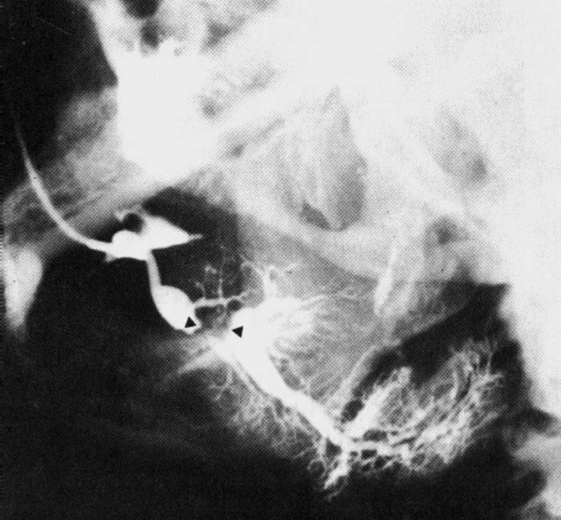
GIT Contrast Radiography
- Sialography
Cannulation of major salivary gland ducts
Water soluble contrast media is used
Demonstrates luminal anatomy and pathology
INDICATIONS
Pain
Swelling
Sjogren’s syndrome
Sicca
Post-traumatic, post-operative strictures, cysts, fistulas
Sialography

Slide 31
GIT Contrast Radiography
- Barium Swallow
Indications
Dysphagia
Pain on swallowing
Hematemesis
Assessment of tracheo-oesophageal fistula(where plain films not diagnostic)
Follow up following oesophageal surgery
NB: In assessment of perforation, water soluble contrast is used instead of barium.

Slide 32
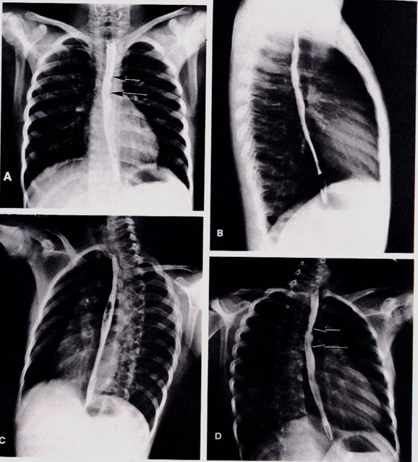
GIT Contrast Radiography
- Barium Swallow
Normal findings
Physiological constrictions may be seen – cricopharyngeus muscle, aortic arch, left main bronchus, left atrium and gastroesophageal junction.

Slide 33
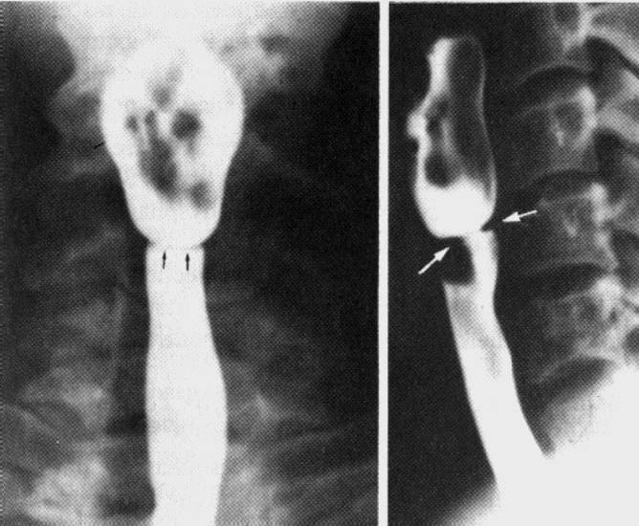
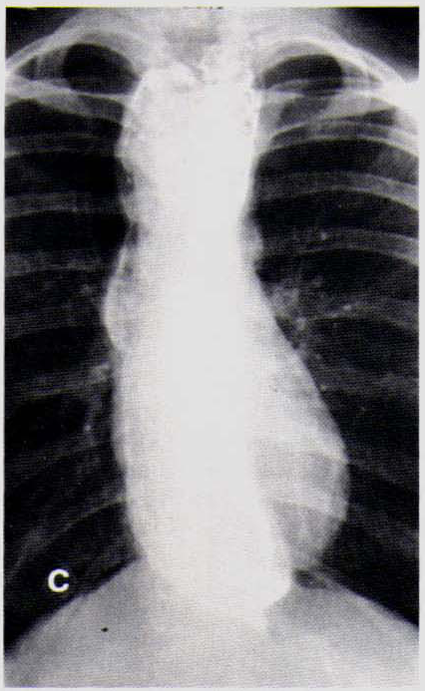
GIT Contrast Radiography
- Barium Swallow
Achalasia (seen on single contrast)
Oesophageal webs (seen on double contrast)

Slide 34
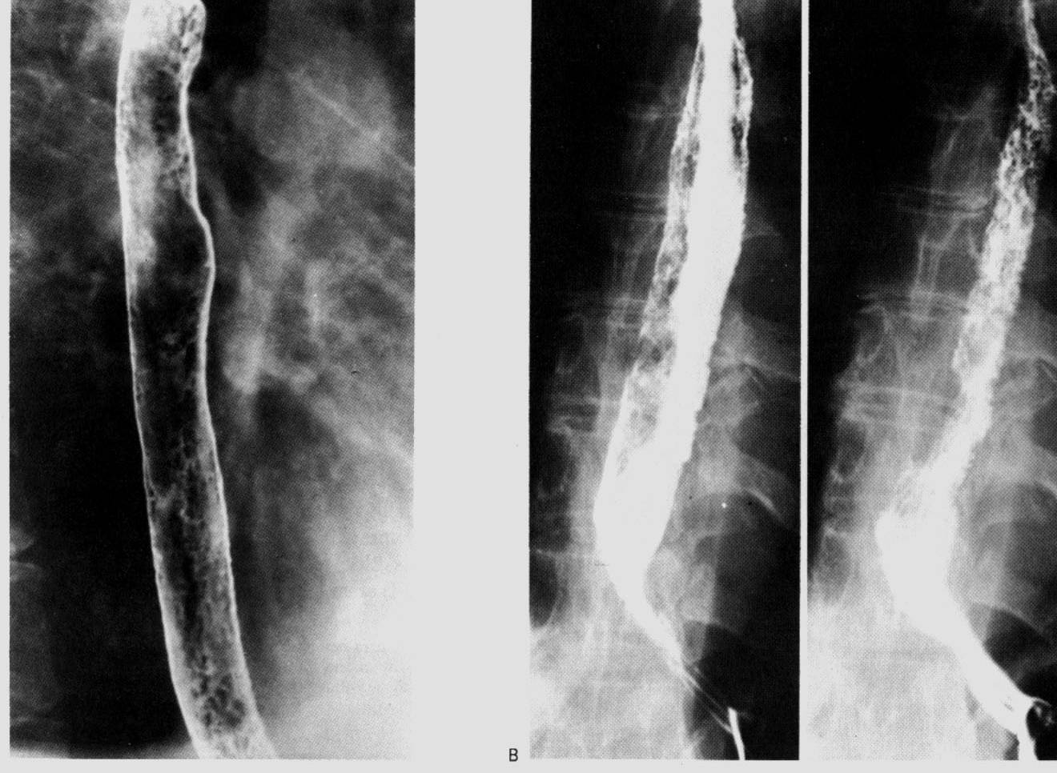
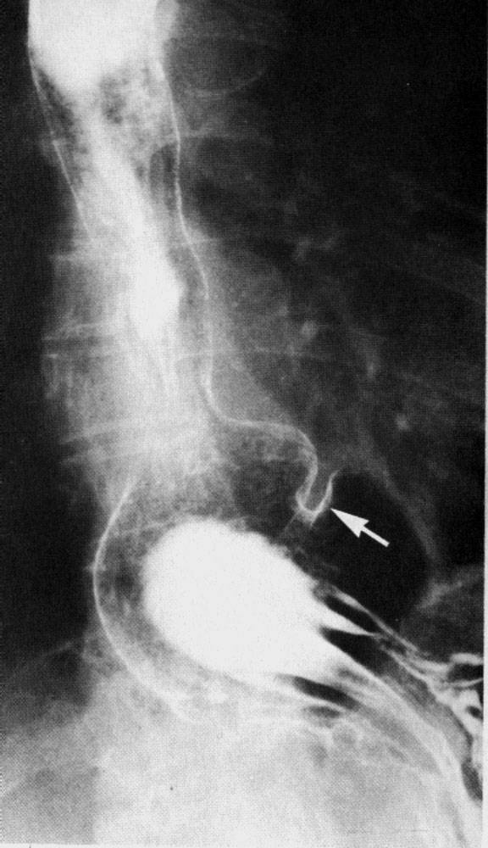
GIT Contrast Radiography
- Barium Swallow
Oesophageal candidiasis (on double contrast)
Hiatal hernia (double contrast)

Slide 35
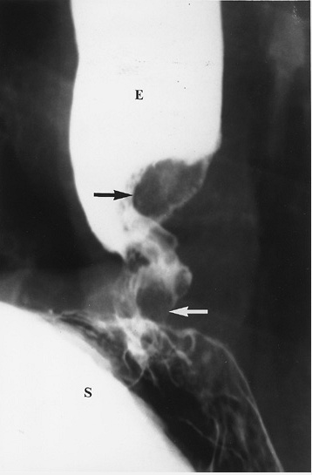
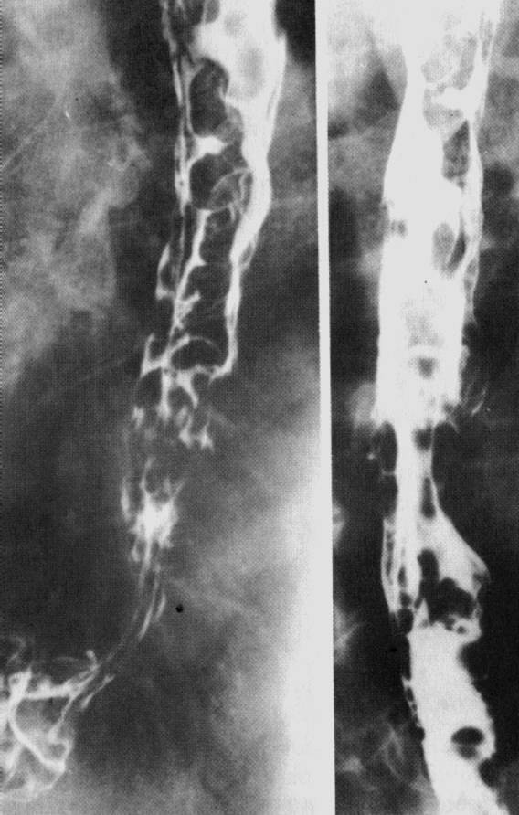
GIT Contrast Radiography
- Barium Swallow
Ca. oesophagus (double contrast)
Oesophageal varices (double contrast)

Slide 36
GIT Contrast Radiography
- Barium Meal
Double contrast is an examination of choice in adults. Single contrast is used in children and very ill adults.
INDICATIONS
dyspepsia
weight loss.
Follow up after surgery
suspected gastrointestinal bleeding or unexplained iron deficiency
partial obstruction

Slide 37
GIT Contrast Radiography
- Barium Meal
Contraindications
Complete large bowel obstruction
Suspected perforation (there is up to 50% mortality if barium leaks into the peritoneum).

Slide 38
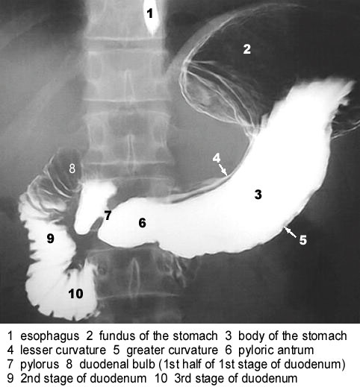
Normal Ba. Meal
(Double contrast)

Slide 39
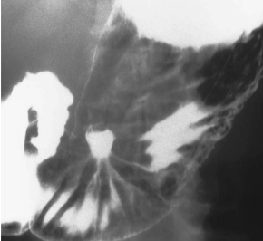
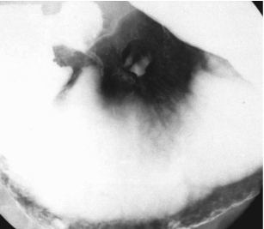
GIT Contrast Radiography
- Barium Meal (Double Contrast)
Stomach ulcer

Slide 40
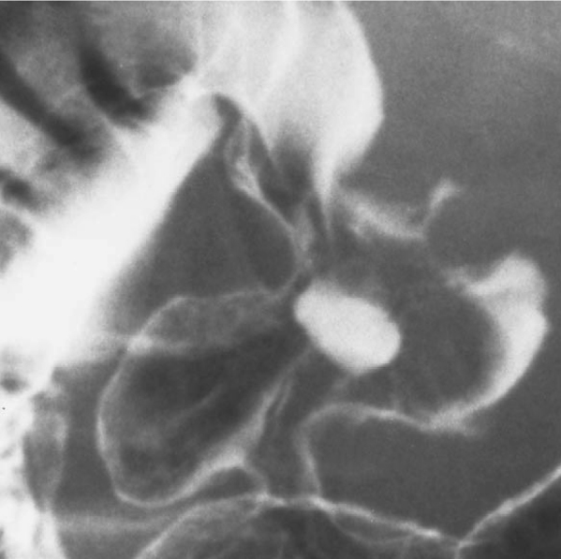
GIT Contrast Radiography
- Barium Meal
Duodenal Ulcer

Slide 41
GIT Contrast Radiography
- Barium Meal Follow Through
Indications
Pain
Diarrhoea e.g. malabsorption syndromes
Bleeding
Partial obstruction
Contraindications
As for Ba meal

Slide 42
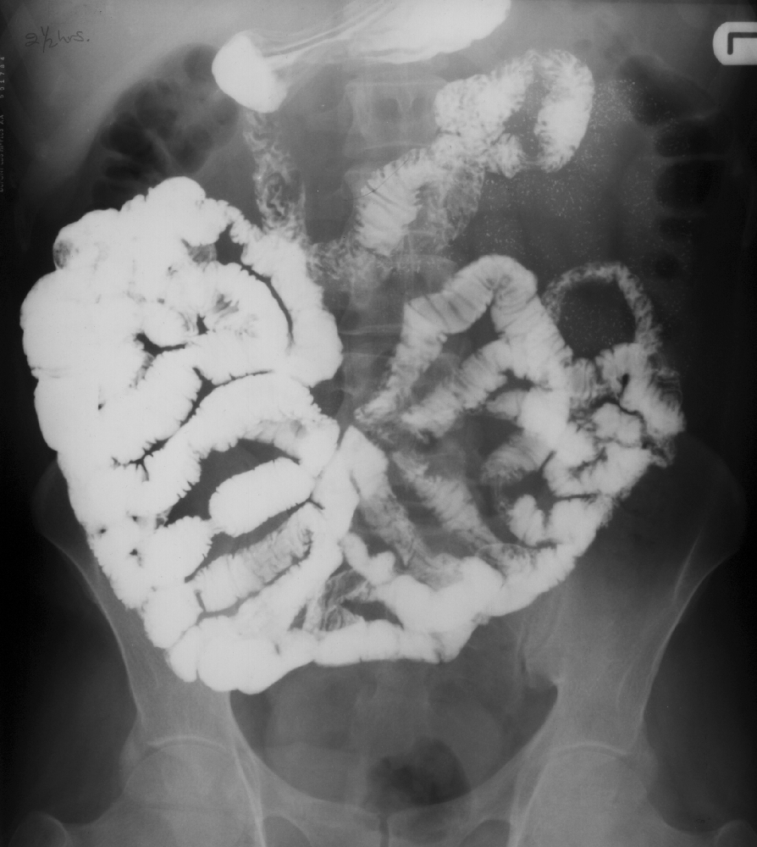
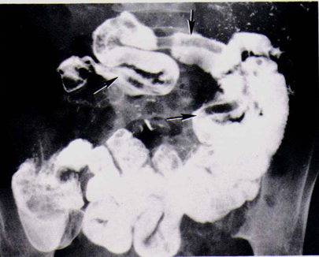
GIT Contrast Radiography
- Barium Meal Follow Through
Ascariasis
Normal

Slide 43
GIT Contrast Radiography
- Small Bowel Enema (Enteroclysis)
Gives better visualization of small bowel than that achieved by barium meal follow through.
However it has the disadvantage of being unpleasant to the patient due to intubation and time consuming to the radiologist.
Indication
Same as for Barium meal follow through

Slide 44
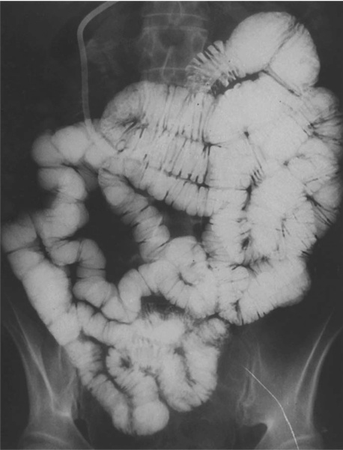
GIT Contrast Radiography
- Small Bowel Enema (Enteroclysis)
Normal

Slide 45
GIT Contrast Radiography
- Ba Enema
Examination of the large bowel.
It is currently getting replaced by CT colonography.
Two methods commonly used.
Double contrast: This is examination of choice to demonstrate mucosal pattern.
Single contrast: This is used in children since it is not usually necessary to demonstrate mucosal pattern. It can also be used to reduce an intussusception

Slide 46
GIT Contrast Radiography
- Ba Enema
Indications
Change in bowel habits
Unexplained abdominal pain
Melena
Obstruction e.g. intussusception
Contraindications
Toxic megacolon
Pseudomembranous colitis
Rectal biopsy within previous 3 days

Slide 47
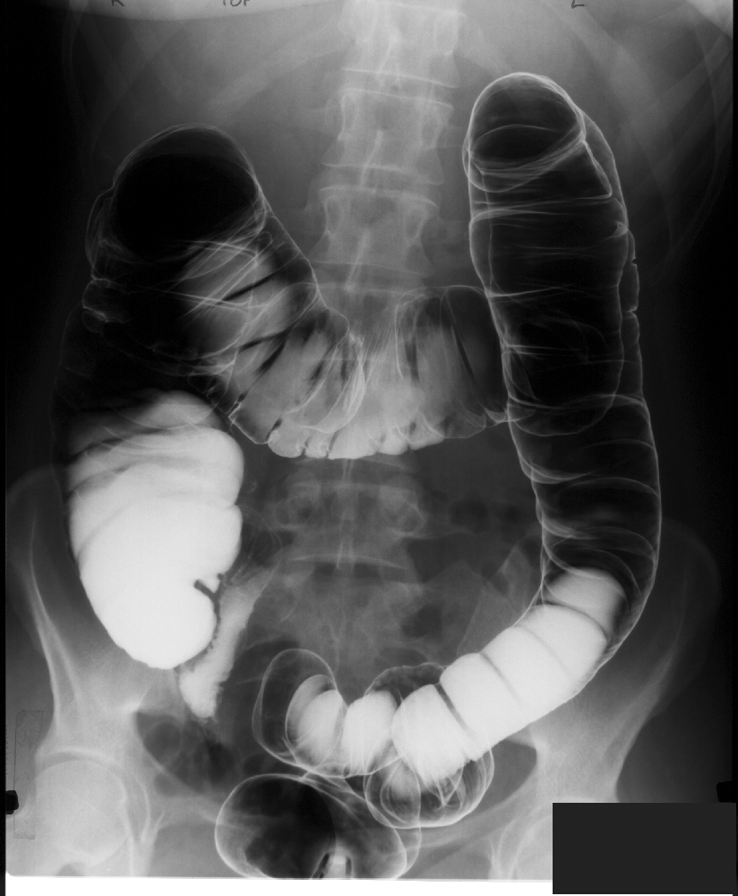
GIT Contrast Radiography
- Ba Enema
Normal

Slide 48
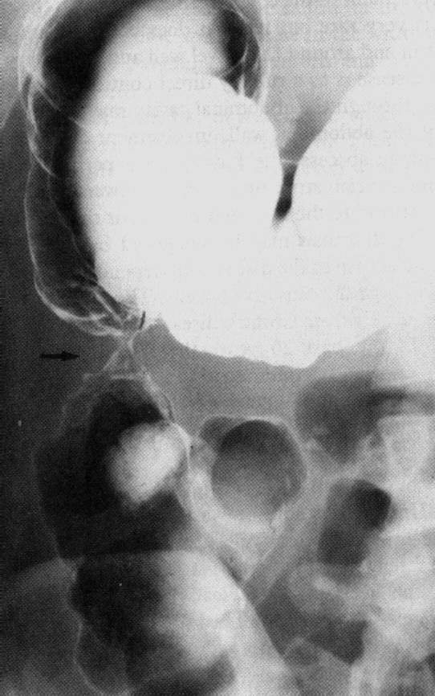
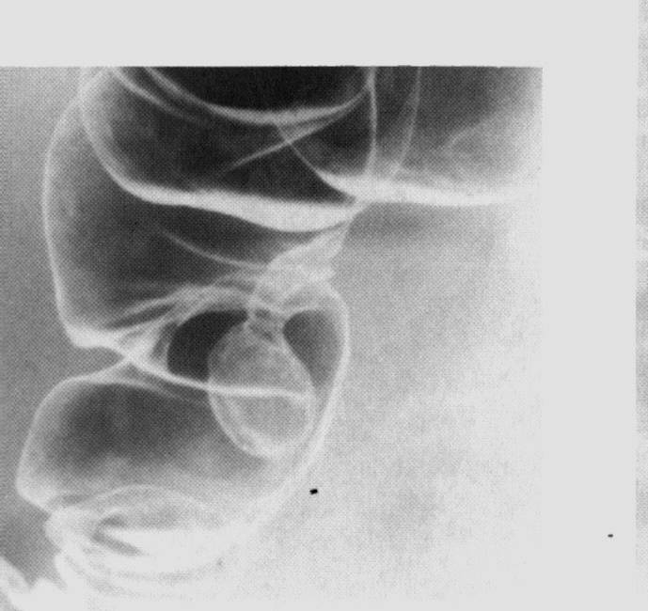
GIT Contrast Radiography
- Ba Enema
Colonic polyp
Ca. colon (ascending portion)

Slide 49
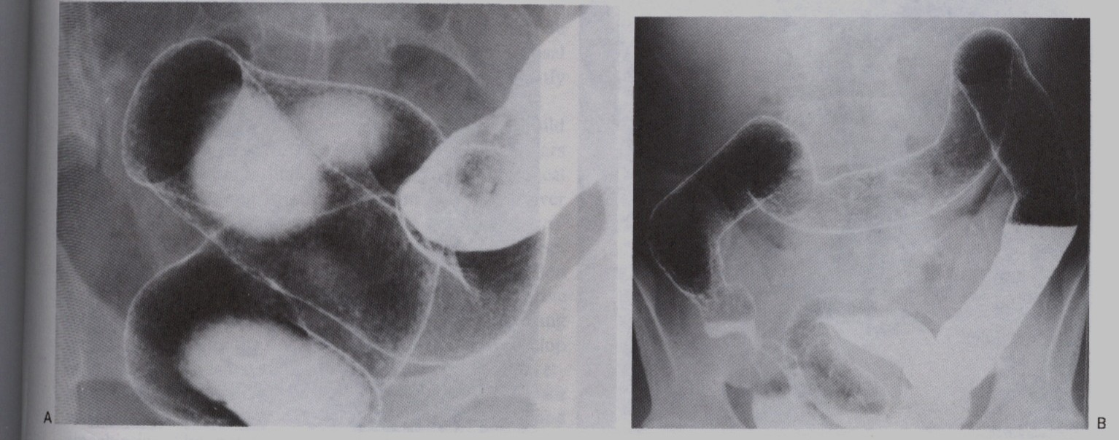
GIT Contrast Radiography
- Ba Enema
Ulcerative colitis

Slide 50
Ultrasound in GIT Imaging
Though of limited value in imaging the GIT, for the reason that gas produces poor sound penetration, it can be useful in the following areas
Suspected masses
Suspected peritoneal fluid collections
Suspected calculus
Suspected inflammatory conditions like appendicitis
Suspected intusussception
Suspected hernias
The jaundiced patient

Slide 51
Ultrasound in GIT Imaging
- Salivary Glands
Parotid gland
1- retromandibular v. 2 – ECA 3- mandible 4 – parotid gland
5 – masseter M

Slide 52
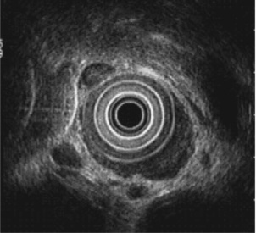
Ultrasound in GIT Imaging
- Oesophagus
Endoluminal ultrasound demonstrating intramural involvement from Ca. oesophagus

Slide 53
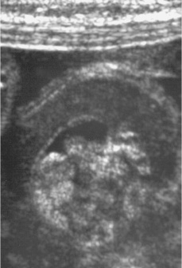
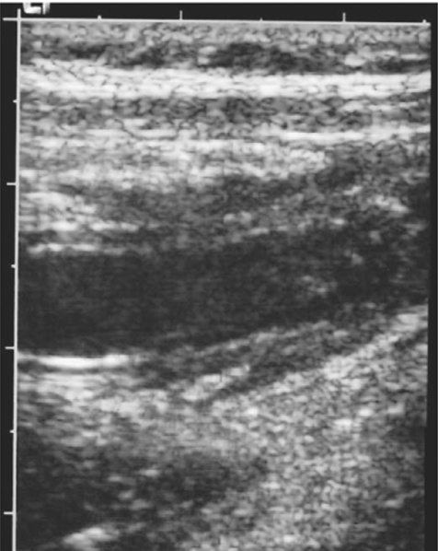
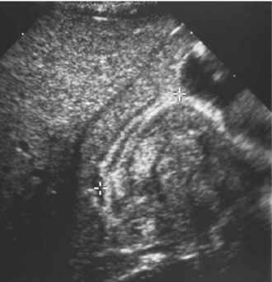
Ultrasound in GIT Imaging
Hypertrophic pyloric stenosis
Appendicitis
Intussusception

Slide 54
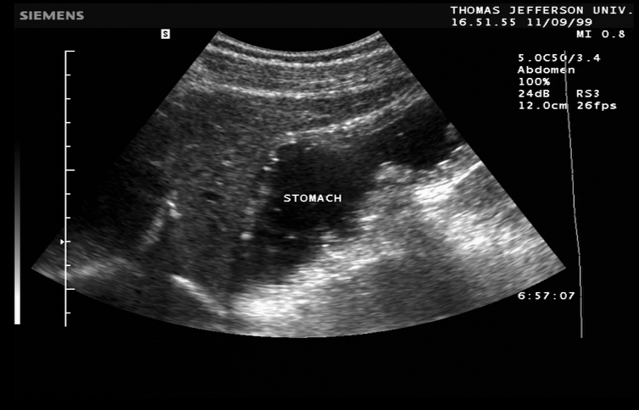
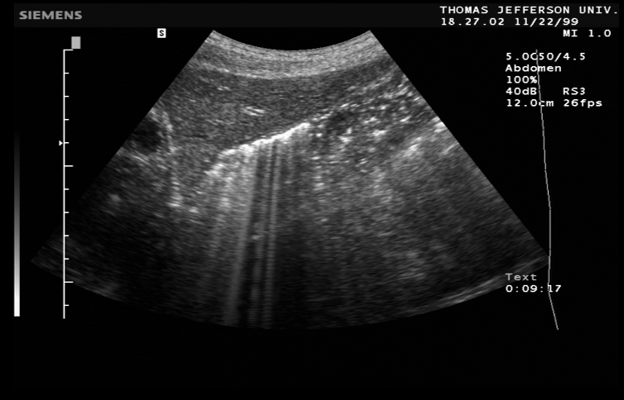
Ultrasound in GIT Imaging
Gas filled stomach
Fluid filled stomach

Slide 55
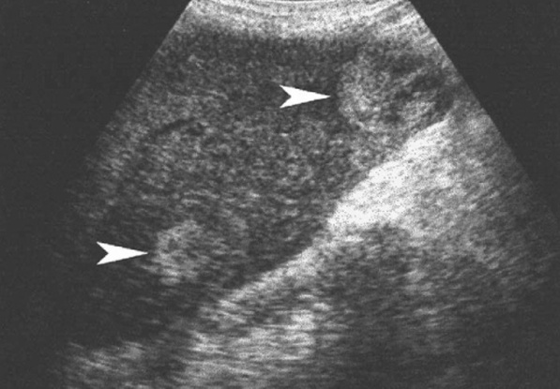

Ultrasound in GIT Imaging
Liver metastases from colonic cancer
Gallbladder calculi

Slide 56



Slide 57
Computerised Tomography (CT) in GIT
Gaining popularity as investigation of choice in acute abdomen and trauma
Complement other radiological studies of the GIT to determine the extent of disease
Evaluatethe mesentery, adjacent solid organs, the peritoneal cavity, and the retroperitoneum
Stage malignancies and evaluate for recurrence
CT enteroclysis to evaluate the small bowel
Virtual endoscopy – CT Colonography has largely replaced Ba enema as the imaging modality of choice in large bowel disease. It is also incorporated as a screening tool for colorectal carcinoma in high risk groups.

Slide 58
Computerised Tomography (CT) in GIT
Take note of the following:
CT is relatively expensive and unavailable
Caution has to be taken since it gives high radiation dose to the patient

Slide 59


Computerised Tomography (CT) in GIT
Normal appendix
Acute appendicitis

Slide 60


Computerised Tomography (CT) in GIT
Metastatic liver lesions from Ca.colon
Caecal malignant tumour

Slide 61

Computerised Tomography (CT) in GIT
CT (virtual) colonoscopy) reveals a polyp

Slide 62
Magnetic Resonance Imaging (MRI) in GIT
Though more expensive and less available compared to the modalities we have already discussed it has these main advantages
Excellent soft tissue contrast
Non- ionising radiation
Multi- sequential multi-planar capabilities
Its application includes the same as CT except that it is not used in acute setting.

Slide 63


Magnetic Resonance Imaging (MRI) in GIT
Small bowel - FISP
Small bowel - FLASH

Slide 64

Magnetic Resonance Imaging (MRI) in GIT
Hepatocellular carcinoma

Slide 65
Increasing Role of mri in rectal cancer
Paradigm shift has taken place in imaging of rectal carcinoma with High Resolution MRI taking centre stage in tumour staging.
Excellent anatomical depiction can be attained with this modality influencing surgical decision making since the introduction of total mesorectal excision (TME) as standard surgical procedure. The mesorectal fascia determines the potential circumferential resection margin (CRM).

Slide 66


Normal anatomy: Axial Turbo SE T2W image shows the mesorectal fat (*), the mesorectal fascia (white arrows) and confluence of Denovillier’s and mesorectal fasciae (black arrows).
Sagittal turbo SE T2W image demonstrates the normal anatomy

Slide 67


A
B
The driver of the paradigm shift as demonstrated in this rectal tumour on CT (A) and HRMRI (B). The MR image confidently puts it as stage 1 tumour since the mscularis propria is intact.

Slide 68

Radionuclide Imaging in GIT
Salivary gland tumor

Slide 69


Radionuclide Imaging in GIT
Meckel’s diverticulum
Achalasia

Slide 70

Angiography in GIT
Right colic artery extravasation of contrast demonstrating point of hemorrhage

Slide 71
ACUTE Decision Making

Slide 72

Thank you
Musila Mutala

