Slide 1
Imaging modalities in medicine

Slide 4
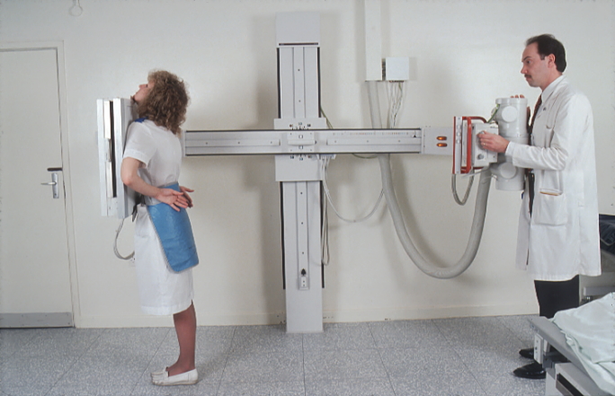

Slide 27
Triphasic CT

Slide 35
Multislice CT

Slide 39
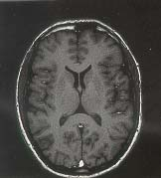
Sequences at MR can vary

Slide 40
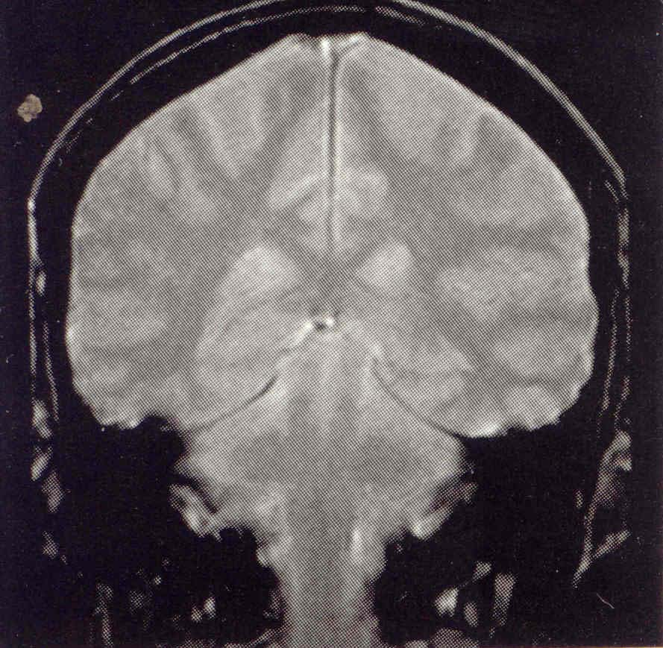
Imaging planes are infinite

Slide 41
Can see vessels without intravascular contrast agents

Slide 42
PILOCYTIC ASTRO.
CECT T1Gd T2WI
19YM. Pilocytic astro right basal ganglia

Slide 43
Favored sites of JPA
60% are seen in the posterior fossa.
The typical cerebellar astrocytoma in the pediatric age group is cystic in 60-80% of cases.
Chiasmatic hypothalamic astrocytomas may present with the diencephalic syndrome characterized by weight loss, motor hyperactivity and euphoria.
Talk of tots sucking on blow pops with a sugar buzz.

Slide 46
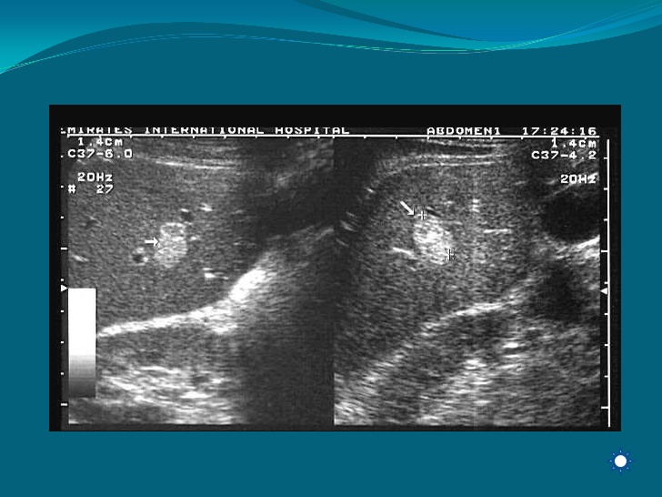

Slide 49
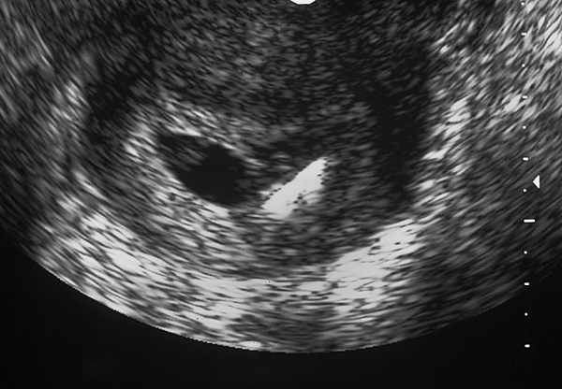
Pg with IUD.

Slide 50
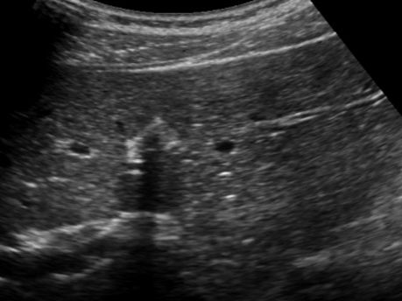
RUQ

Slide 51
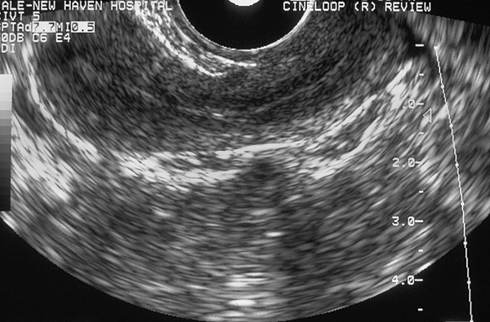
Pelvic scan.

Slide 54
PET physics

