Slide 1
INTRODUCTION TO RADIATION SAFETY
DATE: 11/8/2016

Slide 2
IONIZING VS. NON-IONIZING RADIATION
Ionizing radiation include:
  X-rays and gamma rays
  Charged particles (electrons, protons, alpha particles)
  Neutrons
Non-ionizing radiation
  Ultra-sound
  Optical radiation
  Radiofrequency radiation

Slide 3
SOURCES OF IONIZING RADIATION
Natural sources include:
  Cosmic radiation from outer space
  Terrestrial radiation in soil, rocks, water ( these sources constitute natural background)
Artificial sources
  All man-made radiation

Slide 4
EXPOSURE OF POPULATIONS
The most important source is natural background.
From artificial sources, medical exposure is most important
Within medical exposure, X-ray diagnosis is the leading contributor

Slide 5
MODALITIES OF EXPOSURE
External exposure/Irradiation – the radiation source is outside the body e.g. X-ray
  There can also be external contamination when radionuclides are spread on the skin
Internal exposure – the radiation source is inside the body e.g. Nuclear medicine (injection of a radiopharmaceutical)
  This can take place because of inhalation or injection of radionuclides

Slide 6
BIOLOGICAL EFFECTS OF IONIZING RADIATION
Evidence exists for biological effects
Effects at cellular level include:
  Cell killing
  Mutations
  Loss of proliferative capacity
Cellular effects may affect organ/tissue function
Effects on organism, include possible death

Slide 7
CLASSIFICATION OF RADIATION EFFECTS
Acute vs. delayed
Somatic, Hereditary or fetal/embryonic
  Somatic effect occurs in the irradiated person
  Hereditary effects occur in the descendants of the irradiated person.
  Fetal effects occur in the unborn child of an irradiated pregnant mother.
Deterministic vs. Stochastic
  Deterministic effects have a threshold dose below which they do not occur. Severity is dose-dependent
  Stochastic effects have no threshold dose. The probability of occurrence depends on dose. Severity is independent of dose.

Slide 8
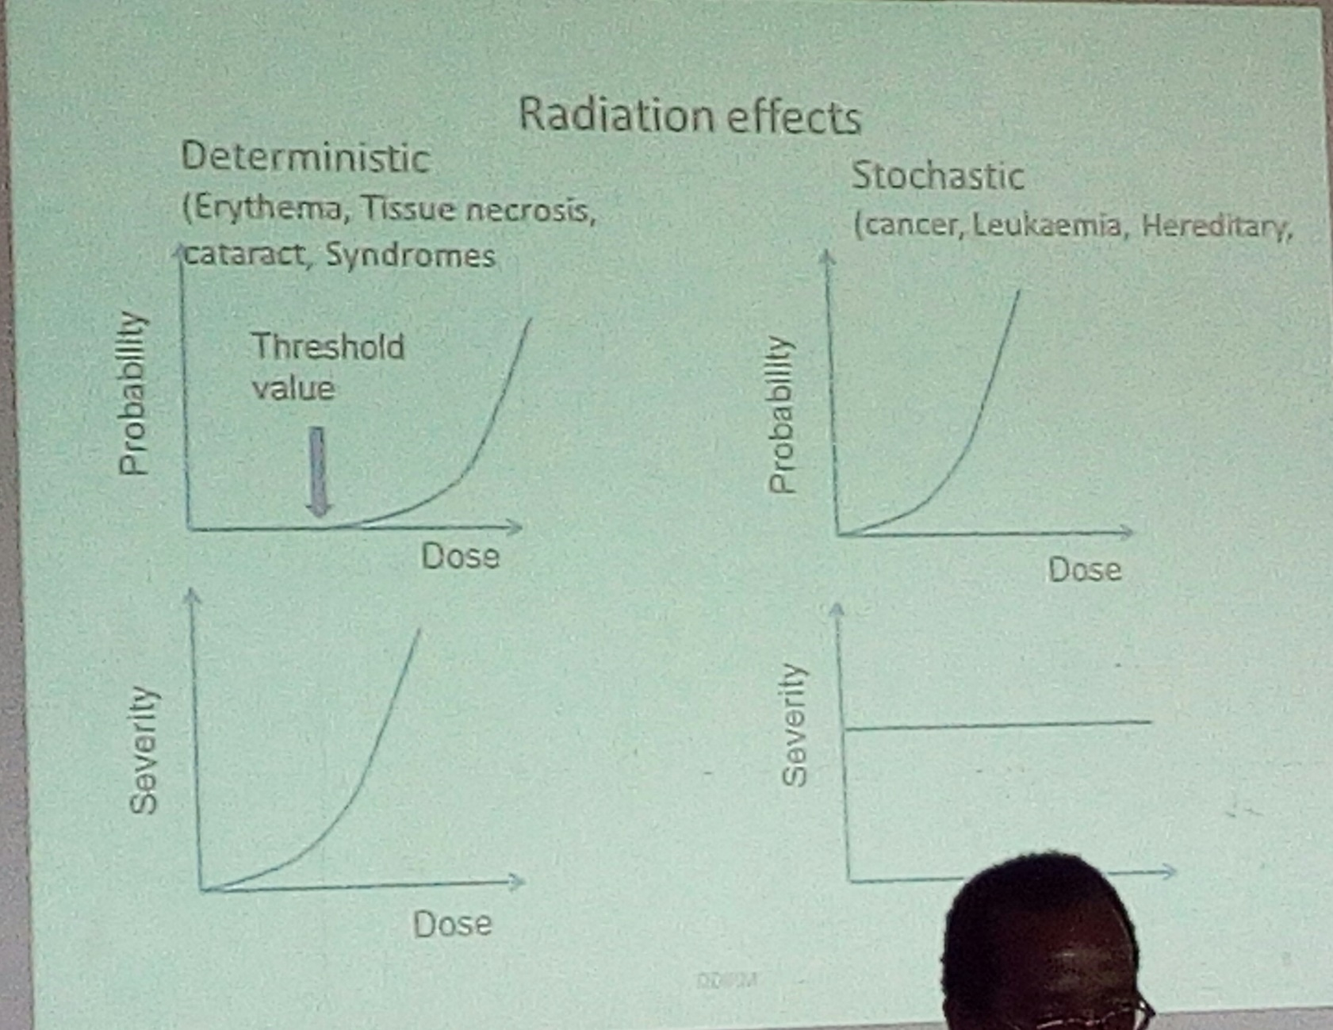

Slide 9
IMPLICATIONS
NO amount of radiation exposure (no matter how little) is completely safe
Even very low doses of radiation may induce severe health detriment (carcinogenesis and hereditary effects are stochastic)
All unnecessary exposures to ionizing radiation should be avoided (principle of justification)
All necessary exposures to radiation should be kept As Low As Reasonably Achievable (ALARA principle)

Slide 10
AIMS OF RADIATION PROTECTION
Prevent the occurrence of the deterministic/threshold effects
Limit the probability of occurrence of stochastic/non-threshold effects
Philosophy radiation protection:
  Justification of practices
  Optimization of procedures
  Dose limitation

Slide 11
CATEGORIES OF RADIATION EXPOSURE
Occupational exposure
  Exposure of designated radiation workers in normal courses of their duties
  Dose limits for radiation workers apply
  Monitoring of radiation doses is required
Medical exposure
  Exposure of patients during diagnostic or therapeutic procedures, based on medical decisions
  Include exposures from artificial body implants emitting ionizing radiation
  When radiation workers are exposed as patients, that component or exposure is classified as medical exposure
  No dose limits prescribed for medical exposure
  However ALARA principle applies; guidance dose levels should be noted
  Radiation dose monitoring not done on routine basis.

Slide 12
CONT.
Public exposure
  Refers to non-occupational, non-medical exposure of members of the general public
  Dose limits for members of the general public apply, for planning purposes
  No radiation monitoring

Slide 13
RADIATION PROTECTION OF WORKERS
Radiation workers are:
  Occupational exposed
  Specially trained
  Subject to prescribed dose limits
Strategies:
  Training of personnel
  Planning of radiological facilities
    Facility design e.g. structural shielding
    Equipment selection

Slide 14
OPERATION PRINCIPLES
Minimize time of exposure (dose received is proportional to time)
Maximize distance between the source and workers (dose varies inversely as square of distance)
Use of physical shielding between source and worker (extent of protection varies with barrier material, barrier thickness and radiation quality). The physical barrier has the following features:
  Z value
  Density value
  Thickness

Slide 15
PERSONAL PROTECTIVE CLOTHING
Lead rubber aprons, gloves (minimum lead equivalence is 0.25 mm)
Thyroid shields
Spectacles
MANAGEMENT RESPONSIBILITIES:
Departmental regulations
Personnel monitoring
Quality assurance

Slide 16
PROTECTION OF PATIENTS IN X-RAY DIAGNOSIS
X-ray diagnosis contributes largest proportion of artificial exposure to populations
Collective doses to populations depend on frequencies of radiological examinations and on mean doses per examination
Very wide variation in patient dose are observed

Slide 17
STRATEGIES OF PATIENT PROTECTION
Clinical judgment (necessity of examination)
Trained personnel
Radiological equipment in good condition
  Performance specifications
  Maintenance
  Quality assurance programs
Sensitive image receptors
Adequate preparation , proper instruction or patient
Proper performance of examination
  Positioning, views, exposure factors. Limitation of beam size, gonad shielding
  Proper film processing practice
  Through quality control programs, minimize repeat examinations
  Consider alternatives of X-rays to use when appropriate e.g. ultrasound

Slide 18
SENSITIVE PATIENT GROUPS
Children
Pregnant female

Slide 19
PUBLIC PROTECTION
Involved institutions should put in place regulations that protect the public from radiation exposure.

Slide 20
SAFETY IN DIAGNOSTIC ULTRASOUND
Biological effects observed with animal experimentation using very high intensities of ultrasound
Biological effects may be due to:
  Tissue temperature elevation
  Formation of bubbles in liquids
Diagnostic ultrasound employs beam intensities well below the thresholds for observed effects
Diagnostic ultrasound is considered to be a safe method of medical imaging, with a wide margin of safety

Slide 21
SAFETY IN MRI
Risk of biological effects considered remote
The environment around powerful magnets presents some risks to patients, relatives and staff
  Attraction of objects into magnet (ferromagnetic missiles)
  Rapid evaporation of cryogens
Restricted access (0.5 mT) if necessary, monitor entrants
Warning signs and symbols
Screening of patients
Pre-exam instructions
Design with faraday cage
  Confines high magnetic field to restricted zone
  Keeps out extraneous sources of electromagnetic fields
Design to facilitate escape route in case of cryogen boil-off
Staff awareness and good practice
There should be warning signs and symbols to indicate the presence of magnetic fields.

Slide 22
TYPED BY DR. E. NAILA

