Slide 1
LIMITATIONS OF CONVENTIONAL RADIOLOGY AND THE CONCEPT OF CONTRAST MEDIA BY: DR. I. MATHENGE DATE: 25/8/2016

Slide 2
Every imaging modality has its strengths and weaknesses

Slide 3
A major limitation inherent in conventional X-ray technology is the inability to show the difference between soft tissues (e.g. blood vessels, muscles, kidneys and intestines etc.)
Radiographs shows the difference between bone, air and in certain situations fat with soft tissues having similar density

Slide 4
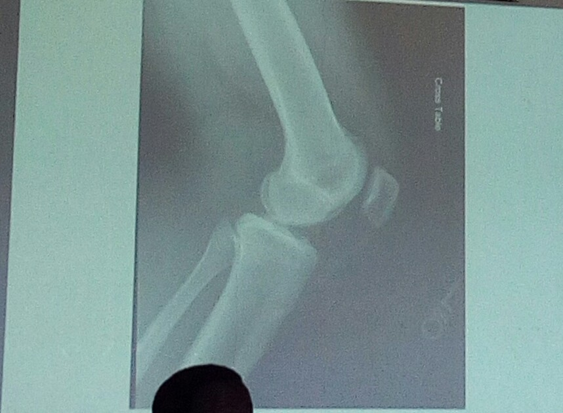

Slide 5
Differences in DENSITY gives contrast.

Slide 6
When there is a significant difference in density between 2 adjacent organs e.g. between air in the lungs and heart muscle, outlines between these structures are well visualized on a radiograph – the result of inherent contrast

Slide 7
If 2 organs adjacent to each other have similar densities – it is not possible to distinguish them on radiograph – because no natural/inherent contrast exists

Slide 8
Contrast agents usually add density to the organ of interest. On the X-ray film the organ appears brighter than the neighboring areas where there is no contrast material present – because the contrast material absorbs more radiation than the surrounding tissue.

Slide 9
Contrast media are introduced into a hollow viscous organ – allowing us to define the outline of the organ

Slide 10
Example
If you have a bottle filled with milk, you can visualize the milk clearly. You may have a problem seeing where the bottle surface is but you do not have a problem with seeing the milk.

Slide 11
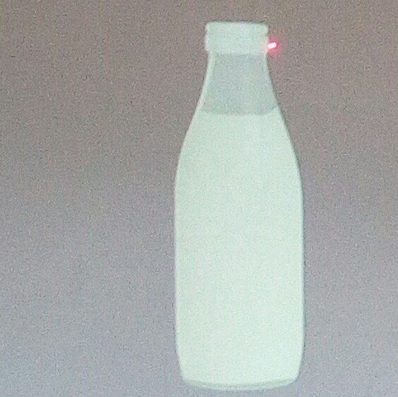

Slide 12
Barium sulfate, a contrast material is introduced into the body to outline the alimentary canal – e.g. the stomach or intestine it defines the intestine so that is can be visualized better. It is difficult to differentiate the intestine from surrounding soft tissues without a contrast medium within it.

Slide 13
Contrast agents injected into the blood vessels are water soluble and usually contain iodine. The more iodine in the compound used, the greater the radio-density of the contrast agent. Visualization of blood vessels is clearer and interpretation of the radiograph is enhanced.

Slide 14
Contrast agents – the choice depends on the organ being imaged made of elimination from the body and potential adverse reactions.

Slide 15
Very important to have knowledge of agents in order to redict their effect on the patient and to be able to evaluate the advisability of using them in a procedure.

Slide 16
Find radiographs of various body systems

Slide 17
TYPED BY EFFIE NAILA

