Slide 1
CONTRAST MEDIA IN IMAGING AND RELATED ADVERSE EFFECTS
DDIRM
MNW
26/11/15

Slide 2
Definition
Italian: contrastare
To stand out against.
CM will enhance and/ or outline structures or fluids in the body and;
Improve visibility or make the invisible visible
Legally contrast medium is a registered pharmaceutical drug.

Slide 3
Contrast agents cont.
Types
Several types of contrast media are in use in medical imaging and they can roughly be classified based on the imaging modalities where they are used.

Slide 4
General physical properties of contrast media
Non-toxic
Provide adequate contrast in the area of interest e.g. dense in aortography but dilute in choledochography
Have suitable viscosity especially in intravascular contrast
Suitable persistence e.g. contrast introduced into the lymphatic system
Must have miscibility or immiscibility as needed e.g. in renal cyst puncture, myodil vs iopamidol

Slide 5
IMAGING MODALITIES
X-Ray Imaging
CAT or CT Scans
Ultrasound Imaging
Magnetic Resonance Imaging
Scintigraphy (Radionucleotides)

Slide 6
CONTRAST AGENTS
Most common contrast agents in use are based on X-ray in its quality of attenuation
(radio contrast agents)
and Magnetic resonance signal enhancement, based on body water content.

Slide 7
Radiographic Contrast : Influenced by
Radiation Quality (KVP)
Film Contrast
Radiographic object (Patient)
- patients body consists of:-
water, fat, muscle, bone.
- each of these has a specific density,
governed by the relative Atomic No.
of its elements.

Slide 8
KEY DENSITIES IN THE HUMAN BODY
1 - Air/Lung
2 - Fat (layer between soft tissues,below skin.)
3 - Soft tissue
4 - Bones.
The greatest contrast is found in areas of greatest difference in density of adjacent structures ( AIR/BONE).

Slide 9
Human Body Tissue relative Densities
Substance Atomic # Density (kg/m3)
Fat 6.3 910
Soft Tissue 7.4 1000
Water 7.6 1000
Muscle 7.6 1000
Bone 13.8 1850

Slide 10
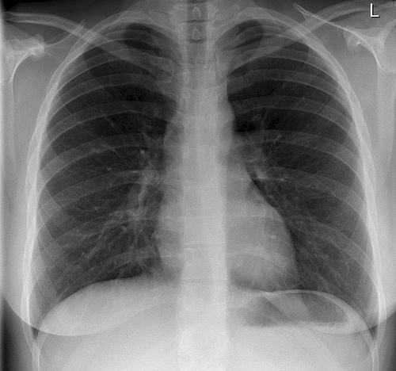
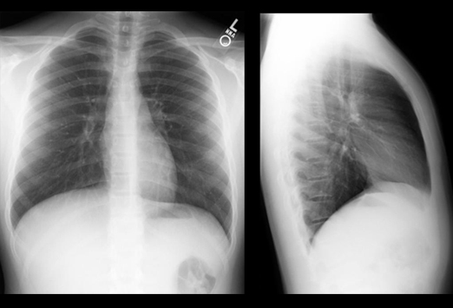
DENSITIES ON A CHEST X-RAY
FEMALE
MALE

Slide 11
4
Radio Contrast Material
Contrast Agent Atomic # Density (kg/m3)
Air ---------------- 7.6 1.3
Iodine-------------- 53 4930
Barium---------------56 3500

Slide 12
X- ATTENUATION
X-rays are attenuated as they pass through matter.
That is, the intensity of an X-ray beam decreases the farther it penetrates into matter.
Basically, each interaction of an X-ray photon with an atom of the material removes an X-ray from the beam, decreasing its intensity.

Slide 13
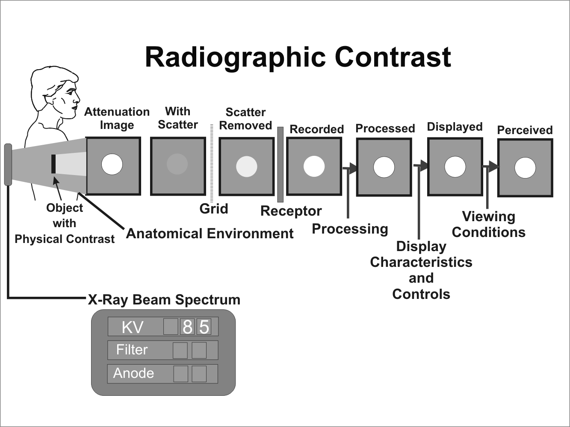
X-ray Imaging

Slide 14
X-ray attenuation
The Radiocontrast agent:-
Iodine and barium are the most common types of contrast medium for enhancing x-ray-based imaging methods.
Various sorts of iodinated contrast media exist, with variations occurring between the osmolarity, viscosity and absolute iodine content of different media. These can be ionic or non ionic.
The Iodine element is usually bound to the stable benzene element, an hydrocarbon (C6H6 ).

Slide 15
RADIO CONTRAST AGENTS
RCA ARE EITHER INTRAVEOUS OR ORAL
Intravenous Agents
  Are usually iodine based
  Eliminated from the body mainly by the kidneys.
  Travel through the blood vessels, to all organs and body tissues
Oral Agents
  Most common are Barium Sulphate and Gastrograffin administered in a milk shake type formula
Rectal Agents
  Used in imaging the lower gastrointestinal tract including the large intestine

Slide 16
RADIO CONTRAST AGENTS
BARUIM Z# 56
IODINE Z# 53
NON WATER SOLUABLE
GI TRACT ONLY INGESTED OR RECTALLY
KVP 90 – 120*
WATER SOLUABLE
POWDER
LIQUID
INTRAVENOUS OR
Intrathecal
GI TRACT
Also OIL based
KVP BELOW 90

Slide 17
Water- soluble contrast media
Properties:-
  Very hydrophilic
  Low lipid solubility
  Low binding affinities for protein, receptors or membranes
  Molecular weights < 2000; 600-800 for monomers
  Good distribution/ bio-availability on intravascular injection
  Do not enter blood or tissue cells
  Rapid excretion with > 90% renal excretion within 12 hours
  Minimal pharmacological action

Slide 18
ICM
They can be Monomers or Dimers (based on the Iodine carrier benzene ring)
Non-ionic dimers are favored for their low osmolarity and toxicity, but have a correspondingly higher price attached to their use.

Slide 19
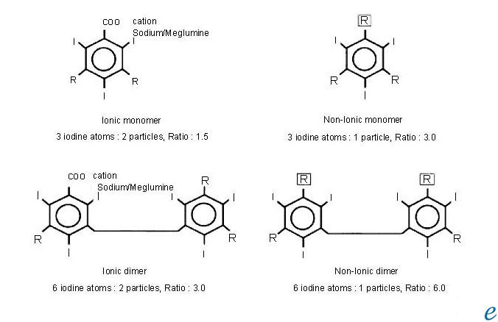
THE BEZENZE RING

Slide 20
IVC AGENTS /MEDIA
All intravascular iodinated contrast agents are based on a tri-iodinated benzene ring.
Three primary forms exist:
- High-osmolar contrast media (HOCM)
These are the oldest agents.
They are relatively inexpensive, but their utility
is limited.
They are monomers (single benzene ring) that
ionize in solution with a valence of -1.
Their cation is either sodium or meglumine.

Slide 21
LOW OMOLAR CONTRAST MEDIA (LOCM)
A major advance was the development of
non ionic compounds.
They are monomers that dissolve in water but
do not dissociate.
Hence, with fewer particles in solution, they
are designated low-osmolar contrast media.

Slide 22
ISO- OSMOLAR CONTRAST MEDIA
The most recent class of agents are dimers they consist of a molecule with two benzene rings ( each with 3 iodine atoms) that do not dissociate in water (nonionic).
These compounds are designated iso-osmolar contrast media (IOCM).

Slide 23
1- Iodine based contrast; classification
Depending on chemical properties:-
  Water-soluble or lipid-soluble
  Ionic or non-ionic
  High osmolar/ low osmolar
  Monomer or dimer
  For ionic water-soluble contrast can be salts of sodium, meglumine or both
Method of administration
  Oral
  Intravascular

Slide 24
NON SOLUBLE RCA
Barium Sulfate is the sulfate salt of barium, an alkaline, divalent metal.
Barium sulfate is quite insoluble in water, and is used as a radiopaque agent to diagnose gastrointestinal medical conditions.
Barium sulfate is taken by mouth or given rectally.

Slide 25
PATIENT PREPARATION
To enhance imaging patients are given laxatives, enemas, or suppositories, to clean the GIT.
NPO for a minimum of 6-5hrs.
Radio CMA include:-
  Barium (Ba)
  Barium Sulphate (BaSO4)
  Iodine (I) Intravenous
  Gastrograffin ( water soluble GIT CM)
These agents all work in the same way but vary in function by how they are administered and how they are removed from the body

Slide 26
Other drugs used in imaging.
Glucagon
Ordinarily used to treat hypoglycemia
Causes relaxation of the smooth muscles of the GI tract
Useful as a diagnostic aid in examinations of the GI tract because it slows peristalsis and prevents cramping. Preferred over atropine because of lower incidence of side effects.
Preferred over atropine because of lower incidence of side effects.

Slide 27
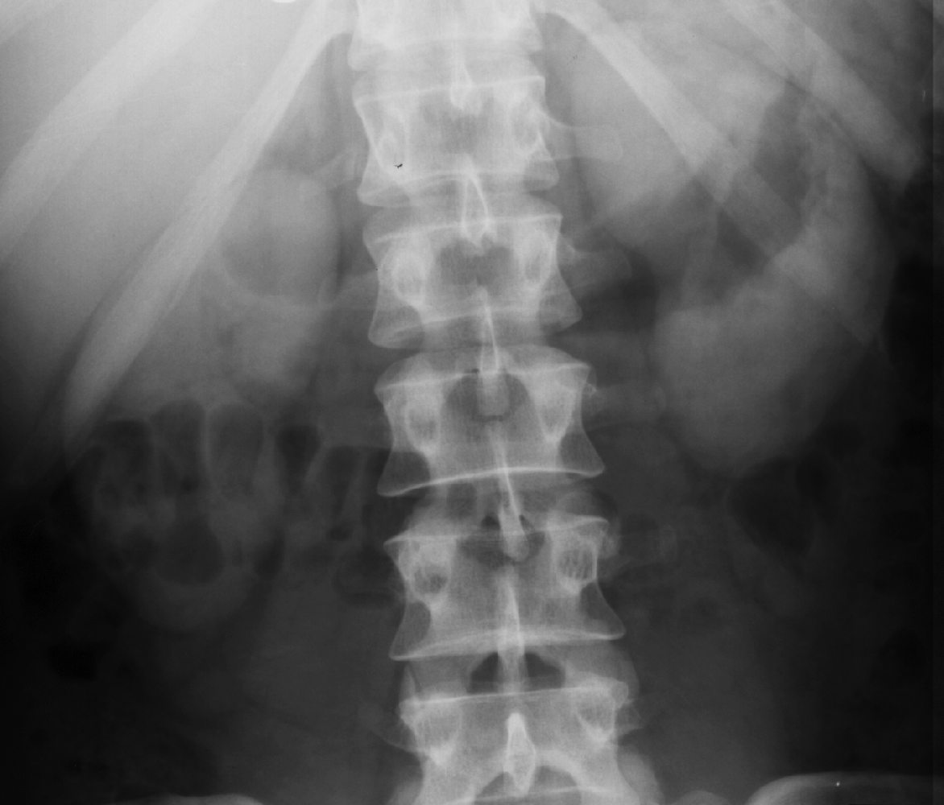
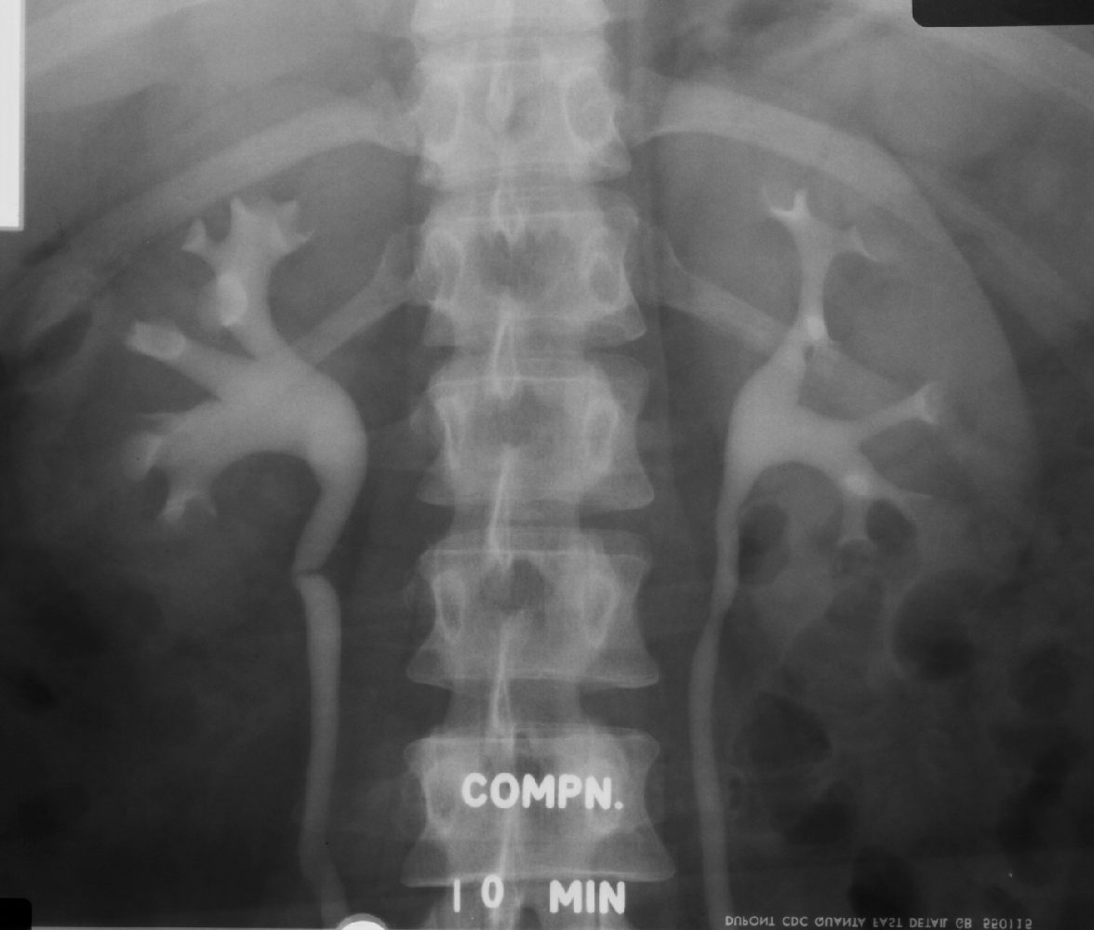
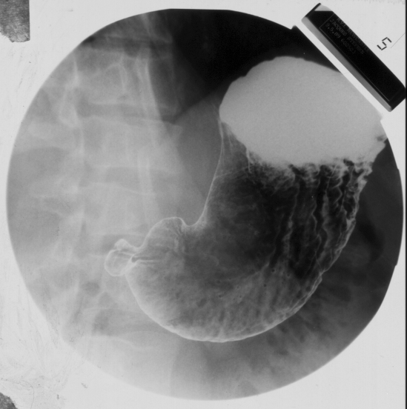

IMAGES WITH CONTRAST

Slide 28
RCA-Facts to remember
Osmolality is dependent on the number and not size of particles in solution
Radiographic contrast is dependent on the iodine concentration of the solution and therefore the number of iodine particles per molecule and the concentration of the molecules in solution
Non-ionic contrast does not dissociate in solution and can be used for myelography/ radiculography
Low osmolality reduces;
  pain on intra-arterial injections
  adverse reactions

Slide 29
ULTRASOUND
The most underdeveloped of the 5areas(s5)
Used in imaging solid or water filled organs, including the liver, spleen, kidney, heart, blood vessels, the Gall Bladder, urinary bladder, and the uterus, (GS).

Slide 30
Contrast media for ultrasound
the ultrasound image is created by ultrasound energy reflected by different structures of the body: "echoes".
An ultrasound contrast medium is therefore an echogenic substance which is introduced into a vessel or organ system in order to induce and increase echogenicity - increased ability to reflect ultrasound energy.

Slide 31
ULTRASOUND
The extent to which sound is reflected by a tissue depends on the acoustic impedance of the tissue or the tissue components.
The larger the difference in acoustic impedance between two tissue types, the larger the reflection of the ultrasound from the interface between those two tissues.
No Contrast Agents are used on a regular basis for U/S but the use of microbubbles has potential

Slide 32
ULTRASOUND
Such media may be injected intravenously and examples are
- suspensions of solid particles, emulsions of
fluid droplets, micro bubbles of pure gas,
gas bubbles encapsulated in various
structures or liquids that release micro
bubbles.
  Like other contrast media, ultrasound media should have low toxicity and fast excretion.
  The biggest problem is preventing break down of the bubbles in the heart and the lungs.

Slide 33
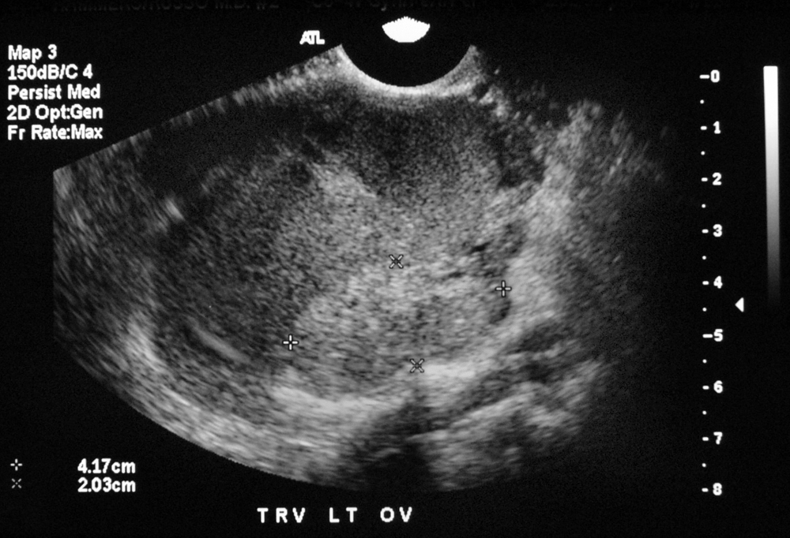
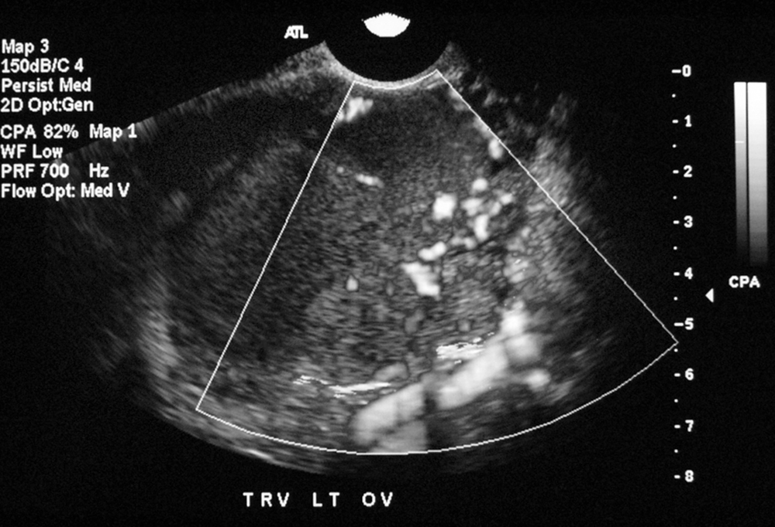
Micro bubbles in blood vessels
Contrast enhanced US
⇧ number of vessels
Irregular, clustered
Abnormal branching patterns
Abnormal enhancement pattern
  rapid uptake

Slide 34
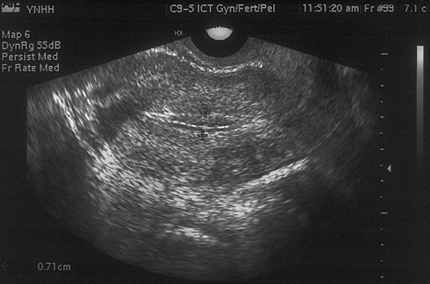
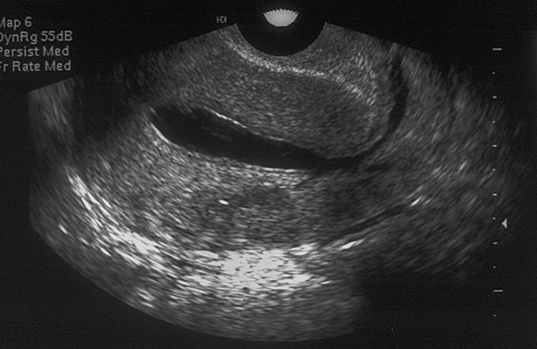
Ultrasound contrast cont.
Uterine cavity poorly visualised
Fluid in the uterine cavity

Slide 35
MRI and contrast agents
Initially thought to be unnecessary due to MRI inherent ‘soft tissue’ contrast ad spatial resolution
MRI contrast depends on multiple parameters
  Spin density
  T1, T2 Relaxation
  Magnetic susceptibility
  Diffusion- movements of bulk water molecules
  Perfusion-tissue microcirculation or perfusion
The contrast agent development is targeted at the above parameters

Slide 36
MRI CONTRAST AGENTS
MRI contrast agents cause changes in local magnetic fields by inducing proton relaxation time shortening.
According to their physical characteristics intravenous MRI contrast agents can be classified into the following two major groups.
a) Paramagnetic contrast agents
Shorten T1 relaxation time of the protons. Gadolinium, a rare-earth
metal, is the most commonly used paramagnetic contrast agent.
Gadolinium as a free ion is highly toxic, therefore stabile chelated
gadolinium compounds, which is generally regarded as safe, are used in
medical imaging.
Apart from the gadolinium-containing contrast agents there are other, so-called
organ- or tissue-specific contrast agents containing other metallic elements.
b) Superparamagnetic contrast agents
reduce the T2 relaxation time of the protons in absorbing tissues.

Slide 37
MRI contrast agents
Gadolinium Chelates have similar clinical properties as iodinated contrast
  Gd has a molecular weight of 592.
  Gd has 7 unpaired electrons. Shortens both T1 & T2 values. This effect is seen best on T1 weighted images.
  Gd chelates circulates within the vascular system, do not cross the normal BBB and are excreted unchanged by the kidneys

Slide 38
Oral MRI contrast
Two main groups
  Enhance T1 signal- Gd and Mn Chelates, iron oxide salts
  Reduce T2 signal- SPIO, barium sulphate, air, clay.
  Natural products that contain high manganese like blueberry and green tea can also be used.
  Perflubron has been used in pediatric GIT imaging.
  It reduces the amount of protons in the body cavity making it appear darker on images.

Slide 39
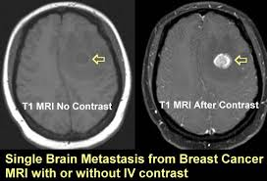

Slide 40
CONTRAST REACTIONS
MOST CONTRAST RELATED REACTIONS ARE RELATED TO IODINATED CONTRAST AGENTS.
METHODS OF CATEGORIZING.
There are two useful ways to approach contrast reactions.
One is to categorize them according to their severity.
This method has immediate clinical relevance when reactions occur and provides a framework for determining an appropriate course of treatment.
The other approach is to analyze them according to the
type of adverse reaction.
This is important to understand the mechanisms of reaction

Slide 41
Incidence of Reactions
Reaction
HOCM
LOCM
Overall
5-8%
1-2%
H/O Allergy
10%
3-4%
Severe
.1%
.01%
Fatal
1/40k-170k
1/200k-300k
Indications for LOCM: previous reaction, asthma, atopy or allergies, cardiac disease, children, patient request, no history, renal insufficiency, extravasation risk, physician discretion

Slide 42
Types of Reactions
Anaphylactoid
Nonanaphylactoid
Delayed

Slide 43
Anaphylactoid Reactions
Urticaria
Facial/laryngeal edema
Broncho spasm
Circulatory collapse

Slide 44
Mri contrast react.
Gadolinium MRI contrast agents have proved safer than the iodinated contrast agents.
Anaphylactic reactions are rare, but might occur similarly to X-ray radiography and computed tomography.
There is a risk of a rare but serious illness called nephrogenic systemic fibrosis, this is linked to the use of gadolinium-containing MRI contrast agents.
Its pathophysiological background is unknown, renal impairment carries a risk of its development.
For this reason MRI contrast is contraindicated in patients with GFR under 30 and in children under the age of one year.

Slide 45
Non anaphylactoid Reactions
Nausea/vomiting
Cardiac arrhythmia
Pulmonary edema
Seizure
Renal failure

Slide 46
Delayed Reactions
Fever, chills
Rash, flushing, pruritis
Arthralgias
Nausea, vomiting
Headache

Slide 47
Risk Factors and Precautions
Risks
  Allergy
  Renal failure
  Other
Precautions
  Premedication
  Hydration
  Dose limitation

Slide 48
Renal Risk
Elevated creatinine, especially with diabetes, or paraproteinemia such as myeloma
  Hydration
  Limit dose
  Consider premedication

Slide 49
Allergic Risk
Patients with hx of major allergy, asthma- pre medication recommended
50 mg prednisone PO 13, 7, and 1 hr prior
50 mg Benadryl PO/IM 1 hour prior
If urgent: 200mg hydrocortisone IV q 4 hrs
  Consider ephedrine (NOT if HTN, angina, arrhythmia)
  At least 6 hours from first dose

Slide 50
Metformin
  Risk of lactic acidosis
  Discontinue for 48 hrs after contrast
  Check creatinine before resuming
  If Metformin+CRI+IVC LA
50% mortality

Slide 51
Cardiac Risk
Angina/CHF with minor exertion
Aortic stenosis
Primary pulmonary hypertension
Severe cardiomyopathy
Limit dose

Slide 52
Other Risks
Pregnancy: category B
Breast-feeding:
  Package insert: may substitute with bottle for 24 hrs, not necessary
  1% excreted in milk, of which 2% absorbed by baby

Slide 53
Other Risks
Pheochromocytoma
Sickle cell disease
Untreated hyperthyroid
Myasthenia gravis
Interleukin-2 therapy
Hypertensive crisis*
Sickle cell crisis
Thyroid storm
Exacerbation*
Delayed reaction
*Doubtful risk with nonionic agents

Slide 54
MANANGEMENT
Being aware of manangent of these acute reactions is a duty of all the medical team in the Imaging department.

Slide 55
Acute Reactions
ALWAYS
  ABC’s
  Vitals
  Physical exam
OFTEN
  Oxygen 10L/min
  IV Fluids: NS or Ringer’s

Slide 56
Urticaria
OBSERVE
Listen to lungs
Benadryl 25-50mg PO/IM/IV
Zantac 50mg PO or slowly IV
Epi SC (1:1000) .1-.3ml = .1-.3mg

Slide 57
Laryngeal Edema
EPINEPHRINE IV slow, 1.0ml*
  May repeat up to 1mg*
O2 10L/min via mask*
NO BRONCHDILATORS
*Consider calling code

Slide 58
Bronchospasm
O2 10L/min
Monitor: ECG, O2 sat, BP
ALBUTEROL INHALER
Epinephrine SC .1-.3ml*
Epinephrine IV 1.0 ml, may repeat*

Slide 59
Hypotension with Bradycardia (Vagal Reaction)
  Legs elevated, Monitor vital signs
  O2 10L/min
  Ringer's lactate or normal saline
  ATROPINE .6-1.0mg IV slow, repeat to .04mg/kg

Slide 60
Hypotension with Tachycardia
Legs elevated > 60 degrees, head down
Monitor ECG, O2 sat, BP
O2 10L/min
Ringer's lactate or normal saline
Epinephrine IV 1.0ml slowly, up to1mg
DOPAMINE 1600 ug/ml: 2-5 ug/kg/min IV
Consider ICU transfer

Slide 61
Contrast-Induced Nephrotoxicity
Usually asymptomatic: creatinine peaks 3-5 days, in severe oliguric renal failure: peaks 5-10 days
Incidence:
  7-8% arterial injections
  2-5% venous injections
  ~0% venous injections if no risk factors

Slide 62
Air Embolism
Clinically silent air embolism not uncommon: air bubbles in the thoracic veins, MPA or RV
Significant air embolism potentially fatal but extremely rare
Symptoms: air hunger, dyspnea, cough, pulmonary edema, tachycardia, HTN, wheezing
Treatment: 100% O2, LLD, hyperbaric O2, CPR if arrest occurs

Slide 63
TAKE HOME POINTS
  Legally contrast medium is a pharmaceutical drug; therefore it has contraindications and might have side effects.
  Barium sulphate, an insoluble oral radiocontrast, is contraindicated in suspected bowel perforation and in patients at risk for aspiration.
  Kidney function has to be checked prior to intravenous contrast administration.
  In hyperthyroidism the thyroid function has to be checked before a iodinated contrast study.
  It has been recommended that all drugs which are excreted by the kidney be stopped temporarily before intravascular administration of contrast media.

Slide 64


