Slide 1
Imaging in rheumatology.

Slide 2
What is Rheumatology?
Rheumatology is the subspecialty of medicine devoted to the diagnosis and treatment of diseases that affect bones muscles, ligaments, tendons, joints, and other body parts including the immune system.

Slide 3
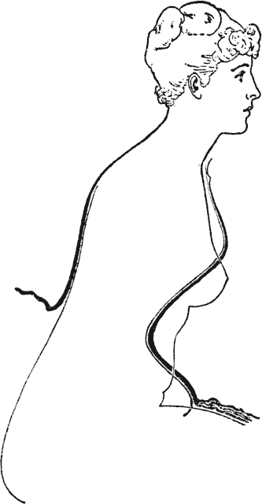
Outline
Inflammatory arthritis
Rheumatoid arthritis
Psoriatic arthritis
Reiter’s disease
Juvenile chronic arthritis DDx:
Osteoarthritis
Septic arthritis
Other inflammatory arthritides
Hemophilia
Collagen vascular disease

Slide 4
Why?
Sutton's Law
This law has been ascribed to Willie Sutton, a famous bank robber. When asked why he robbed banks, he reportedly said, "Because that's where the money is."
In the radiographic evaluation of appendicular arthropathies, the "money" is generally in a relatively small handful of disorders.
Even though over 90 different rheumatic diseases are recognized by the American College of Rheumatology, only three entities are commonly seen in most clinical radiology practices, even including those located in large tertiary medical centers.

Slide 5
More laws….
In George Orwell's Animal Farm, it is stated that "All animals are equal.
But some animals are more equal than others.
" This principle is manifested in the appendicular arthropathies, where some radiographic findings are quite specific and can quickly lead one to the correct diagnosis.
Other findings are less specific and are usually unhelpful in ordering one's differential diagnosis.

Slide 6
And the last…
The Law of Parsimony
In medical school, one is taught to take historical points and physical findings and to put them together into one diagnosis which explains everything (the law of parsimony).
However, once one reaches the ward rotations and opens a patient's chart to the problem list, one sees that most real patients have several disorders going on simultaneously.
In real life, patients often have more than one arthropathy.
This is most commonly seen in patients with secondary osteoarthritis superimposed upon some other arthropathy.

Slide 7
Approach
ABCDE’S
Alignment
Bone
Cartilage/Joint space
Distribution
Erosions.
Soft tissue

Slide 8
Rheumatoid arthritis.
Rheumatoid arthritis (RA) is a chronic systemic disease of unknown origin that predominantly involves synovial tissue.
Early diagnosis and initiation of proper therapy help modify the course of the disease and reduce the degree of severe late sequel.
Radiology plays a key role in diagnosis and management of RA.

Slide 9
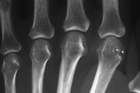
Tools of the trade.
Currently, magnetic resonance imaging is the best imaging modality because it depicts soft-tissue changes and damage to cartilage and bone even better and at an earlier stage than does computed tomography.
Ultrasound and conventional radiography are more readily available but cannot show the entire spectrum of the disease.

Slide 10
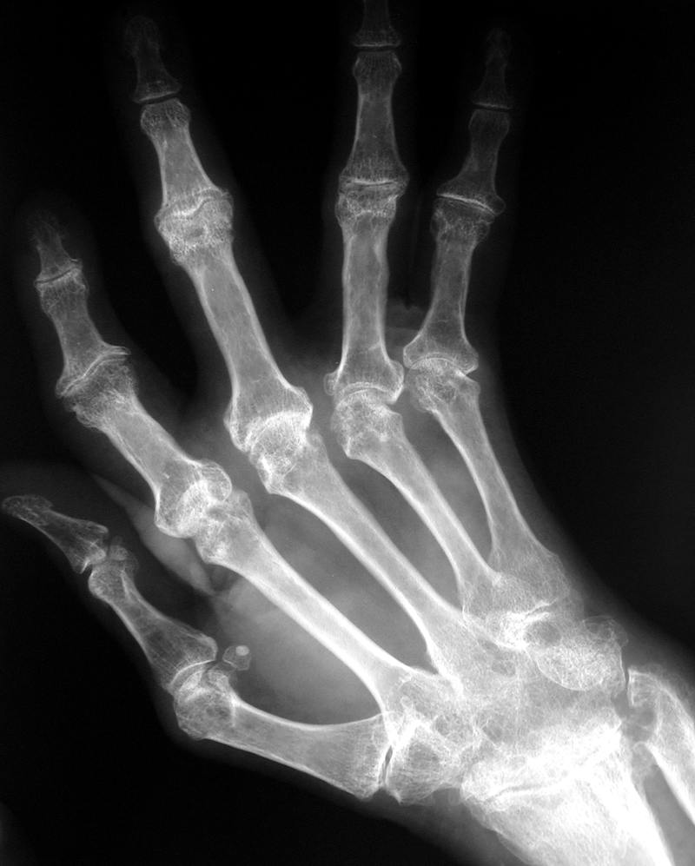
ABCDE’S
Alignment
Malalignment: subluxation and dislocations occur late in RA.
Boutonniere and Swan-neck deformities

Slide 11
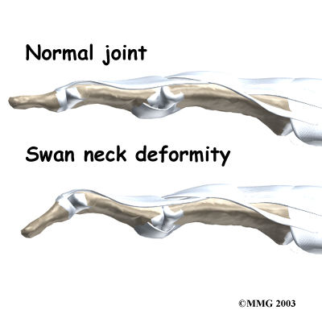

Slide 12
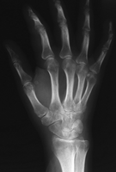
ABCDE’S
Bones
Osteoporosis due to hyperemia

Slide 13
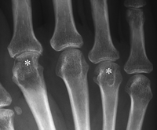
ABCDE’S
Cartilage/Joint Space
Uniform joint space narrowing

Slide 14
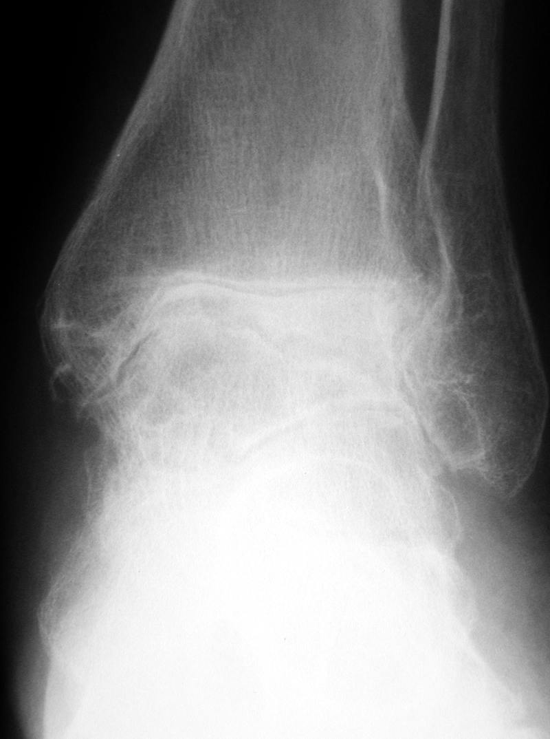
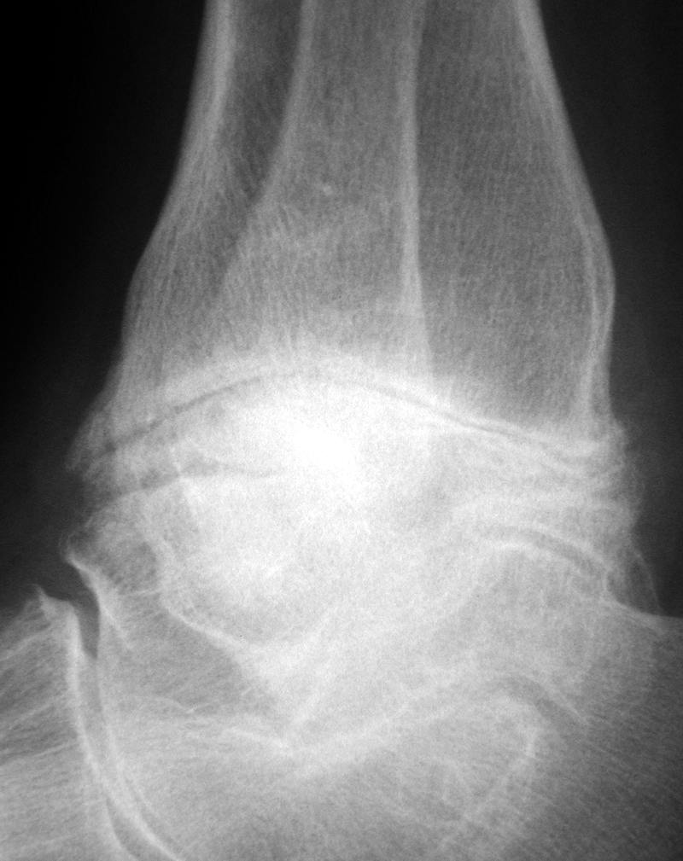
Cartilage/Joint Space

Slide 15
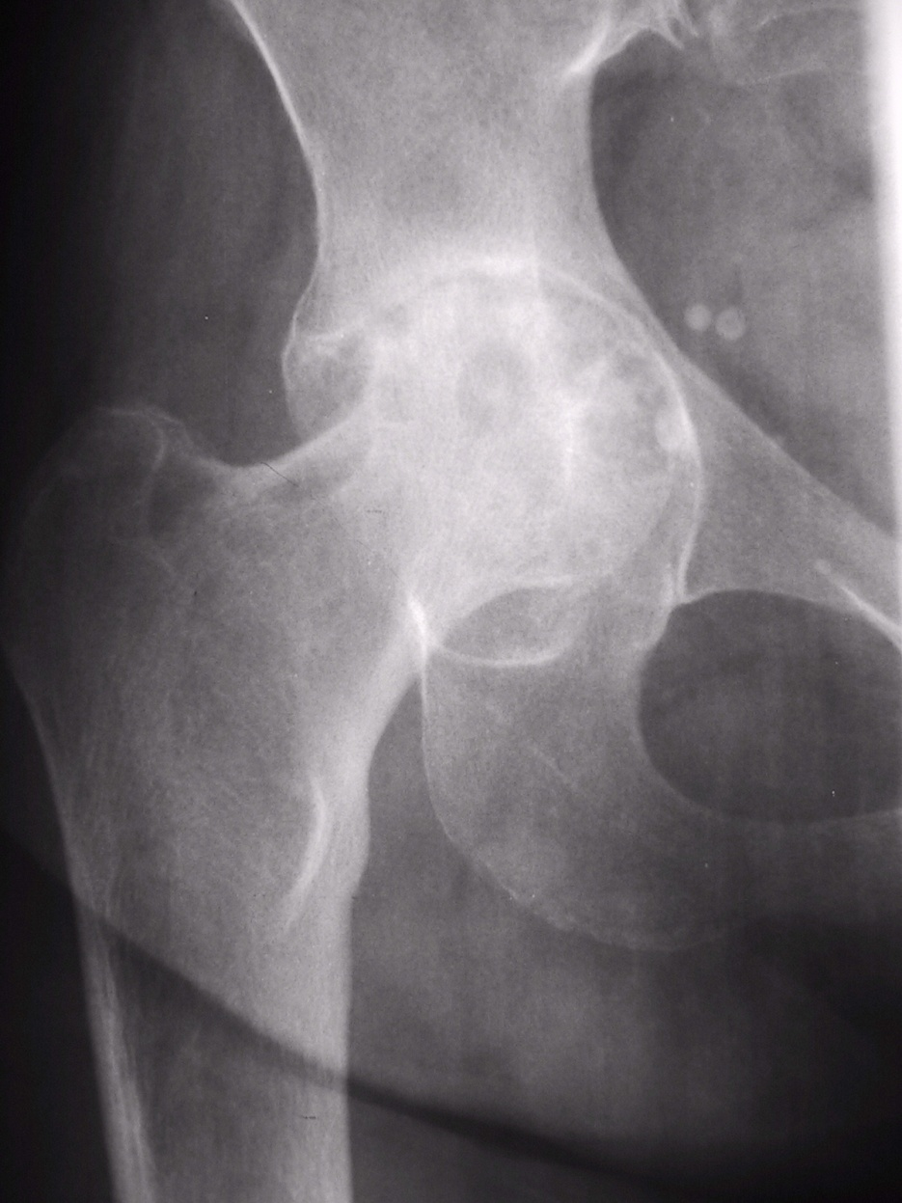
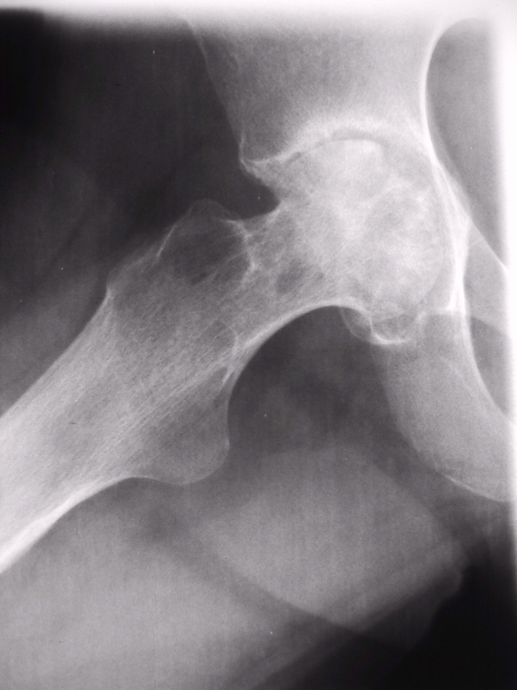
Cartilage/Joint Space

Slide 16
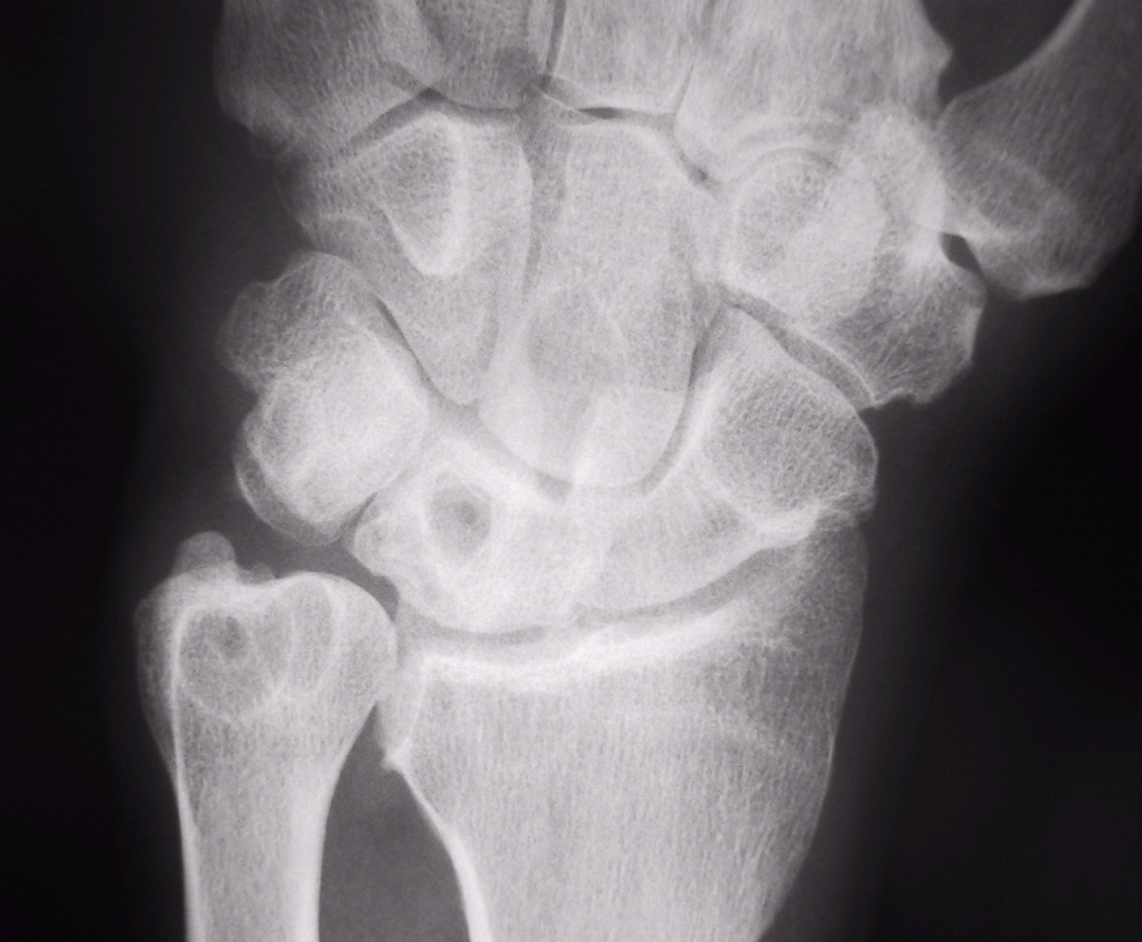
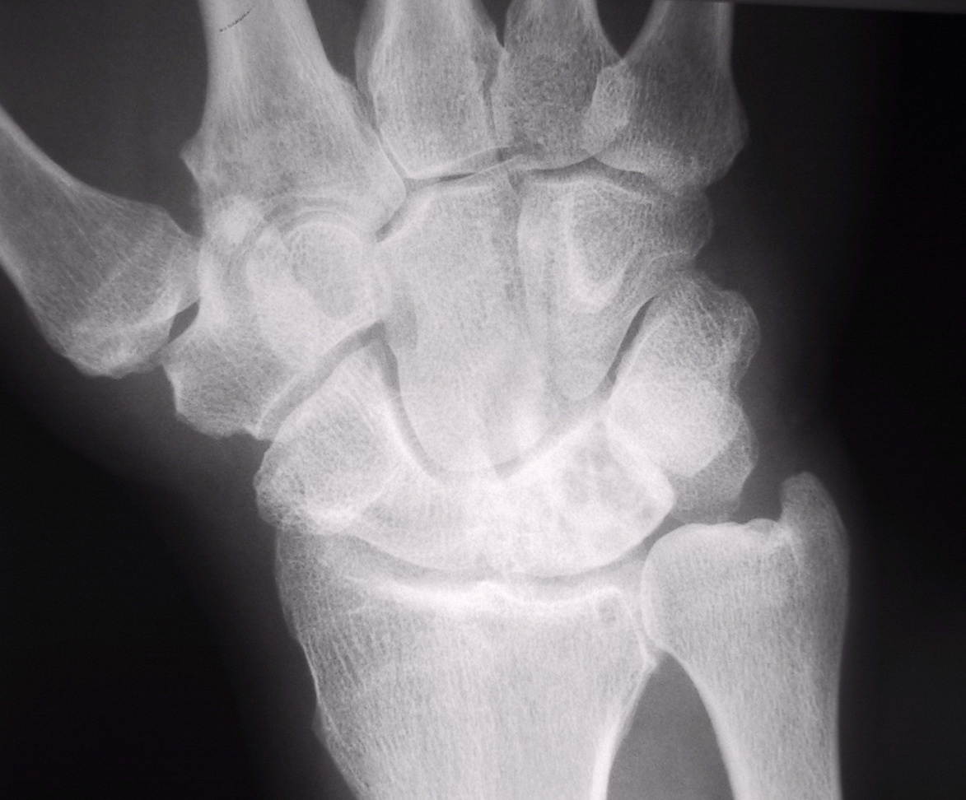
Distribution.

Slide 17
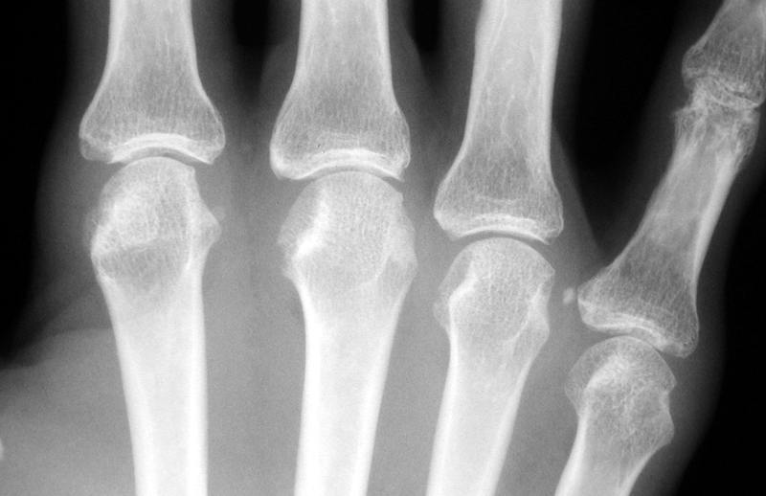
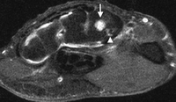
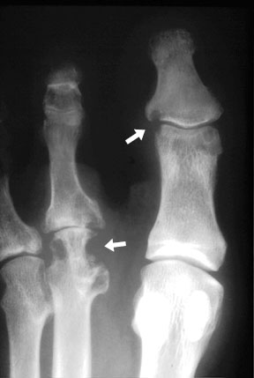
Erosions.

Slide 18
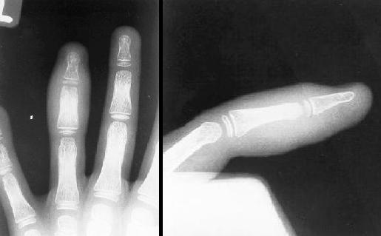
Soft tissue
Periarticular soft tissue swelling (earliest radiographic sign)

Slide 19
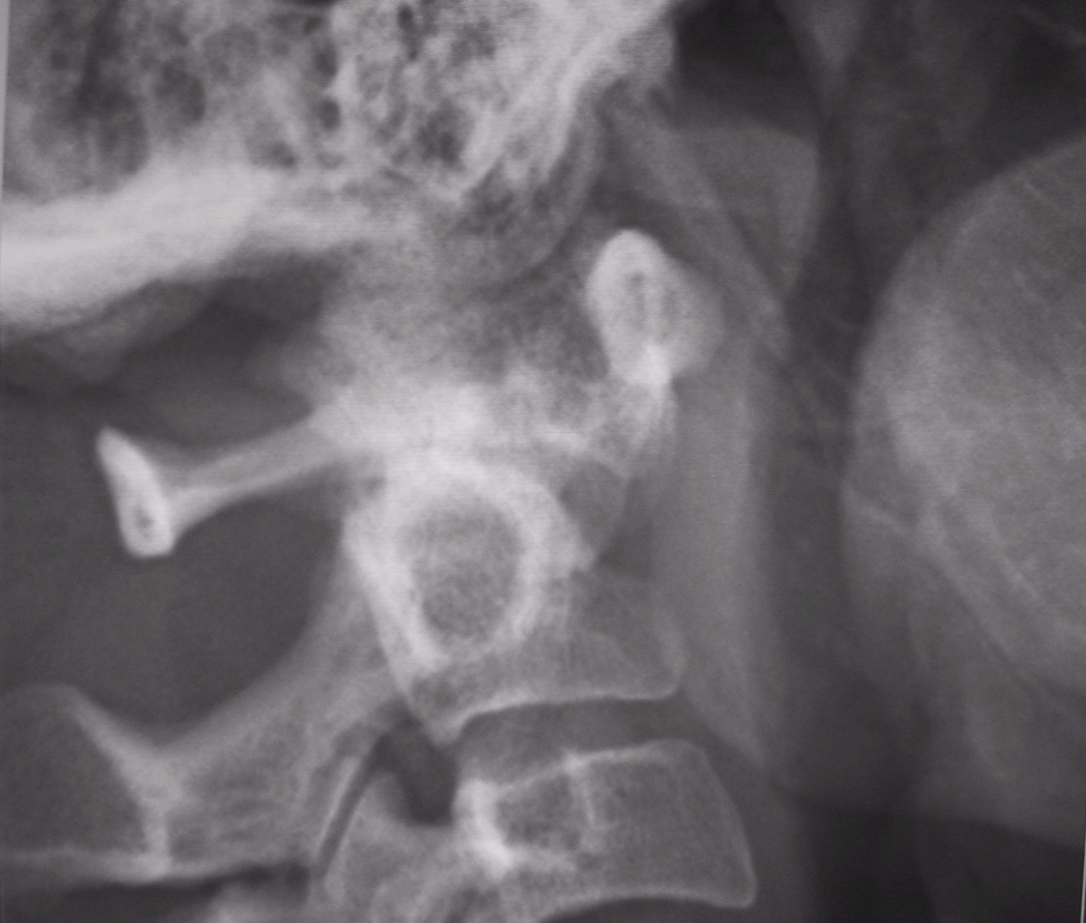
Odontoid erosion

Slide 20
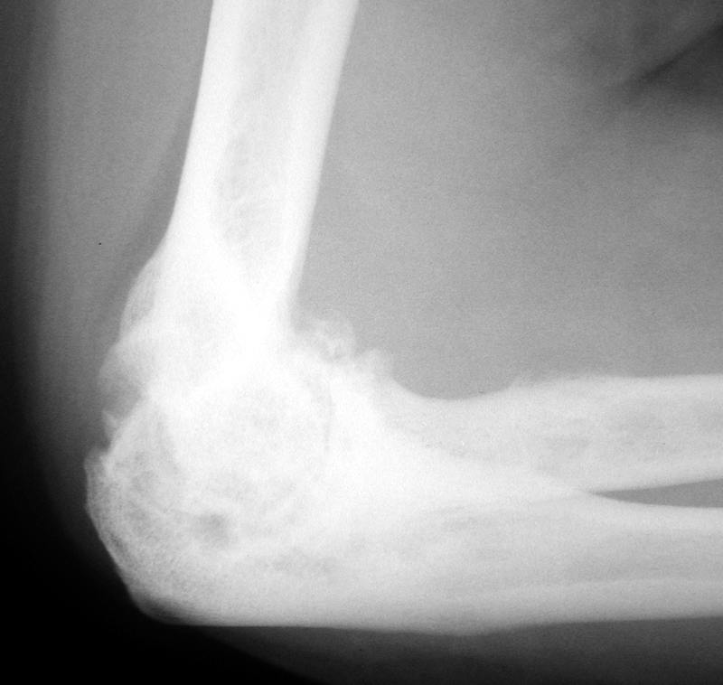
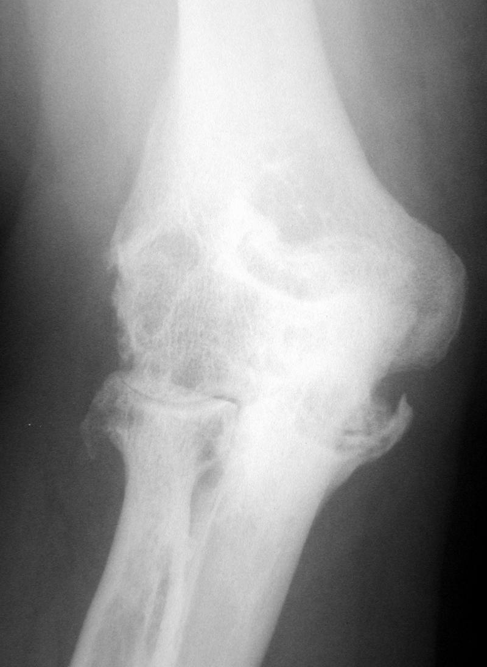
Elbow involvement.

Slide 21
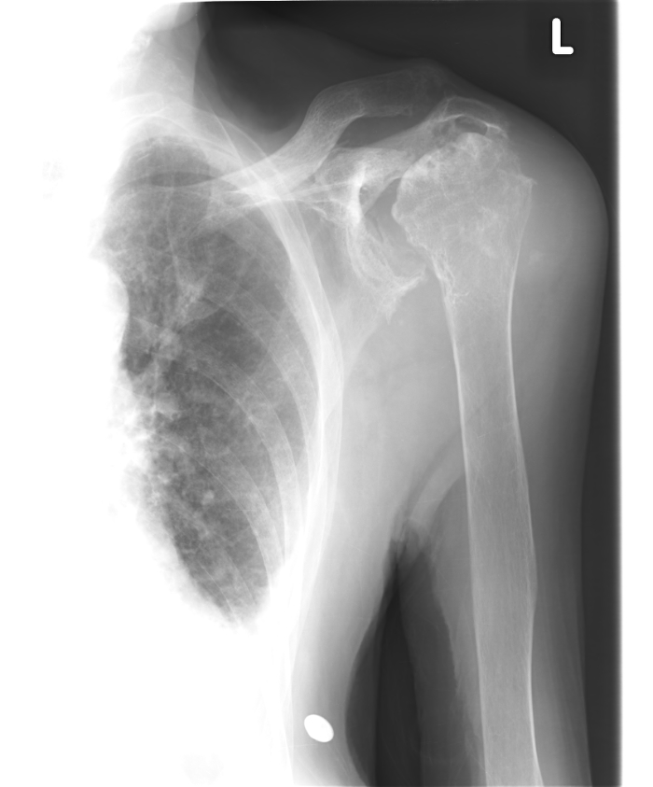
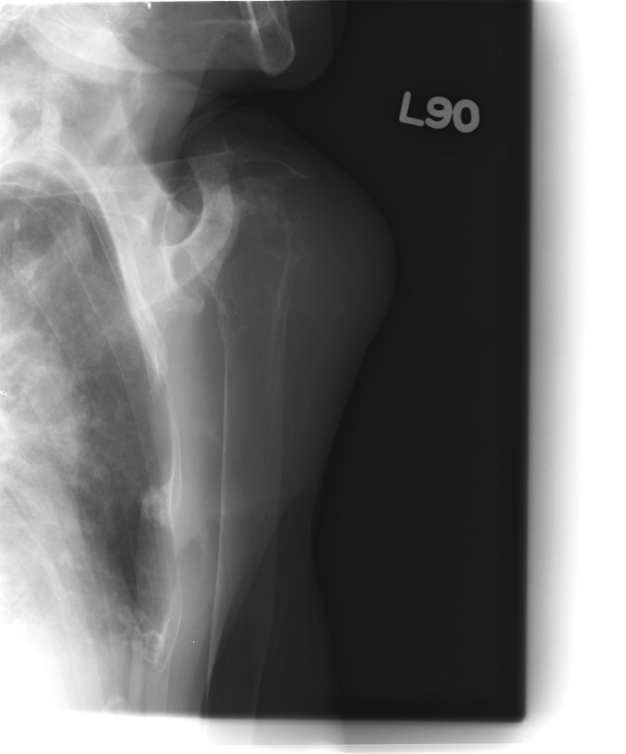
Shoulder joint RA

Slide 22
Psoriatic Arthritis
Different from RA
Bone proliferation
Often asymmetric although usually bilateral
Normal bone mineralization

Slide 23
Psoriatic Arthritis
Five patterns
Monoarthritis/asymmetric oligoarthritis (most common): sausage digit
Sacroilitis/spondylitis
Symmetric polyarthritis (resembling RA)
Polyarthritis w/ DIP involvement
Arthritis mutilans

Slide 24
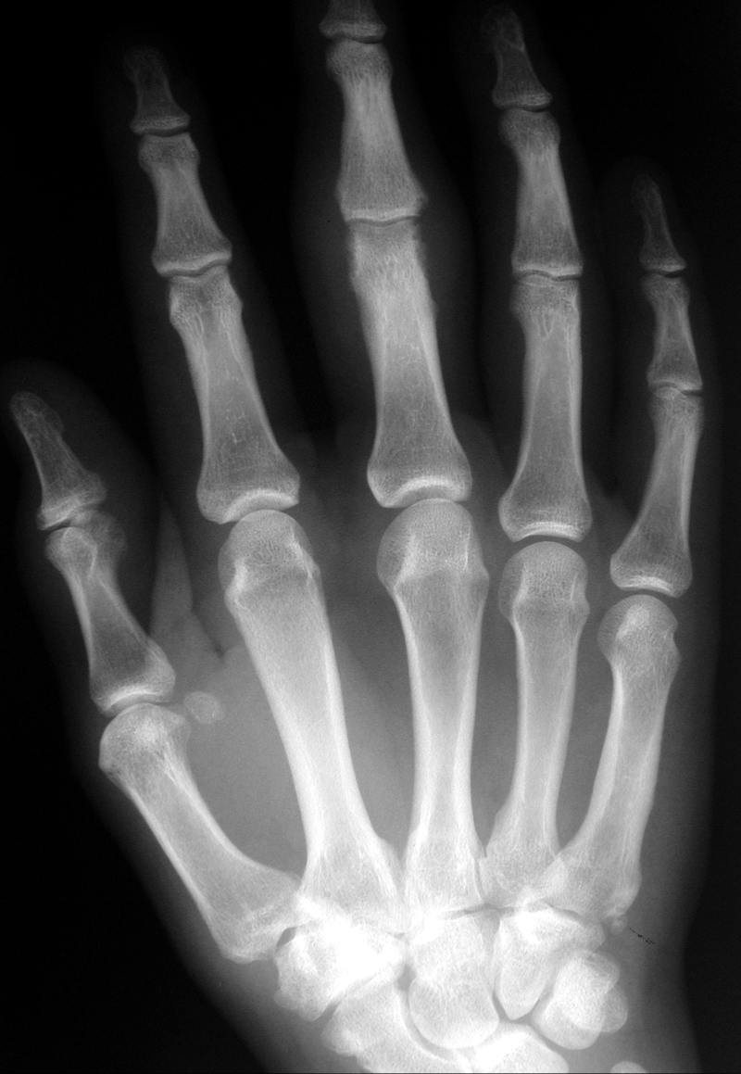
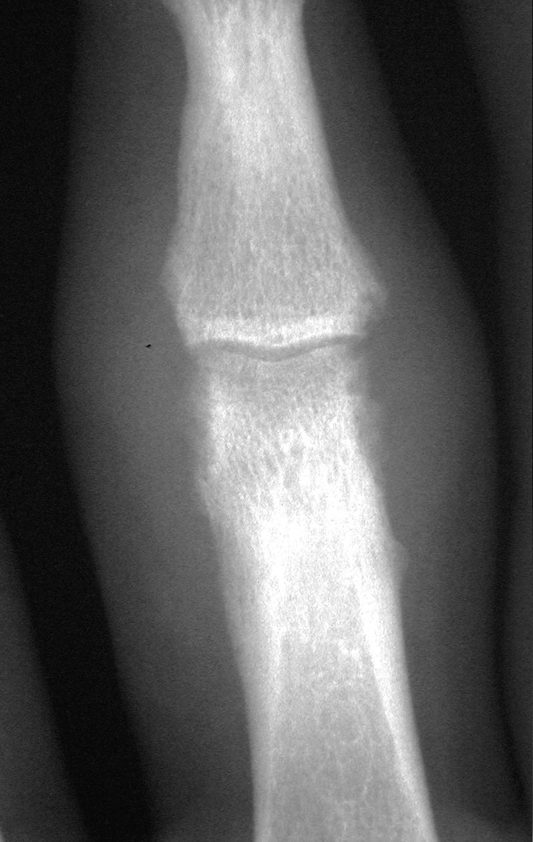

Slide 25
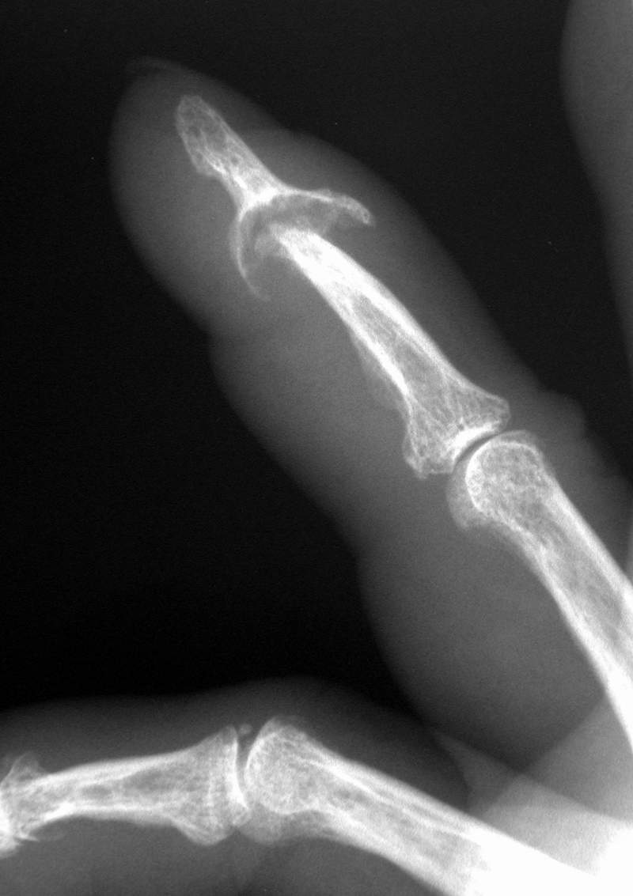
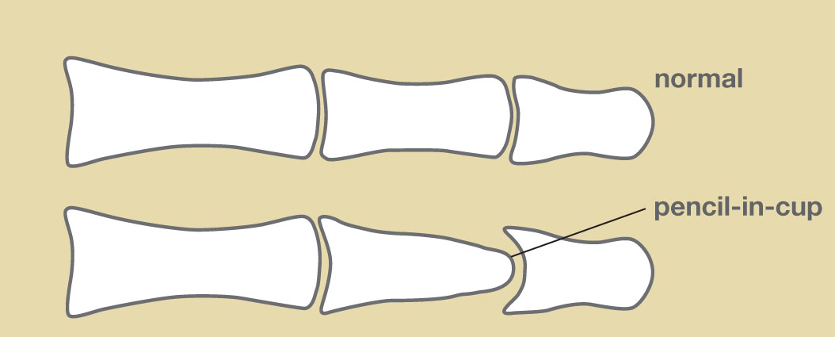

Slide 26
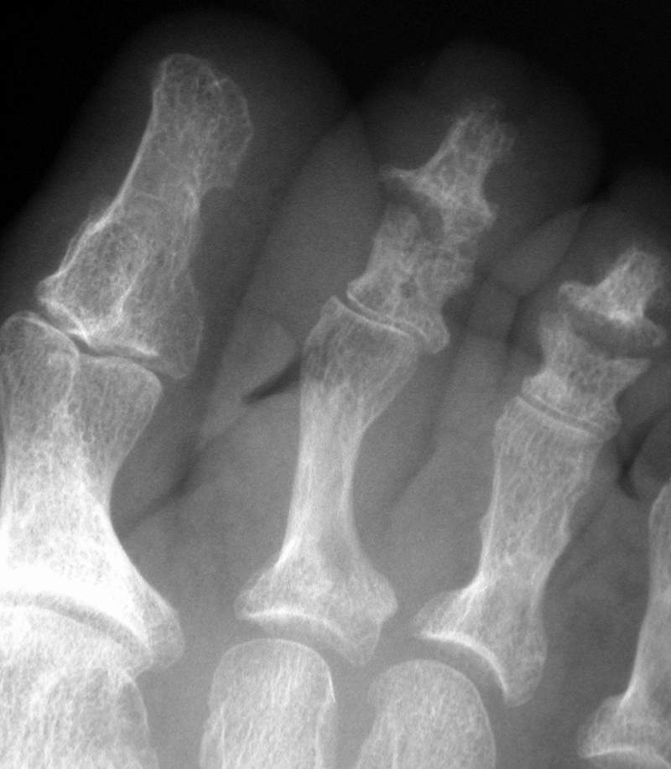
Foot pencil in cup

Slide 27
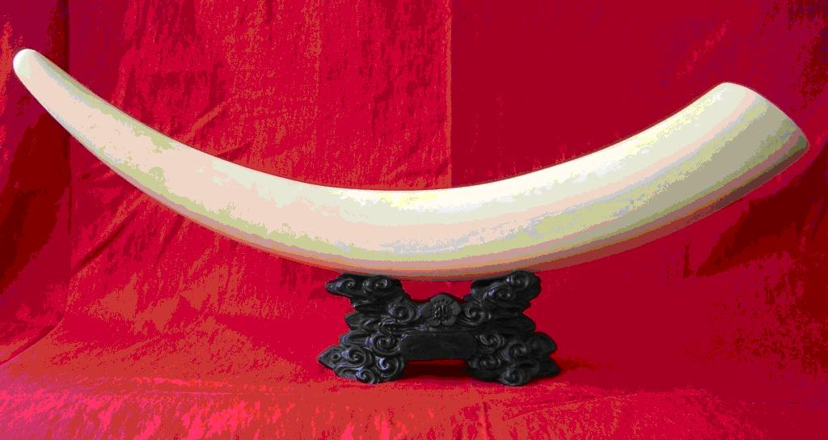
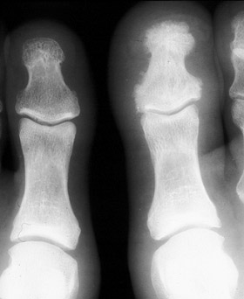
Ivory phalanx

