Slide 1
Reiter’s Disease
Radiographically indistinguishable from psoriatic arthritis
Distribution different from psoriatic arthritis
Primarily involving feet, ankles, knees
Hands, hips, SI joints and spine much less frequently involved

Slide 2
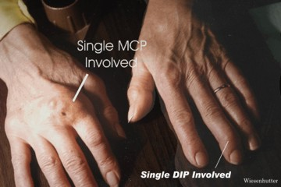
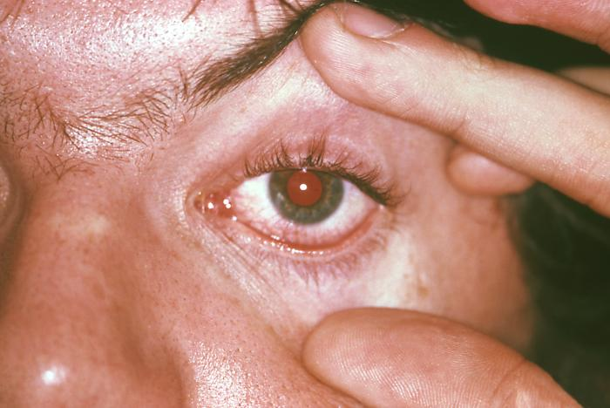
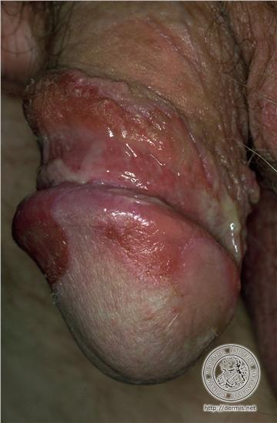
Reiter’s Disease
Clinical triad
Arthritis
Conjunctivitis
Urethritis/cervicitis

Slide 3
Juvenile Chronic Arthritis
Including a variety of disorders in children
Still’s disease 70% (seronegative chronic arthritis)
ankylosing spondylitis
psoriatic arthritis of inflammatory bowel disease
juvenile onset adult type RA

Slide 4
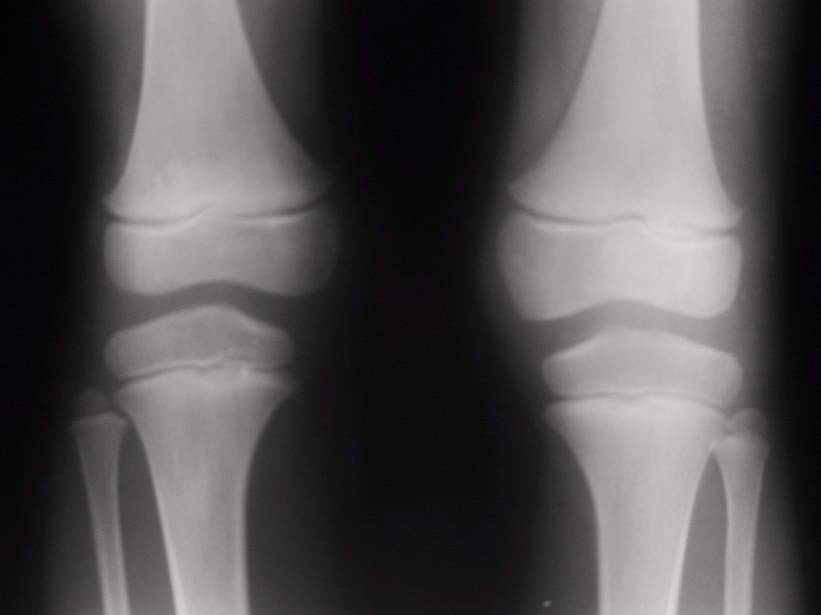
JCA

Slide 5
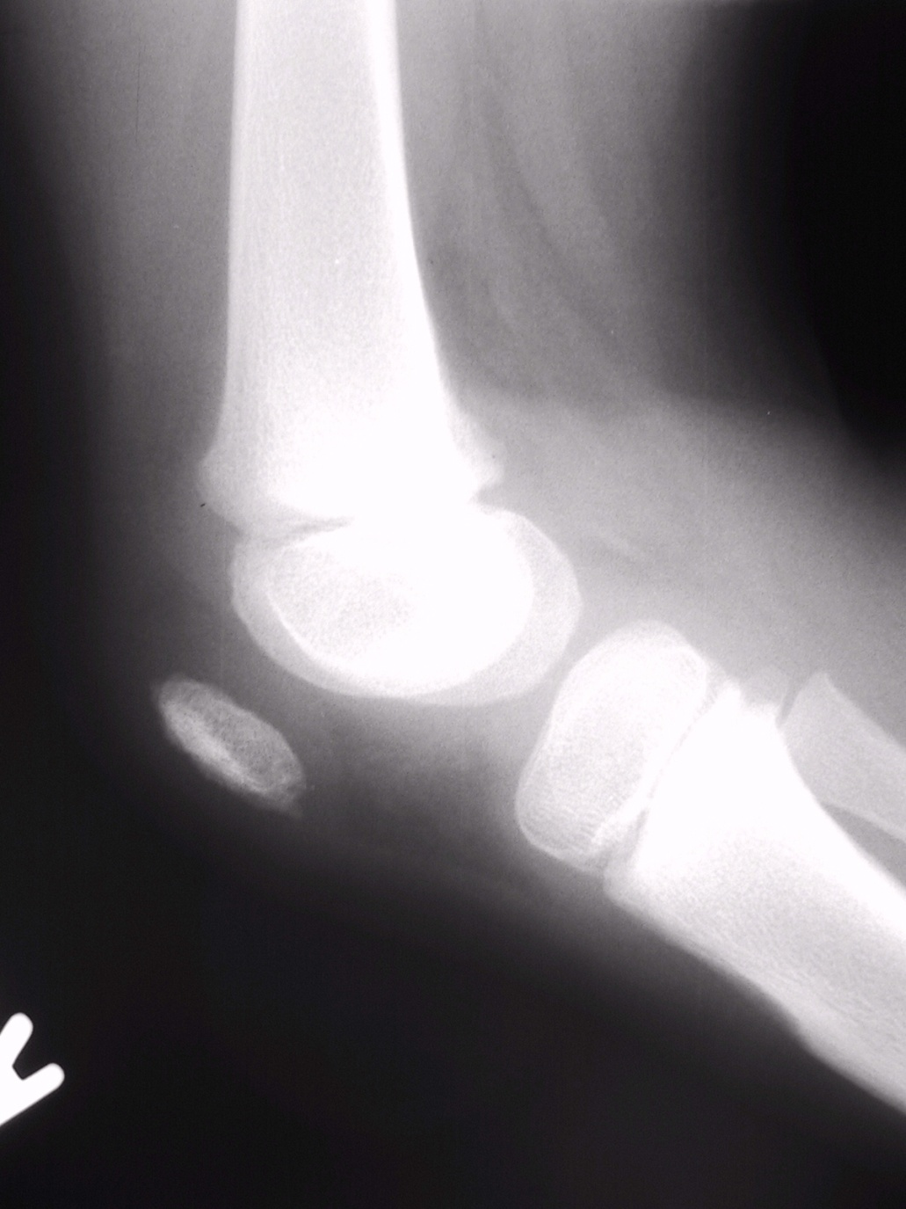
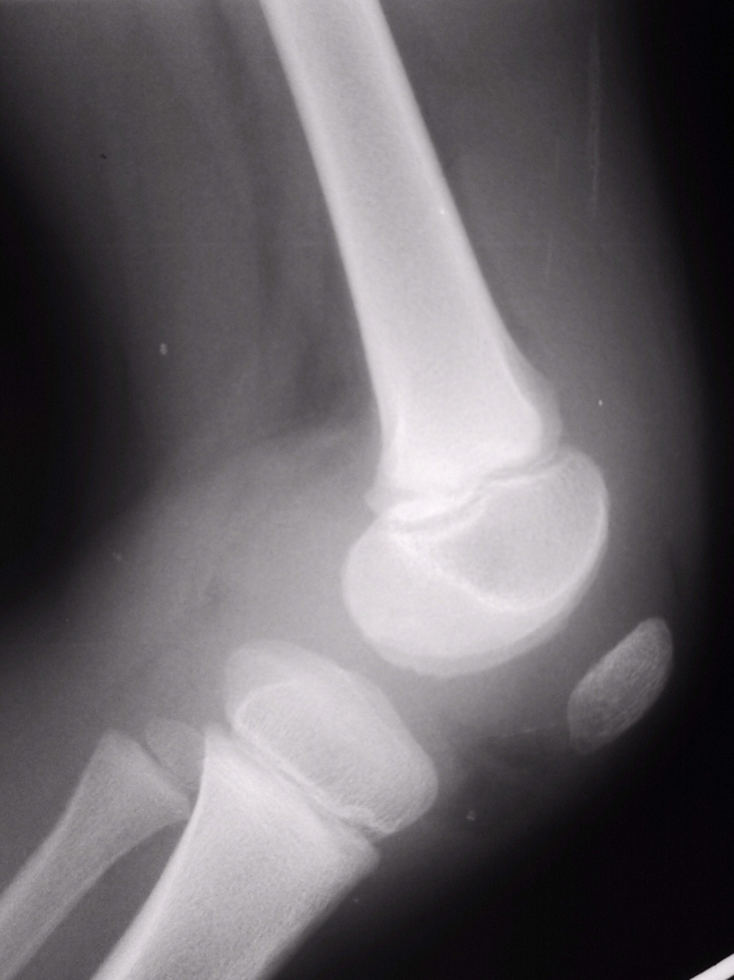

Slide 6
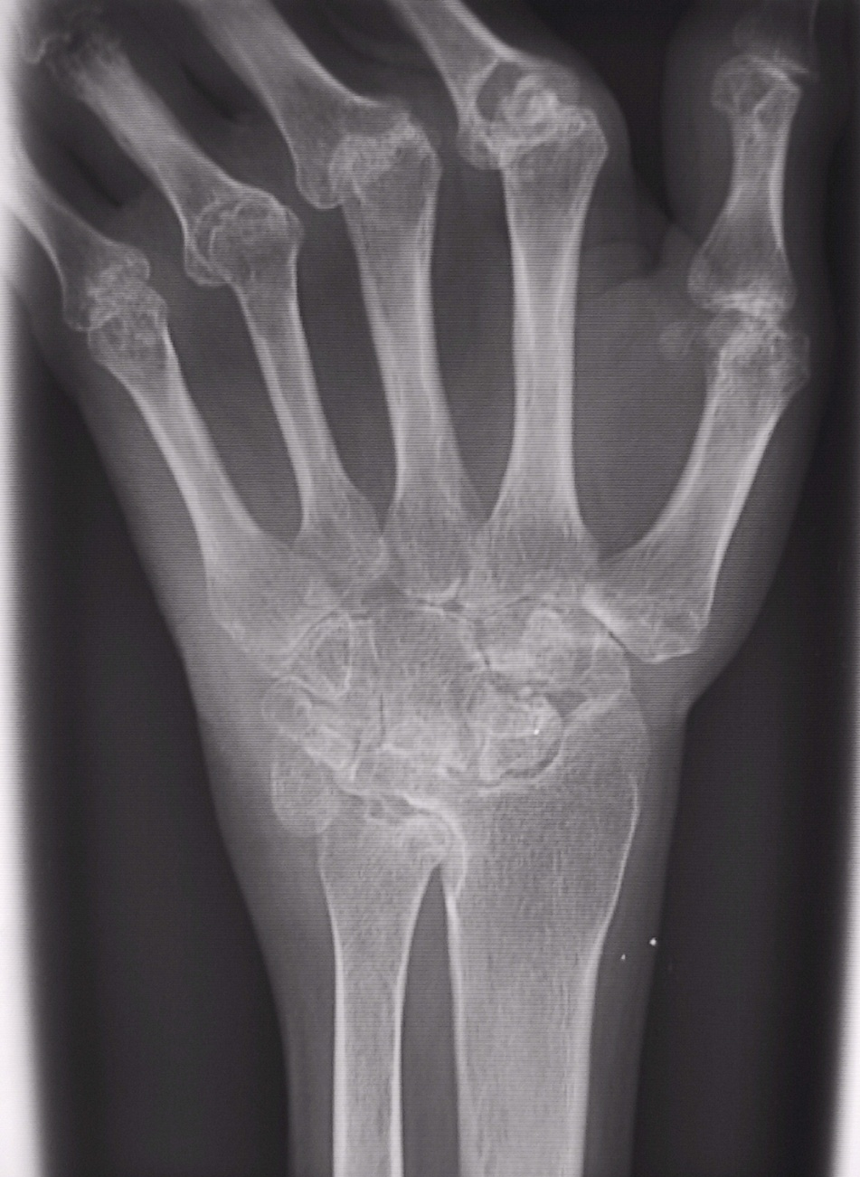
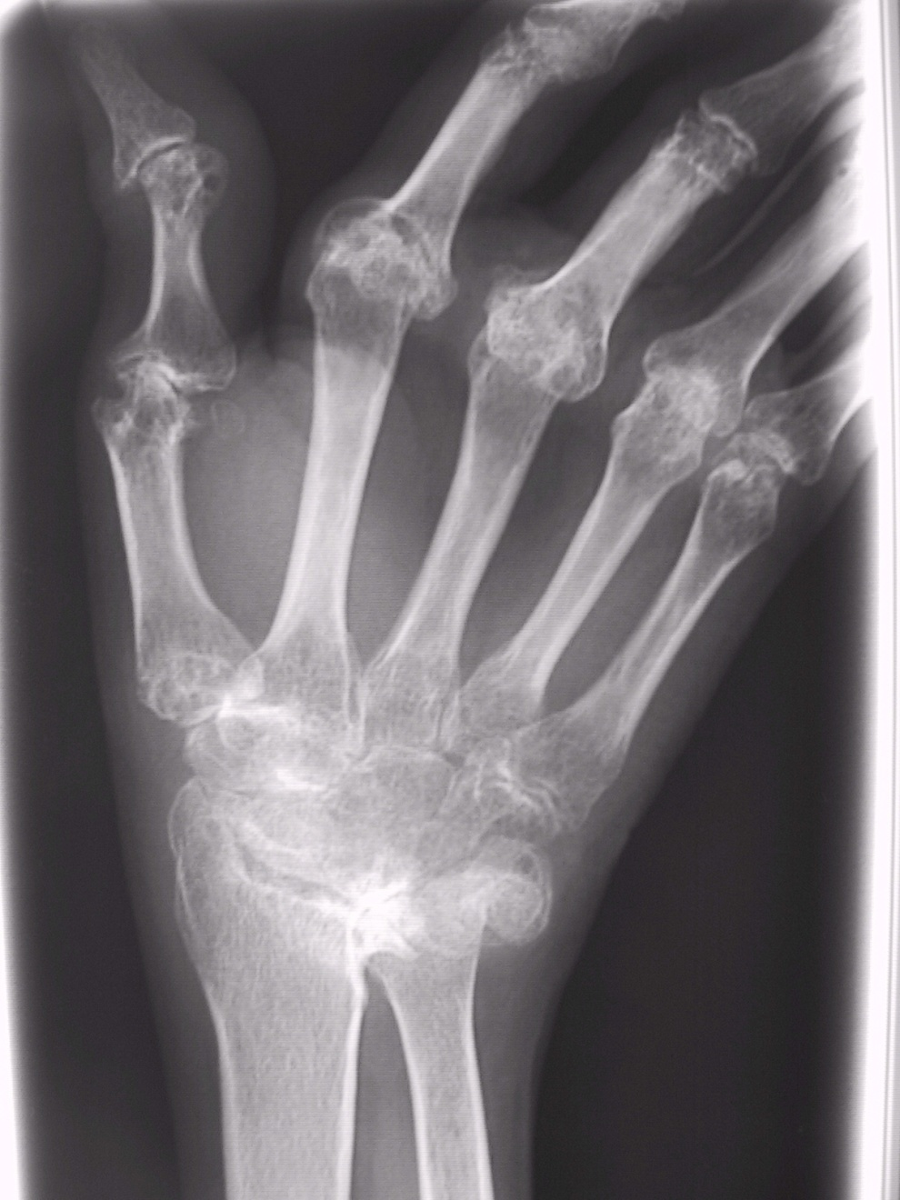

Slide 7
Osteoarthritis
Non-uniform joint space loss
Osteophytes
Subchondral cysts and sclerosis
Normal mineralization
No erosions
Locations
Common in hands DIP/PIP, 1st CMC, feet, knees (esp. medial compartment), and hips
Shoulders/elbows generally spared
Wrists/ankles uncommonly involved

Slide 8
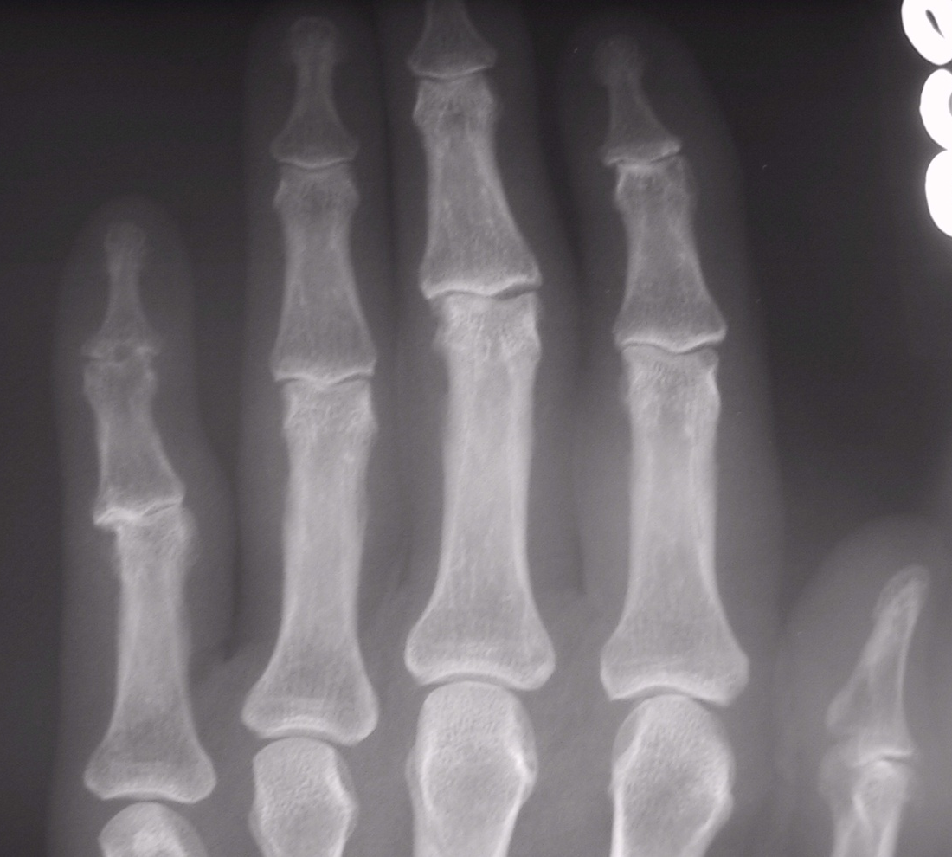
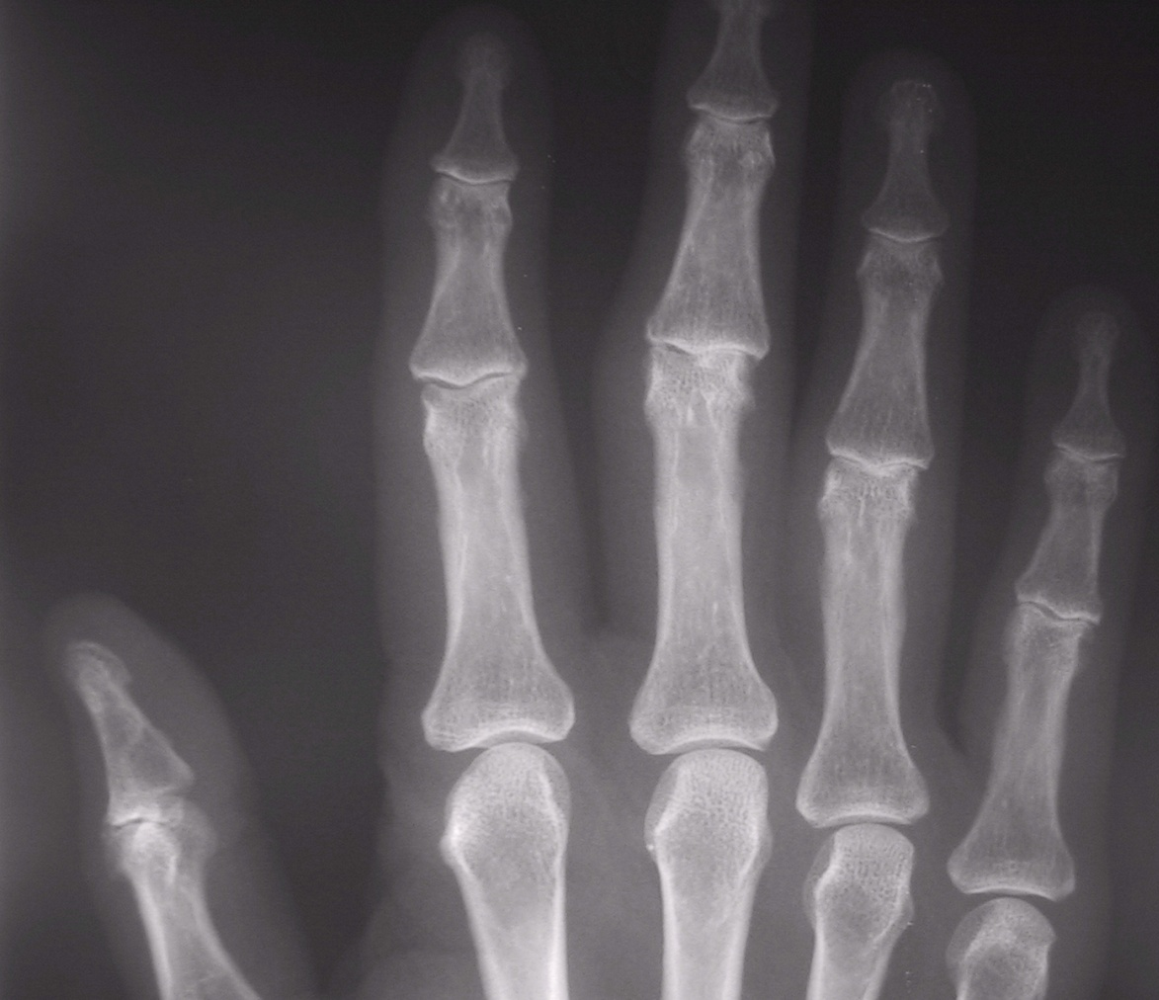
Early

Slide 9
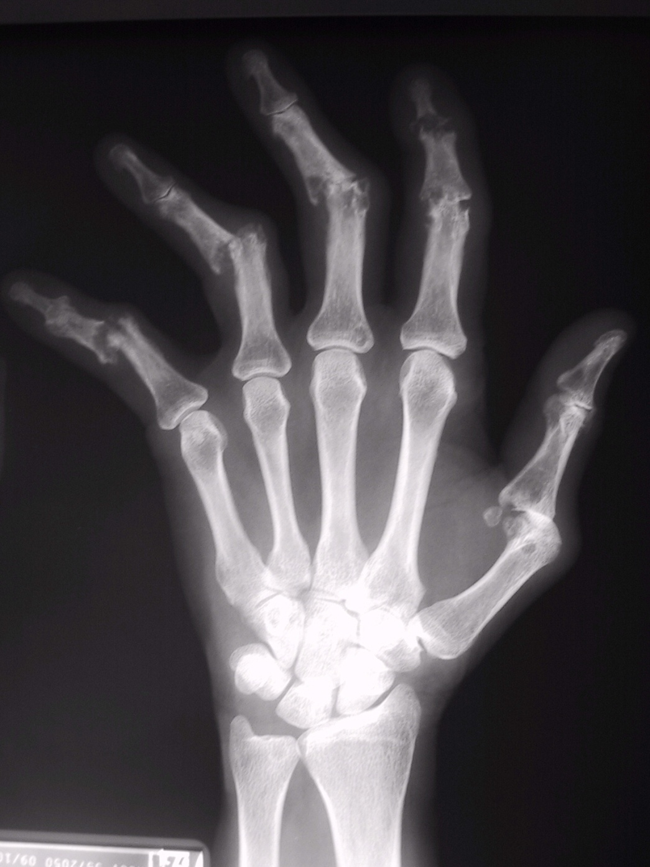
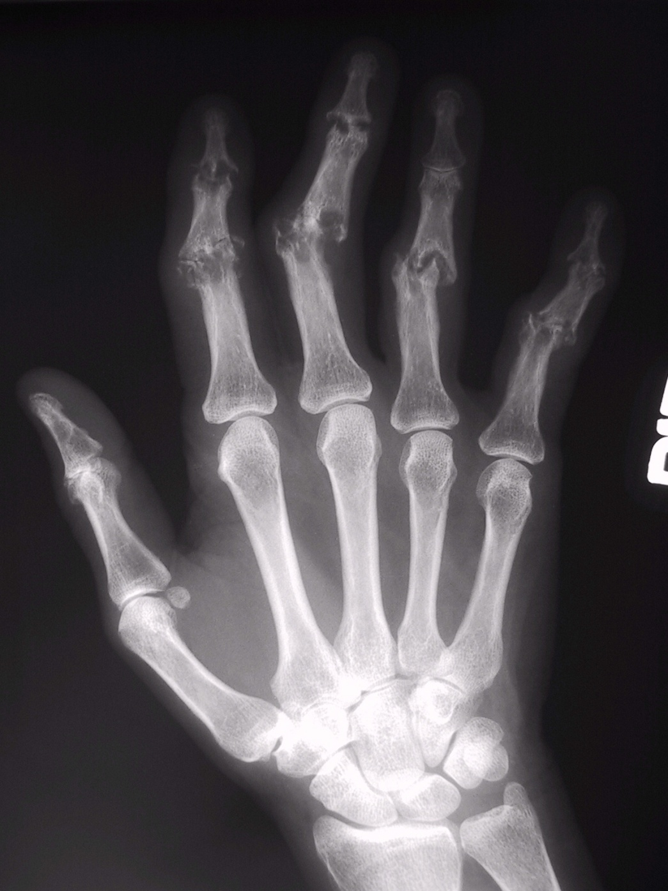
Later

Slide 10
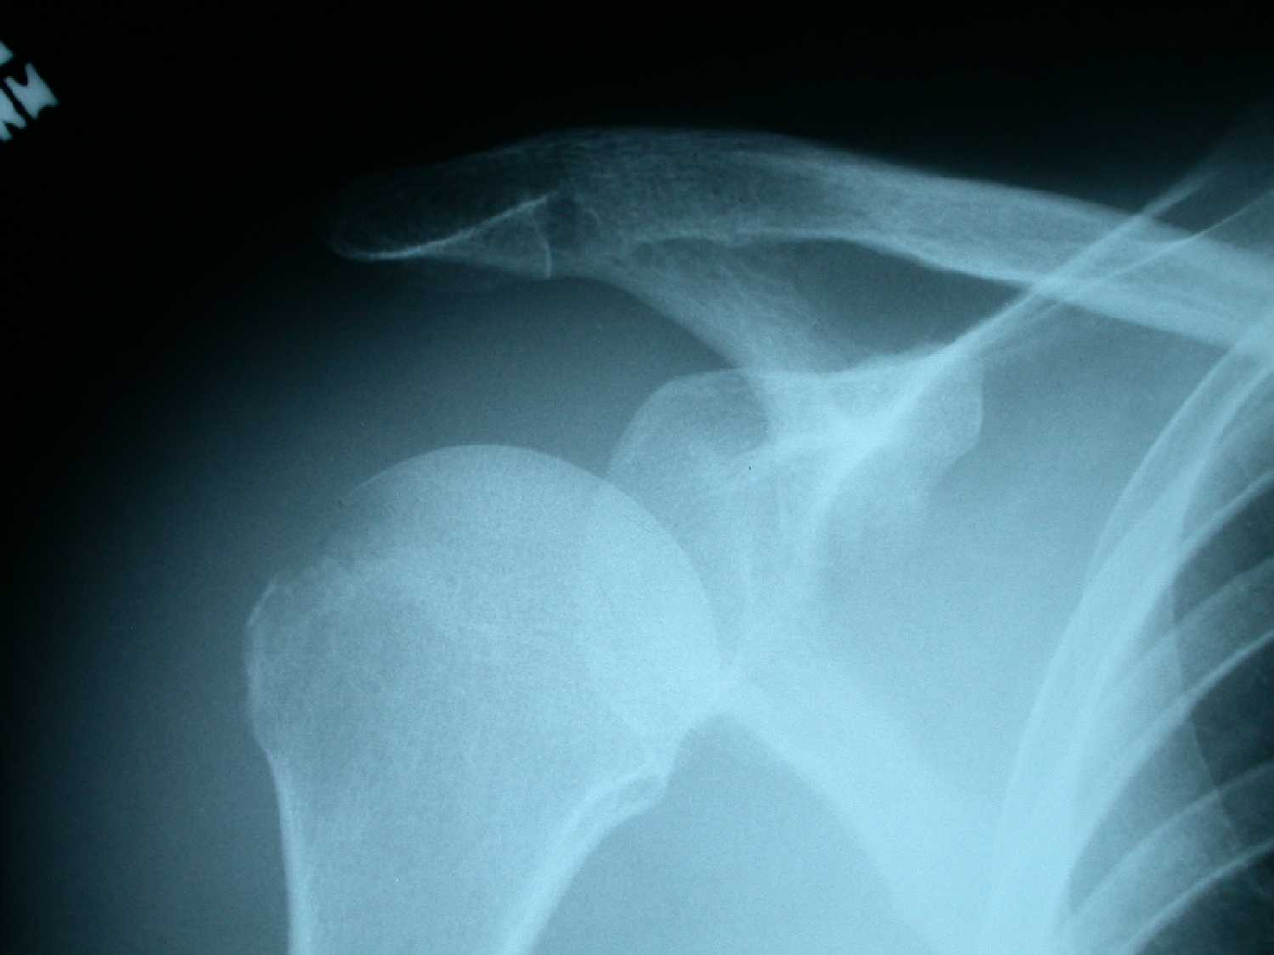
Septic Arthritis
Monoarticular
Early sign
Joint effusion
Periarticular soft tissue swelling
Later
Uniform joint space loss
Joint-centered osseous destruction
Juxtaarticular osteopenia

Slide 11
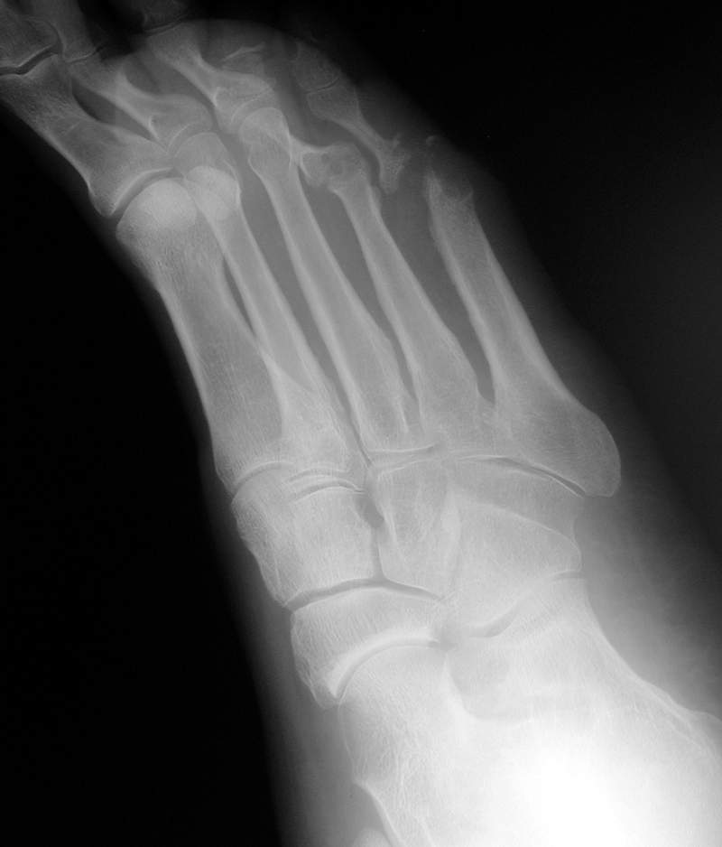
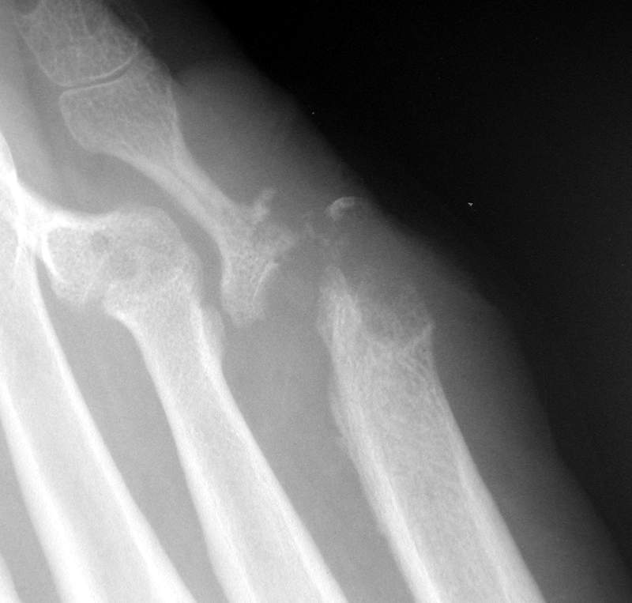

Slide 12
Tuberculous Arthritis
Location:
hips, knees, tarsal joints, and spine
Periarticular soft-tissue swelling
Osteopenia
No bone formation
Marginal and peripheral erosions
Cartilage destruction a late finding

Slide 13
Tuberculous Arthritis
Phemister’s triad:
Periarticular osteopenia
Peripheral/marginal osseous erosions
Gradual joint space narrowing

Slide 14
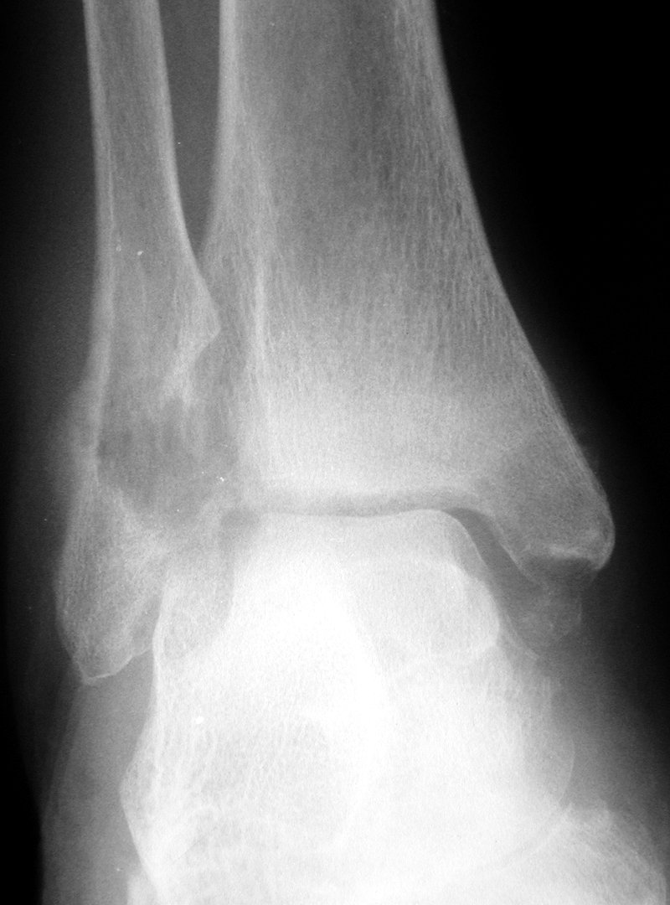
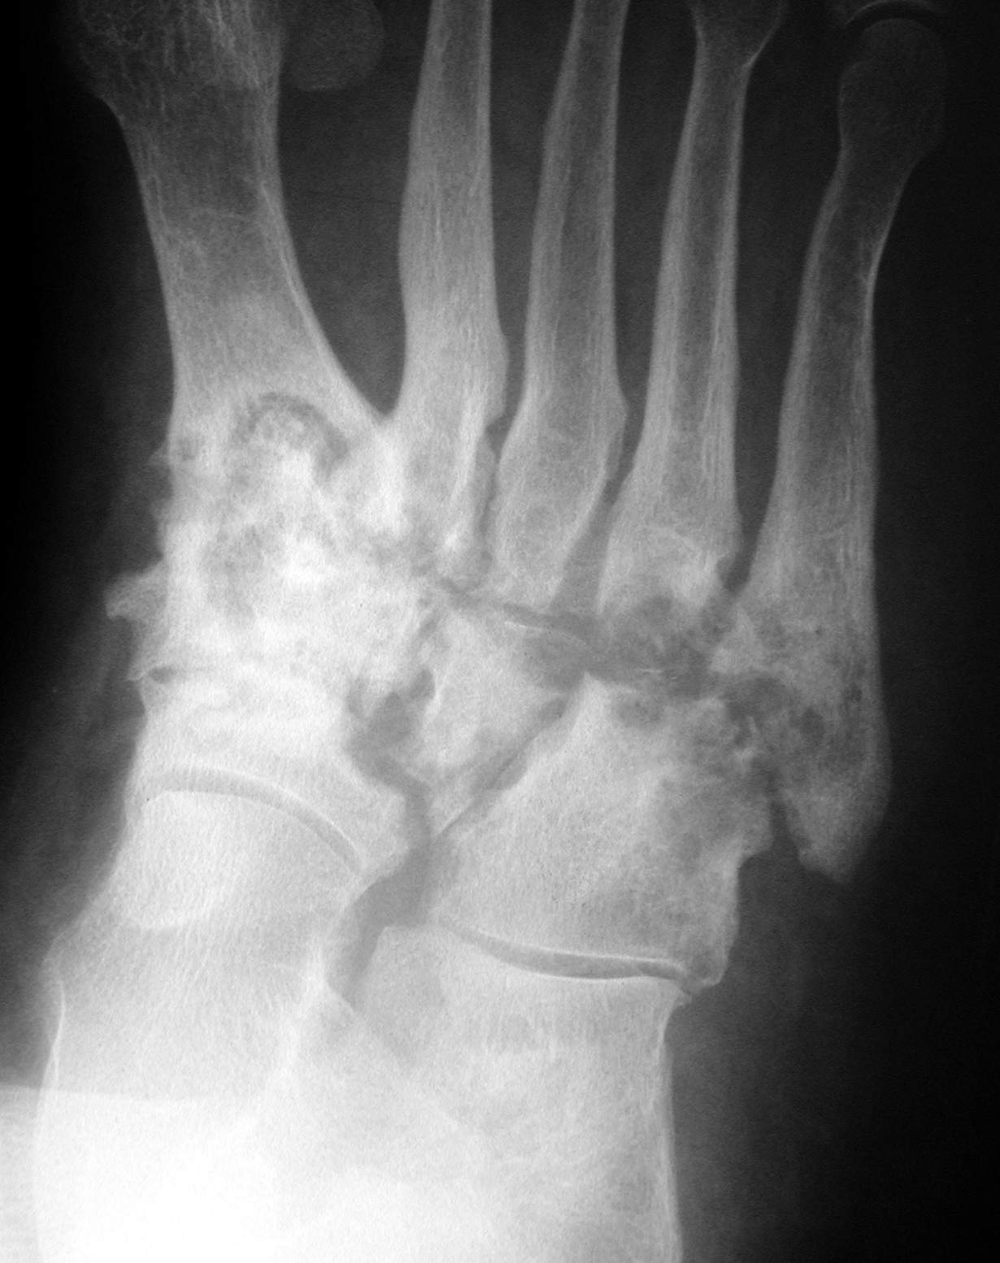
Tuberculous Arthritis

Slide 15
Hemophilia
Chronic repetitive hemarthrosis
Chronic repetitive intraosseous bleeding

Slide 16
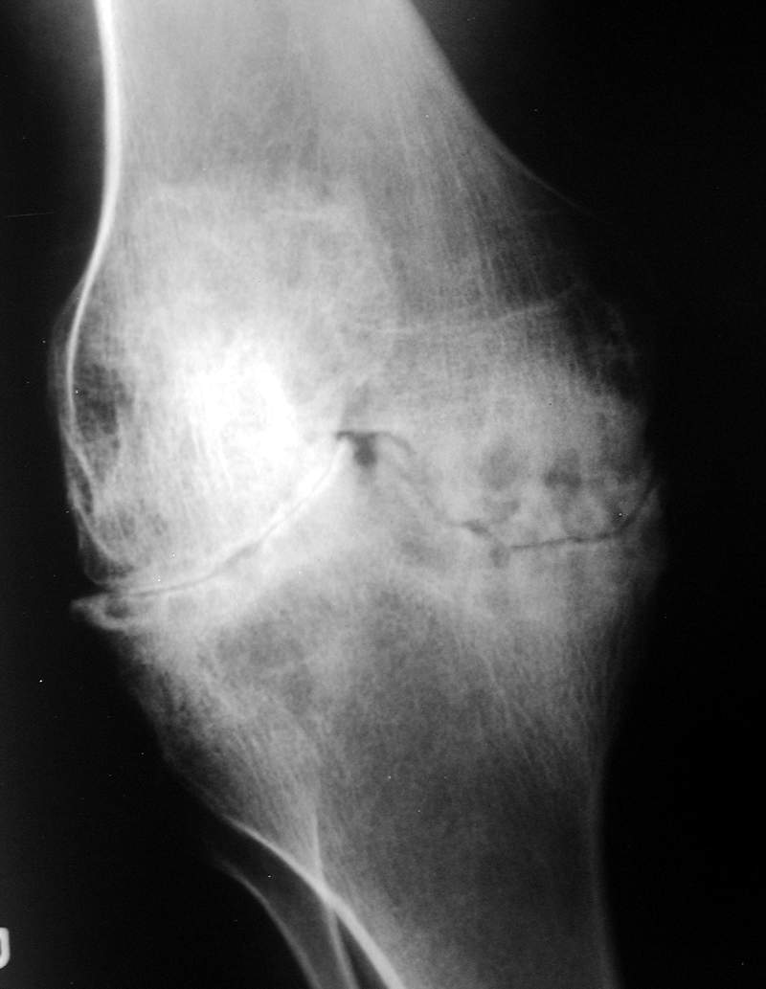
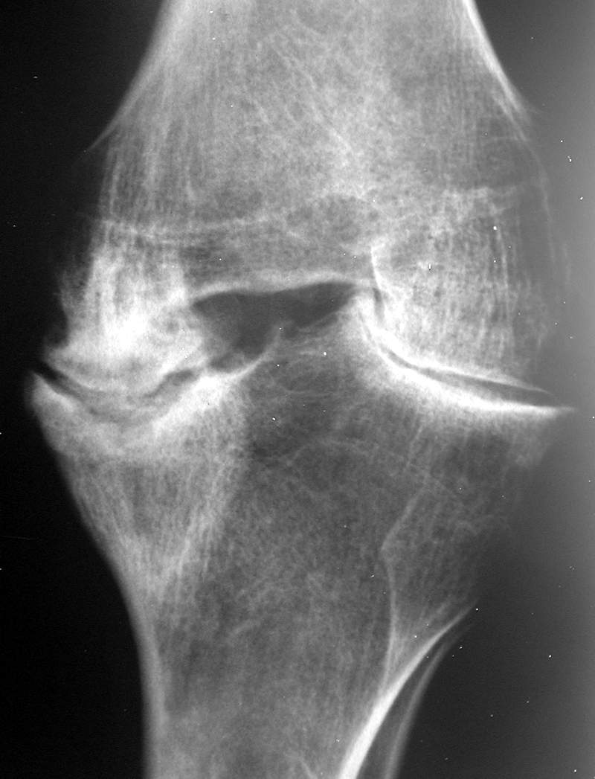
Hemophilia

Slide 17
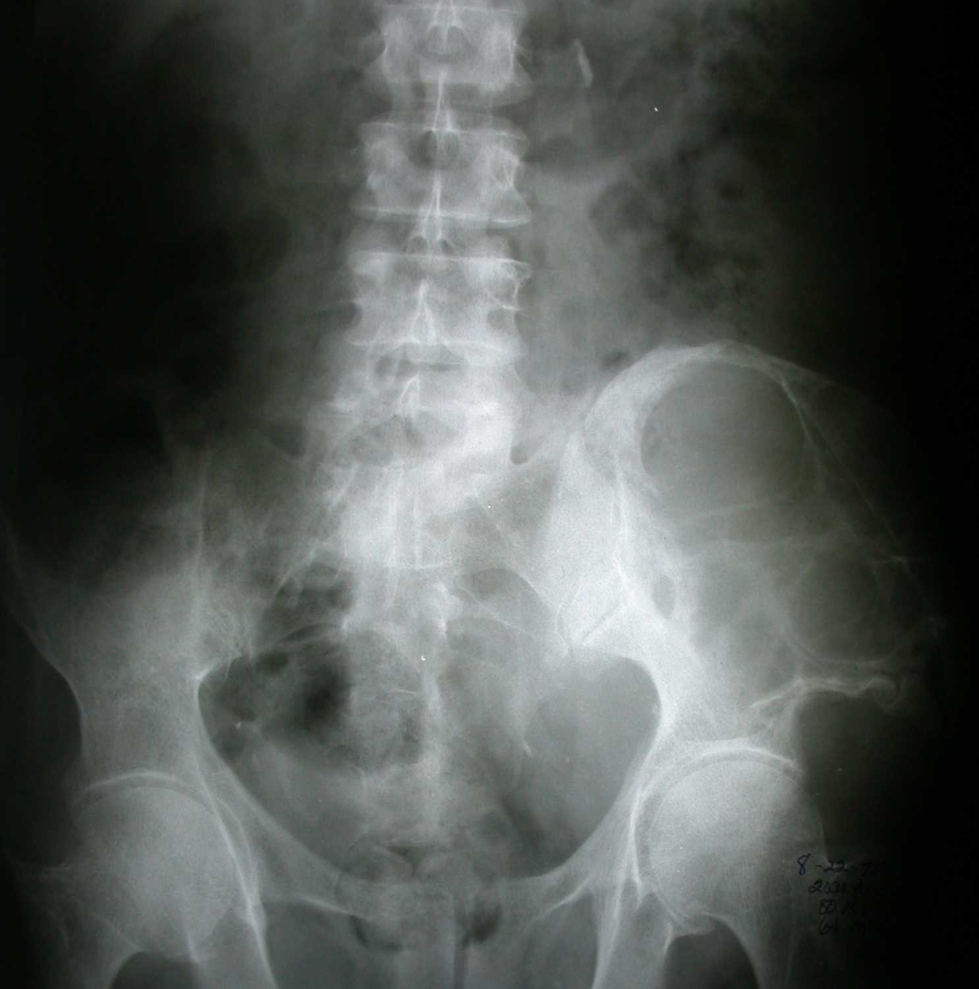
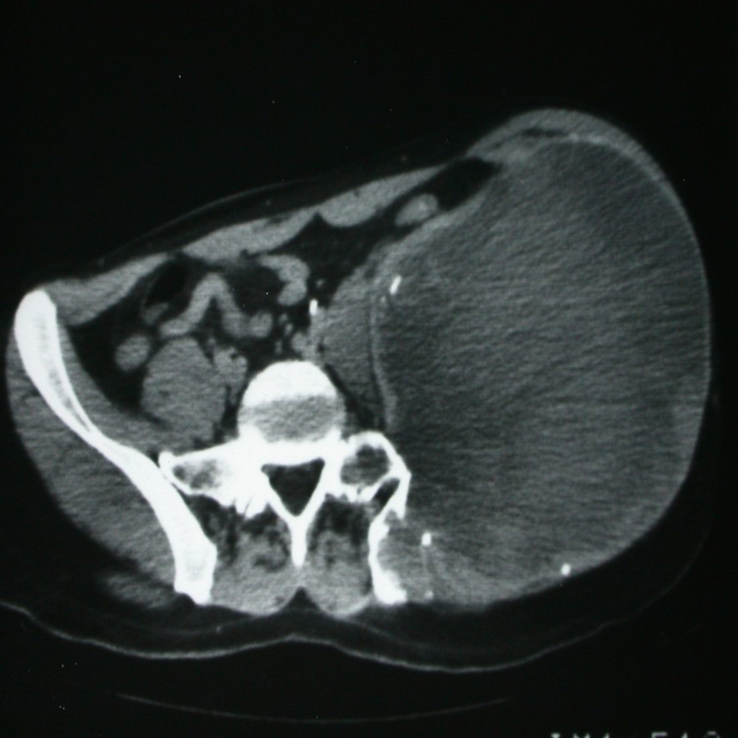

Slide 18
Scleroderma
50% of patients with articular symptoms
Fingertip soft-tissue resorption
Erosions of distal tuft
Subcutaneous calcification
Acroosteolysis and acrosclerosis (less frequently)

Slide 19
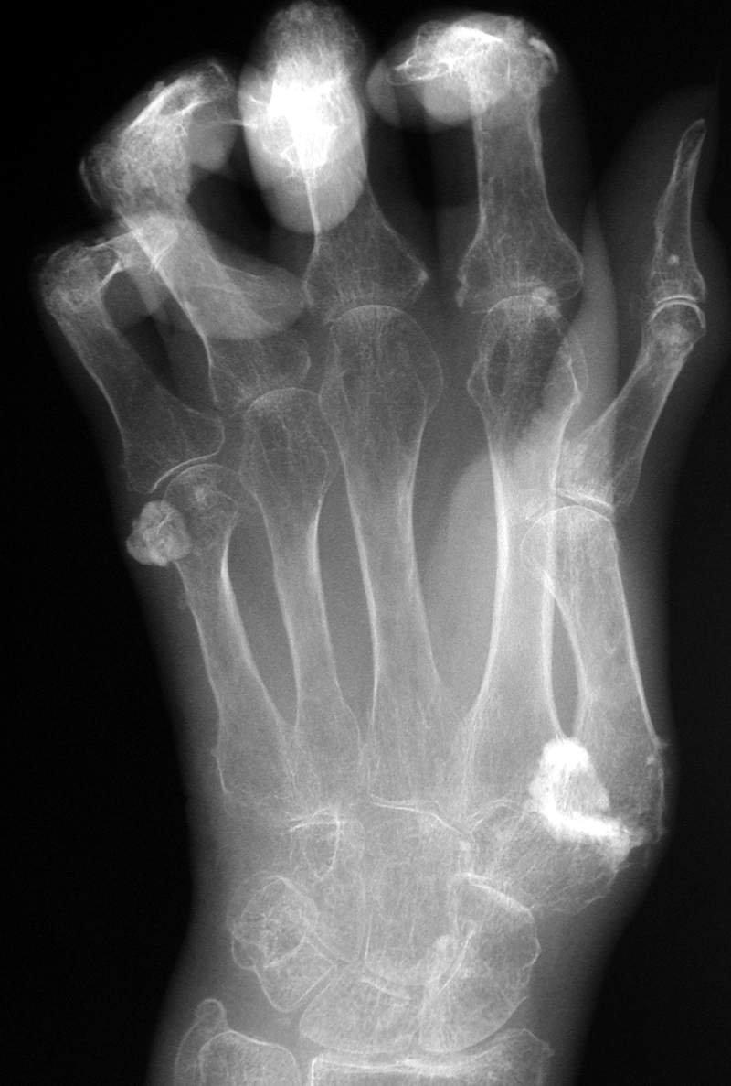
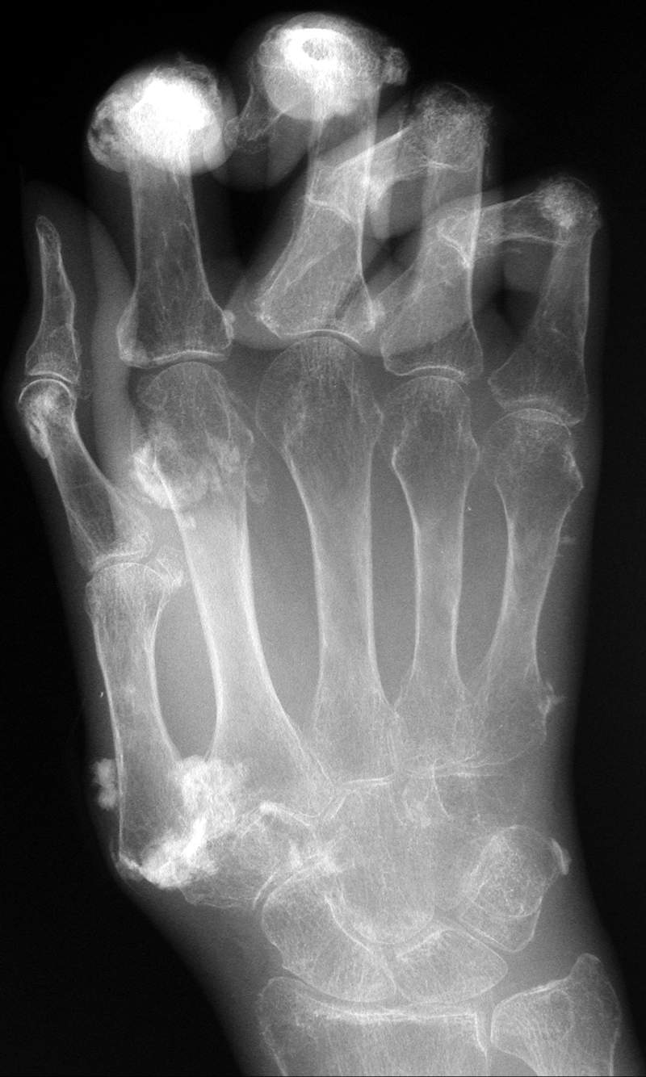
Scleroderma

Slide 20
Lupus
Like RA but without erosions
No erosions
Bilaterally symmetric
Juxtaarticular osteopenia or normal mineralization
Periarticular soft-tissue swelling
Reducible subluxations and dislocations
Normal joint spaces

Slide 21
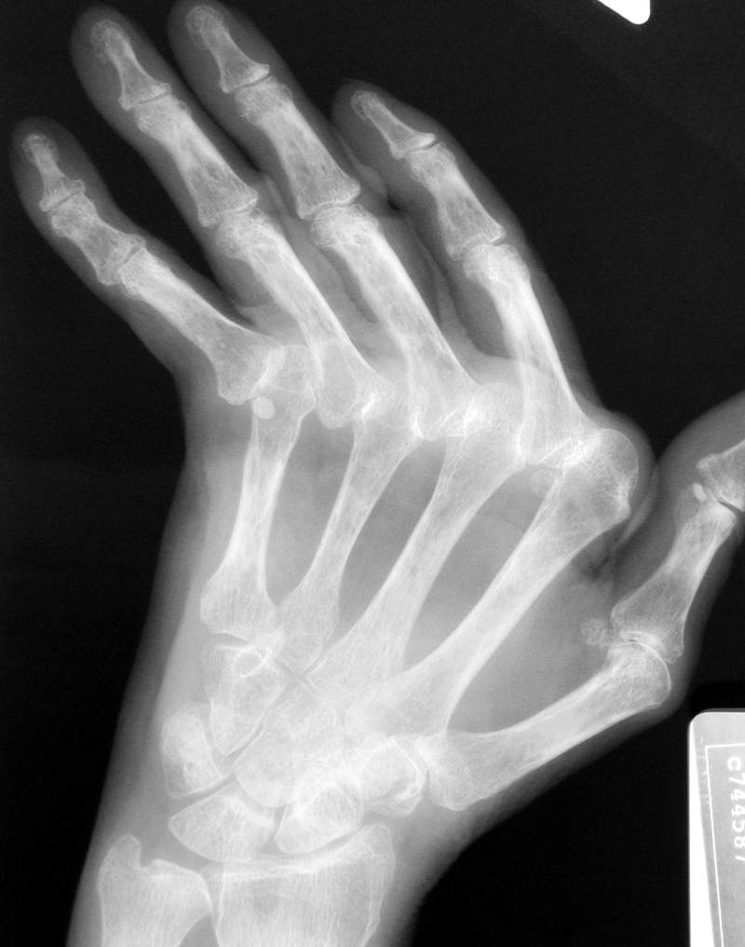
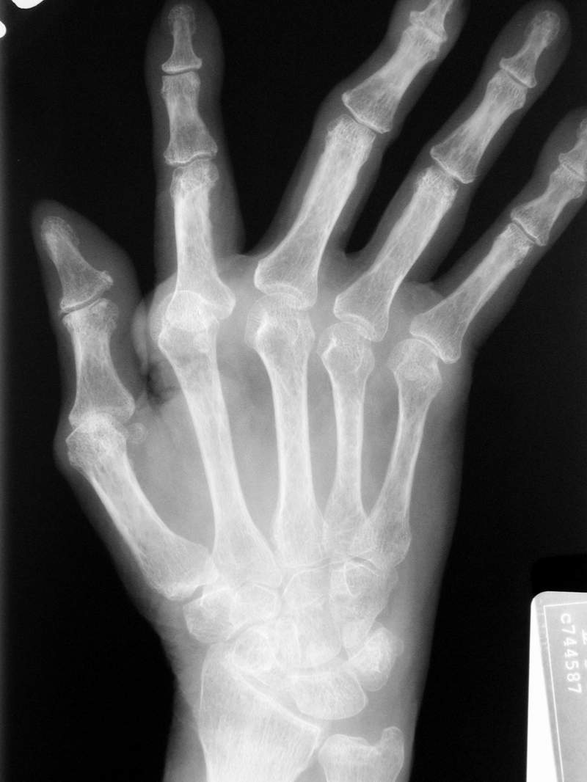
Lupus

