Slide 1
Uro-radiology.
Dr Alfred Odhiambo.
Diagnostic radiologist..

Slide 2
Our menu.
Usual introductory remarks.
Tools of the trade in uroradiology.
Trends in uroradiology.
Discuss select pathologies in uroradiology.
The classics of uroradiology.
Epilogue.

Slide 3
INTRODUCTION
Imaging modalities in uroradiology have undergone a dramatic transformation in the recent past.
Earlier plain films were the only available study.
Subsequently for no less than 7 decades IVU was the pillar of uroradiology.
Today cross-sectional imaging studies have taken centre stage albeit without a definite flag bearer....

Slide 4
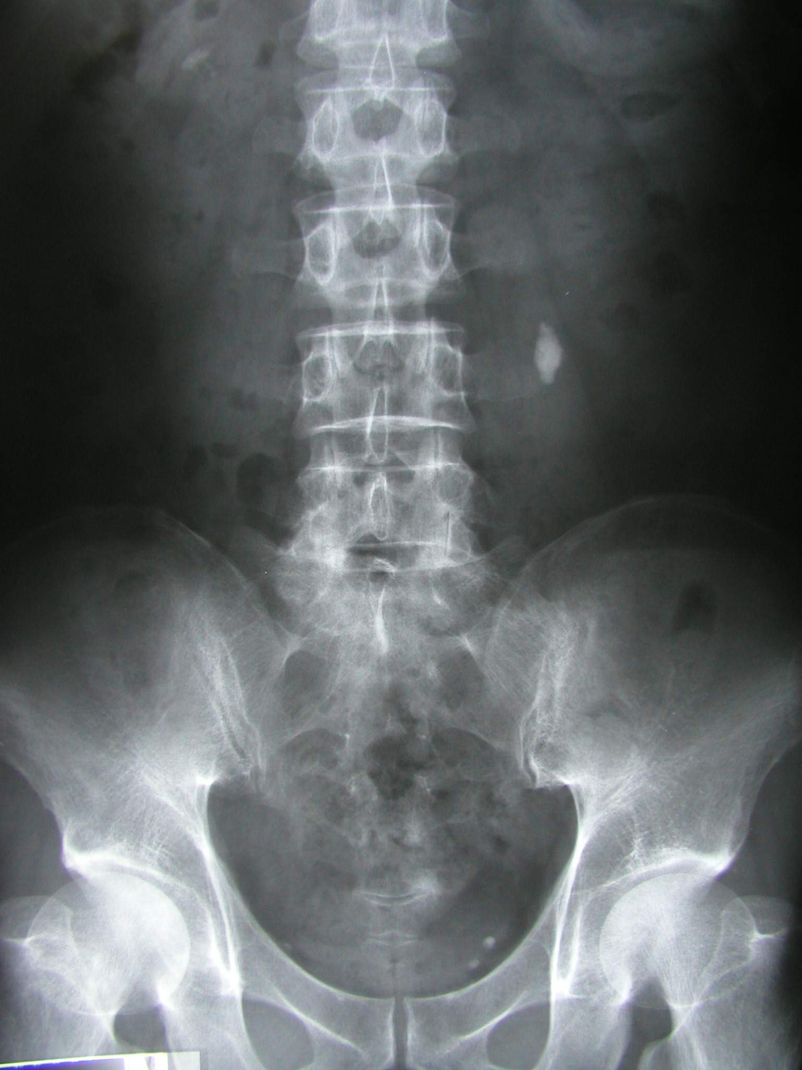
Plain film. Natural contrast.
Perirenal fat gives a lucent outline to the kidneys and allows an assessment of their position to be made.
The loss of the psoas outline may indicate retroperitoneal pathology but is a notoriously inaccurate sign.

Slide 5
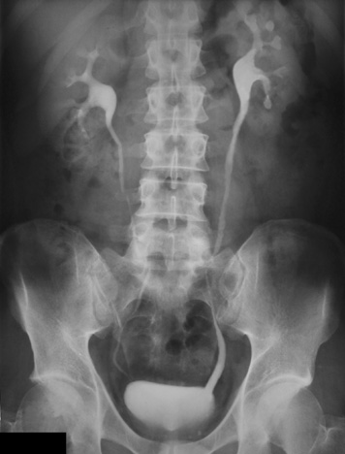
IVU
The excretory urogram is a valuable examination of the urinary tract.
It gives excellent anatomical images of the kidneys and to some extent an indication of their function.

Slide 6
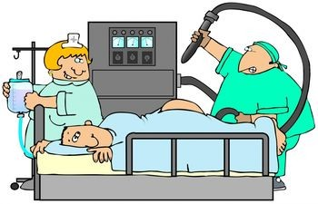
Patient preparation.
Bowel preparation is useful but no longer essential. Plumber unnecessary.
Fluid restriction unless severe does not influence radiographic densities.
At this severe level it becomes counter productive when it influences tubular function.
Patients with diabetes and myeloma specifically require hydration.

Slide 7
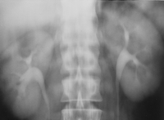
Normal nephrogram
Final image of a tomographic sequence demonstrates symmetric nephrograms and pyelograms.
Renal size is normal.

Slide 8
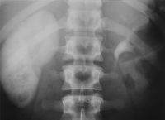
Image obtained at 80 minutes shows a persistent, very dense right nephrogram, a typical finding in acute high-grade obstruction.
A 2-mm stone was discovered at the right ureterovesical junction.

Slide 9
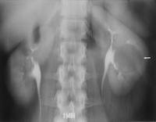
Simple cyst.
Nephrotomogram shows a nephrographic defect in the midportion of the left kidney (arrow) with increased parenchymal thickness and distortion of the underlying collecting system. US helped confirm a simple cyst.

Slide 10
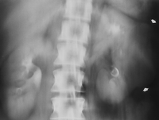
Renal cell carcinoma.
Nephrotomogram shows a mass in the midportion of the left kidney (arrows) producing increased parenchymal thickness and distorting the collecting system.

Slide 11
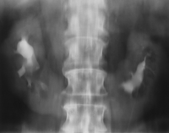
Axis and position alteration.
Nephrotomogram demonstrates characteristic axis alteration associated with a horseshoe kidney.

Slide 12
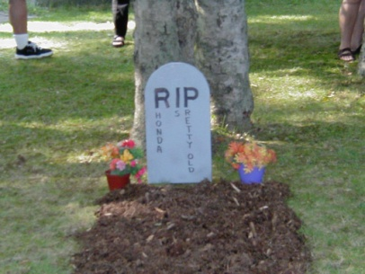
Epitaph for the Urogram¹ E. Stephen Amis, Jr, MD ¹ From the Department of Radiology, Albert Einstein College of Medicine and Montefiore Medical Center, 111 E 210th St, Bronx, NY 10467. Received July 29, 1999; accepted August 9. Address reprint requests to the author (e-mail: amis@aecom.yu.edu).

Slide 13
“The excretory urogram is terminally ill. It survives only because of clinicians and radiologists who do not fully appreciate that more accurate delineation of the urinary tract can be gained with other techniquesIt is now time to move on to different techniques.”
Stephen Amis, Jr, MD

Slide 14
Hematuria…..
The remaining major indication for excretory urography is hematuria.
Patients with hematuria require evaluation of both the renal parenchyma and the urothelium.
The traditional evaluation has been with cystoscopy and excretory urography (supplemented with retrograde ureteropyelography as needed).

Slide 15
The last IVU sermon….
“In the near future, excretory urography will be replaced by nonenhanced helical CT to evaluate for stones and by CT urography to evaluate for hematuria and other genitourinary conditions.
CT urography should be viewed simply as an evolution of urography, which survived for 7 decades as one of the mainstays in imaging of the urinary tract.

Slide 17
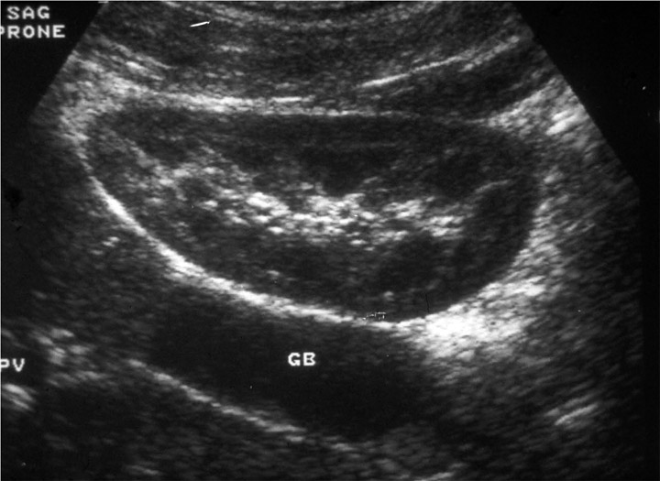
ULTRASOUND
The ability to differentiate normal from abnormal is directly related to the skill of the ultrasonagrapher
Resolution of pathology at an earlier stage is being recognised by improvement in US equipment.
So updating of skills and equipment is also needed

Slide 18
ULTRASOUND IMAGE
Composed of a variety of bright dots on a film that vary in intensity according to the strength of returning echoes from tissues or structures in the body
Provides anatomic and non-anatomic information
Notes:
An ultrasound image is composed of a variety of bright dots on a film that vary in intensity according to the strength of the returning echoes from internal tissues and/or structures in the body.
The location of each dot corresponds to the anatomic location of each echo-generating organ or structure.
Each image provides a dot-for-dot correct anatomic representation of organs and structures in the body.
On the image there is also non-anatomic information, which is the result of things happening to the ultrasound beam before, during or after it strikes a reflecting surface. These phenomena, which are the result of the imaging technique itself, are called artifacts and are discussed elsewhere.

Slide 19
NORMAL KIDNEY
Capsule Hyperechoic
Cortex Hypoechoic
Medulla Almost anechoic
Sinus Hyperechoic
Perirenal fat Hyperechoic

Slide 20
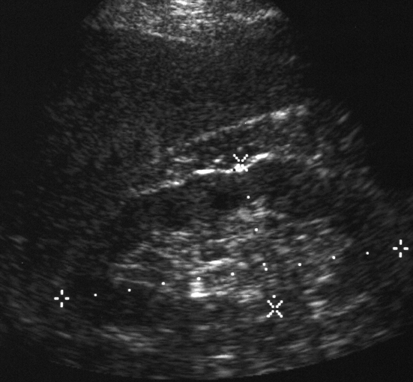
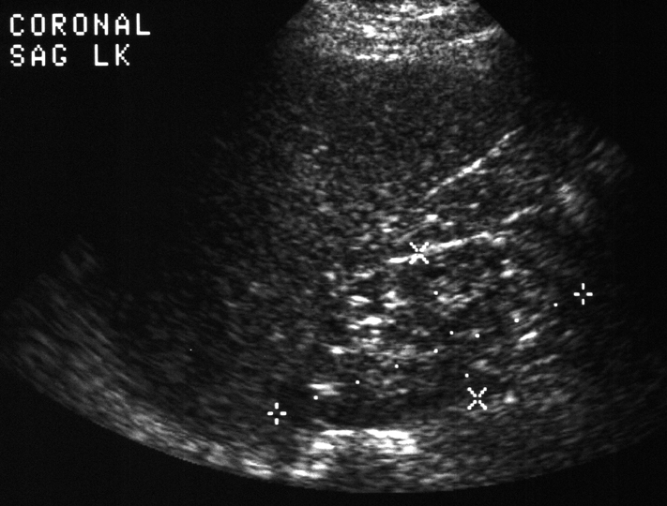
Renal lengths should be within 2 cm
LT KIDNEY 7.7 cm
RT KIDNEY 10.4 cm
Notes:
RENAL SIZES
The right and left kidney should be within 2 cm of their respective lengths.
The left kidney in this patient is 2.7 centimeters shorter than the right kidney. It also has a thin cortex and increased echogenicity, all signs of a diseased kidney.

Slide 21
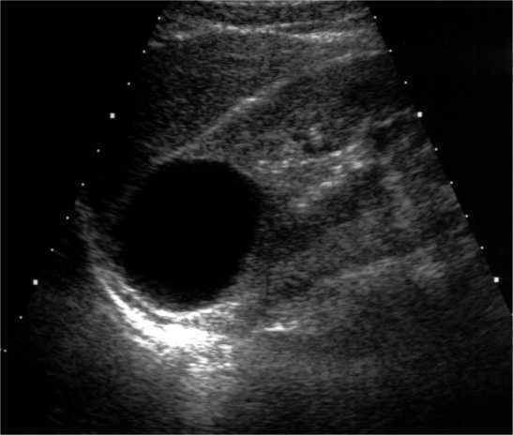
Notes:
SIMPLE RENAL CYST
Renal cysts are common incidental findings in the kidney. They tend to increase in size and number with age.

Slide 22
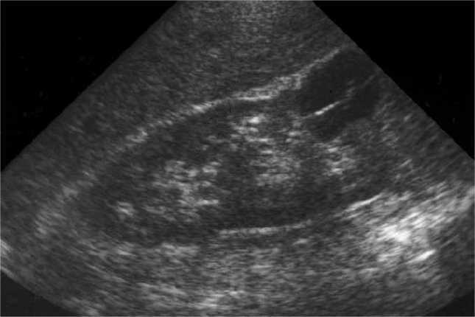
Notes:
COMPLICATED CYST
Any cyst which does not meet the strict criteria becomes suspicious for the possibility of malignancy. Actually one thin septation (arrow) is allowed to be present within the cyst, but no other findings, such as multiple or thick septations, a nodule, debris, wall thickening or irregularity, a solid component, are allowed. Needle aspiration of the contents is recommended in such cases.
QUESTION:
What type of findings in a renal cyst raise suspicion of malignancy?
ANSWER:
Septations (especially thick or multiple), nodules, debris, wall thickening or irregularity, solid elements.

Slide 23
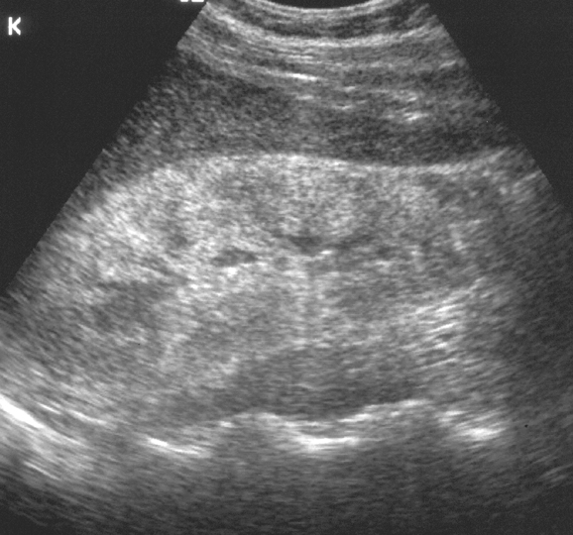
Notes:
DIFFUSE PARENCHYMAL DISEASE
The parenchyma of the kidney is diffusely echogenic in this patient with interstitial nephritis due to chronic analgesic abuse.

Slide 24
Multi-Detector Row CT of the Kidneys and Urinary Tract
Multi–detector row helical computed tomography (CT) offers considerable advantages in evaluation of the urinary tract.
It has the potential to become the single imaging modality used for comprehensive evaluation and treatment planning of most conditions affecting the kidneys and urinary tract, making conventional diagnostic techniques such as intravenous urography and angiography nearly obsolete.

Slide 25
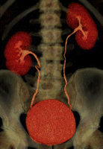
With the introduction of multidetector technology, CT urography, to date, has emerged as the initial heir apparent to intravenous urography; many years of experience have now clearly demonstrated that CT is the test of choice for many urologic problems, including urolithiasis, renal masses, urinary tract infection, trauma, and obstructive uropathy.

Slide 26
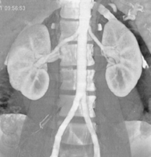
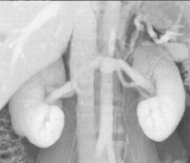
CT Angiography of the Renal Arteries.
The main applications of CT angiography include evaluation of potential renal donors, evaluation of suspected renal artery stenosis or aneurysms, and demonstration and location of crossing vessels prior to pyeloplasty for ureteropelvic junction obstruction.

Slide 27
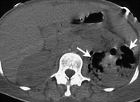
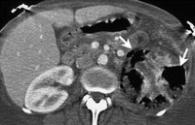
Emphysematous pyelonephritis in a 45-year-old woman with sepsis.

Slide 28
MR Urography: Techniques and Clinical Applications
Magnetic resonance (MR) urography comprises an evolving group of techniques with the potential for allowing optimal noninvasive evaluation of many abnormalities of the urinary tract.
MR urography is clinically useful in the evaluation of suspected urinary tract obstruction, hematuria, and congenital anomalies, as well as surgically altered anatomy, and can be particularly beneficial in pediatric or pregnant patients or when ionizing radiation is to be avoided.

Slide 29
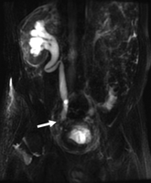
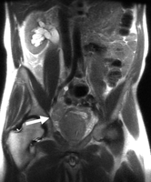
Prostate cancer metastatic to lymph nodes in a 53-year-old man.

Slide 30
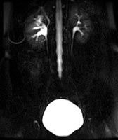
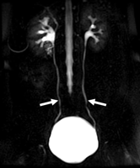
Importance of cine MR urography in demonstrating the entire ureters with static-fluid techniques.
(a) On a coronal thick-slab MR urogram from a cine series obtained in a 52-year-old woman with hematuria, the ureters are poorly delineated.
(b) Coronal thick-slab MR urogram from the same series shows improved delineation of the ureters (arrows).

Slide 31
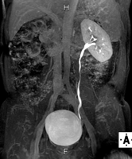
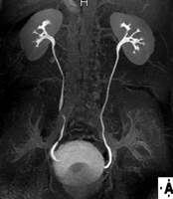
Excretory MR Urography

Slide 32
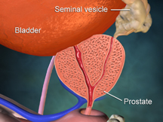
Prostate gland.

Slide 33
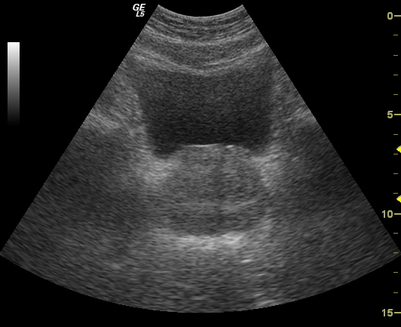
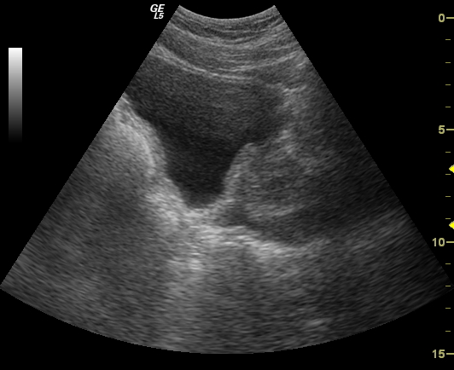
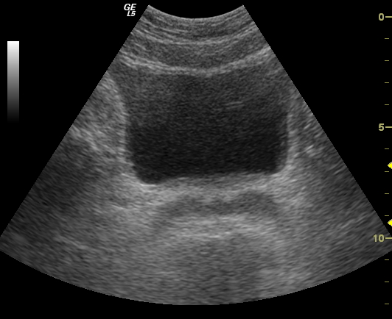
Transabdominal sonography

Slide 34
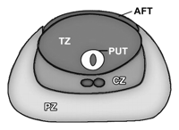
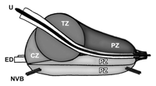
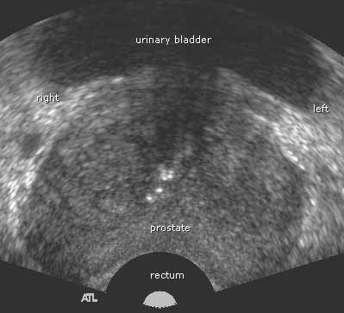
TRUS. TRX.

Slide 38
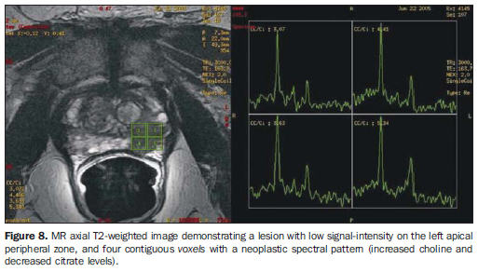

Slide 39
NUCLEAR MEDICINE
“Unclear Medicine” ?
The use of small amounts of radioactive materials to diagnose and treat disease.
NUCLEAR MEDICINE SHOWS PHYSIOLOGY
Whereas
RADIOLOGY SHOWS ANATOMY

Slide 40
GENERATOR SYSTEM
The basis of the generator system (the cow) is that the daughter is physically separable from the parent.
This process is termed “milking”.
The eluate contains sodium pertechnetate.
Since the generator system is small and can be shipped easily, it makes the routine use of 99mTc possible in nuclear medicine
Molybdenum-99

Slide 41
BILATERAL TESTICULAR INFARCTION
SCROTAL RNI
Testicular torsion leads to testicular infarction. Testicular ischemia may also result from epididymitis as in this pt.
Early scintigraphic flow images show markedly increased flow to scrotal regions bilaterally. Tissue-phase scintigram shows increased peri-testicular activity with bilateral central regions of diminished activity.

Slide 42
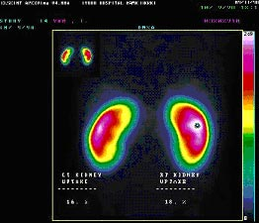

Slide 43
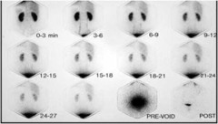

Slide 44
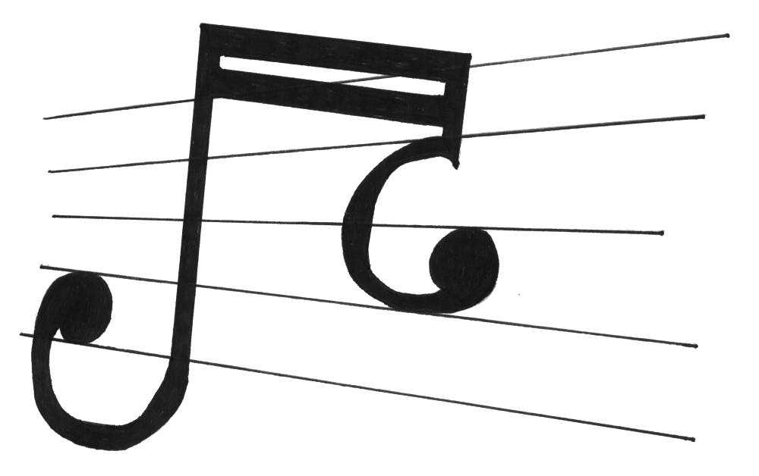
Uroradiology classics.

Slide 45
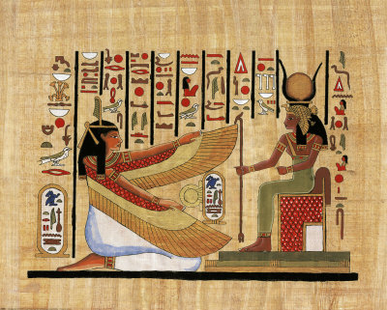
Radioglyphics…
The language of radiology is rich with descriptions of imaging findings, often metaphorical, which have found common usage in the day-to-day practice of genitourinary radiology.
These "classic signs" give us confidence in our diagnosis.
Some of the signs have become so familiar to us that they are referred to as an "Aunt Minnie."

Slide 46
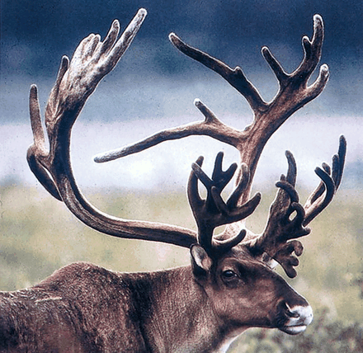
Staghorn
A renal stone described as a staghorn implies a branched renal calculus that resembles the antlers of a stag.
It is usually composed of struvite; but less commonly, it is formed from cystine or uric acid.

Slide 47
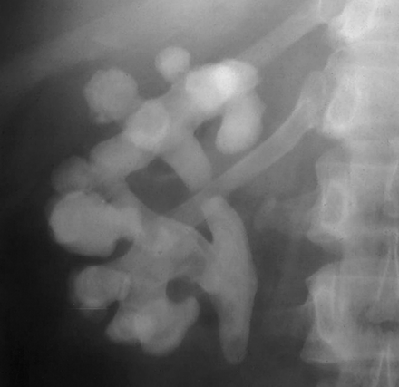
(a) Staghorns. (b) On a scout image obtained before excretory urography, a calculus fills nearly the entirety of a bifid right renal collecting system, giving it a branched appearance that resembles the antlers of a stag.

Slide 48
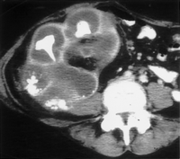
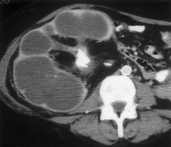
Bear’s paws sign.
(a) A bear’s paws. (Photograph entitled "Bad Boys of the Arctic" reprinted with permission from Thomas D. Mangelsen, Inc.)
(b) Contrast material-enhanced CT scan (same patient as in Fig 2) demonstrates a centrally obstructing stone with replacement of the renal parenchyma by low-attenuation collections in a "hydronephrotic" pattern. Note the lack of dilatation of the renal pelvis and infundibula.
(c) CT scan obtained at a slightly lower level shows the fragments of a staghorn calculus within the parenchymal collections, which exhibit marginal enhancement. The pattern seen at CT resembles a bear’s paw.

Slide 49
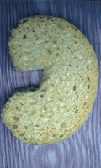
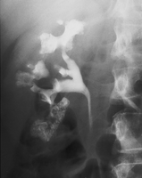
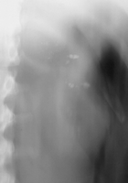
"growing calculus sign"
"Sponge" kidney, made from a sponge! (b) Scout image from excretory urography demonstrates calcifications clustered in the medullary portion of the left kidney. (c) After contrast material administration, numerous cavities are identified within the renal papilla in the patient with medullary sponge kidney. Some of the calcifications appear to grow, as contrast agent fills the entire cavity containing the stone.

Slide 50
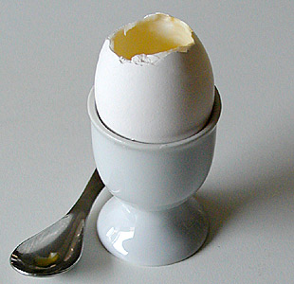
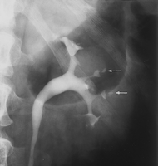
Egg in cup
Papillary necrosis caused by analgesic abuse.
Pyelographic image shows central cavities within multiple papillae (arrows).

Slide 51
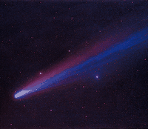
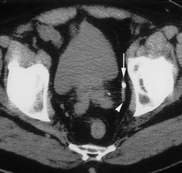
comet sign.
Comet. (Photograph entitled "Comet Hyakutake" reprinted with permission from Bill and Sally Fletcher.) (b) CT scan shows a calcification (the comet nucleus) (arrow) with a soft-tissue tail that represents a pelvic vein (arrowhead). Together, this appearance constitutes the comet sign. Note the stone at the left ureterovesical junction.

Slide 52
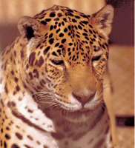
Spotted Nephrogram
Irregular, patchy enhancement in the renal parenchyma, referred to as the spotted nephrogram, may occur as a result of small vessel occlusion, which can be seen with necrotizing vasculitis (periarteritis nodosa), scleroderma, and hypertensive nephrosclerosis
Although first observed on angiograms, the abnormal perfusion pattern can be identified on CT and MR images after contrast material administration.

Slide 53
Spotted nephrogram.
(a) Spotted cat. (Courtesy of Russell I. Poole, Mishawaka, Ind.)
(b) Late image from midstream aortography demonstrates patchy perfusion in both kidneys, giving the parenchyma a spotted appearance: the spotted nephrogram.
(c) Late image from selective right renal arteriography in the same patient demonstrates small vessel occlusion and multiple areas of parenchymal infarction (arrow) with islands of preserved perfusion. The patient proved to have periarteritis nodosa.

Slide 54
Crescent Sign
This sign is fundamentally different in its pathophysiology from the rim sign of hydronephrosis.
The crescent sign refers to the appearance of concentrated contrast material in collecting tubules, arranged parallel to the margin of a dilated calix, which produces a thin line of contrast material at the edge of the calices, resembling a crescent.

Slide 55
(a) Crescent. (Photograph entitled "Moon with Earthshine" reprinted with permission from Bill and Sally Fletcher.) (b) Crescent sign. CT image obtained during the corticomedullary phase of enhancement shows decreased thickness of the parenchyma surrounding the dilated collecting system in the left kidney. (c) Concentrated contrast material crescents surround the dilated collecting system elements (arrows) on this delayed image, which also shows a urine-contrast agent level in the dependent aspect.

Slide 56
Balloon on a String Sign.
The balloon on a string sign may be seen with the rim sign of hydronephrosis, with the crescent sign, or as an isolated finding.
This sign refers to the appearance of a high and somewhat eccentric exit point of the ureter from a dilated renal pelvis and is a typical finding of ureteropelvic junction obstruction.
The possibility of an associated crossing vessel should always be evaluated before therapeutic intervention.

Slide 57
Balloon on a string (with thanks to Richard T. Dyer for his help with this photograph). (b) Balloon on a string sign. Delayed tomographic image from excretory urography shows caliceal crescents (arrowheads) surrounding the dilated collecting system. Contrast material pools dependently. (c) Image from retrograde ureteropyelography, performed after several weeks of ureteral stent placement, shows an eccentric exit of the ureter from the dilated renal pelvis. This appearance resembles a balloon on a string and is typical of ureteropelvic junction obstruction.

Slide 58
Epilogue.
Thank you for offering me 40 minutes of your precious time.
This is but the foundation of uroradiology.
We can irrigate this nascent discipline then tropicalize it.

