Slide 1
DIAGNOSTIC IMAGING OVERVIEW
DR A. AYWAK
Senior lecturer DDIRM
University of Nairobi

Slide 2
Introduction
Diagnostic Imaging is the study of healthy and diseased organs and tissues by imaging. The interventional branch provides treatment to certain disease processes.
The information acquired makes it a primary tool in clinical medicine at primary, secondary and tertiary care.
The images are an extension of patient examination
The practicing physician must know from physical examination when to opt for an imaging Test, which imaging modality to order and its contribution to patient management.

Slide 3
Introduction cont..
Indeed every speciality of medicine utilizes imaging at one point or other to
help establish a diagnosis
assess disease extend
and more often than not, provide information on prognosis especially in cases of malignancies and their spread to other areas.

Slide 4
Introduction cont.
As a student in your clinical years of study you should be able to answer the following questions in every given clinical case.
Does the patient require an imaging examination?
If so which imaging modality will be most suitable and cost effective.
What is the selected imaging modality likely to confirm or exclude

Slide 5
Introduction cont..
Does the patient require an imaging examination?
If so which imaging modality will be most suitable and cost effective.
What is the selected imaging modality likely to confirm or exclude

Slide 6
Imaging in medicine
Imaging joined the practice of medicine with the discovery of X-rays by Roentgen in 1895

Slide 7
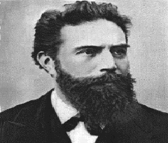
Wilhelm Conrad Roentgen 1845-1923
discovered X-rays November 8, 1895
Won Nobel Prize in 1901
Jan. 13, 1896 – Images needle in patient’s hand – X-ray used presurgicaly

Slide 8
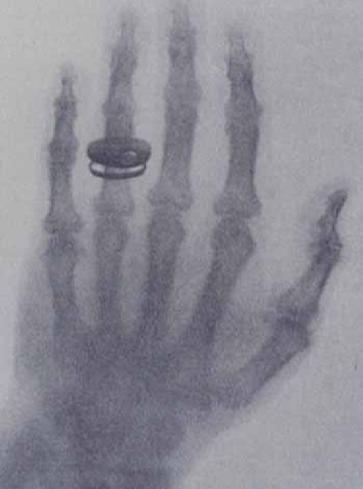
The first radiograph January 1896
Radiograph of the hand of Roeontgen’s wife
January 1896 - First x-ray made in public

Slide 9
Comparison of initial 1896 radiograph and current
January 1896 - First x-ray made in public
Routine x-ray current technology

Slide 10
It is from this early beginnings that imaging has
grown such that it now plays two major roles in
Diagnostic and Interventional imaging procedures

Slide 11
Imaging Equipment
Imaging equipment use electromagnetic radiation or sound waves.
Electromagnetic Radiation
  X-ray & Computed Tomography (CT)
  Magnetic Resonance Imaging (MRI)-radio-waves
  Nuclear Scintigraphy (Nuclear Medicine)
Sound Waves (not radiation)
  Ultrasound

Slide 12
Imaging Modalities.
Conventional modalities
1 Plain X-rays --conventional and Digital
2 Contrast studies
Newer cross sectional Modalities
1 Computerised tomography(CT)
2 Ultrasound
3 Magnetic resonance imaging(MRI)
Radionuclide Imaging
1 SPECT and PET

Slide 13
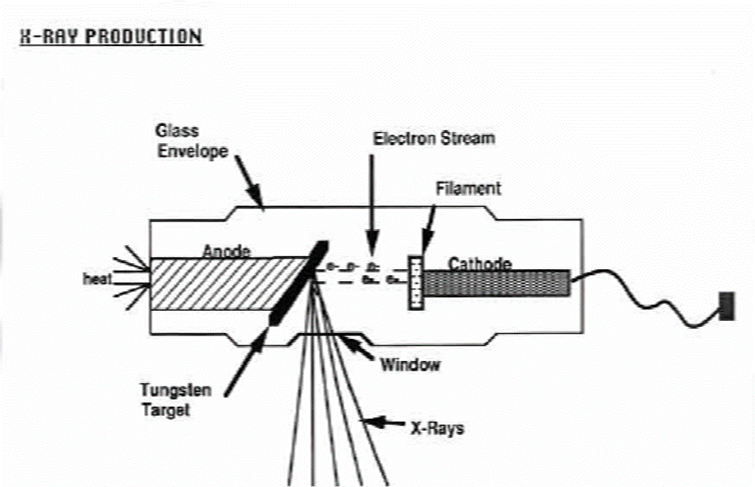
Modalities that use Xrays
Plain Radiography
X RAY PRODUCTION
inherent contrast
film
digital
Contrast Radiography
barium
iodine
Fluoroscopy
CT (Computed Tomography)
Mammography

Slide 14
X-ray production and interaction with body tissues
Electrons generated at filament
Negatively charged electrons move toward anode and strike target at high speed
99% result in heat dissipated by the rotating target
1% create x-rays which are directed through the window
X-rays pass through patient to a receptor (film, digital, fluorescent screen, etc

Slide 15
X-ray image
A diagnostic image is composed of differences in contrast between tissues which result from differences in radiation interaction in the tissues

Slide 16
Inherent Contrast
Tissue
Air
Fat
Soft Tissues
Bone, Calcium
Metal
Appearance on XRAY
Black
Dark Gray
Gray
White
Really White

Slide 17
BONE
FAT
SOFT TISSUE
AIR

Slide 18
‘Digital’ Radiography
Two types
Computed radiography, called CR
  Uses existing equipment to make exposures
  Film cassette is replaced with a charged metal plate
  After exposure, plate is ‘read in a special device
Digital radiography, called DR
  Requires conversion of the entire x-ray room
  Film cassette is replaced by a CCD sensor (like in a digital camera or video camera)

Slide 19
Contrast Agents
Anything that enhances the differences between tissues of similar densities is a contrast agent
For XRAY there are TWO commonly used contrast agents: Note they are both METALS
  Barium
  Iodine
Ways in which they are introduced
  Swallowed: barium swallow, upper GI
  By enema: barium enema
  In vein: Intravenous urogram
  In artery: Arteriogram

Slide 20
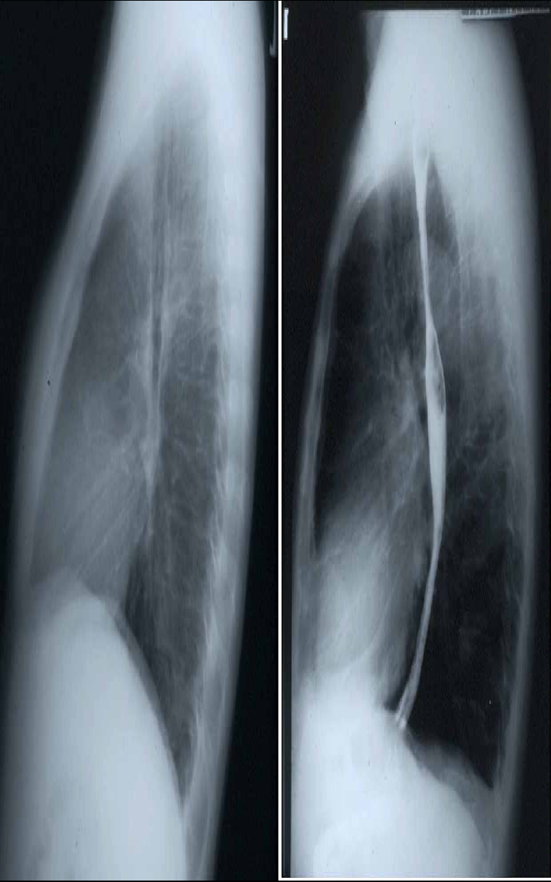
CHEST: LATERAL VIEW
BARIUM SWALLOW

Slide 21
Use of contrast in radiography
Plain lateral chest radiograph
Lateral chest with barium
iIn B, the oesophagus is visualized due to the bariunn
AA
BB

Slide 22
PLAIN RADIOGRAPH OF ABDOMEN
BARIUM ENEMA

Slide 23
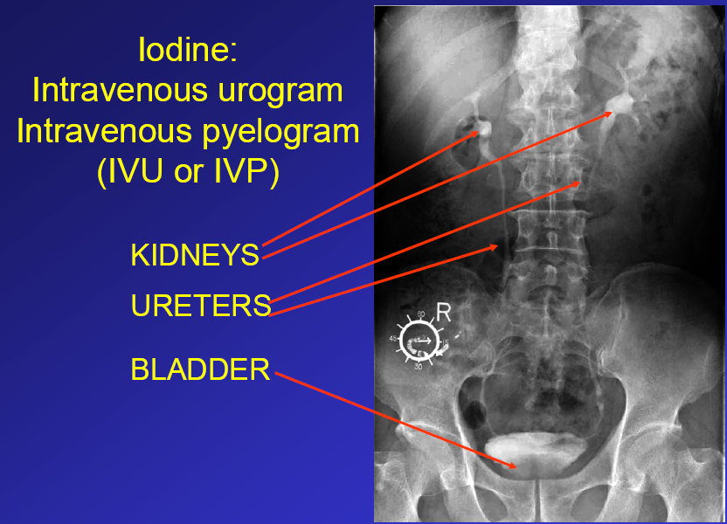

Slide 25
Computerised Tomography(CT)
CT uses X.rays to produce images
In the initial equipments, the x-ray tube spins around the patient while detectos moved around the patient in opposite direction to the tube
A computer then performs calculations of densities in each square of a slice to produce the images

Slide 26
In computerised tomography (CT) the X-ray source rotates around a plane of the body, taking serial pictures with a detector (instead of a film) which are synthesized by a computer.
The resulting picture created by the computer is like a section of the body and can be recorded on a film. CT pictures are therefore like X-ray images.
ima

Slide 27
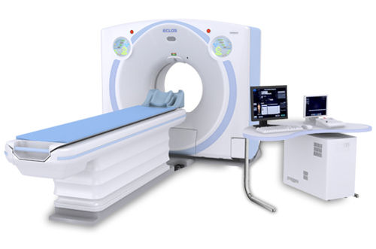
CT Equipment

Slide 28
Technological advancements of CT
The first generation CT scanners used in the !970s and !980 were slow each slice taking a minute to produce an image.
Marked technological advancements have been made to this single slice equipments to multislice
equipments upto 640 slice in which the whole body can be scanned in a minute and image reconstructions can be achieved

Slide 30
What more can we can do with CT these days?
CT Angiography
  Scan rapidly during Iodine injection in vein
CT Colonography
  Scan colon after filling with air
CT Bronchoscopy
  Scan chest air is already in bronchi
Construct 3D Images
  Computer reconstruction

Slide 33
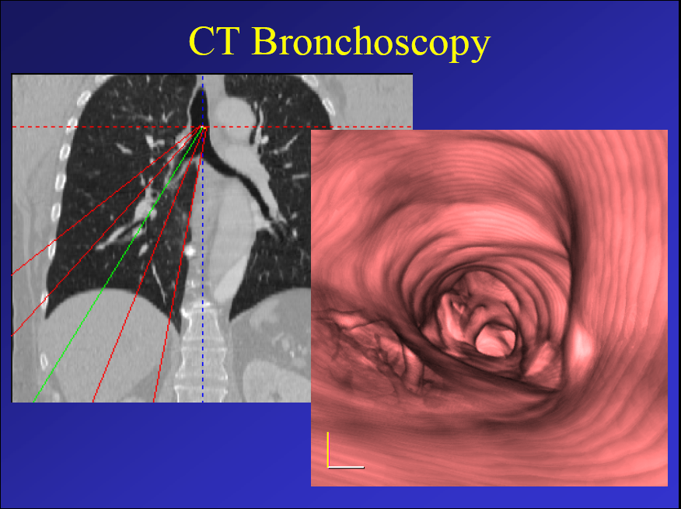

Slide 37
Ultrasound
Ultrasound uses mechanical waves of frequencies beyond the audible range.
These waves are reflected to various degrees from junctions of tissues of different nature.
Ultrasound pictures require considerable skill to Produce and interpret.
Ultrasound has a great advantage – it does not cause cellular damage when used in quantities required for imaging

Slide 38
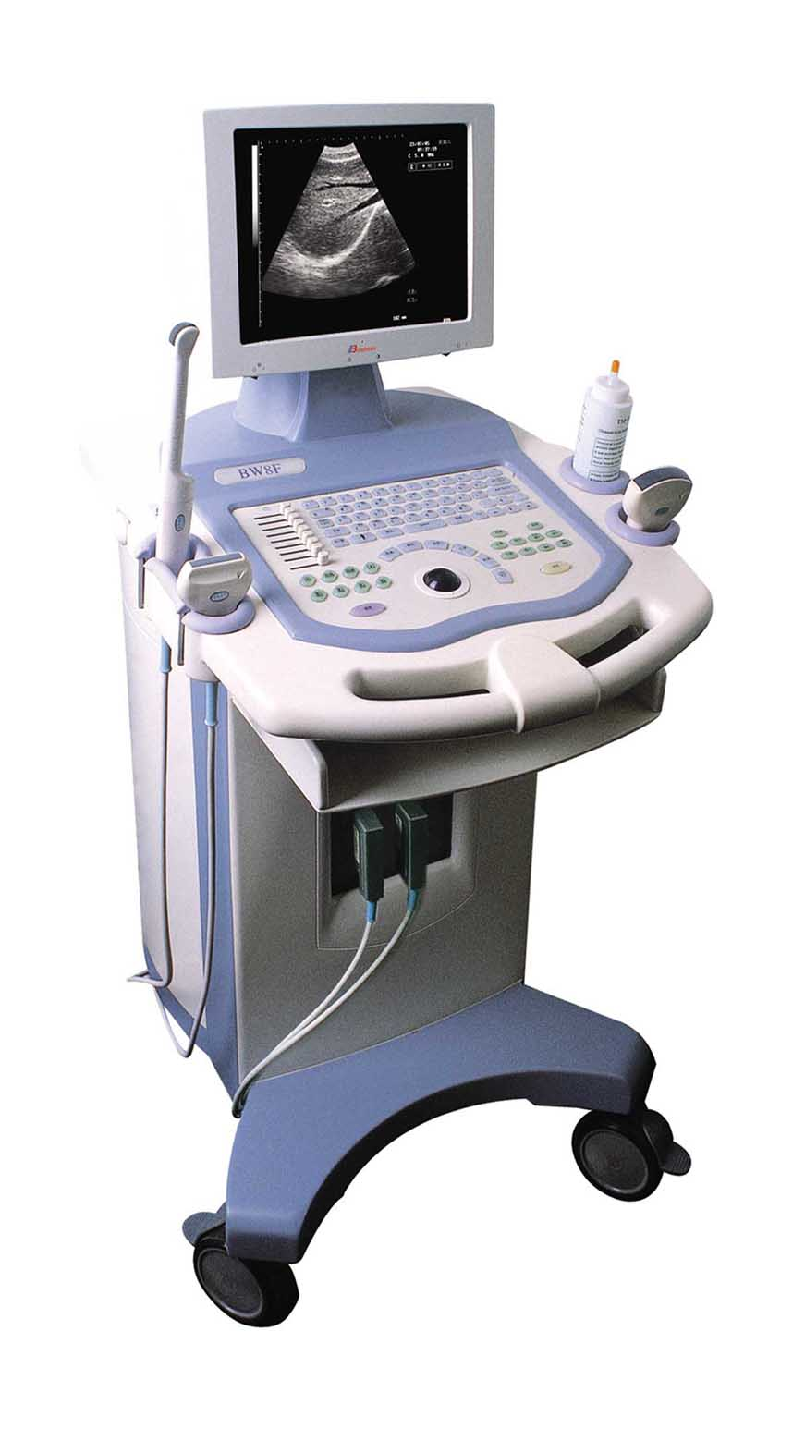
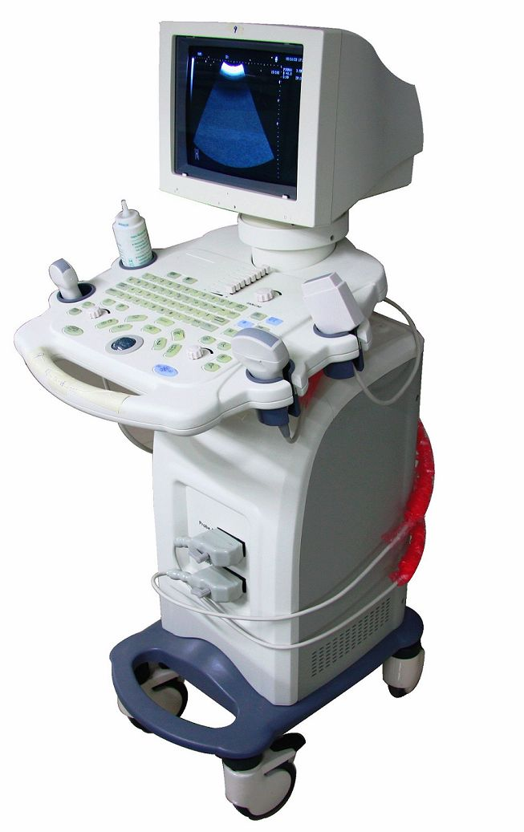
Ultrasounds equipments

Slide 40
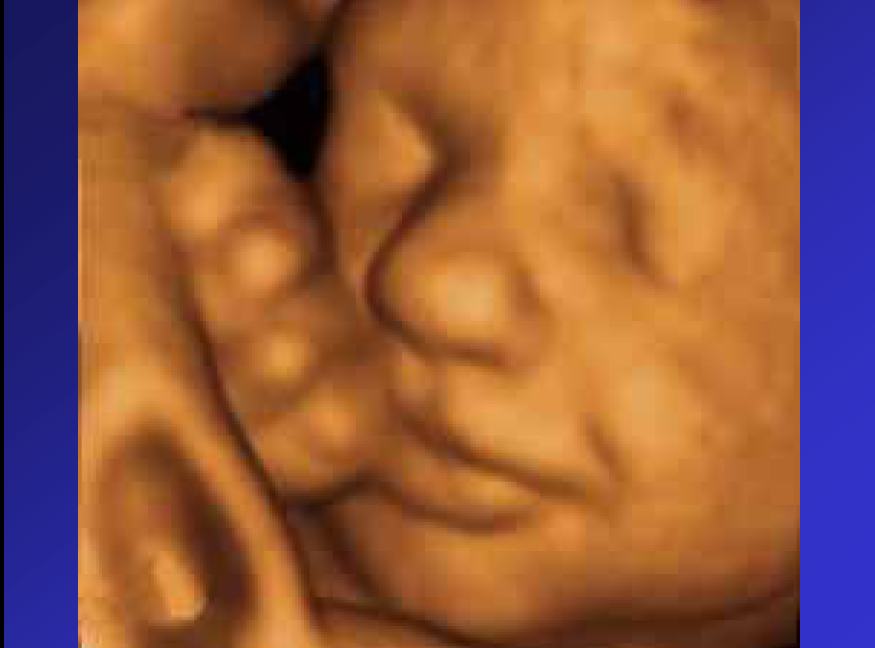
4D ultrasound of fetal face

Slide 41
Magnetic Resonance Imaging(MRI)
Magnetic resonance imaging exploits the existence of induced nuclear magnetism in the patient.
Magnets with an odd number of photons or neutrons possess a weak but observable nuclear magnetic moment.
Hydogen nucleus is the most commonly imaged, although
(13C, Phosphorous (P) sodium (Na) and Fluorine (F) are also of significant interest.
The nuclear moments are normally randomly oriented, but they align when placed in a strong magnetic field (typically 0.2-1.5 T).
The NMR signal from a human is due predominantly to water protons.
frequency.

Slide 42
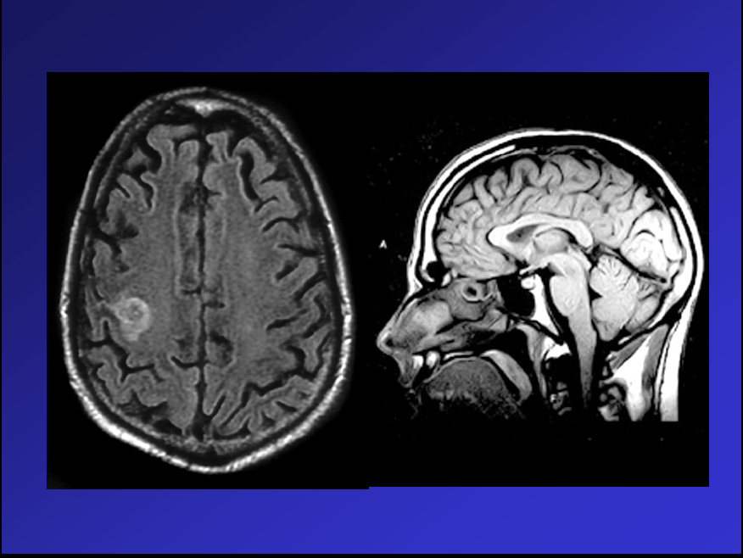
Axial and sagittal MRI images of the brain
a

Slide 43
Lesion in the cord
L/spine
c/spine
Sagittal MRI scans of the spine

Slide 44
MR Angiography (MRA)

Slide 45
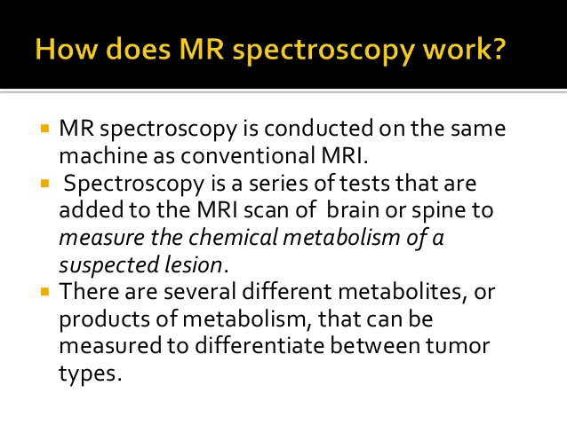
MR SPECTROSCOPY

Slide 46
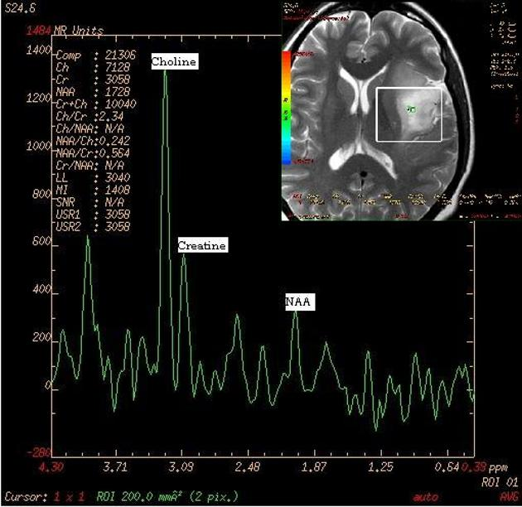
MRI spectroscopy

Slide 47
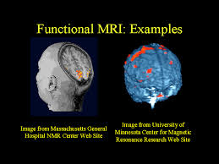
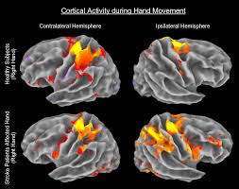
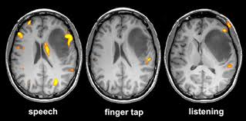
Funtional MRI

Slide 48
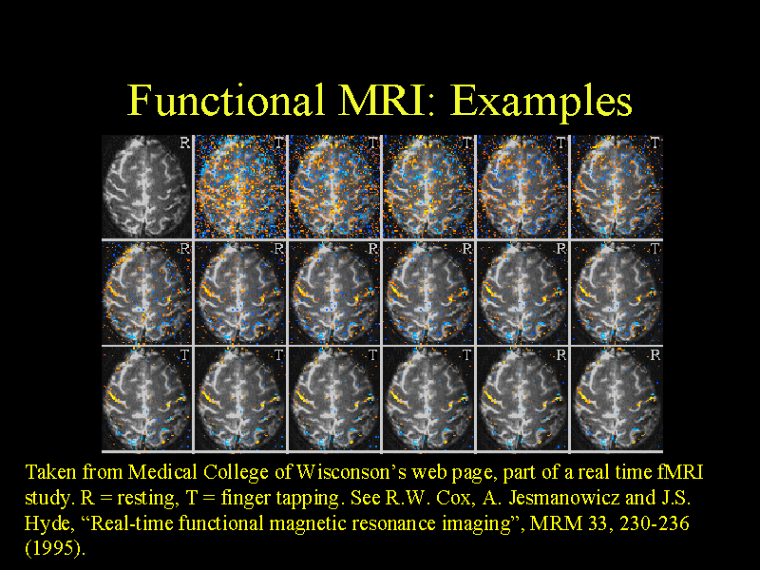

Slide 51
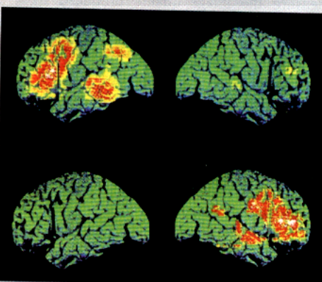
POSITRON EMISSION TOMOGRAPHY (PET)
PET scan of the brain active in word recognition.

Slide 55
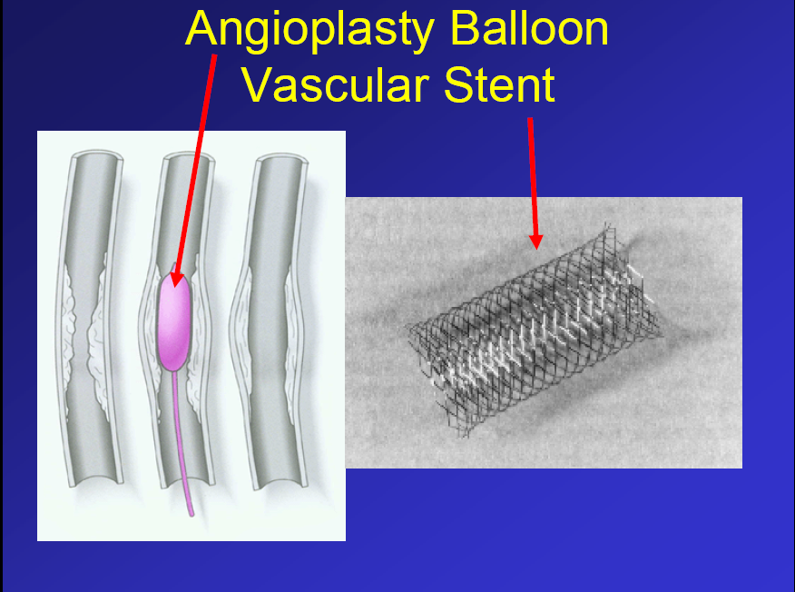

Slide 59
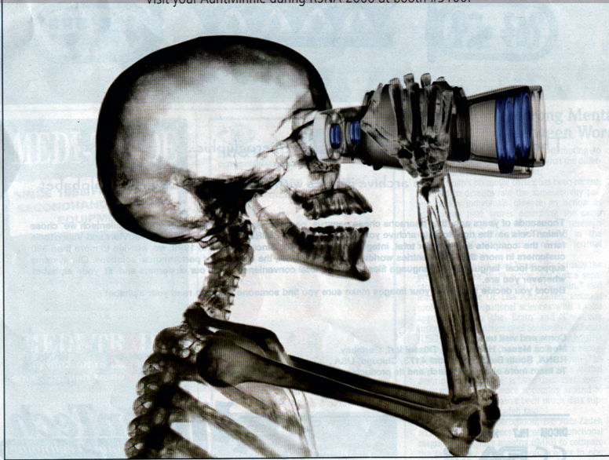
Imaging despite all this advances we are still seeing more in the future

