Slide 7
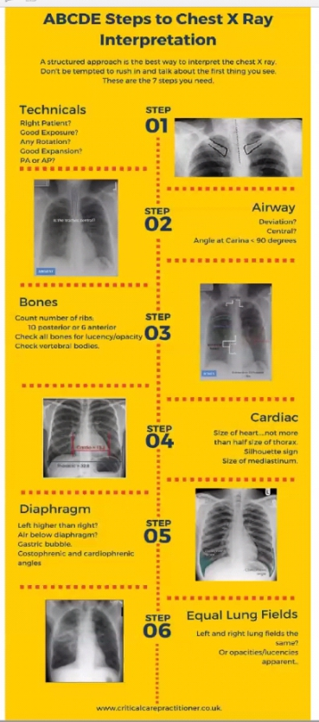

Slide 55
COMPILED BY PRIYANKA SINGH PANWAR

