Slide 1
LEVEL 4
CVS 1

Slide 2
OUTLINE
INTRODUCTION
EMBRYOLOGY
IMAGING MODALITIES
CONGENITAL HEART DISEASES
SPECIFIC CONDITIONS

Slide 3
INTRODUCTION
The fetal heart develops from a series of complex and rapid changes which occur between second and eighth week of intrauterine life.
During third to fifth weeks cardiac structures develop most actively and are most susceptible to adverse external influence eg. rubella virus or drugs such as thalidomide resulting in CHD.

Slide 4
EMBRYOLOGY
The heart originates from splanchnic mesoderm
endocardial tube is the initial basic structure
development is characterised by rapid and complex changes
Initially straight longitudinal midline tube.
5 dilatations develop along it;
common truncus arteriosus
bulbous cordis
common primitive ventricle
common primitive atrium
sinus venosus

Slide 5
Adult derivatives of the primitive heart

Slide 6
Normal fetal circulation
Oxygenated blood is carried by umbilical vein (UV) through ductus venosus (DV) and IVC into RA through foramen ovale into LA & LV, aorta & systemic arteries.
SVC & IVC blood is passed into RA, RV & PA. Most of the RV output passes through PDA into descending aorta to supply lower parts of fetus and umbilical arteries which supply the fetal placental plexus.

Slide 7
CHD IMAGING MODALITIES
Plain radiography
Echocardiography- First line to assess anatomy and function.
Cardiac catheterization- definition of vascular anatomy.
CT- description of cardiac and vascular anatomy in relation to other structures of the chest.
MRI- Quantification of cardiac function and vascular flow in vivo.

Slide 8
CHD IMAGING MODALITIES
Plain radiography
Echocardiography- First line to assess anatomy and function.
Cardiac catheterization- definition of vascular anatomy.
Radionuclide imaging - quantify left-to-right shunts, assess relative pulmonary perfusion.
CT- description of cardiac and vascular anatomy in relation to other structures of the chest.
MRI- Quantification of cardiac function and vascular flow in vivo.

Slide 9
Chest radiograph indications
Suspected congenital heart disease
Cyanosis
Cardiac failure
Failure to thrive
Difficult in feeding in the neonatal period
Fainting spells

Slide 10
Chest Radiograph
Standard views - Erect PA/AP chest
- Left lateral
Role- Provides clues to underlying CHD.
- instrumental in planning further investigations.
- limited use in neonates and young children.
-may show related skeletal anomalies
Assessment:
Cardiac and visceral situs- situs solitus, inversus, ambiguous
Cardiac size & shape.
Mediastinum- Aortic arch, PA, trachea indentation
Pulmonary vasculature-normal, plethora, oligemia, congestion
Skeletal features - Rib notching: coarctation of aorta
post surgical stigmata eg. sternal sutures, implants

Slide 12
CARDIAC SIZE MEASURMENT
r-max. Extension of the heart to
the right of the midline
I-max. extension of the heart to the left
of the midline
Transverse diameter is of the heart is r+L
td=max. transverse diameter of the thorax
=50-55% upto 60% in children

Slide 13
Echocardiography
Gives a wealth of anatomical and physiological information without ionising radiation, patient discomfort or significant risk
1D (M Mode), 2D most commonly used, 3 D
Doppler echocardiography ;
-CFI; ‘non-invasive’ angiogram
-Pulsed doppler echo (valves)
-continuous wave doppler
Contrast echocardiography

Slide 14
Contrast echocardiography
Use of intravascular contrast effects produced when microbubbles of gas present in solution are injected into a peripheral vein or selected area of the heart via a catheter.
Microbubbles are generated by rapid injection of saline, blood, indocyanine

Slide 15
Indications
Myocardial perfusion can be investigated directly/indirectly after intracoronary/ venous contrast injection with/out DSA
Better define anatomy not shown well on 2D E.g imaging the anomalous venous connections to the heart
Enhancement of endocardial boundaries increasing sensitivity of wall motion abnormalities e.g.valvular regurgitation,shunts

Slide 16
Doppler echocardiography
Used to study venous flow from IVC, SVC, pulmonary vessels and flow across the valves
Measure direction and speed of blood flowing through the heart and blood vessels
Check for abnormal communication between left and right side of the heart and regurgitation
Calculate cardiac output/ejection fraction
Flow towards the transducer- red away from it – blue, and turbulence flow – mixture of red and blue- yellow

Slide 17
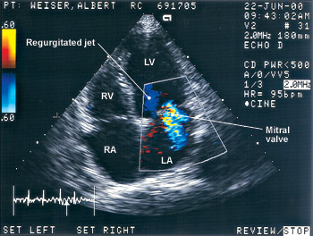
A; Parasternal long axis view –shows regurgitant jet consistent with massive aortic insufficiency
B; Apical 4c view-systolic murmer; c:Apical 4c view – severe left vent. Systolic dysfunction.
Tricuspid regurgitation is shown; D;Parasternal long axis – shows aorto-right
ventricular fistula (arrow) with aortic regurgitation

Slide 18
Clinical applications of echocardiography
Congenital heart disease
Anatomical defects, shunts
Stress echo
Pericardial disease
Coronary artery disease
Cardiomyopathies
Valvular disease
Cardiac masses
Diseases of the aorta

Slide 19
Angiocardiography
Important technique for cardiac and great vessel anatomy
Coronary angiography commonest
-transfemoral approach using Judkins or Amplatz catheters
Pulmonary angiography; for possible embolism.
Adv; Offers high resolution images of the heart and great vessels.
Disadv ; Requires experienced hands and cardiac monitoring, invasive

Slide 20
Angiocardiography cont’d
Indications :
CHD, valvular/myocardial disease, ventricular function
Technique;
-right sided structures studied by introducing catheter into a peripheral vein, femoral or antecubital or basilic
-left sided structures by introducing catheter into femoral artery retrogradely
CM-LOCM 370; 1ml/kg at 18-20mls/s (adults),1.5ml/kg
( 0-1yr);1.0ml/kg (>5 yrs)

Slide 21
Angiocardiography cont’d
Equipment- fluoroscopy unit on a C-arm with DSA facilities, pressure recording device, ECG monitor, blood oxygen analyser, catheters ( pigtail, NIH), cournand catheter-for pressure measurements
Angled views which place the pathological lesion at right angles to the Xray beam increase diagnostic accuracy of cardiography
Complications; sudden death, arrhythmias, MI, C. Media s/effects

Slide 22
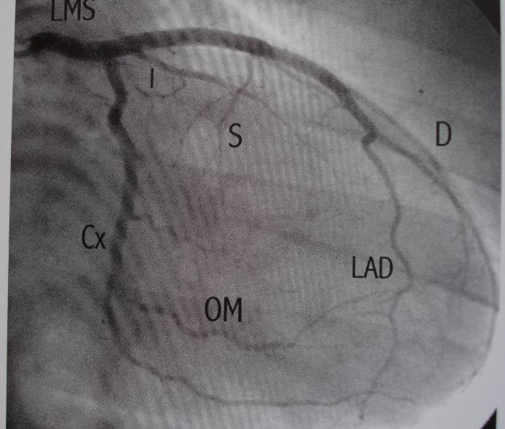
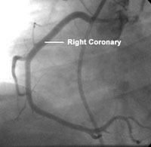
RV
LV
LAO-Left coronary artery
Open arrowhead=LAD,
Solid arrowhead=diagonal, arrow=circumflex
LAO-Right coronary artery
Solid arrow head=RCA, open arrow head=posterior
desced. C. artery, black Arrow head=sinus node artery,
black arrow inverted u at the crux,
white arrow =posterolateral left vent. branch
PDA
RAO=I-intermediate branch,S-septal,D-diagonal
LAD-lt ant.desced,OM-obtuse marginal,Cx-circumflex
LAO =RV-rt vent. Branch,PDA-post. desced. artery,
LV-inferior lt vent branch

Slide 23
CARDIAC MRI
Advantages; Provides anatomy, dynamic motion studies of function, flow and chemistry with minimal risk to the patient
Disadvantage – expensive
-availability
- metallic implants

Slide 24
Clinical applications of Cardiac MRI
ventricular function analysis
Myocardial function at rest and during stress
Myocardial perfusion
Measurement of coronary flow
Valvular heart disease
Pericardial pathology
Cardiac tumors and thrombi
Cardiomyopathies
Assessing great vessels- aortic/pulmonary disease

Slide 25
Pulse sequences used
Tissue characterization-done usingT1W, T2W, contrast enhancement and spectroscopy
T1W-best anatomic depiction,
Blood-show signal void
Gradient echo-Impart bright signal to coherently flowing blood-white blood
Fast spin echo- vascular wall bright, blood black

Slide 26
C/MRI –cont’d
Gradient recalled echo-technique -applied for motion studies,to show flowing blood as well as cardiac motion
ECG gated MRI of the heart-
Velocity mapping sequences
Images-tomographic slices,of any selected plane

Slide 27
MRI Cont’d
Gadolinium -as contrast used in;
myocardial perfusion
MR angiography; time of flight MRA, phase contrast MRA, contrast enhanced MRA
Myocardial infarction
Ischemia

Slide 28
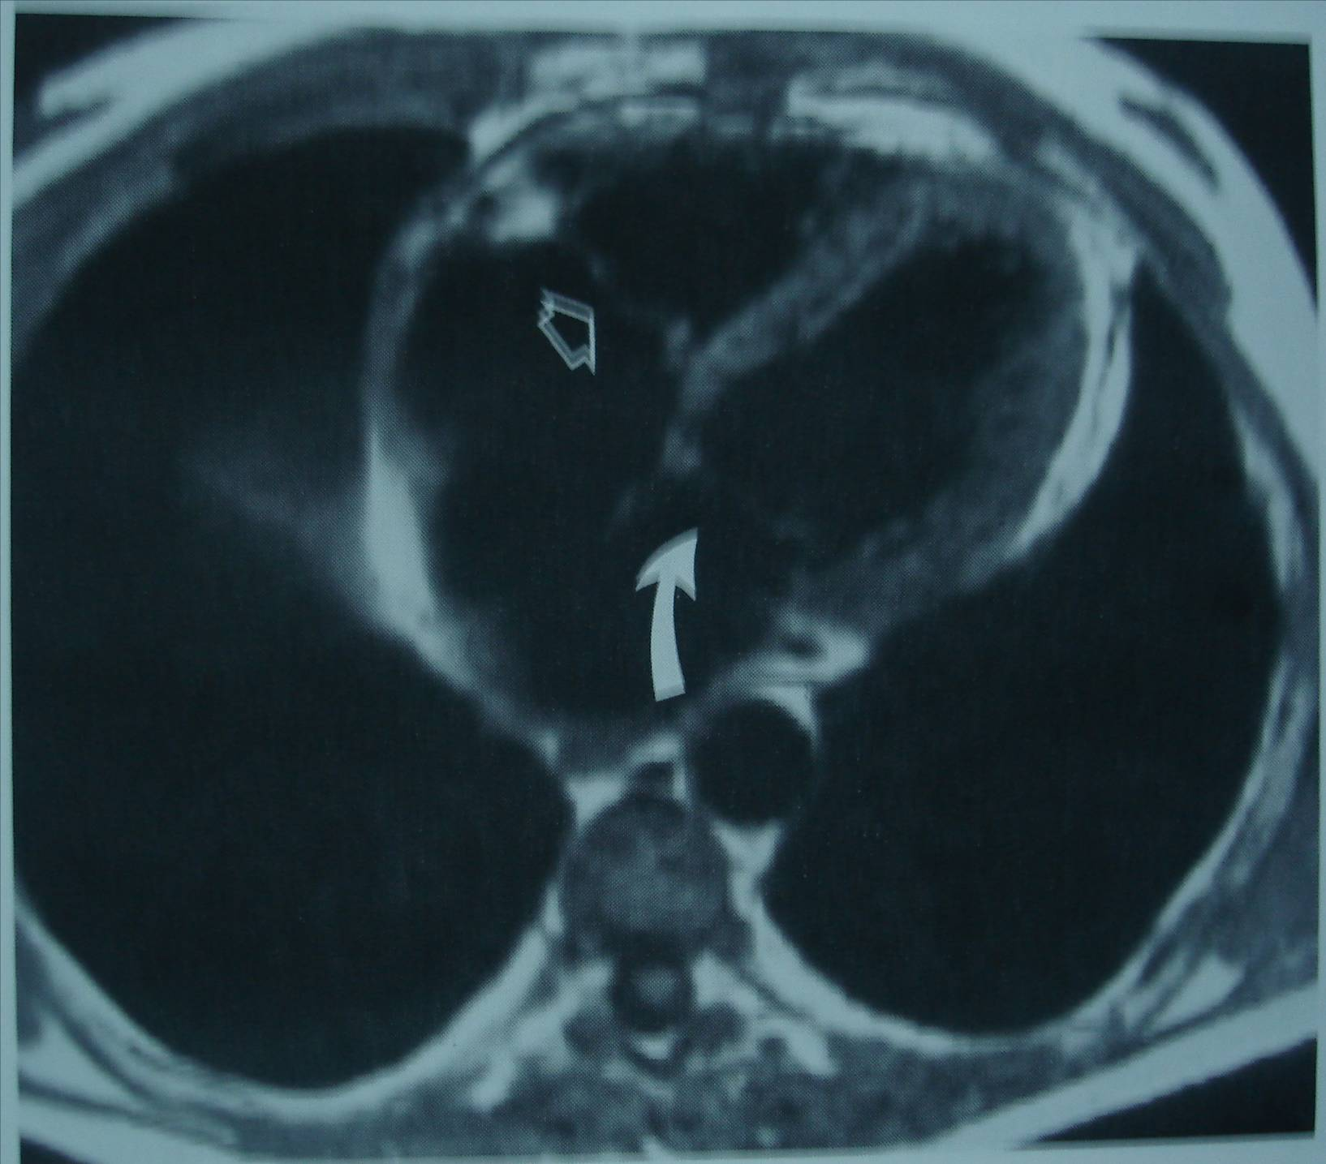
Oblique axial image of the heart –turbo S.E image.solid white arrow-parietal band, CT-crista terminalis, black arrow RCA , Curved arrow- lt circumflex CA, da- desced. Aorta, p-pulm. Vein, AV-aortic valve
TRANSVERSE IMAGE-through ventricles at AV Valve level
TV-open arrow; MV—curved arrow

Slide 29
CARDIAC CT
Good images of thoracic anatomy and major cardiac structures and large vessels
CECT first line in imaging aortic rupture or dissection
Calcification on the coronary vessels
Evaluation of coronary vessels
Disadvantages; ionizing radiation, motion artifact

Slide 30
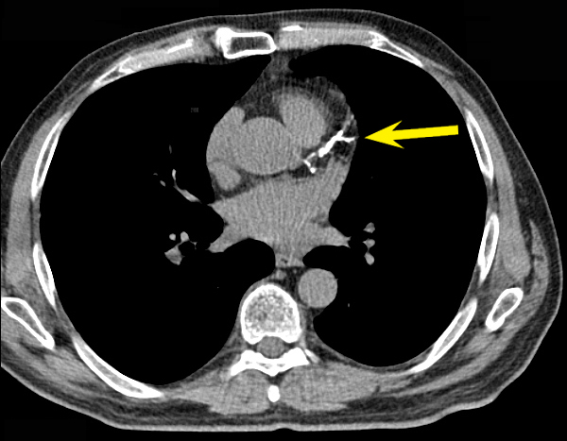
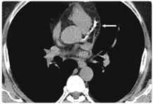

Slide 31
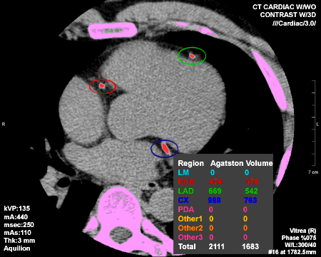

Slide 32
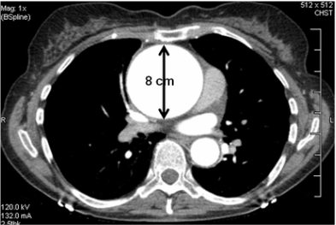
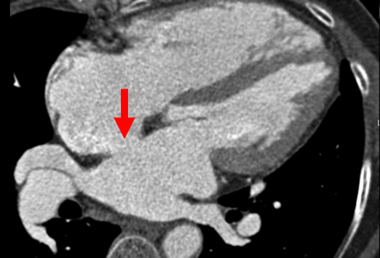
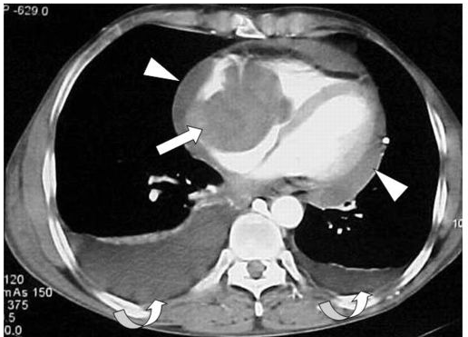
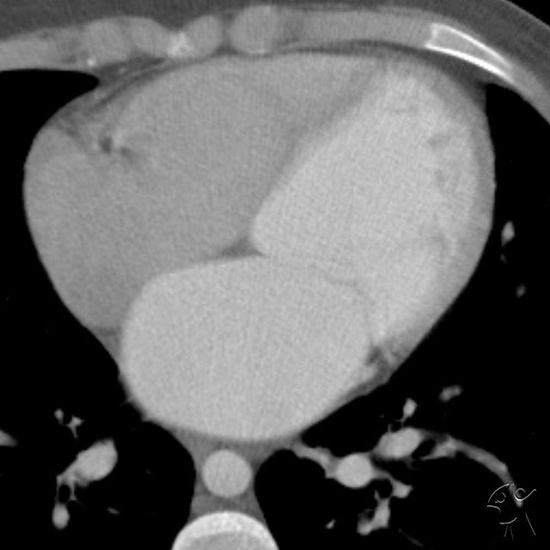

Slide 33
RVO
RA
A.Ao
LA
OES
D.Ao
Av
Coronal 3D reconstruction of right heart chambers using MDCTA.RAO views of right heart shown by MIP
D-volume rendered technique-RCA running in the low attenuation fat of the ant. Atrioventricular groove
E&F-Sagittal 3D Reconstruction of right chambers using MDCTA by (E) MIP and (F) VRT showing
position of pulmonary valve (white arrows)

Slide 34
CARDIAC SCINTIGRAPHY
Injection of radiophamarceutical to study the heart
indications;
assessment of myocardial perfusion
ischaemia,
infarction
viability.
-Ventricular function
diagnosis and quantification of abnormal passages

Slide 35
Perfusion studies
Used to diagnose ischemia and m/infarction
Radiopharmacuticals used include;
Thallium 201
technetium 99m labeled tracers;like tetrofosmin

Slide 36
Technique
scans are taken in;stress and resting phases
Stress induced by:-
Physical exercise test: treadmill, bicycling.
Pharmacologic stress test: dipyridamole, adenosine, dobutamine.
The heart scanned in longitudinal, vertical and short axes

Slide 37
Normal perfusion scans
Horse-shoe in vertical and long.axes and doughnut in short axis
stress and rest images are same in normal myocardial perfusion
Ischaemia-normal at rest and reduced at stress
infarcted and scars -reduced in both

Slide 38
Axes
VERTICAL LONG
AXIS
HORIZONTAL LONG
AXIS
SHORT
AXIS

Slide 39
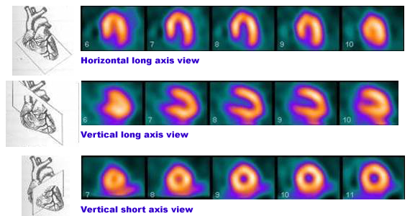
HEART AXES
Normal perfusion scan showing cardiac slice information and horizontal long, vertical long and vertical short axis images.

Slide 40
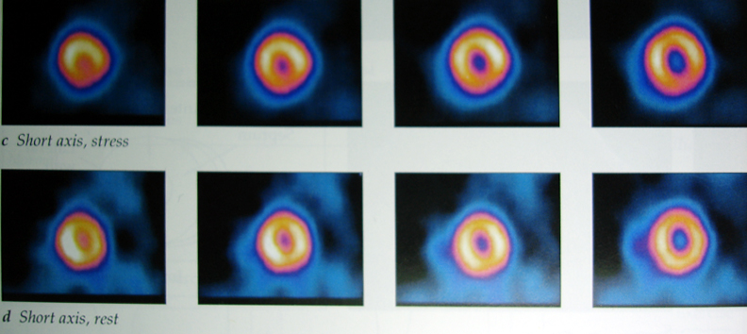
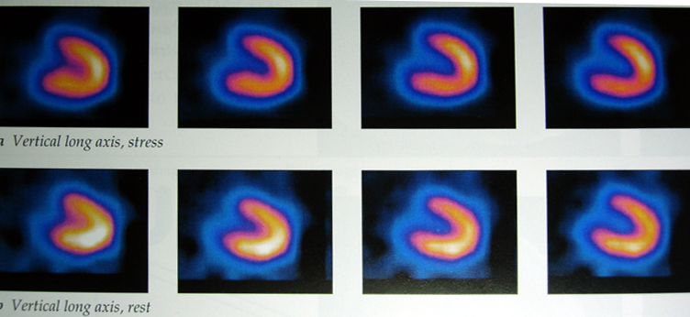
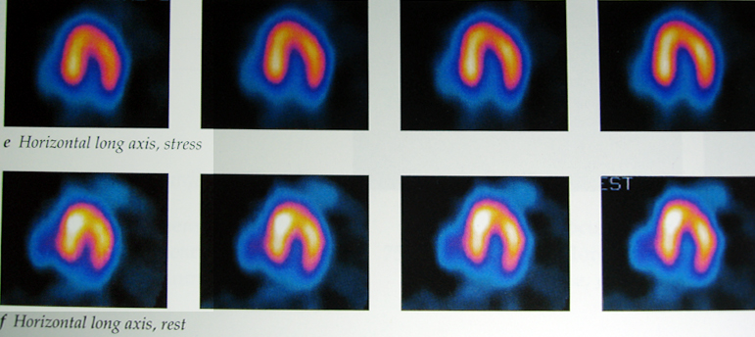
Normal examination
Short axis
-stress
-rest
Vertical long axis
-stress
-rest
Horizontal long axis
-stress
-rest

Slide 41
Normal Thallium myocardial perfusion tomograms in vertical long axis (left), horizontal
long axis (centre), and short axis planes (right). Stress images (top) and redistribution
(bottom). There is homogenous uptake of tracer throughout the myocardium

Slide 42
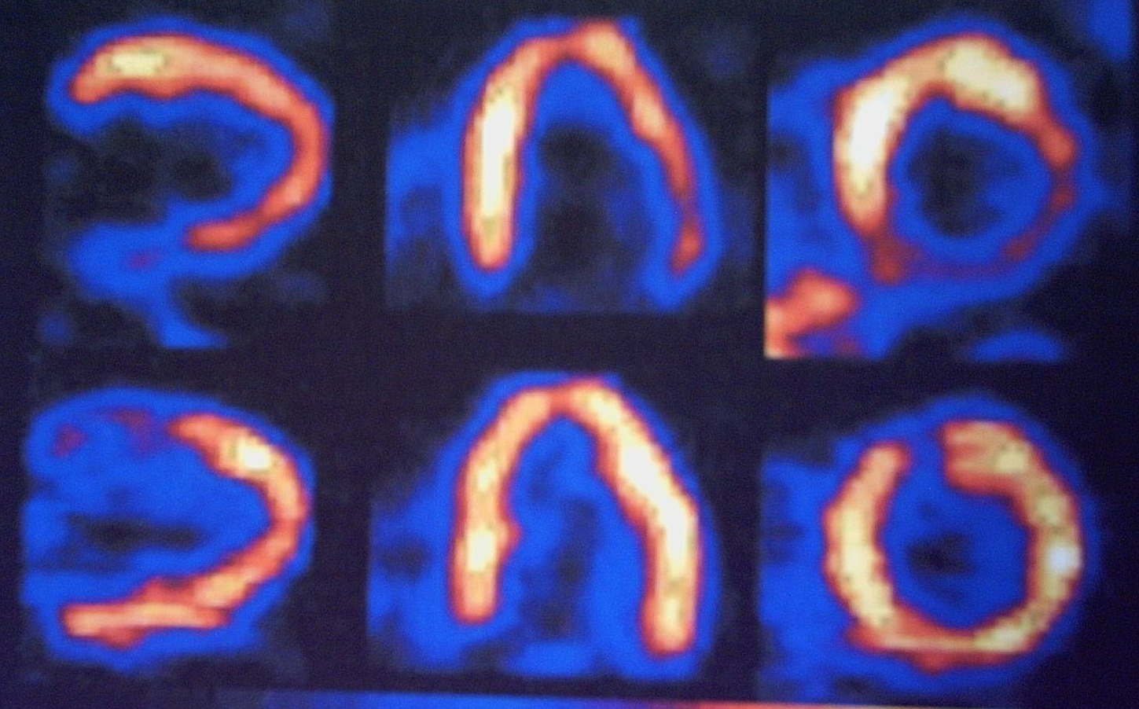
Hibernating myocardium; vertical long axis-(left), horizontal long axis (centre),and short axis( right) PET images. Ammonia perfusion images (top) show decreased uptake in the inferior and basal lateral regions. But the glucose metabolic images (bottom) show increased metabolism in these areas. Typical of hibernating myocardium

Slide 43
Clinical applications RNI
Diagnosis of coronary heart disease
Prognosis of CAD
Myocardial infarction; infarct detection
Myocardial viability and hibernation
Other myocardial disease; alcoholic induced, viral, metabolic
Valve disease
arrhythmias

Slide 44
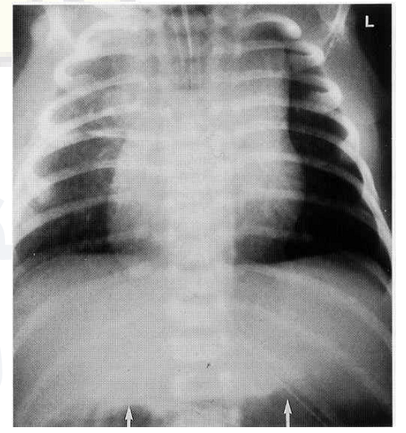
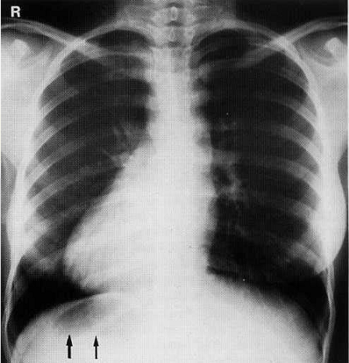
CHD
Visceroatrial situs solitus, isolated dextrocardia.
Situs ambiguous- central cardiac apex, transverse liver.
Situs inversus.

Slide 45
CHD has an incidence of 6–8 per 1000 at birth.

Slide 46
Risk Factors
Genetic – Downs syndrome-25%
- Holt-Oram Syndrome
- Ellis van Creveld Syndrome
- Turner’s, Noonans
Alcohol.
Prenatal Rubella infection, Toxoplasmosis.
Drugs: Thalidomide toxicity---17% have a cardiac lesion.
Gestational diabetes.

Slide 47
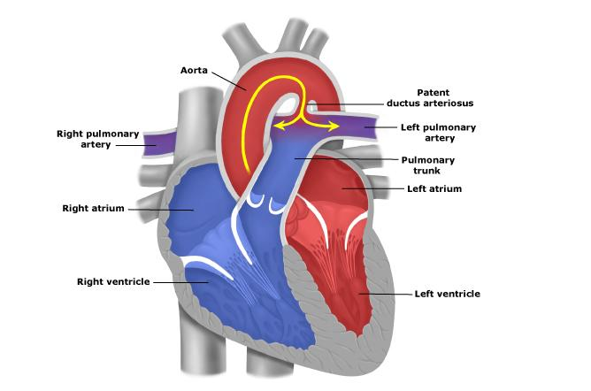
Patent Ductus Arteriosus

Slide 48
Patent Ductus Arteriosus
Persistence beyond 10 days is considered abnormal.
Accounts for 15% of all congenital heart diseases.
Commoner in females (2-3:1)
Associated with low birth weight, prematurity, high altitudes.

Slide 49
PDA CXR
Prominent central pulmonary arteries.
Cardiomegally.
Enlarged left atrial appendage.

Slide 50
2D + Color Doppler Echo

Slide 51
Secundum ASD- accounts for 80%
Defect @ center
Normal Heart for cf.

Slide 52
Secundum ASD
Apical 4 chamber view echo.
Note the enlarged right chambers.

Slide 53
ASD B4 Eisenmenger
Note the pulmonary plethora:
Large heart
Large central pulmonary arteries.
Large peripheral pulmonary arteries.
Recruitment of upper zone arteries( Cephalization)
No pulmonary edema.
Patient had ASD.

Slide 54
Complications of ASDs.
Eisenmenger syndrome.
Enlargement of the right atrium causing tachyarrhythmias.
Paradoxical thrombo-embolic stroke.
This patient initially had a large ASD with a major left to right shunt. Note the large central pulmonary arteries with peripheral pruning. Arrow points @ calcified lt. pulmonary artery.

Slide 55
VSDs.
One of the commonest anomaly (second only to bicuspid aortic valves). Incidence 3570/1m live births.
50% of patients with VSD have associated cardiac anomaly e.g. coarctation of the aorta.
80% are perimembranous & the vast majority(75%) of small ones close spontaneously.

Slide 56
VSD
Lets us first understand the anatomy.
The Interventricular septum has two parts, the larger muscular and the smaller membranous part.
The membranous part is the postero-superior region.
Membranous VSDs account for 80% of all VSDs.
Muscular VSDs tend to close spontaneously.
Its possible to have multiple VSDs at any part of the interventricular septum.

Slide 57
Congenital Cyanotic heart disease
For clinically detectable central cyanosis, there must be at least 5 g of reduced Hb per 100 ml of aortic blood. Occurs in 3 ways:
1. Direct right to left shunt eg. TOF
2. Transposition of great arteries.
3. Common chambers eg. Common atria, common ventricle, truncus arteriosus.

Slide 58
TOF
Most common cyanotic heart lesion.
Incidence: 3-5 per 10,000 live births.
Primary hypoplasia of infundibular septum secondary to unequal partitioning of the conotruncus.
Conotruncal septum displaced anteriorly, and its lowermost component, the Infundibular septum fails to fuse with the top of the IV septum.
Features include:
Infundibular right ventricular outflow tract stenosis
subaortic VSD
Over-riding aorta
Right ventricular hypertrophy

Slide 59
TOF
Desaturated blood enters RA, flows through RVOT into lungs. Some blood shunts right to left through VSD into ascending aorta.

Slide 60
TOF
Graphic- subvalvular(infundibular) stenosis, small pulm valve, large aortic valve, over-riding aorta, VSD, RVH, rt arch.
CTA cor- hypoplastic MPA, high VSD, over-riding aorta.

Slide 61
TOF
Radiography:
“Boot-shaped heart” = “coeur en sabot”.
Right ventricular hypertrophy.
Concave pulmonary artery segment.
Decreased pulmonary vascularity(oligaemia).
Normal heart size at birth.
Right aortic arch, mirror image branching (25%).

Slide 62
TOF
boot shaped heart, concave pulmonary artery segment.
Right aortic arch, elevated cardiac apex, pulmonary oligemia

Slide 63
TOF
Parasternal long axis- VSD, over-riding aorta,
CF doppler- right to left flow from RV to aorta.

Slide 64
Ebstein anomaly
Downward displacement of septal & posterior leaflets of tricuspid valve.
Insufficient separation of tricuspid valve leaflets and chordae tendineae from Rt ventricular endocardium.
Massive tricuspid regurgitation.
Associated anomalies-PFO, ASD in 90%.
Normal or decreased vascularity
Rt. to Lt. shunt thru PFO causes cyanosis.

Slide 65
Ebstein anomaly
Inferior displacement of tricuspid valve leaflets into RV.
Thin-walled, low-pressure “atrialized” segment of RV.
tricuspid valve is grossly insufficient.
RA blood flow is shunted rt. to lt. across an ASD or PFO into LA. Some blood may cross the RVOT and enter PA.
Severe cyanosis will develop in neonates when PDA closes.

Slide 66
Ebstein anomaly
Graphic-Downward displacement of posterior valve leaflet, incorporated into RV.
MR cine- Dilated RA, low placement of tricuspid valve, atrialized RV.

Slide 67
Ebstein anomaly
Radiography: Severe right sided cardiomegally.
Echo- Rt chamber enlargement, enlarged tricuspid annulus, tricuspid regurgitation, PFO with Rt. to Lt. shunting.
Treatment- Tricuspid valve replacement and/ or valvuloplasty

Slide 68
EBSTEIN ANOMALY
Massive globular cardiomegally (RA dilatation), pulmonary oligemia.
DDX: pericardial effusion

Slide 69
Ebstein anomaly
A. Subcostal 4 chamber - displacement of tricuspid valve leaflets inferiorly.
B. Color Doppler- severe regurgitation of the dysplastic tricuspid valve.

Slide 70
Ebstein anomaly
Mri cine- 16mm distance btn septal leaflets of MV & TV(arrow).
CECT- RA dilatation, apical displacement of septal tricuspid leaflet.

Slide 71
REFERENCES
1.Grainger&allisons textbook of diagnostic imaging 5th edition
2. Textbook of radiology and imaging. Volume 1. seventh edition. David Sutton

