Slide 1
CENTRAL NERVOUS SYSTEM IMAGING (LEVEL IV)
DR. N.M KIMANI
LECTURER
DEPT OF DIAGNOSTIC IMAGING

Slide 2
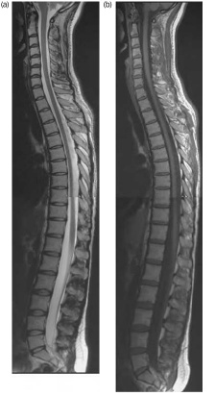
Central Nervous System
Cranium/Brain
Spine/Spinal cord/Spinal canal

Slide 3
CENTRAL NERVOUS SYSTEM IMAGING (Neuroimaging, Brain imaging)
Techniques used in either directly or indirectly image the structures, function or pharmacology of the nervous system.
Medicine discipline (neuroscience)
Physicians who specialize in the performance and interpretation of the neuro images are called Neuroradiologists

Slide 4
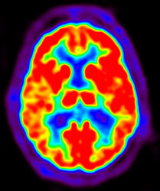
Falls into two categories;
1) Structure imaging- deals with structure of nervous system and diagnosis of gross intracranial disease e.g tumors, injury
2) Functional imaging used to diagnose metabolic disease and lesions on a finer scale.
This enables the processing of
information by centers in the
brain to be visualized

Slide 5
Brain imaging techniques
Plain Radiography (X-RAY)
Computed Tomography(CT)
Magnetic Resonance Imaging (MRI)
-Functional MRI
-MRS (Spectroscopy)
-MR Tractography
Radionuclide Imaging
- Positron Emission Tomography (PET)
- Single Photon Emission Tomography(SPECT)
Cranial Sonography
Event Relate optical signal (EROS)
Diffuse Optical Imaging(DOI)—uses infrared light to generate images of the body

Slide 6
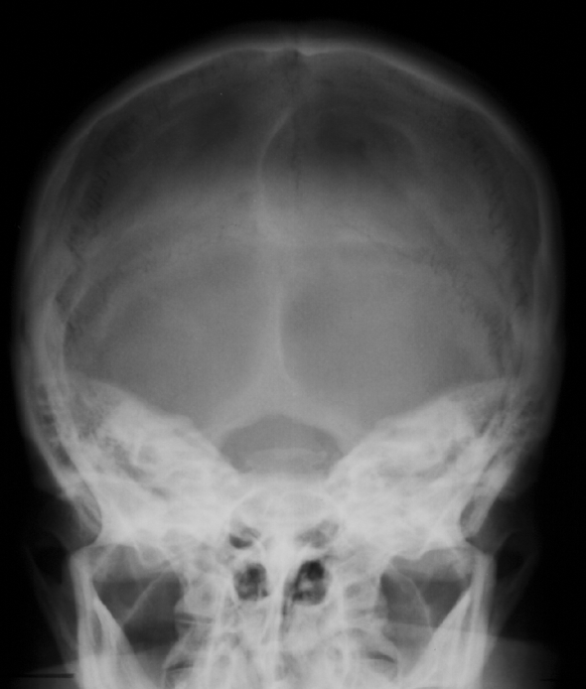
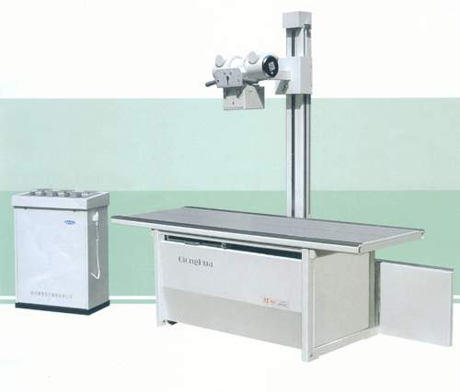
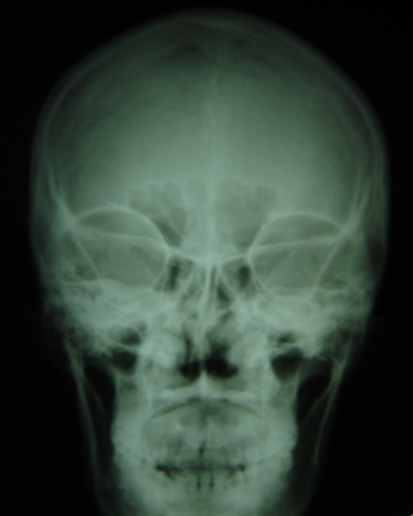
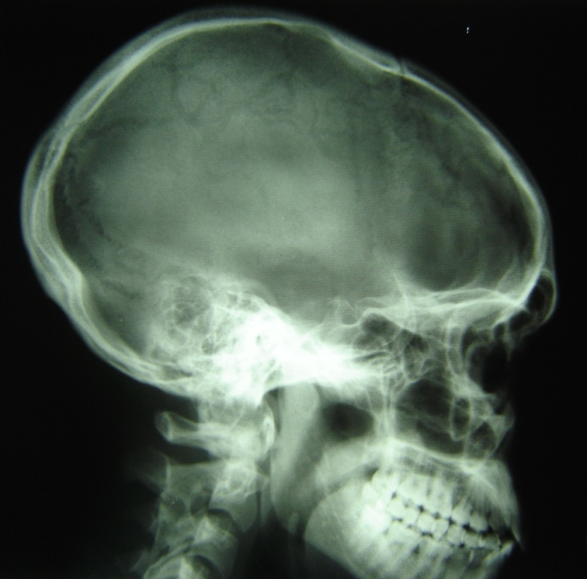
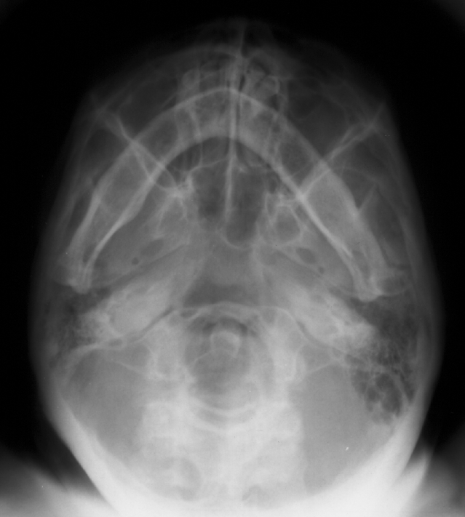
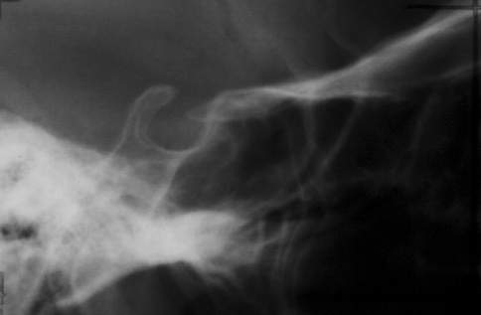
Plain Radiography (X-RAY)
views
Basic Ap, lateral, townes view.
additional views

Slide 7
What can we show on x-ray?
FractureS

Slide 8
.
Assaults ,foreign bodies

Slide 9
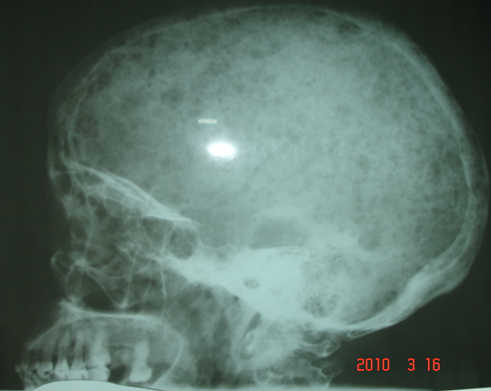
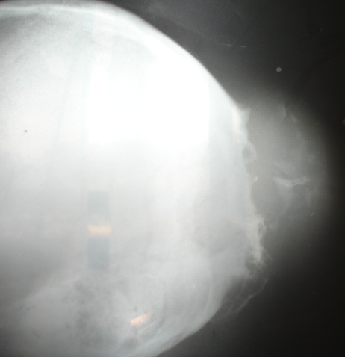
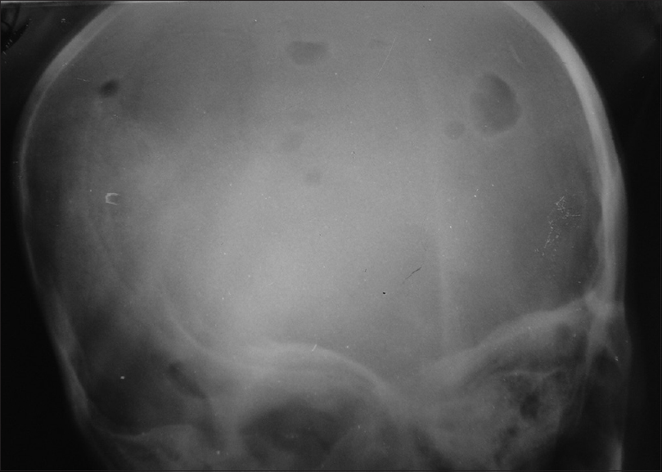
Osteolytic lesions
Metastasis
multiple myeloma
Histiocytosis x

Slide 10
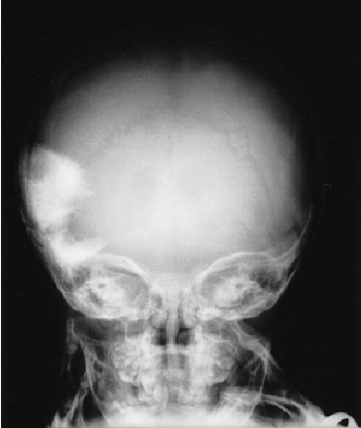
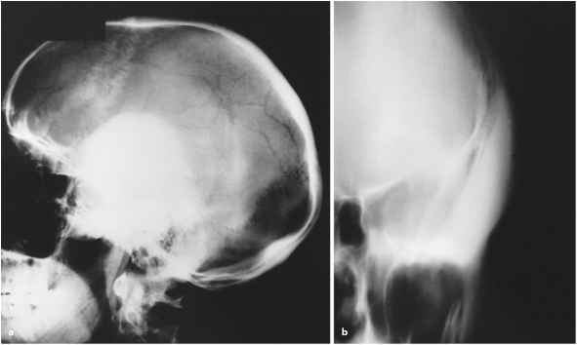
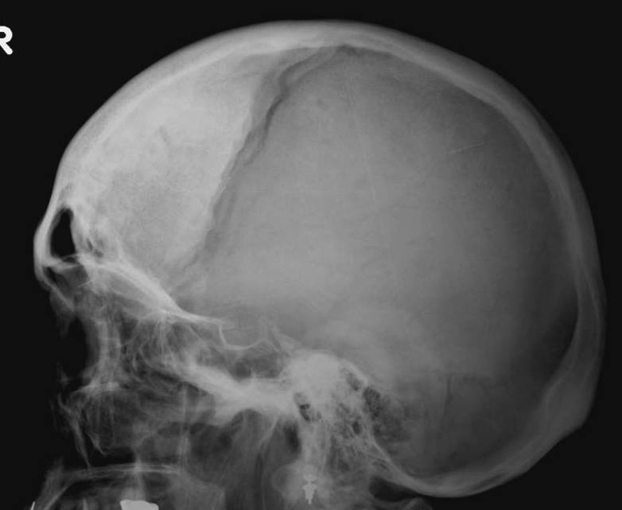
Sclerotic lesions( bone forming)
Melanotic neuroectodermal tumor of infancy
(MNTI) --rare neoplasms
Hyperostosis frontalis interna
Osteoma in an adult male patient

Slide 11
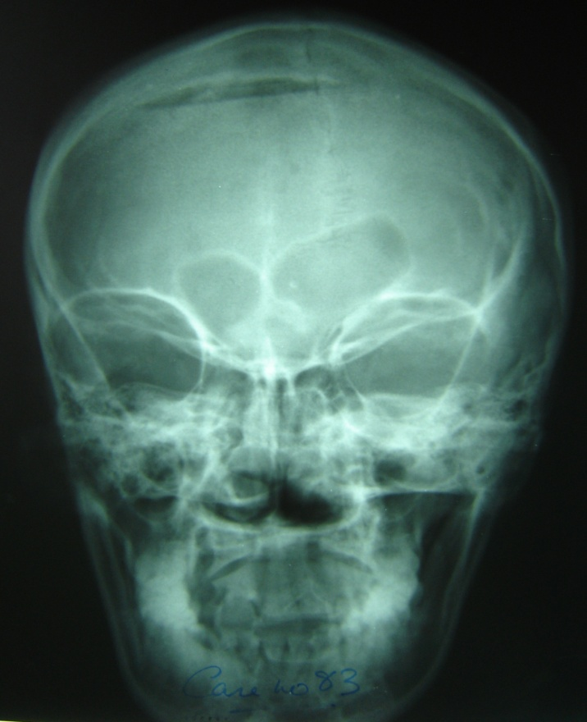
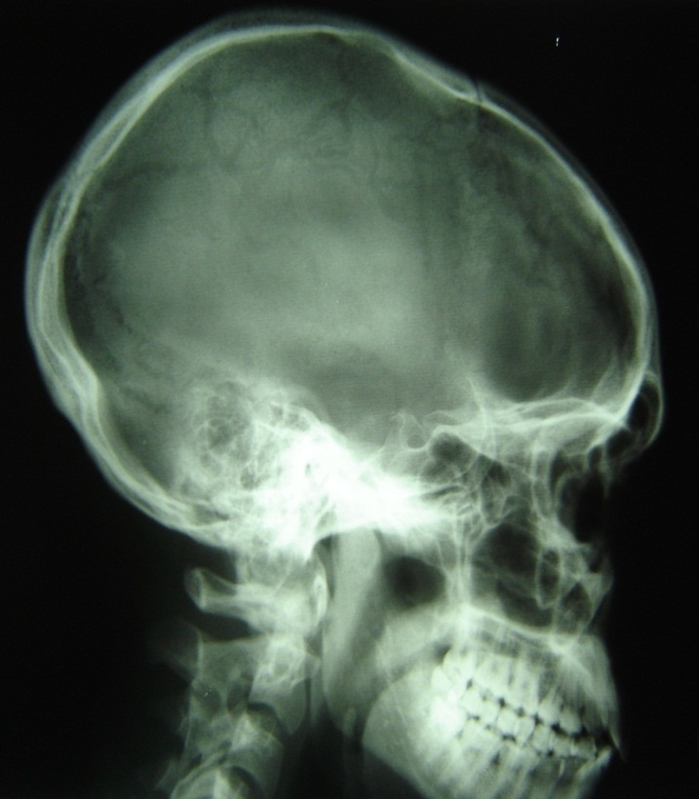
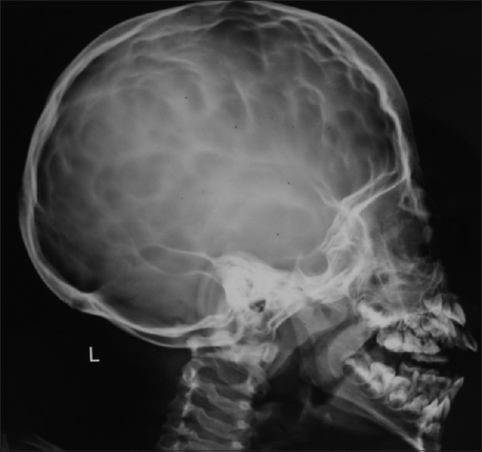
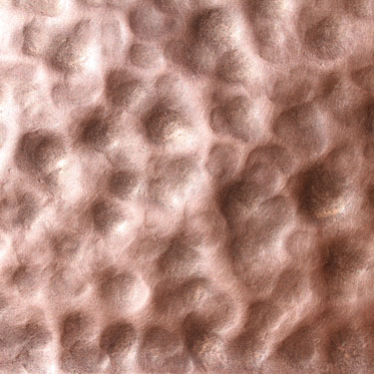
Pneumocephalus
Copper beaten appearance

Slide 12
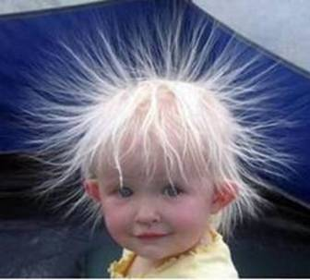
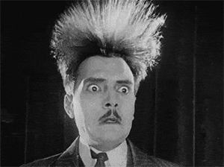
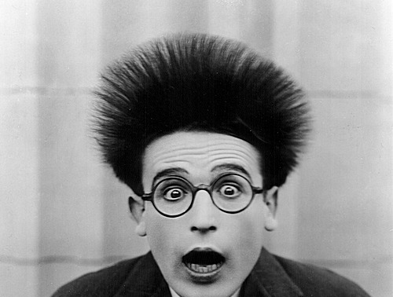
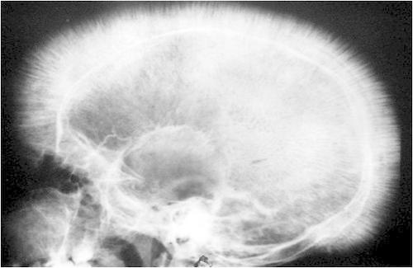
- Hair-on-end appearance Thalassemia, sickle cell disease

Slide 13
Advantages
-covers a wide area quickly
- high spatial resolution
- may be used without moving the patient
- available
-low cost

Slide 14
Disadvantages
radiation
poor resolution
Overlap of structure
Soft tissues not resolved

Slide 15
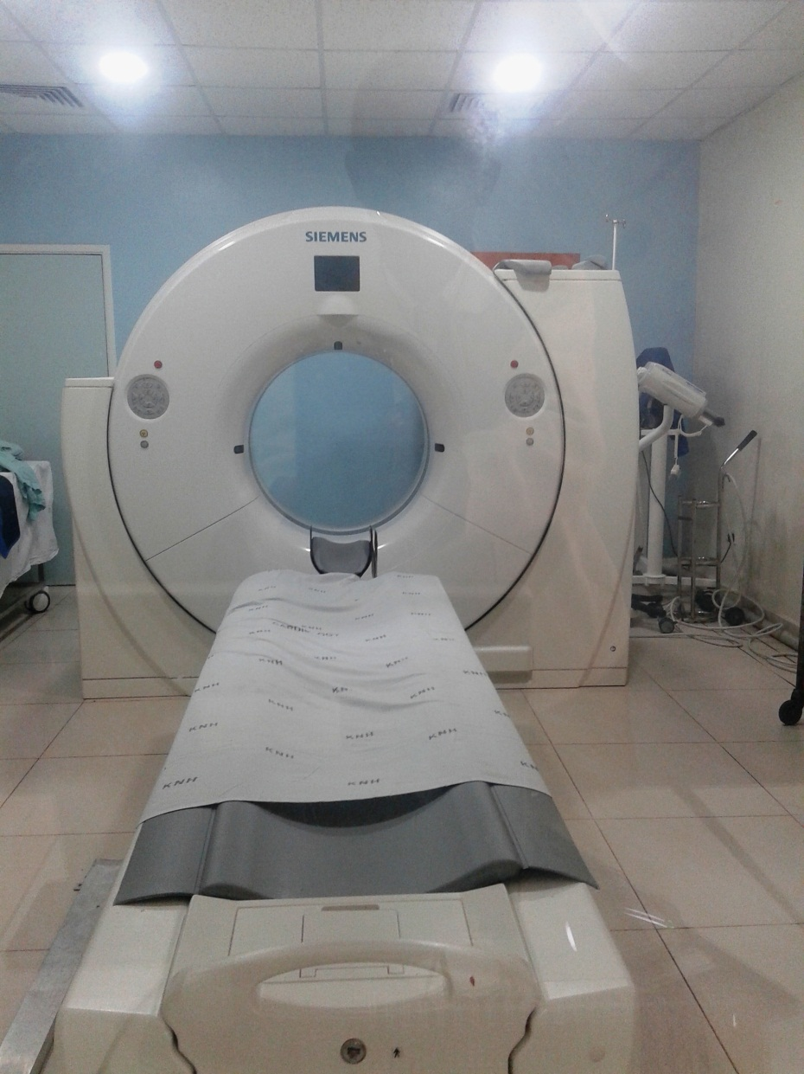
Computerised Tomography (CT)
First presented in 1972.
Several generations of scanners. Latest spiral /multislice CT scanner.
3D reconstruction obtained
CT angiography following injection of contrast.
128 slice CT scanner at KNH

Slide 16
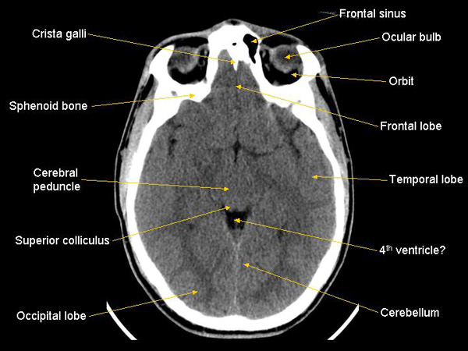
Normal CT scan of the head

Slide 17
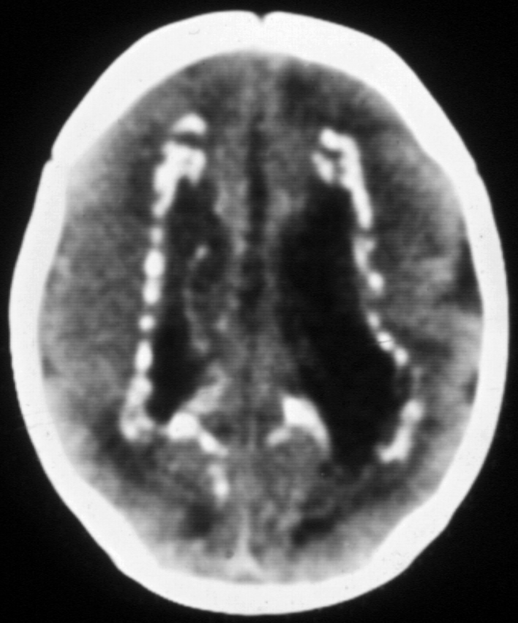
Advantages
Non-invasive
Available
Calcification better defined
Patient easily monitored and even uncooperative patients can be examined
3D reconstruction
NB Minimal requirement in modern neuroradiological unit.
.
Cmv infection

Slide 18
Computerised tomography
Disadvantages
Artifacts of bone and foreign bodies
Posterior fossa
Isodense lesions may be missed
contrast reactions may occur.

Slide 19
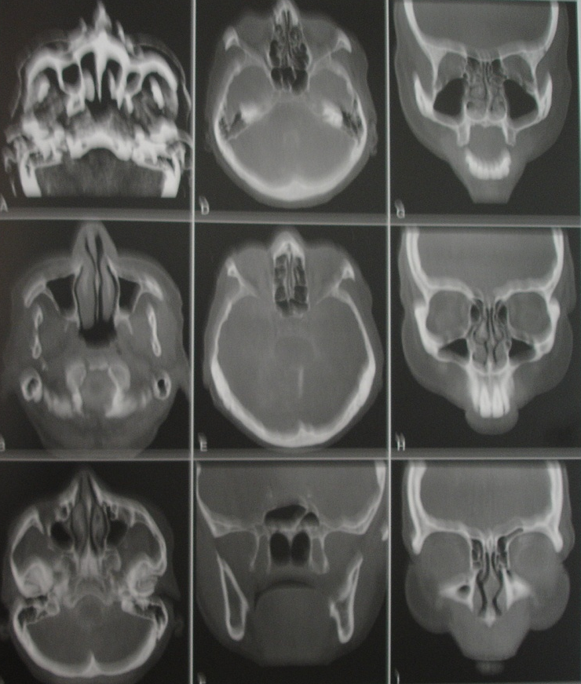
Facial Bones

Slide 20
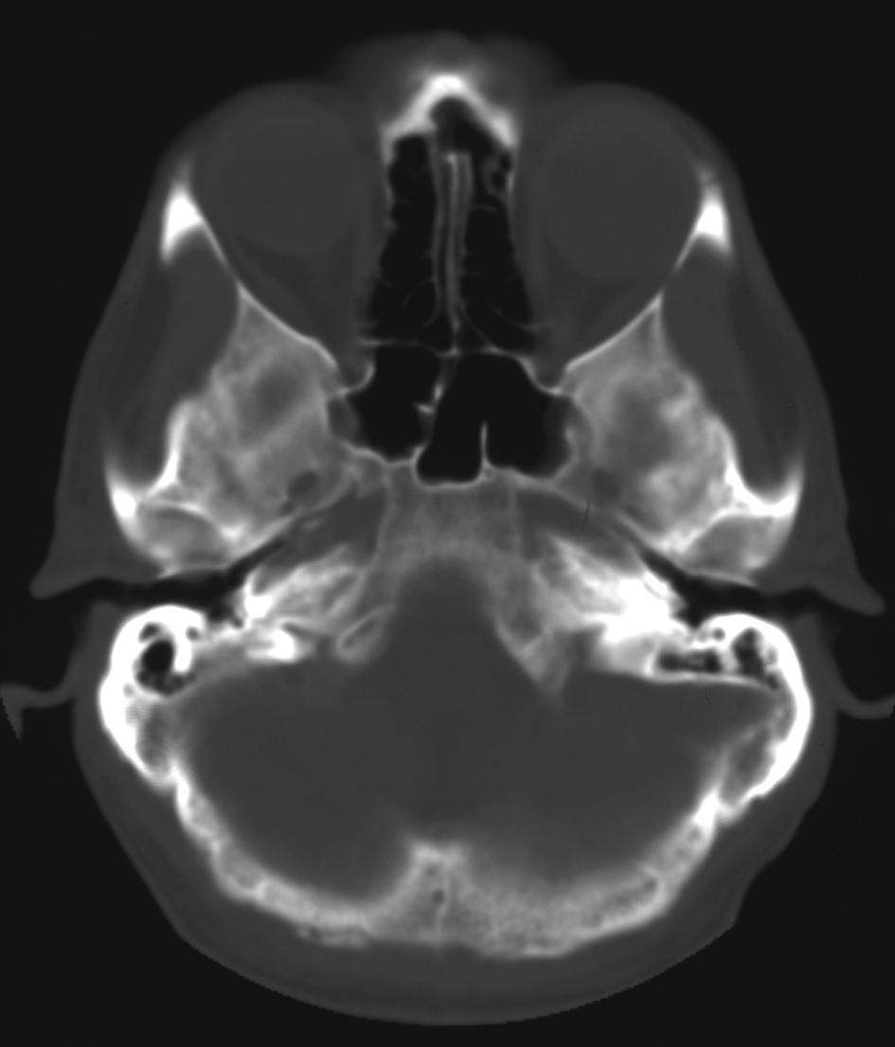
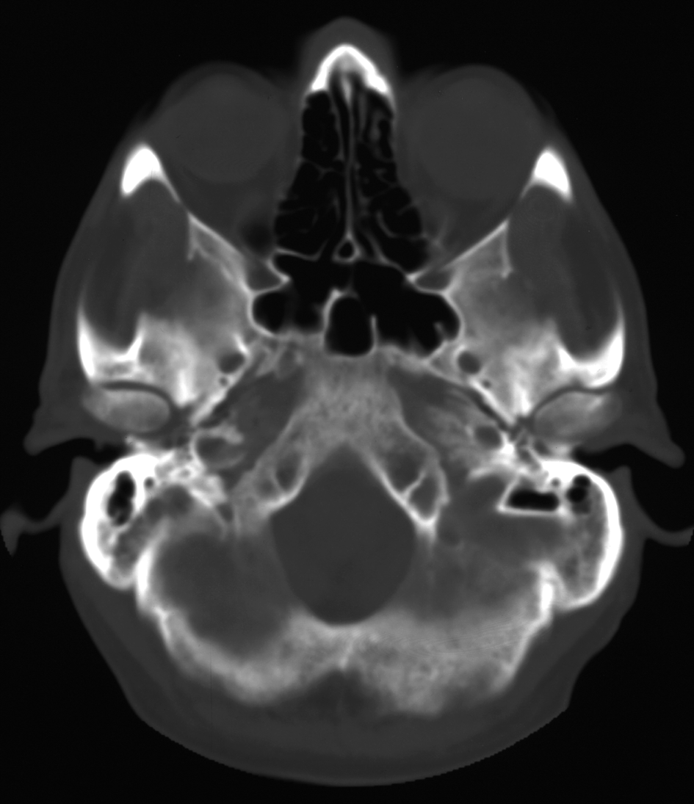
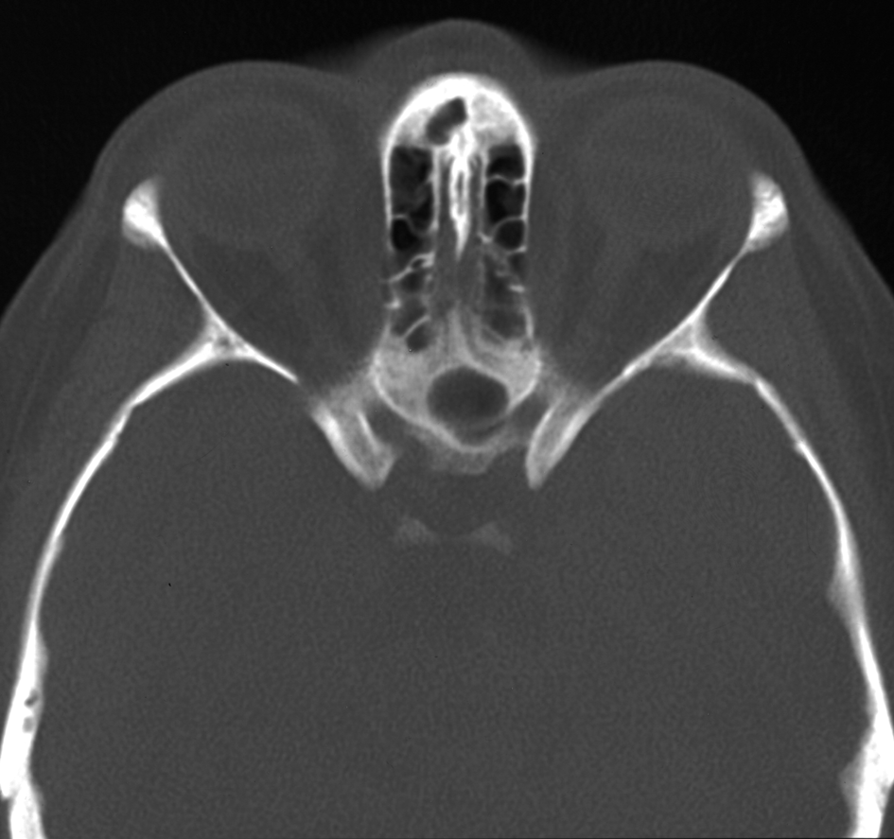
BASE OF SKULL

Slide 21
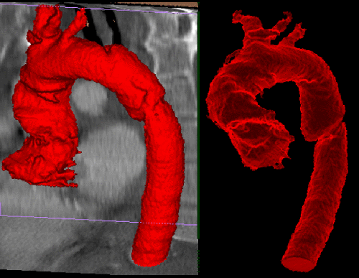
3D volume rendered CTA

Slide 22
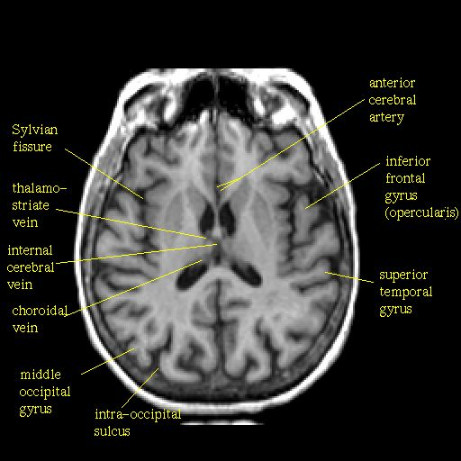
Magnetic Resonance Imaging
Has been in use for > 10 years.
Superior to CT especially posterior fossa and lesions of white matter.
Advantages
High tissue contrast
Absence of bone artifacts
Good analysis of anatomical detail in all three planes.

Slide 23
MRI…contd
Disadvantages
Difficulty visualizing fresh blood
Morphological technique
Long imaging periods. Severe movement artifacts uncooperative patients.
Ferro-magnetic implants e.g. aneurysmal clip contraindicated
Expensive.
Claustrophobia
Noise-due to vibration, patient wears ear defenders
Metallic projectiles-power of magnetic field is substantial metallic objects may cause injury

Slide 25
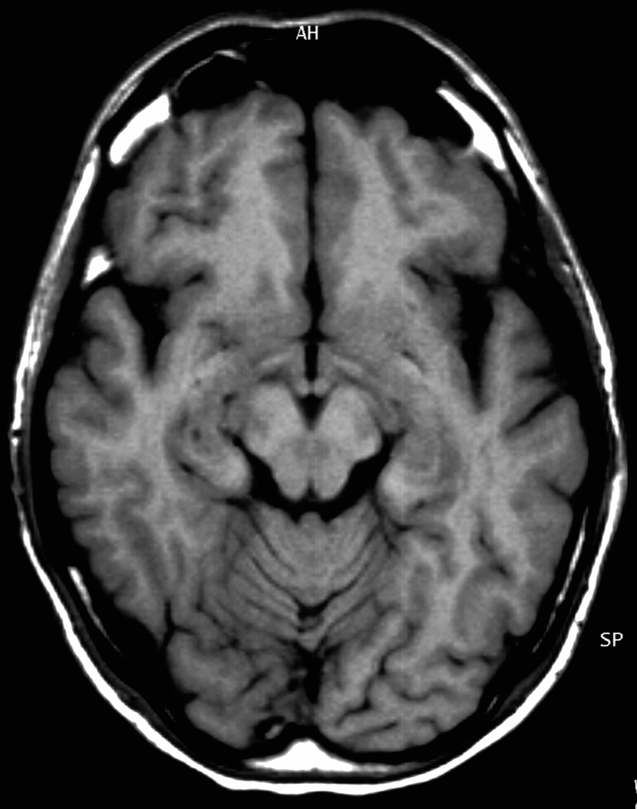
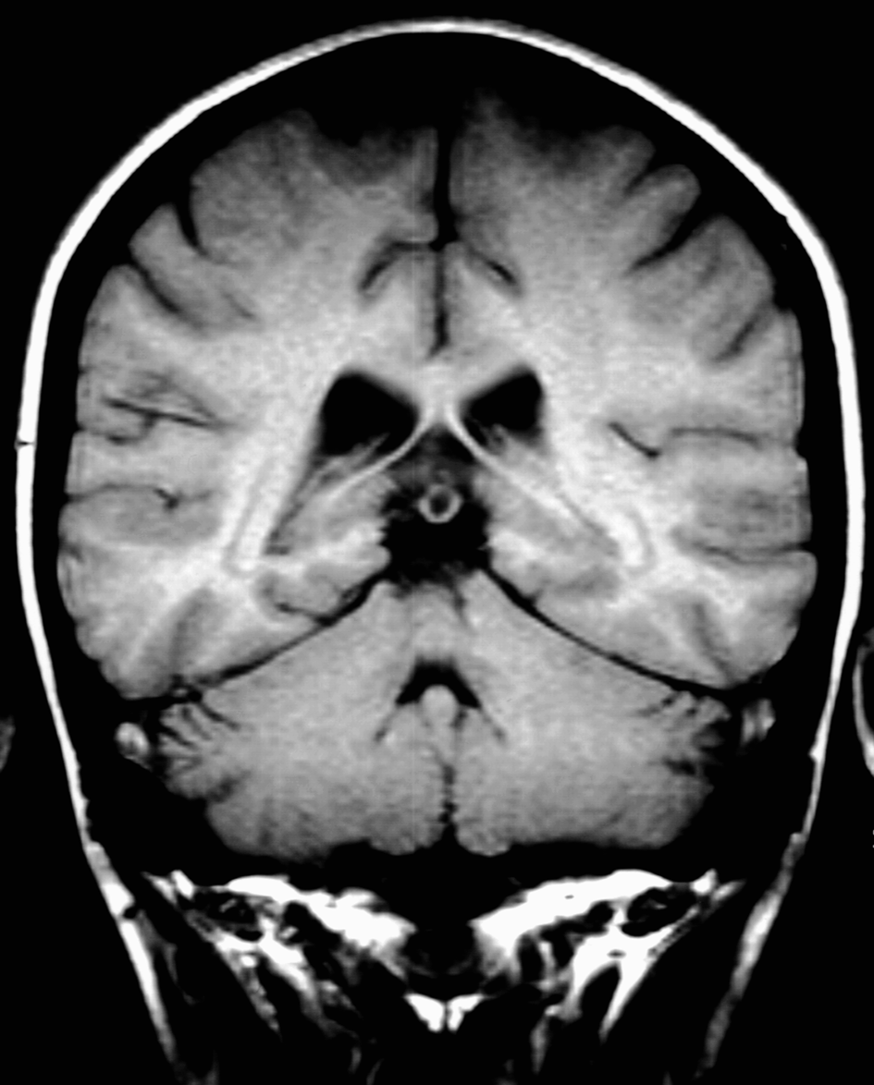
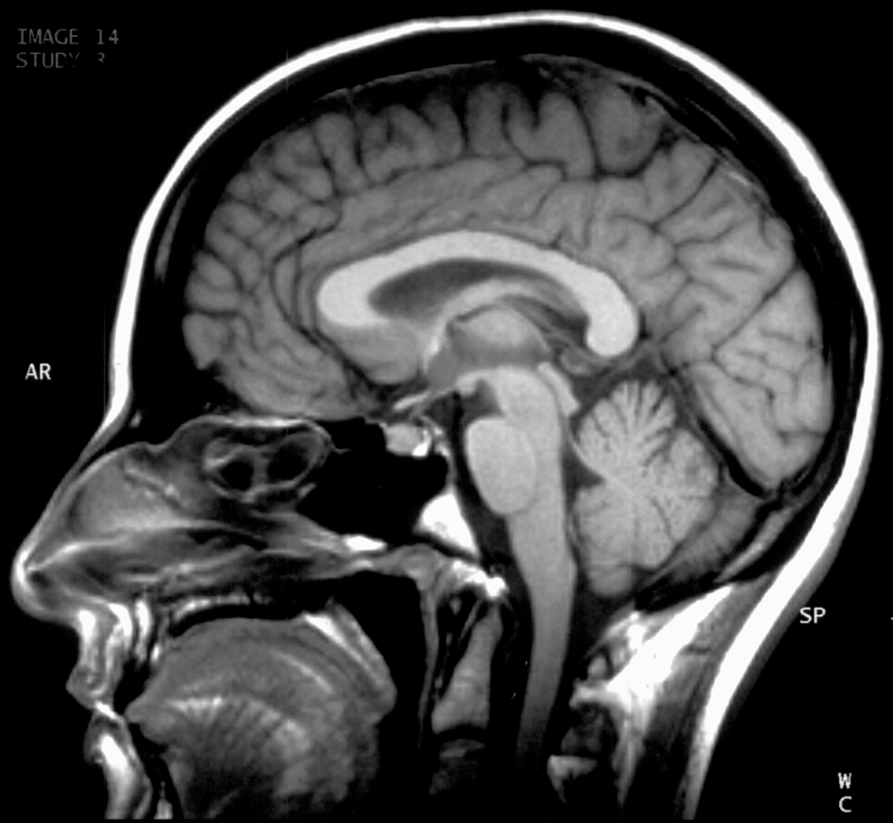
axial
coronal
sagittal

Slide 26
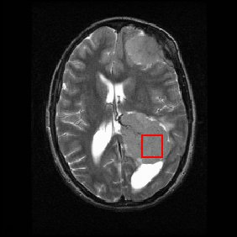
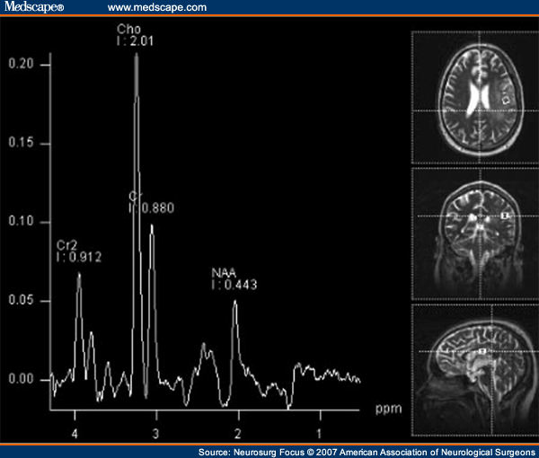
Advances in MRI
MR Spectroscopy-analytical technique used to study metabolic changes in Brain in tumors , infections etc (N- Acetyl Aspartate, Choline, creatinine, lactate, lipids, myo-inositol )
Diffusion Tensor Imaging (DTI)

Slide 27
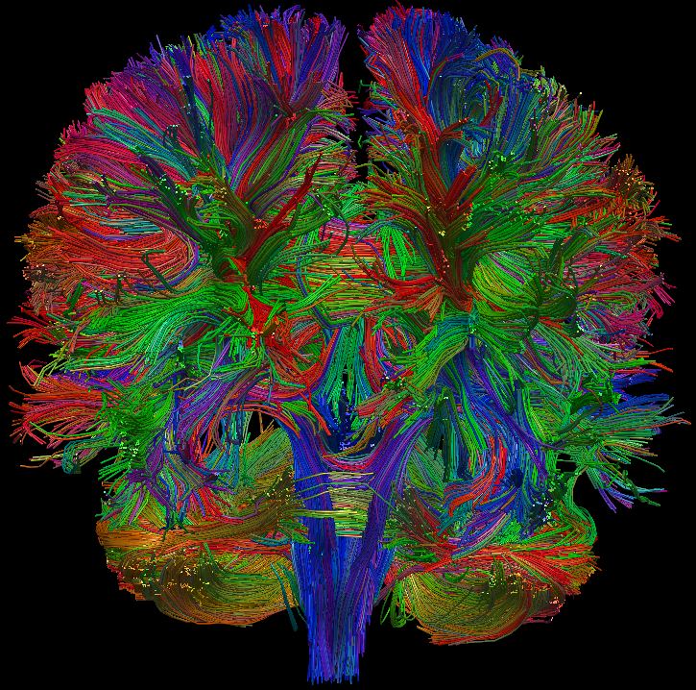
MR Tractography

Slide 28
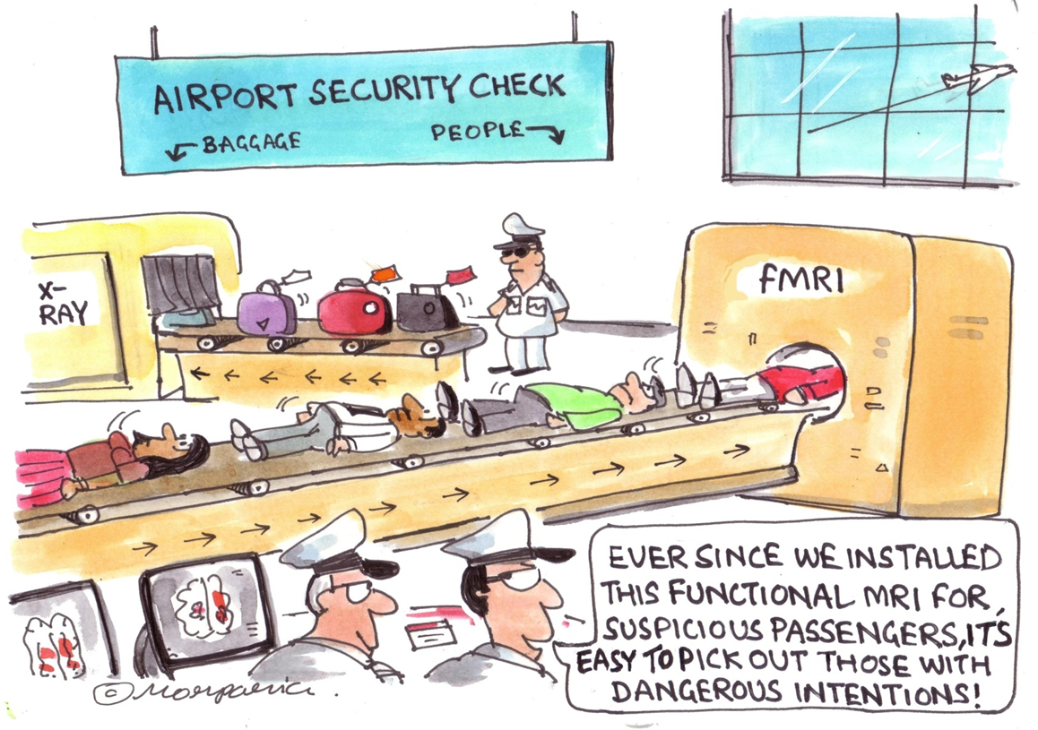
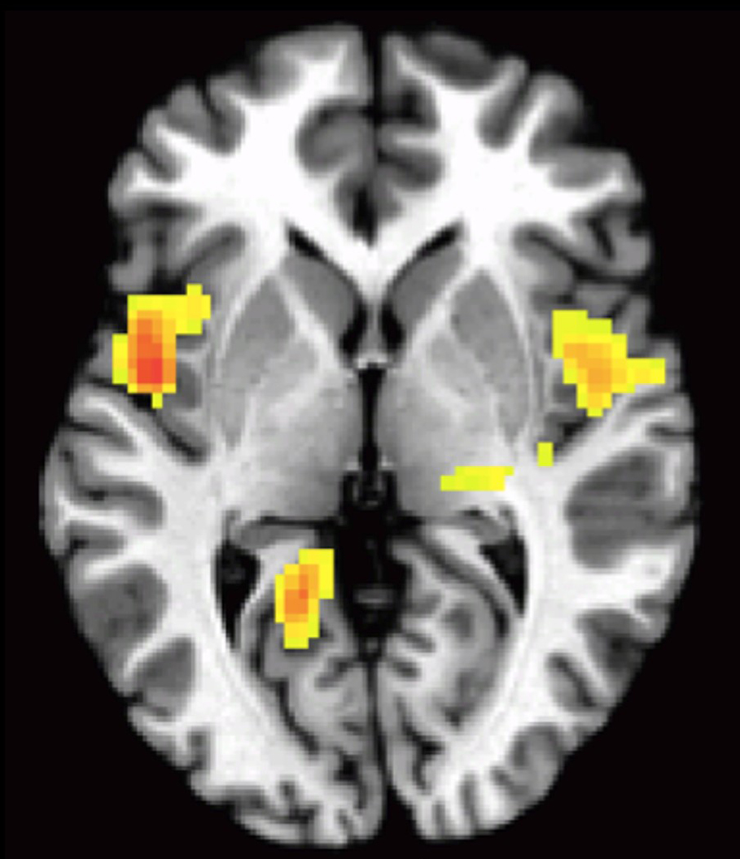
Functional imaging

Slide 29
ANGIOGRAPHY
Invasive technique (transfemoral technique)
Usually preceeded by CT or MRI
performed in :-
- subarachnoid haemorrhage
- arterio-venous malformations (AVM)
- pre-operative evaluation of tumour e.g
meningioma.

Slide 30
Routinely used prior to advent of CT/MRI
Subdural haematoma with midline shift
Extradural haematoma CT

Slide 31
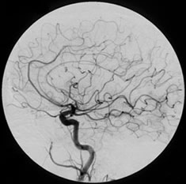
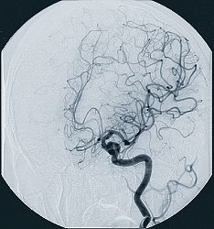
ANGIOGRAPHY
Now reserved for demonstration of vascular injury
Dissections
Ruptures
Pseudo aneurysms
Fistulas

Slide 32
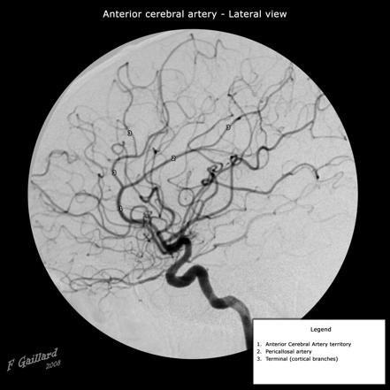
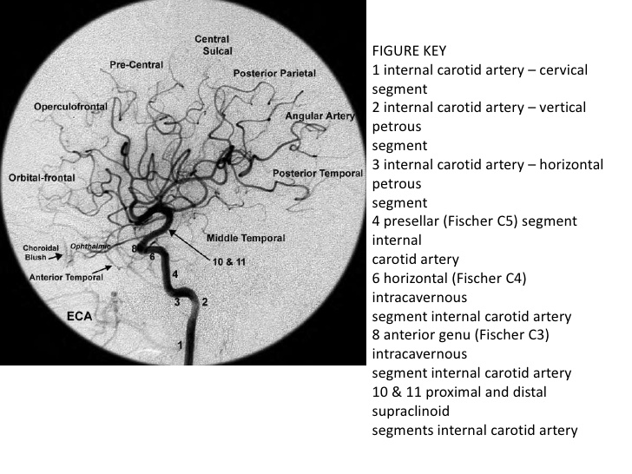

Slide 33
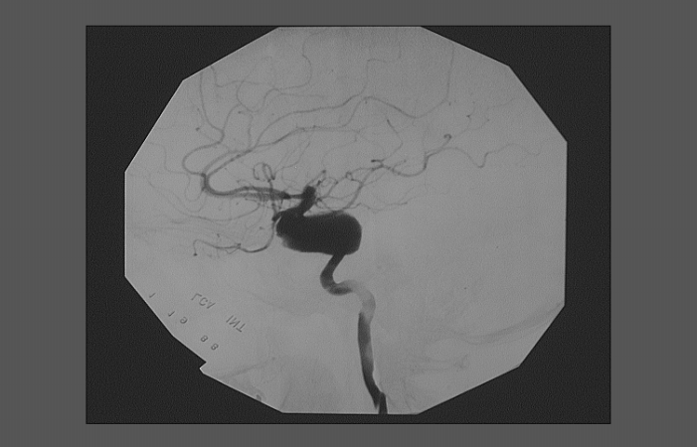
Angio….
INTERVENTIONAL TECHNIQUES
Tumor ablation.
Thrombolysis
Stents
Balloon Angioplasty
Embolization

Slide 34
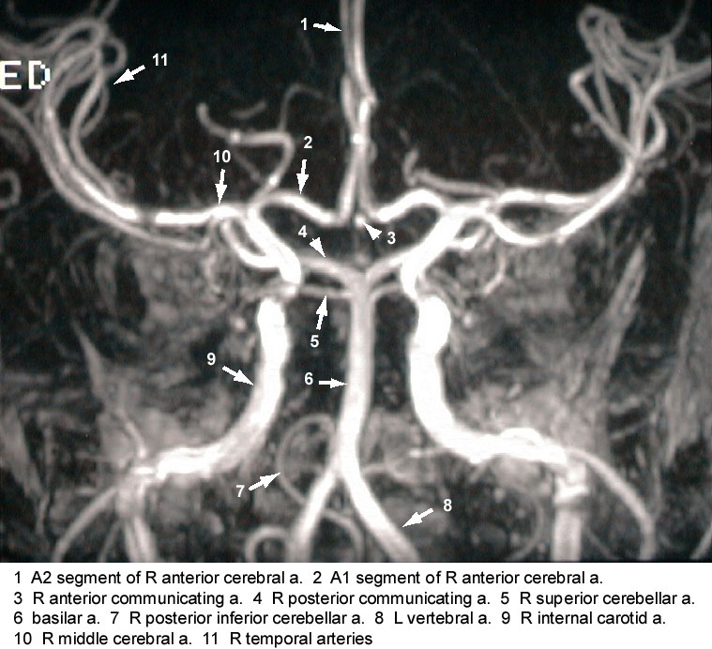
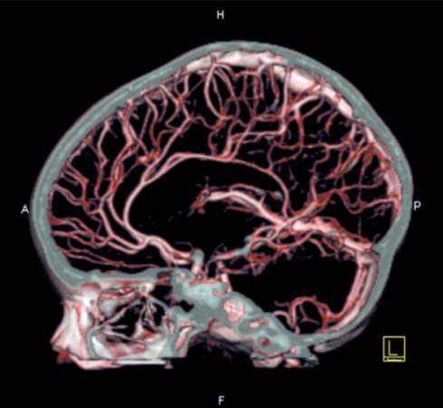
Newer angiography techniques
CT/MR Angiography
3D volume rendered CTA

Slide 35
ULTRASONOGRAPHY
INDICATIONS:
Infant brain
Hydrocephalus/cystic intracranial lesions
Intracranial hemorrhage
Meningitis-monitor progress and complications.
US in-utero;
- anencephaly
-meningocele
-meningomyelocele

Slide 36
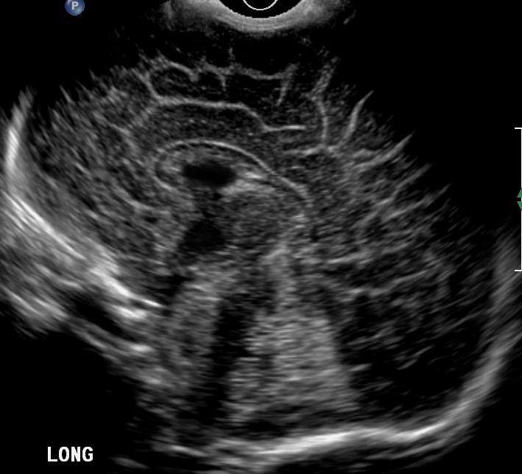
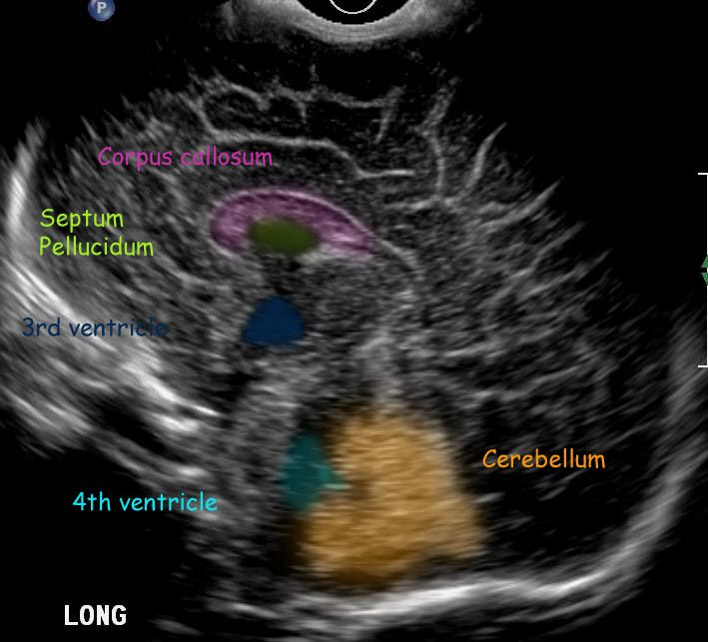
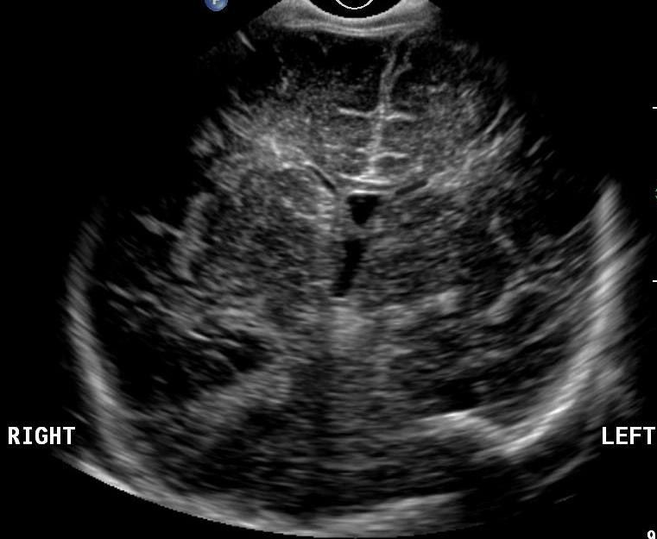
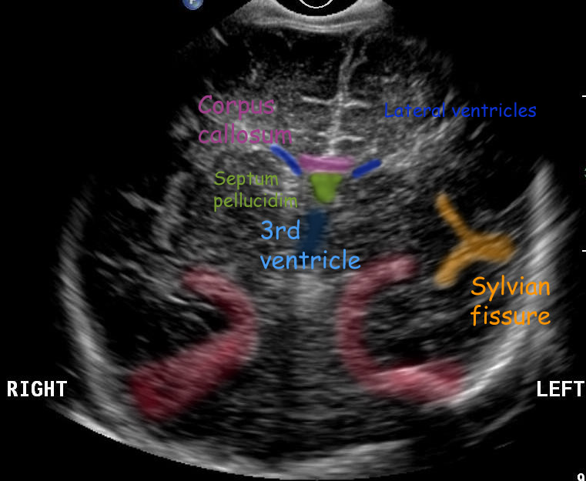
Normal cranial sonograms

Slide 38
A.Hydranencephaly. B.Aquiductal stenosis. C. Dandy-Walker malfomation
B
A
C

Slide 39
RADIONUCLIDE IMAGING
Functional information
Poor spatial resolution resulting in limited morphological information.
Capable of identifying region of interest.

Slide 40
Radionuclide..Contd
1)Positron Emission Tomography(PET)
-Biochemical and functional information.
-Blood volume, blood flow, metabolism
can be studied.
2)Single Photon Emission Tomography
(SPECT)

Slide 42
Positron Emission Tomography (PET)
traces activity and chemical reactions in the brain and body
PET scan of a normal and healthy Brain
who does not do drugs

Slide 43
PET Scan

Slide 44
END END END END

