Slide 1
PREVENTIVE CARDIOLOGY
PROF E N OGOLA

Slide 2
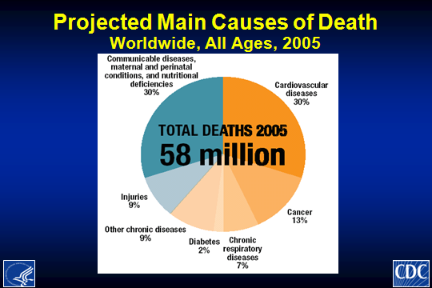

Slide 3
Global Burden of Disease: CVDs cause 1 in 3 deaths worldwide
Estimated global deaths by cause, all ages, 2005
Source : WHO 2005: «Preventing Chronic Diseases: A Vital Investment»

Slide 4
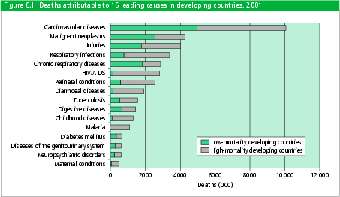

Slide 5
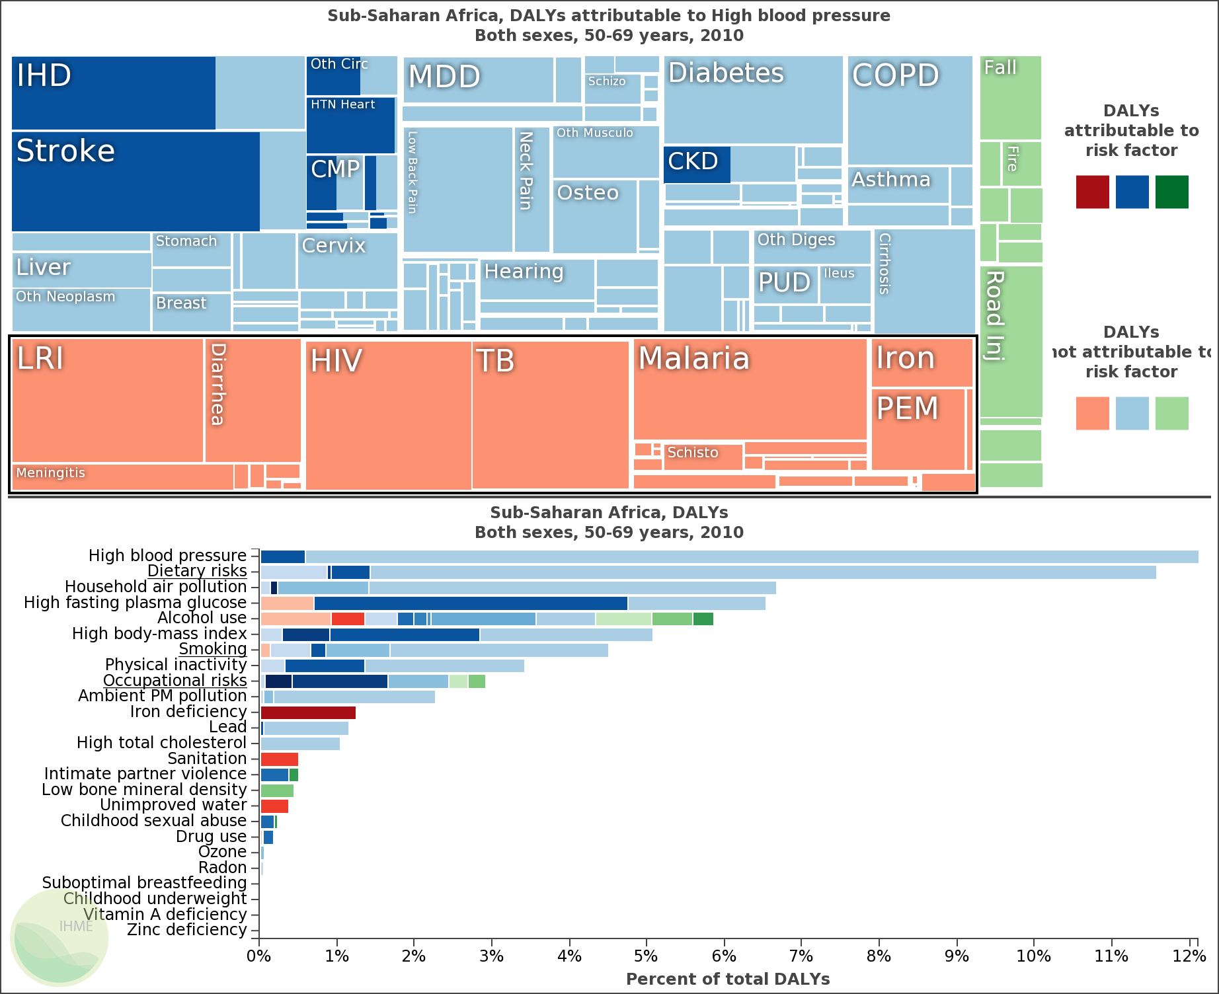
Global burden of disease, DALYS for SSA -2010

Slide 6
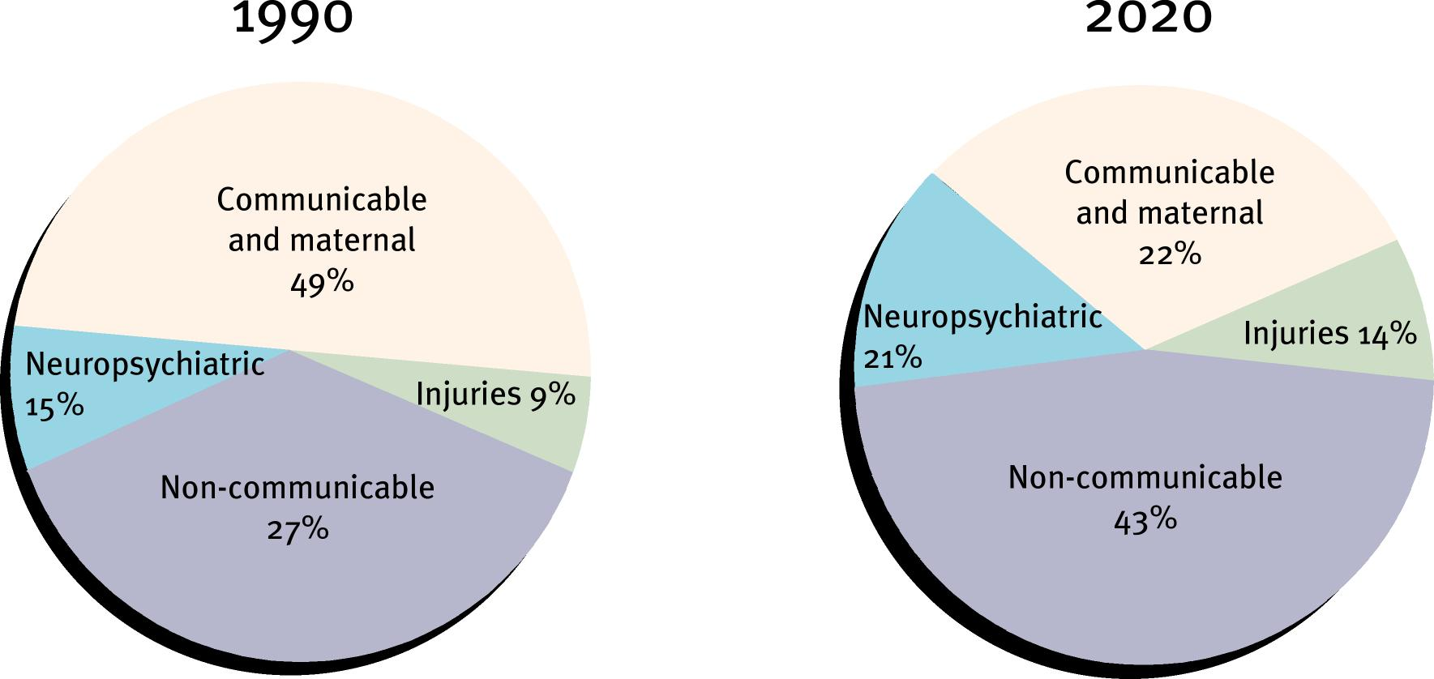
Major causes of DALYs in low and middle income countries

Slide 7
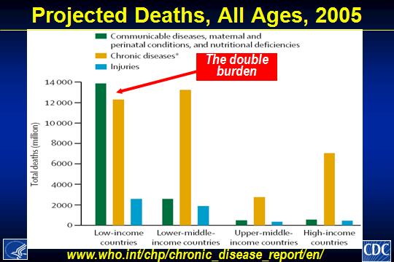

Slide 8
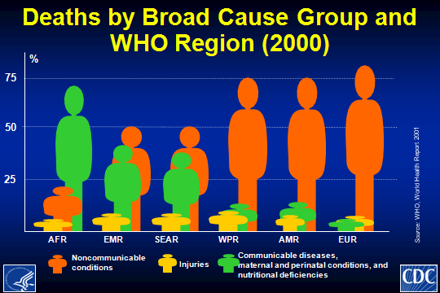

Slide 9
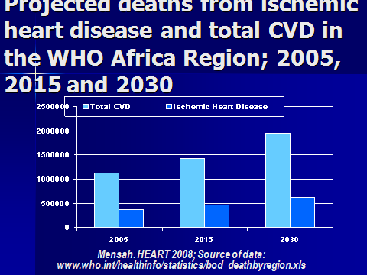

Slide 10

Noncommunicable Diseases
Death trends (2006-2015)
 | 2005 |  | 2006-2015 (cumulative)
Geographical regions (WHO classification) | Total deaths (millions) | NCD deaths (millions) | NCD deaths (millions) | Trend: Death from infectious disease | Trend: Death from NCD
Africa | 10.8 | 2.5 | 28 | +6% | +27%
Americas | 6.2 | 4.8 | 53 | -8% | +17%
Eastern Mediterranean | 4.3 | 2.2 | 25 | -10% | +25%
Europe | 9.8 | 8.5 | 88 | +7% | +4%
South-East Asia | 14.7 | 8.0 | 89 | -16% | +21%
Western Pacific | 12.4 | 9.7 | 105 | +1 | +20%
Total | 58.2 | 35.7 | 388 | -3% | +17%
(WHO Chronic Disease Report, 2005)
WHO projects that over the next 10 years, the largest increase in deaths from cardiovascular disease, cancer, respiratory disease and diabetes will occur in developing countries.
Notes:
10

Slide 11
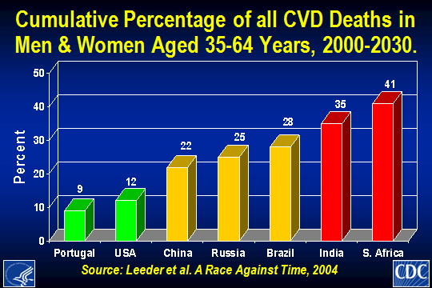

Slide 12
RISK FACTOR CONCEPT
Risk Factor {RF} refers to an exposure that increases an individual’s chance of developing a disease
Distinct from “cause” as in infectious diseases
NCD associated with well defined RF
Cross cut across many NCDs
Often begin in childhood
Related to lifestyle, offering opportunity for intervention
Urbanization a major factor
Apply to all populations, a few RF account for most risk

Slide 13
Proven and proposed modifiable risk factors for CVD
Risk factors
Tobacco smoking
Elevated LDL cholesterol
Low HDL cholesterol
High BP
Diabetes
Physical inactivity
Obesity
Diet
Risk markers
Low socioeconomic status
Elevated fibrinogen
Markers of infection/ inflammation
Elevated homocysteine
Elevated lipoprotein(a)
Psychological factors (e.g. stress, hostility, life events)
Social breakdown (loss of social support and cohesion
Yusuf et al. Circulation 2001; 104: 2746-2753
Notes:
NB Many others e.g. passive smoking

Slide 14
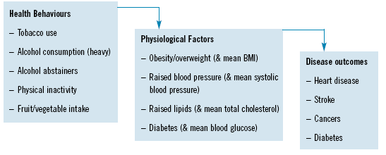

Slide 15
Population Attributable Fractions (PAF) for Ischemic Heart Disease
PAF, Percent
Notes:
Table XX: Population attributable fractions for ischemic heart disease by risk factor in sub-Saharan Africa and the world.
Source of Data: Ezzati M, Vander Hoorn S, Lopez AD, et al. Comparative quantification of mortality and burden of disease attributable to selected risk factors. In: Lopez AD, Mathers CD, Ezzati M, Murray CJL, Jamison DT, eds. Global burden of disease and risk factors. New York: Oxford University Press; 2006: 241–68.

Slide 16
POPULATION ATTRIBUTABLE RISK (PAR) OF COMBINATIONS OF RISK FACTORS
Risk Factor | RR (95% CI) | PAR (95% CI)
Current and former smoking, diabetes, hypertension
Overall Interheart Study | 13.04 (11.63,14.62) | 57.72 (56.04,59.38)
Overall Africa population | 17.35 (10.51,28.66) | 64.46 (56.69,71.54)
Black Africans | 37.96 (14.10,102.23) | 56.95 (43.46,70.44)
Coloured Africans | 7.67 (3.69,15.93) | 61.47 (45.92,74.98)
European/other Africans | 32.72 (8.52,125.74) | 69.49 (52.42,82.49)
Current and former smoking, diabetes, hypertension + Apob/a ratio (tertiles 2,3 vs 1)
Overall Interheart Study | 22.83 (19.69,26.47) | 74.24 (72.44,75.97)
Overall Africa population | 28.89 (14.83,56.29) | 80.62 (72.73,86.65)
Black Africans | 89.64 (24.52,327.66) | 73.80 (58.19,85.08)
Coloured Africans | 14.29 (5.35,38.14) | 80.98 (66.07,90.30)
European/other Africans | 130.76 (15.50,1103.02) | 92.59 (78.71,97.69)
Current and former smoking, diabetes, hypertension + Apob/a ratio (tertiles 2,3 vs 1)+waist/hip ratio (tertiles 2,3 vs 1)
Overall Interheart Study | 27.78 (23.64,32.65) | 78.41 (76.59,80.12)
Overall Africa population | 49.28 (22.75,106.75) | 89.18 (82.77,93.39)
Black Africans | 136.50 (30.71,606.66) | 83.74 (68.42,92.44)
Coloured Africans | 22.06 (7.28,66.85) | 89.14 (77.02,95.26)
European/other Africans | 1622.56 (95.49,27569.75) | 99.13 (94.82,99.86)

Slide 17
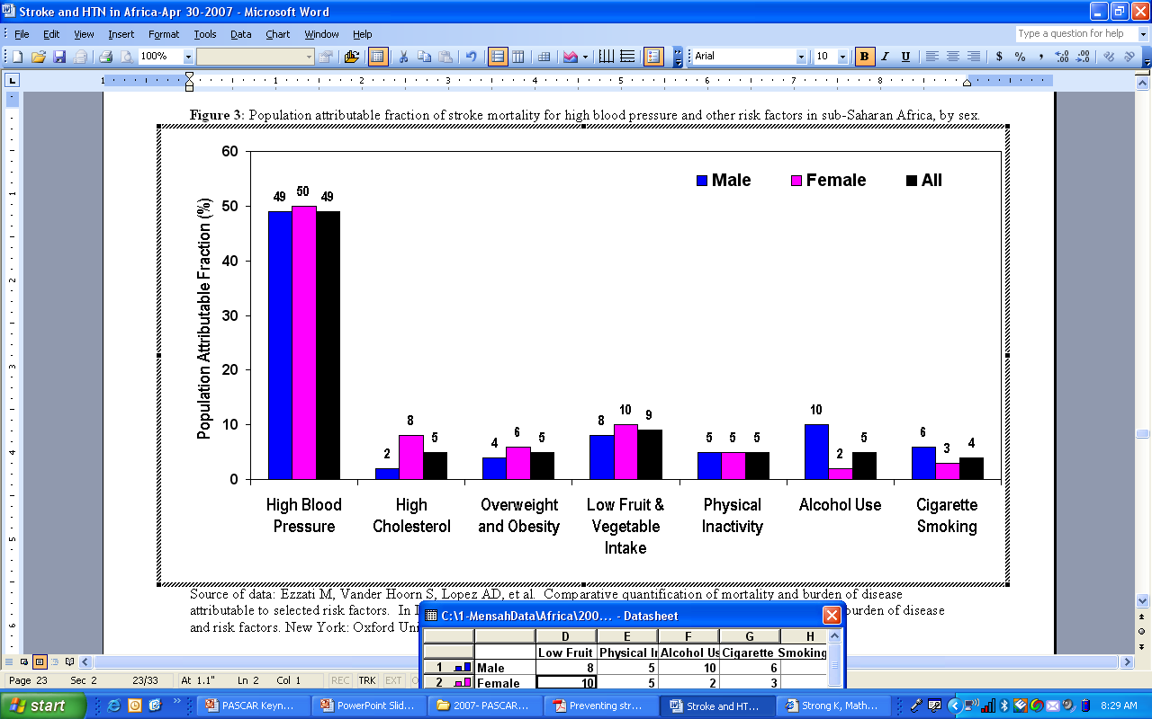
Population Attributable Fraction of Stroke Mortality for Various Risk Factors in Sub-Saharan Africa
Mensah, HEART 2008; Source of data: Ezzati, et al. Global Burden of Disease and Risk Factors, 2006
Notes:
Ezzati M, Vander Hoorn S, Lopez AD, et al. Comparative quantification of mortality and burden of disease attributable to selected risk factors. In Lopez AD, Mathers CD, Ezzati M, Murray CJL, Jamison DT, eds. Global burden of disease and risk factors. New York: Oxford University Press 2006:241–68

Slide 18
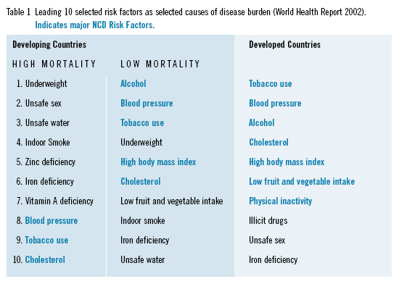

Slide 19
HYPERTENSION
Donnison: Lancet (1929). No hypertension in 1800 consecutive admissions of “Natives” in Kavirondo

Slide 20
Epidemiology of Hypertension in Africa

Slide 21
HYPERTENSION
Small studies in 80s, prevalence of 5 – 8%
Nakuru district (Mathenge et al)
  App 5000 subjects , ≥ 50 years
  Prevalence – 50.1% (47.5-52.6): Urban 57% vs. Rural 47% ; OR 1,7 (1.5-1.9)
  Awareness 15%, control 29%
Kibera slums, Nairobi (Njau et al)
  Young poulation (60% < 35 years), low SE class
  Overall prevalence 13%
  Progressive increase with age: 35-44 – 31%; 45-54 – 43%

Slide 22
HYPERTENSION
Garissa (Hassan)
  Young population, mean age 35years, 82% < 50years
  Overall prevalence 12.6% (11.1-14.2)
  Age: 50-57 – 26.3%; 58-65 – 23.4%; >65 – 38.5%
Korogocho, Viwandani slums (Vijver et al)
  Prevalence 19.1%
  Awareness 21%, treatment 15%, control 5%
  Age: 40-49 -18.7%; 50-59 – 28.2%; 50-59 – 42.8%

Slide 23
DIABETES MELLITUS
Nakuru
  Overall prevalance– 6.6 % (5.6-7.7)
  Urban > Rural, up to 14-16% in selected populations
Kibera (Wanjiru)
  Young age group; mean 33.4, ≥ 55 yrs only 5.2%
  Prevalence – 3.2%
Garissa
  Prevalence 3.7% (2.9-4.7)
  Associated with age, sex(m>f), obesity, hypertension

Slide 24
OBESITY
Nakuru
  Overall prevalence – 13 %
  Urban > Rural: Overweight 20 vs 10%; Obesity 30 vs 19%. Also higher mean WHR
Garissa
  Overweight – 23.9% (21.9-25.9)
  Obesity by BMI – 12.6% (11.3-14.3)
  Central obesity – 20.4% (18.5-22.3)
Kibera
  Overweight 28.7%
  Obesity (BMI) – 16.3%
  Central obesity – 13.1%

Slide 25
TOBACCO
Garissa – 5.2%
Kibera – 13.1%
Nakuru – Urban 8%, Rural 7%
Predominantly cigarette smoking
Almost exclusively male

Slide 26
DYSLIPIDAEMIA
Nakuru High cholesterol 21.1% (18.6- 23.9)
Hassan : 16.9% (11-24.3)

Slide 27
Control Rate at KNH

Slide 28
EPIDEMOLOGICAL TRANSITION
Shift from nutritional deficiencies and infectious diseases to chronic degenerative diseases
Associated with demographic transition;
- Better sanitation
- Food availability, change in nutritional patterns
- Less energy expenditure
- Increased life expectancy
New habits e.g. smoking
Urbanization critical component, especially in Africa

Slide 29
OTHER CVDs
RHD
Pericardial disease esp in context of HIV/TB
Cardiomyopathies – EMF, peripartum, alcoholic, nutritional deficiencies
HIV - ?atherosclerosis, cardiomyopathy, PHT
Congenital heart disease

Slide 30
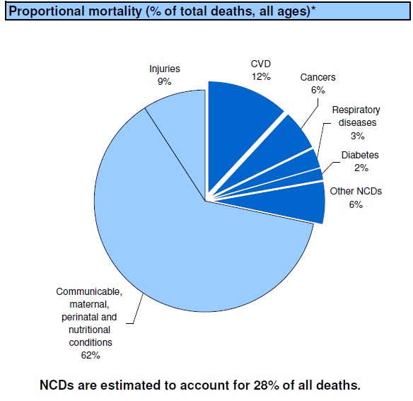

Slide 31
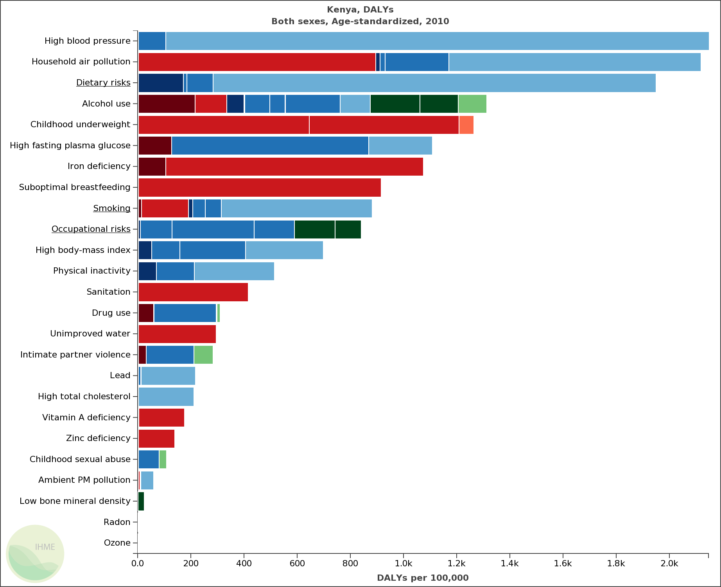
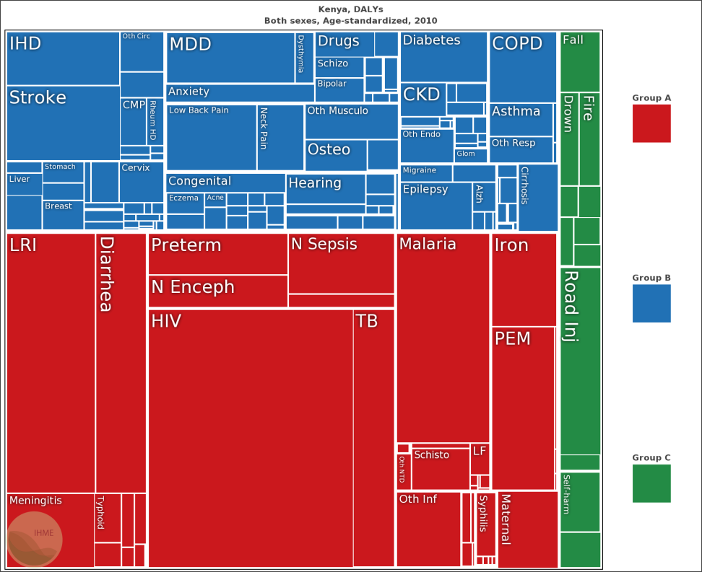
DALYS KENYA- 2010

Slide 32
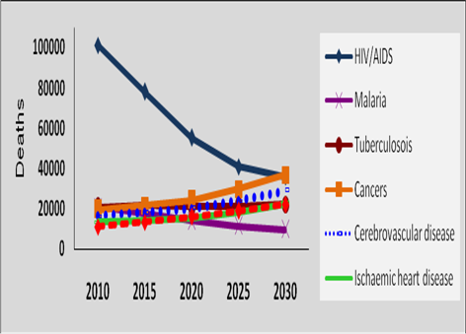
Trends of major diseases

Slide 33
CVDS ARE TO A GREAT EXTENT
PREVENTABLE DISEASES
Medical evidence for prevention exists.
Population-based prevention is the most cost-effective and the only affordable option for major public health improvement in CVD rates.
Major changes in population rates can take place in a surprisingly short time.

Slide 34
LEVELS OF PREVENTION
Primordial
Primary
Secondary
Tertiary

Slide 35
Population strategy and high-risk strategy
Population approach
Distribution density
Original distribution
Combined strategies
Distribution density
Risk factor
Distribution density
High risk approach
Risk factor
Risk factor
Density distribution
Risk factor

Slide 36
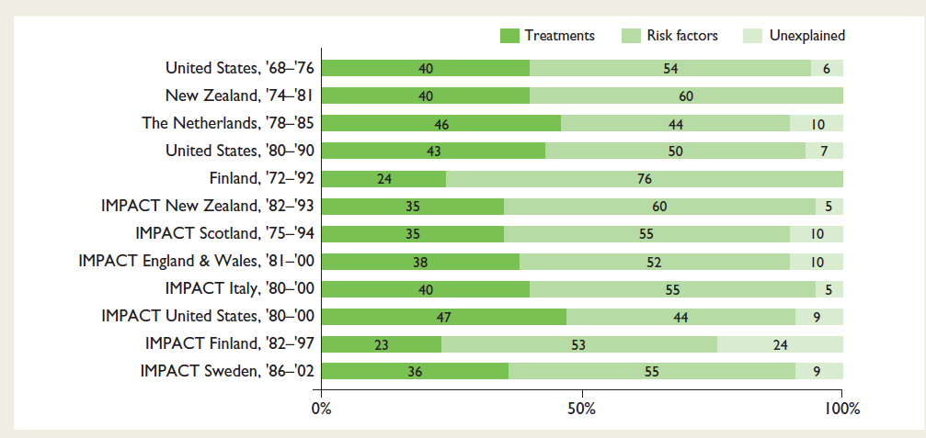

Slide 37
SEVEN OF THE TEN TOP DETERMINANTS
OF MORTALITY IN THE WORLD
RELATE TO HOW WE EAT, DRINK AND MOVE
  DIET AND PHYSICAL ACTIVITY, TOGETHER WITH TOBACCO AND ALCOHOL, ARE KEY DETERMINANTS OF CONTEMPORARY PUBLIC HEALTH

Slide 38
COMBING PERSONAL AND PUBLIC RESPONSIBILITIES
Personal Responsibility
”Nobody can take better care of your health than yourself”
Public Responsibility
”Make the healthy choices the easy ones”
(Ottawa declaration)

Slide 39
Does it work
YES – PLENTY OF EVIDENCE

Slide 40
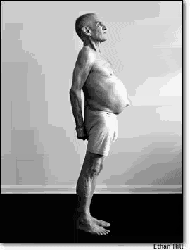
"You must be the change you wish to see in the world."
Mahatma Gandhi

Slide 41
