Slide 1
Ischemic heart disease
Dr Martin M Murage

Slide 2
Ischemia refers to lack of oxygen due to inadequate perfusion of the myocardium causing an imbalance between oxygen supply and demand
Most common cause is obstructive atherosclerotic disease of the epicardial coronary arteries

Slide 3
Coronary circulation is unique its responsible for generating the arterial pressure that is required for systemic perfusion,
myocardial perfusion is impeded during systolic contraction: there is an increase in tissue pressure , circulation is redistributed from the subendocardial layers of the heart to the subepicardial , impedes coronary artery inflow ,reduces the diameter of the intramyocardial microcirculatory vessels, increases coronary venous outflow,
in diastole coronary arterial inflow increases with a gradient that favours perfusion to the subendocardial layers.

Slide 4
Myocardial oxygen extraction is 75% at rest
Increases in myocardial oxygen consumptions are met by increases in coronary blood flow and oxygen delivery
Oxygen delivery is directly determined by arterial oxygen content PaO2
Determinants of myocardial oxygen consumption are heart rate, systolic pressure(myocardial wall stress), and LV contractility
A 2 fold increase in any of these determinants requires a approx. 50% increase in coronary blood flow.

Slide 5
The classic manifestation of ischemia is angina described as heavy chest pressure or squeezing ,burning feeling or difficulty in breathing , pain may radiate to the left shoulder or arm , neck
Builds in intensity over few minutes , may develop with exercise or psychological stress , may occur without any precipitating factors

Slide 6
Ischemic heart disease can be present as acute coronary syndrome or as stable angina secondary chronic coronary artery disease .
with acute chest pain and persistent (>20 min) ST-segment elevation.
This condition is termed ST-elevation ACS and generally reflects an acute total coronary occlusion. Most patients will ultimately develop an ST-elevation myocardial infarction (STEMI)

Slide 7
acute chest pain but no persistent ST-segment elevation.
ECG changes may include transient ST-segment elevation, persistent or transient ST-segment depression, T-wave inversion, flat T waves or pseudo-normalization of T waves or the ECG may be normal.

Slide 8
spectrum of non-ST-elevation ACS (NSTE-ACS) may range from patients free of symptoms at presentation to individuals with ongoing ischaemia, electrical or haemodynamic instability or cardiac arrest.
The pathological correlate at the myocardial level is cardiomyocyte necrosis [NSTE-myocardial infarction (NSTEMI)] or, less frequently, myocardial ischaemia without cell loss (unstable angina)

Slide 9
Acute myocardial infarction (MI) defines cardiomyocyte necrosis in a clinical setting consistent with acute myocardial ischaemia.
A combination of criteria is required to meet the diagnosis of acute MI, namely the detection of an increase and/or decrease of a cardiac biomarker, preferably high-sensitivity cardiac troponin, with at least one value above the 99th percentile of the upper reference limit and at least one of the following:

Slide 10
Symptoms of ischaemia.
New or presumed new significant ST-T wave changes or left bundle branch block on 12-lead ECG.
Development of pathological Q waves on ECG.
Imaging evidence of new or presumed new loss of viable myocardium or regional wall motion abnormality.
Intracoronary thrombus detected on angiography or autopsy

Slide 11
Type 1 MI
characterized by atherosclerotic plaque rupture, ulceration, fissure, erosion or dissection with resulting intraluminal thrombus in one or more coronary arteries leading to decreased myocardial blood flow and/or distal embolization and subsequent myocardial necrosis.
The patient may have underlying severe coronary artery disease (CAD) but, on occasion (i.e. 5–20% of cases), there may be non-obstructive coronary atherosclerosis or no angiographic evidence of CAD, particularly in women.

Slide 12
Type 2 MI
myocardial necrosis in which a condition other than coronary plaque instability contributes to an imbalance between myocardial oxygen supply and demand.
Mechanisms include coronary artery spasm, coronary endothelial dysfunction, tachyarrhythmias, bradyarrhythmias, anaemia, respiratory failure, hypotension and severe hypertension.
In addition, in critically ill patients and in patients undergoing major non-cardiac surgery, myocardial necrosis may be related to injurious effects of pharmacological agents and toxins.⁶

Slide 13
type 3 MI (MI resulting in death when biomarkers are not available)
type 4 and 5 MI (related to percutaneous coronary intervention [PCI] and coronary artery bypass grafting [CABG], respectively).

Slide 14
Unstable angina is defined as myocardial ischaemia at rest or minimal exertion in the absence of cardiomyocyte necrosis.
Compared with NSTEMI patients, individuals with unstable angina do not experience myocardial necrosis, have a substantially lower risk of death and appear to derive less benefit from intensified antiplatelet therapy as well as early invasive strategy.

Slide 15
Anginal pain in NSTE-ACS patients may have the following presentations:
Prolonged (>20 min) anginal pain at rest;
New onset (de novo) angina (class II or III of the Canadian Cardiovascular Society classification)
Recent destabilization of previously stable angina with at least Canadian Cardiovascular Society Class III angina characteristics (crescendo angina); or

Slide 16
Post-MI angina.
Prolonged and de novo/crescendo angina are observed in ∼80% and ∼20% of patients, respectively. Typical chest pain is characterized by a retrosternal sensation of pressure or heaviness (‘angina’) radiating to the left arm (less frequently to both arms or to the right arm), neck or jaw, which may be intermittent (usually lasting several minutes) or persistent.
Additional symptoms such as sweating, nausea, abdominal pain, dyspnoea and syncope may be present

Slide 17
Atypical presentations include epigastric pain, indigestion-like symptoms and isolated dyspnoea.
Atypical complaints are more often observed in the elderly, in women and in patients with diabetes, chronic renal disease or dementia.
The exacerbation of symptoms by physical exertion and their relief at rest increase the probability of myocardial ischaemia. The relief of symptoms after nitrates administration is not specific for anginal pain as it is reported also in other causes of acute chest pain.

Slide 18
In patients presenting with suspected MI , Older age, male gender, family history of CAD, diabetes, hyperlipidaemia, hypertension, renal insufficiency, previous manifestation of CAD as well as peripheral or carotid artery disease increase the likelihood of ACS.
Conditions that may exacerbate or precipitate-ACS include anaemia, infection, inflammation, fever, and metabolic or endocrine (in particular thyroid) disorders.

Slide 19
Physical examination
May be unremarkable in patients with suspected NSTE-ACS.
Signs of heart failure or haemodynamic or electrical instability
systolic murmur due to ischaemic mitral regurgitation, which is associated with poor prognosis, or aortic stenosis (mimicking ACS)
systolic murmur may indicate a mechanical complication (i.e. papillary muscle rupture or ventricular septal defect) of a subacute and possibly undetected MI.
signs of non-coronary causes of chest pain (e.g. pulmonary embolism, acute aortic syndromes, myopericarditis, aortic stenosis)
extracardiac pathologies (e.g. pneumothorax, pneumonia or musculoskeletal diseases). In this setting, the presence of a chest pain that can be reproduced by exerting pressure on the chest wall has a relatively high negative predictive value for NSTE-ACS

Slide 20
According to the presentation, abdominal disorders (e.g. oesophageal spasm, oesophagitis, gastric ulcer, cholecystitis, pancreatitis) may also be considered in the differential diagnosis.
Differences in blood pressure between the upper and lower limbs or between the arms, irregular pulse, jugular vein distension, heart murmurs, friction rub and pain reproduced by chest or abdominal palpation are findings suggestive of alternative diagnoses.
Pallor, sweating or tremor may point towards precipitating conditions such as anaemia and thyrotoxicosis

Slide 21
The resting 12-lead ECG is the first-line diagnostic tool in the assessment of patients with suspected ACS . It is recommended to obtain it within 10 min of the patient's arrival in the emergency room or, ideally, at first contact with emergency medical services in the pre-hospital setting and to have it immediately interpreted by a qualified physician.
While the ECG in the setting of NSTE-ACS may be normal in more than one-third of patients, characteristic abnormalities include ST depression, transient ST elevation and T-wave changes

Slide 22
Measurement of a biomarker of cardiomyocyte injury, preferably high-sensitivity cardiac troponin, is mandatory in all patients with suspected NSTE-ACS.
Cardiac troponins are more sensitive and specific markers of cardiomyocyte injury than creatine kinase (CK), its MB isoenzyme (CK-MB) and myoglobin.
In patients with MI, levels of cardiac troponin rise rapidly (i.e. usually within 1 h if using high-sensitivity assays) after symptom onset and remain elevated for a variable period of time (usually several days)

Slide 23
echocardiography should be routinely available in emergency rooms and chest pain units and performed/interpreted by trained physicians in all patients during hospitalization for NSTE-ACS.
useful to identify abnormalities suggestive of myocardial ischaemia or necrosis (i.e. segmental hypokinesia or akinesia).
In the absence of significant wall motion abnormalities, impaired myocardial perfusion detected by contrast echocardiography or reduced regional function using strain and strain rate imaging might improve the diagnostic and prognostic value of conventional echocardiography

Slide 24
In patients without ischaemic changes on 12-lead ECGs and negative cardiac troponins (preferably high-sensitivity) who are free of chest pain for several hours, stress imaging can be performed during admission or shortly after discharge. Stress imaging is preferred over exercise ECG due to its greater diagnostic accuracy.
Various studies have shown that normal exercise, dobutamine or dipyridamole stress echocardiograms have high negative predictive value for ischaemia and are associated with excellent patient outcomes.
stress echocardiography demonstrated superior prognostic value over exercise ECG.
The addition of contrast may improve endocardial border detection, which may facilitate detection of ischaemia.

Slide 25
Cardiac magnetic resonance (CMR) can assess both perfusion and wall motion abnormalities, and patients presenting with acute chest pain with a normal stress CMR have an excellent short- and midterm prognosis.
CMR also permits detection of scar tissue (using late gadolinium enhancement) and can differentiate this from recent infarction (using T2-weighted imaging to delineate myocardial oedema).
Moreover, CMR can facilitate the differential diagnosis between infarction and myocarditis or Tako–Tsubo cardiomyopathy

Slide 26
Multidetector computed tomography (MDCT) allows for visualization of the coronary arteries and a normal scan excludes CAD

Slide 27
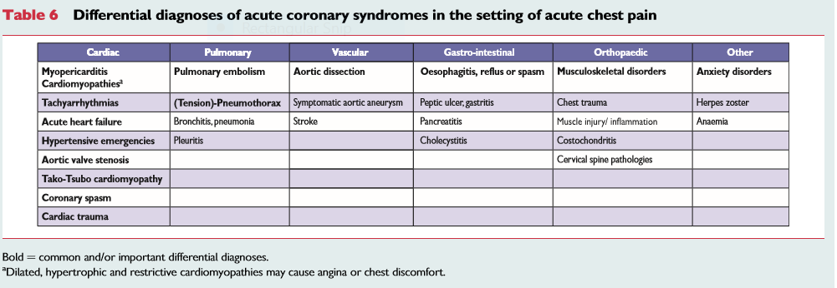

Slide 29
pharmacological treatment
anti-ischaemic therapy to decrease myocardial oxygen demand (secondary to a decrease in heart rate, blood pressure, preload or myocardial contractility) or to increase myocardial oxygen supply (by administration of oxygen or through coronary vasodilation).

Slide 30
Oxygen: should be administered when blood oxygen saturation is <90% or if the patient is in respiratory distress.
Nitrates :Intravenous nitrates are more effective than sublingual nitrates with regard to symptom relief and regression of ST depression
Beta-blockers:Beta-blockers competitively inhibit the myocardial effects of circulating catecholamines and reduce myocardial oxygen consumption by lowering heart rate, blood pressure and myocardial contractility

Slide 31
Platelet inhibition ;
Aspirin irreversibly inactivates the cyclooxygenase (COX) activity of platelet prostaglandin endoperoxide (PGH) synthase 1 (COX-1), thereby suppressing thromboxane A₂ production throughout the platelet lifespan
Clopidogrel, P2Y₁₂ inhibitors Clopidogrel (300–600 mg loading and 75 mg/day maintenance dose) is an inactive prodrug that requires oxidation by the hepatic cytochrome P450 (CYP) system to generate an active metabolite
Prasugrel (60 mg loading and 10 mg/day maintenance dose) is a prodrug that irreversibly blocks platelet P2Y₁₂ receptors with a faster onset and a more profound inhibitory effect than clopidogrel

Slide 32
Ticagrelor is an oral, reversibly binding P2Y₁₂ inhibitor with a plasma half-life of 6–12 h.
Cangrelor is an i.v. adenosine triphosphate (ATP) analogue that binds reversibly and with high affinity to the platelet P2Y₁₂ receptor and has a short plasma half-life (<10 min)
Glycoprotein IIb/IIIa inhibitors Intravenous GPIIb/IIIa inhibitors block platelet aggregation by inhibiting fibrinogen binding to a conformationally activated form of the GPIIb/IIIa receptor on two adjacent platelets

Slide 33
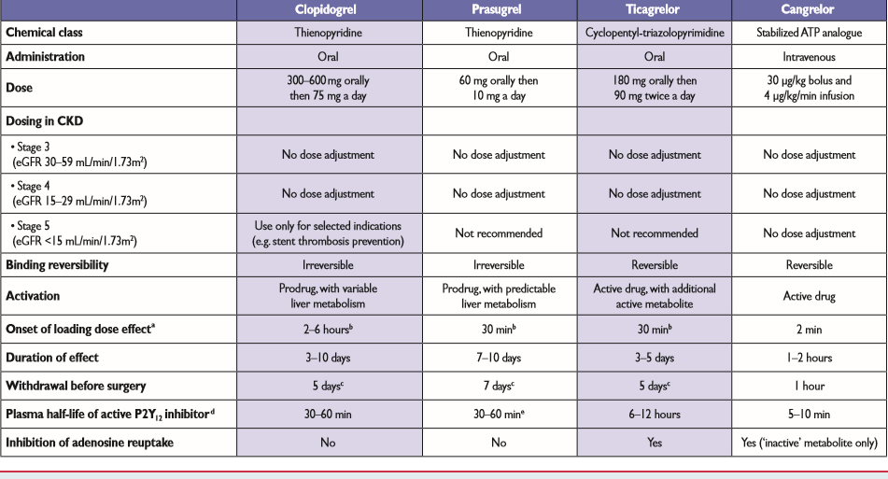

Slide 34
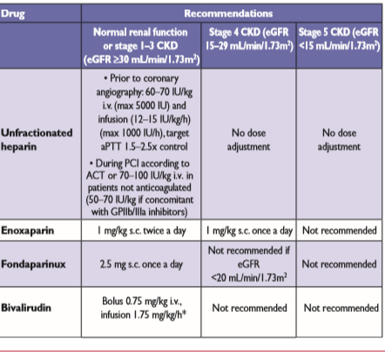

Slide 35
Anticoagulation Anticoagulants are used to inhibit thrombin generation and/or activity, thereby reducing thrombus-related events.
There is evidence that anticoagulation is effective in reducing ischaemic events in NSTE-ACS and that the combination with platelet inhibitors is more effective than either treatment alone

Slide 36
Reperfusion
thrombolysis
Invasive coronary angiography, followed if indicated by coronary revascularization

Slide 37
For patients with the clinical presentation of STEMI within 12 h of symptom onset and with persistent ST-segment elevation or new or presumed new LBBB, early mechanical (PCI) or pharmacological reperfusion should be performed as early as possible

Slide 38
