Slide 1
VASCULITIS
Dr. Lawrence Owino Okong’o,
MBChB; MMed (Paed). Mphil. (Paed Rheum).
Paediatrician and Paed Rheumatologist.
Lecturer, University of Nairobi.

Slide 2
OUTLINE
Introduction and Definition
Classification
Clinical manifestations
Diagnosis
Management
Complications
Questions
Summary

Slide 3
Introduction1
Vasculitis refers to inflammation of blood vessels.
This may lead to narrowing (stenosis) and dilation (aneurysms) of the blood vessels.
IgA vasculitis (Henoch Shonlein Purpura) and Kawasaki disease are the most common.
HSP incidence 10-20/100,000.

Slide 4
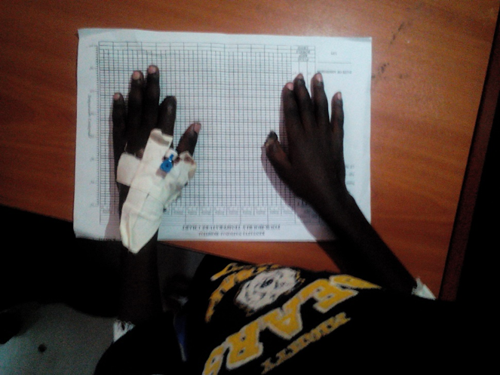
Introduction 2: “Could this be Vasculitis?”
Systemic
  Fever, weight loss, fatigue
Vascular
  Hypertension
  Absent/asymmetric pulse.
  Palpable aneurysms
  Tissue gangrene
Cutaneous
  Palpable purpura, painful nodules
  Livedo reticularis, ulceration

Slide 5
Introduction 3: “Could this be Vasculitis?”
Pulmonary infiltrates or hemorrhage
Neurologic
    Headache, mononeuritis multiplex, focal CNS signs
Musculoskeletal
    Arthralgia, arthritis, myalgia, myositis
Renal
    Hematuria, hypertension, renal failure
Laboratory
    Abnormal urinalysis, ANCA, Elevated ESR, CRP

Slide 6
Vasculitis classification
Large vessel
Medium vessel
Small vessel
Takayasu’s arteritis
PAN
Kawasaki disease
ANCA vasculitis
HSP
Wegeners
MPA
Churg Strauss
Giant Temporal Arteritis
Relatively common vasculitides

Slide 7
Clinical features
Padiatric vasculitis

Slide 8
GIANT CELL ARTERITIS AND POLYMYALGIA RHEUMATICA

Slide 9
Giant cell arteritis
Also called temporal arteritis.
Occurs in people aged <50 years.
Symptoms:
  Pain over temporal arteries
  Jaw claudication when eating
  Visual disturbances/ visual loss.
Treatment: steroids.

Slide 10
Polymyalgia rheumatic (PMR)
Is closely related to giant cell arteritis.
Occurs mainly in those >70 years old.
Its more common in women than men.
Causes pain, stiffness and inflammation especially of muscles of the pelvic and shoulder girdles.
It also causes fever, tiredness, loss of appetite, weight loss and depression.
Management: steroids.

Slide 11
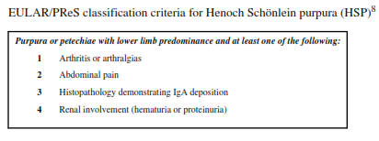
Classification: IgA Vasculitis (HSP)
Purpura mainly lower limb.
Abdominal pain.
Hematuria or proteinuria.
Arthritis or arthralgia.
IgA on biopsy.

Slide 12
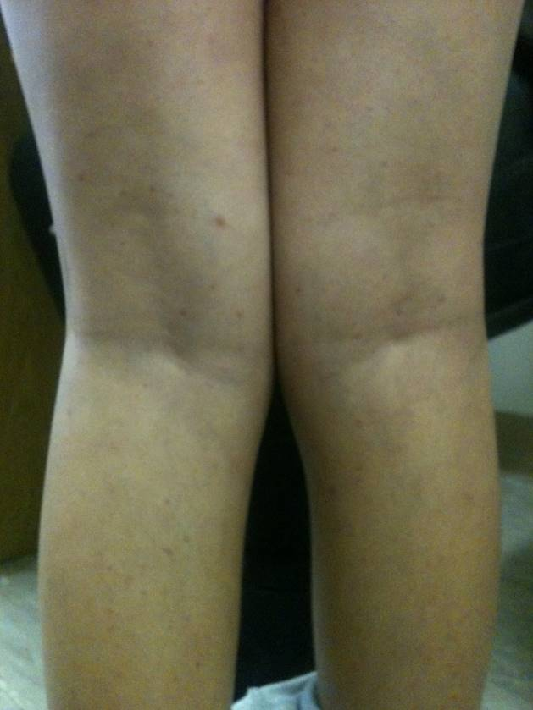
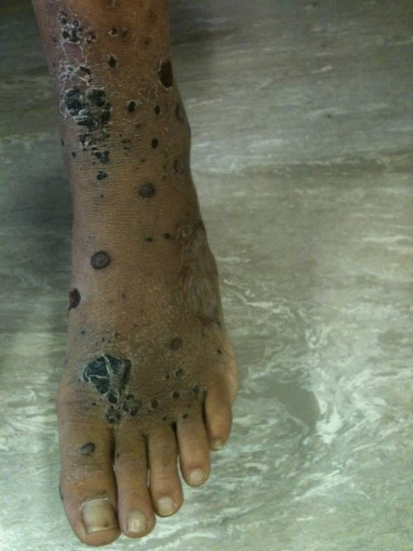
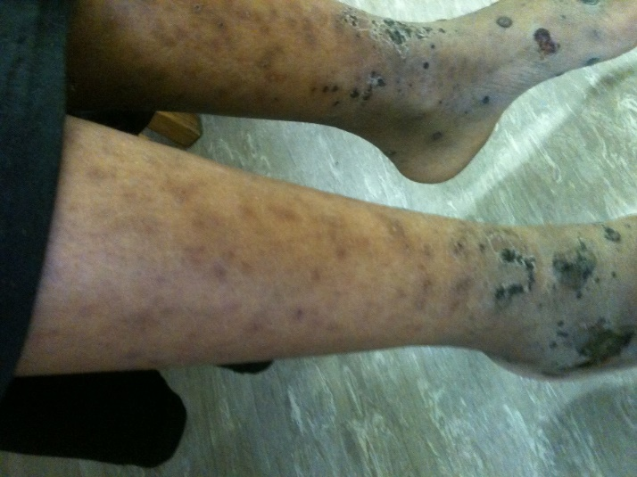
HSP

Slide 13
IgA Vasculitis
Course variable & often relapsing: symptoms relapse in upto 1/3 within 4 months.
May cause end stage renal disease.
It’s a small vessel vasculitis with type III hypersensitivity associated with IgA deposition.

Slide 14
IgA Vasculitis: clinical
Palpable purpura mainly lower limb/buttock
Colicky abdominal pain with vomiting, hematemesis, melena stools.
Arthritis or arthralgia mainly lower limbs in upto 60% .
Renal involvement in 25-60% manifesting proteinuria/hematuria.
Other: orchitis, pulmonary haemorrhage.

Slide 15
Kawasaki disease:
Second commonest paediatric vasculitis.
Leading cause of acquired heart disease in developed countries.
IVIG and aspirin reduces coronary artery aneurysm from 25% to 4-9%.
Aetiology is unknown. Worldwide distribution with bias to Asiatic/Japanese populations.
Incidence: Japan 184.6/100,000 in under fives; and 5-8/100,000 in UK.

Slide 16
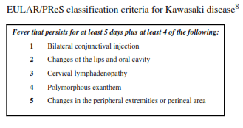

Slide 17
KD: other clinical features
Coronary manifestations the most important.
Coronary involvement occurs in 15-25% cases.
Irritability is another important sign.
Reactivation/ erythema and induration of BCG scar. Mechanism unknown.
Other features: aseptic meningitis, arthritis, sterile pyuria, Macrophage activation syndrome

Slide 18
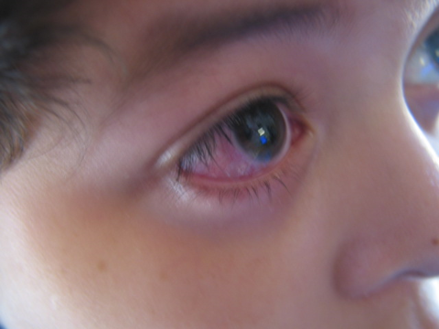
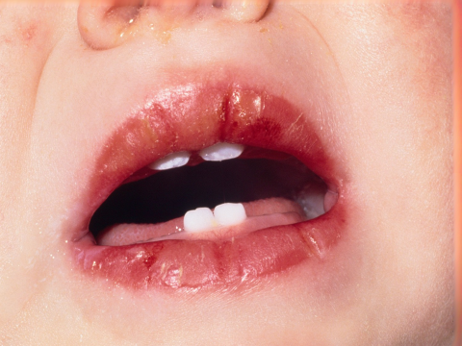
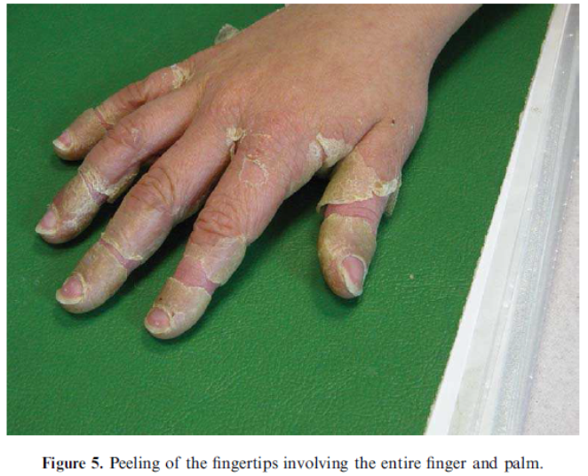
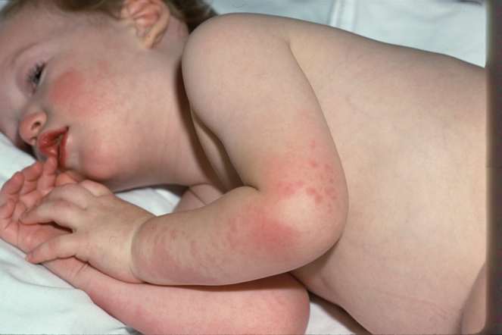
Kawasaki

Slide 19
KD: Differential diagnoses
Systemic JIA
Scarlet fever (hand foot and mouth syndrome).
Measles and other viral infections.
Systemic lupus erythematosus (SLE).

Slide 20
ANCA Vasculitis

Slide 21
Granulomatous Polyangiitis (wegener’s granulomatosis)
Granulomatous inflammation involving the respiratory tract and necrotizing vasculitis affecting small to medium-sized vessels

Slide 22
Granulomatous Polyangiitis
Classification Criteria
  Nasal or oral inflammation
    Oral ulcers or purulent or bloody nasal discharge
  Abnormal Chest X-ray
    Nodules, fixed infiltrates or cavities
  Abnormal urine sediment
    > 5 RBC/hpf or RBC casts
  Granulomatous inflammation
    Granuloma within wall of an artery or in the perivascular or extravascular area of an artery or arteriole
Presence of 2 criteria has sensitivity of 88.2% and specificity of 92.0
Leavitt et al. Arthritis Rheum 33:1101, 1990.

Slide 23
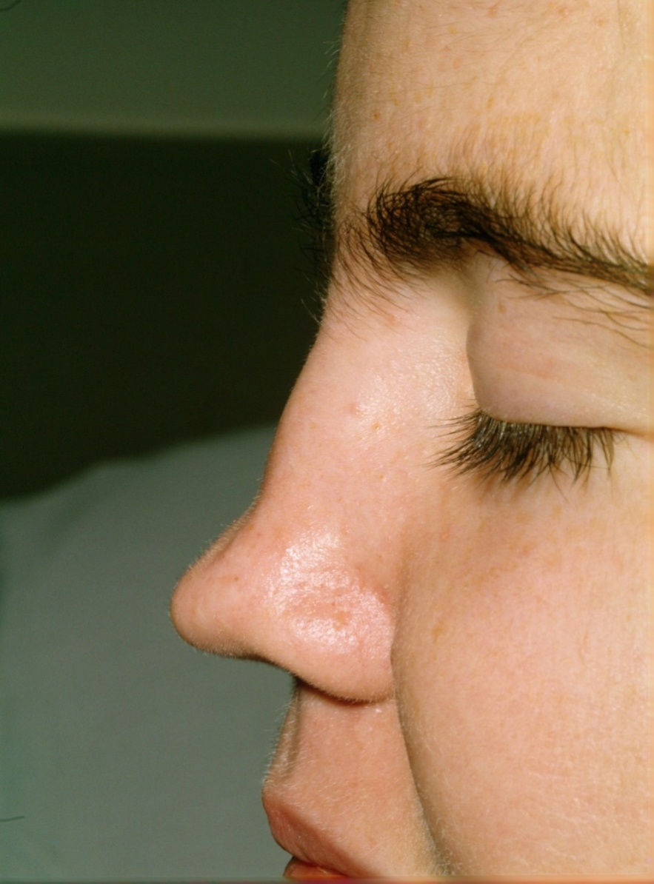
Granulomatous Polyangiitis

Slide 24
Airways Disease in
Granulomatous Polyangiitis
Sinusitis 60 %
Epistaxis 50 %
Saddle Nose Deformity 25 %
Oral Ulcers 20 %
Otitis Media 30 %
Subglottic Stenosis 30 %
Pulmonary Hemorrhage 30 %
Data from Rottem et al (J Pediatr 1993), Belotstosky et al (Ped Nephrol 2002), and Akikusa et al.* (Arthritis Rheum 2007)

Slide 25
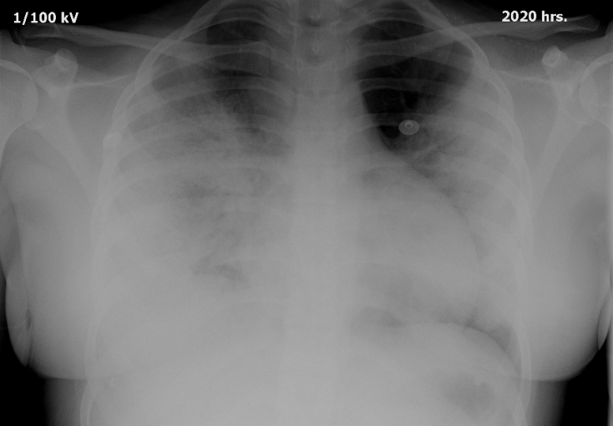
KD
KD

Slide 26
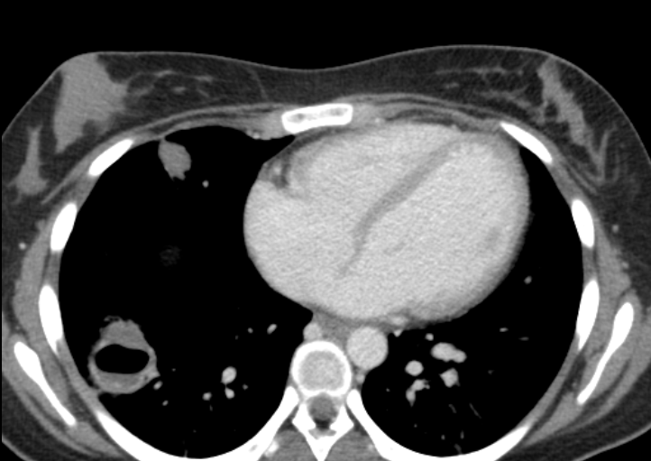
KD

Slide 27
Systems Affected in 65 Children with Wegener’s Granulomatosis
ENT 94 %
Pulmonary 80 %
Renal 67 %
Joint 58%
Ocular 54 %
Skin 51 %
Venous Thrombosis (16%)
Data from Rottem et al (J Pediatr 1993), Belotstosky et al (Ped Nephrol 2002), and Akikusa et al.* (Arthritis Rheum 2007)

Slide 28
Granulomatous Polyangiitis
Wung and Stone 2005; Nature Clin Pract Rheum 2:192-200
Limited Disease
Confined to upper airways and lungs
Severe Disease
Rapidly progressive glomerulonephritis
Pulmonary hemorrhage
Mononeuritis Multiplex
Scleritis or peripheral ulcerative keratitis

Slide 29
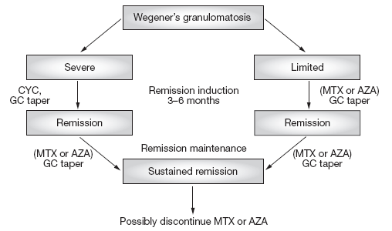
Granulomatous Polyangiitis
Wung and Stone 2005; Nature Clin Pract Rheum 2:192-200

Slide 30
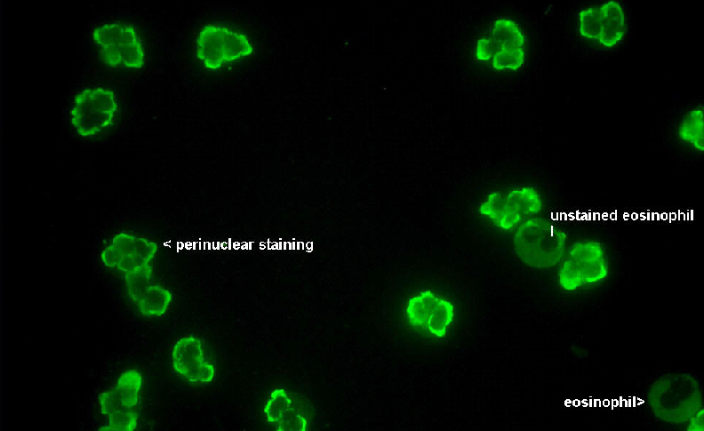
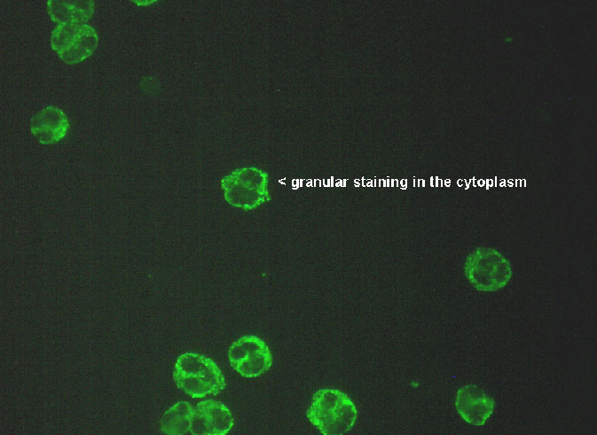
ANCA
P-ANCA (Anti MPO*) C-ANCA (Anti PR3)
Granulomatous Polyangiitis
    Eosinophilic Polyangiitis
PAN
Microscopic Polyangiitis
* And Anti lactoferrin, elastase, cathepsin G

Slide 31
ANCAs in Vasculitis
Antigen ANCA Disease %
Pattern Associations
PR 3 c ANCA Granulomatous Polyangiitis 30 – 90
Eosinophilic Polyangiitis 25 – 50
MPO p ANCA Microscopic polyarteritis 25 – 75
Eosinophilic Polyangiitis 50 – 75
Ulcerative colitis 40 – 80
Sclerosing cholangitis 65 – 85
Crohn’s disease 10 – 40
BPI pANCA Cystic fibrosis 80 – 90
Actin p ANCA Autoimmune Hepatitis Type I 70 - 75

Slide 32
MPA
Vasculitis affecting small vessels.
Often associated pulmonary capillaritis.
Renal: rapidly progressive glomerulonephritis.
Perinuclear ANCA positive.

Slide 33
EGPA (Churg Strauss syndrome)
Eosinophillic granulomatous inflammation of respiratory tract.
Often associated late onset asthma, and eosinophilia.

Slide 34
Polyarteritis nodosa (PAN)
Necrotizing vasculitis of medium sized muscular vessels.
Aneurysm formation along vessel walls.
3rd most common childhood vasculitis after IgA vasculitis and Kawasaki.
Peak age 7-11 years.
Some cases especially in adults associated with Hep B infection.

Slide 35
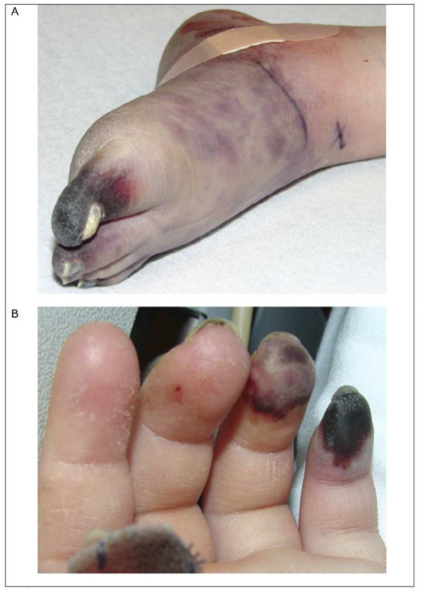
PAN: Clinical
Systemic: fever, wt loss, myalgia, rash, abdominal pain, arthritis.
Skin: livedo reticularis, tender subcut nodules, skin infarction.
Renal: hypertension, proteinuria, haematuria.
GIT: GI haemorrhage, pain
Neurologic: focal defects, hemiplegia
Other: testicular pain.

Slide 36
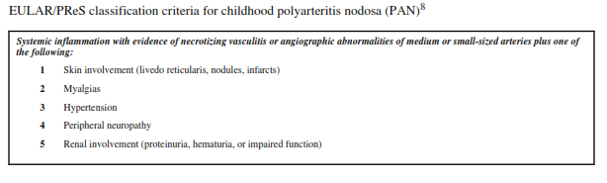
Diagnosis

Slide 37
Takayasu’s arteritis
Is inflammation of the aorta and its large branches.
Named after Mikito Takayasu, a Japanese ophthalmologist who described retinal vasculitis with absent pulses.
Vessel Inflammation associated with stenosis, as well as dilatation with aneurysms.

Slide 38
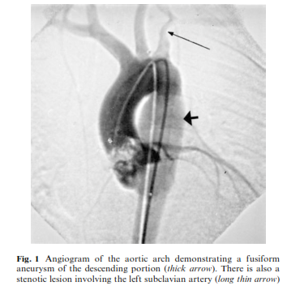

Slide 39
Takayasu: clinical, acute
Systemic: fever, weight loss, malaise, arthralgia, myalgia.
Rash (erythema nodosum, pyoderma gangrenosum)
Arthritis
Hypertension
Thrombosis, myocardial infarction.

Slide 40
Takayasu: clinical, chronic
Asymmetric or absent pulses
BP difference of >10mmhg on 4 limb BP
Systemic hypertension.
Arterial bruits
CCF
Claudication, Abdominal pain
CNS: from ischaemia and hypertension. Dizziness, headaches, seizures, TIA, stroke.

Slide 41
Takayasu: clinical, chronic
Eye: diplopia, blurred vision.
Renal: renovascular hypertension, renal failure.
Differentials
  Other vasculitides
  Fibromuscular dysplasia
  Williams syndrome
  Aortic stenosis
  TB

Slide 42
Vasculitis: investigations
Increased ESR, CRP.
Urine dipstick: Proteinuria, hematuria.
Renal function, liver function.
ANCA, ANA, dsDNA.
Biopsy: renal, respiratory tract, skin etc
Radiology: pulmonary cavities, nodules.
CT/Xray of sinuses: erosions; ECG, CXR, Echo
MRA, CTA, Angiography.

Slide 43
Management of vasculitides
Supportive: pain, BP, Aspirin
Induction: prednisone; cyclophosphamide.
Maintenance: Azathioprine, MMF, prednisone, aspirin.
Other: Biologic therapy- rituximab, anti-TNF.
Kawasaki: IVIG, Aspirin.
Takayasus: surgery.

Slide 44
Complications
Renal failure
Tissue/ digital gangrene
Stroke (thrombotic/ hypertensive).
Treatment related
  Steroid toxicity
  Gonadal failure: cyclophosphamide

Slide 45
QUESTIONS

Slide 46
SUMMARY
Primary vasculitides are rare in children.
IgA vasculitis, Kawasaki disease are the most common.
Diagnosis includes finding systemic features of malaise, weight loss, fever, myalgia, arthralgia, arthritis and …..
Clinical features specific to each condition.
Management involves an induction phase usually 6 months; and maintenance phase.

Slide 47


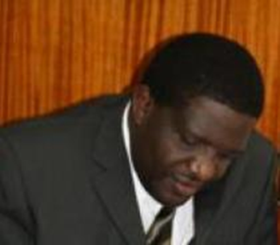


Thanks

