Slide 1
Thyroid Disorders
Dr Ojuka KD

Slide 2
Introduction
Most prevalent endocrine disorder known
> 21 million Americans affected , no statistics are available in our setup
By age 50: 10% of women have an abnormal TSH
By age 60: almost a 2 fold increase in women (17%) and a dramatic increase in men (9%)

Slide 3
Introduction
The health consequences of overt thyroid disease have long been recognized.
However, undiagnosed thyroid disease is also a serious public health problem.
A study concluded that… “thyroid disease is common, may often go undetected, and may be associated with adverse health outcomes ….”1

Slide 4
Prevalence of thyroid failure by Gender
 | Prevalence of Thyroid Failure by Sex
Study | Women | Men
Whickham (1977)¹ | 7.7% | 2.8%
Framingham (1985)² | 13.6% | 5.7%
Colorado (2000)3 | 4-2% | 3-16%
Rotterdam (2000)⁴** | 12.3% | NA
NHANES (2002)⁵ | 12.9 | 9.3%
Tunbridge WMG, et al. Clin Endocrinol. 1977;7:481-493.
Sawin CT, et al. Arch Intern Med. 1985;145:1386-1388.
Canaris GJ, et al. Arch Intern Med. 2000;160:523-534.
Hak AE, et al. Ann Intern Med. 2000;132:270-278.
Hollowell JG et al. JCEM. 2002, 87, 489-500.

Slide 5
Prevalence of thyroid failure by age
The incidence of thyroid disease increases with age.
For all age groups, thyroid disease is more common in women than men
1.GJ Canaris, et al. Arch Intern Med. 2000;160:526-534

Slide 6
Diagnostic Approach
low
TSH
high
nml
Free T4
? Secondary
(central) dz
Free T4
high
low
high
low
nml
nml
2º Hyperthyroid
Or Thyroid hormone resistance
1º Hypothyroid
2º Hypothyroid
Subclinical
Hypothyroid
Subclinical
Hyperthyroid
1º Hyperthyroid
RAIU
None
diffuse
focal
Serum Thyroglobulin
homogeneous
heterogeneous
low
high
Functioning
Adenoma
Grave’s Dz
Toxic multinodular goiter
Thyrotoxicosis factitia
Iodine load
Thyroiditis
Struma ovarii

Slide 7
Introduction
Nontoxic goitre
Thyroid nodules & thyroid cancer
Benign thyroid nodules
Thyroid cancer
Papillary carcinoma
Follicular carcinoma
Medullary carcinoma
Anaplastic carcinoma
Lymphoma
Cancer metastatic to the thyroid
Thyroid disorders:
Hypothyroidism
Hyperthyroidism and thyrotoxicosis
Graves’ disease
Thyroiditis
Toxic adenoma
Toxic multinodular goitre
Thyrotoxicosis factitia
Struma ovarii
Hydatidiform mole
TSH-secreting pituitary adenoma

Slide 8
Hypothyroidism
Etiology:
Primary:
Hashimoto’s thyroiditis with or without goitre
Radioactive iodine therapy for Graves’ disease
Subtotal thyroidectomy for Graves’ disease or nodular goitre
Excessive iodine intake
Subacute thyroiditis
Rare causes
Iodide deficiency
Goitrogens such as lithium; antithyroid drug therapy
Inborn errors of thyroid hormone synthesis
Secondary: Hypopituitarism
Tertiary: Hypothalamic dysfunction (rare)
Peripheral resistance to the action of thyroid hormone

Slide 9
Hypothyroidism
Clinical features
Cardiovascular signs:
Bradycardia
Low voltage ECG
Pericardial effusion
Cardiomegaly
Hyperlipidemia
Constipation, ascites
Weight gain
Cold intolerance
Rough, dry skin
Puffy face and hands
Hoarse, husky voice
Yellowish color of skin due to reduced conversion of carotene to vitamin A
Respiratory failure
Menorrhagia, infertility, hyper- prolactinemia
Renal function:
Impaired ability to excrete a water load
Anemia:
Impaired Hb synthesis
Fe deficiency due to:
Menorrhagia
Reduced intestinal absorption
Folate def. due to impaired intestinal absorption
Pernicious anemia
Neuromuscular system:
Muscle cramps, myotonia
Slow reflexes
Carpal tunnel syndrome
CNS symptoms:
Fatigue, lethargy, depression
Inability to concentrate

Slide 10
Hypothyroidism
Diagnosis:
A iFT4 and hTSH is diagnostic of primary hypothyroidism
Serum T3 levels are variable (maybe in normal range)
+ve test for thyroid autoantibodies (Tg Ab & TPO Ab) PLUS an enlarged thyroid gland suggest Hashimoto’s thyroiditis
With pituitary myxedema FT4 will be i but serum TSH will be inappropriately normal or low
TRH test may be done to differentiate pituitary from hypothalamic disease. Absence of TSH response to TRH indicates pituitary deficiency
MRI of brain is indicated if pituitary or hypothalamic disease is suspected. Need to look for other pituitary deficiencies.
If TSH is h & FT4 & FT3 are normal we call this condition subclinical hypothyroidism

Slide 11
Hashimoto’s Thyroiditis
Hashimoto’s thyroiditis is a commom cause of hypothyroidism and goitre especially in children and young adults.
It is an autoimmune disease that involves heavy infiltration of lymphocytes that totally destroys normal thyroidal architecture
Three different autoantibodies are present: Tg Ab, TPO Ab, and TSH-R Ab (block)
It is familial and may be associated with other autoimmune diseases such as pernicious anemia, adrenocortical insufficiency, idiopathic hypoparathyroidism, and vitiligo.
Shmidt’s syndrome consists of Hashimoto’s thyroiditis, adrenal insufficiency, hypoparathyroidism, DM, ovarian failure, and (rarely) candidal infections.

Slide 12
Hashimoto’s Thyroiditis
Symptoms & Signs:
Usually presents with goitre in a patient who is euthyroid or has mild hypothyroidism
Sex distribution: four females to one male
The process is painless
Older patients may present with severe hypothyroidism with only a small, firm atrophic thyroid gland
Transient symptoms of thyrotoxicosis can occur during periods of hashitoxicosis (spontaneously resolving hyperthyroidism)
Lab:
Normal or low thyroid hormone levels, and if low, TSH is elevated
High Tg Ab and/or TPO Ab titres
FNA bx reveals a large infiltration of lymphocytes PLUS Hurthle cells
Complications:
Permanent hypothyroidism (occurs in 10-15% of young pts)
Rarely, thyroid lymphoma

Slide 13
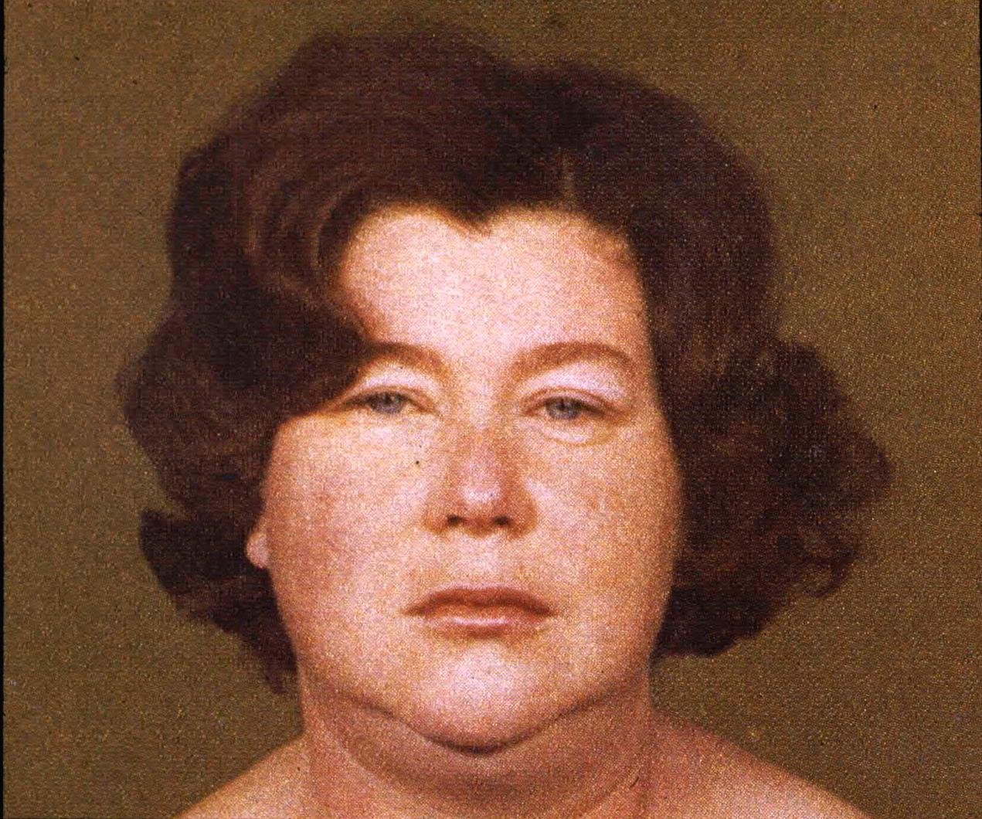

Slide 14
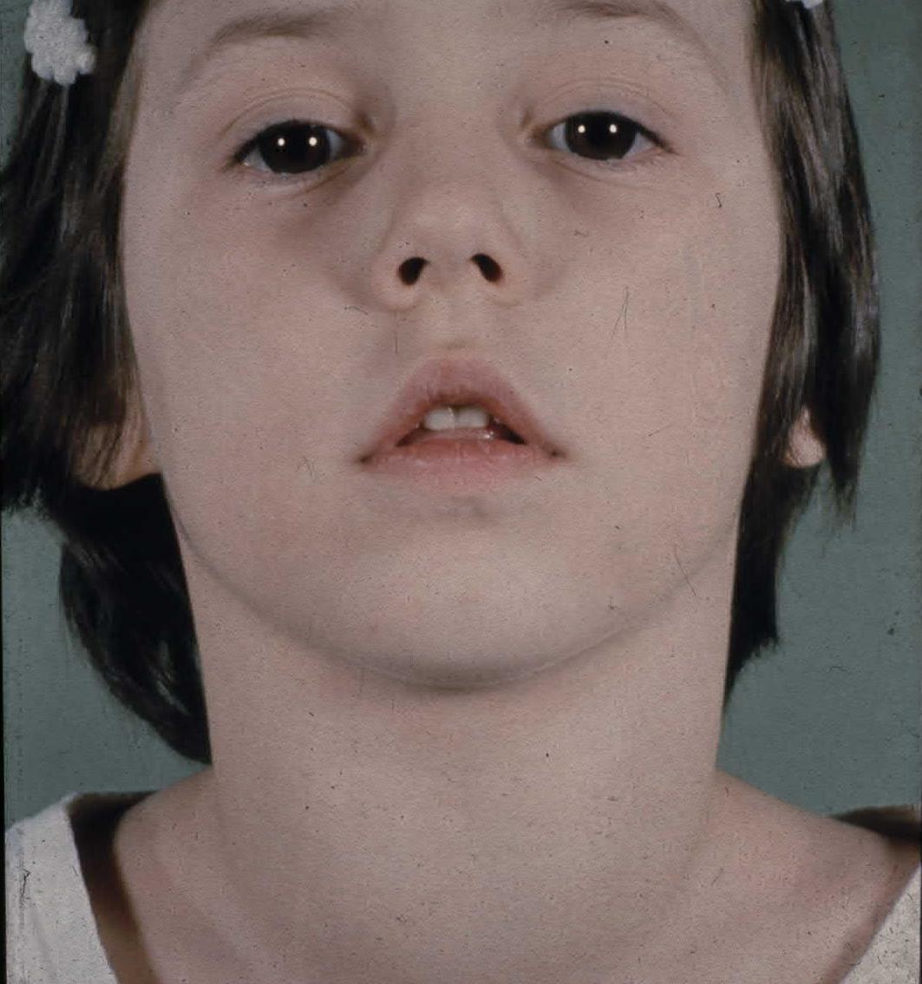

Slide 15
Management of Hypothyroidism
Start patient on L-thyroxine 0.05-0.1mg PO OD. L-thyroxine treats the hypothyroidism and leads to regression of goitre.
If patient is elderly or has IHD start 0.025mg PO OD.
Check TSH level after 4-6 weeks to adjust the dose of L-thyroxine.
In case of secondary hypothyroidism monitor FT4 instead of TSH.
Hypothyroidism during pregnancy:
Check TFT every month. L-thyroxine dose requirement tends to go up as the pregnancy progresses.
If patient has concommitant hyperprolactinemia and hypercholesterolemia, treat if not normalized after adequate thyroid replacement.

Slide 16
Myxedema Coma
Medical emergency, end stage of untreated hypothyroidism
Characterized by progressive weakness, stupor, hypothermia, hypoventilation, hypoglycemia, hyponatremia, shock, and death
The patient (or a family member) may recall previous thyroid disease, radioiodine therapy, or thyroidectomy
Hx is of gradual onset of lethargy progressing to stupor or coma. A hx of amenorrhea or impotence with pituitary myxedema
PE reveals iHR and marked hypothermia (as low as 24C)
The pt is usually an obese elderly woman with yellowish skin, a hoarse voice, a large tongue, thin hair, puffy eyes, ileus, and slow reflexes. An anterior neck scar may be present. Scanty pubic or axillary hair with pituitary myxedema
Lab: low FT4, TSH high, normal, or low, cholesterol high or N, serum Na low
ECG: bradycardia and low voltage
May be ppt by HF, pneumonia, excessive fluid administration, narcotics

Slide 17
Management of Myxedema Coma
Initiate therapy if presumptive clinical diagnosis after TSH, FT3 FT4 drawn. Also draw serum cortisol, ACTH, glucose.
General measures:
Patient should be in ICU setting
Support ventilation as respiratory failure is the major cause of death in myxedema coma
monitors ABG`s
support blood pressure; hypotension may respond poorly to pressor agents until thyroid hormone is replaced
hypothermia will respond to thyroxin therapy ; in interim use passive warming only
hyponatremia will also be corrected by thyroxine therapy in majority of cases
hypoglycemia requires IV glucose
avoid fluid overload

Slide 18
Management of Myxedema Coma
Specific measure:
L-thyroxine 0.2-0.5 mg IV bolus, followed by 0.1 mg IV OD until oral therapy is tolerated
Results in clinical response in hours
Adrenal insufficiency may be precipitated by administration of thyroid hormone therefore hydrocortisone 100 mg IV q 8h is usually given until the results of the initial plasma cortisol is known.
Identify and treat the underlying precipitant cause

Slide 19
Graves’ Disease
Most common form of thyrotoxicosis
May occur at any age but mostly from 20-40
5 times more common in females than in males
Syndrome consists of one or more of the following:
Thyrotoxicosis
Goitre
Opthalmopathy (exopthalmos) and
Dermopathy (pretibial myxedema)
It is an autoimmune disease of unknown cause
15% of pts with Graves’ have a close relative with the same disorder

Slide 20
Graves’ Disease
Pathogenesis:
T lymphocytes become sensitized to Ag within the thyroid gland and stimulate B lymphocytes to synthesize Ab to these Ag
One such Ab is the TSH-R Ab(stim), which stimulates thyroid cell growth and function
Graves’ may be ppt by pregnancy, iodide excess, viral or bacterial infections, lithium therapy, glucocorticoid withdrawal
The opthalmopathy and dermopathy associated with Graves’ may involve lymphocyte cytokine stimulation of fibroblasts in these locations causing an inflammatory response that leads to edema, lymphocytic infiltration, and glycosaminoglycans deposition
The tachycardia, tremor, sweating, lid lag, and stare in Graves’ is due to hyperreactivity to catecholamines and not due to increased levels of circulating catecholamines

Slide 21
Graves’ Disease
Clinical features:
I Eye features: Classes 0-6, mnemonic “NO SPECS”
Class 0: No signs or symptoms
Class 1: Only signs (lid retraction, stare, lid lag), no symptoms
Class 2: Soft tissue involvement (periorbital edema, congestion
or redness of the conjunctiva, and chemosis)
Class 3: Proptosis (measured with Hertel exopthalmometer)
Class 4: Extraocular muscle involvement
Class 5: Corneal involvement
Class 6: Sight loss (optic nerve involvement)
Notes:
18mm oriental, 20mm white, 22mm black, 3-4mm mild, 5-7 moderate, >7mm severe
Inferior rectus then medial rectus

Slide 22
Graves’ Disease
Clinical features:
II Goitre:
Diffuse enlargement of thyroid
Bruit may be present
III Thyroid dermopathy (pretibial myxedema):
Thickening of the skin especially over the lower tibia
The dermopathy may involve the entire leg and may extend onto the feet
Skin cannot be picked up between the fingers
Rare, occurs in 2-3% of patients
Usually associated with opthalmopathy and very hTSH-R Ab

Slide 23
Graves’ Disease
Clinical features:
IV Heat intolerance
V Cardiovascular:
Palpitation, Atrial fibrillation
CHF, dyspnea, angina
VI Gastrointestinal:
Weight loss, happetite
Diarrhea
VII Reproductive:
amenorrhea, oligo- menorrhea, infertility
Gynecomastia
VIII Bone:
Osteoporosis
Thyroid acropachy
IX Neuromuscular:
Nervousness, tremor
Emotional lability
Proximal myopathy
Myasthenia gravis
Hyper-reflexia, clonus
Periodic hypokalemic paralysis
X Skin:
Pruritus
Onycholysis
Vitiligo, hair thinning
Palmar erythema
Spider nevi

Slide 24
Graves’ Disease
Diagnosis:
Low TSH, High FT4 and/or FT3
If eye signs are present, the diagnosis of Graves’ disease can be made without further tests
If eye signs are absent and the patient is hyperthyroid with or without a goitre, a radioiodine uptake test should be done.
Radioiodine uptake and scan:
Scan shows diffuse uptake
Uptake is increased
TSH-R Ab (stim) is specific for Graves’ disease. May be a useful diagnostic test in the “apathetic” hyperthyroid patient or in the pt who presents with unilateral exopthalmos without obvious signs or laboratory manifestations of Graves’ disease

Slide 25
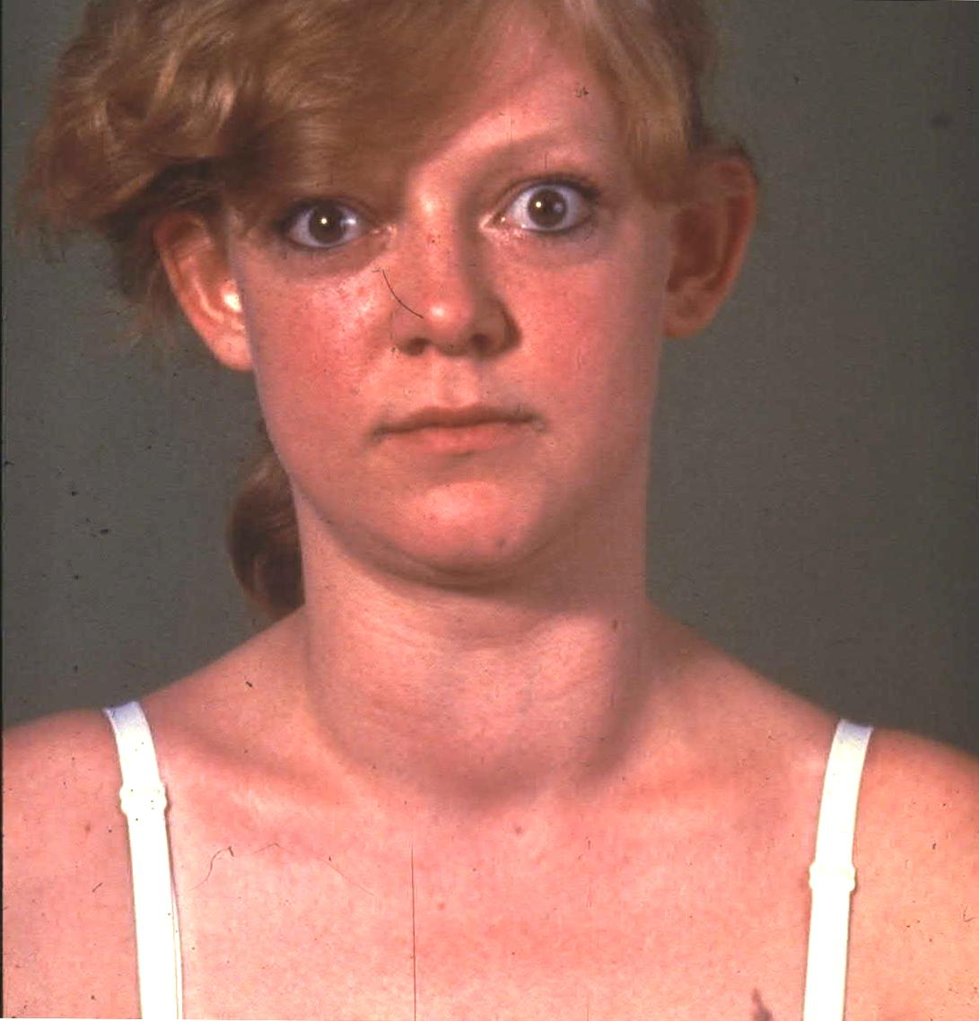

Slide 26
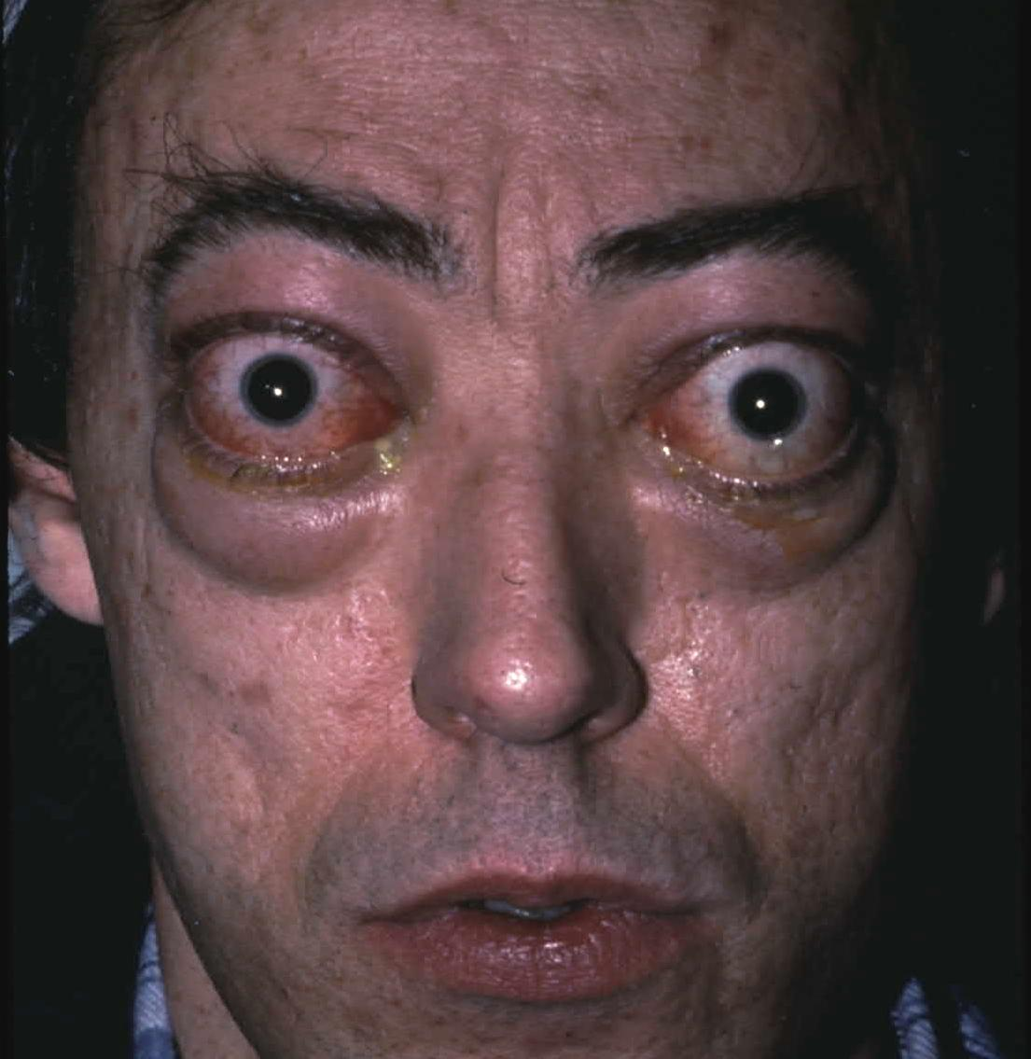

Slide 27
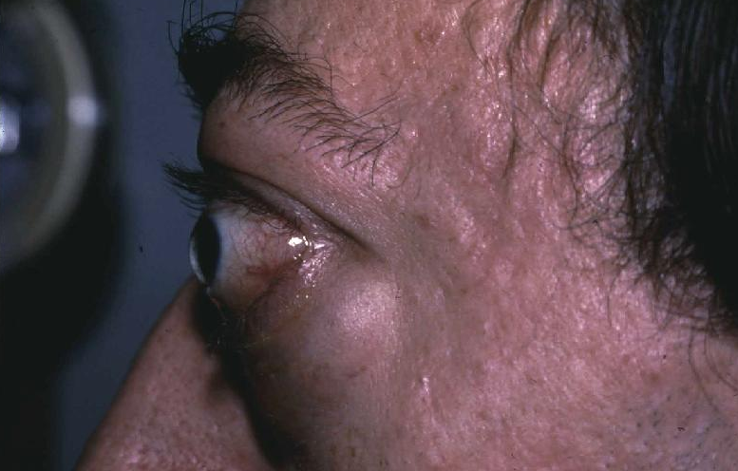

Slide 28
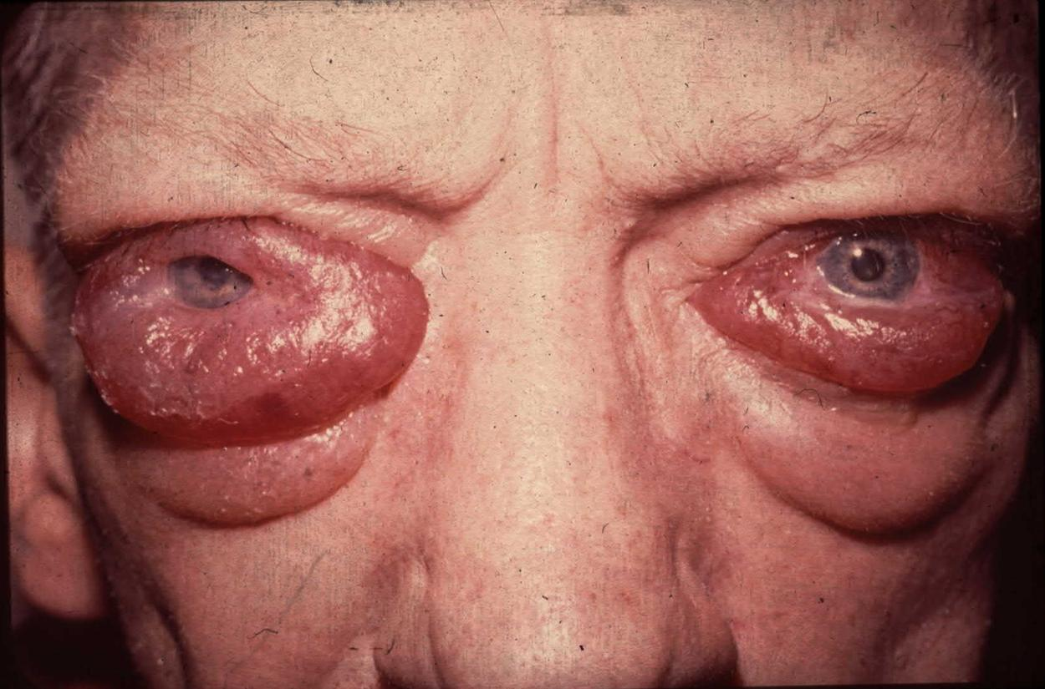

Slide 29
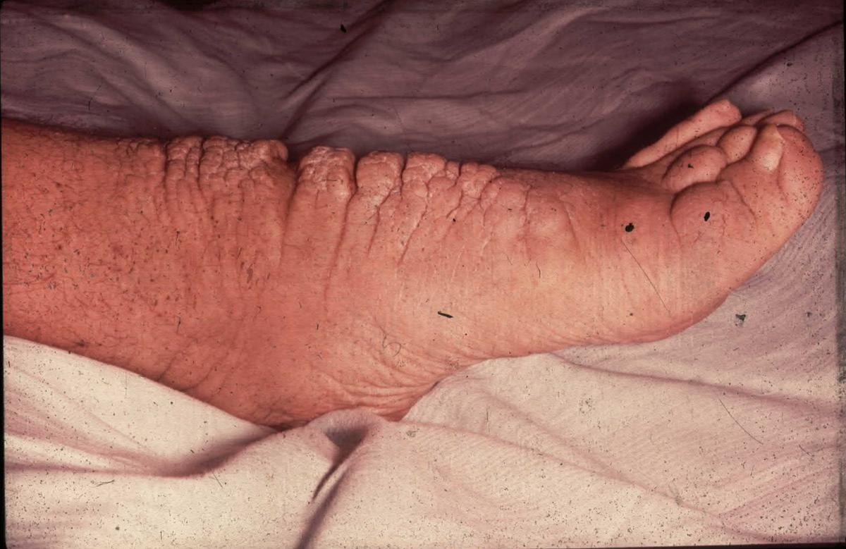

Slide 30
Treatment of Grave’s Disease
There are 3 treatment options:
Medical therapy
Surgical therapy
Radioactive iodine therapy

Slide 31
Treatment of Grave’s Disease
A. Medical therapy:
Antithyroid drug therapy:
Most useful in patients with small glands and mild disease
Treatment is usually continued for 12-18 months
Relapse occurs in 50% of cases
There are 2 drugs:
Neomercazole (methimazole or carbimazole): start 30-40mg/D for 1-2m then reduce to 5-20mg/D.
Propylthiouracil (PTU): start 100-150mg every 6hrs for 1-2m then reduce to 50-200 once or twice a day
Monitor therapy with fT4 and TSH
S.E.: 5%→rash, 0.5%→agranulocytosis (fever, sore throat), rare: cholestatic jaundice, hepatocellular toxicity, angioneurotic edema, acute arthralgia

Slide 32
Management of Grave’s disease
A. Medical therapy:
Propranolol 10-40mg q6hrs to control tachycardia, hypertension and atrial fibrillation during acute phase of thyrotoxicosis. It is withdrawn gradually as thyroxine levels return to normal
Other drugs:
Ipodate sodium (1g OD): inhibits thyroid hormone synthesis and release and prevents conversion of T4 to T3
Cholestyramine 4g TID lowers serum T4 by binding it in the gut

Slide 33
Management of Grave’s disease
B. Surgical therapy:
Subtotal thyroidectomy is the treatment of choice for patients with very large glands
The patient is prepared with antithyroid drugs until euthyroid (about 6 weeks). In addition 2 weeks before the operation patient is given SSKI 5 drops BID to diminish vascularity of thyroid gland
Complications (1%):
Hypoparathyroidism
Recurrent laryngeal nerve injury

Slide 34
Management of Grave’s Disease
C. Radioactive iodine therapy:
Preferred treatment in most patients
Can be administered immediately except in:
Elderly patients
Patients with IHD or other medical problems
Severe thyrotoxicosis
Large glands >100g
In above cases it is desirable to achieve euthyroid state first
Hypothyroidism occurs in over 80% of cases.
Female should not get pregnant for 6-12m after RAI.

Slide 35
Management of Grave’s Disease
Management of opthalmopathy:
Management involves cooperation between the endocrinologist and the opthalmologist
A course of prednisone immediately after RAI therapy 100mg daily in divided doses for 7-14 days then on alternate days in gradually diminishing dosage for 6-12 weeks.
Keep head elevated at night to diminish periorbital edema
If steroid therapy is not effective external x-ray therapy to the retrobulbar area may be helpful
If vision is threatened orbital decompression can be used

Slide 36
Management of Grave’s Disease
Management during pregnancy:
RAI is contraindicated
PTU is preferred over neomercazole
FT4 is maintained in the upper limit of normal
PTU can be taken throughout pregnancy or if surgery is contemplated then subtotal thyroidectomy can be performed safely in second trimester
Breastfeeding is allowed with PTU as it is not concentrated in the milk

Slide 37
Toxic Adenoma (Plummer’s Disease)
This is a functioning thyroid adenoma
Typical pt is an older person (usually > 40) who has noted recent growth of a long-standing thyroid nodule
Thyrotoxic symptoms are present but no infiltrative opthalmopathy. PE reveals a nodule on one side
Lab: low TSH, high T3, slightly high T4
Thyroid scan reveals “hot” nodule with suppressed uptake in contralateral lobe
Toxic adenomas are almost always follicular adenomas and almost never malignant
Treatment: same as for Grave’s disease

Slide 38
Toxic Multinodular Goitre
Usually occurs in older pts with long-standing MNG
PE reveals a MNG that may be small or quite large and may even extend substernally
RAI scan reveals multiple functioning nodules in the gland or patchy distribution of RAI
Hyperthyroidism in pts with MNG can often be ppt by iodide intake “jodbasedow phenomenon”.
Amiodarone can also ppt hyperthyroidism in pts with MNG
Treatment: Same as for Grave’s disease. Surgery is preferred.

Slide 39
Subacute Thyroiditis
Acute inflammatory disorder of the thyroid gland most likely due to viral infection. Usually resolves over weeks or months.
Symptoms & Signs:
Fever, malaise, and soreness in the neck
Initially, the patient may have symptoms of hyperthyroidism with palpitations, agitation, and sweat
PE: No opthalmopathy, Thyroid gland is exquisitely tender with no signs of local redness or heat suggestive of abscess formation
Signs of thyrotoxicosis like tachycardia and tremor may be present
Lab:
Initially, T4 & T3 are elevated and TSH is low, but as the disease progresses T4 & T3 will drop and TSH will rise
RAI uptake initially is low but as the pt recovers the uptake increases
ESR may be as high as 100. Thyroid Ab are usually not detectable in serum

Slide 40
Subacute Thyroiditis
Management:
In most cases only symptomatic Rx is necessary e.g. acetaminophen 0.5g four times daily
If pain, fever, and malaise are disabling a short course of NSAID or a glucocorticoid such as prednisone 20mg three times daily for 7-10 days may be necessary to reduce the inflammation
L-thyroxine is indicated during the hypothyroid phase of the illness. 10% of the patients will require L-thyroxine long term

Slide 41
Other Forms of Thyrotoxicosis
Thyrotoxicosis Factitia:
Due to ingestion of excessive amounts of thyroxine
RAI uptake is nil and serum thyroglobulin is low
Struma Ovarii:
Teratoma of the ovary with thyroid tissue that becomes hyperactive
No goitre or eye signs. RAI uptake in neck is nil but body scan reveals uptake of RAI in the pelvis.
Hydatidiform mole:
Chorionic gonadotropin is produced which has intrinsic TSH-like activity.
TSH-secreting pituitary adenoma:
FT4 & FT3 is elevated but TSH is normal or elevated
Visual field examination may reveal temporal defects, and CT or MRI of the sella usually reveals a pituitary tumour.

Slide 42
Thyroid storm (Thyrotoxic crisis)
Usually occurs in a severely hyperthyroid patient caused by a precipitating event such as:
Infection
Surgical stress
Stopping antithyroid medication in Graves’ disease
Clinical clues
fever→ hyperthermia
marked anxiety or agitation→ coma
Anorexia
tachycardia→ tachyarrhythmias
pulmonary edema/cardiac failure
hypotension→ shock
confusion

Slide 43
Thyroid storm (Thyrotoxic crisis)
Initiate prompt therapy after free T4, free T3, and TSH drawn without waiting for laboratory confirmation.
Therapy
1. General measures:
Fluids, electrolytes and vasopressor agents should be used as indicated
A cooling blanket and acetaminophen can be used to treat the pyrexia
Propranolol for beta–adrenergic blockade and in addition causesdecreased peripheral conversion of T4→T3 but watch for CHF.
The IV dose is 1 mg/min until adequate beta-blockade has been achieved. Concurrently, propranolol is given orally or via NG tube at a dose of 60 to 80 mg q4h

Slide 44
Thyroid storm (Thyrotoxic crisis)
Therapy
2. Specific Measures:
PTU is the anti-thyroid drug of choice and is used in high doses: 1000 mg of PTU should be given p.o. or be crushed and given via nasogastric tube, followed by PTU 250mg p.o. q 6h. If PTU unavailable can give methimazole 30mg p.o. every 6 hours.
One hour after the loading dose of PTU is given –give iodide which acutely inhibits release of thyroid hormone, i.e. Lugol’s solution 2-3 drops q 8h OR potassium iodide (SSKI) 5 drops q 8h.
Dexamethasone 2 mg IV q 6h for the first 24-48 hours lowers body temperature and inhibits peripheral conversion of T4-T3
With these measures the patient should improve dramatically in the first 24 hours.
3. Identify and treat precipitating factor.

Slide 45
Nontoxic Goitre
Enlargement of the thyroid gland from TSH stimulation which in turn results from inadequate thyroid hormone synthesis
Etiology:
Iodine deficiency
Goitrogen in the diet
Hashimoto’s thyroiditis
Subacute thyroiditis
Inadequate hormone synthesis due to inherited defect in thyroidal enzymes necessary for T4 and T3 biosynthesis
Generalized resistance to thyroid hormone (rare)
Neoplasm, benign or malignant

Slide 46
Nontoxic Goitre
Symptoms and Signs:
Thyroid enlargement, diffuse or multinodular
Huge goitres may produce a positive Pemberton sign (facial flushing and dilation of cervical veins on lifting the arms over the head) especially when they extend inferiorly retrosternally
Pressure symptoms in the neck with upward or downward movement of the head
Difficulty swallowing, rarely vocal cord paralysis
Most pts are euthyroid but some are mildly hypothyroid
RAI uptake and scan:
Uptake may be normal, low, or high depending on the iodide pool
Scan reveals patchy uptake with focal areas of increased and decreased uptake corresponding to “hot” and “cold” nodules respectively

Slide 47
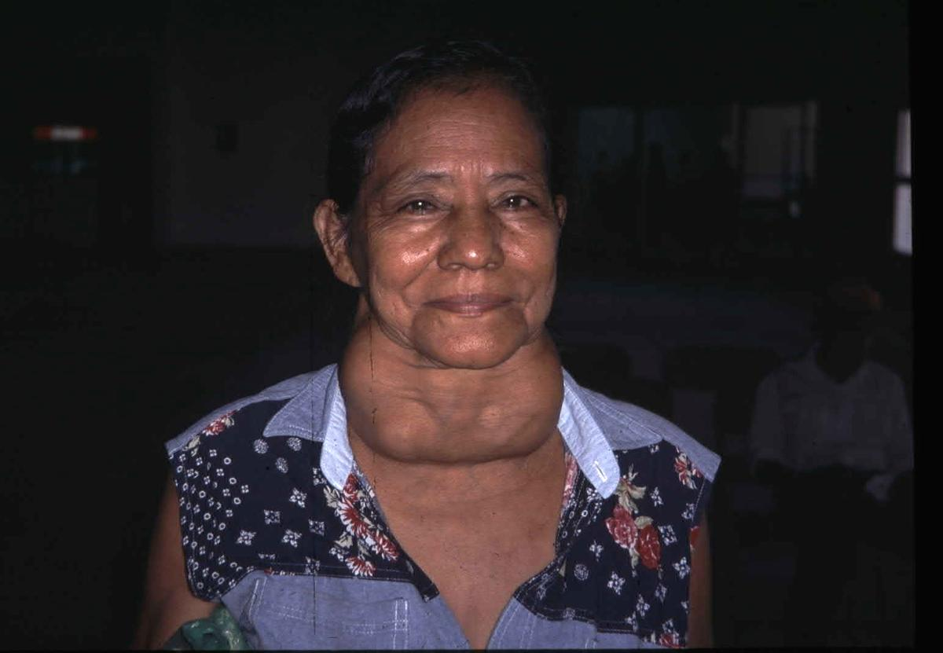

Slide 48
Management of Nontoxic Goitre
L-thyroxine suppressive therapy:
Doses of 0.1 to 0.2mg daily is required
Aim is to suppress TSH to 0.1-0.4 microU/L (N 0.5-5)
Suppression therapy works in 50% of cases if continued for 1 year
If suppression does not work or if there are obstructive symptoms from the start then surgery is necessary

Slide 49
Benign Thyroid Nodules
Thyroid nodules are common especially among older women
Etiology:
Focal thyroiditis
Dominant portion of multinodular goitre
Thyroid, parathyroid, or thyroglossal cysts
Agenesis of a thyroid lobe
Postsurgical remnant hyperplasia or scarring
Postradioiodine remnant hyperplasia
Benign adenomas:
Follicular
Colloid or macrofollicular
Hurthle cell
Embryonal
Rare: Teratoma, lipoma, hemangioma

Slide 50
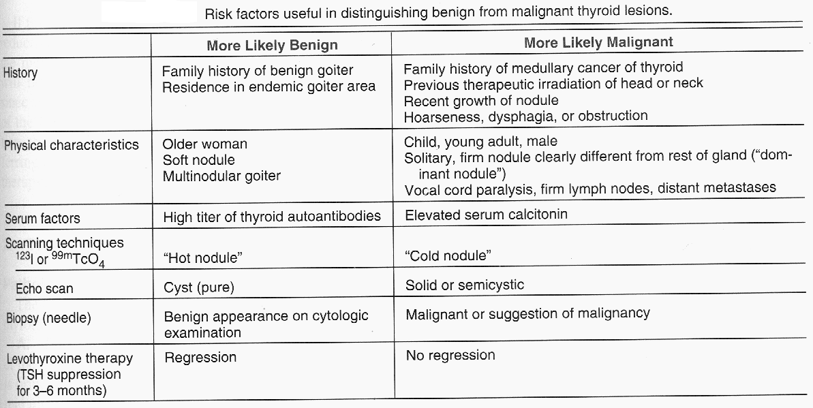

Slide 51
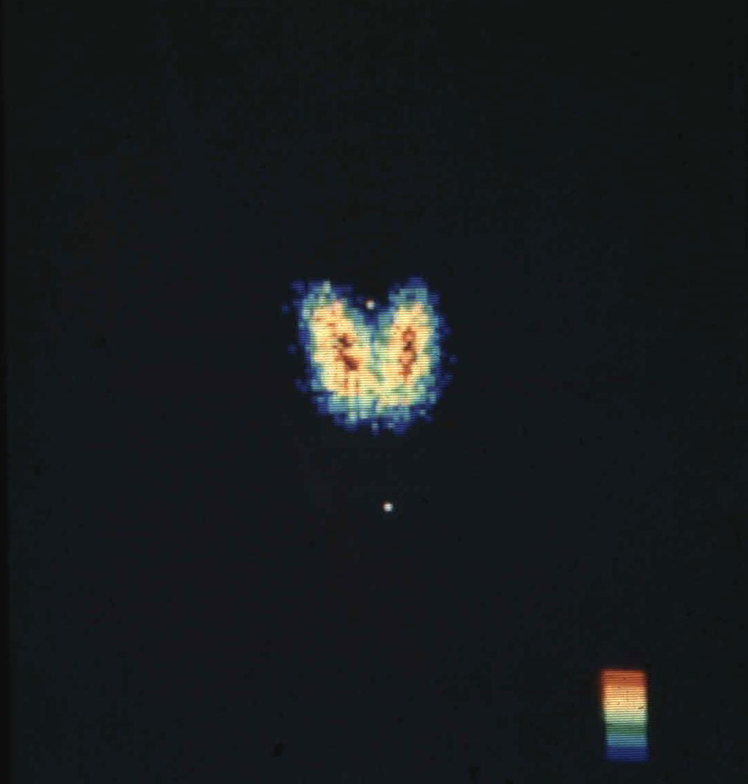

Slide 52
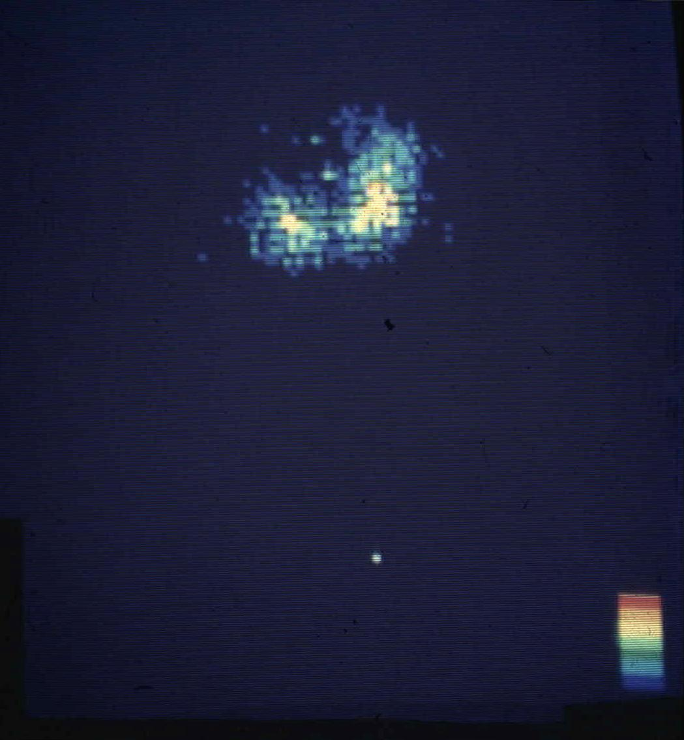

Slide 53
Thyroid Cancer
Approximate frequency of malignant thyroid tumours
Papillary carcinoma (including mixed papillary and follicular | 75%
Follicular carcinoma | 16%
Medullary Carcinoma | 5%
Undifferentiated carcinomas | 3%
Miscellaneous (e.g. lymphoma, fibrosarcoma, squamous cell ca, teratoma, & metastatic ca) | 1%

Slide 54
Papillary Carcinoma
Usually presents as a nodule that is firm, solitary, “cold” on isotope scan, and usually solid on thyroid US
In MNG, the cancer is usually a “dominant nodule” that is larger, firmer and different from the rest of the gland
10% of papillary ca present with enlarged cervical nodes
Grows very slowly and remains confined to the thyroid gland and local lymph nodes for many years.
In later stages they can spread to the lung
Death usually from local disease or lung metastases
May convert to undifferentiated carcinoma
Many of these tumours secrete thyroglobulin which can be used as a marker for recurrence or metastasis of the cancer

Slide 55
Follicular Carcinoma
Differs from follicular adenoma by the presence of capsular or vascular invasion
More aggressive than papillary ca and can spread either by local invasion of lymph nodes or by blood vessel invasion with distant metastases to bone or lung
Death is due to local extension or to distant bloodstream metastasis with extensive involvement of bone, lungs & viscera
These tumours often retain the ability to concentrate RAI
A variant of follicular carcinoma is the “Hurthle cell” carcinoma. These tumours behave like follicular cancer except that they rarely take up RAI
Thyroglobulin secretion by follicular carcinoma can be used to follow the course of the disease

Slide 56
Management of Papillary and Follicular Carcinoma
Patients are classified into low risk and high risk groups
The low risk group includes patients under age 45 with primary lesions under 1cm and no evidence of intra- or extraglandular spread. Lobectomy is adequate therapy for these patients.
All other patients are considered high risk and require total thyroidectomy. Modified neck dissection is indicated if there is lymphatic spread.
Surgery is usually followed by RAI ablation therapy
Patient is placed on L-thyroxine suppressive therapy
Regular F/U with thyroglobulin level, thyroid US, whole body scan etc.

Slide 57
Medullary Carcinoma
A disease of the C cells (parafollicular cells)
More aggressive than papillary or follicular carcinoma but not as aggressive as undifferentiated thyroid cancer
It extends locally, and may invade lymphatics and blood vessels
Calcitonin and CEA are clinically useful markers for DX and F/U
80% of medullary ca are sporadic and the rest are familial. There are 4 familial patterns:
FMTC without endocrine disease
MEN 2A: medullary ca + pheochromocytoma + hyperparathyroidism
MEN 2B: medullary ca + pheochromocytoma + multiple mucosal neuromas
MEN 2 with cutaneous lichen amyloidosis
The familial syndromes are associated with mutations in the ret proto-oncogene (a receptor protein kinase gene on chrom. 10)
Dx is by FNA bx. Pt needs to be screened for other endocrine abnormalities found in MEN 2. Family members need to be screened for medullary ca and MEN 2 as well.

Slide 58
Undifferentiated (Anaplastic) Carcinoma
This tumour usually occurs in older patients with a long history of goitre in whom the gland suddenly—over weeks or months—begins to enlarge and produce pressure symptoms, dysphagia, or vocal cord paralysis.
Death from massive local extension usually occurs within 6-36 months
These tumours are very resistant to therapy

