Slide 1
CALCIUM AND PHOSPHATE METABOLISM AND DISORDERS OF CALCIUM AND PHOSPHATE METABOLISM
KIMAIGA H.O
MBChB (University of Nairobi)

Slide 2
Outline
Review of calcium and phosphate metabolism
Abnormalities of calcium balance
Abnormalities of phosphate balance
Example cases

Slide 3
CALCIUM AND PHOSPHATE METABOLISM
Co exist in relatively fixed form proportions in mineral phase of hard tissues – bone dentin and enamel
Calcium ions and inorganic phosphate depend in part on balance between bone mineral deposition and bone resorption
Regulation of calcium ions and inorganic phosphate – Parathyroid Hormone, Vitamin D and Calcitonin

Slide 4
CALCIUM
Most is extracellular - 99% is in hard tissues exists in crystalline hydoxyapatite form.
Exists in plasma in 3 physicochemical states.
Approx 45% - protein bound – most 80% to albumin and 20% to globulin.
Approx 45% - ionized form – is the physiologically active form.
Approx. 10% - complexed with citrate, lactate, phosphate bicarbonate.

Slide 5
The ionized form is in dynamic equilibrium with other forms – is affected by pH and Plasma proteins
serum levels:2.2-2.6mmol/l
in-25mmol;out-20mmol-stool,5mmol-urine
Acidosis leads to dissociation hence increase in ionized calcium while in alkalosis,hydrogen ions dissociate from albumin,and calcium binding increases

Slide 6
Different Forms of Calcium
At any one time, most of the calcium in the body exists as the mineral hydroxyapatite, Ca₁₀(PO₄)₆(OH)₂.
Calcium in the plasma:
45% in ionized form (the physiologically active form)
45% bound to proteins (predominantly albumin)
10% complexed with anions (citrate, sulfate, phosphate)
To estimate the physiologic levels of ionized calcium in states of hypoalbuminemia:
[Ca⁺²]_{Corrected} = [Ca⁺²]_{Measured} + [ 0.8 (4 – Albumin) ]

Slide 7
Physiological Functions of Calcium
Intracellular calcium plays a vital role in;
Regulating cell functions especially adenylate cyclase and phosphodieterase
Function as plasma membrane and regulates membrane permeability and affects neuromuscular release
Regulation of secretions of endocrine glands – parathyroid hormone, calcitonin
Important in cell coagulation

Slide 8
Major Mediators of Calcium and Phosphate Balance
Parathyroid hormone (PTH)
Calcitriol (active form of vitamin D₃)

Slide 9
Role of PTH
Stimulates renal reabsorption of calcium
Inhibits renal reabsorption of phosphate
Stimulates bone resorption
Inhibits bone formation and mineralization
Stimulates synthesis of calcitriol
Net effect of PTH →
↑ serum calcium
↓ serum phosphate

Slide 10
Regulation of PTH
Low serum [Ca⁺²] → Increased PTH secretion
High serum [Ca⁺²] → Decreased PTH secretion

Slide 11
Role of Calcitriol
Stimulates GI absorption of both calcium and phosphate
Stimulates renal reabsorption of both calcium and phosphate
Stimulates bone resorption
Net effect of calcitriol →
↑ serum calcium
↑ serum phosphate

Slide 12
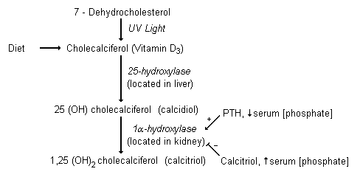
Regulation of Calcitriol

Slide 13
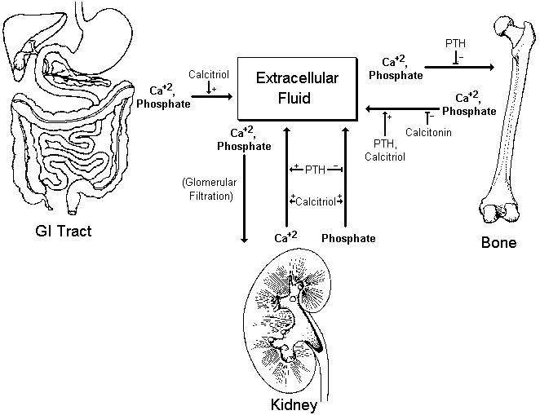
Overview of Calcium-Phosphate Regulation

Slide 14
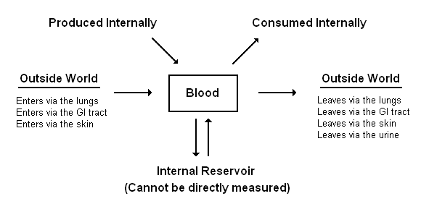
Overview of Biochemical Homeostasis

Slide 15
PHOSPHATE
Distributed equally between extracellular and intracellular compartments.
Intracellular phosphate – component of structural organic – macro-molecules – phospholipids and phosphoproteins – called organic phosphate.
Extracellular phosphate – occurs in organic form as hydoxyapatite.
Plasma or serum phosphate – most occurs in the inorganic form (Pi) as mono or dihydrogen forms.
normal serum levels:0.80-1.40mmol/l
15% of plasma phosp is protein bound the rest in complexed and free form.

Slide 16
HYPOCALCIMIA
Chronic renal failute
Hypoalbuminemia
Magnesium deficiency
Hypoparathyroidism
Osteomalacia and rickets due to vitamin D deficiency or resistance.
Healing phase of bone disease of treated hypoparathyroidism, and haematological malignancies
Thyroidectomy + surgical removal of the parathyroids.

Slide 17
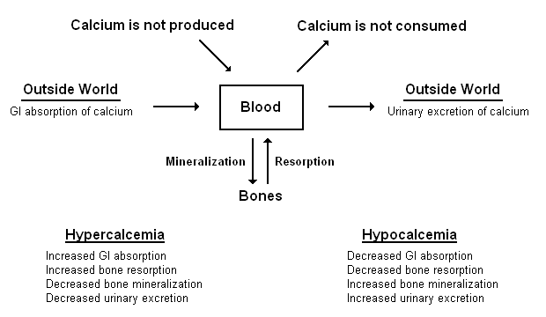
Overview of Calcium Balance

Slide 18
Etiologies of Hypocalcemia
Decreased GI Absorption
Poor dietary intake of calcium
Impaired absorption of calcium
Vitamin D deficiency
Poor dietary intake of vitamin D
Malabsorption syndromes
Decreased conversion of vit. D to calcitriol
Liver failure
Renal failure
Low PTH
Hyperphosphatemia
Decreased Bone Resorption/Increased Mineralization
Low PTH (aka hypoparathyroidism)
PTH resistance (aka pseudohypoparathyroidism)
Vitamin D deficiency / low calcitriol
Hungry bones syndrome
Osteoblastic metastases
Increased Urinary Excretion
Low PTH
s/p thyroidectomy
s/p I¹³¹ treatment
Autoimmune hypoparathyroidism
PTH resistance
Vitamin D deficiency / low calcitriol

Slide 19
Causes of Hypercalcaemia
Primary hyperparathyroidism
Malignancy
PTH producing tumors
Skeletal metastasis of tumor
Multiple myeloma
Vitamin D toxicity
Drug induced hypercalcemia – thiazides
Sarcoidosis – absorption of calcium in GIT; secondary to vitamin D hypersensitivity
renal disease
milk alkali syndrome
Thyrotoxicosis-increases osteoclastic activity n causes osteoporosis
Immobilization esp Paget's disease, e.g patients with pelvic bone fractures.

Slide 20
Etiologies of Hypercalcemia
Increased GI Absorption
Milk-alkali syndrome
Elevated calcitriol
Vitamin D excess
Excessive dietary intake
Granuomatous diseases
Elevated PTH
Hypophosphatemia
Increased Loss From Bone
Increased net bone resorption
Elevated PTH
Hyperparathyroidism
Malignancy
Osteolytic metastases
PTHrP secreting tumor
Increased bone turnover
Paget’s disease of bone
Hyperthyroidism
Decreased Bone Mineralization
Elevated PTH
Aluminum toxicity
Decreased Urinary Excretion
Thiazide diuretics
Elevated calcitriol
Elevated PTH

Slide 21
Hyperphosphatemia
Poisoning – phosphate containing laxatives;excessive intake;vit D intoxication
Respiratory acidosis-prevents entry into cells
Redistribution-cell damage eg haemolysis,tumors and rhabdomyolysis
Chronic renal failure
Hypoparathyroid state;pseudohypoparathyroidism-tissue resistance to PTH
Acromegally

Slide 22
Hypophosphatemia <0.3mmol/l
Hyperparathyroidism
Intake; deficiency of dietary phosphate
Hungry Bone Syndrome
Refeeding syndrome-in malnourished patients

Slide 23
Redistribution – glucose infusion and respiratory alkalosis-moves into cells;diabetic ketoacidosis Rx -insulin shifts phosphate into cells
Renal causes;
Specific phosphate transport defects are x-linked dominant hypophosphatemia
Multiple renal tubular transport defect e.g. idiopathic fanconi syndrome and galactosaemia ;diuretics

Slide 24
Laboratory findings depends on the cause
Changes (serum) of calcium, inorganic phosphate, 25 – OH D and 1 α25 (OH)₂D vary with different disorders
Vit D deficiency – serum calcium is normal or low
Phosphorus and 25OH-D – characteristically low
Renal tubular disorders – normal calcium but low phosphorus (inorganic)
Chronic renal failure;
Hyperphosphatemia
Hypocalcemia
Normal 25(OH)D
Low 1,25(OH₂)D
Radiological investigations are important
ADJUSTED CALCIUM(mmol)=Total measured calcium+0.02(47-albumin)

Slide 25
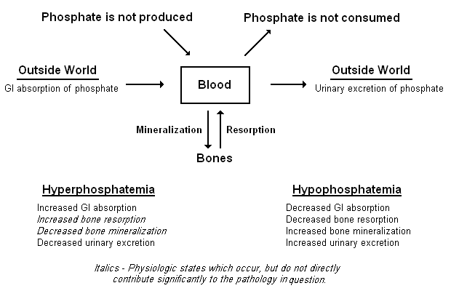
Overview of Phosphate Balance

Slide 26
Etiologies of Hyperphosphatemia
Increased GI Intake
Fleet’s Phospho-Soda
Decreased Urinary Excretion
Renal Failure
Low PTH (hypoparathyroidism)
s/p thyroidectomy
s/p I¹³¹ treatment for Graves disease of thyroid cancer
Autoimmune hypoparathyroidism
Cell Lysis
Rhabdomyolysis
Tumor lysis syndrome

Slide 27
HYPOPHOSPHATEMIA - causes
Redistribution – intracellular shift glucose – oral or intravenous hyperalimentation.
Lowered renal phosphate threshold
Primary or secondary hyperparathyroidism.
Renal tubular defects –
(i)familial hypophosphatemia
(ii)Fanconi syndrome
• Decreased net intestinal
phosphate absorption.
Increased loss
Vomiting
Diarrhea
Phosphate binding antacids.
- Decreased absorption
Mal absorption syndrome
Vit D deficiency
• Intracellular phosphate loss – acidosis Ketoacidosis, lactic acidosis

Slide 28
Etiologies of Hypophosphatemia
Decreased GI Absorption
Decreased dietary intake (rare in isolation)
Diarrhea / Malabsorption
Phosphate binders (calcium acetate, Al & Mg containing antacids)
Decreased Bone Resorption / Increased Bone Mineralization
Vitamin D deficiency / low calcitriol
Hungry bones syndrome
Osteoblastic metastases
Increased Urinary Excretion
Elevated PTH (as in primary hyperparathyroidism)
Vitamin D deficiency / low calcitriol
Fanconi syndrome
Internal Redistribution (due to acute stimulation of glycolysis)
Refeeding syndrome (seen in starvation, anorexia, and alcholism)
During treatment for DKA

Slide 29
Case 1
Mrs. T is a 59 year old woman with a past medical history significant for hypertension who comes for a routine clinic visit. She initially states that she has no symptomatic complaints, but later in the interview describes chronic fatigue and a mildly depressed mood. Her exam is unremarkable. Labs are as follows:
Calcium (total) – 11.9 mg/dL (normal ~ 8.5-10.2 mg/dL)
Phosphate – 1.8 mg/dL (normal ~ 2.0-4.3 mg/dL)
Albumin – 3.8 g/dL (normal ~ 3.5-5.0 g/dL)
PTH – 124 pg/mL (normal ~ 10-60 pg/mL)
Creatinine – 1.2 mg/dL

Slide 30
Case 2
Mr. G is a 40 year old man with a history of alcoholism. He had not seen a doctor for 15 years before police brought him to the ER after finding him confused and disheveled behind a local convenience store. In the ER, he was thought to be confused simply due to intoxication, but was admitted for mild alcoholic hepatitis and marked malnutrition. His mental status cleared up about 8 hours after admission. During morning rounds on hospital day #2, he complained of feeling fatigued and weak. Later that day, the nurses find him seizing. The seizures stop with low dose IV diazepam. Stat labs are sent:
Sodium – 136 meq/L
Potassium – 3.2 meq/L
Calcium (total) – 6.8 mg/dL (normal ~ 8.5-10.2 mg/dL)
Phosphate – 0.7 mg/dL (normal ~ 2.0-4.3 mg/dL)
Albumin – 1.8 g/dL (normal ~ 3.5-5.0 g/dL)
Creatinine – 1.3 mg/dL
CK – 3500 U/L

Slide 31
Case 3
Mr. H is a 74 year old man with a past history significant for hypertension and COPD from smoking 2 packs per day for the last 40 years. He presented to an urgent pulmonary clinic appointment with 2 months of increased cough and 5 days of “mild” hemoptysis. Upon further obtaining further history, he reports feeling fatigued, nauseous, and chronically thirsty for several weeks. His exam is significant for bilateral rhonchi (no change from baseline lung exam) and absent reflexes. Stat labs are ordered from clinic:
Sodium – 138 meq/L CBC, PT/PTT – WNL
Potassium – 3.7 meq/L PTH - Pending
Magnesium – 1.8 mg/dL Albumin – 2.2 g/dL
Calcium (total) – 13.1 mg/dL
Phosphate – 1.3 mg/dL
Creatinine – 2.8 mg/dL (baseline creatinine = 1.1)

Slide 32
Case 4
Miss L is a 16 year old woman with no significant past medical history, who is brought to the ER by her mother after she noted her to be acting bizarrely for the past several weeks. Thought to be actively psychotic, a psychiatry consult is asked to see the patient, who recommends checking routine labs:
Sodium – 142 meq/L Urine tox. screen – Negative
Potassium – 4.1 meq/L Urine pregnancy - Negative
Magnesium – 2.3 mg/dL
Calcium (total) – 6.9 mg/dL
Phosphate – 4.4 mg/dL
Albumin – 4.2 g/dL
Creatinine – 0.8 mg/dL

