Slide 1
ABNORMAL LFTS AND MANAGEMENT OF LIVER FAILURE

Slide 2
PATTERN OF ABNORMAL LFTS
Hepatocellular – ALT/AST>ALP; Bilirubin is normal or high; INR/ALB is normal or abnormal
Cholestatic – ALP>ALT/AST; Bilirubin is normal or high; INR/ALB is normal or abnormal
Isolated abnormalities – Elevated bilirubins or single enzymes
Mixed pattern – Equally elevated parameters

Slide 3
TYPICAL PATTERNS OF ALT/AST
Alcoholic fatty liver disease: AST <8X ULN, ALT <5X ULN
Non-alcoholic fatty liver disease: AST and ALT < 4 X ULN
Acute viral hepatitis or toxin-related hepatitis with jaundice: AST and ALT > 25 X ULN
Ischemic Hepatopathy (ischemic hepatitis, shock liver): AST and ALT > 50 X ULN(in addition the LDH is often markedly elevated)
Chronic hepatitis C virus infection: wide variability; typically normal to less than twice the ULN, rarely more than 10 X ULN
Chronic hepatitis B virus infection: levels fluctuate; the AST and ALR may be normal, though most patients have mid-moderate elevations (approx. 2X ULN); with exacerbations, levels are more than 10 X ULN.

Slide 4
MARKED ELEVATION IN ALT/AST
Acute viral hepatitis syndrome/veno-occlusive disease
Paracetamol poisoning
Alcoholic hepatitis
Autoimmune hepatitis
Wilson’s disease
Sepsis
Ischemic Hepatopathy
Budd Chiarri
Post hepatectomy
HELLP
Heat stroke
Toxins
Malignant infiltration
Muscle disorders etc.

Slide 5
MILD-MODERATE ELEVATION IN ALT/AST (2-15 X ULN)
Medications
Coeliac disease
Chronic viral hepatitis
NAFLD Alcoholic liver disease
Anorexia nervosa
Hemochromatosis
Adult bile ductopenia
Thyroid disorders
Adrenal insufficiency

Slide 6
APPROACH TO ABNORMAL LIVER CHEMISTRY
History: focus on risk factors for liver disease:
Alcohol, substance use
Medications
Transfusions
Tatoos
Sexual promiscuity
Family history of liver disease
Autoimmune disease
P/E: focus on stigmata for liver diseases such as ascites, jaundice, splenomegaly and dermatological manifestation of liver disease
Neurologic exam to exclude Wilson’s disease and hepatic encephalopathy

Slide 8
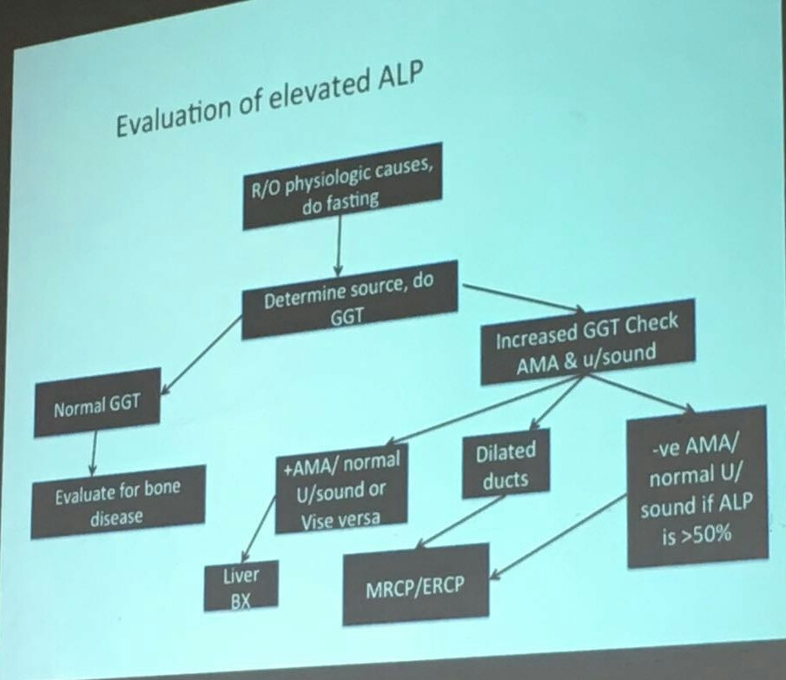

Slide 9
CAUSES OF ISOLATED HYPER-GGT
Pancreatic disease
Myocardial infarction
Renal failure
COPD DM
Alcoholism especially with AST/ALT ratio of 2:1
Phenytoin and barbiturates

Slide 10
ISOLATED HYPERBILIRUBINEMIA
Conjugated:
Biliary obstruction: usually high ALP/GGT
Dubin Johnson & Rotor syndrome: mild elevation of bilirubin; normal ALP/GGT
Unconjugated:
Medications: rifampicin, probenecid
Hemolysis
Gilbert syndrome: 3-7% of population; M:F -> 2-7:1
Criggler-najjar syndrome type 1 and 2

Slide 11
EVALUATION
Bilirubin – conjugated and unconjugated
ALT/AST levels
Alkaline phosphatase
gGT
Albumin
INR
FBC
Hepatitis antibodies (A-E): EBV, Toxoplasma, CMV, Leptospirosis
Ferritin and fasting transferrin saturation
Hemochromatosis genetics
Caeruloplasmin and copper (serum)
24 hour urine for copper
Autoantibodies: ANA, ASMA, AMA< Coeliac
Immunoglobulins: IgG, IgA, IgM
Cholesterol, triglycerides, glucose, TFTS
Alpha 1 antitrypsin levels (+/- phenotype)
Alpha fetoprotein (cirrhotics only)

Slide 12
IMAGING
Ultrasound – liver substance, lesions, gall bladder and biliary tree, vessels (Doppler exam), spleen size and varices
CT scan – confirm small lesions, see pancreas
MRI of liver – classify smaller lesions
MRCP: Magnetic resonance cholangiopancreatography, to see biliary tree
ERCP: Endoscopic Retrograde cholangiopacreatography – diagnostic and therapeutic: stones, strictures etc.

Slide 13
LIVER FAILURE
Acute: coagulopathy (abnormal INR) and encephalopathy within 8-26 weeks in a patient with no prior history of liver disease
Chronic: Coagulopathy and encephalopathy in a patient with pre-existing liver disease

Slide 14
SYMPTOMS
Altered mental status and coagulopathy in the setting of acute hepatic disease
Fulminant considered < 8 weeks from jaundice to encephalopathy
Sub-fulminant < 26 weeks
Jaundice
Encephalopathy – stupor, coma
Decreased synthetic function with INR > 1.5
New ascites

Slide 15
DIFFERENTIAL DIAGNOSIS
Vascular: Budd-Chiari (HVT), Ischemia ‘shock liver’, hepatic veno-occlusive disease, portal vein thrombosis, arterial thrombosis
Infectious: Hepatitis A/B, HSV, CMV, EBV, Hemorrhagic fever viruses (Ebola, Hassa, marbug), paramyxoviruses; Toxoplasma, Leptospira, Candida, Brucella, Mycobacteria
Trauma: laceration
Autoimmune/Inflammatory: Autoimmune hepatitis, Reye syndrome, Adult onset Still’s disease (systemic RA)
Metabolic: fatty liver of pregnancy, HELLP
Inherited/congenital: Wilson‘s disease, haemochromatosis, Alpha-1 antitrypsin deficiency, Galactosemia, Tyrosinemia, Urea cycle disorders (Ornithine transcarbamylase def.), fructose intolerance
Neoplastic: primary vs. metastatic lesions
Drugs/toxins

Slide 16
CONT.
Toxins:
Dose-dependent toxin mediated
Bacillus cereus toxin
Cyanobacteria toxin
Organic solvents (e.g. carbon tetrachloride)
Yellow phosphorus (fireworks)
Amanita phalloides mushroom toxin
Golerina mushrooms
Illicit drugs
Ecstaasy
Cocaine
Herbal supplements
Ginseng
Pennyroyal oil
Teucrium polium
Chaparral or germander tea
Kava Kava

Slide 17
RADIOLOGY
CT head: cerebral edema, mass lesions
Liver U/S with dopplers: eval clot, parenchyma
Liver CT vs. MRI: delineate anatomy for possible transplantation
EEG: in the obtunded patient to R/O seizures

Slide 18
OTHER STUDIES
Liver biopsy: trans-jugular, contraindicated in coagulopathy
ICP monitoring with extra vs. intra-dural catheters, again with care in coagulopathy

Slide 19
CEREBRAL EDEMA
Vasogenic and cytotoxic in origin
Ammonia -> glutamine which accumulates in cortical astrocytes
Increased cerebral blood flow via:
Increased NO₂
Increased TNF alpha
Increased Il6
Increased IL2
Increased bacterial endotoxin

Slide 20
INITIAL MANAGEMENT: ED
Labs as indicated
Triage to appropriate service: consider ICU when grade II encephalopathy is present for new disease for frequent neuro checks
N-acetylcysteine
Intubation if GCS < 8, grade III encephalopathy
Use short-acting, low dose medications only
Head CT
Encephalopathy:
Grade I: confused, altered mood
Grade II: Inappropriate, drowsy
Grade III: Stuporous but arousable, markedly confused
Grade IV: Coma, unresponsive to pain

Slide 21
MANAGEMENT ANTIDOTES
Amanita – penicillin G 1mg/kg/d +/- activated charcoal
Silibinin – derivative of milk thistle, antioxidant (proposed but not well studied)
Inchinko-to – Chinese herbal preparation for Cholestatic hepatitis (proposed suppression of TNF alpha, inhibition of hepatic apoptosis)

Slide 22
MANAGEMENT COAGULOPATHY
Correction of coagulopathy not indicated unless active bleeding is present or procedure
FFP 15 mL/kg or 4 units
Cryoprecipitate
FVIIa for unresponsive bleeding 4mcg/kg push
Platelet transfusion only < 10K or procedure <50K

Slide 23
MANAGEMENT: RENAL FAILURE
1/3 of patient will develop Oliguric ARF
Fluid resuscitation
CVVHD as indicated
Avoid nephrotoxic medications
Avoid NSAIDs

Slide 24
MANAGEMENT: CV AND ENDOCRINE
Fluid resuscitation
Low SVR with normal or increased CO
Dopamine or NE parenteral
Impaired gluconeogenesis
Frequent capillary blood glucose q1/2
D5/10 containing solution as necessary
Monitoring potassium, phosphate and magnesium

Slide 25
MANAGEMENT: ANTIBIOTICS
Empiric antibiotics for:
Progressive encephalopathy
Signs of SIRS (temperature > 38⁰C or < 36⁰C; WBC pf > 12000 mcL or < 4000/mcL; PR of > 90 bpm)
Persistent hypotension
Tazocin and fluconazole considered initially. IN hospital-acquired IV catheter infections, consider vancomycin

Slide 26
MANAGEMENT: CEREBRAL EDEMA
Mechanical ventilation to protect the airway and hyperventilate (short-lived)
Head of bled elevated to 30º
Mannitol (0.5 – 1g/kg) goal Osm around 320
Hypertonic saline 3% (goal Na 145-155)
Barbiturate coma
Hypothermia is under investigation
Seizure control with phenytoin
Call neurology/neurosurgery
Refractory increased ICP r decreased CPP is a contraindication for transplantation in most centers

Slide 27
MELD (MODEL FOR END STAGE LIVER DISEASE)
3.78 [Ln serum bilirubin (mg/dL)] + 11.2 [Ln INR] + 9.57 [Ln serum creatinine (mg/dL)] + 6.43
Utilized to prioritize transplant recipients
In hospitalized patients, the 3 month mortality is
40 0r more – 100% mortality
30-39 – 83% mortality
20-29 – 76% mortality
10-19 – 27% mortality
<10 – 4% mortality

Slide 28
CHRONIC LIVER FAILURE
Principles similar to acute liver failure
Cerebral edema is not common
Ammonia reduction mainstay of management of encephalopathy
All other interventions are as in acute liver failure

