Slide 1
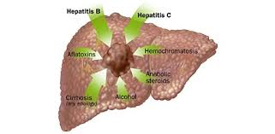
Hepatocellular carcinoma
EDNA KAMAU
Gastroenterologist

Slide 2
introduction
Hepatocellular carcinoma is a primary tumor of the liver.
Occurs commonly in patients with chronic liver disease especially viral hepatitis

Slide 3
epidemiology
Men -fifth most common cancer worldwide, and second leading cause of cancer-related death
In women-seventh most common cancer and the sixth leading cause of cancer death
high case fatality- Cancer death parallel the cancer incidence
In kenya- liver cancer 7th most common cancer in males & 9th amongst females ( 70% are HCC) 2006

Slide 4
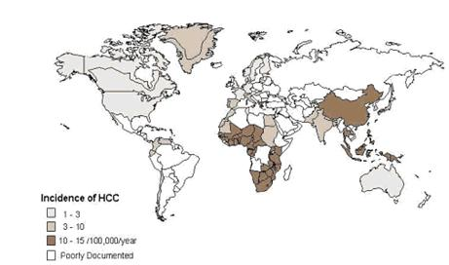
Epidemiology……

Slide 5
Sex: men more affected- esp. in high-incidence regions, 2.1 -5.7 times women (mean 3.7:1)
Age: Asia and Western Europe mean age -50 and 60 years. In sub-Saharan Africa -33 years
Race: incidence highest in Asians, then Blacks, least in whites.-related to underlying liver ds, genetics and enviromental exposure

Slide 6
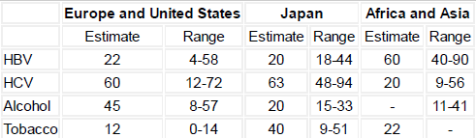
Risk factors
Chronic hepatitis B
Chronic hepatitis C
Enviromental toxins-alfatoxin
Alcohol
Tobacco
Chronic cirrhosis from other causes-hemachromatosis, Alpha -1 anti-trypsin deficiency
Non alcoholic fatty liver disease

Slide 7
Chronic hepatitis B
Higher with HepBeAg positive
Risk directly related to serum level of HBV DNA
Treatment of chronic Hep B with interferons and nucleotide analogues reduces the risk
Increased risk in males, older age, alcohol consumption, elevated serum ALT levels, co-infection with HCV

Slide 8
Chronic hepatitis C
Accounts for 1/3 of HCC cases in developed countries
HCC occurs in patients with advanced fibrosis and cirrhosis unlike Hep B
male=female
Risk increases with viral load
Treatment with interferon reduces the risk

Slide 9
Aflatoxin
Aflatoxin is a mycotoxin produced by the aspergillus molds which infest maize, peanuts, rice and wheat.
Chronic low level exposure to especially aflatoxin B1 leads to HCC thru mutations of the p53 tumor suppressor gene
Risk potentiated by HBV

Slide 10
CLINICAL FEATURES
Usually no symptoms other than those of chronic liver ds. Suspect HCC if sudden decompensation of stable chronic liver ds
mild to moderate upper abdominal pain, weight loss, early satiety, or a palpable mass in the upper abdomen
Obstructive jaundice

Slide 11
Clinical features…..
Paraneoplastic syndrome-hypoglycemia, erythrocytosis, hypercalcemia, or severe watery diarrhea
lung, intraabdominal lymph nodes, bone, and adrenal gland. Brain metastases are rare

Slide 12
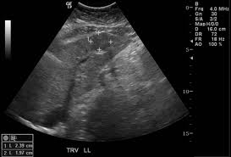
Diagnosis-Imaging
Ultrasound – characteristics of a hepatic lesion that are suggestive of HCC include, hypoechoic lesions, poorly-defined margins and coarse, irregular internal echoes.
60% sensitivity and 97% specificity in the cirrhotic population

Slide 13
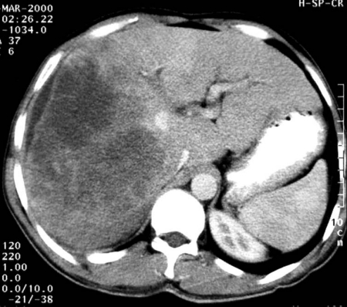
CT scan- appears as a focal nodule with early enhancement on the arterial phase with rapid washout of contrast on the portal venous phase of a 3-phase contrast scan.
-sensitivity 68 % and specificity 93%
MRI -high signal intensity on T2 imaging

Slide 14
Tumor markers
Alpha fetoprotein levels-> 400ng/ml diagnostic of HCC if accompanied by a space occupying lesion in a cirrhotic liver
<400ng/ml to normal levels-regenerative nodules and inflammation
Normal values do not exclude HCC

Slide 15
In patients with elevated AFP and consistent imaging characteristics, patients can be treated presumptively for hepatocellular carcinoma without a biopsy

Slide 16
Biopsy
In patients with hepatic nodules resembling HCC >2 cm with low AFP
Directed core biopsies (US/CT-scan guided) more useful than fine needle biopsy because of the increased amount of tissue obtained and the ability to obtain uninvolved hepatic parenchyma

Slide 17
Histopathology
- well-differentiated (with individual hepatocytes appearing nearly identical to normal hepatocytes) or poorly differentiated lesions consisting of large multinucleate anaplastic tumor giant cells
Central necrosis of large tumors is common

Slide 18
Evaluation for metastasis
- CT scan abdomen-Extension beyond the liver precludes cure
- CT scan chest/ Chest X-ray

Slide 19
Surveillance for hepatocellular carcinoma in patients with chronic liver disease
Who
All patients with liver cirrhosis
HBV carriers without cirrhosis who are
  Asian men over the age of 40 years
  Asian women over the age of 50 years
  Africans and North American blacks
  Patients with a family history of HCC
How: 6 monthly AFP and Abdominal Ultrasound

Slide 20
Treatment
It is typically diagnosed late in its course, median survival -6 to 20 months
choice treatment modality depends on extent of the disease and severity of underlying liver disease which limits the tolerance to any therapy

Slide 21
Surgical resection
Potentially curative partial hepatectomy is the optimal treatment for HCC in patients with adequate liver functional reserve.
Solitary HCC (<5 cm), confined to the liver with no radiographic evidence of invasion of the hepatic vasculature, no evidence of portal hypertension, and well-preserved hepatic function.
Most pts not eligible due to tumor size and hepatic dysfunction

Slide 22
Liver transplantation
indicated in patients who are unresectable because of the degree of underlying liver dysfunction rather than tumor extent
solitary HCC ≤5 cm in diameter or up to three separate lesions none of which is larger than 3 cm, no evidence of gross vascular invasion, and no regional nodal or distant metastases.

Slide 23
Other approaches
Indicated In patients with unresectable disease, who are poor transplant candidates but with local disease
Radiofreqeuncy ablation
Transrterial chemoembolization
Percutaneous ethanol or acetic acid injection

Slide 24
Systemic therapy
Molecularly targeted therapy: sorafenib
Alone or in combination with doxorubicin
In patients with advanced HCC
Systemic chemotherapy in advanced HCC not routinely used as tumor is chemotherapy refractory. Response rate < 20%. Therefore not recommended

Slide 25
Other hepatic masses

Slide 26
Malignant
Benign

Slide 27
Malignant hepatic tumors
Metastatic Tumors
Commonest liver cancer in developed countries
U/S findings: adenocardinoma-multiple hypoechoeic masses
CT-Scan-multiple hypoechoeic lesions

Slide 28
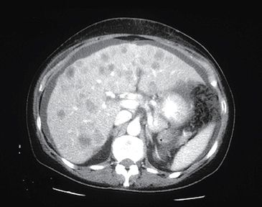
CT Scan- liver metastasis from the colon

Slide 29
cholangiocarcinoma
Suspect in patients with history of chronic cholestatic liver diseases such as primary sclerosing cholangitis, long standing choledochocele and intrahepatic lithiasis due to parasites
Do Endoscopic retrograde cholangiopancreatography for biliary brushings

Slide 30
Rare tumors
soft tissue sarcomas (such as epithelioid hemangioendothelioma, a low grade malignant neoplasm of vascular origin)
non-Hodgkin lymphoma
diaphragmatic cysts (which can appear to arise from the liver)

Slide 31
Benign liver masses
Cysts
Cavernous hemangiomas
Focal nodular hyperplasia
Hepatic adenomas
abscesses

Slide 32
Cysts
Ddx of cystic liver lesions: simple cysts, cystadenoma, cystadenocarcinoma, hepatic abscess, a necrotic malignant tumor, hemangioma, and hamartoma
simple cysts
-U/S -well-defined thin wall and increased through-transmission
-CT scan-a very sharply demarcated wall and near water density in the cyst. On contrast enhanced studies, no enhancement is detected within the cyst.

Slide 33
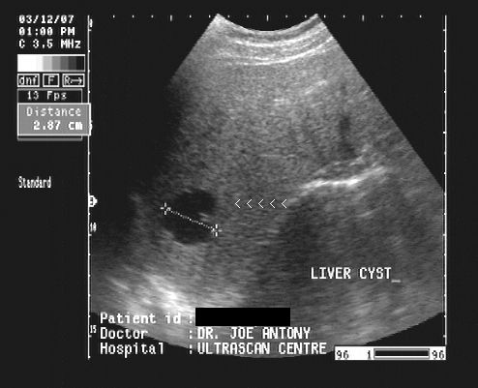
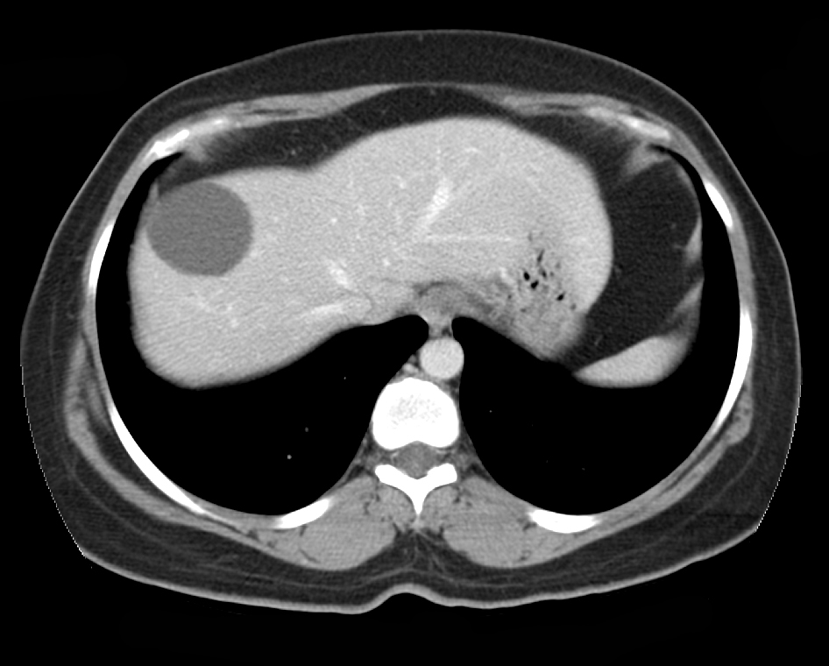
IMAGING
U/S
CT-SCAN

Slide 34
Common, increase with age
Usually asymptomatic , more in women, on right lobe
Larger cysts cause- spontaneous hemorrhage, rupture into the peritoneal cavity or bile duct, infection , and compression of the biliary tree
Small cysts do not need treatment

Slide 35
Large cysts->4cm do periodic U/S monitoring 3 months then yearly
If symptomatic or increasing in size consider cystadenoma –surgical management-deroofing or resection

Slide 36
POLYCYSTIC LIVER DISEASE
often associated with polycystic kidney disease. Incidence of liver ds increases with age
autosomal dominant polycystic liver disease, is distinct from polycystic kidney disease –genetic defect with a mutation in the PRKCSH gene & SEC63 gene

Slide 37
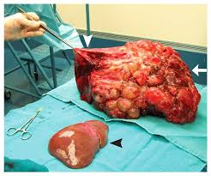
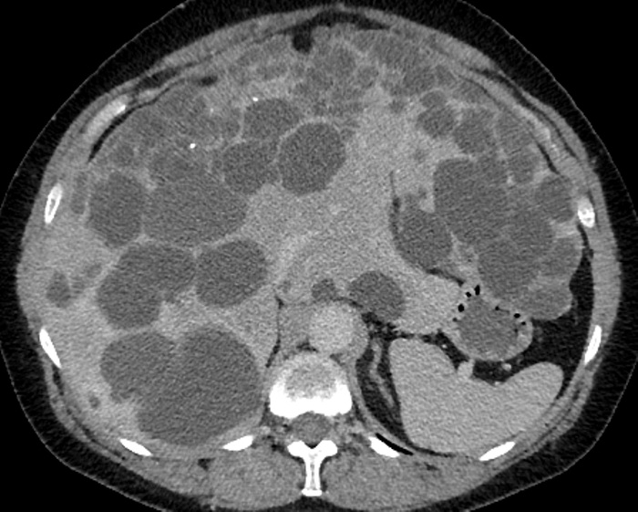
Polycystic liver disease

Slide 38
Hepatic hemangiomas
Most common benign liver tumor
Often solitary , 40% multiple
Few millimeters to over 20 cm. The majority are small (<5 cm). > 5cm giant hemangiomas
considered to be vascular malformations or hamartomas of congenital origin that enlarge
Hormonal influence important as increase in pg , with estrogen and progresterone and regress on withdrawal

Slide 39
Often asymptomatic
If large-Abdominal pain and RUQ discomfort
If <1.5 cm no need to follow-up
>5cm regular imaging
Surgical resection if large or symptomatic

Slide 40
Hepatic adenoma
benign epithelial liver tumor that usually occurs in noncirrhotic liver.
common in premenopausal women older > 30 with hx of oral contraceptives for >2 years prior to diagnosis
Most occur in the right lobe
Risk of rupture and malignant transformation to HCC

Slide 41
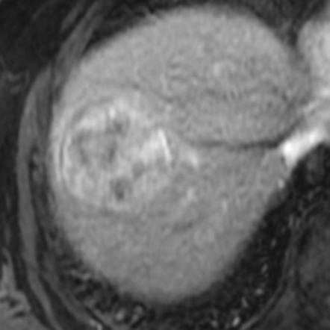
Diagnosis
U/S -usually hyperechoic in relation to the surrounding liver parenchyma
CT-scan-variable, difficult to differentiate from HCC
Normal AFP
Biopsy-not important, as they bleed and often non-diagnostic

Slide 42
Treatment
Given the risk of rupture and malignant transformation, HA should generally be resected.
Increase in pg, therefore avoid pregnancy till resection
If <5 cm and using contraceptives, stop then serially image, most regress
If no regression-resect

Slide 43
Focal nodular hyperplasia
benign liver tumor - hyperplastic response to an anomalous artery
Common in women in their 30s and 40s.
Majority dx incidentally during imaging studies or laparotomy performed for unrelated reasons
No relation with COC

Slide 44
Microscopically, the lesions have fibrous septae with bile ductular proliferation, blood vessels, and inflammatory cells
No malignant potential and very low risk of rupture therefore reassurance and prospective observation is recommended irrespective of size.
Surgical resection only in symptomatic patients, or when hepatic adenoma or HCC cannot be definitively excluded.

Slide 45
Pyogenic abscess
-local spread from contiguous infections within the peritoneal cavity
-hematogenous seeding of the liver
Organisms involved:
streptococcus milleri-most commonly inv.
Staph aureus, s. pyogenes and other staphylococci if previous transarterial chemoembolization
Klebsilla pneumonia
Candida-if using chemotherapy

Slide 46
non-specific symptoms: dull right upper quadrant abdominal pain, malaise, weakness, anorexia, and weight loss. They are often febrile and have rigors.
Fever in 95% of patients

Slide 47
25 to 50 % have hepatomegaly or splenomegaly
Laboratory -anemia and leukocytosis
- Elevated alkaline phosphatase and serum aminotransferases
Imaging:
Chest X-ray: right-sided pneumonitis, consolidation, or pleural effusion, elevated right hemidiaphragm

Slide 48
Abdominal X-ray- hepatic mass with an air fluid level
U/S: Single or multiple round or oval areas that are hypoechoic in relation to the surrounding liver. The portal vein may be thrombosed as a result of local phlebitis
CT–scan- rounded areas that do not enhance. surronded by an irregular or rim-like area of inflammation.

Slide 49
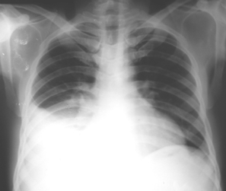
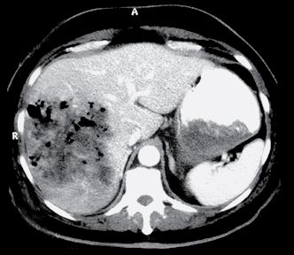
Imaging-abscess

Slide 50
Microbiology-aspirate obtained via CT or ultrasound-guided aspiration should be sent to the laboratory for gram stain and culture (both aerobic and anaerobic). bacterial organisms and polymorphonuclear cells seen on gram stain
Blood cultures; positive in up to 50 % of cases

Slide 51
treatment
Drainage and antibiotics
Drainage — CT-guided or ultrasound-guided percutaneous drainage (with or without catheter placement), surgical drainage, or drainage by endoscopic retrograde cholangiopancreatography (ERCP).
For single abscesses with a diameter ≤5 cm, either percutaneous catheter drainage or needle aspiration is acceptable . Drainage catheters should remain in place until drainage is minimal (usually up to seven days).

Slide 52
Abscess > 5cm- surgical drainage
Antibiotics
Based on local sensitivity patterns, include anaerobes
Start before results of culture
4-6 weeks
First choice
Third generation Cephalosporin (cefriaxone ) + metronidazole

Slide 53
Amoebic abscess
Results from ingestion of cysts of Entamoeba histolytica, which invade the colonic mucosa and invade the mesenteric venules migrate to the liver via the portal vein and sinusoids and stimulate hepatocyte necrosis and inflammation with subsequent abscess formation.
The majority occur in the right lobe

Slide 54
Present acutely with one to two weeks of fever and right upper quadrant pain.
Concurrent diarrhea is present in less than one-third of patients; although some patients will give a history of having had dysentery within the previous few months.
In travellers to endemic areas 95% within 5 months, others upto 12 years

Slide 55
diagnosis
Imaging
Serology- amoeba ELISA
Aspiration-not warranted except if:
Imminent rupture, To exclude other dx
Findings: acellular, proteinaceous debris, and a brown fluid- "anchovy paste," -mainly necrotic hepatocytes. Trophozoites in < 20 % of cases often present in the peripheral parts of the abscess, invading and destroying adjacent tissue
PCR or antigen testing on aspirate may aid the dx

Slide 56
TREATMENT
a tissue agent and a luminal agent (to eliminate intraluminal cysts)
Tissue agents-metronidazole, tinidazole, ornidazole or nitazoxanide
Luminal agents- paromomycin , diiodohydroxyquin or diloxanide furoate

