Slide 1
Acute & Chronic Pancreatitis
Dr. Adam sheikh

Slide 2
Outline
Anatomy
Definition
Aetiology
Mechanism of disease
Presentation
Diagnosis
Management

Slide 3
Anatomy
Retroperitoneal structure, 10–15 cm long, lying across the upper lumbar spine .
Extends from the duodenal loop (head)to the hilum of the spleen (tail).
Its close proximity to a number of intra-abdominal structures, gives rise to the possibility of a number of local complications of pancreatic inflammation.
Major digestive organ of the body. Secretes up to 20 g of enzyme protein into the duodenum each day.
synthetic capacity of proteins similar to that of the lactating mammary gland.

Slide 4
Definition
Pancreatitis is a necro-inflammatory condition of the pancreas.
arises as a result of inappropriate activation of digestive enzymes within the gland.
Acute pancreatitis is generally a mild, self-limiting disease, requiring only conservative medical therapy.
A minority of cases are severe, with local and/or systemic complications and significant mortality (10%–30%).

Slide 5
Acute pancreatitis: aetiologic associations
Common
■ Gallstones
Uncommon
■ Hypertriglyceridaemia
■ Hyperparathyroidism
■ Surgery
■ Endoscopic pancreatography
■ Trauma
■ Drugs: azathioprine, thiazide diuretics, oestrogens, frusemide, sulfonamides, tetracyclines, valproic acid, pentamidine
■ Infections: mumps, viral hepatitis, coxsackie,echo virus, ascariasis,mycoplasma
■ Vasculitis
■ Obstruction of ampulla of Vater
■ Penetrating peptic ulcer

Slide 6
Pathogenesis
Duct obstruction→Blockage of Exocytosis of zymogen granules from pancreatic acinar cells → zymogen granules coalesce with lysosomes within the acinar cell to form autophagic vacuoles → lysosomal enzymes activate digestive enzymes → autodigestion of the gland.
Cell injury and death give rise to an inflammatory response, with local release of pro-inflammatory cytokines and other inflammatory mediators.
severe inflammatory response → multiorgan failure & local complications

Slide 7
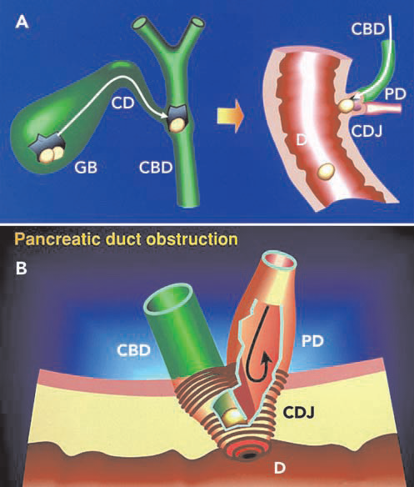
Mechanism of gall stone Pancreatitis
A: Gallstones may intermittently migrate out of the gallbladder (GB) via
the cystic duct (CD) into the common bile duct (CBD) and then pass
through the choledochoduodenal junction (CDJ) into the duodenum (D).
B: Gallstones cause transient obstruction of the pancreatic duct (PD) as
they pass from the CBD through the CDJ into the duodenum.
Obstruction of the PD raises hydrostatic pressure within it, causing
blockage of pancreatic secretion and subsequent activation of
pancreatic enzymes within the pancreas. This is thought to be the
initiating factor in gallstone pancreatitis. Gallstones may also become
impacted at the CDJ, causing a persistent obstruction.

Slide 8
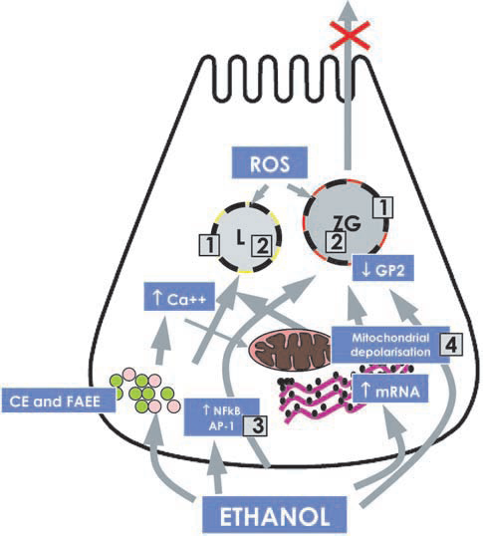
Mechanism of alcoholic pancreatitis
The diagram depicts an overall hypothesis for the pathogenesis of alcoholic pancreatitis, based on experimental evidence of molecular effects of alcohol on the pancreatic acinar cell. Alcohol, its metabolites and oxidant stress exert a number of toxic effects on pancreatic acinar cells, which predispose the gland to autodigestive injury, acute necro-inflammation and cell death.
These include:
1: destabilisation of lysosomes (L) and zymogen granules (ZG) (mediated by
oxidant stress [reactive oxygen species; ROS], cholesteryl esters [CE], fatty
acid ethyl esters [FAEE] and decreased glycoprotein 2 [GP2], a major
structural component of zymogen membranes);
2: increased digestive and lysosomal enzyme content (due to increased
synthesis [increased mRNA] and impaired secretion);
3: increased activation of transcription factors (NFkB and AP-1) which
regulate cytokine expression;
4: a sustained increase in cytoplasmic calcium (Ca++) and mitochondrial
calcium overload leading to mitochondrial depolarisation.
The above changes sensitise the cell such that in the presence of an
appropriate trigger or cofactor, injury is initiated.

Slide 9
Possible susceptibility factors in alcoholic pancreatitis
Inherited factors Lifestyle factors
HLA Diet
α1-antitrypsin deficiency Beverage type
Cystic fibrosis genotype
Alcohol metabolising enzymes Drinking pattern
Alcohol dehydrogenase Smoking
Cytochrome P450-2E1
Cholesteryl ester lipase
Trypsinogen gene mutations
PSTI/SPINK1 mutations
Cytokines
Detoxifying enzymes
Glutathione S-transferase
UDP-glucuronosyl transferase

Slide 10
CLINICAL FEATURES
Acute pancreatitis
Major symptom is severe, constant abdominal pain. usually epigastric or peri-umbilical.
It may radiate to the back and into the chest or flank.
Often, pain is relieved by sitting forward and exacerbated by lying flat.
pain is often associated with nausea and vomiting.

Slide 11
Physical examination
Gc is sick looking, dehydratated,+/- Pyrexia, tachycardia
PA: tenderness, guarding, distension, ileus
signs of pulmonary decompensation may be present and may be harbingers of severe pancreatitis.
Cullen’s sign (blue discolouration around the umbilicus)
Grey-Turner’s sign (purple discolouration in the flanks) rarely seen, but indicate severe necrotising pancreatitis

Slide 12
Differential diagnosis
Intra-abdominal | Non-abdominal
Perforated viscus | Pneumonia
Mesenteric ischaemia | Myocardial infarction
Aortic rupture/ dissection | Vasculitis
Intestinal obstruction | Diabetic ketoacidosis
Biliary disease

Slide 13
Diagnosis
presence of two of the following three criteria:
1. Typical abdominal pain
2. Elevation in serum levels of amylase or lipase > 3 times the upper limit of normal
3. Evidence of inflammation in the pancreas on imaging
(CT is the preferred modality)
Elevation of serum levels of amylase or lipase to < 3 times the upper limit of normal in the presence of abdominal pain is suggestive but not diagnostic of acute pancreatitis.

Slide 14
Pancreatic enzymes
serum amylase and lipase : usually elevated during an episode of acute pancreatitis.
Lipase is more specific than amylase, as the latter can be elevated in conditions such as parotitis, macroamylasaemia and some malignancies.
Lipase persists for longer in serum & is more sensitive therefore considered the preferred test.
no added value in measuring both enzymes.
The absolute level of either amylase or lipase does not correlate with the severity of pancreatitis,
serial measurements are not helpful in monitoring the course of the disease.

Slide 15
Others…….
Other serum enzyme markers of pancreatitis include;
carboxypeptidase,
trypsin,
trypsinogen-2,
trypsinogen activation peptide,
phospholipase,
carboxyl ester lipase and colipase.

Slide 16
Imaging studies
Contrast-enhanced, thin slice, multi-detector CT scanning is the imaging investigation of choice for staging the severity of acute pancreatitis
Distinguishes between interstitial and necrotising pancreatitis.
Identifies major complications (splenic vein thrombosis, pancreatic necrosis, pancreatic duct disruption, ascites and pseudocyst formation)
Excludes conditions that may mimic acute pancreatitis (visceral perforation and mesenteric ischaemia etc).

Slide 17
Other investigations
MRCP- more sensitive for choledocholithiasis
CXR- to exclude perforated viscus
MRI/ERCP/EUS may be indicated to evaluate biliary aetiology
LFTS: elevated ALT/AST suggest biliary causes
Serum Calcium and Lipid profile
FBC, CRP

Slide 18
PREDICTING SEVERITY

Slide 19
CT Severity Index
CT grade Score
A Normal pancreas 0 points
B Oedematous pancreas 1 point
C B plus mild extrapancreatic changes 2 points
D Severe extrapancreatic changes plus one fluid collection 3 points
E Multiple or extensive fluid collections 4 points
Necrosis
A None 0 points
B Less than one-third 2 points
C Greater than one-third but less than half 4 points
D More than half 6 points
Scoring: CT grade +necrosis score.
Score > 5 predicts severe disease. Adapted from Balthazar, 1990.31

Slide 20
Clinical and Biochemical predictors of severity
Predictor | Comment
Age > 55 years | Correlates with worse prognosis
Obesity | Assoc with greater local and systemic morbidity but not mortality
Organ failure at admission | Associated with higher mortality. Progression of single organ failure to multiple organ failure predicts worse outcome. Persistence of organ failure beyond 48 hours correlates with higher mortality.
Pleural effusion at presentation | Correlates with pancreatic necrosis, organ failure and mortality
Pulmonary infiltrates | Associated with higher mortality
C- Reactive Protein | Value > 150mg/L at 48 hours (not at admission) has comparable predictive value to Ranson’s criteria and Acute Physiology and Chronic Health Evaluation (APACHE II) score.
Haematocrit | Value > 48% or failure of haematocrit to improve at 48 hours after admission predicts pancreatic necrosis38

Slide 21
Ranson’s criteria
At admission
Age >55 years
White blood cell count 16.0 109/L
Blood glucose 11.1mmol/L
Serum lactate dehydrogenase > 350 U/L
Aspartate transaminase > 250U/L
During initial 48 hours
Haematocrit decrease > 10%
Blood urea nitrogen increase 1.8mmol/L
Serum calcium < 2mmol/L
Base deficit > 4mEq/L
Fluid sequestration > 6000mL
PaO2 <60mmHg
Scoring: 1 point for each criterion met. Score > 3 predicts severe disease. Adapted from Ranson, 1974.

Slide 22
Management-Acute pancreatitis
supportive measures
monitoring for complications
symptom control
Manage pain with Narcotics
IVF to address haemodynamic instability, prevent haemoconcentration and optimise hydration
Nutrition: early enteral feeding encouraged. Although naso-jejunal feeding has been preferred because of reduced pancreatic stimulation, recent evidence supports the safety of naso-gastric feeding
Antibiotics: for those with severe necrotizing pancreatitis
Early intervention for those with ERCP/sphincterotomy for those with biliary aetiology(reduced comp by 50%)
Antiemetics
Manage hyperglycemia

Slide 23
Chronic pancreatitis
Chronic pancreatitis occurs as a result of repeated necroinflammatory episodes, with progressive loss of normal pancreatic structure and function.
Pathologically, chronic pancreatitis is characterised by necro-inflammation, fibrosis, and loss of glandular tissue (atrophy)

Slide 24
Chronic pancreatitis: aetiology
Common
■ Alcohol consumption
Uncommon
■ Idiopathic
■ Trauma
■ Hereditary
■ Hypertriglyceridaemia
■ Hyperparathyroidism
■ Cystic fibrosis
■ Protein energy malnutrition

Slide 25
Presentation
Pain: usually chronic with a tendancy to abuse narcotic analgesics
Maldigestion: as a result insufficiency of exocrine pancreas. Assoc steatorrhoea and weight loss
IDDM: as aresult endocrine pancreas insufficiecy, DM tends to be brittle
O/E: wasting with features of PEM and underlying CLD

Slide 26
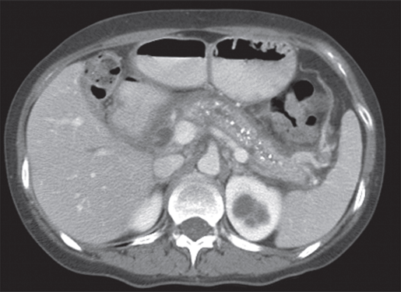
Diagnosis: CT scan

Slide 27
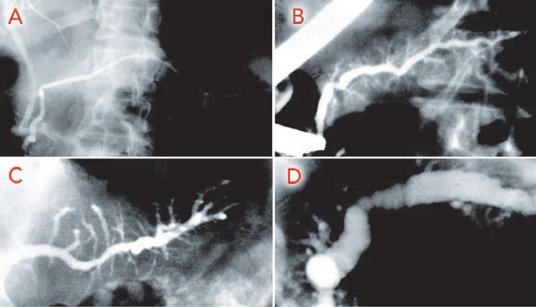
ERCP:Pancreatograms demonstrating changes in chronic pancreatitis

Slide 28
Management: chronic pancreatitis
Supportive: pain management
Pancreatic enzyme supplementation for steatorrhoea
Insulin for Mx of DM
Abstain from alcohol
Surgical approaches??
Monitor for pancreatic cancer

Slide 29
Complications
Abcess/sterile collections/pseudocyst: monitor with MRI/CT and aspirate for bacteriological evaluation/drainage
Endocrine insufficiency
Pancreatic cancer

Slide 30
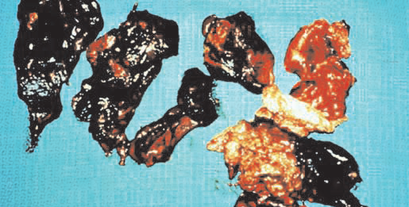
Inflamed pancreases
Thanks

