Slide 1
Approach to abnormal LFTs
& Management of acute and chronic liver failure
Dr. Adam Sheikh.
U.o.N

Slide 2
Objectives
By the end of this Module the learner should be able to;
Recognize patterns of abnormal liver chemistry
Evaluate a patient with abnormal liver biochemistry
Recognize common causes of an abnormal liver chemistry.
Recognize and maanage a patient with liver failure

Slide 3
Outline
Introduction
Patterns of abnormal liver chemistry
Etiology of abnormal liver biochemistry
Approach to evaluation of abnormal chemistry
Management of liver failure

Slide 4
introduction
1-4% of asymptomatic general population have mildly elevated LFTs
Kenya: 3.5% of apparently healthy 20-24 years old had abnormal LFTs( odhiambo et al 1972)
US survey 8.9% had abnormal Liver chemistry¹
1.Pratt DS, Kaplan MM. Evaluation of abnormal liver-enzyme results in asymptomatic patients. N Engl J Med 2000; 342:1266.

Slide 5
Reference ranges
Varies with labs , population being studied and gender
No recent local Data on population references
ALT: male<30, female<20 iu/ml ( optimal recomended cut offs)
Ruhl CE, Everhart JE. Upper limits of normal for alanine aminotransferase activity in the United States population. Hepatology 2012; 55:447.
Ruhl CE, Everhart JE. Trunk fat is associated with increased serum levels of alanine aminotransferase in the United States. Gastroenterology 2010; 138:1346.

Slide 6
Patterns of abnormal LFTs
Hepatocellular
Cholestatic
Isolated abnormalities
Mixed pattern
ALT/AST>ALP) Bilirubin Normal or high, INR/ALB normal or abnormal
ALP> ALT/AST,Bilirubin Normal or high, INR/ALB normal or abnormal
Elevated Bilirubins or single enzymes
Equally elevated parameters

Slide 7
Typical patterns of ALT/AST
Alcoholic fatty liver disease: AST <8X ULN; ALT <5 xULN
Nonalcoholic fatty liver disease: AST and ALT <4 xULN
Acute viral hepatitis or toxin-related hepatitis with jaundice: AST and ALT >25 xULN
Ischemic hepatopathy (ischemic hepatitis, shock liver): AST and ALT >50 xULN (in addition the lactate dehydrogenase is often markedly elevated)
Chronic hepatitis C virus infection: Wide variability, typically normal to less than twice the ULN, rarely more than 10 xULN
Chronic hepatitis B virus infection: Levels fluctuate; the AST and ALT may be normal, though most patients have mild to moderate elevations (approx: 2x ULN); with exacerbations, levels are more than 10 xULN

Slide 8
Marked elevation in ALT/AST(>15xULN)
Acute viral hepatitis Budd chiarri syndrome/ veno occlusive dse
Paracetamol poisoning post hepatectomy
Alcoholic hepatitis HELLP
Autoimmune hepatitis Heat stroke
Wilsons disease Toxins
Sepsis malignant infiltration
Ischemic hepatopathy Muscle disorders and others

Slide 9
Mild-Moderate elevation in ALT/AST(2-15xULN)
Medications
celiac disease
Chronic viral hepatitis
NAFLD
Alcoholic liver disease
Anorexia nervosa
Haemochromatosis
Adult bile ductopenia
Thyroid disorders
Adrenal insufficiency
Pratt DS, Kaplan MM. Evaluation of abnormal liver-enzyme results in asymptomatic patients. N Engl J Med 2000; 342:1266.

Slide 10
Approach to abnormal Liver chemistry
History: focus on risk factors for liver disease:alcohol, substance use, medications,transfussions, tatoos, sexual promiscuity, family history of liver disease and autoimmune disease
Physical exam: focus on stigmata for liver disease such as ascites, jaundice, splenomegaly, jaundice and dermatological manifestation of liver disease
Neurologic exam to exclude wilson’s d’se & hepatic encephalopathy

Slide 11
Approach…..
If Hx & PE suggests advanced liver disease. Rapid evaluation is necessary
If potential hepatotoxins are identified in asymptomatic pts, stop the offending agents and recheck liver parameters in 8-12wks, if LFTs still abnormal evaluate
If asymptomatic with unrevealing Hx, recheck in 8-12 wks, if ALT/AST is abnormal evaluate

Slide 12
HX & PE
Asymptomatic,
ALT<1.5
Symptomatic with abN liver Fxn
Asymptomatic, suggestive Hx
Rechek in 8-12 wks
Imaging, viral serology,autoimmune markers, ceruloplasmin
Stop offending agents & life style changes
Normal ALT/AST
High ALT/AST
Normalisatin of AST/ALT
No further work up
Liver Bx
YES
NO

Slide 13
Evaluation of elevated ALP
Evaluation of Elevated ALP
R/O physiologic causes, do fasting
Determine source, do GGT
Normal GGT
Increased GGT Check AMA & u/sound
Evaluate for bone disease
+AMA/ normal U/sound or Vise versa
Dilated ducts
-ve AMA/ normal U/sound if ALP is >50%
Liver BX
MRCP/ERCP

Slide 14
Causes of isolated hyper-GGT
pancreatic disease
myocardial infarction
renal failure
chronic obstructive pulmonary disease
diabetes mellitus
alcoholism especially with AST/ALT ratio of 2:1
Phenytoin and barbiturates

Slide 15
Isolated Hyperbilirubinaemia
Conjugated: consider
Billiary obstruction: usually high ALP/GGT
Dubin-johnson & Rotor syndrome: mild elevation of bilirubin, normal ALP/GGT
Unconjugated: consider
Medications; rifampicin/ probenecid
Hemolysis
Gilbert syndrome:3-7% of popn, M:F 2-7:1
Criggler-najjar syndrome type 1 and 2

Slide 16
Jaundice
Pre hepatic
  Haemolysis
  Conjugation abnormalities
Hepatic – any liver disease, acute or chronic
Post hepatic – Obstruction

Slide 17
Evaluation
Bilirubin – Conjugated and Unconjugated
ALT/AST levels
Alkaline Phosphatase
gGT
Albumin
INR
FBC

Slide 18
Evaluation
Hepatitis antibodies: A, B, C….D, E
  EBV, Toxo, CMV, Leptospirosis
Ferritin and fasting transferrin saturation,
  Haemochromatosis genetics
Caeruloplasmin and copper (serum),
  24 hour urine for copper
Autoantibodies: ANA, ASMA, AMA, Coeliac
Immunoglobulins: IgG, IgA, IgM
Cholesterol, triglycerides, glucose, TFTs
α₁antitrypsin levels + phenotype
α−fetoprotein (cirrhotics only)

Slide 19
Imaging
Ultrasound – Liver substance, lesions, gallbladder and biliary tree, vessels (Doppler exam), spleen size and varices
CT scan – confirm small lesions, see pancreas
MRI of Liver – classify smaller lesions
MRCP: Magnetic resonance cholangiopancreatography, to see the biliary tree
ERCP: Endoscopic retrograde cholangiopancreatography– diagnostic and therapeutic: stones, strictures etc.

Slide 20
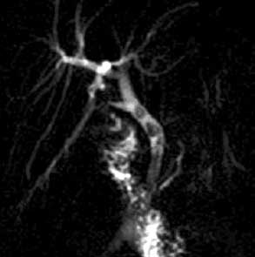
MRCP

Slide 21
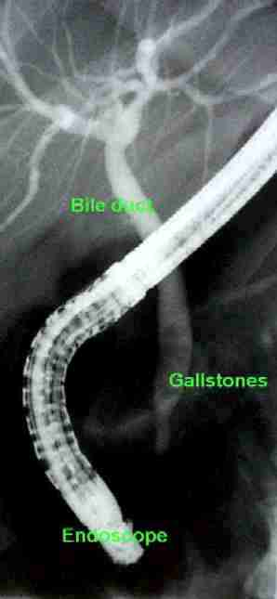
ERCP

Slide 22
Liver Biopsy
Very useful for confirming a diagnosis, staging degree of inflammation and/or fibrosis, iron content, mass lesions
Contraindications: Bleeding disorders, ascites, small liver, uncooperative patient
Complications: Bleeding, pain, perforation another viscus, biliary leak, pneumothorax
Methods: Percutaneous, transjugular, laparoscopically

Slide 23
Liver failure: definition
Acute: Coagulopathy(abnormal INR) and encephalopathy within 8-26 weeks in a patient with no prior history of liver disease
Chronic: coagulopathy and encephalopathy in a patient with pre-existing liver disease

Slide 24
Symptoms
Altered mental status and coagulopathy in the setting of acute hepatic disease
Fulminant considered <8 wks from jaundice to encephalopathy
Subfulminant <26 weeks
Jaundice
Encephalopathy – stupor , coma
Decreased synthetic function with INR>1.5
New ascites

Slide 25
Differential diagnosis
Vascular: Budd-Chiari (hepatic vein thrombosis), ischemia “shock liver”, hepatic veno-occlusive dz, portal vein thrombosis, arterial thrombosis
Infectious: Hepatitis A/B, HSV, CMV, EBV, Hemorrhagic fever viruses (ebola, lhassa, marburg), paramyxoviruses. Toxoplasma, Leptospira, Candida, Brucella, Myobacteria
Trauma: laceration
Autoimmune/Inflam: Autoimmune hepatitis, Reye syndrome , Adult onset Still’s dz (systemic RA)
Metabolic: fatty liver of pregnancy, HELLP
Inherited/Cong: Wilson’s disease, hemachromatosis, alpha-1 antitrypsin def., galactosemia, tyrosinemia, urea cycle disorders (ornithine transcarbamylase def.), fructose intolerance
Neoplastic: Primary vs metastatic lesions
Drugs/toxins: …..

Slide 26
Differential: Drugs/Toxins
Acetaminophen
Alcohol (chronic use depletes glutathione stores)
Antidepressants: amitriptyline, nortriptyline
Oral hypoglycemics: roglitazone, troglitazone
Antiepileptics: phenytoin, valproate
Antibiotics: tetracycline, amox/clav, cipro, doxy, erythromycin, isoniazid, nitrofurantoin
Anesthetic agents: halothane
Statins
Immunosuppressants: cyclophosphamide, methotrexate
Salicylates: Reye syndrome
Gold
Disulfiram
Propylthiouracil

Slide 27
Toxins: continued…
Dose dependent toxin mediated
  Bacillus cereus toxin
  Cyanobacteria toxin
  Organic solvents (eg, carbon tetrachloride)
  Yellow phosphorus (fireworks)
  Amanita phalloides mushroom toxin
  Galerina mushrooms
Illicit Drugs
  Ecstasy
  Cocaine
Herbal Supplements
  Ginseng
  Pennyroyal oil
  Teucrium polium
  Chaparral or germander tea
  Kava Kava (kawa kawa)

Slide 28
Epidemiology
Caucasian (72%) > Hispanic > African American> Asian
Toxin mediated #1 in US
  Acetaminophen 42%
  Idiosyncratic drug rxn 12%
  Hepatitis B
  Autoimmune hepatitis
  Wilson’s disease
  Fatty liver dz of pregnancy, HELLP
Worldwide
  HBV +/- HDV
  HEV (particularly in pregnant women in Mexico, Central America, India, SE Asia)
  Acetaminophen in Europe, Great Britain

Slide 29
Laboratory Studies
Capillary glucose
Ammonia
Chemistry
Liver panel w/albumin
Lipase
Coags (INR >1.5)
Type & screen
CBC
Lactate
Pregnancy test
Acetaminophen & salicylate level
Toxicology screen
Viral serologies: anti-
  HAV IgM
  HBV surf ag/ab, core IgM
  HEV
ANA, ASMA, LKMA, Ig levels
Ceruloplasmin (acute phase rxct)
Serum free copper
HIV
Blood cultures

Slide 30
Radiology
CT Head: cerebral edema, mass lesions
Liver u/s with dopplers: eval clot, parenchyma
Liver CT vs MRI: delineate anatomy for possible transplantation
EEG: in the obtunded pt to r/o seizures

Slide 31
Other studies
Liver biopsy: transjugular, contraindicated in coagulopathy
ICP monitoring with extra- vs intradural catheters, again with care in coagulopathy

Slide 32
Complications
Coagulopathy
Encephalopathy
Cerebral edema and herniation
Hypoglycemia
Renal failure
Systemic Inflammatory Response Syndrome (SIRS) low SVR
Sepsis

Slide 33
Cerebral Edema
Vasogenic and cytotoxic in origin
Ammonia→glutamine which accumulates in cortical astrocytes
Increased cerebral blood flow via
  ↑ NO2
  ↑ TNF alpha
  ↑ IL6
  ↑ IL2
  ↑ bacterial endotoxin

Slide 34
Initial management: ED
Labs as indicated
Triage to appropriate service: consider ICU when grade II encephalopathy is present for new dx for freq neuro checks
N-acetylcysteine
Intubation if GCS <8, grade III encephalopathy
Use short-acting , low dose meds only
Head CT
Encephalopathy:
  Grade I
    Confused, altered mood
  Grade II:
    Inappropriate, drowsy
  Grade 3:
    stuporous but arousable, markedly confused
  Grade 4:
    Coma, unresponsive to pain

Slide 35
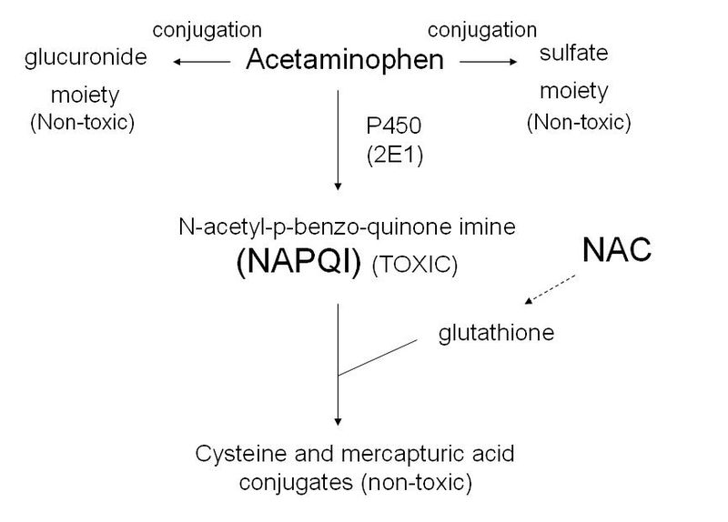
Mangement: Antidotes
N-acetylcysteine
Load 140mg/kg, then 15mg/kg/hr
Pharmacy infusion protocol

Slide 36
Management: Antidotes
Amanita = Penicillin G (mech unknown) 1mg/kg/d +/- activated charcoal
Silibinin – derivative of milk thistle, antioxidant (proposed but not well studied)
Inchinko-to – Chinese herbal preparation for cholestatic hepatitis (proposed suppression of TNF-α, inhibition of hepatic apotosis)

Slide 37
Management: Coagulopathy
Correction of coagulopathy not indicated unless active bleeding is present or procedure
  FFP 15ml/kg or 4 units
  cryoprecipitate
  Factor VIIa for unresponsive bleeding 4mcg/kg push
  Platelet transfusion only <10K or procedure <50K

Slide 38
Management: Renal Failure
1/3 of patients will develop oliguric ARF
Fluid resusciation
CVVHD as indicated
Avoid nephrotoxic medications
Avoid NSAIDS

Slide 39
Management: CV and Endocrine
Fluid resuscitation
Low SVR with normal or increased CO
Dopamine or norepinephrine prn
Impaired gluconeogenesis
Frequent capillary blood glucose q1/2
D5/10 containing solution as necessary
Montior potassium, phosphate and magnesium

Slide 40
Management: Antibiotics
  Empiric antibiotics for
    Progressive encephalopathy
    Signs of SIRS (temperature, >38ºC or <36ºC; white blood cell [WBC] count, >12,000/μL or <4000/μL; pulse rate, >90 bpm)
    Persistent hypotension
  Tazocin and fluconazole considered initially. In hospital-acquired IV catheter infections, consider vancomycin.

Slide 41
Management: Cerebral edema
Mechanical ventilation to protect airway and hyperventilate (short-lived)
Head of bed elevated to 30 degrees
Mannitol (0.5 - 1g/kg) goal osm around 320
Hypertonic saline 3% ( goal na 145-155)
Barbituate coma
Hypothermia is under investigation
Seizure control with phenytoin
Call neurology/neurosurgery early
Refractory increased ICP or decreased CPP is a contra-indication for transplantation in most centers

Slide 42
Prognosis: King’s College Criteria
Acetaminophen toxicity
Arterial lactate >3.5 4 hrs after resuscitation or
pH <7.30 or lactate >3.0 12 hours after resuscit. or
  Arterial pH <7.3
  PT >100 sec
  Creatinine >3.4
Non-acetaminophen related toxicity
  INR >6.5 (PTT>100) or
  Arterial lactate >3.5 4hrs after resuscitation or
3 of 5
  Age <10 or >40
  INR >3.5
  Idiosyncratic drug rxn
  Jaundice > 1wk
  Serum bilirubin >17.5mg/dL

Slide 43
MELD
Model for End-Stage Liver Disease
3.78[Ln serum bilirubin (mg/dL)] + 11.2[Ln INR] + 9.57[Ln serum creatinine (mg/dL)] + 6.43
Utilized to prioritize transplant recipients
In hospitalized patients, the 3 month mortality is:
  40 or more — 100% mortality
  30–39 — 83% mortality
  20–29 — 76% mortality
  10–19 — 27% mortality
  <10 — 4% mortality

Slide 44
Management: Transplant
Prior to OLT, mortality >80%
6% of OLT due to fulminant hepatic failure
Mortality now around 20-40% center dependent

Slide 45
Chronic liver failure
Principles similar to Acute liver failure
Cerebral edema is not common
Ammonia reduction mainstay of management of encephalopathy
All other interventions are as in acute liver failure

