Slide 1
GASTROINTESTINAL BLEEDING

Slide 2
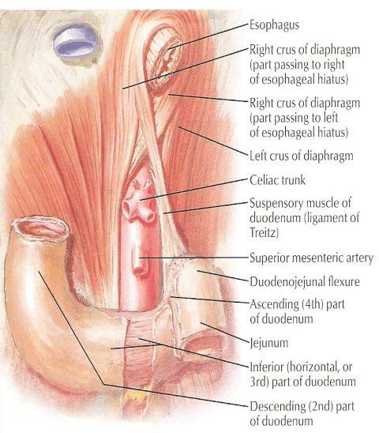
INTRODUCTION
Can be divided into 2 clinical syndromes:-
- upper GI bleed (pharynx to ligament of Treitz)
- lower GI bleed (ligament of Treitz to rectum)
LIGAMENT OF TREITZ

Slide 3
UPPER GASTROINTESTINAL BLEEDING

Slide 4
EPIDEMIOLOGY
Upper GI bleed remains a major medical problem.
About 75% of patient presenting to the emergency room with GI bleeding have an upper source.
In-hospital mortality of 5% can be expected.
The most common cause are peptic ulcer, erosions, Mallory-Weiss tear & esophageal varices.

Slide 5
CLINICAL FEATURES
Haematemesis : vomiting of blood (fresh and red or digested and black).
Melaena : passage of loose, black tarry stools with a characteristic foul smell.
Coffee ground vomiting : blood clot in the vomitus.
Hematochezia : passage of bright red blood per rectum (if the haemorrhage is severe).

Slide 6
CLINICAL FEATURES
Haematemesis without malaena is generally due to lesions proximal to the ligament of Treitz, since blood entering the GIT below the duodenum rarely enters the stomach.
Malaena without haematemesis is usually due to lesions distal to the pylorus
Approximately 60mL of blood is required to produced a single black stool.

Slide 7
AETIOLOGY
Oesophagus
-Oesophageal varices
-Oesophageal CA
-Reflux oesophagitis
-Mallory-Weiss syndrome
LOCAL
Stomach
-Gastric ulcer
Erosive gastritis
-Gastric CA
-gastric lymphoma
-gastric leiomyoma
-Dielafoy’s syndrome
-Haemophilia
-Leukemia
-Thrombocytopenia
-Anti-coagulant therapy
GENERAL
Duodenum
-Duodenal ulcer
-Duodenitis
-Periampullary tumour
-Aorto-duodenal fistula

Slide 8
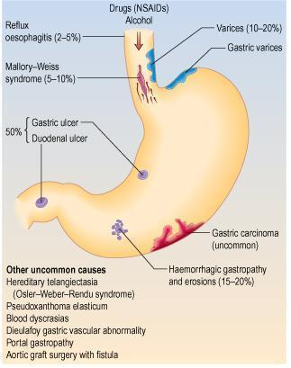

Slide 9
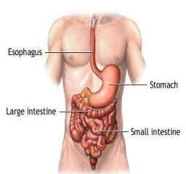
OESOPHAGEAL VARICES
Abnormal dilatation of subepithelial and submucosal veins due to increased venous pressure from portal hypertension (collateral exist between portal system and azygous vein via lower oesophageal venous plexus).
Most commonly : lower esophagus.

Slide 10
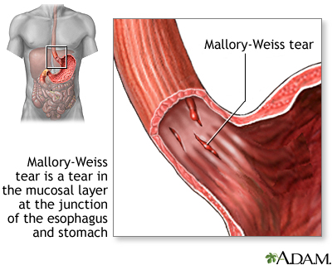
MALLORY-WEISS
TEAR
Longitudinal tears at the oesophagogastric junction.
may occur after any event that provokes a sudden rise in intragastric pressure or gastric prolapse into the esophagus.
Precipitating factors:
- hiatus hernia
- retching & vomiting
- straining
- hiccuping
- coughing
- blunt abdominal trauma
- cardiopulmonary resuscitation

Slide 11
MALLORY-WEISS TEAR: MANAGEMENT
- Bleeding from MWTs stops spontaneously in 80-90% of patients
- A contact thermal modality, such as multipolar electrocoagulation (MPEC) or heater probe.
- Epinephrine injection -reduces or stops bleeding via a mechanism of vasoconstriction and tamponade
- Endoscopic band ligation
- Endoscopic hemoclipping

Slide 12
ESOPHAGEAL CANCER
8th most common cancer seen throughout the world.
40% occur in the middle 3rd of the oesophagus and are squamous carcinomas.
adenoCA (45%) occur in the lower 3rd of the oesophagus and at the cardia.
Tumours of the upper 3rd are rare (15%)

Slide 13
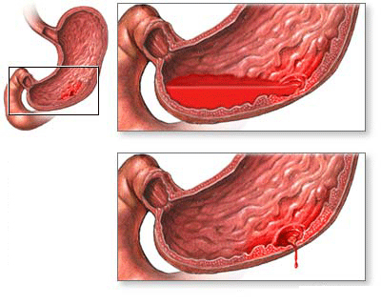
PEPTIC ULCER: COMPLICATION
Haemorrhage
- posterior duodenal ulcer erode the gastroduodenal artery
- lesser curve gastric ulcers erode the left gastric artery
Perforation
- generalized peritonitis
- signs of peritonitis
Pyloric obstruction
- profuse vomiting, LOW, dehydrated, weakness, constipation

Slide 14
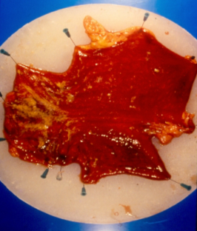
EROSIVE GASTRITIS
Acute mucosal inflammatory process
Accompanied by hemorrhage into the mucosa and sloughing of the superficial epithelium (erosion).
Notes:
Is an acute mucosal inflammatory process usually of a transient nature.
May be accompanied by hemorrhage into the mucosa and in more severe circumstances, by sloughing of the superficial epithelium (erosion).

Slide 15
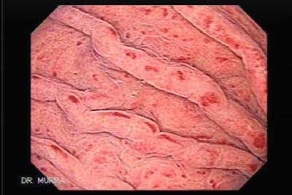
EROSIVE GASTRITIS: AETIOLOGY
- NSAIDs
- alcohol
- smoking
- chemotherapy
- uraemia
- stress
- ischaemia and shock
- suicide attempts
- mechanical trauma
- distal gastrectomy
Notes:
- heavy use of NSAIDs
- excessive alcohol consumption
- heavy smoking
- treatment with cancer
chemotherapy drugs
- uraemia
- severe stress (e.g. trauma, burns,
surgery)
- ischaemia and shock
- suicide attempts with acid and
alkali
- mechanical trauma
- after distal gastrectomy with
reflux of bilious material

Slide 16
EROSIVE GASTRITIS:
CLINICAL FEATURES
- asymptomatic
- epigastric pain with nausea & vomiting
- haematemesis and melaena
- fatal blood loss
It is one of the major causes of haemetemesis, particularly in alcoholic!

Slide 17
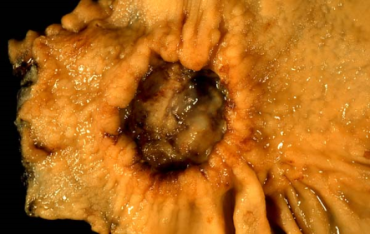
GASTRIC CANCER
BENIGN GASTRIC NEOPLASM
- adenomatous polyps
- leiomyoma
- neurogenic tumour
- fibromata
- lipoma
- gastric adenocarcinoma (90%)
- lymphomas
- smooth muscle tumour
GASTRIC CARCINOMA

Slide 18
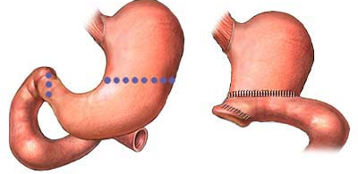
GASTRIC CANCER
Early signs
-Indigestion
-Flatulence
-Dyspepsia
Late signs
- LOW
-anemia
-dysphagia
-vomiting
-epigastric/back pain
- epigastric mass
-sign of metastases (jaundice, ascites, diarrhoea, intestinal obstruction)
CLINICAL FEATURES
TREATMENT
Radical total gastrectomy
Palliative resection
Palliative bypass

Slide 19
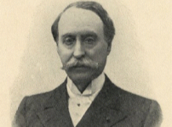
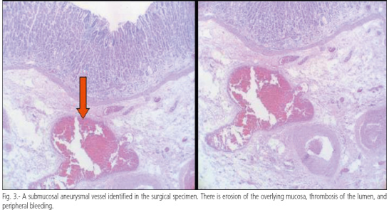
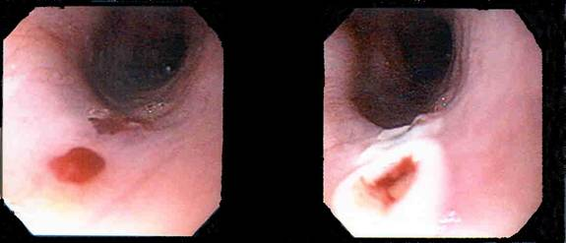
DIEULAFOY’S DISEASE
Rare – erosion of mucosa overlying artery in stomach causes necrosis arterial wall & resultant hemorrhage.
Gastric arterial venous abnormality
covered by normal mucosa
profuse bleeding coming from an area of apparently normal mucosa.
Notes:
Rare – erosion of mucosa overlying artery in stomach causes necrosis arterial wall & resultant hemorrhage.
Gastric arterial venous abnormality that has a characteristically histological apperance.
The lesion itself is covered by normal mucosa and, when not bleeding, it may be invisible.
If it can be seen while bleeding, all that may be visible is profuse bleeding coming from an area of apparently normal mucosa

Slide 20
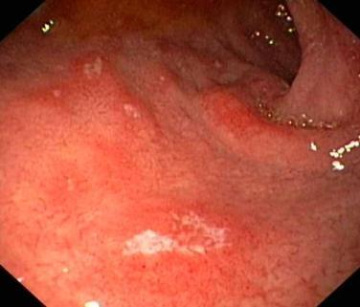
DUODENITIS
AETIOLOGY
- aspirin,
- NSAIDs
- high acid secretion
CLINICAL FEATURE
- Symptoms are similar to peptic ulcer disease
- stomach pain
- bleeding from the intestine
- nausea & vomiting
- intestinal obstruction(rare)
Notes:
inflammation and irritation of the wall of the first part of the small intestine.

Slide 21
OVERVIEW:
MANAGEMENT OF UPPER GI BLEED
Acute Upper Gastrointestinal Bleed
Routine Blood Test
Resuscitation and Risk Assessment
Endoscopy (within 24 hrs)
Varices
Peptic Ulcer
No obvious cause
Management Varices
Major SRH
Minor SRH
Minor Bleed
Major Bleed
Endoscopic Treatment
Eradicate H.pylori & Risk Reduction
Other colonoscopy or angiography
Failure
Surgical

Slide 22
RESUSCITATION
airway and oxygen
Correct clotting abnormalities
Blood Transfusion
Monitor
Insert urinary catheter and monitor hourly urine output if shocked.
Consider a CVP line to monitor CVP and guide fluid replacement.
Organize a CXR, ECG, and check arterial blood gases in high-risk patient.
Arrange an urgent endoscopy.
Notify surgeon of all severe bleeds on admission.
Notes:
Protect airway and give high-flow oxygen
Insert 2 large-bore (14-16G) IV cannulate take blood for FBC, U&E, LFT, clotting, cross-match 4-6 units (1 unit per g/dL < 14g/dL)
Give IV colloid while waiting for blood to be crossmatched. In a dire emergency, give group O Rh-ve blood.
Transfuse until haemodynamically stable.
Correct clotting abnormalities (vit K, FFP, platelet)
Monitor pulse, BP, and CVP at least hourly until stable.
Insert urinary catheter and monitor hourly urine output if shocked.
Consider a CVP line to monitor CVP and guide fluid replacement.
Organize a CXR, ECG, and check arterial blood gases in high-risk patient.
Arrange an urgent endoscopy.
Notify surgeon of all severe bleeds on admision.

Slide 23
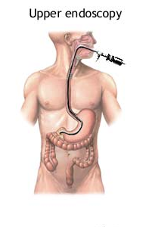
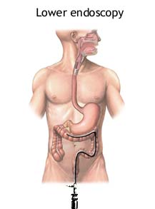
DETECTION & ENDOSCOPIC
Used to detect the site of bleeding.
May also be used in a therapeutic capacity (active bleeding from the ulcer, the presence of a visible vessel, adherent clot overlying the ulcer)
Injection sclerotherapy is used commonly. Other method include the use of heat probes and lasers.
Angiography in whom endoscopy does not identify the bleeding point. Limitation: can only detect active bleeding of greater than 1mL/min.

Slide 24
UPPER GI BLEED:
RISK FACTORS FOR DEATH
  1. Advanced AGE
  2. SHOCK on admission(pulse rate >100 beats/min; systolic blood pressure < 100mmHg)
  3. COMORBIDITY (particularly hepatic or renal failure and disseminated malignancy)
  4. Diagnosis (worst PROGNOSIS for advanced upper gastrointestinal malignancy)
  5. ENDOSCOPIC FINDINGS (active, spurting haemorrhage from peptic ulcer; non-bleeding visible vessel)
  6. RECURRENT BLEEDING (increases mortality 10 times)

Slide 25
GASTROINTESTINAL BLEEDING
LOWER

Slide 26
LOWER GI BLEED: AETIOLOGY
1) Hemorrhoids
2) Diverticulosis
3) Arteriovenous malformations
4) Polyps
5) Inflammatory bowel disease
6) Infectious gastroenteritis
7) Meckel diverticulum

Slide 27
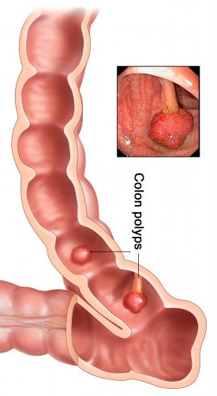
Colorectal polyps
Adenomatous polyps and adenomas
Has malignant potential
Morphology:
-polypoid and pedunculated
-dome-shaped and sessile

Slide 28
MANAGEMENT
Subtotal colectomy & ileorectal anastomosis
Panproctocolectomy & ileotomy / ileal pouch
Follow-up colonoscopies
- an adenomatous polyp is found / a colorectal
cancer has been treated
-intervals depend on number, size &
pathology of polyps

Slide 29
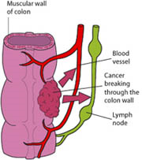
ADENOCARCINOMA OF COLON & RECTUM
Common > 60 years old
Common site- sigmoid colon, rectum
Clinical features:
-altered bowel habit & large bowel obstruction
-rectal bleeding
-iron deficiency anaemia
-tenesmus
-perforation
-anorexia & weight loss

Slide 30
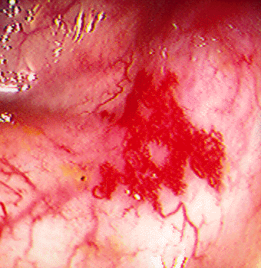
ANGIODYSPLASIA
1 or multiple small mucosal or submucosal vascular malformation.
> 60 years old
Common site : ascending colon and caecum
Malformations consist of dilated tortuous submucosal veins
In severe cases, the mucosa is replaced by massive dilated deformed vessels
Clinical features:
-acute / chronic rectal bleeding
-iron deficiency anaemia

Slide 31
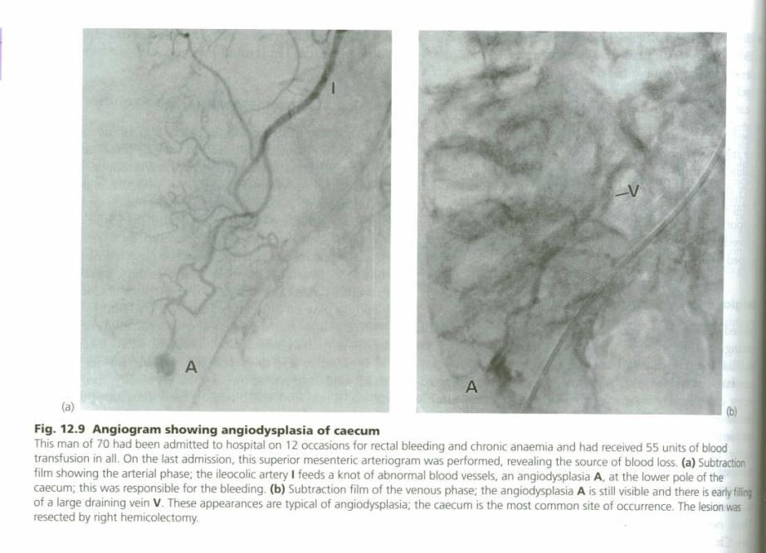

Slide 32
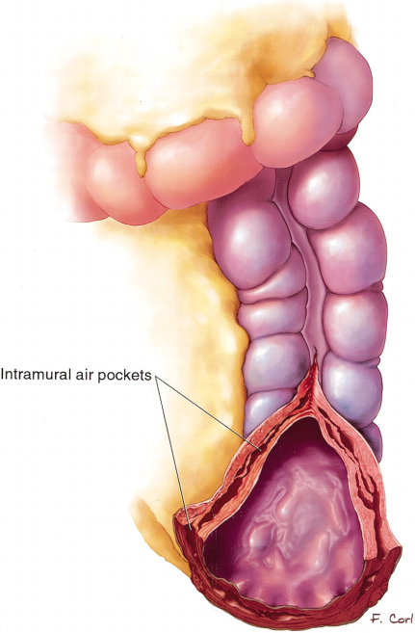
ISCHAEMIC COLITIS
Elderly
Transient ischaemia of a segment of a large bowel, followed by sloughing of mucosa
Common site –splenic flexure
Clinical features:
-abdominal pain
-rectal bleeding ( dark red)
-1-3x over 12 hours
Complication- fibrotic sticture

Slide 33
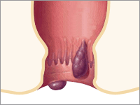
HAEMORRHOIDS
M > F
Female- late pregnancy, puerperium
Supine lithotomy position- 3 ,7, 11 o’clock positions
Classification:
1st degree : never prolapse
2nd degree: prolapse during
defaecation but
return spontaneously
3rd degree : remain prolapse but
can be reduced digitally
4th degree : long-standing
prolapse cannot be
reduced

Slide 34
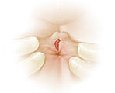
ANAL FISSURE
Longitudinal tear in mucosa & skin of anal canal
M > F
Common site: midline in posterior anal margin
Clinical features:
- acute pain during defaecation
- fresh bleeding at defaecation

Slide 35
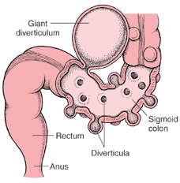
DIVERTICULAR DISEASE
Rare < 40 years old
F > M
Causes:
-Chronic lack of dietary fibre
-Genetic
Common site: sigmoid colon
Clinical features:
-diverticulosis (asymptomatic)
-chronic grumbling diverticular pain (chronic constipation & episodic diarrhoea)

Slide 36
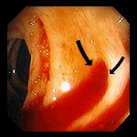
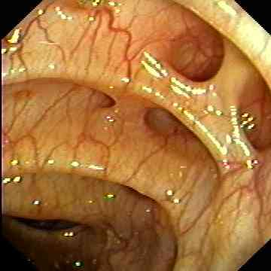

Slide 37
MANAGEMENT
MEDICAL
SURGICAL
Vasoconstrictive agents:
vasopressin
2. Therapeutic embolization:
-Embolic agents: Autologous clot, Gelfoam, polyvinyl alcohol, microcoils,
ethanolamine, and oxidized cellulose
-Selective angiography
3. Endoscopic therapy:
-Diathermy / laser coagulation
-Short term control of bleeding during resuscitation
The bleeding point is localized, perform a limited segmental resection of the small or large bowel
Poor prognostic features:
-age over 60 years
-chronic history
-relapse on full medical treatment
-serious coexisting medical conditions
-> 4 units of blood transfusion required during resuscitation

Slide 38
THANK YOU

