Slide 1
Biliary Tract Disease
EDNA KAMAU
GASTROENTEROLOGIST

Slide 2
Overview
Gallstones
Biliary tract tumours
Other conditions
Acute acalculous cholecystitis
Primary Biliary Cirrhosis
Primary Sclerosing Cholangitis
Biliary tract cysts
Biliary strictures

Slide 3
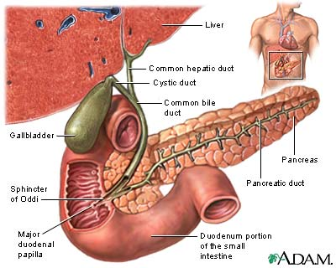
Biliary Tract
Part of the digestive system.
Made up of:
Intra hepatic ducts
Exta hepatic ducts
Gallbladder
Common Bile Duct

Slide 4
The Gallbladder
The gallbladder concentrates and stores bile.
Bile:
Secreted by the liver
Contains cholesterol, bile pigments and phospholipids
Flows from the liver, through the hepatic ducts, into the gallbladder
Exits the gallbladder via the cystic duct
Flows from the cystic duct into the common bile duct, into the small intestine
In the small intestine, bile aids in digestion by breaking down fatty foods and fat-soluble vitamins

Slide 5
Gallstones – Pathophysiology
If ratio of cholesterol, phospholipids, and bile salts altered, cholesterol crystals may form
Gallstone formation involves a variety of factors:
Cholesterol supersaturation
Mucin hypersecretion by the gallbladder mucosa creates a viscoelastic gel that fosters nucleation.
Bile stasis
Occurs in diabetes, pregnancy, oral contraceptive use, and prolonged fasting in critically ill patients on total parenteral nutrition.

Slide 6
Gallstones – Frequency
Gallstone disease is one of the most common and costly of all digestive diseases
9% of those > 60 years
In USA, 6.3 million men and 14.2 million women aged 20-74 years have gallbladder disease
Incidence of gallstones is 1 million new cases per year
Prevalence is 20 million cases in USA

Slide 7
Gallstones
Sex
Higher among females than males (lifetime risk of 35% vs 20%, respectively)
Due to endogenous sex hormones (enhance cholesterol secretion and increase bile cholesterol saturation)
Progesterone may contribute by relaxing smooth muscle and impairing gallbladder emptying.
Age
Increased age is associated with lithogenic bile and increased rate of gallstones

Slide 8
Gallstones – Types
Two main types:
Cholesterol stones (85%):
2 subtypes—pure (90-100% cholesterol) or mixed (50-90% cholesterol).
Pure stones often are solitary, whitish, and larger than 2.5 cm in diameter.
Mixed stones usually are smaller, multiple in number, and occur in various shapes and colors.
Pigment stones (15%) occur in 2 subtypes—brown and black.
Brown stones are made up of calcium bilirubinate and calcium-soaps. Bacteria involved in formation via secretion of beta glucuronidase and phospholipase
Black stones result when excess bilirubin enters the bile and polymerizes into calcium bilirubinate (patients with chronic hemolysis)

Slide 9
Gallstones – Natural History
80% of patients, gallstones are clinically silent
20% of patients develop symptoms over 15-20 years
About 1% per year
Almost all become symptomatic before complications develop
Biliary-type pain due to obstruction of the bile duct lumen

Slide 10
Gallstones – Diverse symptoms
Abdominal pain
Aching or tightness, typically severe and located in the epigastrium
May develop suddenly, last for 15 minutes to several hours, and then resolve suddenly
Referred pain – posterior scapula or right shoulder area
Nausea and vomiting
Jaundice
Miscellaneous:
Fatty food intolerance
Gas
Bloating
Notes:
History
Biliary disease presents with some diversity, from no symptoms to a constellation of signs and symptoms of varying severity and combination. Accurate diagnosis, therefore, begins with listening closely to the patient. Reaching an accurate diagnosis is aided by clinical experience and often involves imaging studies.
When abdominal pain is the chief symptom, seek to determine when it began and the subsequent events. Clarify what the pain feels like to the patient; visceral pain is perceived as a vague, dull, gnawing, burning, or aching sensation, whereas parietal pain is sharper in quality and better localized. Psychological conditions (eg, anxiety, worry) may enhance pain perception, while impaired consciousness tends to blunt pain perception.
• Biliary-type pain: Biliary disease often presents with upper abdominal pain. The pain quality is a penetrating aching or tightness, typically severe and located in the epigastrium. The sensation usually is difficult to describe; it may develop suddenly, last for 15 minutes to several hours, and then resolve suddenly. Although the term biliary colic is used commonly, it is a misnomer because the pattern of pain is constant. The pain is caused by an obstruction to the flow of bile, with distension of the biliary lumen, and is clinically similar whether the obstruction occurs at the cystic duct or at another level of the common bile duct. As noxious visceral stimuli become more intense, referred pain may be experienced in the posterior scapula or right shoulder area and be accompanied by nausea and vomiting.
• Jaundice: Bilirubin metabolism and transport principally are handled by the hepatobiliary tract. A yellow discoloration of the skin begins to appear when serum bilirubin rises above 3 mg/dL, and the yellow discoloration is termed jaundice. Abnormalities leading to jaundice may occur in various phases of the process.
o Jaundice and abdominal pain: The combination of jaundice and abdominal pain suggests a subacute obstruction of the biliary ductal system. In elderly patients, however, biliary tract obstruction may be painless. Rarely, acute viral hepatitis can be confused with biliary-type pain.
o Painless jaundice: The development of jaundice in the absence of abdominal pain is suggestive of a malignant obstruction of the bile duct. Here, the onset of jaundice is gradual and may be associated with anorexia; weight loss; and acholic, soft or loose stools. Nonbiliary causes should be considered, including increased bilirubin production (eg, from hemolysis, blood transfusions, or ineffective erythropoieses) and decreased bilirubin clearance due to hereditary defects (eg, unconjugated hyperbilirubinemia in Gilbert syndrome and Crigler-Najjar syndrome types I and II, conjugated hyperbilirubinemia in Dubin-Johnson syndrome and Rotor syndrome).
• Pruritus: Itching is an unpleasant sensation in the skin associated with a strong desire to scratch. While several causes exist, itching is associated with cholestasis and may become the patient's most bothersome symptom. Itching may appear first in the hands and feet* but usually becomes generalized and typically is worse at night. Itching does not distinguish the cause of cholestasis as hepatic or biliary.
• Fatigue: The insidious onset of fatigue, followed by pruritus and then jaundice, is observed to varying degrees in diseases of the intrahepatic bile ducts, such as primary biliary cirrhosis, primary sclerosing cholangitis, and vanishing bile duct syndrome.
• Weight loss: A history of weight loss is associated with more serious diseases of the biliary tract. The weight loss may be caused by inadequate nutrient intake (eg, anorexia) or malabsorption of fats (eg, a paucity of bile in cholestatic diseases or prolonged biliary obstruction).
• Miscellaneous: Other symptoms, including fatty food intolerance, gas, bloating, and dyspepsia, do not indicate the presence of biliary tract disease reliably.

Slide 11
Complications of Gallstones
In the gallbladder
Biliary colic
Acute and chronic cholecystitis
Empyema
Mucocoele
Carcinoma
In the bile ducts
Obstructive jaundice
Pancreatitis
Cholangitis
In the Gut
Gallstone ileus

Slide 12
Obstructive Jaundice
Blockage of the biliary tree by gallstones
Symptoms
Pain, Jaundice, dark urine, pale stools
Signs
Jaundice
Investigations
Bloods – U&E, FBC, LFT, Amylase, CRP, Hepatitis screen, Coagulation screen
Ultrasound of abdomen
Treatment
Endoscopic Retrograde CholangioPancreatogram

Slide 13
Ascending Cholangitis
Obstruction of biliary tree with bile duct infection
Symptoms
Unwell, pain, jaundice, dark urine, pale stools
Charcot triad (ie, fever, right upper quadrant pain, jaundice) occurs in only 20-70% of cases
Signs
Sepsis (Fever, tachycardia, low BP), Jaundice.
Investigations
Bloods – U&E, FBC, LFT, Amylase, CRP, Coagulation screen
Ultrasound of abdomen
Treatment
Intravenous antibiotics
Endoscopic Retrograde CholangioPancreatogram

Slide 14
Gallstone ileus
Obstruction of the small bowel by a large gallstone
A stone ulcerates through the gallbladder into the duodenum and causes obstruction at the terminal ileum
Symptoms
Small bowel obstruction (vomiting, abdominal pain, distension, nil pr)
Signs
Abdominal distension, obstructive bowel sounds.
Investigations
Bloods – U&E, FBC, LFT, Amylase, CRP, Hepatitis screen, Coagulation screen
Plain film of abdomen – Air in CBD, small bowel fluid levels and stone
Treatment
Laparotomy and removal of stone from small bowel.

Slide 15
Management of gallstones
DX: Abdominal U/S, CT scan Abdomen
When to treat
Asymptomatic vs. symptomatic
How to treat
Surgery : open vs. laparascopic cholecystectomy
Medical therapy:
ursodeoxycholic acid to dissolve stones; very slow upto years, very ill pts and surgically unfit
Chemical dissolution
On the stones. Experimental
Lithotripsy

Slide 16
Acute Acalculous Cholecystitis
Presence of an inflamed gallbladder in the absence of an obstructed cystic or common bile duct
Typically occurs in the setting of a critically ill patient (eg, severe burns, multiple traumas, lengthy postoperative care, prolonged intensive care)
Accounts for 5% of cholecystectomies
Aetiology is thought to have ischemic basis, and gangrenous gallbladder may result
Increased rate of complications and mortality

Slide 17
Primary Sclerosing Cholangitis
Chronic cholestatic biliary disease characterized by non-suppurative inflammation and fibrosis of the biliary ductal system
Cause is unknown but is associated with autoimmune inflammatory diseases, such as chronic ulcerative colitis and Crohn colitis, and rare conditions, such as Riedel thyroiditis and retroperitoneal fibrosis
Most patients present with fatigue and pruritus and, occasionally, jaundice
Natural history is variable but involves progressive destruction of the bile ducts, leading to cirrhosis and liver failure
Clinical features of cholangitis (ie, fever, right upper quadrant pain, jaundice) are uncommon unless the biliary system has been instrumented.

Slide 18
Primary Sclerosing Cholangitis
Medical Care
Chronic progressive disease with no curative medical therapy
Goals of medical management are to treat the symptoms and to prevent or treat the known complications
Liver transplantation is the only effective therapy and is indicated in end-stage liver disease.
Surgical Care
Indications for liver transplantation include variceal bleed or portal gastropathy, intractable ascites, recurrent cholangitis, progressive muscle wasting, and hepatic encephalopathy.
Recurs in 15-20% of patients after transplantation.

Slide 19
Primary Biliary Cirrhosis
Progressive cholestatic biliary disease that presents with fatigue and itching or asymptomatic elevation of the alkaline phosphatase.
Jaundice develops with progressive destruction of bile ductules that eventually leads to liver cirrhosis and hepatic failure.
Autoimmune illness has a familial predisposition
Antimitochondrial antibodies (AMA) are present in 95% of patients
Goals of treatment are to slow the progression rate of the disease and to alleviate the symptoms (eg, pruritus, osteoporosis, sicca syndrome)
Liver transplantation appears to be the only life-saving procedure.

Slide 20
Biliary Tract Cysts
Choledochal cysts
Consist of cystic dilatations of the extra-hepatic biliary tree
Uncommon abnormality
50% present with combination of jaundice, abdominal pain, and an abdominal mass.
? Due to anomalous union of the pancreatic and biliary ductal system.
Classified into 5 types
Treatment for choledochal cysts is surgical (excision of the cyst with construction).
Notes:
This suggests that pancreatic juice enters the bile, causes a proteolytic and inflammatory injury to the duct wall, and leads to biliary cyst formation.
sification scheme was proposed by Todani, which defines 5 cyst types, with groups I and IV having subtypes.
Type I involves a cystic dilatation of the extrahepatic biliary system. In subtype 1a (most common), the entire extrahepatic duct is diffusely involved. In subtype 1b (rare), a localized portion of the common bile duct is segmentally cystic. In subtype 1c (uncommon), the common bile duct is diffusely dilated.
Type II (rare) is a diverticulum of the extrahepatic bile duct.
Type III (uncommon) is a cystic dilatation of the intraduodenal portion of the common bile duct (sometimes referred to as a choledochocele).
Type IV has multiple cysts. Subtype IVa (uncommon) involves both the intrahepatic and extrahepatic biliary system, while subtype IVb (rare) has multiple cysts confined to the extrahepatic system.

Slide 21
Biliary Tract Tumours Cholangiocarcinoma Cancer of the Gall Bladder

Slide 22
Biliary Tree Neoplasms
Clinical symptoms:
Weight loss (77%)
Nausea (60%)
Anorexia (56%)
Abdominal pain (56%)
Fatigue (63%)
Pruritus (51%)
Symptomatic patients usually have advanced disease, with spread to hilar lymph nodes before obstructive jaundice occurs
Associated with a poor prognosis.
Fever (21%)
Malaise (19%)
Diarrheoa (19%)
Constipation (16%)
Abdominal fullness (16%).

Slide 23
Cholangiocarcinoma
Adenocarcinoma of the bile ducts
May occur without associated risk factors
Associated with chronic cholestatic liver disease such as:
Primary Sclerosing Cholangitis
Choledochal cysts
Asbestos.
Accounts for 25% of biliary tract cancers
Presentation:
Jaundice
Vague upper or right upper quadrant abdominal pain
Anorexia, weight loss
Pruritus.

Slide 24
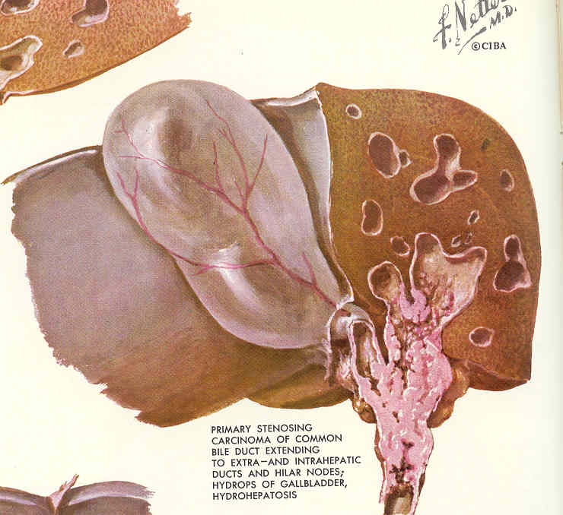
Cholangiocarcinoma
Slow growing malignancy of biliary tract which tend to infiltrate locally and metastasize late.
Gall Bladder cancer = 6,900/yr
Bile duct cancer = 3,000/yr
Hepatocellular Ca = 15,000/yr

Slide 25
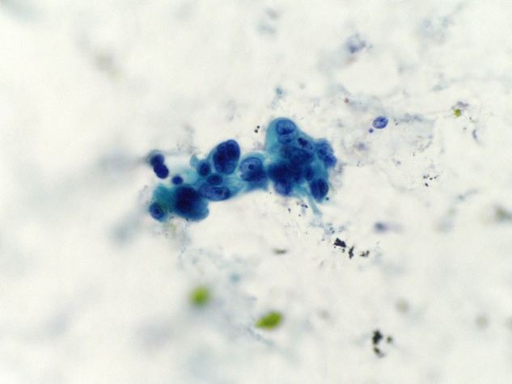
Cholangiocarcinoma Diagnosis and Initial Workup
Jaundice
Weight loss, anorexia, abdominal pain, fever
US – bile duct dilatation
Quadruple phase CT
MRCP/MRI
ERCP with Stent and Brush Biopsy
Percutaneous Cholangiogram with Internal Stent and Brush Biopsy

Slide 26
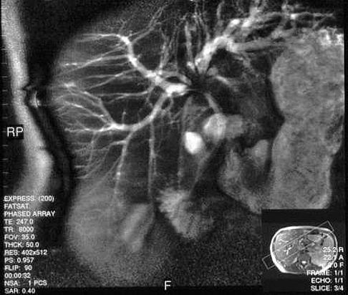
MRCP: Cholangiocarcinoma at the Bifurcation
Klatskin tumour = Cholangiocarcinoma of junction of right & left hepatic ducts

Slide 27
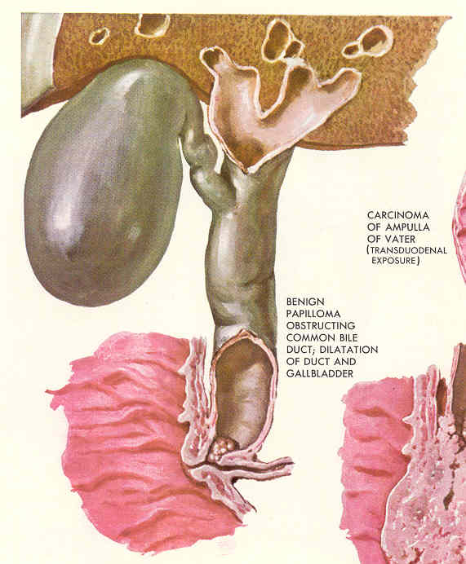
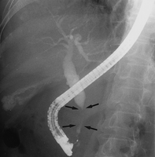
ERCP: Distal CBD Cancer

Slide 28
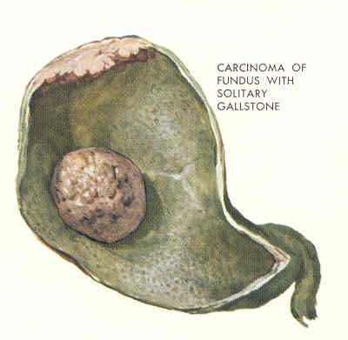
Gallbladder Cancer
6th decade
1:3, Male:Female
Highest prevalence in Israel, Mexico, Chile, Japan, and Native American women.
Risk Factors: Gallstones, porcelain gallbladder, polyps, chronic typhoid and some drugs

Slide 29
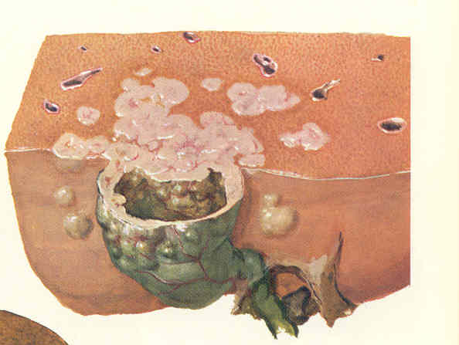
Gallbladder Cancer
Uncommon malignancy
2.5 per 100,000 population
Represents 54% of biliary tract cancers.

Slide 30
Gall Bladder Cancer Presentation
RUQ pain, jaundice, weight loss: CT
Biopsy yields adenocarcinoma consistent with GB primary
Biliary Decompression
Chemo/Radiation
Median survival with chemoradiotherapy is 9 months.

Slide 31
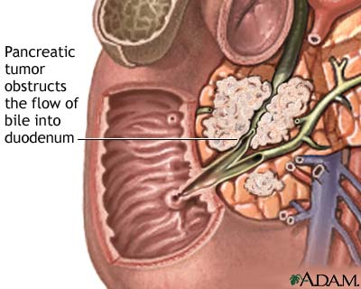
Biliary Stricture
Biliary stricture is an abnormal narrowing of the bile duct.
Among biliary strictures:
90% are malignant
Pancreatic cancer is the most common malignant cause, followed by cancers of the gallbladder, bile duct, liver, and large intestine.

Slide 32
Biliary Stricture – Non Cancerous Causes
Noncancerous causes of bile duct stricture include:
Injury to the bile ducts during surgery for gallbladder removal (accounting for 80% of nonmalignant strictures)
Pancreatitis (inflammation of the pancreas)
Primary sclerosing cholangitis (an inflammation of the bile ducts that may cause pain, jaundice, itching, or other symptoms)
Gallstones
Radiation therapy
Blunt trauma to the abdomen

Slide 33
Biliary Stricture – Patient Symptoms
Patients with biliary strictures may present with:
Jaundice (yellow skin color)
Abdominal pain
Fever
Vomiting

Slide 34
Biliary Stricture – Diagnostic Tests
Common diagnostics for biliary stricture are:
Ultrasound
CT
MRI
Biopsy
Cholangiography
A cholangiogram is an X-ray of the bile ducts
Can be performed:
Endoscopically
Percutaneously

Slide 35
Stent Placement - Endoscopic Approach
The Endoscope is positioned in the duodenum at the opening of the bile duct.

Slide 36
Summary
Gallstones
In the gallbladder
Biliary colic
Acute and chronic cholecystitis
Empyema
Biliary tract tumours
Other conditions
Acute acalculous cholecystitis
Mirizzi’s syndrome
Primary Biliary Cirrhosis
Primary Sclerosing Cholangitis
Biliary tract cysts
Biliary strictures
In the bile ducts
Obstructive jaundice
Pancreatitis
Cholangitis
In the Gut
Gallstone ileus

Slide 37
HEPATOCELLULAR CANCER (HCC)
General points to remember
Increasing incidence
Prognosis improving with screening, early diagnosis, more therapies for Hep B and C, more therapies for the cancer itself
Can be diagnosed without biopsy
Can be cured by transplant, surgery or in some cases local ablation
Some patients can live several years without treatment
Need to get sense of natural history
Increasing understanding of different biology of the cancer in different patients
Importance of multidisciplinary team including GI, surgery (transplant and liver surgeons), interventional radiology, medical and radiation oncology, support systems (navigators, nutrition, social work)

Slide 38
General Stats
5th most common cancer worldwide
Approx. 500,000 per year
3rd most common cause of cancer death
Asia and Africa due to HBV endemic
Increased incidence in HIV but mainly attributable to HCV and ETOH
HCV can also cause lymphoma
Hep B vaccine reducing rate of HCC in Asia
Hep B treatment also reducing rate of cancer
Rise in US also fueled by steatohepatitis which is an increasing cause of HCC

Slide 39
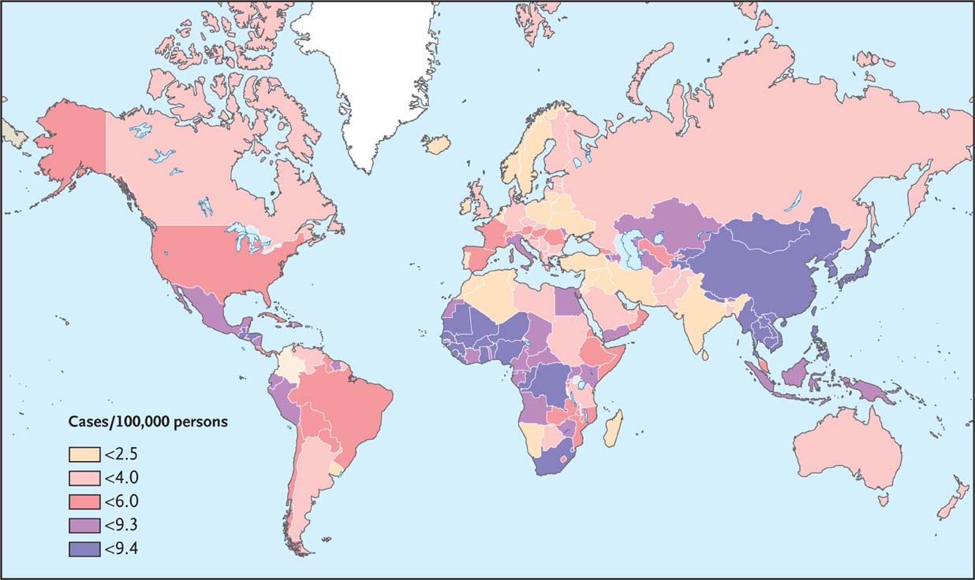
El-Serag HB. N Engl J Med 2011;365:1118-1127
Notes:
Figure 1 Regional Variation in the Estimated Age-Standardized Incidence Rates of Liver Cancer. The incidence rates shown (numbers of cases per 100,000 persons) pertain to both sexes and all ages. Adapted from the World Health Organization.3

Slide 40
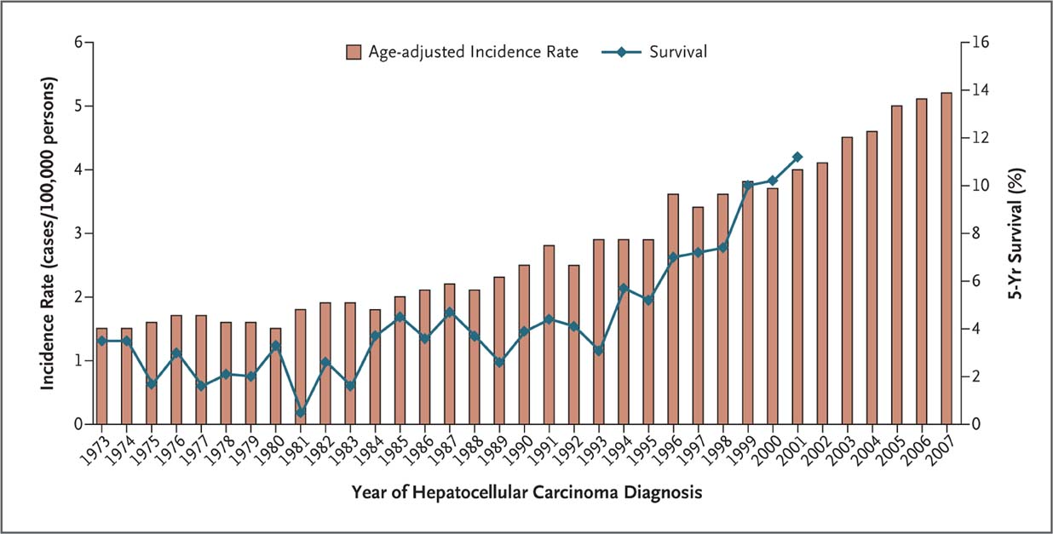
Age-Adjusted Incidence and 5-Year Survival Rates for Patients with Hepatocellular Carcinoma in the United States, 1973–2007.
El-Serag HB. N Engl J Med 2011;365:1118-1127
Notes:
Figure 2 Age-Adjusted Incidence and 5-Year Survival Rates for Patients with Hepatocellular Carcinoma in the United States, 1973–2007.

Slide 41
Etiology
Hepatitis B, C
Can get without cirrhosis in Hep B
Alcoholism
Association with high body mass, steatohepatitis, diabetes
Statins and coffee drinking reduces risk
Hemachromatosis, Porphyria Cutanea Tarda (some types), auto-immune hepatitis
Wilson’s disease, α1 anti-trypsin deficiency
Aflatoxin
Common theme is persistent inflammation in liver

Slide 42
General
Old criteria: AFP > than 400 in right context with liver lesion accepted as diagnostic
New Criteria: Arterial enhancing lesion with early washout (MR or CT); size 2cm or greater
Need well done triple phase MRI or CT to get the early arterial enhancement and the delayed wash out (tumor very dependent on arterial supply while rest of liver can be fed by portal vein)
If biopsy done useful to biopsy uninvolved liver to determine if cirrhosis is present
Approx. 2.7 % rate of tumor seeding

Slide 43
Types
HEPATOCELLULAR CARCINOMA: invasive, males 4-8 to 1 over females, <20% resectable; 90% have cirrhosis; 80% AFP +; mean age 55; molecular subsets being identified
Those with HBV less likely to have cirrhosis than those with HCV (although 70-80% do have cirrhosis)
Concurrent risks for HBV: high viral load, HCV or delta virus co-infection, ETOH, tobacco, early childhood infection)
Concurrent risk factors among HCV patients include increased age, male sex, HIV or HBV co-infection, probably diabetes and obesity
FIBROLAMELLAR VARIANT: circumscribed; Male:female 1:1; cirrhosis, HBV+, AFP+ only about 5%; 50-70% resectable; mean age 25

Slide 44
Clinical features
Bruit approx. 25%
Right upper quad pain, mass and wt loss; Tumor fever can occur
Liver failure symptoms as presentation also: mainly due to replacement of already reduced liver parenchyma
Propensity for vascular invasion and this can contribute to liver failure

Slide 45
Clinical features
GI bleeding: if from varices this has poor prognosis: In one study 25% of HCC deaths were due to variceal hemorrhage
Tumor rupture can occur at presentation (2-5%) and these can be rescued surgically or through embolization (see series in JCO)
If jaundice is from biliary obstruction by tumor this has better prognosis than from liver failure
Hypoglycemia, erythrocytosis, hypercalcemia, PCT, hypertrophic osteoarthropathy, virilization

Slide 46
Clinical features
Mets: lung, peritoneum, adrenal gland, bone
Triple phase MRI or CT best overall test
Be aware of vascular invasion and multicentricity
Importance of staging liver function: Child’s classification A-C

Slide 49
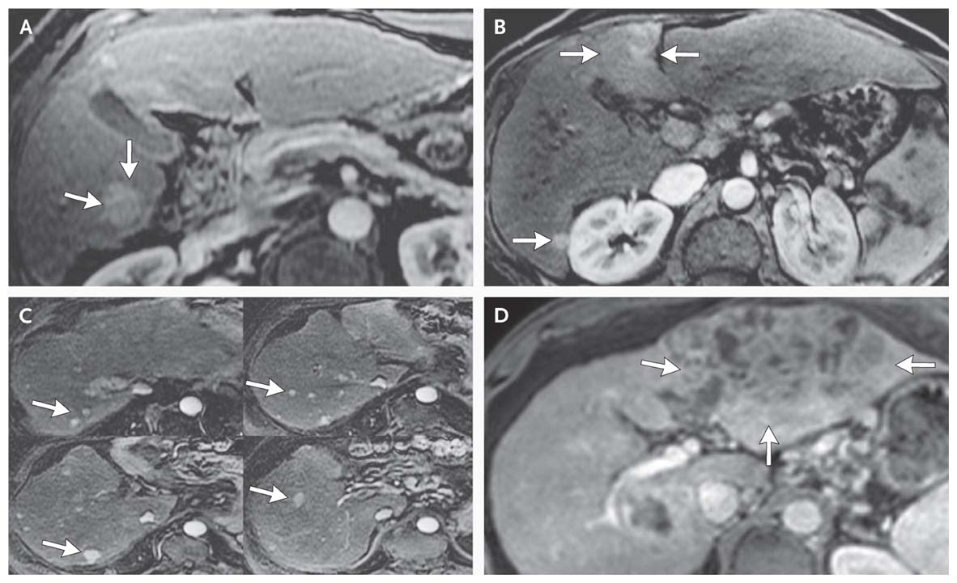
MRI Studies Showing the Effects of Hepatocellular Carcinoma at Different Stages of the Disease.
A: Very early stage (one lesion 1.7cm), B: early stage (2 lesions 2.4 and 1.2 cm)
C: Intermediate stage (multiple lesions, Childs B),
D: Advanced (large mass and ascites)
Notes:
Figure 4 MRI Studies Showing the Effects of Hepatocellular Carcinoma at Different Stages of the Disease. All MRI studies were performed with the use of intravenous contrast material and show areas of enhancement typically found in patients with hepatocellular carcinoma. Panel A shows a single mass measuring 1.7 cm in diameter (arrows), indicating very-early-stage hepatocellular carcinoma (defined as a single lesion measuring less than 2 cm in diameter). Panel B shows two lesions, measuring 2.4 and 1.2 cm in diameter (arrows), indicating early-stage hepatocellular carcinoma (defined as fewer than three nodules, each measuring less than 3 cm in diameter). Panel C shows multiple hepatocellular-carcinoma nodules (arrows) in a patient with Child–Pugh class B cirrhosis, indicating intermediate-stage disease. Panel D shows a large mass (more than 10 cm in diameter) and ascites (arrows), indicating advanced-stage hepatocellular carcinoma.

Slide 50
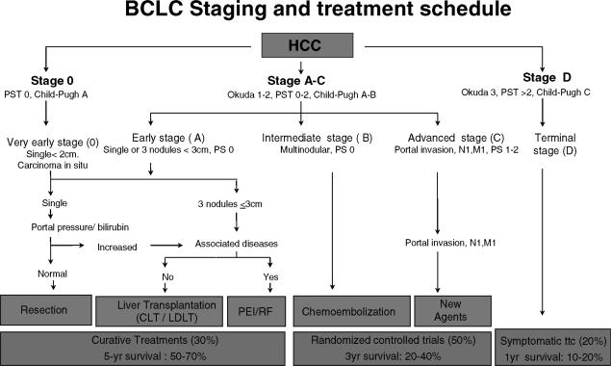

Slide 51
Therapy
Curative modalities first
Resection, Transplant, Possibly RFA in early stage lesions
Modalities that extend overall survival second
RFA or chemoembolization (intermediate stage)
Sorafenib (advanced stage but preserved liver function: trials mostly Child’s A some B)
Terminal Stage no evidence of survival benefit
Do no harm

