Slide 1
ALIMENTARY TRACT AND PANCREATIC DISEASE
COMPILED BY EFFIE NAILA

Slide 2
OUTLINE
INVESTIGATION OF GASTROINTESTINAL DISEASE
PRESENTING PROBLEMS IN GASTROINTESTINAL DISEASE
DISEASES OF THE ESOPHAGUS
DISEASES OF THE STOMACH AND DUODENUM
DISEASES OF THE SMALL INTESTINE
DISEASES OF THE PANCREAS
INFLAMMATORY BOWEL DISEASE
IRRITABLE BOWEL SYNDROME
ISCHEMIC GUT INJURY
DISORDERS OF THE COLON AND RECTUM

Slide 3
1. INVESTIGATIONS OF GASTROINTESTINAL DISEASE

Slide 4
OUTLINE
Imaging
Plain X rays
Contrast studies
U/S, CT & MRI
Endoscopy
Histology
Tests of infection
Bacterial cultures
Serology
Breath tests
Tests of function
Esophageal motility
Gastric emptying
Colonic & ano - rectal motility
Radioisotope tests

Slide 5
2. PRESENTING PROBLEMS IN GASTROINTESTINAL DISEASE

Slide 6
OUTLINE
Dysphagia
Dyspepsia
Vomiting
GI bleeding
Diarrhea
Malabsorption
Weight loss
Constipation
Abdominal pain

Slide 7
DYSPEPSIA
Definition: group of symptoms characterized by discomfort in the upper epigastrium, usually following meals. The most characteristic symptoms is fullness but can also be a burning, true pain.
Causes: Esophagitis, peptic ulcer, stomach cancer, drugs

Slide 8
HISTORY & PE
History:
Age
Associated symptoms: weight loss & vomiting
Drugs esp. NSAIDs
P/E:
Adenopathy, organomegaly
Carnett’s sign: pain increases during muscle contraction e.g. during a sit up → abdominal wall muscle problem

Slide 9
RED FLAGS
Unintended weight loss
Persistent vomiting
Progressive dyspepsia
Odynophagia
Unexplained anemia or iron deficiency
Hematemesis
Jaundice
Palpable abdominal mass or lymphadenopathy
FHx of Upper GI malignancy
Previous gastric surgery

Slide 10
INVESTIGATIONS
Lab investigations:
CBC, LFTs, RBS, U/E/Cs
Amylase, albumin, calcium, protein Elp, TSH
Helicobacter serology

Slide 11
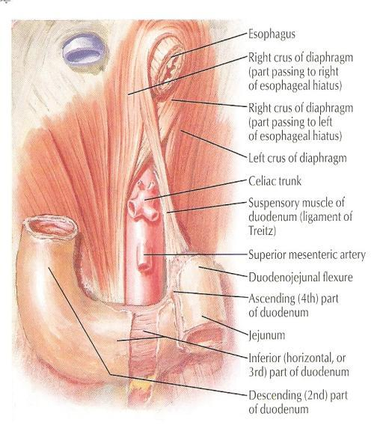
GI BLEEDING
Can be divided into 2 clinical syndromes:
Upper GI bleed (Pharynx → ligament of Treitz)
Lower GI bleed (ligament of Treitz → rectum)
LIGAMENT OF TREITZ

Slide 12
UPPER GASTROINTESTINAL BLEEDING
Epidemiology
Upper GI bleed remains a major medical problem.
About 75% of patient presenting to the emergency room with GI bleeding have an upper source.
In-hospital mortality of 5% can be expected.
The MCCC are PUD, erosions, Mallory-Weiss tear & esophageal varices.

Slide 13
CLINICAL FEATURES
Haematemesis : vomiting of blood (fresh and red or digested and black).
Melena : passage of loose, black tarry stools with a characteristic foul smell.
Coffee ground vomiting : blood clot in the vomitus.
Hematochezia : passage of bright red blood per rectum (if the hemorrhage is severe).

Slide 14
CONT.
Hematemesis without melena is generally due to lesions proximal to the ligament of Treitz, since blood entering the GIT below the duodenum rarely enters the stomach.
Melena without hematemesis is usually due to lesions distal to the pylorus
Approximately 60mL of blood is required to produced a single black stool.

Slide 15
LOCAL CAUSES
ESOPHAGUS: Esophageal varices, esophageal Ca, Mallory – Weis syndrome, reflux esophagitis,
STOMACH: GU, erosive gastritis, gastric Ca, Diuelafoy’s syndrome, gastric lymphoma, gastric leiomyoma,
DUODENUM: DU, duodenitis, peri – ampullary tumor, Aorto – duodenal fistula

Slide 16
GENERAL CAUSES
Hemophilia
Leukemia
Thrombocytopenia
Anti – coagulant therapy

Slide 18
ESOPHAGEAL VARICES
Abnormal dilatation of sub - epithelial and sub - mucosal veins due to increased venous pressure from portal hypertension (collaterals exist between the portal system and azygous vein via lower esophageal venous plexus).
MC site: lower esophagus.

Slide 19
MALLORY – WEIS TEAR (MWT)
Longitudinal tears at the oesophagogastric junction that may occur after any event that provokes a sudden rise in intra - gastric pressure or gastric prolapse into the esophagus.
Precipitating factors: Hiatus hernia, Retching & vomiting, Straining, Hiccuping, Coughing, Blunt abdominal trauma, Cardiopulmonary resuscitation

Slide 21
MANAGEMENT
Bleeding from MWT stops spontaneously in 80 – 90% of patients
A contact thermal modality, such as multipolar electrocoagulation (MPEC) or heater probe
Epinephrine injection → reduces or stops bleeding via a mechanisms of VC and tamponade
Endoscopic band ligation
Endoscopic hemoclipping

Slide 22
ESOPHAGEAL CANCER
8th MC cancer seen throughout the world.
40% occur in the middle 3rd of the esophagus and are squamous carcinomas.
adenoCA (45%) occur in the lower 3rd of the esophagus and at the cardia.
Tumors of the upper 3rd are rare (15%)

Slide 23
COMPLICATION OF PUD
Hemorrhage
Posterior duodenal ulcer erode the gastroduodenal artery
lesser curve gastric ulcers erode the left gastric artery
Perforation → generalized peritonitis (signs of peritonitis)
Pyloric obstruction → profuse vomiting → dehydration, weakness, constipation, Loss of weight (LOW)

Slide 25
ACUTE GASTRITIS
This is an acute mucosal inflammatory process usually of a transient nature
Accompanied by hemorrhage into the mucosa and in more severe circumstances, by sloughing of the superficial epithelium (erosion)

Slide 26
ETIOLOGY
Heavy use of NSAIDs
Excessive alcohol consumption
Heavy smoking
Chemotherapy
Uremia
Severe stress: trauma, burns surgery
Ischemia & shock
Suicide attempts: acid and alkali
Mechanical trauma
After distal gastrectomy with reflux of bilious material

Slide 27
CLINICAL FEATURES
Asymptomatic
Epigatric pain with N & V
Hematemesis & melena
Fatal blood loss
It is one of the major causes of hematemesis, particularly in alcoholics

Slide 28
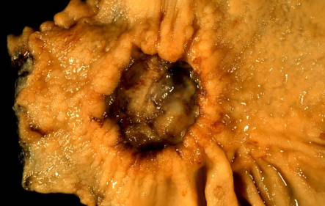
GASTRIC CANCER
BENIGN GASTRIC NEOPLASM
Adenomatous polyps
Leiomyoma
Neurogenic tumor
Fibromata
Lipoma
GASTRIC CARCINOMA
Gastric adenocarcinoma (90%)
Lymphomas
Smooth muscle tumor

Slide 29
CLINICAL FEATURES
Early signs: indigestion, flatulence, dyspepsia
Late signs:
LOW, anemia, dysphagia, vomiting, epigastric/ back pain, epigastric mass
Signs of metastases: jaundice, ascites, diarrhea, intestinal obstruction

Slide 30
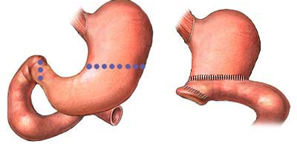
TREATMENT
Radical total gastrectomy
Palliative resection
Palliative bypass

Slide 31
DIEULAFOY’S DISEASE
Erosion of mucosa overlying an artery in the stomach → necrosis of arterial wall & resultant hemorrhage
2⁰ to a gastric arterial venous abnormality that has a characteristic histological appearance
The lesion itself is covered by normal mucosa and, when not bleeding, it may be invisible.
If it can be seen while bleeding, all that may be visible is profuse bleeding coming from an area of apparently normal mucosa

Slide 32
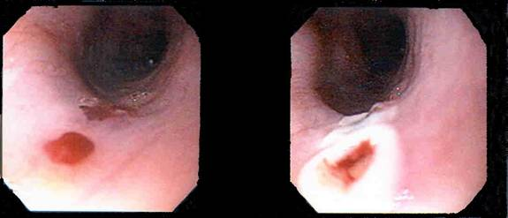

Slide 33
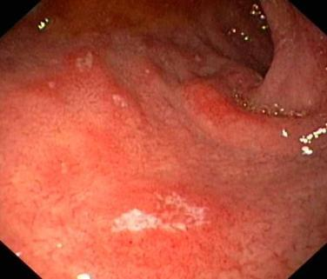
DUODENITIS
This is inflammation & irritation of the wall of the first part of the small intestine
Etiology: Aspirin, NSAIDs, high acid secretion
Clinical features:
Symptoms are similar to PUD stomach pain
Bleeding from the intestine
N & V
Intestinal obstruction

Slide 34
OVERVIEW OF MANAGEMENT OF UPPER GI BLEED
Acute upper GI bleed
Resuscitation & risk assessment, routine blood tests
Endoscopy in 24 hours →
Varices → Management of varices
Peptic ulcer →
Major SRH → endoscopic treatment →
Failure? → surgical
Minor SRH → eradicate H. pylori & risk reduction
No obvious cause →
Minor bleed → eradicate H. pylori & risk reduction
Major bleed → other colonoscopy & angiography

Slide 35
RESUCITATION
Protect the airway and give high – flow oxygen
Blood transfusion: Insert 2 large – bore (14 – 16 gauge) IV cannulate to take blood for FC, U &E, LFT, clotting, cross – match (4 – 6 units); Give IV colloid while waiting for blood to be cros s- matched. In a dire emergency, give group O Rh –ve blood; Transfuse until hemodynamically stable; Correct clotting abnormalities (vitamin K, FFP, platelet)
Monitor pulse, BP, and CVP at least hourly until stable.
Insert urinary catheter and monitor hourly urine output if shocked.
Consider a CVP line to monitor CVP and guide fluid replacement.
Organize a CXR, ECG, and check arterial blood gases in high-risk patient.
Arrange an urgent endoscopy.
Notify surgeon of all severe bleeds on admission.

Slide 36
DETECTION & ENDOSCOPIC
Used to detect the site of bleeding.
May also be used in a therapeutic capacity (active bleeding from the ulcer, the presence of a visible vessel, adherent clot overlying the ulcer)
Injection sclerotherapy is used commonly. Other method include the use of heat probes and lasers.
Angiography in whom endoscopy does not identify the bleeding point. Limitation: can only detect active bleeding of greater than 1mL/min.

Slide 37
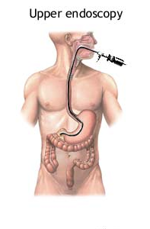
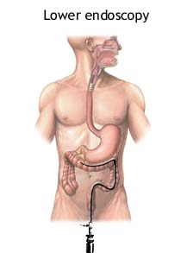

Slide 38
RISK FACTORS FOR DEATH (UPPER GI BLEED)
1. Advanced AGE
2. SHOCK on admission(pulse rate >100 beats/min; systolic blood pressure < 100mmHg)
3. COMORBIDITY (particularly hepatic or renal failure and disseminated malignancy)
4. Diagnosis (worst PROGNOSIS for advanced upper gastrointestinal malignancy)
5. ENDOSCOPIC FINDINGS (active, spurting hemorrhage from peptic ulcer; non-bleeding visible vessel)
6. RECURRENT BLEEDING (increases mortality 10 times)

Slide 39
LOWER GASTROINTESTINAL BLEEDING
ETIOLOGY
Hemorrhoids
Diverticulosis
Arteriovenous malformations
Polyps
IBD
Infectious gastroenteritis
Meckel diverticulum

Slide 40
COLORECTAL POLYPS
Adenomatous polyps and adenomas
Has malignant potential
Morphology:
Polypoid and pedunculated
Dome-shaped and sessile

Slide 42
MANAGEMENT
Subtotal colectomy & ileo - rectal anastomosis
Pan - proctocolectomy & ileotomy / ileal pouch
Follow-up colonoscopies
An adenomatous polyp is found/ a colorectal cancer has been treated
Intervals depend on number, size & pathology of polyps

Slide 43
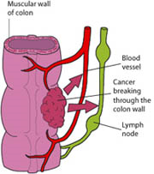
ADENOCARCINOMA OF COLON & RECTUM
Common > 60 years old
Common site → sigmoid colon, rectum
Clinical features:
Altered bowel habit & large bowel obstruction
Rectal bleeding
Iron deficiency anaemia
Tenesmus
Perforation
Anorexia & weight loss

Slide 44
ANGIODYSPLASIA
1 or multiple small mucosal or submucosal vascular malformation.
> 60 years old
Common site : ascending colon and caecum
Malformations consist of dilated tortuous submucosal veins
In severe cases, the mucosa is replaced by massive dilated deformed vessels
Clinical features:
Acute / chronic rectal bleeding
IDA

Slide 46
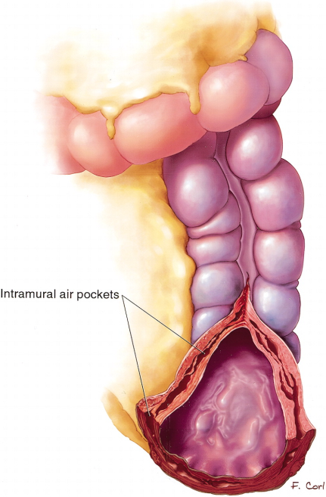
ISCHEMIC COLITIS
Elderly; transient ischemia of a segment of a large bowel, followed by sloughing of mucosa
Common site → splenic flexure
Clinical features:
Abdominal pain
Rectal bleeding ( dark red)
1-3x over 12 hours
Complication → fibrotic stricture

Slide 47
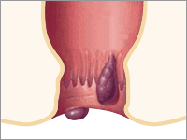
HEMORRHOIDS
M > F; Female → late pregnancy, puerperium
Supine lithotomy position → 3 ,7, 11 o’clock positions
Classification:
1st degree : never prolapse
2nd degree: prolapse during defecation but return spontaneously
3rd degree : remain prolapsed but can be reduced digitally
4th degree : long-standing prolapse cannot be reduced

Slide 48
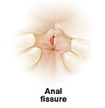
ANAL FISSURE
Longitudinal tear in mucosa & skin of anal canal
M > F
Common site: midline in posterior anal margin
Clinical features:
Acute pain during defecation
Fresh bleeding at defecation

Slide 49
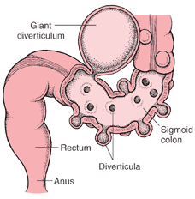
DIVERTICULAR DISEASE
Rare < 40 years old; F > M
Causes:
Chronic lack of dietary fiber
Genetic
Common site: sigmoid colon
Clinical features:
Diverticulosis (asymptomatic)
Chronic grumbling diverticular pain (chronic constipation & episodic diarrhea)

Slide 50
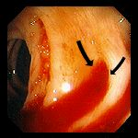
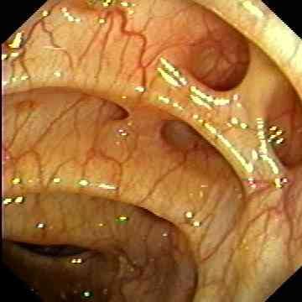

Slide 51
MEDICAL MANAGEMENT
Vasoconstrictive agents: Vasopressin
Therapeutic embolization:
Embolic agents: autologous clot, Gelfoam, polyvinyl alcohol, microcoils,
ethanolamine, and oxidized cellulose
Selective angiography
Endoscopic therapy:
Diathermy / laser coagulation
Short term control of bleeding during resuscitation

Slide 52
SURGICAL MANAGEMENT
The bleeding point is localized, perform a limited segmental resection of the small or large bowel
Poor prognostic features:
age over 60 years
chronic history
relapse on full medical treatment
serious coexisting medical conditions
4 units of blood transfusion required during resuscitation

Slide 53
DISEASES OF THE MOUTH & SALIVARY GLANDS

Slide 54
OUTLINE
Aphthous ulceration
Oral cancer
Candidiasis
Parotitis

Slide 55
APHTHOUS ULCERATION
Common, superficial, painful and idiopathic
In severe cases, causes such as infection, drug reaction or Behcet’s syndrome must be considered
Rx:
Topical triamcinolone
Choline salicylate gel

Slide 56
SQUAMOUS CARCINOMA OF THE ORAL CAVITY
Common worldwide
Mortality → ~50%; largely due to late diagnosis
Suspicious lesions should be biopsied if treatment for local trauma or infection fails to produce improvement after 2 weeks
Rx: resection, radiotherapy or both.

Slide 57
RISK FACTORS
Poor diet
Alcohol
Smoking
Chewing tobacco or areca nuts in betel leaves
HPV types 16 & 18 are also implicated

Slide 58
CANDIDIASIS
Caused by candida albicans, a normal mouth commensal that proliferates to cause thrush in:
Babies
Patients receiving corticosteroids, antibiotics or cytotoxic therapy
People with DM or HIV
P/C:
White patches are seen on the tongue and buccal mucosa
Dysphagia suggests pharyngeal and esophageal candidiasis
Rx:
Nystatin or amphotericin suspensions or lozenges
Oral fluconazole in resistant cases

Slide 59
PAROTITIS
Due to viral or bacterial infection
Mumps causes a self – limiting acute parotitis
Bacterial parotitis usually occurs as a complication of major surgery and can be avoided by good post – operative care
Broad – spectrum antibiotics are required, whilst surgical drainage is necessary if abscesses are present

Slide 60
DISEASES OF THE ESOPHAGUS

Slide 61
OUTLINE
GASTRO – ESOPHAGEAL REFLUX DISEASE
MOTILITY DISORDERS
TUMORS OF THE ESOPHAGUS
PERFORATION OF THE ESOPHAGUS

Slide 62
GASTROESOPHAGEAL REFLUX DISEASE
Definition: condition in which chronic symptoms or chronic mucosal damage are produced by the abnormal reflux of gastric contents (acid) into the esophagus.
It is a common and very significant problem
Only a minority of patients with symptoms of GERD seek medical help.
Patients with symptoms of GERD are often misdiagnosed.
There are 2 categories: GERD +/- erosive esophagitis

Slide 63
ETIOLOGY
Inappropriate transient relaxation of LES (MCC)
Low basal LES tone (esp. in scleroderma)
Contributing factors include: delayed esophageal clearance (hypothyroidism), delayed gastric emptying (pyloric stenosis), obesity, pregnancy, acid hyper - secretion (rare) from ZES.
Hiatal hernia (esp. in children) → worsens reflux.

Slide 64
LOS ANGELES CLASSIFICATION
LA GRADE A: One or more mucosal breaks no longer than 5mm, not bridging the tops of mucosal folds
LA GRADE B: one or more mucosal breaks longer than 5 mm, not bridging the tops of mucosal folds
LA GRADE C: one or more mucosal breaks bridging tops of mucosal folds involving <75% of the circumference
LA GRADE D: one or more mucosal breaks bridging the tops of mucosal folds involving >75% of the circumference. BE is seen here.

Slide 65
CLINICAL FEATURES
‘Heartburn’ (pyrosis) → 90% & acid regurgitation
+/- Sour regurgitation. water brash, sensation of a lump in the throat (globus sensation), frequent belching

Slide 66
CONT.
Foods/ substances that aggravate GERD symptoms: Ethanol, caffeine, tobacco, fatty/ fried foods, chocolate, peppermint, spicy foods, citrus fruit juices, tomato – based products
Medications that may aggravate GERD symptoms by impairing LES function: Beta adrenergic agonists, theophylline, anti – cholinergics, TCAs, progesterone, alpha – adrenergic agonists, diazepam, CCBs
Medications that may aggravate GERD symptoms damaging esophageal mucosa: Tetracycline, Quinidine

Slide 67
GERD SIGNS & SYMPTOMS
NON - ESOPHAGEAL
RESPIRATORY
Chronic cough
Asthmatic symptoms: wheezing
Aspiration pneumonia
NON – RESPIRATORY
Sore throat
Hoarseness and clearing of throat
Dental caries
Otitis media
ESOPHAGEAL
TYPICAL
Pyrosis
Acid regurgitation
ATYPICAL
Chest pain
Dysphagia (late)
Odynophagia (rare)

Slide 68
INVESTIGATIONS
Clinical diagnosis is sufficient based on symptoms history and relief following a trial of pharmacotherapy (PPIs)
Gastroscopy
Indications: heartburns accompanied by red flags (bleeding, weight loss etc.); persistent reflux symptoms or prior severe erosive esophagitis after therapeutic trial of PPIs; Hx of esophageal stricture with persistent dysphagia
Esophageal manometry
24h pH monitoring: most accurate test but not required or performed in most cases

Slide 69
TREATMENT
PPIs (maintenance therapy)
On demand: antacids, H₂ – blockers
Diet changes: avoid alcohol, coffee, spices, tomatoes & citrus juices, eat small meals frequently
Lifestyle changes: weight loss if obese; elevating the head of the bed (if nocturnal symptoms); do not eat immediately before going to bed
Symptoms may recur if therapy is discontinued

Slide 70
COMPLICATIONS
Esophageal stricture disease: scarring can lead to dysphagia (solids)
Ulceration
Bleeding
Barret’s esophagus and esophageal adenocarcinoma: gastroscopy is recommended for patients with chronic GERD or symptoms are suggestive of complicated disease e.g. anorexia, weight loss, bleeding dysphagia etc.

Slide 71
BARRET ESOPHAGUS
Definition: metaplasia of normal squamous esophageal epithelium to abnormal columnar epithelium containing – type intestinal mucosa (intestinal metaplasia)
It is a premalignant lesions for esophageal adenocarcinoma
Etiology: long – standing GERD
Epidemiology: MC in males, age > 50, Caucasians, smokers, overweight, hiatus hernia & long – standing history of reflux symptoms

Slide 72
PATHOPHYSIOLOGY
Endoscopy shows erythematous epithelum in distal esophagus
Biopsy: specialized intestinal epithelium within the esophagus (diagnostic)
BE predisposes 1st to premalignant changes characterized as low or high – grade dysplasia which then progress to adenocarcinoma
Risk of malignant transformation is ~0.12% per year for all BE patients prior to dysplasia.
Patients with BE may be 30 – 60 times more likely to develop malignancy.

Slide 73
DIAGNOSTIC METHODS
History
Endoscopy
Empiric therapy: antacids
pH monitoring
Radiology is irrelevant

Slide 74
pH monitoring
Allows investigation of:
The amount and timing of reflux
Correlation between reflux and symptoms
Effect of therapy on reflux
In general, most useful in:
Endoscopy negative patients
Patients with non-cardiac chest pain or URT symptoms
Patients with refractory symptoms: Frequent visits to the dentist

Slide 75
TREATMENT
Acid suppressive therapy with high – dose PPI indefinitely (or surgical nissen fundoplication)
Endoscopy every 3 year if no dysplasia;
Low grade dysplasia: Regular surveillance with intensive biopsy, Endoscopic ablation
High grade dysplasia:
Regular surveillance with intensive biopsy (2 endoscopies annually)
Endoscopic ablation
Esophagectomy

Slide 76
DISEASES OF THE STOMACH AND DUODENUM

Slide 77
OUTLINE
GASTRITIS
PEPTIC ULCER DISEASE
FUNCTIONAL DISORDERS
TUMORS

Slide 78
PEPTIC ULCER DISEASE
Definition: focal defects in the mucosa that penetrate the muscularis mucosa layer resulting in scarring
Defects superficial to the muscularis mucosa have erosions & no scarring
Includes defect in the stomach (GU) & duodenum (DU)

Slide 79
ETIOLOGY
 | DUODENAL | GASTRIC
H. PYLORI INFECTION | 90% | 60%
NSAIDs | 7% | 35%
PHYSIOLOGIC STRESS – INDUCED | <3% | <5%
ZES | <1% | <1%
IDIOPATHIC | 15% | 10%

Slide 80
CONT.
NSAID (-ve), H. pylori (-ve) ulcers are becoming more commonly recognized
Other causes: CMV< Ischemic, idiopathic
Alcohol: damages gastric mucosa but rarely causes ulcers
PUD is also associated wit tobacco, cirrhosis, COPD & CRF
Cigarette smoking & PUD:
Increased risk of ulcers and complications;
Increased risk of death from the ulcers
Impaired healing

Slide 81
CLINICAL FEATURES
Dyspepsia (MC): only 5% of patients with dyspepsia have ulcers (most have functional disease)
DU:
Epigastric pain (may localize to tip of the xiphoid)
Burning
Develops 1 – 3h after meals
Relieved by eating & antacids
Interrupts sleep
Periodicity (tends to occur in clusters over week with subsequent periods of remission)
GU: more atypical symptoms; a biopsy is necessary to exclude malignnancy

Slide 82
COMPICATIONS
Bleeding 10% (severe if from gastroduodenal artery)
Perforation 2% (usually anterior ulcers)
Gastric outlet obstruction (2%)
Penetration (posterior) 2%; may also cause pancreatitis

Slide 83
INVESTIGATIONS
Endoscopy (most accurate)
Upper GI series
H. pylori tests
Fasting serum gastrin measurement if ZES is suspected

Slide 84
TREATMENT
Specific management depends on etiology
Eradicate H. pylori if present: chief advantage of triple therapy over PPI is to lower ulcer recurrence rate
Stop NSAIDs if possinle
Start PPI
Discontinue tobacco
No diet modifications required but some people have fewer symptoms if they avoid caffeine, alcohol & spices

Slide 85
MANAGEMENT OF BLEEDING PEPTIC ULCERS
OGD to explore upper GIT
IV pantoprazole continuous drip
Establish risk of re - bleeding/ continuous bleeding
Clinical risk factors: increased age (>60), bleeding diathesis, history of PUD, comorbid disease, hemodynamically unstable
Endoscopic signs: active bleeding, visible vessel, clot, red spot (more predictive)
If high risk, consider ICU admission

Slide 86
H. PYLORI INDUCED PEPTIC ULCERATION

Slide 87
NSAID – INDUCED ULCERATION

Slide 88
STRESS – INDUCED ULCERATION

Slide 89
DISEASES OF THE SMALL INTESTINES

Slide 90
OUTLINE
DISORDERS CAUSING MALABSORPTION
MOTILITY DISORDERS
UPPER & LOWER GIT BLEED
INFECTIONS OF THE SMALL INTESTINES
TUMORS OF THE SMALL INTESTINE

Slide 91
DISEASES OF THE PANCREAS

Slide 92
OUTLINE
ACUTE PANCREATITIS
CHRONIC PANCREATITIS
CONGENITAL ANOMALIES
TUMORS OF THE PANCREAS

Slide 93
INFLAMMATORY BOWEL DISEASE

Slide 94
IRRITABLE BOWEL SYNDROME

Slide 95
ISCHEMIC GUT INJURY

Slide 96
DISORDERS OF THE COLON & RECTUM

