Slide 1
ACUTE DIARRHOEAL DISEASE
Ahmed Laving

Slide 2
Outline
Definition
Epidemiology
Physiology of water absorption
Aetiology
Pathogenesis
Clinical presentation
Management
Prevention

Slide 3
Diarrhoea
Defined as passing three or more loose stools in 24-hours
a loose stool is one that takes shape of the container
Duration:
Acute: 2 weeks
Persistent: 2-4 weeks
Chronic: 4 weeks
Stool vol. >10g/kg/day in infants & toddlers
>200g/day in older children
Dysentery: bloody diarrhoea

Slide 4
Epidemiology: Diarrhoeal Disease
Second leading cause of death in children under five
Account for 9% of all deaths among children under age 5 worldwide in 2015
over 1400 children dying each day, or about 530,000 children a year
From 2000 to 2015, total number of deaths from diarrhoea in children under 5 decreased by >50 per cent – from over 1.2 million to half a million
In Kenya, deaths due to diarrhoeal diseases reached 23,374 or 6.98% of total deaths (KDHS 2014)

Slide 5
Physiology of Water Absorption
Water is absorbed by three basic mechanisms:
”Neutral" sodium chloride (NaCl) absorption - Predominantly in the ileum
“Electrogenic" sodium absorption - Na+/K+ ATPase - Colon
Sodium co-transport - Small intestine only

Slide 6
GIT Physiology
Input
Absorption
Diet/Saliva : 3 L/d
Diarrhoea defined as >200 mL liquid excretion/day. In extremes, the GIT can both absorb and secrete 20 L of water per day
Stomach : 2 L
Jejunum 5 L/d
Bile : 1 L
Pancreas : 2 L
Bowel : 1 L
Ileum : 2-3 L
Total 9 L
Colon : 1-2 L
Total 8.8 L
Fecal Water 100-200 mL/d

Slide 7
Pathophysiology
4 main mechanisms:
Osmotic e.g. Lactose intolerance
Inflammatory e.g. Salmonella infection
Secretory e.g. Cholera infection
Motility e.g. Irritable colon of infants

Slide 9
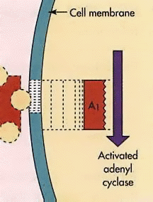
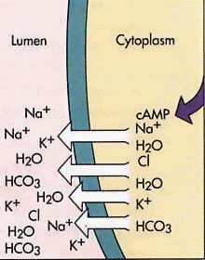
Secretory Diarrhoea:

Slide 10
Aetiology of Acute Diarrhoea
Infectious:- Viruses
- Bacteria
- Parasites
Non-infective:- Food (allergy, poisoning, intolerance)
Drugs: (direct effects, dysmotility, normal flora)

Slide 11
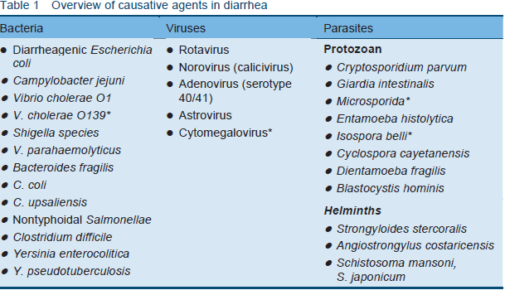

Slide 12
Viruses
Rotavirus accounts for 15-25% of all diarrheal causes
Replicate within villous epithelium of the small bowel causing patchy epithelial cell destruction and villous shortening
Loss of the absorptive capacity of villous cells leading to loss of disaccharides especially lactose
Recovery occurs when villi regenerate and villous epithelium matures

Slide 13
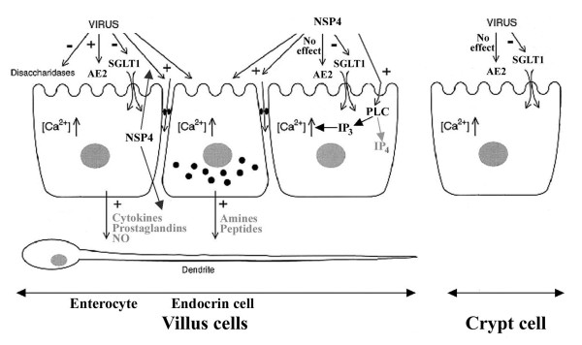
Pathogenesis of Rotavirus Diarrhoea

Slide 14
Bacteria
TOXINS THAT CAUSE SECRETIONS :
Enterotoxigenic E coli and V. cholerae 01 produce toxins that alter epithelial cell function
Reduce absorption of sodium and increase secretion of chloride causing secretion of water and electrolytes
MUCOSAL INVASION
Shigella, E coli and salmonella cause bloody diarrhea by invading and destroying mucosal epithelial cells
Occurs in colon and distal part of the ileum

Slide 15
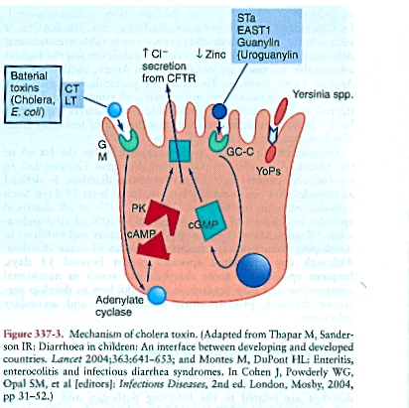
Pathogenesis of Cholera

Slide 16
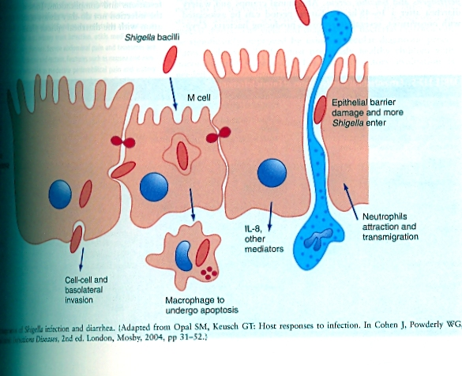
Pathogenesis of Shigella infection

Slide 17
Protozoa
Mucosal adhesion: G. lamblia and Cryptosporidium adhere to small bowel epithelium causing shortening of the villi
Mucosal invasion: E. histolytica causes diarrhoea by invading epithelial cells in colon and Ileum causing micro abscesses and ulcers

Slide 18
Clinical Presentation
HISTORY
consistency, color, volume, and frequency of stool
Systemic symptoms
Daycare use: rotavirus; astrovirus; calicivirus; Campylobacter, Shigella, Giardia, and Cryptosporidium species.
Travel history :Enterotoxigenic E coli
Food history:
Dairy food -Campylobacter and Salmonella species
Eggs -Salmonella species
Meats -C perfringens and Aeromonas, Campylobacter, and Salmonella species
Ground beef - Enterohemorrhagic E coli

Slide 19
Stool Characteristics | Small Bowel | Large Bowel
Appearance | Watery | Mucoid and/or bloody
Volume | Large | Small
Frequency | Increased | Highly increased
Blood | Possibly positive but never gross blood | Commonly grossly bloody
pH | Possibly < 5.5 | >5.5
Reducing substances | Possibly positive | Negative
WBCs | < 5/high power field | Commonly >10/high power field
Serum WBCs | Normal | Possible leukocytosis, bandemia
Organisms | Viral Rotavirus,Adenovirus,Calicivirus Astrovirus Norovirus | Invasive bacteria Escherichia Coli (enteroinvasive, enterohemorrhagic) Shigella, Salmonella Campylobacter,Yersinia Aeromonas species Plesiomonas species
 | Enterotoxigenic bacteria E coli,Klebsiella, Clostridium Cholera ,Vibrio species | Toxic bacteria Clostridium difficile
 | ParasitesGiardia species Cryptosporidium species | ParasitesEntamoeba organisms

Slide 20
Organism | Incubation | Duration | Vomiting | Fever | Abdominal Pain
Rotavirus | 1-7 d | 4-8 d | Yes | Low | No
Adenovirus | 8-10 d | 5-12 d | Delayed | Low | No
Norovirus | 1-2 d | 2 d | Yes | No | No
Astrovirus | 1-2 d | 4-8 d | +/- | +/- | No
Calicivirus | 1-4 d | 4-8 d | Yes | +/- | No
Aeromonas species | None | 0-2 wk | +/- | +/- | No
Campylobacter species | 2-4 d | 5-7 d | No | Yes | Yes
C difficile | Variable | Variable | No | Few | Few
C perfringens | Minimal | 1 d | Mild | No | Yes
Enterohemorrhagic E coli | 1-8 d | 3-6 d | No | +/- | Yes
Enterotoxigenic E coli | 1-3 d | 3-5 d | Yes | Low | Yes
Plesiomonas species | None | 0-2 wk | +/- | +/- | +/-
Salmonella species | 0-3 d | 2-7 d | Yes | Yes | Yes
Shigella species | 0-2 d | 2-5 d | No | High | Yes
Vibrio species | 0-1 d | 5-7 d | Yes | No | Yes
Y enterocolitica | None | 1-46 d | Yes | Yes | Yes
Giardia species | 2 wk | 1+ wk | No | No | Yes
Cryptosporidium species | 5-21 d | Months | No | Low | Yes
Entamoeba species | 5-7 d | 1-2+ wk | No | Yes | No

Slide 21
Physical examination
Dehydration: principal cause of morbidity and mortality
Abdominal pain
Malnutrition
Perianal erythema

Slide 22
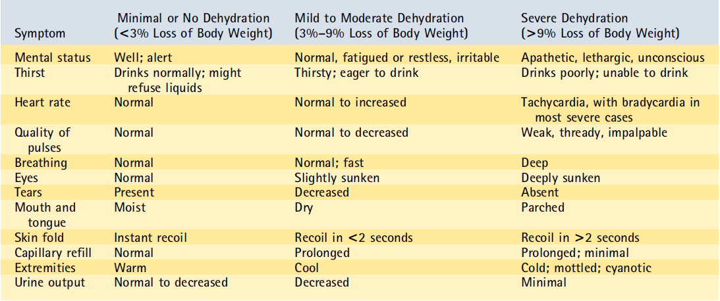

Slide 23
Investigations
Stool pH
Reducing substances
Leukocytes in stool
Stool culture
Enzyme immunoassay and latex agglutination: rotavirus antigen, adenovirus antigens
Examination of stool for ova and parasites
stool anion gap : 290 - [(Na+K) X 2].
> 100, osmolar diarrhea
<100, secretory diarrhea

Slide 24
Management
Fluid therapy: depending on level of dehydration:
Rehydration therapy
Replacement of ongoing losses
Ringers lactate
ORS
Zinc sulphate
Antimicrobial therapy: majority of bacterial causes are self limiting and do not require antibiotics.

Slide 25
Prevention
Access to safe water and adequate sanitation,
Good hygiene practices:handwashing with soap
Adequate nutrition
Breastfeeding
Micronutrient supplementation: vitamin A supplementation, zinc
Immunization: rotavirus vaccination

Slide 26
References
WHO/UNICEF Joint Statement: Clinical management of acute diarrhoea
Up to date
Medscape
Paediatrics in review

