Slide 1
Management of microcytic anaemia
MBCHB IV lecture series
Prof J Githanga

Slide 2
Lecture outline
Microcytic anaemias
Differential diagnosis
Review of principles of management of an anaemia
Treatment
Differentiation of IDA and anaemia of chronic disorders
Refractory IDA

Slide 3
Microcytosis:
Red cells that are smaller than normal.
MCV reduced to below lower normal limit.
Normal MCV 76 -96 fl

Slide 4
Differential diagnosis of microcytosis.
Iron deficiency – commonest cause
2. Thalassaemias and haemoglobinopathies:
β−thalassaemias, δβ−thalassaemia, α thal minor, Hb E, Hb Lepore trait etc
3. Blockade of haem synthesis:
Lead poisoning, Pyridoxine deficiency, Pyrazinamide, Isoniazid,

Slide 5
Differential diagnosis of microcytosis cont..
4. Sideroblastic anaemias
5. Chronic inflammatory states (usually NN)
(Some anaemias of chronic disease)
6. Others e.g. Congenital atransferrinemia (rare)

Slide 6
Management:
Diagnosis Clinical features (History
& physical examination)
Lab Tests
Treatment Symptomatic
Specific

Slide 7
Principles of mgt of anaemia
Guided by History and physical findings
Assess patient ? decompensated
Tests to demonstrate the anaemia
TBC - Hb , MCV, Hct
? Severity
What is the type of anaemia?
Red cell indices, PBF, Retic count, LDH, Haptoglobulin, Bilirubin
What is the cause?

Slide 8
Clinical Features of ID
Anaemia
Effect of chronic iron deficiency
Underlying/causative disorder
Notes:
History and physical findings

Slide 9
Epithelial tissue changes
Nails- Koilonychia
Tongue - Atrophic glossitis
Angular stomatitis
Oesophageal webs- Kelly Patterson syndrome (middle aged females with chronic severe IDA)

Slide 10
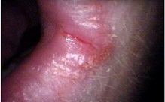
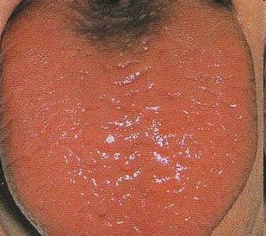
Koilonychia
Angular stomatitis
Atrophic glossitis

Slide 11
Differential diagnosis of MH
Anaemia of chronic disease
30% of anaemias are MH
Thalassaemia – less common in our setting
Thal trait - needs lab differentiation
Chronic haemolysis, jaundice, splenomegaly
Lead poisoning
Developmental delays, learning difficulties, abdominal pain, vomiting, wt loss, behavioural changes etc

Slide 13
Biochemical Features
Serum Fe ↓ < 14 μmol/l (n= 14-29 μmol/l)
Serum ferritin reduced < 15 μg/l
N average male 100 μg/l
N average female 30 μg/l
Transferrin saturation reduced < 33%
TIBC ↑
Red cell porphyrin ↑
Transferrin receptors ↑

Slide 14
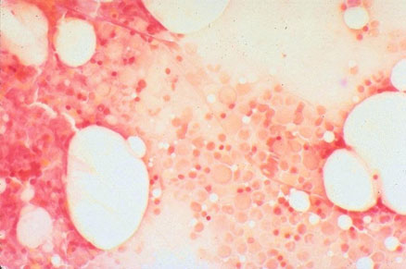
B.M.A
Not necessary for uncomplicated IDA
Iron stain (Perl’s reaction) – Absent stores
Iron deficient erythropoiesis (micronormoblastic)
Absent iron stores

Slide 15
Investigate appropriately for the cause (guided by Hx/PE)
Stools exam - O/C, occult blood
Urine examination
Endoscopy
Pelvic examination
Imaging e.g. U/S etc.

Slide 16
Principles of Treatment
Bring Hb to normal
Treat underlying disease
Supportive measures as necessary
Replace iron stores

Slide 17
Options to raise Hb:
1. Treatment with oral iron preps
2. Parenteral iron treatment
3. Blood transfusion –packed red cells

Slide 18
Oral Iron:
Preferred mode
~ 100 mg elemental iron daily
Ferrous sulphate : 200mg t.d.s
Treatment needs to be for up to 6 months to restore iron stores.
Other preps: Ferrous gluconate, ferrous fumerate
Compounds with other haematinics (folate)
e.g. ranferon

Slide 19
Parenteral Iron:
Iron sucrose (IV); Iron dextran (IM); Jectofer (IM); ferrivenin (IV)
Indications: intolerance to oral iron, chronic blood loss, GI diseases aggravated by oral iron, rapid replenishment needed, impaired absorption

Slide 20
Transfusion
Indications:
Severe anaemia <5g/dl
Hb > 5g/dl and impending CCF
CCF or impending CCF
Pregnant woman close to delivery
Transfuse packed cells, slowly, under diuretic cover

Slide 21
63 year old male with microcytic hypochromic anaemia on treatment
Initial blood counts
HB - 6.8 g/dl
Hct - 20.9 %
MCV - 64 fl
MCH - 21 pg
Retic - 0.1%
4 weeks later
HB – 7.1 g/dl
Hct - 21.4 %
MCV - 66 fl
MCH - 22 pg
Retic - 5%

Slide 22
Refractory IDA
Consider:
Have you addressed the cause? e.g. continued blood loss; correct dose and duration of Rx; compliance, etc.
Is it iron deficiency?
Consider differentials

Slide 23
Further investigations
History – dyspepsia, black stools
P/E – features of anaemia, vague mass in epigastrium
Serum ferritin, transferrin saturation, TIBC done
Occult blood in stool positive
Endoscopy and histology – Gastric cancer

Slide 24
DIFFERENTIAL DIAGNOSIS:
Distinguish between the other major differentials:
Anaemia of chronic disorders – Hx, underlying
disorder e.g. infection, inflammatory
Thalassaemias
Sideroblastic anaemias

Slide 25
Feature Fe def Chronic Dx
MCV  N/
sFe  
TIBC  
Transferrin satn  N/
Transferrin receptor  N/
BM iron Absent Present
Serum Ferritin  N/ 
Rbc protoporph  

Slide 26
Sideroblastic anaemias
Acquired:
Drugs
Lead poisoning
Alcoholism
Some haematol dx
Hereditary:
Sex-linked tmt

Slide 27
SIDEROBLASTIC ANAEMIAS.
Characterized by ringed sideroblasts (RS) in bone marrow
RS are developing erythroblasts with iron granules arranged in ring around nucleus (usually > 6 granules per cell)
Iron contained in the mitochondria.
Disordered porphyrin and abn. haeme synthesis is common

Slide 28
Thank you!
Questions?

