Slide 1
BONE MARROW FAILURE
JRAJAB
MBChB III intergrated lecture series
AUG 2013

Slide 2
Bone Marrow(BM) failure …Lecture outline
Definition
Classification
Mechanisms of Bone marrow failure
Clinical features of
Laboratory Management
Principles of Management

Slide 3
Lecture Objectives
At the end of the lecture you should be able to:
Define and classify BM failure
Describe the disease conditions that lead to bone marrow failure.
Describe some of the aetiological factors that are associated with Hypoplastic (Aplastic) Anaemia in particular
Investigate Bone marrow failure.
Apply the principles of management of bone marrow failure

Slide 4
BM Failure…..Definition
Inability of the bone marrow to maintain normal levels of circulating blood cells.
Characterized by Anaemia, Leucopenia, Thrombocytopenia
Can affect a single or more (Bicytopaenia) or all the cell lines (Pancytopaenia)

Slide 6
BM failure …Definition
Mechanisms of Bone Marrow failure:
destruction of marrow tissue or suppression of normal haemopoeitic cell growth and/or
differentiation. Stem cell failure)
(hypoplastic/aplastic)
replacement of marrow tissue by abnormal cells (Infiltrative, Myelodysplasia)

Slide 7
Marrow replacement or infiltration.
Leukaemias
Lymphomas
Plasma cell disorders
Metastatic malignancies to Bone marrow
Myeloproliferative Disorders
Secondary Myelofibrosis
Infections- Kalazaar,Toxoplasmosis(RES cell hyperplasia)
Marble bone Disease.
Storage disorders (Gaucher’s disease , Niemann Pick disease)
The Histiocytoses disorders
Bone marrow is cellular infiltrated by abnormal cells or tissue

Slide 8
BM failure...Myelodysplasia
Hetergenous group of haematological disorders
Characterized by abnormal proliferation and maturation of the stem cell with quantitative and qualitative defects
Ineffective production of myeloid blood cells (dysplastic)
Gradually worsening peripheral cytopenias
Can be Primary or Secondary
Bone marrow is cellular (dysplastic haemopoetic cells )

Slide 9
BM Failure…Marrow Destruction or Suppression
Hypoplastic/Aplastic marrow.
Marrow replaced by Fat tissue Hypocellular
(Marrow not uniformly hypocellular)
No abnormal cells detected in PB or BM
-Qualitative defect in multipotent stem cell
-Defective marrow micro environment.

Slide 10
BM failure…Classification Primary or Constitutional syndromes .
Fanconi Anaemia
Dyskeratosis Congenita
Amegakaryocytic Thrombocytopaenia
Schwachman Diamond
Cytopenias
Diamond Blackfan Syndrome
Kostmans Syndrome
Thrombocytopaenia with Absent Radii(TAR)

Slide 11
BM Failure…….Constitutional
Fanconi Anaemia
-Autosomal Recessive or sex linked
-39% present with physical abnormalitiea and & haematological abn.
-75% Dx 3-14 yrs
.abn chromosome fragility in metaphase
.chromosomal breaks in lymphocytes cultured with DNA crosslinking agents(mitomycin C,diepoxybutane DEB)
.
-propensity to malignancy-head & neck, medulloblastoma, acute leukemia, breast, pancreas, ovary
may be the first presentation
haematological findings evolve over months to years

Slide 12
BM failure ..constitutional
Fanconi Anaemia
-Hypopigmented or hyperpigmented spots, café-au-lait spots -
Abnormality of digits and skeletal abnormalities
Ectopic, pelvic, fused kidneys
-Microcephaly, micrognathia
Hypogonadism
Short stature

Slide 13
f

Slide 14
BM failure ….ACQUIRED
Idiopathic – Over 50% of cases
Drugs – High risk, Medium & Low risk.
Infection – Parvovirus B19
- EBV, CMV
- HIV, Hepatitis
Chemicals and Metals

Slide 15
Drugs Expected effects at normal doses(high risk)
Cytotoxic- alkylating agents
antimetabolites , antimitotic agents
Frequent but not inevitable(medium risk)
-Benzene
-chloramphenicol

Slide 16
BM failure…. Acquired
Drugs Low probability(low risk)
-Insecticides- DDT
Antiprotozoals-chloroquine,mepacrine
NSAIDs-phenylbutazone,ibuprofen,AA,indomethacin.
Anticonvulsants-hydantoins,carbamazepine,felbamate
D-penicillamine
Heavy metals- lead,bismuth,arsenic
Antithyroid-propylthiouracil,methimazole
Anti Diabetics -chlorpropramide,tolbutamide
Antibiotics – streptomycin,tetracycline,methicillin,septrin

Slide 17
Hypoplastic/aplastic Anaemia....Drugs
Chloramphenical
-dose related in all patients.
-direct toxicity to proerythroblast causing perinuclear vacuolation.
-reversible
Idiosyncratic bone marrow aplasia
-1 in every 20,000.
-several months after treatment
-irreversible

Slide 18
Radiotherapy
Radiotherapy
Immune Related
Paroxysmal Nocturnal Haemoglobinuria
Pregnancy
Cytopenias
Pure Red Cell Aplasia (Drugs, Infection)
Idiopathic
Drugs
Toxins

Slide 19
BM failure…Pathogenesis
-Lymphocyte activation- haemopoietic inhibition mediated by IFN gamma and
Reduction in Natural killer cells (responsible for bm regulation) in Bone marrow
Autoantibodies to haemopoietic cell antigens

Slide 20
BM FAILURE
Clinical Features
Related to the cytopaenias
Anaemia, bleeding (usually mucosal)
recurrent infections)
No organomegaly
Dysmorphic features in the constitutional group, early onset

Slide 21
LABORATORY MANAGEMENT
TBC – Pancytopaenia
Single-bi-Cytopaenia
- MCV may be in AA
- Reticulocyte count – low
PBF - Macrocytes (round)
- Poikilocytes ( tear drops)
Bone Marrow Examination - Aspirate
- Bone biopsy – Trephine

Slide 22
Aetiology – Drug Screen
- Viral Screen
- Cytogenetics
- Folate/B12, Assays
- Flow Cytometry CD55/59
- Fanconi (DEB Screen)

Slide 23
BONE MARROW FAILURE – Principles of Management
SUPPORTIVE
Transfusions – Components
Antimicrobials – group micro lab support (Well stocked Pharmacy)
Barrier Nursing
Gut decontamination
Reverse barrier nursing
Suppression of menses
Counselling and psychological support.

Slide 24
MANAGEMENT OF COMPLICATIONS OF CHRONIC TRANSFUSION.
Immunosuppressants in 2o BM failure
(Immune theory, Idiopathic – 70 response)
Definitive
Haemopoietic stem cell transplant
Immunosuppressants (cyclosporine ATG, Steroids)
Androgens –oxymetholone
HGF

Slide 25
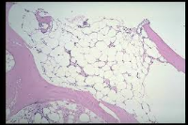
Bone marrow

Slide 26
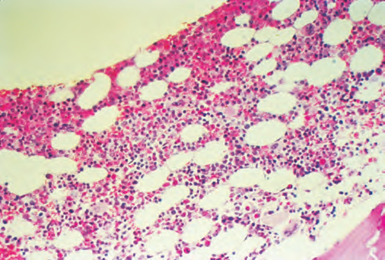
Normal bone marrow. Low-power view of normal adult marrow (H&E stain), showing a mix of fat cells (clear areas) and hematopoietic cells. The percentage of the space that consists of hematopoietic cells is referred to as marrow cellularity . In adults, normal marrow cellularity is 35–40%. If demands for increased marrow production occur, cellularity may increase to meet the demand. As people age, the marrow cellularity decreases and the marrow fat increases. Patients >70 years old may have a 20–30% marrow cellularity.

Slide 27
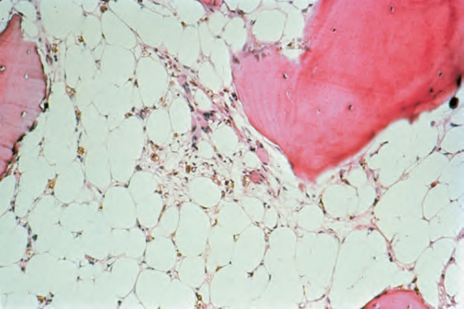
Aplastic anemia bone marrow. Normal hematopoietic precursor cells are virtually absent, leaving behind fat cells, reticuloendothelial cells, and the underlying sinusoidal structure.

