Slide 1
MALARIA
BY: DR. K. M. BHATT
DATE: 16/8/2016

Slide 2
LECTURE OUTLINE
Epidemiology
Life cycle
Pathogenesis
Clinical features
Management
Prophylaxis
Vaccine

Slide 3
RISK GROUPS
Pregnant women (primi gravida) are most susceptible due to lack of immunity against
The susceptibility is highest during the 2nd and 3rd trimesters of pregnancy and early post-partum period
The placenta is preferably susceptible to infection with P. falciparum
HIV infection suppresses antibody responses to malarial antigens during pregnancy.

Slide 4
PLASMODIUM SPECIES
P. falciparum
Responsible of 90% of parasitemia in Africa
It causes malaria associated with a lot of morbidity and mortality
This parasite can infect any age group of cells resulting in very heavy parasitemia (> 10%)
Another attack is called: recrudescence
P. vivax
Not a major problem in Africa
Duffy blood group; most Africans are Duffy negative
Liver phase (hypnozoites) can result in relapse
Infects young RBCs (reticulocytes; therefore parasitemia does not exceed 2%): less severe than falciparum
P. ovale
Liver phase can result in relapse
Infects young RBCs
P. malariae
Can persist sub-clinically for extended periods of time
Infects old RBCs
P. knowlesii
Malaria research has been transformed by the use of molecular genetic techniques (PCR-based)
A cluster of cases in Kapit (Sarawak, Malaysia) were caused by infection with the monkey parasite P knowlesi, and not with the morphologically similar P malariae (in later stages) as had been previously thought
Resembles PF in early stages
More aggressive than PM clinically

Slide 5
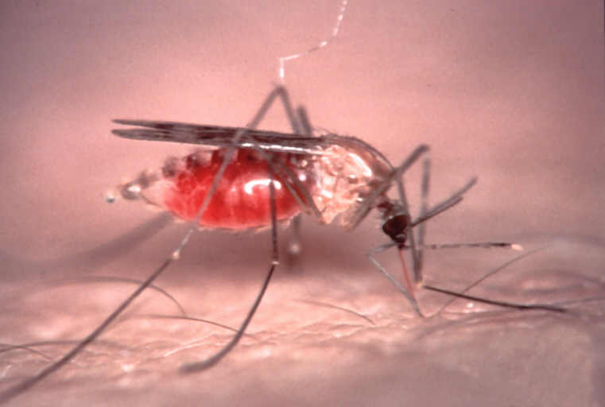
TRANSMISSION
Done by an infected anopheles mosquito
Other modes of transmission include:
Blood transfusion
Contaminated needle
Organ transplant
Congenital
“Airport malaria"

Slide 6
PATHOGENESIS
Parasite-derived toxins
Host-induced cytokines
Sequestration – cyto-adherence and rosseting
P. falciparum erythrocyte membrane protein 1 (pfemp 1) → ligand responsible for majority of binding interactions
Antigenic variation also a major feature of pfemp1

Slide 7
CYTOKINES
Macrophages secrete TNF alfa & IL-1 that interact with hepatocytes rendering them resistant to parasite; TNF alfa correlates with disease severity
CD8+ cells produce IFN-gamma which inhibits multiplication of parasites in hepatocytes and/or destroys them;CD8+ do not affect blood stage parasites because RBC do not express MHC-1
Infection of hepatocyte by sporozoites can be prevented by IL-2 & IFN-gamma,& limit the development in the Kuppfer cell

Slide 8
CYTOADHERENCE
In the P. falciparum infection, membrane histidine-rich ‘knobs’ appear within 24 hour of asexual cycle-these knobs extrude PfEMP1 protein ,a high molecular wt. antigenically variant strain-specific adhesive protein that mediate cytoadherence
Cytoadherence is facilitated by:
ICAM-1 in the brain
Chondroitin sulfate in the placenta
CD36 receptors in other organs
P. falciparum infected RBCs can adhere to normal RBC, producing rosettes and also to other infested RBCs (Agglutination)
Agglutination and cytoadherence are central to pathogenesis of P. falciparum
Sequestered continue to develop out of reach of host defense, with some being filtered in the spleen; only young forms of asexual parasites are seen predominantly

Slide 9
SITE SPECIFIC SEQUESTRATION
Brain
Measurable reduction in blood flow
Intestines
Diarrhea
Placenta
Intervillus space

Slide 10
CLASSIFICATION OF MALARIA
Uncomplicated
Travel history in the past 10 days e.g. Coast or Nyanza
Initial phase (cold) – 3 hours
Chills
Temperature rising
Hot phase (1-2 hours)
Very high fever (39-41)
Headache, nausea, vomiting
Sweating phase
Profuse sweating
Temperature comes down
Nausea disappears
Cycle repeats itself; It corresponds to the rupture of merozoites.
Severe (in-patient treatment)
Hyper-parasitemia > 5%
Depends with a person’s immunity and previous exposure to malaria.
Hyperpyrexia >41ºC
At such high temperatures, enzyme systems are deranged and this can be fatal.
Anemia (Hb < 5g/dL)
Hypoglycemia (BS < 2.2 mmol/L)
Acute renal failure
More common in adults
Also: Jaundice; Respiratory distress syndrome and pulmonary edema; Haemoglobinuria; Algid malaria (shock and gram negative septicemia); Electrolyte disturbances; DIC; Spontaneous bleeding and bloody diarrhea; Mental confusion and coma (cerebral malaria)
Treatment failure
Persistent symptoms 2-3 days after initiation of drug therapy

Slide 11
FEVER CHART FOR DIFFERENT PLASMODIUM SPP.

Slide 12
DIAGNOSIS
Light microscopy
Stained fixed blood smear
Thick film – presence/absence
Thin film – morphology/species
-You should suspect malaria in any febrile patient with a history of possible exposure to infected mosquitoes, whether they’ve been on chemoprophylaxis or not. One of the most important concepts to understand is: when to do a malaria blood smear on a patient?—and the answer is…WHENEVER malaria is suspected or possible.
-The Giemsa-stained blood smear is considered the “gold standard” for lab diagnosis of malaria.
-The thick smears are used for screening to detect the presence of malaria parasites
-The thin smears are used for identifying which species is/are present
-Multiple thick smears and thin smears should be prepared—
a) Use venous or capillary blood for the blood smears–
b) If the sample is negative, it should be repeated as often as every 6-8 hours for 24 –36 hours for two
reasons—1) because symptoms can precede detectable parasitemia by 24-36 hours; and 2) if the
parasites are synchronous, they may be present in the peripheral circulation for only half of the cycle
(cycle is 48 h for falciparum, vivax, and ovale).

Slide 13
CONT.
If the sample is positive, then slides should be repeated periodically to determine whether the parasitemia is decreasing in response to treatment –very important, especially with falciparum.
Para-sight F is like a rapid “dipstick” for Plasmodium falciparum only- it doesn’t identify the presence of other species. It is a very promising technique, but isn’t yet available in the U.S.
-The most common lab findings that can be seen on a CBC are:
(1) anemia, thrombocytopenia, leukopenia (or leukocytosis), without eosinophilia
-Other lab findings include:
(2) elevated liver enzymes
(3) elevated urinary albumin, urobilinogen, and bilirubin
-The most specific finding, of course, is the presence of parasites on peripheral blood smears.

Slide 14
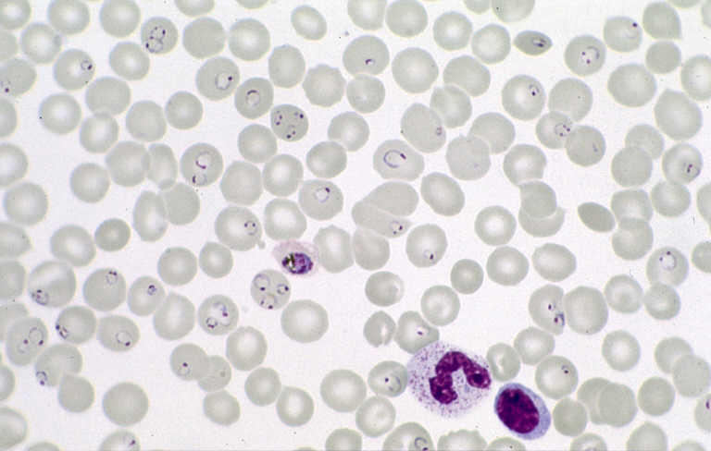
-There are several diagnostic features that we look for when examining the thin blood smears under the microscope that help identify the species. In general they include:
a) Which developmental erythrocytic stages are present;
b) The size of the parasitized RBCs- whether they’re enlarged, normal (or smaller )
c) The morphology of the RBCs and the parasites
In this slide we see many RBCs with ring forms in them:
-Ring forms are small and delicate (about 1/5 the size of the RBC), and its quite common to see multiple forms in single RBCs
P. falciparum
Notes:
-There are several diagnostic features that we look for when examining the thin blood smears under the microscope that help identify the species. In general they include:
a) which developmental erythrocytic stages are present;
b) the size of the parasitized RBCs- whether they’re enlarged, normal (or smaller )
c) the morphology of the RBCs and the parasites
In this slide we see many RBCs with ring forms in them:
-Ring forms are small and delicate (about 1/5 the size of the RBC), and its quite common to see multiple forms in single RBCs;
Ref: 1,5.

Slide 15
GAMETOCYTES: Pink – Male Blue - Female
This is the banana or crescent-shaped gametocyte- it has a single nucleus.
If you see this, you know the patient has P. falciparum.

Slide 16
OTHER DIAGNOSTIC METHODS
Fluorescent microscopy
Antigen-capture
RDTs; rapid diagnostic tests
HPR-2 (histidine rich protein-2; PF only)
pLDH (parasite LDH; all species)
PCR
Other non-specific lab abnormalities
FBC
Anaemia
Haemolysis
Thrombocytopenia
LFTS
Raised transaminases (mildly)
Hyperbilirubinemia
Sometimes evidence of DIC

Slide 17
MANAGEMENT: OPTIMAL TREATMENT APPROACH
Rapid case identification
Rapid parasitological classification
Rapid initiation of therapy
Rapid initiation of supportive care

Slide 18
RECOMMENDED ACTs FOR UNCOMPLICATED FALCIPARUM MALARIA
Artemether – Lumefantrine
First line
Dihydroartemisinin + Piperaquine
Second line
Artesunate + Amodiaquine – significant resistance to amodiaquine in Kenya
Artesunate + Mefloquine
Side effects to Mefloquine are not pleasant
Dizziness, mental confusion
Artesunate + SP – obsolete in Kenya
There is a lot of resistance to sulfapyrimethamine (fansidar)

Slide 19
SUPPORTIVE THERAPY
Antipyretics
Anti-emetics
Hydration
Electrolytes
Generalized anti-convulsants
Organ failure transport
Nutrition

Slide 20
TREATMENT OF SEVERE AND COMPLICATED MALARIA
Parenteral Artesunate at 2.4 mg per Kg stat IV and repeated after 12 hours, 24 hours and then for 6 days daily
Parenteral quinine
Loading dose 20 mg/Kg thereafter 10 mg/Kg 8 hourly (as infusion in 5% dextrose to run over 4 hours)
Change to oral ACT as soon as the patient can tolerate oral medication
Read about the drug preparation

Slide 21
SPECIAL POPULATIONS
Pregnant women
IPT
Breast feeding: avoid dapsone and tetracycline
Infants and young children: ACTS seem safe
Use artemisinin derivatives after 3-4 weeks of pregnancy
All pregnant women in malaria endemic areas should receive dose of SP to prevent fetal loss, low birth weight and low HB
As a single SP dose in the beginning of 2nd trimester
Second dose of SP in the 3rd trimester between 28 and 34 weeks
Travelers
Co-morbidities
HIV
Malnutrition: drug kinetics are changed but no evidence to support modification of therapy
In HIV-positive monthly SP from 2nd trimester up to 36 weeks may be more efficacious
Mefloquine can also be used

Slide 22
PREVENTION
ITN
Indoor residual spraying
Repellant cream (Containing DEET 30% and over; in pediatric patients → only 10%)
Chemoprophylaxis
Mefloquine 250 mg once a week 3 weeks before one travels, during the stay in the malaria-endemic zone and 4 weeks after one has left the endemic zone.
Malarone (Proguanil - atovaquone); very expensive (5,000 Kshs); take 600 mg daily from just the day before the travel to a week after one comes back; it has a favorable side-effect profile.
Environmental management
Vaccine
Sporozoite-based; gives 30%-60% protection
Sporozoite is irradiated and injected
It is difficult to produce vaccines because of antigenic variation in the malarial parasite

Slide 23
CHEMOPROPHYLAXIS FOR PREVENTION OF MALARIA IN OTHER RISK GROUPS
Proguanil-dose 200mg per day
Mefloquine-dose 250mg once weekly
Doxycycline-dose 100mg daily, but not for children under 8 years and pregnant women
Atovaquone + Proguanil [one Malarone daily]
Chemoprophylaxis be continued for 4 weeks after leaving a malaria endemic area
No anti-malarial drug can guarantee absolute protection

Slide 24
ASSIGNMENT
Review antimalarial pharmacology with a special focus on artemisinin
Review malaria life cycle

Slide 25
TYPED BY DR. E. NAILA

