Slide 1
Systemic Inflammatory Response Syndrome (SIRS), Sepsis, Severe Sepsis, Septic Shock
S.O. MCLIGEYO
PROFESSOR OF NEPHROLOGY

Slide 2
Overview
Significance of the Problem
Defining the continuum
Brief overview of Pathophysiologic derangements
Prevention
Early Recognition & Resuscitation

Slide 3
Severe Sepsis: A Significant Healthcare Challenge
Major cause of morbidity and mortality worldwide
Leading cause of death in noncoronary ICU (US)¹
10th leading cause of death overall (US)²*
More than 750,000 cases of severe sepsis in the US annually³
In the US, more than 500 patients die of severe sepsis daily^{3†}
* Based on data for septicemia
†Reflects hospital-wide cases of severe sepsis as defined by infection in the presence of organ dysfunction
1 Sands KE, et al. JAMA 1997;278:234-40.
2 National Vital Statistics Reports. 2005.
3 Angus DC, et al. Crit Care Med 2001;29:1303-10.
Notes:
Sepsis is a major worldwide cause of morbidity and mortality. Sands et al described the epidemiology of sepsis in eight academic medical centers in the United States. They reported that sepsis is the leading cause of death in patients admitted to noncoronary intensive care units. The National Vital Statistics Report indicates that sepsis is the 11th leading cause of death in the United States, based on data for septicemia.
Angus et al studied the age-specific incidence and outcomes of severe sepsis in the United States. Their investigation indicates that there are more than 750,000 cases of severe sepsis (sepsis with acute organ dysfunction) each year in the United States.
Based on data from Angus et al, more than 500 Americans die of severe sepsis daily.
Angus DC, Linde-Zwirble WT, Lidicker J, et al. Epidemiology of severe sepsis in the United States: analysis of incidence, outcome and associated costs of care. Crit Care Med 2001;29:1303-10.
Murphy SL. Deaths: final data for 1998. National Vital Statistics Reports Web site. Available at: http://www.cdc.gov/nchs/data/mvs48_11.pdf. Accessed January 2001.
Sands KE, Bates DW, Lanken PN, et al. Epidemiology of sepsis syndrome in 8 academic medical centers. JAMA 1997;278:234-40.

Slide 4
Severe Sepsis is a Significant Healthcare Burden
Sepsis consumes significant healthcare resources.
In a study of Patients who contract nosocomial infections, develop sepsis and survive:
ICU stay prolonged an additional 8 days.
Additional costs incurred were $40,890/ patient.
Estimated annual healthcare costs due to severe sepsis in U.S. exceed $16 billion.

Slide 5
Sepsis : A Growing Healthcare Challenge
Future
Today
Growing elderly population
Life-sustaining technology
Immunocompromised patients
Invasive devices and procedures
Community –acquired infections
Nosocomial infections
Antibiotic resistance
1.5 million cases of severe sepsis
Estimated ICU restricted cases in OECD countries ,based on 1995 population data

Slide 6
Severe Sepsis Is Common
1 in 10 patients admitted to the ICU has severe sepsis.*
2.26% of total hospital discharges nationally
Incidence is expected to increase by nearly 17% by 2014.
All analyses were performed using the 2000 MEDPAR Hospital Discharge Database. The information presented represents national averages, and similar analyses performed at an individual institution may provide different results.
1. Angus DC, Linde-Zwirble WT, Lidicker J, et al. Epidemiology of severe sepsis in the United States: Analysis of incidence, outcome and associated costs of care. Crit Care Med. 2001;29(7):1303-1310. 2. Data of file, Eli Lilly and Company: XIG20070405b.
Notes:
So – let’s start by looking at the size/scope of the problem. Just how common is severe sepsis?
One out of every ten patients admitted to an ICU has severe sepsis, resulting in occurrence of 2.26% of all hospital discharges nationally.
By 2014, the incidence of severe sepsis is expected to increase by nearly 17%. This increase is largely driven by the “graying” of America (increasing population of elderly). Additional drivers of the increased incidence includes antibiotic resistance, increasing invasive procedures, increasing incidence of immunosuppression for organ transplants and disease states (e.g., AIDS), etc.

Slide 7
Severe Sepsis: Comparison With Other Major Diseases
Incidence of Severe Sepsis
Mortality of Severe Sepsis
Cases/100,000
AIDS*
Colon
Breast
CHF†
Severe Sepsis‡
AIDS*
Breast Cancer§
AMI†
Severe
Sepsis‡
Cancer§
†National Center for Health Statistics, 2001. §American Cancer Society, 2001. *American Heart Association. 2000. ‡Angus DC et al. Crit Care Med 2001
Notes:
Angus et al studied the incidence, cost, and outcome of severe sepsis in the United States. In a study based on 1995 state hospital discharge records from 7 large states with population and hospital data from the US Census, Centers for Disease Control, HCFA, and the American Hospital Association, the investigators generated national sepsis data. In this study, they report that the incidence of severe sepsis is 300 cases/100,000 population. As shown on the slide, this is significantly greater than the incidence of other well recognized diseases as reported by the American Heart Association.
Similarly, Angus et al reported that the annual mortality of severe sepsis in 1995 was 215,000. According to the American Heart Association, this is virtually identical to the number of people in the US who die suddenly of coronary heart disease without being hospitalized.
American Cancer Society. 2000 Statistics. Available at: www.cancer.org on 3/19/01.
American Heart Association. 2001 Heart and Stroke Statistical Update. Dallas, Tex: American Heart Association, 2000.
Angus DC, Linde-Zwirble WT, Lidicker J, et al. Incidence, cost, outcome of severe sepsis in the United States. Crit Care Med. 2001 (In Press).
National Center for Health Statistics. Fast Stats (AIDS/HIV). Available at: www.cdc.gov/nchs/fastats/aids-hiv.htm on 3/19/01.

Slide 8
Severe Sepsis is increasing in incidence

Slide 9
Begin Proven Care Strategies
Early appropriate antibiotic use
EGDT: Early Goal-Directed Therapy
Low-tidal volume ventilation/ARDS/ALI
Xigris if not contraindicated
Tight glycemic control
Low-dose steroid administration for refractory septic shock particularly in patients with relative adrenal insufficiency
Implementation Through Proven Change Strategies

Slide 10
Risk factors of sepsis
aggressive oncological chemotherapy and radiation therapy
use of corticosteroid and immunosuppressive therapies for organ transplants and inflammatory diseases
longer lives of patients predisposed to sepsis, the elderly, diabetics, cancer patients, patients with major organ failure, and with granulocyopenia.
Neonates are more likely to develop sepsis (ex. group B Streptococcal infections).
increased use of invasive devices such as surgical protheses, inhalation equipment, and intravenous and urinary catheters.
indiscriminate use of antimicrobial drugs that create conditions of overgrowth, colonization, and subsequent infection by aggressive, antimicrobial-resistant organisms.
Angus DC, et al. Crit Care Med 2001, 29:1303-1310.

Slide 11
Patients at increased risks of developing sepsis
Underlying diseases: neutropenia, solid tumors, leukemia, dysproteinemias, cirrhosis of the liver, diabetes, AIDS, serious chronic conditions.
Surgery or instrumentation: catheters.
Prior drug therapy: Immuno-suppressive drugs, especially with broad-spectrum antibiotics.
Age: males, above 40 y; females, 20-45 y.
Miscellaneous conditions: childbirth, septic abortion, trauma and widespread burns, intestinal ulceration.
Angus DC, et al. Crit Care Med 2001, 29:1303-1310.

Slide 12
Martin et al. NEJM 2003;348:1546-54

Slide 13
Martin et al. NEJM 2003;348:1546-54

Slide 14
Martin et al. NEJM 2003;348:1546-54

Slide 15
Definitions Key to Understanding

Slide 16
The Sepsis Continuum
Severe
Sepsis
Septic
Shock
SIRS
Sepsis
A clinical response arising from a nonspecific insult, with ≥2 of the following:
T >38ºC or <36ºC
HR >90 beats/min
RR >20/min
WBC >12,000/mm³ or <4,000/mm³ or >10% bands
SIRS with a
presumed
or confirmed
infectious
process
Sepsis with
organ failure
Refractory
hypotension
SIRS = systemic inflammatory response syndrome
Chest 1992;101:1644.

Slide 17
SIRS is manifested by two or more of the following conditions:
Temperature >38 degrees Celsius or <36 degrees Celsius.
Heart rate>90 beats per minute.
Respiratory rate>20 breaths per minute or PaCO2<32mmHg.
White blood cell count > 12,000/cu mm, <4,000/ cu mm, or >10% band forms.

Slide 18
Relationship Between Sepsis and SIRS
BACTEREMIA
SEPSIS
TRAUMA
BURNS
INFECTION
SEPSIS
SIRS
PANCREATITIS

Slide 19
Relationship between SIRS and Sepsis

Slide 21
MODS (Multiple Organ Dysfunction Syndrome)
Sepsis with multiorgan hypoperfusion
Two or more of the followings:
SBP < 90 mmHg
Acute mental status change
PaO₂ < 60 mmHg on RA (PaO₂ /FiO₂ < 250)
Increased lactic acid/acidosis
Oliguria
DIC or Platelet < 80,000 /mm³
Liver enzymes > 2 x normal
American College of Chest Physicians/Society of Critical Care Medicine Consensus
Conference Committee. Crit Care Med. 1992;20:864-874.

Slide 23
Chronic Effects of Sepsis
Bone RC et al, Chest1992;101:164-55.

Slide 24
Mortality rate in SIRS
Rangel-Frausto, et al. JAMA 273:117-123, 1995.

Slide 27
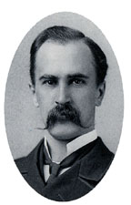
Except on few occasions, the patient appears to die from the body's response to infection rather than from it."
Sir William Osler – 1904
The Evolution of Modern Medicine

Slide 28
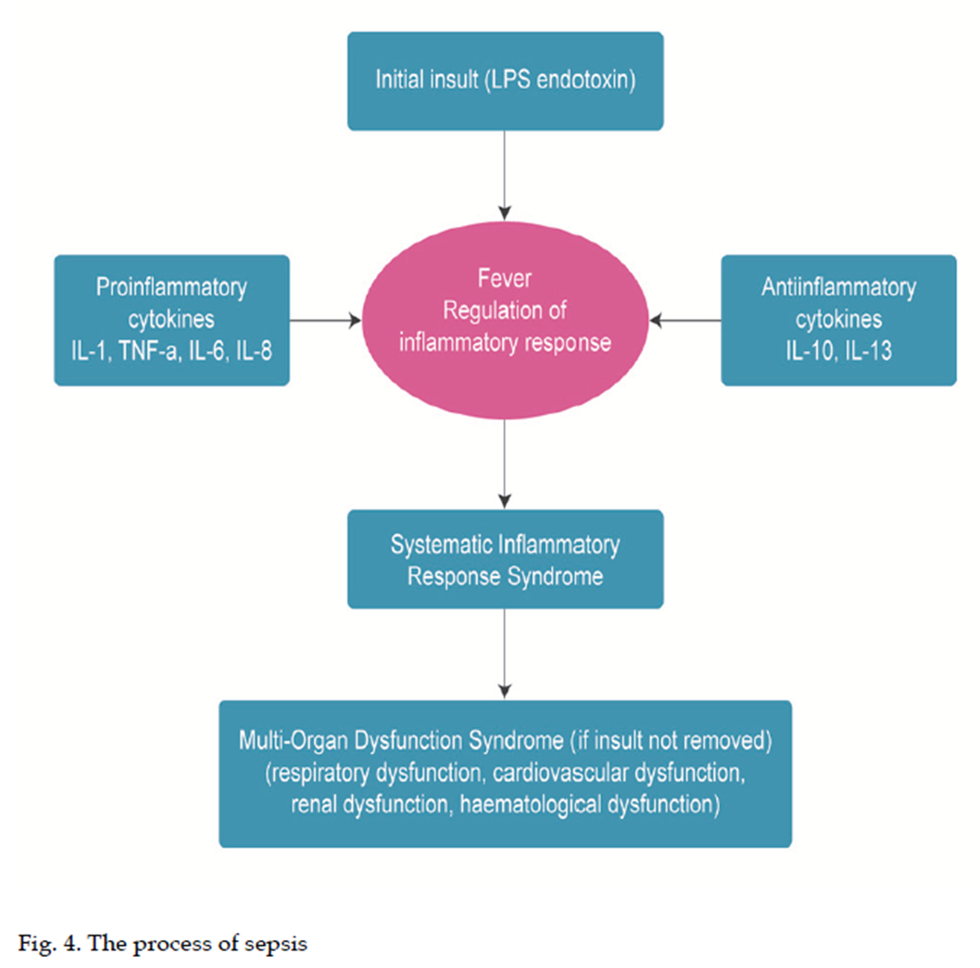
The Response to Pathogens “Cross-Talk”
NEJM 2003;348:138-150.

Slide 29
Pathogenesis of Severe Sepsis
Infection
Microbial Products
(exotoxin/endotoxin)
Cellular Responses
Platelet
Activation
Coagulation Activation
Kinins
Complement
Cytokines
TNF, IL-1, IL-6
Oxidases
Coagulopathy/DIC
Vascular/Organ System Injury
Endothelial damage
Endothelial damage
Multi-Organ Failure
Death

Slide 31
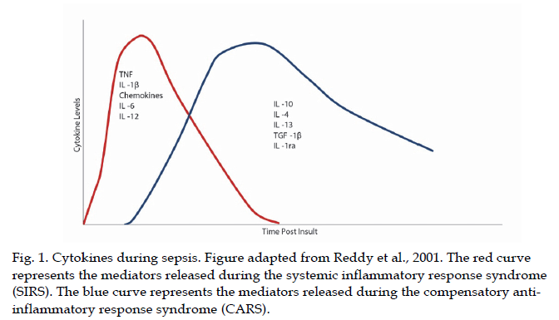

Slide 32
Source (usually an endogenous source of infection)
intestinal tract
oropharynx
instrumentation sites
contaminated inhalation therapy equipment
IV fluids.
Most frequent sites of infection: Lungs, abdomen, and urinary tract.
Other sources include the skin/soft tissue and the CNS.
Angus DC, et al. Crit Care Med 2001, 29:1303-1310.

Slide 33
Diagnosis
History
community or nosocomially acquired infection
immunocompromised patient
exposure to animals, travel, tick bites, occupational hazards, alcohol use, seizures, loss of consciousness, medications
underlying diseases ; specific infectious agents
Some clues to a septic event include
Fever or unexplained signs with malignancy or instrumentation
Hypotension
Oliguria or anuria
Tachypnea or hyperpnea
Hypothermia without obvious cause
Bleeding
Angus DC, et al. Crit Care Med 2001, 29:1303-1310.

Slide 34
Diagnosis
Physical Examination
essential
In all neutropenic patients and in patients with as suspected pelvic infection the physical exam should include rectal, pelvic, and genital examinations
perirectal, and/or perineal abscesses
pelvic inflammatory disease and/or abscesses, or prostatitis
Angus DC, et al. Crit Care Med 2001, 29:1303-1310.

Slide 35
Signs and Symptoms
Nonspecific symptoms of sepsis : not pathognomonic
fever
chills
constitutional symptoms of fatigue, malaise
anxiety or confusion
absent symptoms in serious infections, especially in elderly individuals
Angus DC, et al. Crit Care Med 2001, 29:1303-1310.

Slide 36
Complications
Adult respiratory distress syndrome (ARDS)
Disseminated Intravascular Coagulation (DIC)
Acute Renal failure (ARF)
Intestinal bleeding
Liver failure
Central Nervous System dysfunction
Heart failure
Death
Angus DC, et al. Crit Care Med 2001, 29:1303-1310.

Slide 37
Surviving Sepsis Campaign
Guidelines for Management of
Severe Sepsis and Septic Shock
Dellinger RP, et al. Crit Care Med 2004; 32:858-873.

Slide 38
Diagnosis
Before the initiation of antimicrobial therapy, at least two blood cultures should be obtained
At least one drawn percutaneously
At least one drawn through each vascular access device if inserted longer than 48 hours
Other cultures such as urine, cerebrospinal fluid, wounds, respiratory secretions or other body fluids should be obtained as the clinical situation dictates
Other diagnostic studies such as imaging and sampling should be performed promptly to determine the source and causative organism of the infection
may be limited by patient stability
Weinstein MP. Rev Infect Dis 1983;5:35-53 Blot F. J Clin Microbiol 1999; 36: 105-109.
Dellinger, et. al. Crit Care Med 2004, 32: 858-873.
Notes:
Do not need to draw a blood culture through vascular access devices that were recently inserted (<48 hrs)
Appropriate cultures should always be obtained before antimicrobial therapy is initiated
Recovering the same organism from both cultures enhances the likelihood that the organism is causing the severe sepsis.
If the culture for the peripheral access device (PAD) is positive much earlier than the peripheral blood culture (i.e., >2hrs) then the PAD might be the source of infection.
Volume of blood may also be important

Slide 39
What do we have to offer these patients?
Antibiotics
IV Fluids
Vasoactive agents
Source control
Steroid therapy (adrenal insufficiency)
Activated protein C
Ventilatory Strategies
Glycemic control

Slide 40
Failed therapies
Corticosteroids—high dose methylprednisolone
Bone et al. NEJM 1987;317:653
Anti-endotoxin antibodies
Zieglar et al. NEJM 1991;324;429
TNF antagonists—soluble TNF receptor
Fisher et al. NEJM 1996;334:1697
Ibuprofen
Bernard et al. NEJM 1997;336:912

Slide 41
Sepsis resuscitation bundle
Serum lactate measured
Blood cultures obtained before antibiotics administered
Improve time to broad-spectrum antibiotics
In the event of hypotension or lactate > 4 mmol/L (36 mg/dL)
a. Deliver an initial minimum of 20 mL/kg of crystaloid (or colloid equivalent)
b. apply vasopressors for ongoing hypotension
In the event of persistent hypotension despite fluid resuscitation or lactate > 4 mmol/L (36 mg/dL)
a. achieve central venous pressure of > 8 mmHg
b. achieve central venous oxygen saturation of > 70%
Hurtado FJ. et al. Crit Care Clin;2006; 22:521-9.

Slide 42
Sepsis management bundle
Fluid resuscitation 0K
Appropriate cultures prior to antibiotic administration OK
Early targeted antibiotics and source control OK
Use of vasopressors/inotropes when fluid
resuscitation optimized OK
Surviving Sepsis Campaign Management Guidelines Committee. Crit Care Med 2004; 32:858-873.

Slide 43
Easy way to find out whether Fluid Resuscitation likely to work

Slide 44
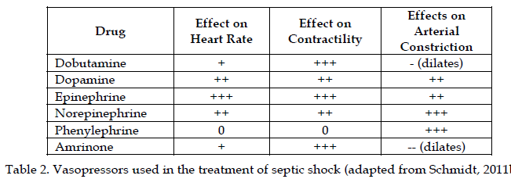
Sepsis management bundle
Fluid resuscitation 0K
Appropriate cultures prior to antibiotic administration OK
Early targeted antibiotics and source control OK
Use of vasopressors/inotropes when fluid
resuscitation optimized OK
Surviving Sepsis Campaign Management Guidelines Committee. Crit Care Med 2004; 32:858-873.

Slide 45
Sepsis management bundle ABSOLUTELY IMPORTANT
Evaluation for adrenal insufficiency ???
Stress dose corticosteroid administration ???
NOT EVEN HIGH DOSE!
Recombinant human activated protein C (xigris) for severe sepsis ???
Low tidal volume mechanical ventilation for ARDS OK
Tight glucose control ???
Surviving Sepsis Campaign Management Guidelines Committee. Crit Care Med 2004; 32:858-873.

Slide 46
Infection Control
Appropriate cultures prior to antibiotic
administration
Early targeted antibiotics and source control
Surviving Sepsis Campaign Management Guidelines Committee. Crit Care Med 2004; 32:858-873.

Slide 47
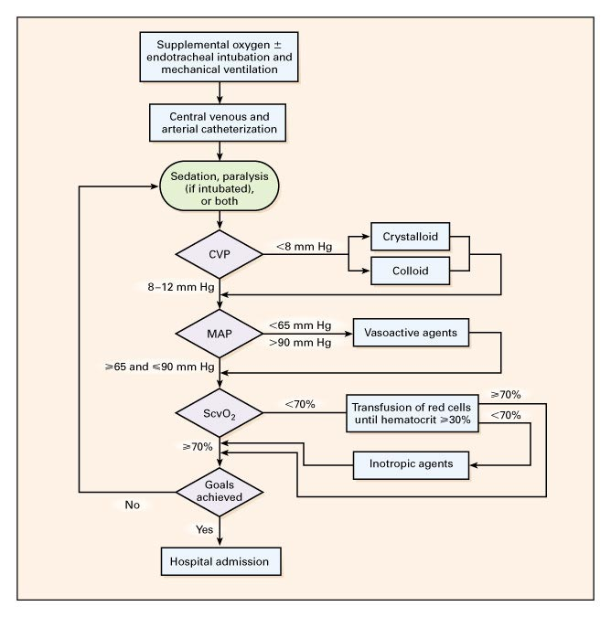
Early Goal-Directed Therapy
CVP : central
venous
pressure
MAP : mean
arterial
pressure
ScvO₂: central
venous
oxygen
saturation
NEJM 2001;345:1368-77.
Notes:
BACK-UP SLIDE: This slide shows specifically how the monitored parameters in EGDT were maintained.
“The protocol was as follows: A 500-ml bolus of crystalloid was given every 30 minutes to achieve a central venous pressure of 8 to 12 mm Hg. If the mean arterial pressure was less than 65 mm Hg, vasopressors were given to maintain a mean arterial pressure of at least 65 mm Hg. If the mean arterial pressure was greater than 90 mm Hg, vasodilators were given until it was 90 mm Hg or below. If the central venous oxygen saturation was less than 70 percent, red cells were transfused to achieve a hematocrit of at least 30 percent. After the central venous pressure, mean arterial pressure, and hematocrit were thus optimized, if the central venous oxygen saturation was less than 70 percent, dobutamine administration was started at a dose of 2.5 µg per kilogram of body weight per minute, a dose that was increased by 2.5 µg per kilogram per minute every 30 minutes until the central venous oxygen saturation was 70 percent or higher or until a maximal dose of 20 µg per kilogram per minute was given. Dobutamine was decreased in dose or discontinued if the mean arterial pressure was less than 65 mm Hg or if the heart rate was above 120 beats per minute. To decrease oxygen consumption, patients in whom hemodynamic optimization could not be achieved received mechanical ventilation and sedatives.” (p. 1370)

Slide 48
Early Goal-Directed Therapy Results
28-day Mortality
60
49.2%
P = 0.01*
50
40
33.3%
30
20
10
0
Standard Therapy
n=133
EGDT
n=130
*Key difference was in sudden CV collapse, not MODS
NEJM 2001;345:1368-77.
Notes:
Cause of in-hospital death:
--Sudden Cardiovascular collapse
Standard Tx= 25/119 (21%) EGDT 12/117 (10.3%)
--MODS
Standard Tx 26/119(21.8%) EGDT 19/117 (16.2%)
P. 1374 in New England Journal of Medicine

Slide 49
Novel and Alternative Therapies in Sepsis
CORTICOSTEROIDS
Reverses shock more rapidly
Effects on mortality unclear
Stress dose (200-300mg hydrocortisone daily) to adults unresponsive to fluid and vasopressor therapy
Addition of fludrocortisone (50ug daily), optional if hydrocortisone used

Slide 50
Novel and Alternative Therapies in Sepsis
ACTIVATED PROTEIN C (DROTRECOGIN)
PROWESS: 2001, Excellent
ENHANCE: 2004, Great material
ADDRESS: 2005, Terminated, Bleeding ++
PROWESS – SHOCK: Mortality similar to placebo, Drug withdrawn from market 25/10/2011

Slide 51
Novel and Alternative Therapies in Sepsis
IVIG
Use in children with sepsis and septic shock
No formal recommendations in adults
Limited studies, but indications that could have benefit in mortality, directly or as an adjuvant
ADEs: Constitutional, Hypersensitivity, Renal failure, Aseptic meningitis
Cost

Slide 52
Novel and Alternative Therapies in Sepsis
STATINS
Sound theoretical background
Not mentioned in Sepsis consensus guidelines
Conflicting data precludes a definitive recommendation for continuing pre-existing statin therapy therapy in patients with severe sepsis or septic shock

Slide 53
Novel and Alternative Therapies in Sepsis
TOLL – LIKE RECEPTOR INHIBITORS
Sound theoretical basis
Eritoran and Resatorvid still investigational
Pharmacological agents targeting TLR2 and TLR 4 remain promising interventions

Slide 54
NEJM;355:1699-1723.

Slide 55
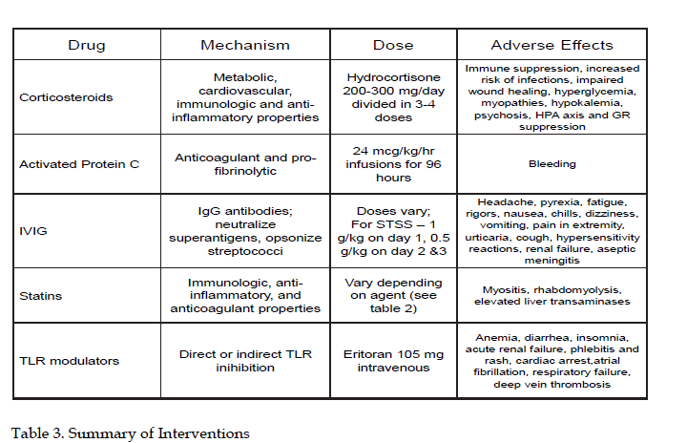
Activated Protein C (Xigris)
NEJM;355:1640, October 19, 2006.

Slide 56
NEJM;355:1640, October 19, 2006.

Slide 57
ANTI-INFAMMATORY ROLE OF NATURAL POLYPHENOLS AND THEIR DEGADATION PRODUCTS
.

Slide 58
Blood Products
Erythropoietin not recommended as a specific treatment of anemia associated with severe sepsis
No specific information in septic patients
Shown to reduce need for blood transfusion without changing clinical outcome*
Corwin et al. Crit Care Med 1999; 27:2346-50
Corwin et al. JAMA 2002;288:2827-35

Slide 59
Blood Products
FFP not recommended to correct coagulopathy in absence of active bleeding or planned invasive procedures
Antithrombin not recommended, since no change in 28 day mortality*
Warren et al. JAMA 2001;286:1869-78

Slide 60
Blood Products
Platelet transfusion for < 5,000 mm³
Transfusion considered for 5,000 to 30,000 and significant risk of bleeding
≥ 50,000 needed for surgery and invasive procedures

Slide 61
Mechanical Ventilation
In ALI/ARDS, low tidal volume ventilation reduced mortality
Goal is 6 cc/kg of predicted body weight, with end-inspiratory plateau pressure of < 30 cmH₂O
“Permissive hypercapnea” allowed to achieve goal
ARDSNET. NEJM 2000;342:1301-08

Slide 62
Mechanical Ventilation
PEEP is used to reduce FiO₂ needs
Prone positioning has been shown to improve oxygenation, but no change in mortality
Stocker et al. Chest 1997;111:1008-17
Lamm et al. AJRCCM 1994;150:184-93
Gattinoni et al. NEJM 2001;345:568-73
Chatte et al. AJRCCM 1997;155:473-78
Jolliet et al. Crit Care Med 1998;26:1977-85

Slide 63
Mechanical Ventilation
Keep head of bed elevated 30º to reduce risk of ventilator-associated pneumonia*
Weaning protocols and spontaneous breathing trials should be used
*Drakulovic et al. Lancet 1999;354:1851-8

Slide 64
Sedation
Sedation protocols using subjective criteria should be used
Either intermittent bolus or continuous infusions
“Spontaneous awake trials” reduce duration of mechanical ventilation, length of stay, and need for tracheostomy*
Kress et al. NEJM 2000;342:1471-77
Brook et al. Crit Care Med 1999;27:2609-15

Slide 65
Sedation
Paralytics should be avoided if possible to reduce risk of prolonged neuromuscular blockade
If continuous paralytics used, monitor with train of four

Slide 66
Glucose Control
Maintain blood glucose < 150 mg/dl
Increased survival with insulin infusion to achieve glucose of 80–110 mg/dl
Can include nutrition protocol, preferably via enteral route
Van den Berghe et al. NEJM 2001;345:1359-67

Slide 67
DVT Prophylaxis
Recommend DVT prophylaxis with either low-dose unfractionated heparin or low-molecular weight heparin
In those with contraindications, may use mechanical device
In very high risk, use combination of mechanical and pharmacologic methods

Slide 68
Stress Ulcer Prophylaxis
Recommended for all patients
H₂ blockers are better than sucralfate, and is the preferred agent
No direct comparison between proton pump inhibitors and H₂ blockers

Slide 69
End of Life Issues
Advance care planning
Communication of likely outcomes and realistic goals of treatment with patients and families

Slide 70
A clinician, armed with the sepsis bundles, attacks the three heads of severe sepsis: hypotension, hypoperfusion and organ dysfunction. Crit Care Med 2004; 320(Suppl):S595-S597

Slide 71
MARKERS OF SEPSIS
Cytokine biomarkers
Coagulation biomarkers
Acute Phase Protein biomarkers
Receptor biomarkers
Cell marker related biomarker
Vascular and endothelial damage dysfunction biomarkers
Vasodilation related biomarkers
Organ dysfunction biomarkers
Genetic biomarkers – single nucleotide PMs

Slide 72
Hormonal Markers and predictors of Outcome of Sepsis
Procalcitonin
Thyroid
Growth Hormone
Copeptin – stable peptide of AVP precursor
Age and Sex hormone

Slide 73
Cellular Markers of Outcome in Septic Shock

Slide 74
Cellular Markers of Outcome in Septic Shock

Slide 75
Cellular Markers of Outcome in Septic Shock

Slide 76
Molecular Markers of Outcome in Septic Shock

Slide 77
Molecular Markers of Outcome in Septic Shock

Slide 78
Molecular Markers of Outcome in Septic Shock

Slide 79
SEPSIS IN SPECIAL SETTINGS
NEONATES
CHILDREN
OBSTETERICS AND GYNAECOLOGY

Slide 80
AFRICAN iPOD

Slide 81
Thank you

