Slide 1
Malaria
Epidemiology
Modes of transmission & life cycle
Pathogenesis
Clinical features
Diagnosis
Treatment
Prevention

Slide 2
MALARIA
By
Prof. K.M. Bhatt
UON

Slide 3
Epidemiology of Malaria
41% of world population live in malaria endemic areas in 99 countries
Most of them are in Africa
500 million episodes of clinical infection every year
2.7 million deaths per year due to malaria
3.5 million low birth weight infants due to malaria
In Kenya specifically there are 8.2 million reported cases every year

Slide 4
Epidemiology of Malaria
Major cause of death equal with HIV/AIDS and tuberculosis
(Drugs 2002:62(9):1315-1329)
Malaria is a leading cause of death in children under 5 years of age in Africa

Slide 5
Risk groups for malaria
Children below the age of 5 years
Sickle cell disease and those having splenectomy
Elderly and immunocompromised
Non-immune –visitors to endemic areas of malaria and tourists
Mortality is determined by patient’s genetic and acquired immunity as well as the genetics of the parasite

Slide 6
Risk groups for malaria
Pregnant women [primigravidae]. The susceptibility highest during the 2nd and 3rd trimesters of pregnancy and early postpartum period
Placenta is preferably susceptible to infection with P. Falciparum
HIV infection suppresses antibody responses to malarial antigens during pregnancy

Slide 7
Species Infecting Humans
Plasmodium falciparum
  Malignant tertian (Cerebral)
Plasmodium vivax
  Tertian
Plasmodium ovale
  Tertian
Plasmodium malariae
  Quartan
Plasmodium knowlesi
Common & Severe
Rare & Mild

Slide 8
Plasmodium Species
P. falciparum
  Most severe and prevalent
  90% of cases in Africa
  Infects RBCs of all ages—Heavy parasitemia
Notes:
-Recall that there are four species of the protozoan genus Plasmodium that cause human malaria:
P. falciparum, P. vivax, P. ovale, and P. malariae.
-P. falciparum and P. vivax are responsible for over 90% of all human malaria infections.
-P. falciparum is the most prevalent, found worldwide in the tropics and sub-tropics, especially in Africa and Asia;
It causes about 50% of all malaria infections. Falciparum causes the most serious forms of malaria, and can be fatal within 24 hours of onset. The other forms of malaria are generally not life-threatening.
-In most places, P. falciparum is resistant to Chloroquine.
Ref: 1,2.

Slide 9
Plasmodium Species
P. vivax
  Not a major problem in Africa
  Duffy blood group
  Liver phase
  INFECTS YOUNG RBCs: LESS SEVERE THAN FALCIPARUM
P. ovale
  Liver phase
  INFECTS YOUNG RBCs
P. malariae
  Can persist SUBCLINICALLY for extended periods of time
  INFECTS OLD RBCs
Notes:
-P vivax is found worldwide in the sub-tropics and more temperate regions; it thrives at average temps that are a little lower than those required by falciparum; It predominates in the Indian sub-continent and in C. America.
-Vivax causes 30 to 40 % of cases. As noted earlier, there is a liver phase of this species.
-Vivax primarily infects young RBCs, making it less severe clinically than P. falciparum.
-P. Ovale also infects young RBCs. Like vivax, it causes relapsing malaria due to ability to form hypnozoites in the liver.
-P malaria can persist subclinically for extended periods. (Low levels of parasites persist, & multiply at some future point to a level that may result again in clinical illness.) In fact, infection with this species may persist for life with or without recurrent febrile episodes.
Ref: 2,5.

Slide 10
P knowlesi
Malaria research has been transformed by the use of molecular genetic techniques (PCR based).
  a cluster of cases in Kapit (Sarawak, Malaysia) were caused by infection with the monkey parasite P knowlesi, and not with the morphologically similar P malariae (in later stages) as had been previously thought
  Resembles PF in early stages
  More aggressive than PM clinically

Slide 11
Modes of Transmission of Malaria
By female Anopheles mosquito. Female mosquito need blood for egg production
At 23⁰c. The gonotropic cycle takes 48 hrs. Blood meal every 2-3 nights
In Africa the most important vector is Anopheles Gambiae
Altitude: rarely exists above 2000 metres

Slide 12
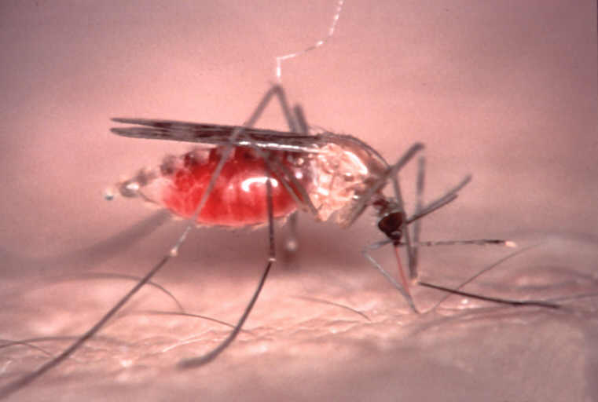
Transmission
Mosquito vector: ANOPHELES
Transmission also possible through:
Blood transfusion
Contaminated needle
Organ transplant
Congenital
“Airport malaria"
Notes:
-Of over 400 Anopheles species, 60 are potential malaria vectors and only about 30 of those are considered effective vectors.
-MOST of these are exclusive night feeders- dusk to dawn -BUT in shaded forests or jungle areas they may feed throughout the day
-The picture on this slide shows a female with an abdomen full of blood – note how much her abdomen has expanded. After a blood meal her weight will increase by 3-5 times.
There are a few other less common modes of transmission of malaria. These are:
Blood Transfusion
Contaminated needle
Organ Transplant
Congenital
Ref: 2,5.

Slide 13
Transmission and Life Cycle
Sporozoites – circulation time 30 mins.
Hepatic stage – sporozoites enter the kupffer cells – hepatic schizont – release of merozoites into circulation
Hypnozoites – p.vivax & P.ovale
Erythrocytic or blood stage responsible for symptoms
Gametocytes – sexual reproduction in mosquito

Slide 14
Pathogeneses of Severe Malaria
Parasite derived toxins
Host induced cytokines
Sequestration – cytoadherence and rosseting
P. falciparum erythrocyte membrane protein 1 (pfemp1) → Ligand responsible for majority of binding interactions
Antigenic variation also a major feature of pfemp1

Slide 15
Cytokines
Macrophages secrete TNF alfa & IL-1 that interact with hepatoctes rendering them resistant to parasite;TNF alfa correlates with disease severity
CD8+ cells produce IFN-gamma which inhibits multiplication of parasites in hepatocytes and/or destroys them;CD8+ do not affect bloodstage parasites because RBC do not express MHC-1
Infection of hepatocyte by sporozoites can be prevented by IL-2 & IFN-gamma,& limit the development in the Kuppfer cell

Slide 16
Cytoadherence
In P. falciparum infection, membrane histidine-rich ‘knobs’ appear within 24 hr of asexual cycle-these knobs extrude PfEMP1 protein ,a high molecular wt. antigenically variant strain-specific adhesive protein that mediate cytoadherence

Slide 17
Site Specific Sequestration
Brain
  measurable reduction in blood flow
Intestines
  diarrhoea
Placenta
  intervillus space

Slide 18
Classification of Malaria
Uncomplicated Malaria
Severe Malaria
Treatment failure
Persistent symptoms 2-3days after initiation of drug therapy

Slide 19
Clinical Features of Malaria
A typical attack of malaria has 3 stages
1. Cold stage – Temp.↑ patient shivers, lasts 1-2 hrs., infected RBCs burst releasing merozoites and many ring forms in the blood smear

Slide 20
Clinical Features of Malaria
2. Hot stage – temp.↑ to about 40ºc, skin
hot and dry, severe headache, nausea
and vomiting
Lasts 3-4 hrs.

Slide 21
Clinical Features of Malaria
3. Sweating stage – Temp.↓ rapidly,
profuse sweating
Lasts 2-4 hrs.
The patient is relieved but exhausted

Slide 22
Clinical Features of Malaria
3. Sweating stage – Temp.↓ rapidly,
profuse sweating
Lasts 2-4 hrs.
The patient is relieved but exhausted

Slide 23
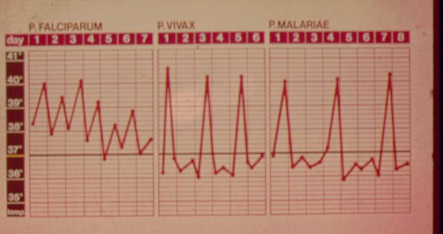
Fever Charts

Slide 24
Severe And Complicated Malaria
Hyperparasitaemia > 5%
Hyperpyrexia- temperature > 41⁰c
Anaemia-haemoglobin < 5g/dl
Hypoglycemia-blood sugar < 2.2 mmol/l
Acute renal failure

Slide 25
Severe And Complicated Malaria
Jaundice
Respiratory distress syndrome and
pulmonary oedema
Haemoglobinuria
Algid malaria (shock and gram - negative septicaemia)

Slide 26
Severe and Complicated Malaria
Electrolyte disturbances
Dic, spontaneous bleeding, bloody
diarrhoea
Mental confusion and comma

Slide 27
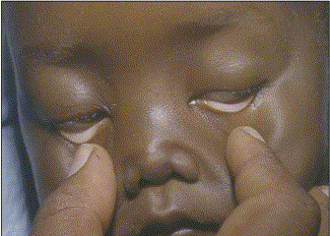
Severe Anaemia

Slide 28
Cerebral Malaria
Coma 6- 96 hours
  shorter in children
20% fatality
Hepatoslenomegaly common
Retinal haemorrhages

Slide 29
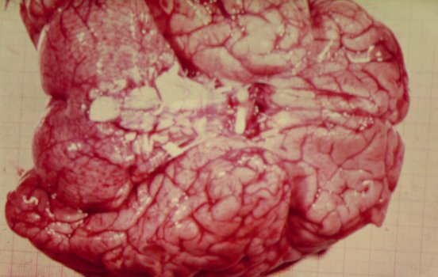
Cerebral Malaria
Numerous small haemorrhages
of grey matter

Slide 30
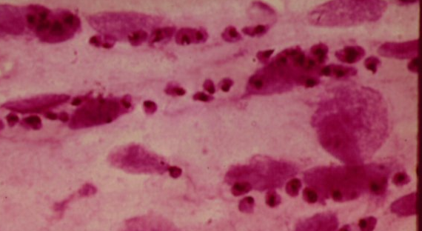
Brain section - P. falciparum

Slide 31
Nephrosis
Renal failure common in adults
  poor prognosis
Transient Nephrosis
  all species
Nephrotic Syndrome
  P. malariae - IC mediated

Slide 32
Nephrosis
P. Malariae
quarten nephrosis

Slide 33
Diagnosis
Light microscopy
  Stained fixed blood smear
      Thick film - presence/absence
      Thin film - morphology/species

Slide 34
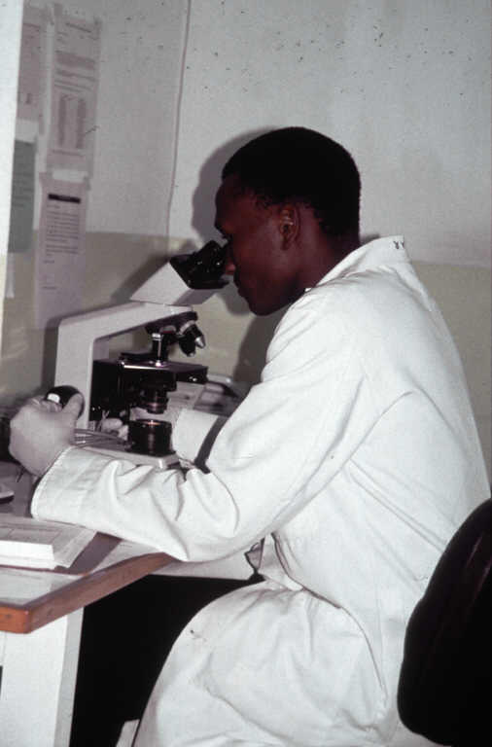
Diagnosis
Gold standard: Multiple thick and thin smears
Notes:
-You should suspect malaria in any febrile patient with a history of possible exposure to infected mosquitoes, whether they’ve been on chemoprophylaxis or not. One of the most important concepts to understand is: when to do a malaria blood smear on a patient?—and the answer is…WHENEVER malaria is suspected or possible.
-The Geimsa-stained blood smear is considered the “gold standard” for lab diagnosis of malaria.
-The thick smears are used for screening to detect the presence of malaria parasites
-The thin smears are used for identifying which species is/are present
-Multiple thick smears and thin smears should be prepared—
a) Use venous or capillary blood for the blood smears–
b) If the sample is negative, it should be repeated as often as every 6-8 hours for 24 –36 hours for two
reasons—1) because symptoms can precede detectable parasitemia by 24-36 hours; and 2) if the
parasites are synchronous, they may be present in the peripheral circulation for only half of the cycle
(cycle is 48 h for falcip, vivax, and ovale).
If the sample is positive, then slides should be repeated periodically to determine whether the parasitemia is decreasing in response to treatment –very important, especially with falciparum.
Para-sight F is like a rapid “dipstick” for Plasmodium falciparum only- it doesn’t identify the presence of other species. It is a very promising technique, but isn’t yet available in the U.S.
-The most common lab findings that can be seen on a CBC are:
(1) anemia, thrombocytopenia, leukopenia (or leukocytosis), without eosinophilia
-Other lab findings include:
(2) elevated liver enzymes
(3) elevated urinary albumin, urobilinogen, and bilirubin
-The most specific finding, of course, is the presence of parasites on peripheral blood smears.
Ref: 1.

Slide 35
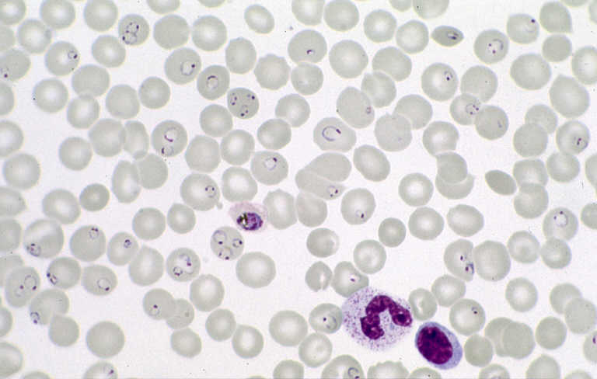
Notes:
-There are several diagnostic features that we look for when examining the thin blood smears under the microscope that help identify the species. In general they include:
a) which developmental erythrocytic stages are present;
b) the size of the parasitized RBCs- whether they’re enlarged, normal (or smaller )
c) the morphology of the RBCs and the parasites
In this slide we see many RBCs with ring forms in them:
-Ring forms are small and delicate (about 1/5 the size of the RBC), and its quite common to see multiple forms in single RBCs;
Ref: 1,5.

Slide 36
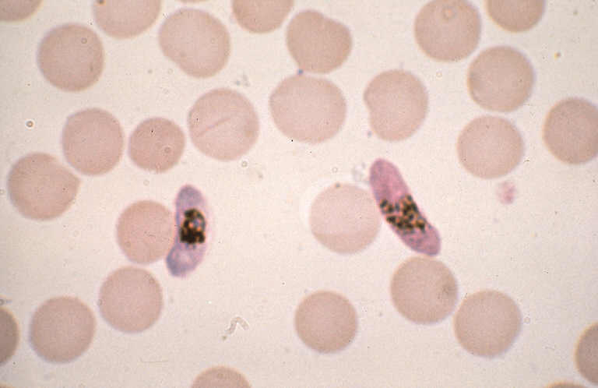
Notes:
-This is the banana or crescent-shaped gametocyte- it has a single nucleus. If you see this, you know the patient has P. falciparum.
Ref: 5.

Slide 37
Other Diagnostic Methods
Fluorescent microscopy
Antigen-capture
  RDTs; rapid diagnostic tests
    HPR-2 (histidine rich protein-2; PF only)
    pLDH (parasite LDH; all species)
PCR
Other non-specific lab abnormalities
  FBC
    Anaemia
    Haemolysis
    Thrombocytopaenia
  LFTS
    Raised transaminases (mildly)
    Hyperbilirubinaemia
  Sometimes evidence of DIC

Slide 38
Management: Optimal Treatment Approach
Rapid case identification
Rapid PARASITOLOGICAL classification
Rapid initiation of therapy
Rapid initiation of supportive care
Notes:
The general approach to a patient with malaria includes
-Rapid case identification
-Rapid clinical and parasite identification
-Initiating therapy to rapidly reduce, then eliminate parasitemia
-And Providing supportive therapy
Ref: 1,5.

Slide 39
CURRENT STATUS OF MALARIA THERAPY
Spread and intensification of resistance
Limited number of efficacious antimalarial drugs still available
Very few new drugs in the pipeline
Notes:
39
So, current situation with respect to treatment of malaria not particularly rosy . . .

Slide 40
Antimalarials
No drug acts on all stages of the life cycle currently
Quinoline derivatives
  Chloroquine, Quinine, Quinidine, Amodiaquine, Mefloquine, Halofantrine and Primaquine: inhibit heme polymerase activity etc. Intra-erythrocytic phase (NB primaquine)
Antifolates
  Pyrimethamine, sulfonamides, dapsone and proguanil: kill intrahepatic forms but not hypnozoites.

Slide 41
Antimalarials
Artemisinin derivatives
  bind iron in the malarial pigment to produce free radicals which damage parasite proteins. All parts of Intra-erythrocytic phase.
Antimicrobials
  Clindamycin, atovaquone and tetracyclines.
  Act synergistically with quinolines to kill blood schizonts
No resistance to artemisinin derivatives has been reported except in Cambodia

Slide 42
Artemisinin derivatives
Potent antimalarial activity
Immediate onset and rapid reduction of parasitemia
Complete clearance of parasites in most cases within 48 hours.
Efficacy is high even in areas with multidrug resistant parasite strains.

Slide 43
Recommended ACTs For Uncomplicated Falciparum Malaria
Artemether-lumefantrine
Artesunate + amodiaquine
Artesunate + mefloquine
Artesunate + SP

Slide 44
Other artemisinine combinations available
Artesunate – Mefloquine
Artesunate – Amodiaquine
Dihydroartemisinin –Piperaquine
Artemisinine – Naphthoquine Phosphate

Slide 45
Artemisinin Derivatives
Conc. of metabolite is significantly greater than that of oral artemether
More than 90% parasitaemia cleared in 24 hrs
Recrudescence after monotherapy is common if used for less than 5 days
Recrudescent infections – 4 fold increase in gametocytes

Slide 46
Artemisinin Derivatives
Induce reduction in gametocyte production
Do not kill mature gametocytes but prevent their development by activity against both young and more mature asexual stage and early (stage I – III) gametocytes

Slide 47
Artemisinin derivatives
At present, only group of antimalarial drugs to which resistance to P. falciparum has not yet developed except in Cambodia
Toxicity of artemisinin, artemether and artesunate is much less than that of quinine
They are superior to intravenous quinine in patients with complicated Malaria

Slide 48
Advantages of artemisinin combination therapy
Reduction of gametocyte carriage, which potentially reduces transmission of resistant alleles.
(The use of antimalarial drugs – Report of an informal consultation, WHO, Geneva, 13-17 November 2000, p. 17 –18)

Slide 49
Artemisinin Derivatives
Therefore any combination that includes an artemisinin derivative could have an impact on transmission and spread of drug resistant strains
In 2001 WHO recommended that any country changing national antimalarial drug policy should change to ACTs
ACTs should be used in epidemics

Slide 50
Advantages of artemisinin combination therapy
Not much documented resistance to artemisinin and its derivatives at present
Possible delay or slowing of spread of resistance to available antimalarial drugs
Few reported adverse clinical effects

Slide 51
Rationale for Treatment of Severe Malaria
Mortality in untreated severe malaria is 100%
Primary objective of treatment is to prevent death
Mortality with current antimalarial treatment is 15-20%
In treatment of severe malaria in pregnant women, the primary objective is saving the life of the mother

Slide 52
Treatment of Severe Complicated Malaria
Current recommended drug of choice is Intravenous artesunate. IV quinine is very effective also with initial loading dose of 20mg/kg. followed by 10 mg/kg 8hrly
Side effects include: hypoglycaemia, tinitus
Given as infusion that requires time regulation
Intramuscular artemether (is erratically absorbed in severe malaria, particularly with shock)
Meta-analysis of trials comparing artemether and quinine showed no difference in mortality in African children Trans R Soc Trop Med Hyg 2001; 95:637-50

Slide 53
Supportive Therapy
Antipyretics
Antiemetics
Generalized seizures

Slide 54
ACT in pregnancy WHO 2005
1st trimester – quinine 10mg/kg three times +/- clindamycin 10mg/kg twice daily for 7 days
2nd trimester – ACT known to be effective in the region or artesunate + clindamycin for 7 days or quinine + clindamycin for 7 days

Slide 55
CEMOHPROPHYLAXIS FOR PREVENTION OF MALARIA IN PREGNANCY
All pregnant women in malaria endemic areas should receive dose of SP to prevent fetal loss, low birth weight, low HB
As a single SP dose in the beginning of 2nd trimester
Second dose of SP in the 3rd trimester between 28 and 34 weeks

Slide 56
CHEMOPROPHYLAXIS FOR PREVENTION OF MALARIA IN PREGNANCY
In HIV-positive monthly SP from 2nd trimester up to 36 weeks may be more efficacious
Mefloquin can also be used

Slide 57
Prevention of Malaria
ITN
Indoor residual spraying
Repellant cream
Chemoprophylaxis
Environmental management
VACCINE?

Slide 58
CHEMOPROPHYLAXIS FOR PREVENATION OF MALARIA IN OTHER RISK GROUPS
Proguanil-dose 200mg per day
Mefloquine-dose 250mg once weekly
Doxycycline-dose 100mg daily, but not for children under 8 years and pregnant women
Atovaquone + Proguanil [one Malarone daily]

Slide 59
CHEMOPROPHYLAXIS FOR PREVENATION OF MALARIA IN OTHER RISK GROUPS
Chemoprophylaxis be continued for 4 weeks after leaving a malaria endemic area
No anti-malarial drug can guarantee absolute protection

Slide 60
Thank you

