Slide 1
Infections & Arthritis
Dr Syokau Ilovi

Slide 2
Introduction/ Definition
Also called Septic arthritis
Denotes direct invasion of the joint space by micro-organism
  Haematologic
  Direct innoculation eg joint aspiration, surgery
Contrast with reactive arthritis
Typically monoarticular but may be oligoarticular

Slide 3
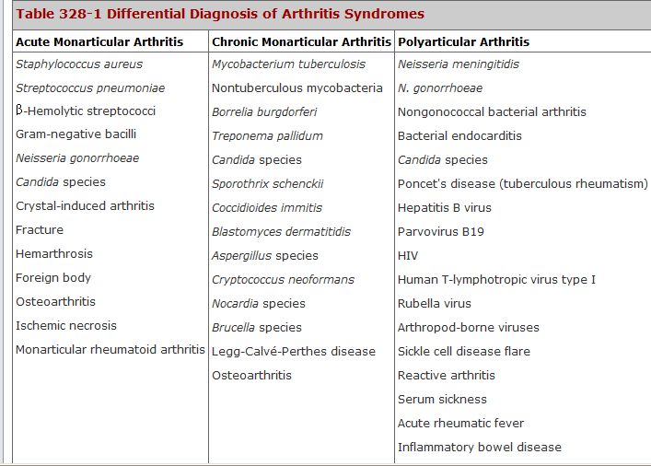

Slide 4
Clinical Presentation
90%- Monoarthritis
Bacterial-Sudden onset (days)- arthralgia, fever, inability to bear weight
Subacute- Mycobacterial- days to weeks
May present with foci of infection elsewhere eg GUT, Lung, bone

Slide 5
Definitive Investigation?
Joint aspiration- Arthrocentesis
Arthroscopy
  Aspiration of synovial fluid, Synovial biopsy
  Therapeutic- Wash-out

Slide 6
Supportive Investigations
TBC, ESR, CRP
CXR
Urine culture
HVS
TB diagnostics

Slide 7
Mx
Admission
Non-weight bearing
Antibiotics- at least 6/52
Anti-TBs- 1 year

