Slide 1
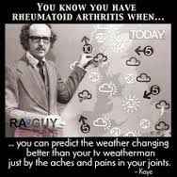
Rheumatoid arthritis for the medical student
Dr Eugene Kalman Genga
University of Nairobi

Slide 2

The goal of this series is to provide up-to-date information and multiple perspectives on:
pathogenesis, symptoms, risk factors, and complications of rheumatoid arthritis as well as current and emerging treatments and best practices in the management of rheumatoid arthritis.

Slide 3






Slide 4
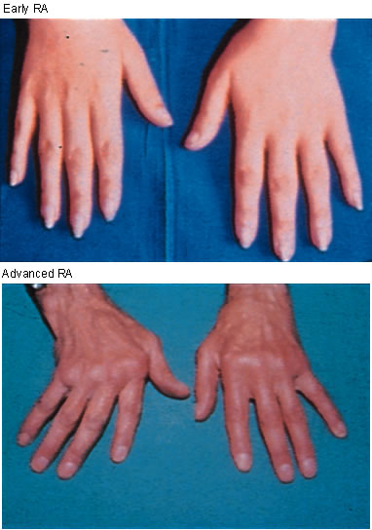
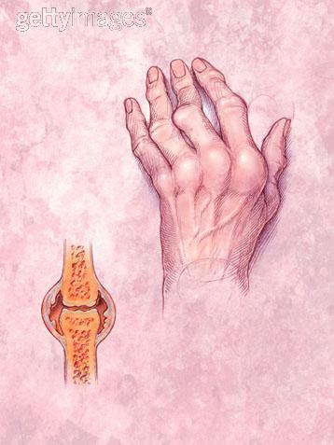
Just what is rheumatoid arthritis……

Slide 5
Rheumatoid arthritis in Kenya…
A single patient with Rheumatoid Arthritis in Kenya in 1962 was considered rare enough to warrant a publication as a case report in the East African Medical Journal (Harries, 1962).

Slide 6
Rheumatoid arthritis in Kenya
2009 Oyoo and colleagues managed to diagnose 60 patients with rheumatoid arthritis over a six month period.
Currently there are 150-200 on follow up in KNH

Slide 7
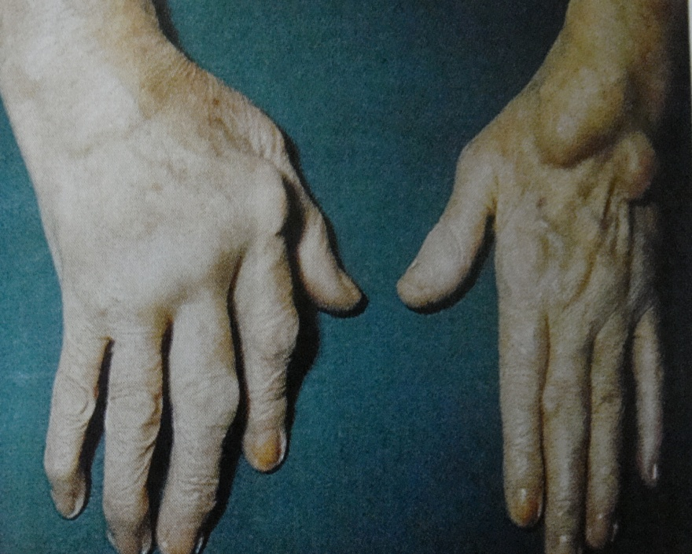
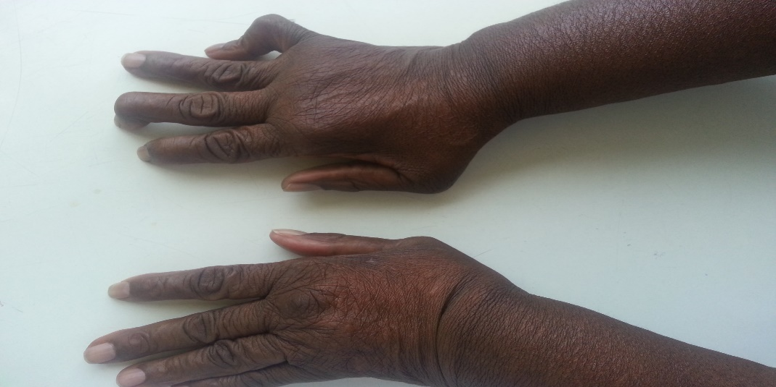

How are we doing so far ……
Earlier Studies at KNH show that we are not doing well with almost 90% RA patients have active disease with no regular objective monitoring.
Reasons for poor control- challenges in diagnosis, treatment options and assessment
Disease activity has reduced with improved diagnosis and introduction of DMARDS
1.G.O.Oyoo, B.O.OWINO, C.F.OTIENO.”An evaluation of health related quality of life in patients with rheumatoid arthritis. East African Orthopedic journal 2011.”
2. G.O.Oyoo, B.M.Mbuthia, Kitonyi. ". Platelet counts in patients with rheumatoid arthritis at the Kenyatta National Hospital Afri J Rheumatol .". 2013
3.Muia GM, GO Oyoo, GW Kitonyi, P Wanzala. “Anaemia in patients with rheumatoid arthritis at the Kenyatta National Hospital”. African Journal of Rheumatology, 2015

Slide 8

Prognosis with RA
40 % of patient become disabled after 10 years.
Persistent active cases more than 1 year likely to lead to joint deformities.
Periods of activity cases have better prognosis.
Mortality rate 2.5 times than general
population

Slide 9
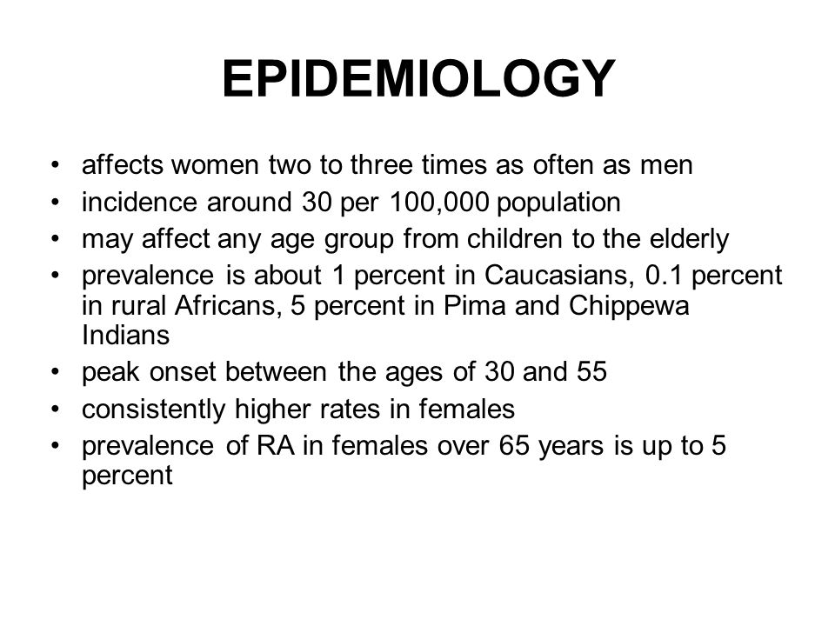

Slide 10
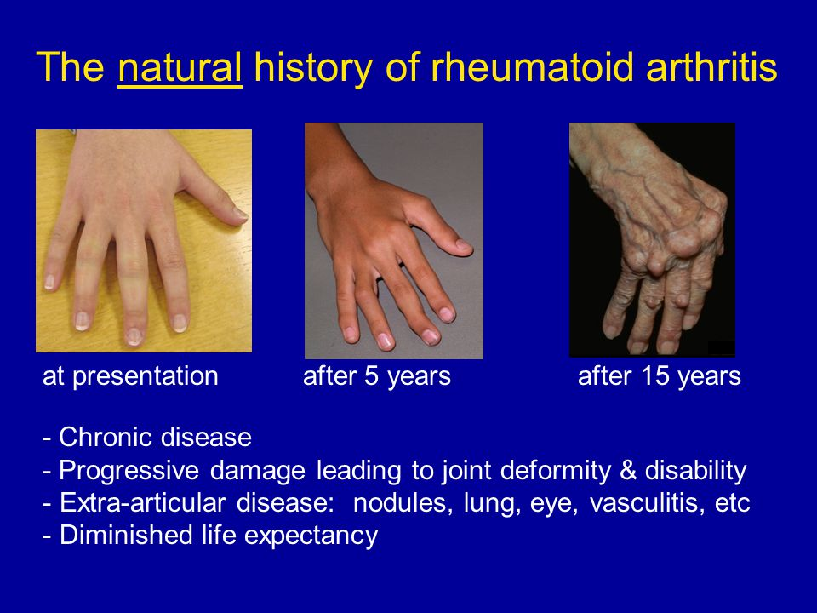

Slide 11
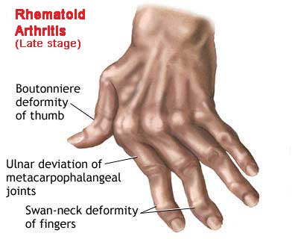
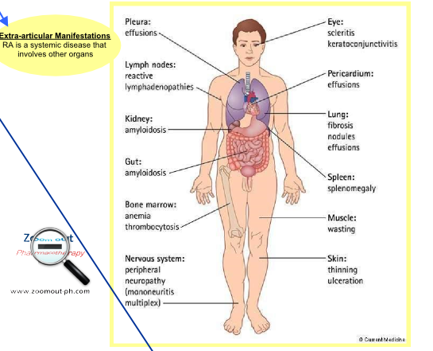
Complications of rheumatoid arthritis

Slide 12

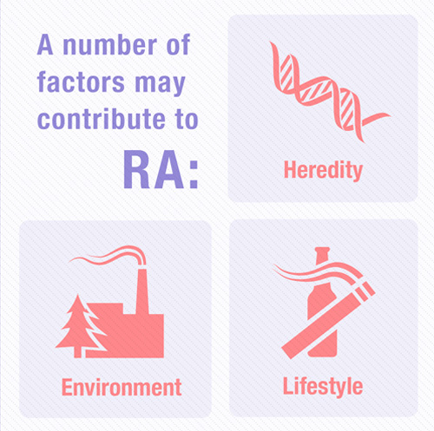
Risk factors for RA

Slide 13

RA pathophysiology: It’s like an Iceberg

Slide 14

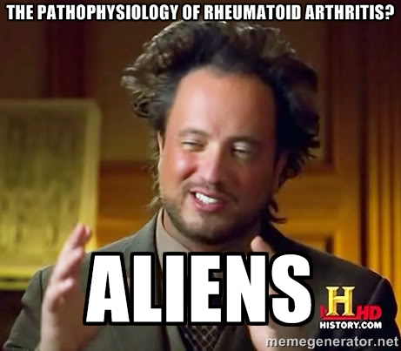
Its what you don’t see…

Slide 15
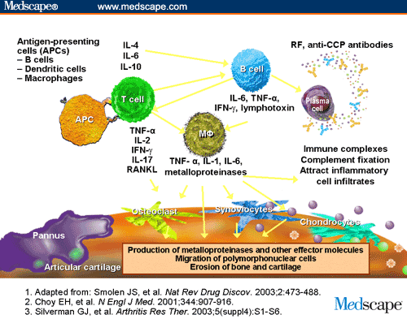

Slide 16
2010 ACR/EULAR classification criteria for RA
A score of ≥6/10 is needed to classify RA
A. Joint involvement Score
  1 large joint 0
  2-10 large joints 1
  1-3 small joints (with or without involvement of large joints) 2
  4-10 small joints (with or without involvement of large joints) 3
  >10 joints (at least 1 small joint) 5
B. Serology (at least 1 test result is needed)
  Negative RF and negative ACPA 0
  Low-positive RF or low-positive ACPA 2
  High-positive RF or high-positive ACPA 3
C. Acute-phase reactants (at least 1 test result is needed)
  Normal CRP and normal ESR 0
  Abnormal CRP or abnormal ESR 1
D. Duration of symptoms
  <6 weeks 0
  ≥6 weeks 1
Aletaha et al. Arthritis Rheum. 2010;62:2569-2581
Aletaha et al. Ann Rheum Dis. 2010; 69:1580-1588
Notes:
-Score-based algorithm: Add score of categories A–D; a score of 6/10 is needed for classification of a patient as having definite RA.
‡ Although patients with a score of <6/10 are not classifiable as having RA, their status can be reassessed
and the criteria might be fulfilled cumulatively over time.
§ Joint involvement refers to any swollen or tender joint on examination, which may be confirmed by
imaging evidence of synovitis. Distal interphalangeal joints, first carpometacarpal joints, and first
metatarsophalangeal joints are excluded from assessment. Categories of joint distribution are classified
according to the location and number of involved joints, with placement into the highest category possible based on the pattern of joint involvement.
“Large joints” refers to shoulders, elbows, hips, knees, and ankles.
“Small joints” refers to the metacarpophalangeal joints, proximal interphalangeal joints, second through fifth metatarsophalangeal joints, thumb interphalangeal joints, and wrists.
** In this category, at least 1 of the involved joints must be a small joint; the other joints can include any
combination of large and additional small joints, as well as other joints not specifically listed elsewhere
(e.g., temporomandibular, acromioclavicular, sternoclavicular, etc.).
†† Negative refers to IU values that are less than or equal to the upper limit of normal (ULN) for the
laboratory and assay; low-positive refers to IU values that are higher than the ULN but 3 times the ULN
for the laboratory and assay; high-positive refers to IU values that are 3 times the ULN for the
laboratory and assay. Where rheumatoid factor (RF) information is only available as positive or negative,
a positive result should be scored as low-positive for RF. ACPA anticitrullinated protein antibody.
‡‡ Normal/abnormal is determined by local laboratory standards. CRP C-reactive protein; ESR
erythrocyte sedimentation rate.
§§ Duration of symptoms refers to patient self-report of the duration of signs or symptoms of synovitis
(e.g., pain, swelling, tenderness) of joints that are clinically involved at the time of assessment, regardless
of treatment status.
16

Slide 17
Case Presentation
32 year old WF presents To a/e dept with a 3 month history of progressive pain and stiffness of several joints, notably the wrists, hands, feet, and ankles. She feels worse in the morning and takes several hours to loosen up.
On your exam you think there may be some mild swelling in her MCP joints and wrists, but you are not absolutely sure. You are concerned that she may early rheumatoid arthritis.

Slide 18
Questions
How do you confirm the diagnosis of rheumatoid arthritis?
If she does have rheumatoid arthritis, is it okay to see how she does for a while on NSAIDS +/- corticosteroids?
Is it important to refer to rheumatology early?

Slide 19
Initial Clinical Presentation - Classic
Insidious onset of symmetric polyarthritis, particularly MCPs, MTPs, PIPs, wrists
Morning stiffness lasting more than one hour
Constitutional symptoms such as fatigue common

Slide 20
Key Physical Findings
Symmetrical soft tissue swelling / tenderness in peripheral joints
>20 joints in severe disease
Most common are MCP and MTP joints
MCP and MTP squeeze test

Slide 21
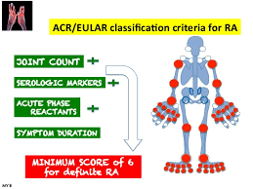

Slide 22
Clinically Useful Biologic Markers
Rheumatoid factor
Anti-CCP antibody
ESR / CRP

Slide 23
Acute Phase Reactants – ESR/CRP
Not specific, but fairly sensitive
Elevation of both: stronger indication of radiographic progression
Correlate with disease activity and used in various metrics to follow disease activity

Slide 24
Rheumatoid Factor(s)
Found in 75-80% of RA patients
Positivity lower at onset but peaks by 6-12 months
High levels associated with more aggressive disease
Nonspecific – can occur in chronic infections (such as HCV) and other autoimmune disease

Slide 25
Anti-Cyclic Citrullinated Peptide (CCP) Antibodies
Found in 50-75% of RA patients
May precede clinical symptoms
Confers increased risk of progressive disease
More specific than RF

Slide 26
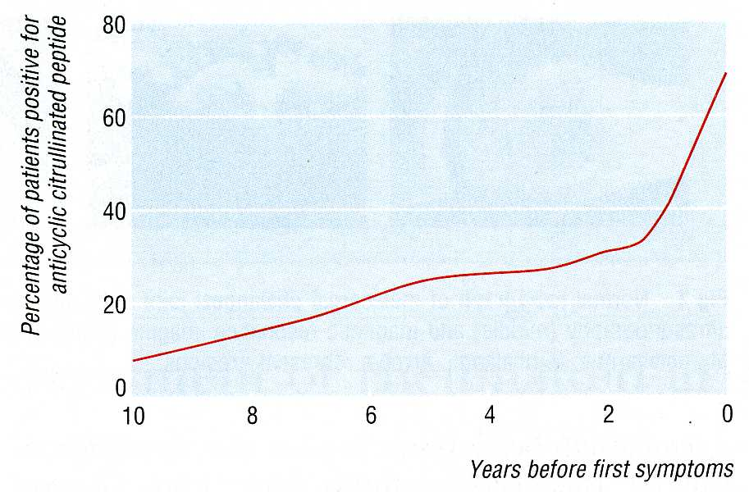

Slide 27
Testing for both RF and anti-CCP antibodies
Sensitivity Specificity
RF 73% 82%
Anti-CCP 56% 90%
Both positive 48% 96%
Remember: higher the specificity, higher the positive predictive value (more likely to have disease)

Slide 28
Imaging
Plain film radiography: unlikely to reveal erosive disease in very early disease but may serve as baseline
MRI: much more sensitive for erosive disease
How often is MRI needed for diagnosis and as a guide to therapy – remains controversial given cost

Slide 29
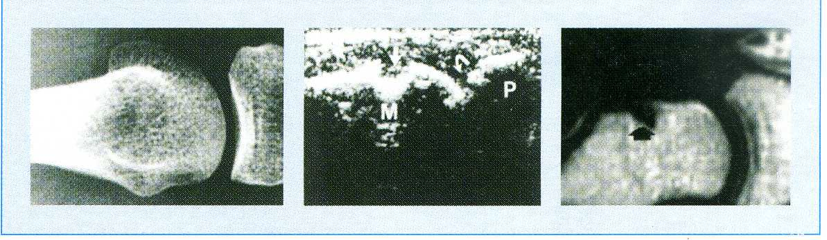

Slide 30
Rheumatoid Arthritis - Diagnosis
Based on a constellation of compatible features and exclusion of other causes of chronic (>6 weeks) inflammatory arthritis

Slide 31
Other Causes of Chronic Inflammatory Arthritis
SLE and other connective tissue diseases
Psoriatic arthritis
Reactive arthritis and undifferentiated spondyloarthropathy
Polyarticular gout / pseudogout
Inflammatory (erosive) interphalangeal OA
Polymyalgia rheumatica/RS3PE syndrome in elderly

Slide 32
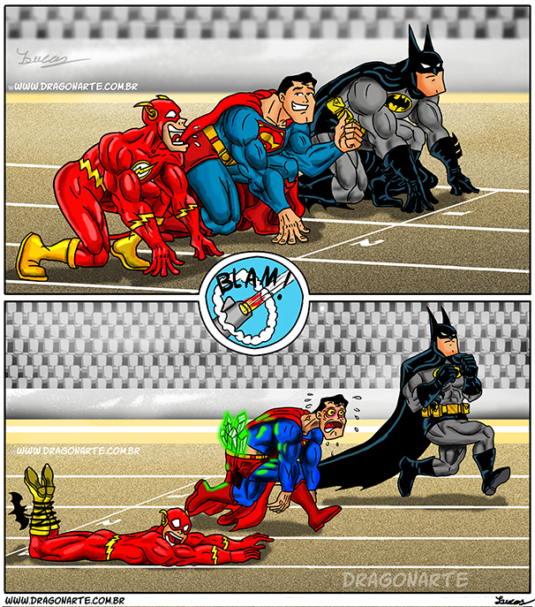
Treatment approach to Inflammatory Arthritis
“Window of Opportunity”
  Early and aggressive treatment may have long-term benefits
Principles of Treatment
  Treat Early
  Treat Appropriately

Slide 33
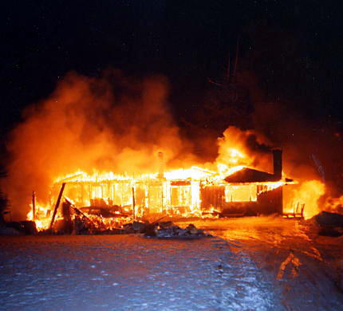
Approach to Inflammatory Arthritis
Paradigm shift in the treatment of inflammatory arthritis
Rationale for Treatment
  Large body of evidence which shows joint damage is an early phenomenon of rheumatoid arthritis
  Joint erosions occur in up to 93% of patients with less than 2 years of disease activity
  The rate of radiographic progression is greatest in the first two years
  Disability occurs early – 50% of patients with RA will be work disabled at 10 years
  Severe disease is associated with increased mortality!

Slide 34
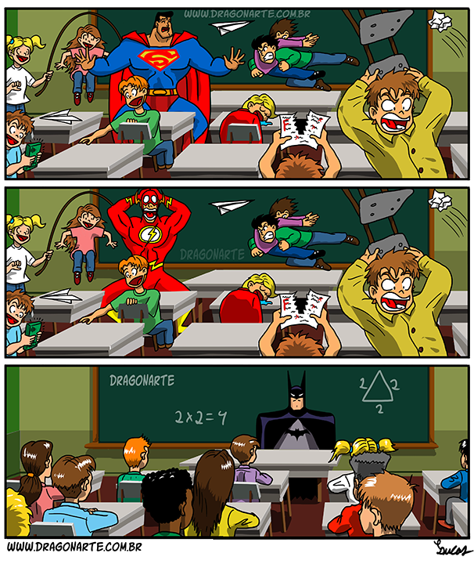
Therapeutic Goals
Control of pain
Suppression of inflammation of the CRP and the absence of swollen joints
Control of joint damage
Maintenance of normal daily activities
Maximization of quality of life

Slide 35
RA: Current Pharmacologic Options
Agents that are effective in controlling the signs and symptoms of RA, but have no effect on disease progression
  NSAIDs reduce inflammation and pain
  COX-2 inhibitors are similar to NSAIDs, but with improved GI safety and tolerability and higher cardiac side effects
  Analgesics- these medicines do not affect inflammation, but work on pain pathways to decrease subjective feeling of pain.
DMARDs impact the signs, symptoms, and disease progression of RA, as well as improve the quality of life and functionality of the patient
Corticosteroids have anti-inflammatory and immunoregulatory activity, but nominal disease-modifying capability
  Irvine S, et al. Ann Rheum Dis. 1999;58:510–513; Madhok R, Capell HA. Lancet 1999;353:257–258; ACR Subcommittee on RA Guidelines. Arthritis Rheum. 2002;46:328–346; Goldbach-Mansky R, Lipsky PE.
  Annu Rev Med. 2003;54:197–216.

Slide 36

What are DMARDs?
Disease Modifying Anti-Rheumatic Drugs (DMARDs).
  Symptom Control
    Control current inflammatory features
  Modify the course of disease
    Reduce joint damage and deformity
    Reduce radiographic progression
    Reduce long-term disability

Slide 37
Spectrum of RA Treatment
NonBiologic Era
Biologic Era
Leflunomide (1998)
MTX
SSZ
HCQ
CQ
Gold
Cyc-A
AZA
PNC
Etanercept(1998)
Rituximab
Infliximab
Abatacept
Golimumab
Certolizumab
(Tocilizumab*)
Adalimumab
Biologic
drug
clinical
trials
Anakinra
1990
2000
‘01
‘03
‘05
‘06
‘09
Year of FDA Approval

Slide 38
DMARDS in RA
Methotrexate Inhibits DNA
synthesis and
cell division
5–25 mg/wk GI upset, stomatitis, rash,
alopecia, hepatotoxicity, acute
pneumonitis
FBC, LFTs Initially monthly,
then every 3 mths
Sulfasalazine Unknown 2–4 g/day Nausea, GI upset, rash,
hepatitis, neutropenia,
pancytopenia (rare)
FBC, LFTs Monthly for 3 mths,
then 3-monthly
Hydroxychloroquine Unknown 200–400 mg/day Rash, nausea, diarrhoea,
headache, corneal
deposits, retinopathy
(rare)
Visual
acuity,
fundoscopy
12-monthly
Leflunomide Blocks T-cell
division
10–20 mg/day Nausea, GI upset, rash,
alopecia, hepatitis,
hypertension
FBC, LFTs,
BP
2–4-weekly
D-Penicillamine Unknown 250–750 mg/day Rash, stomatitis, metallic
taste, proteinuria,
thrombocytopenia
FBC, urine
(for protein)
Initially 1–2-weekly;
4–6-weekly for
maintenance
Gold Unknown 50 mg/mth by IM
injection
Rash, stomatitis, alopecia,
proteinuria, thrombocytopenia,
myelosuppression
FBC, urine
(protein)
Each injection
Ciclosporin Blocks T-cell
activation
150–300 mg/day Nausea, GI upset, renal
impairment, hypertension
FBC, LFTs,
U&E, BP
2–4-weekly
(BP = blood pressure; FBC = full blood count; LFT = liver function tests; U&E = urea and electrolytes)

Slide 39
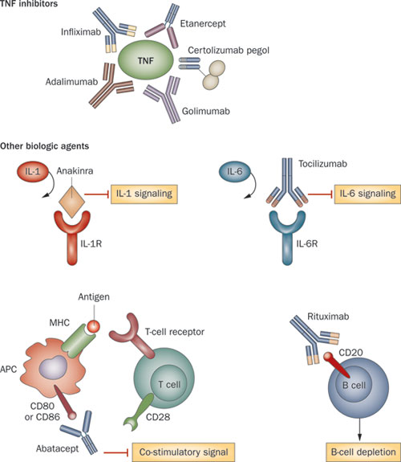


Slide 40
Side Effects of TNF Inhibition
Infusion Reactions with Infliximab, Injection Site Reactions with Adalimumab and Etanercept
Infection
  Tuberculosis
  Serious resulting in death
Malignancy
  Increased risk of lymphoma – early data
  Solid tumors?
Neurologic
  Multiple Sclerosis, seizures, inflammation of the ocular nerve
Autoimmune
  Antibody formation – SLE like illness
Worsening of Congestive Heart Failure

Slide 41

Parting short on corticosteroids…
PROS Anti-inflammatory and immunosuppressive effects
Can be used to bridge gap between initiation of DMARD therapy and onset of action
Intra-articular steroid (IAS)injections can be used for individual joint flares
CONS Does not conclusively affect disease progression
Tapering and discontinuation of use often unsuccessful
Low doses result in skin thinning, ecchymoses, and Cushingoid appearance
Significant cause of steroid-induced osteopenia, diabetes,dyslipidemia

Slide 42
REMISSION
RA - When is it in remission?
• Morning stiffness <15 minutes
• No joint pain
• No fatigue
• No joint tenderness/pain on
motion
• No soft tissue swelling
• ESR <30mm/hr (female)
<20mm/hr (male)

Slide 43
Conclusions
Early diagnosis important, which leads to –
Early treatment, aggressive if necessary, which leads to –
Better outcomes
Communication important between PCP and rheumatologist

Slide 44
History and physical examination
no
Trauma/fracture
Soft tissue rheumatism
Is it articular
No
yes
Infectious arthritris
Crystal induced
Reactive arthritis
Acute
> 6 weeks
yes
Chronic
Chronic inflammatory arthritis
yes
no
Signs of inflammation
yes
Joints involved
DIP, CMC1,Hip ,Knee joint
osteoarthritis
1-3
>3
yes
no
no
Psoriatic
Pauci JA
PCP,MCP/MTP
symmetrical
Osteonecrosis
Charcots joint
no
yes
Psoriatic
Reactive
Rheumatoid
SLE/Scleroderma

Slide 45

When in doubt consult, who says medicine isn’t a team sport…

