Slide 1
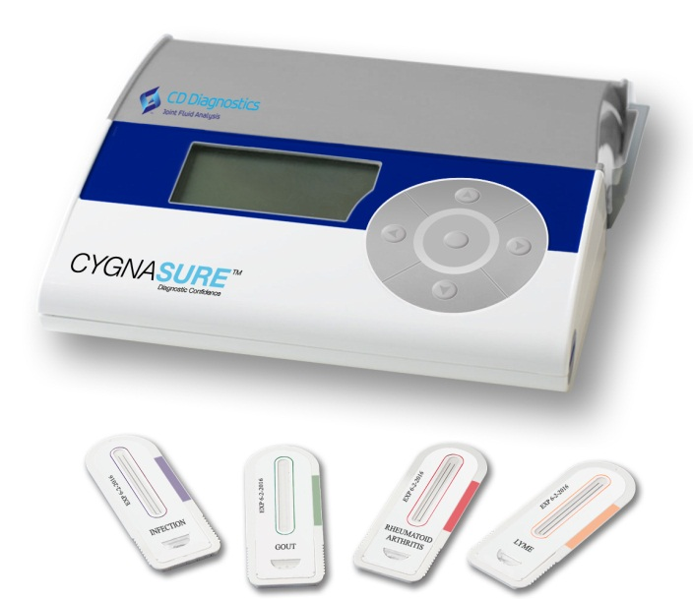
www.cddiagnostics.com

Slide 2
Management Team
CEO | Rick Birkmeyer, Ph. D. -Founder and CEO of Strategic Diagnostics, Inc. (Nasdaq: SDIX) -Obtained funding, 12 corp partnerships, 6 strategic acquisitions -DIF Venture Board, DEDO Venture Board, 4 Corporate Boards
VP Marketing, Co-Founder | Mike Behr -20 years in orthopaedic industry -J&J, Zimmer (Sales & Marketing)
Chief Scientific Officer, Co-Founder | Carl Deirmengian, M.D. -Practicing Orthopedic surgeon -Princeton University, Harvard Medical School
VP Corporate Development | ******* -Co-Founder SDIX -Investment consultant for Delaware Innovation Fund
VP Research & Development | ***** -direct involvement in the development of 15 FDA approved products -has been awarded four U.S. patents and has two pending applications.

Slide 3
CD Diagnostics Strategic Focus
Our mission is to be the leader in joint fluid analysis by providing analytical tools which will facilitate informed decisions in patient care. We will bring these analytical tools to market through corporate partnerships.

Slide 4
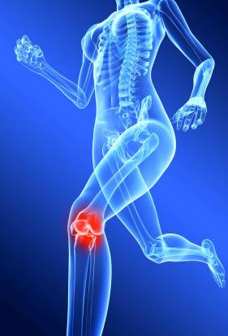
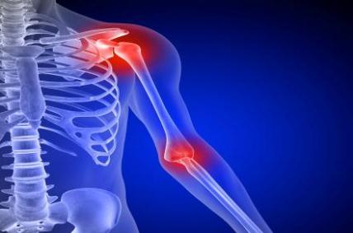
Joint Pain
Many causes of joint pain
frequently misdiagnosed
Unnecessary medical
expenses

Slide 5
USA Patients with Joint Disease 38.5 million total 100+ million with joint pain in 2009
www.cdc.gov

Slide 6
USA Testing Points Ambulatory care visits and hospitalizations 40 million+ for all joint pain 17.4 million total for joint disease
www.cdc.gov

Slide 7
USA Test Market Potential 51.1 million tests for patients with joint disease (Excluding negative results)

Slide 8
Global Test Market Potential 224.03 million tests for patients with joint disease (Excluding negative results)

Slide 9
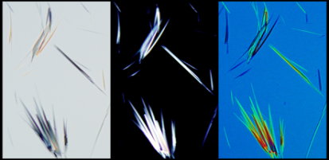
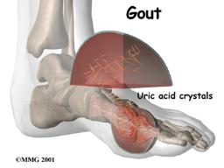
Current Diagnostics
Blood Tests
CRP, ESR
Uric Acid
Rheumatoid Antibody
Lyme Antibody
Joint Tests
Formation of crystals
White Blood Cell Count
Gram Stain/Culture

Slide 10
Current Diagnostics
There are currently NO approved
analytic assays of synovial fluid for
the diagnosis of joint disease

Slide 11
Clinical Utility
Differentiation of chronic joint diseases will lead to a specific therapeutic pathway more quickly.
Prevent secondary complications
Expedite decision regarding joint revision surgery or treatment pathway

Slide 12
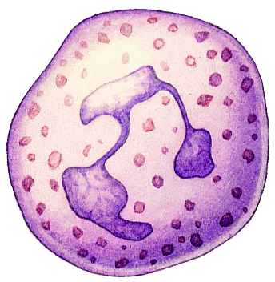
Biomarkers
White Blood Cells
Bacteria
Crystals
Poly debris

Slide 13
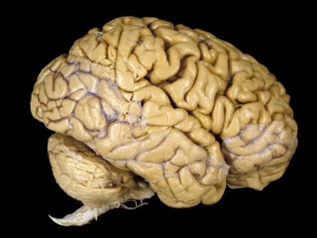
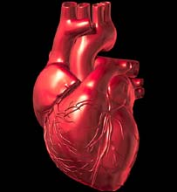
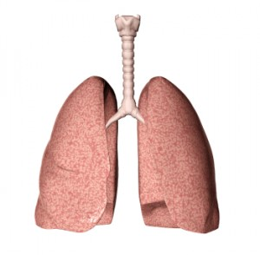
Why Test Joint Fluid?
Concentration
No Confounders
Local test
Serum Test
Dilution
Other Biomarkers

Slide 14
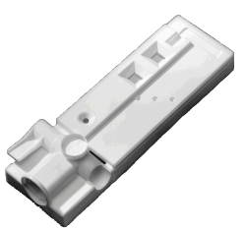
Core Technology
Immunoassay
Immunoassay characteristics
Easy-to-Use
Accurate Results On-Site
Inexpensive
Applied to Joint Fluid Analysis
Replaces ambiguous and inaccurate methods
Enables Rapid Analysis not Currently Possible

Slide 15
Intellectual Property
USPTO
Office of Public Records
Document Services Division
USPTO# 7598080
“Diagnostic Assay for the source of inflammation”
Issued 10/6/2009
Continuations
US20090318301
Filed 8/28/2009
Amended 9/1/2011
13/231,647
Filed 9/13/2011
13/231,665
Filed 9/13/2011
Provisionals
Pseudogout 61/590,248
Rheumatoid Arthritis 61/590,246
Osteoarthritis 61/590,244
Gout 61/590,240
Infection 61/590,234

Slide 16
Corporate Partnering
CD Diagnostics Core Strengths
Synergistic Partner
Market Leader
Complimentary Products
GMP Manufacturing
Immunoassay Development
Market
Leadership

Slide 17
Proof of Concept
First study
Patient data
Compared Gout to Infection
Defined a genetic signature in
joint fluid
Second study
Patient data
Confirmation of first study
Compared infection to aseptic
loosening
Third study
Patient data
Multiple clinical symptoms
Elisa Testing

Slide 18
Technical & Clinical Milestones
Milestone | Infection-Joint
Selection of Biomarkers Patent filed | April 2012
Lab Developed Test | August 2012
Investigational Use Kit | January 2013
510(k) Approval | November 2013

Slide 19
Commercialization Process
Laboratory Developed Test
Regulated by CLIA
No FDA Approval
Can be reimbursed
Can promote for detection
Advertising not restricted
Investigational Use Only Kit
Generation of data
Results can be used by clinicians as adjunct
Charge buyer

Slide 20
Funding
Angel Funding $1.5 million
State Grant
State of Delaware $ .5 million additional $ .5 million available

Slide 21
Corporate Partner Deals
Company A
Infection Joint ($2.9 Million milestone payments)
Infection Native ($1.75 Million milestone payments)
Metal-metal
Metal-allergy
Company B
Osteoarthritis
Company C
Rheumatoid Arthritis

Slide 22
Preferred Round
$1.6 Million conversion of notes
$1.1 Million Corporate Partner
$2.0 Million new money

