Slide 1
Urinary tract Imaging.
Dr Alfred Odhiambo.
Lecturer UoN.
11th Feb 2021.

Slide 2
Our menu.
Usual introductory remarks.
Tools of the trade in uroradiology.
Trends in uroradiology.
Discuss select pathologies in uroradiology.
The classics of uroradiology.
Epilogue.

Slide 3
INTRODUCTION
Imaging modalities in uroradiology have undergone a dramatic transformation in the recent past.
Earlier plain films were the only available study.
Subsequently for no less than 7 decades IVU was the pillar of uroradiology.
Today cross-sectional imaging studies have taken centre stage albeit without a definite flag bearer....

Slide 4
GUIDING PRINCIPLE
In general we should choose the least invasive but appropriate imaging technique.
The modality should generate the lowest radiation dose possible.
Consequently almost all GU studies especially in children should start with an U/S.
In the tropics COST dictates all else.

Slide 5
IMAGING TECHNIQUES
Plain films
Intravenous Urography
Ultrasound
Cystography
Computed Tomography
Magnetic Resonance Imaging
Nuclear medicine
Others.

Slide 6
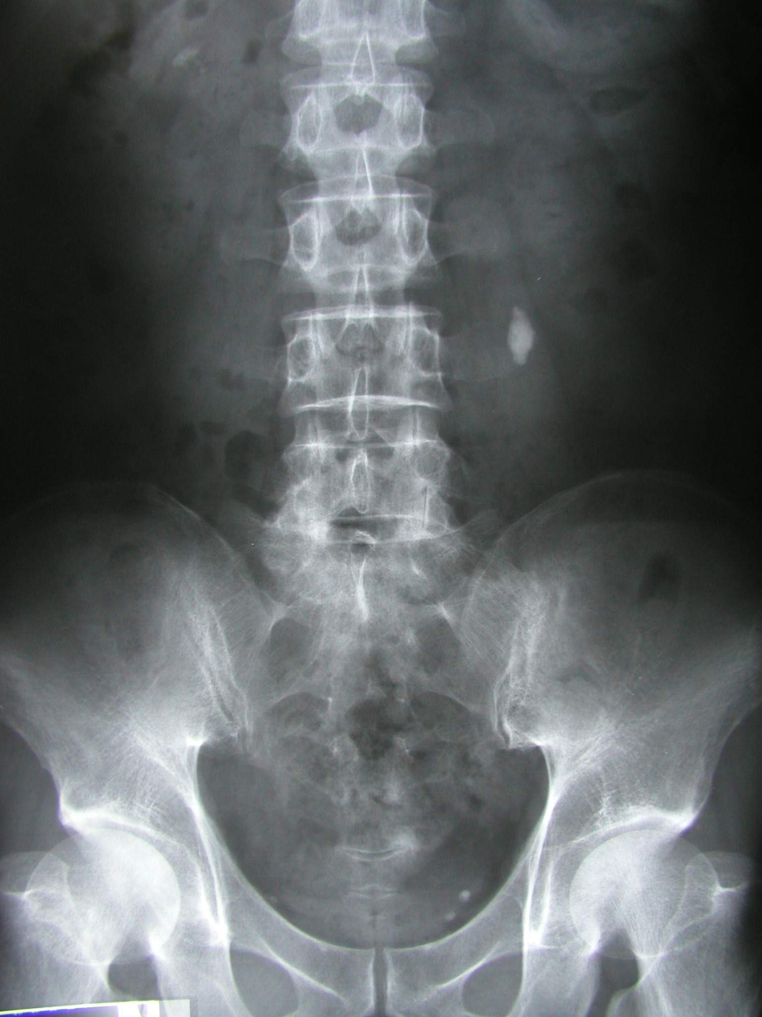
Plain films.
May be used as a stand alone examination to exclude renal calculus disease and emphysematous pyelonephritis.
More often it is obtained before a more definitive contrast studies such as IVU.

Slide 7
Natural contrast.
Perirenal fat gives a lucent outline to the kidneys and allows an assessment of their position to be made.
The loss of the psoas outline may indicate retroperitoneal pathology but is a notoriously inaccurate sign.

Slide 8
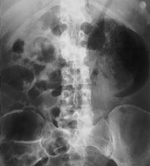
Emphysematous pyelonephritis
Preliminary radiograph reveals striated gas within the renal parenchyma as well as a large perirenal gas collection that extends into the retroperitoneum surrounding the adrenal gland.
A finding of emphysematous pyelonephritis does not require further imaging, but urgent intervention.

Slide 9
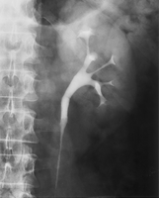
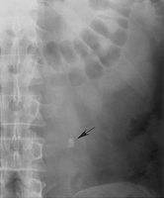
Urogram demonstrates no significant dilatation of the collecting system, with subtle changes in the opacified ureter.
Preliminary radiograph shows an 8-mm calculus in the ureter (arrow).
This case demonstrates how a calculus can be obscured by contrast material.

Slide 10
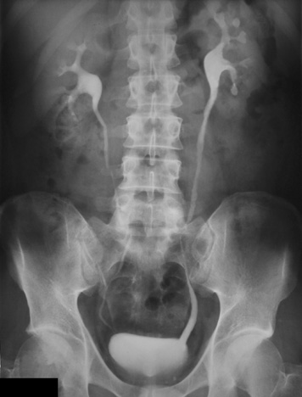
IVU
The excretory urogram is a valuable examination of the urinary tract.
It gives excellent anatomical images of the kidneys and to some extent an indication of their function.

Slide 11
Urographic Interpretation
The renal parenchyma is optimally assessed during the nephrographic phase of urography.
The entire renal contour should be assessed, and nephrotomography almost always affords better visualization than standard imaging.
The renal contour should be smooth, and the inability to visualize a given portion of the contour requires explanation.
There should be temporal symmetry of the nephrographic development.
Nephrographic evolution requires adequate renal blood flow, normal parenchymal excretory function without obstruction, and normal venous outflow.
The size of the kidneys should be assessed on every urogram, and this is best performed during the nephrographic phase.
There is inherent magnification in conventional radiography compared with other imaging modalities.
The normal kidney may range from 9 to 13 cm in cephalocaudal length, with the left kidney inherently larger than the right by 0.5 cm and the kidneys slightly larger in men than in women.
Significant discrepancies (right kidney 1.5 cm larger than the left kidney, left kidney 2 cm larger than the right kidney) require explanation.

Slide 12
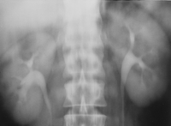
Normal nephrogram
Final image of a tomographic sequence demonstrates symmetric nephrograms and pyelograms.
Renal size is normal.

Slide 13
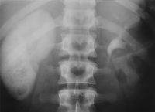
Image obtained at 80 minutes shows a persistent, very dense right nephrogram, a typical finding in acute high-grade obstruction.
A 2-mm stone was discovered at the right ureterovesical junction.

Slide 14
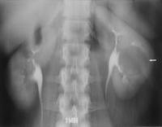
Simple cyst.
Nephrotomogram shows a nephrographic defect in the midportion of the left kidney (arrow) with increased parenchymal thickness and distortion of the underlying collecting system. US helped confirm a simple cyst.

Slide 15
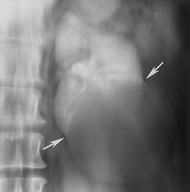
Larger simple cyst.
Nephrotomogram shows build-up of normal parenchymal tissue (cortical "beaking") at the margins of an unenhanced mass in the lower pole of the left kidney (arrows).
The lesion was confirmed to be a simple cyst at US.

Slide 16
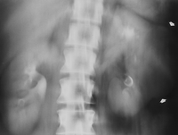
Renal cell carcinoma.
Nephrotomogram shows a mass in the midportion of the left kidney (arrows) producing increased parenchymal thickness and distorting the collecting system.

Slide 17
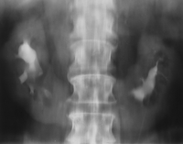
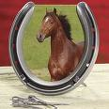
Axis and position alteration.
Nephrotomogram demonstrates characteristic axis alteration associated with a horseshoe kidney.

Slide 18
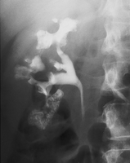
Medullary sponge kidney.
Urographic image shows resolvable collections of contrast material in the papillary tips.
Stones that were evident within the papillae at preliminary radiography appeared to "enlarge" as the cavities filled with contrast material during urography ("growing calculus sign"), a finding that is indicative of Medullary sponge kidney.

Slide 19
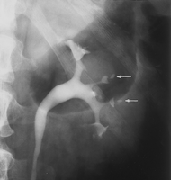
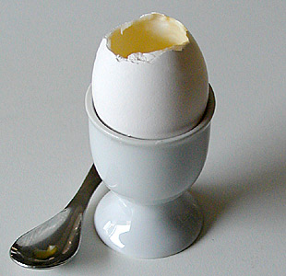
Papillary necrosis caused by analgesic abuse. Egg in cup sign.
Pyelographic image shows central cavities within multiple papillae (arrows).

Slide 20
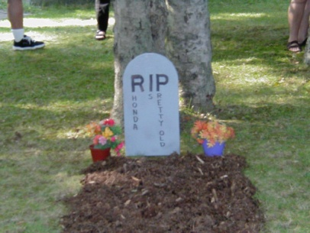
Epitaph for the Urogram¹ E. Stephen Amis, Jr, MD ¹ From the Department of Radiology, Albert Einstein College of Medicine and Montefiore Medical Center, 111 E 210th St, Bronx, NY 10467. Received July 29, 1999; accepted August 9. Address reprint requests to the author (e-mail: amis@aecom.yu.edu).

Slide 21
The last IVU sermon….
“In the near future, excretory urography will be replaced by nonenhanced helical CT to evaluate for stones and by CT urography to evaluate for hematuria and other genitourinary conditions.
CT urography should be viewed simply as an evolution of urography, which survived for 7 decades as one of the mainstays in imaging of the urinary tract.

Slide 22
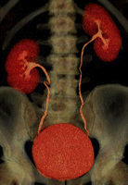
With the introduction of multidetector technology, CT urography, to date, has emerged as the initial heir apparent to intravenous urography; many years of experience have now clearly demonstrated that CT is the test of choice for many urologic problems, including urolithiasis, renal masses, urinary tract infection, trauma, and obstructive uropathy.

Slide 23
Multi-Detector Row CT of the Kidneys and Urinary Tract
Multi–detector row helical computed tomography (CT) offers considerable advantages in evaluation of the urinary tract.
It has the potential to become the single imaging modality used for comprehensive evaluation and treatment planning of most conditions affecting the kidneys and urinary tract, making conventional diagnostic techniques such as intravenous urography and angiography nearly obsolete.

Slide 24
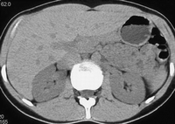
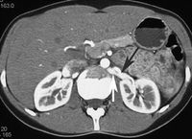
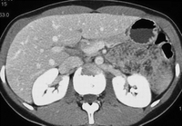
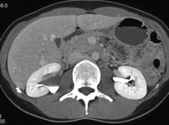
Phases of Contrast Enhancement in the Kidney and Collecting System
Phases of renal enhancement at multidetector CT.
Unenhanced axial CT at level of renal hilum.
Late arterial phase axial CT at level of renal hilum. There is good opacification of the left renal artery (black arrow) and vein (white arrow).
Nephrographic phase axial CT at level of renal hilum.
Excretory phase axial CT at level of renal hilum.

Slide 25
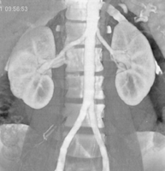
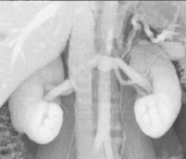
CT Angiography of the Renal Arteries.
The main applications of CT angiography include evaluation of potential renal donors, evaluation of suspected renal artery stenosis or aneurysms, and demonstration and location of crossing vessels prior to pyeloplasty for ureteropelvic junction obstruction.

Slide 26
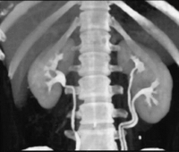
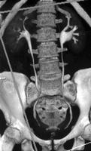
Coronal excretory phase scout CT

Slide 27
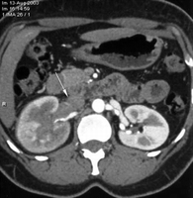
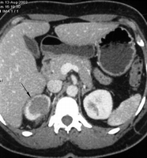
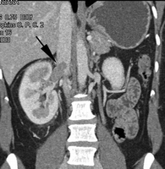
Right renal vein thrombosis in a 46-year-old woman with Escherichia coli urinary tract infection and pyelonephritis.

Slide 28
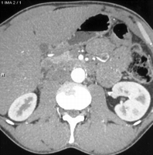
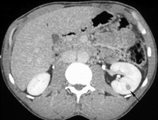
Left renal abscess in a 46-year-old man with a history of human immunodeficiency virus (HIV) infection, left flank pain, and fevers.
(a) Axial CT image in the corticomedullary phase of enhancement does not show any abnormality.
(b) Axial CT image in the late nephrographic phase.
The hypoenhancing lesion in the left renal parenchyma is clearly demonstrated (arrow).
This case illustrates the importance of tailoring image acquisitions to the clinical indication.

Slide 29
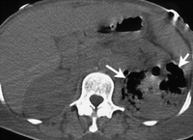
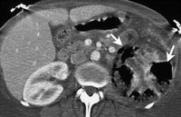
Emphysematous pyelonephritis in a 45-year-old woman with sepsis.

Slide 30
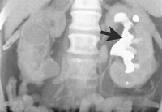
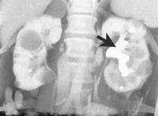
Xanthogranulomatous pyelonephritis in a 80-year-old woman with chronic pyuria.
(a) Coronal unenhanced volume-rendered image shows a large staghorn calculus (arrow) in the left kidney.
(b) Coronal volume-rendered image in early excretory phase shows, in addition to the staghorn calculus (arrow), marked hydronephrosis of the left kidney with poor function. Incidental multiple renal cysts are present in the right kidney.

Slide 31
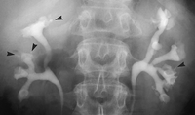
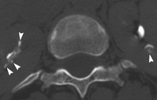
Papillary necrosis.

Slide 32
MR Urography: Techniques and Clinical Applications
Magnetic resonance (MR) urography comprises an evolving group of techniques with the potential for allowing optimal noninvasive evaluation of many abnormalities of the urinary tract.
MR urography is clinically useful in the evaluation of suspected urinary tract obstruction, hematuria, and congenital anomalies, as well as surgically altered anatomy, and can be particularly beneficial in pediatric or pregnant patients or when ionizing radiation is to be avoided.

Slide 33
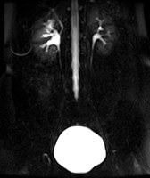
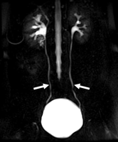
Importance of cine MR urography in demonstrating the entire ureters with static-fluid techniques.
(a) On a coronal thick-slab MR urogram from a cine series obtained in a 52-year-old woman with hematuria, the ureters are poorly delineated.
(b) Coronal thick-slab MR urogram from the same series shows improved delineation of the ureters (arrows).

Slide 34
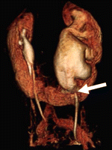
Horseshoe kidney and congenital UPJ stenosis in a 67-year-old woman.
VR image from 3-T excretory MR urographic data shows a dilated left moiety collecting system to the level of the UPJ (arrow).

Slide 35
Solid Renal Masses
In general, any enhancing solid mass in the kidney should be considered a renal neoplasm.
However, it should also be kept in mind that all enhancing solid renal masses do not represent a renal neoplasm.
In most cases, it is possible to preoperatively differentiate those renal masses that require surgery (renal cell carcinoma, invasive transitional cell carcinoma, and oncocytoma) from those that do not.

Slide 36
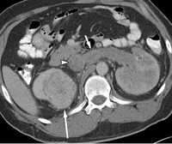
Left kidney contains a poorly defined infiltrating enhancing mass that has grown into and expands the left renal vein (short arrow) and inferior vena cava (arrowhead).
The patient underwent left nephrectomy (and removal of the tumor thrombus from the left renal vein and inferior vena cava) and partial right nephrectomy.
At surgical pathologic evaluation, bilateral renal cell carcinomas of different histologic subtypes were diagnosed, a well-differentiated clear cell carcinoma in the right kidney and infiltrating carcinoma in the left kidney.

Slide 37
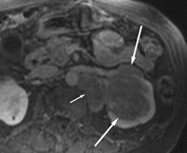
Transverse gadolinium-enhanced fat-suppressed T1-weighted MR image (3.6/1.6; 12° flip angle) in an 84-year-old woman with a renal mass shows a solid enhancing mass (long arrows) in the left renal sinus, infiltrating into the kidney.
Large left periaortic lymph nodes (short arrow) are also present.
Results at biopsy of the lymphadenopathy confirmed lymphoma.

Slide 38
Differentiation of Subtypes of Renal Cell Carcinoma on Helical CT Scans .
The differentiation of the renal cell carcinoma into subtypes has become of interest because of the association with prognosis.
Investigators have also concluded that renal cell carcinoma is not a single disease but, rather, a group of several disease entities.
According to the First International Workshop on Renal Cell Carcinoma held by the World Health Organization, renal cell carcinoma can be classified into conventional (i.e., clear cell) renal carcinoma, papillary renal carcinoma, chromophobe renal carcinoma, collecting duct renal carcinoma, and unclassified renal carcinoma.

Slide 39
Urethrography.

Slide 40
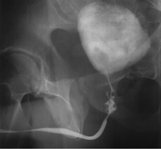
Posterior urethral rupture above the intact urogenital diaphragm following blunt trauma (type II urethral injury).
Partial type II urethral injury.

Slide 41
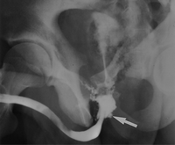
Posterior urethral rupture extending through the urogenital diaphragm to involve the bulbous urethra following blunt trauma (type III urethral injury

Slide 42
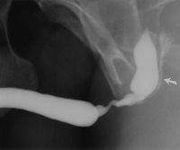
Gonococcal urethral stricture. Retrograde urethrogram reveals a segment of irregular, beaded narrowing in the distal bulbous urethra with opacification of the left Cowper duct (arrow).

Slide 43
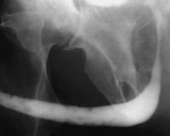
Condyloma acuminata. Retrograde urethrogram demonstrates multiple small filling defects in the anterior urethra.

Slide 44
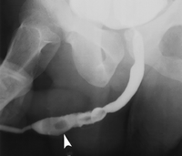
Retrograde urethrogram demonstrates the stones (arrowhead) lying in a segment of anterior urethral stricture.

Slide 45
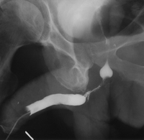
Squamous cell carcinoma of the male urethra.

Slide 46
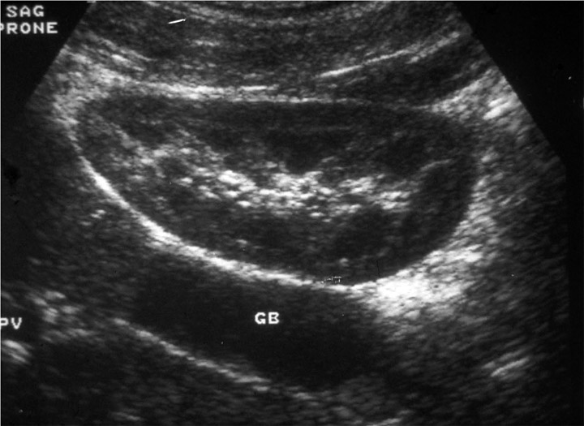
ULTRASOUND
The ability to differentiate normal from abnormal is directly related to the skill of the ultrasonagrapher
Resolution of pathology at an earlier stage is being recognised by improvement in US equipment.
So updating of skills and equipment is also needed

Slide 47
STRENGTHS of U/S
Very sensitive for upper tract dilatation.
Kidney size and the bladder well demonstrated.
Renal calculi and nephrocalcinosis seen.
Doppler evaluation of arterial and venous waveforms possible even with uncooperative child.
Cyst from solid differentiation is excellent.

Slide 48
WEAKNESSES of U/S
Cannot detect focal renal scarring, VUR or renal arterial abnormalities
Assessment of post-micturition volumes may be falsely high in presence of upper tract dilatation
Acurate comparison of small changes in renal pelvic dilatation on sequential US is difficult
Notes:
Secondary filling from upper tracts

Slide 49
ULTRASOUND IMAGE
Composed of a variety of bright dots on a film that vary in intensity according to the strength of returning echoes from tissues or structures in the body
Provides anatomic and non-anatomic information
Notes:
An ultrasound image is composed of a variety of bright dots on a film that vary in intensity according to the strength of the returning echoes from internal tissues and/or structures in the body.
The location of each dot corresponds to the anatomic location of each echo-generating organ or structure.
Each image provides a dot-for-dot correct anatomic representation of organs and structures in the body.
On the image there is also non-anatomic information, which is the result of things happening to the ultrasound beam before, during or after it strikes a reflecting surface. These phenomena, which are the result of the imaging technique itself, are called artifacts and are discussed elsewhere.

Slide 50
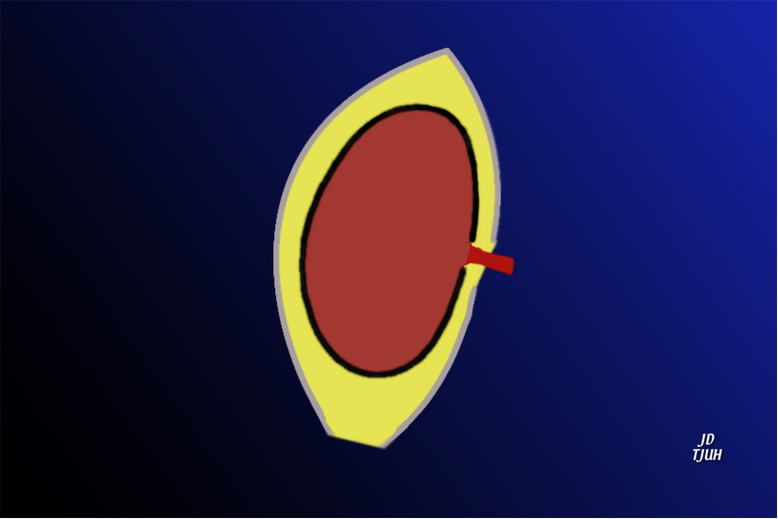
Capsule
Perirenal fat
Kidney
Renal
fascia
Notes:
PERIRENAL SPACES
The kidney is covered by a fibrous capsule, which is closely applied to the surface of the kidney.
The kidney is embedded in perinephric fat, which is enveloped by renal fascia, also known as Gerota’s fascia. The kidney has considerable mobility within this envelope, which is disrupted medially by the renal vessels in the hilum and inferiorly, as shown above. This means that fluid, such as blood, pus, or urine can track out of the perinephric space through these openings and extend into other anatomic spaces.
QUESTION:
Explain how urine can escape out of the perinephric space.
ANSWER:
The renal fascia is disrupted medially, where the renal vessels are attached, and inferiorly.

Slide 51
NORMAL KIDNEY
Capsule Hyperechoic
Cortex Hypoechoic
Medulla Almost anechoic
Sinus Hyperechoic
Perirenal fat Hyperechoic

Slide 52
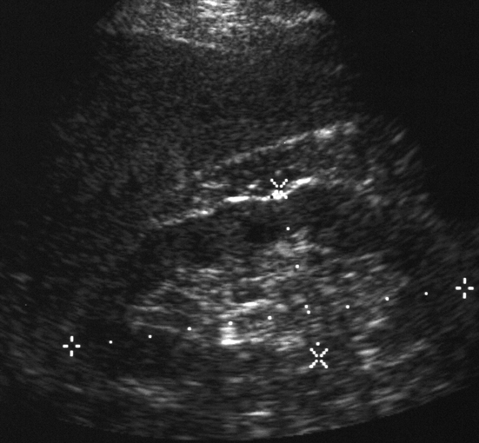
Renal lengths should be within 2 cm
LT KIDNEY 7.7 cm
RT KIDNEY 10.4 cm
Notes:
RENAL SIZES
The right and left kidney should be within 2 cm of their respective lengths.
The left kidney in this patient is 2.7 centimeters shorter than the right kidney. It also has a thin cortex and increased echogenicity, all signs of a diseased kidney.

Slide 53
Notes:
DIFFUSE PARENCHYMAL DISEASE
The parenchyma of the kidney is diffusely echogenic in this patient with interstitial nephritis due to chronic analgesic abuse.

Slide 54
Notes:
SIMPLE RENAL CYST
Renal cysts are common incidental findings in the kidney. They tend to increase in size and number with age.

Slide 55
Notes:
HEMORRHAGIC RENAL CYST
Hemorrhage within a renal cyst may create bizarre appearances, as we know from the multitude of appearances of hemorrhagic ovarian cysts. Unlike the ovarian cyst, any unusual echoes in a renal cyst are considered suspicious of malignancy and must be investigated further, as in this case. Even though the mass in this slide was a hemorrhagic renal cyst proven by surgery, it has too many unusual echoes and should be considered malignant until proven otherwise.

Slide 57
Prostate gland.

Slide 58
Transabdominal sonography

Slide 59
TRUS. TRX.

Slide 60
CT scan…..
Axial CT pelvis-Prostate gland (p) lies posterior to the pubic symphysis.
The spermatic cords (straight arrows) contain vessels, fat, and the vas deferens.
Curved arrows, levator ani; r, rectum; i, obturator internus⁵.

Slide 65
NUCLEAR MEDICINE
“Unclear Medicine” ?
The use of small amounts of radioactive materials to diagnose and treat disease.
NUCLEAR MEDICINE SHOWS PHYSIOLOGY
Whereas
RADIOLOGY SHOWS ANATOMY

Slide 66
IMAGING
Several steps are observed
Pharmaceutical with appropriate biological behaviour
Bind it to radioactive material without changing the biological behaviour
Administer to patient
Radiation detectors used to record internal spatial distribution in 2D or 3D

Slide 67
GENERATOR SYSTEM
The basis of the generator system (the cow) is that the daughter is physically separable from the parent.
This process is termed “milking”.
The eluate contains sodium pertechnetate.
Since the generator system is small and can be shipped easily, it makes the routine use of 99mTc possible in nuclear medicine
Molybdenum-99

Slide 68
IMAGING EQUIPMENT
Imaging equipment
collimator
crystal
PMT
computer processing (SPECT, Gating, Cine)
image display (monitor, film, counts)
GAMMA CAMERA

Slide 69
RENAL SCINTIGRAPHY
Renogram
DTPA
MAG3
Renal Cortical Scan
DMSA
Radionuclide Cystography
Direct
Indirect
20%

Slide 70
PYELONEPHRITIS ASSESSMENT
A 5-yr old boy who presented with a febrile UTI
Diminished but not delayed uptake of Radio-ph by the left kidney is seen on renogram
FUNCTION 99mTc-MAG3
Right (87%)
Left (13%)

Slide 71
ACUTE PYELONEPHRITIS
On CT, an oedematous left kidney is seen with multiple large areas of decreased enhancement in the periphery.
U/S images reveal an enlarged left kidney with heterogeneous echo texture as well as several discrete areas of hypoechogenicity which correspond to the regions of low attenuation seen on CT

Slide 72
End of main presentation. You can fall asleep now.

Slide 73
Uroradiology classics.

Slide 74
Radioglyphics…
The language of radiology is rich with descriptions of imaging findings, often metaphorical, which have found common usage in the day-to-day practice of genitourinary radiology.
These "classic signs" give us confidence in our diagnosis.
Some of the signs have become so familiar to us that they are referred to as an "Aunt Minnie."

Slide 75
Staghorn
A renal stone described as a staghorn implies a branched renal calculus that resembles the antlers of a stag.
It is usually composed of struvite; but less commonly, it is formed from cystine or uric acid.

Slide 76
(a) Staghorns. (b) On a scout image obtained before excretory urography, a calculus fills nearly the entirety of a bifid right renal collecting system, giving it a branched appearance that resembles the antlers of a stag.

Slide 77
(a) A bear’s paws. (Photograph entitled "Bad Boys of the Arctic" reprinted with permission from Thomas D. Mangelsen, Inc.)
(b) Contrast material-enhanced CT scan (same patient as in Fig 2) demonstrates a centrally obstructing stone with replacement of the renal parenchyma by low-attenuation collections in a "hydronephrotic" pattern. Note the lack of dilatation of the renal pelvis and infundibula.

Slide 78
"Sponge" kidney, made from a sponge! (b) Scout image from excretory urography demonstrates calcifications clustered in the medullary portion of the left kidney. (c) After contrast material administration, numerous cavities are identified within the renal papilla in the patient with medullary sponge kidney. Some of the calcifications appear to grow, as contrast agent fills the entire cavity containing the stone.

Slide 79
After contrast material administration, numerous cavities are identified within the renal papilla in the patient with medullary sponge kidney. Some of the calcifications appear to grow, as contrast agent fills the entire cavity containing the stone.

Slide 80
One kind of rim (with thanks to Christopher R. Dyer for his assistance with this photograph.) (b) CT scan shows a thin soft-tissue rim (arrow) surrounding a stone impacted in the middle of the left ureter. The rim represents edema of the ureteral wall. The presence of a tissue rim sign allows a confident diagnosis of a stone within the ureter.

Slide 81
Comet. (Photograph entitled "Comet Hyakutake" reprinted with permission from Bill and Sally Fletcher.) (b) CT scan shows a calcification (the comet nucleus) (arrow) with a soft-tissue tail that represents a pelvic vein (arrowhead). Together, this appearance constitutes the comet sign. Note the stone at the left ureterovesical junction.

Slide 82
Spotted nephrogram.
(a) Spotted cat. (Courtesy of Russell I. Poole, Mishawaka, Ind.)
(b) Late image from midstream aortography demonstrates patchy perfusion in both kidneys, giving the parenchyma a spotted appearance: the spotted nephrogram.
(c) Late image from selective right renal arteriography in the same patient demonstrates small vessel occlusion and multiple areas of parenchymal infarction (arrow) with islands of preserved perfusion. The patient proved to have periarteritis nodosa.

Slide 83
Crescent Sign
This sign is fundamentally different in its pathophysiology from the rim sign of hydronephrosis.
The crescent sign refers to the appearance of concentrated contrast material in collecting tubules, arranged parallel to the margin of a dilated calix, which produces a thin line of contrast material at the edge of the calices, resembling a crescent.

Slide 84
(a) Crescent. (Photograph entitled "Moon with Earthshine" reprinted with permission from Bill and Sally Fletcher.) (b) Crescent sign. CT image obtained during the corticomedullary phase of enhancement shows decreased thickness of the parenchyma surrounding the dilated collecting system in the left kidney. (c) Concentrated contrast material crescents surround the dilated collecting system elements (arrows) on this delayed image, which also shows a urine-contrast agent level in the dependent aspect.

Slide 85
Balloon on a string (with thanks to Richard T. Dyer for his help with this photograph). (b) Balloon on a string sign. Delayed tomographic image from excretory urography shows caliceal crescents (arrowheads) surrounding the dilated collecting system. Contrast material pools dependently. (c) Image from retrograde ureteropyelography, performed after several weeks of ureteral stent placement, shows an eccentric exit of the ureter from the dilated renal pelvis. This appearance resembles a balloon on a string and is typical of ureteropelvic junction obstruction.

Slide 86
Horseshoe kidney. (a) Horseshoe. (b) Enhanced CT image shows the functional isthmus of a horseshoe kidney anterior to the aorta, immediately beneath the inferior mesenteric artery (arrow).

Slide 87
Lying down adrenal glands. US images of the right (a) and left (b) renal fossae demonstrate absence of the kidneys, and long, slender adrenal glands (arrows) in an infant with bilateral renal agenesis.

Slide 89
Epilogue.
Thank you for offering me 60 minutes of your precious time.
This is but the foundation of uroradiology.
We can irrigate this nascent discipline then tropicalize it.

