Slide 4
THE EVOLUTION OF NEPHROLOGY SERVICES IN KENYA
S. O. MCLIGEYO
CHAIRMAN, KENYA RENAL ASSOCIATION
PROFESSOR OF INTERNAL MEDICINE
CONSULTANT PHYSICIAN AND NEPHROLOGIST
DEPUTY DIRECTOR, GRADUATE SCHOOL, UON

Slide 6
Prof Adu Dwamoa, Dr. Ahmed Twahir, Prof. McLigeyo

Slide 7
Diabetic Kidney Disease
Professor S.O. McLigeyo
Consultant Physician and Nephrologist

Slide 8
S.O. MCLIGEYO

Slide 9
THE FAMILY OF AN AFRICAN GENTLEMAN

Slide 10
Diabetes: the most common cause of ESRD
Primary diagnosis for patients who start dialysis
Other
Glomerulonephritis
10%
13%
700
Hypertension
No. of patients
Diabetes
27%
95% CI
600
50.1%
No. of dialysis patients (thousands)
500
400
300
520,240
281,355
200
243,524
100
r²=99.8%
0
1984
1988
1992
1996
2000
2004
2008
United States Renal Data System 2000
Notes:
The pie chart shows that diabetes is currently the most common cause of ESRD.
The lower graph reveals that the number of patients with ESRD maintained on dialysis is predicted to double over present levels by 2010, and the major contributor to this exponential increase is chronic renal failure associated with diabetes.

Slide 11
Change in the pattern of diabetic kidney disease
Percent of all patients
80
60
Chronic glomerulonephritis
40
Diabetic nephropathy
20
0
2000
2001
2002
2003
2004
2005
2006
2007
2008
Year

Slide 16
Carl Eric Mogensen

Slide 17
Natural History of Type 2 Diabetic Nephropathy
Clinical type 2 diabetes
Functional changes*
Structural changes†
Rising blood pressure
Microalbuminuria
Proteinuria
Rising serum creatinine levels
End-stage renal disease
Cardiovascular death
Onset of diabetes
2
5
10
20
30
Years
*Kidney size ↑, short-term GFR ↑, long-term GFR ↓.
†GBM thickening ↑, mesangial expansion ↑, microvascular changes +/-.
Notes:
Slide 71.
Natural History of Type 2 Diabetic Nephropathy
Diabetic nephropathy can be divided into 4 phases: microalbuminuria (UAE 30-300 mg/24 h), macroalbuminuria or proteinuria (>300 mg/24 h), the nephrotic syndrome, and chronic renal failure [Grundy et al, 1999]. Microalbuminuria is the first clinical sign of diabetic damage to the kidney and is a harbinger of progressive kidney damage. Microalbuminuria also reflects a higher risk for cardiovascular disease. Once microalbuminuria is present, it progresses over 5-10 years to macroalbuminuria in 22%-50% of patients [Mogensen, 1984; Cooper et al, 1988; Haneda et al, 1992; Ravid et al, 1992; John et al, 1994; Lebovitz et al, 1994]. Macroalbuminuria denotes significant diabetic nephropathy and will be followed by a decline in glomerular filtration rate (GFR). Once a patient with type 2 diabetes develops macroalbuminuria, further decline in renal function appears to be inevitable; GFR declines at a rate of 4-12 mL/min/year [Pugh et al, 1993; Gall et al, 1993; Hasslacher et al, 1993]. Some patients develop the nephrotic syndrome, which usually heralds progressive renal insufficiency and end-stage renal disease.
In diabetic nephropathy studies where the time of onset of type 2 diabetes is known, patients follow a time course similar to that seen in patients with type 1 diabetes. However, the date of onset of type 2 diabetes is often unknown and usually precedes the clinical diagnosis by several years [Grundy et al, 1999]. By the time patients are diagnosed with type 2 diabetes, many have already developed hypertension, signs of nephropathy (including microalbuminuria or even macroalbuminuria), and cardiovascular disease [Mogensen et al, 1992; The Hypertension in Diabetes Study Group, 1993a; American Diabetes Association, 1998]. Whereas patients with type 1 diabetes are usually normotensive until overt renal disease develops, hypertension commonly occurs in patients with type 2 diabetes before the onset of overt diabetic nephropathy. About 40% of newly diagnosed patients with type 2 diabetes are already hypertensive [The Hypertension in Diabetes Study Group, 1993a].
Both the onset of microalbuminuria and progression of renal disease after the onset of macroalbuminuria are accelerated by hypertension [Epstein et al, 1992].
The majority of patients with type 2 diabetes who have macroalbuminuria also have hypertension [Grundy et al, 1999]. In these patients, control of hypertension slows the decline in GFR. The main goal of any treatment for patients with type 2 diabetic nephropathy should be to prevent the natural progression from microalbuminuria to macroalbuminuria to end-stage renal disease. Effective antihypertensive treatment is the best inhibitor of diabetic nephropathy [Ravid et al, 1993]. Since reducing albuminuria delays progression of diabetic nephropathy, this parameter can be used as a benchmark for measuring the efficacy of therapeutic interventions [Rossing et al, 1994].
Note that the high risk of cardiovascular mortality in patients with type 2 diabetes, even early in their disease, may not allow for the development of nephropathy [Ismail et al, 1999].

Slide 25
Diabetic ESRD patients are at particularly high risk of cardiovascular complications
Non-diabetic ESRD
Prevalence at initiation of dialysis (%)
Diabetic ESRD
60
p = 0.04
p < 0.00001
50
50
48
40
38
p = 0.003
30
32
20
24
18
10
0
Concentric LVH
Ischaemic heart disease
Cardiac failure
Foley et al Diabetologia 1997

Slide 26
Mortality among HD patients
2-year mortality
2-year survival
Non-diabetics
Survival
rate
Diabetics
50%
1.0
Non-diabetics
(n=199)
42%
40%
0.9
31%
30%
0.8
19%
0.7
Diabetics
(n=81)
20%
11%
10%
0.6
0%
0.5
Total
mortality
CV mortality
0
6
12
18
24
Months
Notes:
In this study, the mortality of 280 stable haemodialysis patients was prospectively monitored over a two-year period.
29% of the patients (n=81) suffered from diabetes mellitus (74 patients with type 2 diabetes and 7 patients with type 1 diabetes). During the 2-year follow-up, 72 patients (25.7%) died mostly due to cardiovascular events (58%). Cardiovascular events were defined as myocardial infarction, congestive heart failure, sudden death, and stroke.
Both total as well as cardiovascular mortality were more than doubled in diabetic subjects compared to nondiabetic patients (42% vs. 19% and 31% vs. 11%, respectively).
unpublished data, communicated by Zimmermann J, Metzger T, Wanner C. University Hospital Würzburg, Germany.

Slide 28
Proteinuria Predicts Stroke and CHD Events in Type 2 Diabetes
A: U-Prot <150 mg/L
B: U-Prot 150–300 mg/L
C: U-Prot >300 mg/L
1
40
0.9
p<0.001
A
30
0.8
B
Survival curves for CV mortality
0.7
20
Incidence (%)
0.6
C
10
0.5
Overall: p<0.001
0
0
0
10
Stroke
CHD events
20
30
40
50
60
70
80
90
Months
U-Prot = Urinary protein concentration.
Miettinen H et al. Stroke. 1996;27:2033-2039.
Notes:
Slide 73.
Proteinuria Predicts Stroke and CHD Events in Type 2 Diabetes
In a 7-year follow-up of 1056 patients with type 2 diabetes in Finland, clinical proteinuria significantly predicted mortality and the incidence of stroke and other atherosclerotic vascular disease events, even after adjustments for hypertension and other cardiovascular risk factors. The urinary protein concentration from the morning spot urine at baseline was stratified into three categories: no proteinuria (<150 mg/L), borderline proteinuria (150–300 mg/L), and clinical proteinuria (>300 mg/L). Both all-cause mortality and mortality from cardiovascular disease were significantly higher in patients with clinical proteinuria than in patients without proteinuria. The association between the different degrees of proteinuria and the risk of stroke and coronary heart disease events was stepwise (p<0.001 for trend) [Miettinen et al, 1996].
Both microalbuminuria and clinical proteinuria are therefore strong predictors of cardiovascular morbidity and mortality, even after adjustment for hypertension and other cardiovascular risk factors [Wang et al, 1996; Miettinen et al, 1996; Dinneen et al, 1997].

Slide 29
Mortality in type 2 diabetes with and without microalbuminuria
 | All cause | CHD | Stroke | Other
Microalbuminuria (n=37) | 18 (49%) | 13 (72%) | 2 (11%) | 3 (17%)
Normoalbuminuria (n=109) | 18 (17%) | 7 (39%) | 0 (0%) | 11 (61%)
Mattock et al Diabetes 1998

Slide 30
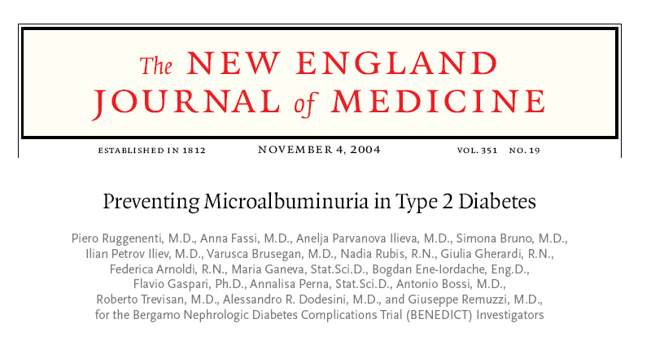
N Engl J Med 2004; 351:1941-1951

Slide 31
Conclusions In subjects with type 2 diabetes and hypertension but with normoalbuminuria, the use of trandolapril plus verapamil and trandolapril alone decreased the incidence of microalbuminuria to a similar extent. The effect of verapamil alone was similar to that of placebo

Slide 39
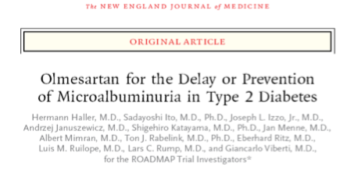
ROADMAP TRIAL
2011

Slide 40
IRMA 2 Primary Endpoint Time to Overt Proteinuria
20
Control
Irbesartan 150 mg
Irbesartan 300 mg
15
Subjects
(%)
10
5
0
0
3
6
12
18
22
24
Follow-up (mo)
Parving H-H, et al. N Engl J Med 2001;345:870-878.
Notes:
IRMA 2 is a positive study, demonstrating a 70% risk reduction for the primary endpoint (prevention or slowing of progression to overt diabetic nephropathy), independent of the effects of irbesartan on systemic blood pressure.
A clear dose response is observed in IRMA 2 for the primary endpoint.¹ The irbesartan 150 mg group demonstrates a 39% relative risk reduction (RRR) vs. the control group (placebo in addition to other nonexcluded antihypertensive therapies) in the development of overt proteinuria (urinary albumin excretion rate [AER] > 200 μg/min, or 300 mg/day, and an increase of urinary AER from baseline by at least 30%), p=0.08. The irbesartan 300 mg group demonstrates a highly significant 70% RRR vs. the control group, p<0.001. The Kaplan-Meier curves separate at the first visit (at 3 months) and continue to diverge.
After adjustment for the baseline level of microalbuminuria and the achieved blood pressure during the study, the benefits of irbesartan in slowing progression to overt proteinuria are still present: RRR of 44% for irbesartan 150 mg vs. the control group (p=0.05); RRR of 68% for irbesartan 300 mg vs. the control group (p<0.001).
¹ Parving et al, 2001a.

Slide 41
IRMA 2 Normalization of Urinary Albumin Excretion Rate
45
P=0.006
40
35
34
30
25
24
Subjects (%)
21
20
15
10
5
0
Control (n=201)
150 mg (n=195)
300 mg (n=194)
Irbesartan
Parving H-H et al. N Engl J Med. 2001;345:870-878.
Notes:
Regression to normoalbuminuria (< 20 μg/min, or < 30 mg/day) at the last visit was more frequent in the patients treated with irbesartan 300 mg than in the control (placebo in addition to other antihypertensive therapies) group (34% vs. 21%, respectively, p=0.006).

Slide 42
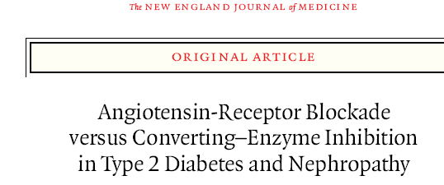
Telmisartan is not inferior to enalapril in providing long-term renoprotection in persons with type 2 diabetes and early nephroapthy
The DETAIL (Diabetics Exposed to Telmisartan and Enalapril) study was designed to demonstrate that the renoprotective effect of telmisartan an angiotensin II–receptor blocker, was similar (i.e., not inferior) to that of once-daily enalapril

Slide 43
IDNT: Changes in Proteinuria
Placebo
Amlodipine
10 mg/d
Irbesartan
300 mg/d
-0.1
-0.1±2.9
-0.3
-0.3±4.3
-0.5
Δ UPE
(g/24h)
-0.7
-0.9
-1.1
-1.1±2.7
-1.3
P = NS
P < .0001
-1.5
P < .0001
Lewis EJ et al. N Engl J Med. 2001;345:851-860.

Slide 44
Primary Endpoint: IDNT Time to Doubling of Serum Creatinine, ESRD, or Death
70
Irbesartan
Amlodipine
Control
RRR 23% P=0.006
60
RRR 20% P=0.024
50
RRR –4% P=NS
40
Subjects reaching primary endpoint (%)
30
20
10
0
0
6
12
18
24
30
36
42
48
54
60
Follow-up (mo)
Lewis EJ et al. N Engl J Med 2001;345:851-860.

Slide 46
RENAAL
Reduction of Endpoints in NIDDM with the AII Antagonist Losartan
An investigator initiated, multicenter, triple-blind, randomized, placebo-controlled study to evaluate the renal protective effects of losartan in patients with Type 2 diabetes and nephropathy
1513 Patients; 250 Centers; 29 Countries
Brenner BM et al J Renin-Angio-Aldo System 2000;1(4):328-335.

Slide 47
ARBs and progression of CKD-RENAAL study
Placebo
30
RR 25%
p=0.006
Losartan
Doubling of serum creatinine (%)
20
10
40
20
Placebo
Change in the level of proteinuria (%)
0
Text
–20
p<0.001
–40
Losartan
–60
Placebo
30
RR 28%
p=0.002
End-stage renal disease (%)
Losartan
20
10
0
0
12
24
36
48
Month
Brenner et al N Engl J Med 2001

Slide 49
Combining ACEI + ARBs

Slide 51
2000, 321; 1440

Slide 53
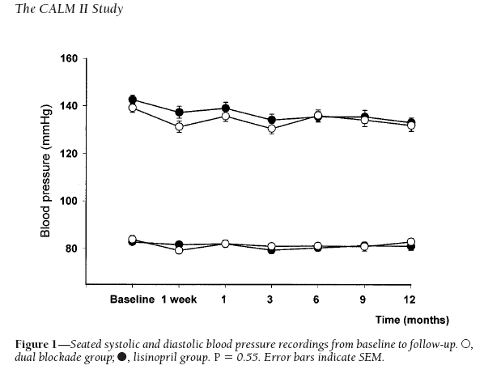
Lisinopril 40 mg
Candersartan 16 mg + Lisinopril 20 mg

Slide 54
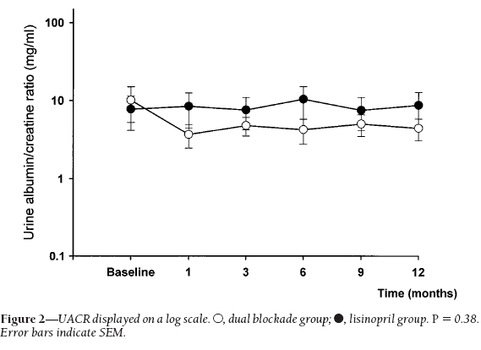
CALM II

Slide 57
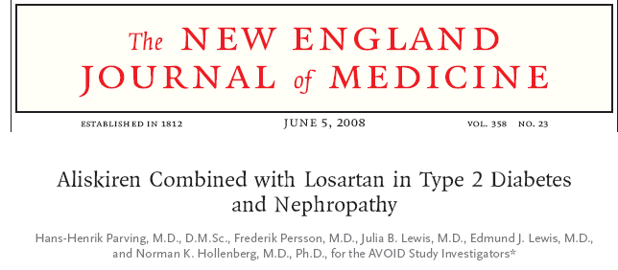

Slide 58
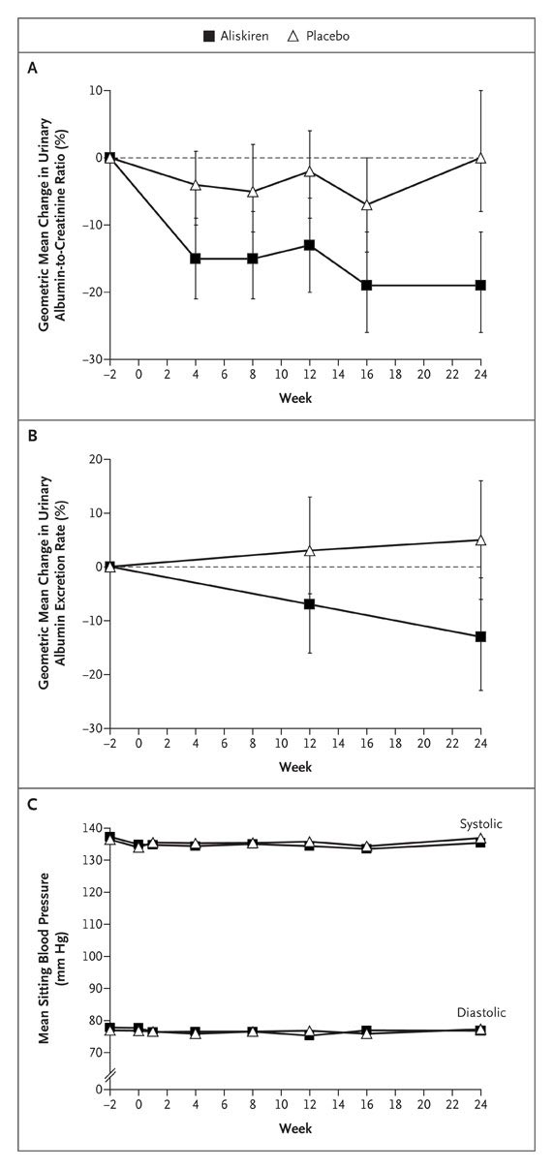
Changes from Baseline in the Urinary Albumin-to-Creatinine Ratio, Urinary Albumin Excretion Rate, and Blood Pressure According to Study Group
Parving HH et al. N Engl J Med 2008;358:2433-2446
Notes:
Figure 2. Changes from Baseline in the Urinary Albumin-to-Creatinine Ratio, Urinary Albumin Excretion Rate, and Blood Pressure According to Study Group. The percentage change from baseline (2 weeks before randomization), in the geometric mean, with 95% confidence intervals, is shown for the ratio of urinary albumin to creatinine (Panel A), overnight urinary albumin excretion rate (Panel B), and mean blood pressure, measured while the patient was seated (Panel C). The data show a dose-dependent effect of aliskiren on albuminuria.

Slide 59
Conclusion
Aliskiren may have renoprotective effects that are independent of its blood-pressure−lowering effect in patients with hypertension, type 2 diabetes, and nephropathy who are receiving the recommended renoprotective treatment

Slide 60
Aliskiren Neutralizes the Rise in PRA Induced by an ARB
Geometric mean change from baseline in PRA at Week 8 (%)
300
*‡
200
160
100
18
0
n=51
n=59
n=51
n=61
–73
–44
−100
Placebo
**‡
Valsartan 320 mg
**
Aliskiren 300 mg
Aliskiren/valsartan 300/320 mg
*p<0.001, **p<0.0001 vs placebo
‡p<0.0001 vs aliskiren/valsartan combination
Yarows SA, et al. 2007 (Study 2327).
Notes:
This was a double-blind, randomized, placebo and active-controlled 8-week trial in 1797 patients with mild-to-moderate hypertension (defined as mean sitting diastolic blood pressure [MSDBP] ≥95 mmHg and <110 mmHg).
Following a washout period of 1–2 weeks, patients underwent a single-blind placebo run-in period lasting 3–4 weeks. Patients with MSDBP ≥95 mmHg and <110 mmHg were randomized to receive aliskiren 150 mg, valsartan 160 mg, aliskiren 150 mg with valsartan 160 mg, or placebo, once daily. After 4 weeks of treatment, the dosages of aliskiren and valsartan were doubled for the final 4 weeks of the study. Plasma renin concentration (RC), plasma renin activity (PRA) and plasma aldosterone levels were assessed in a subset of 222 patients (placebo, n=51; aliskiren, n=51; valsartan, n=59; aliskiren/valsartan combination, n=61 [n=60 for RC]).
Monotherapy with valsartan 320 mg produced a significantly greater increase in PRA at the Week 8 endpoint compared with placebo (160% vs 18%, respectively; p<0.001). In contrast, aliskiren 300 mg significantly reduced PRA compared to placebo when administered alone (-73%; p<0.0001) and in combination with valsartan 320 mg (-44%; p<0.0001). The change in PRA from baseline produced by aliskiren/valsartan 300/320 mg combination therapy was significantly different compared to that produced by valsartan 320 mg monotherapy (-44% vs 160%, respectively; p<0.0001).
Abbreviations
MSDBP = mean sitting diastolic blood pressure
PRA = plasma renin activity
RC = renin concentration
Reference
Yarows SA, Oparil S, Patel S, et al. Suppression of the renin system with the oral direct renin inhibitor aliskiren alone and in combination with valsartan in patients with hypertension Poster presented at ESH 2007.

Slide 61
Aliskiren Neutralizes The Rise In PRA Induced By An ACE Inhibitor
Change in PRA from baseline (%)
*
120
111
100
80
60
40
20
0
n=74
n=79
n=75
−20
−40
−60
−44
−80
−68
*
†
*
Aliskiren monotherapy
Ramipril monotherapy
Aliskiren/ramipril combination
*p<0.001 vs baseline
†p<0.05 vs aliskiren monotherapy and ramipril monotherapy
Kilo C, et al. 2006 (Study 2307).
Notes:
A total of 837 patients with diabetes were randomized in this double-blind study to receive double-blind once-daily treatment with aliskiren 150 mg, ramipril 5 mg, or the combination of aliskiren 150 mg and ramipril 5 mg. After 4 weeks of treatment, all patients were force-titrated to elevated doses of their respective treatments (aliskiren 300 mg, ramipril 10 mg or aliskiren 300 mg and ramipril 10 mg, once daily) for an additional 4 weeks. Plasma renin activity (PRA) and renin concentration (RC) were assessed in a subgroup of patients.
By study endpoint, PRA was significantly increased from baseline with ramipril monotherapy (111%; p<0.001 vs baseline). In contrast, aliskiren monotherapy produced a statistically significant reduction from baseline in PRA of 68% (p<0.001). When combined, aliskiren neutralized the ramipril-induced increase in PRA, leading to an overall reduction from baseline in PRA of 44% (p<0.05 vs both aliskiren and ramipril monotherapies).
Abbreviations
ACEI = angiotensin converting enzyme inhibitor
RC = renin concentration
PRA = plasma renin activity
Reference
Kilo C, Taylor A, Tschoepe D, et al. Aliskiren, a novel renin inhibitor for treatment of hypertension, enhances renin system suppression by reducing plasma renin activity alone or in combination with ramipril in patients with diabetes. Eur Heart J 2006;27(Suppl):118-9 P-789.
Uresin Y, Taylor A, Kilo C, et al. Aliskiren, a novel renin inhibitor, has greater BP lowering than ramipril and additional BP lowering when combined with ramipril in patients with diabetes and hypertension. J Hypertens 2006;24(Suppl 4):S82(P-269).

Slide 62
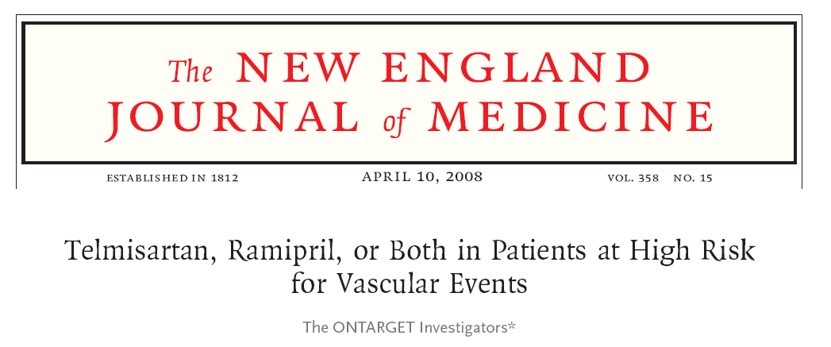

Slide 64
Inhibition of the progression of diabetic nephropathy by ARBs or ACE inhibitors
Angiotensin receptor blockers
INNOVATION
IRMA-2
MARVAL
IDNT RENAAL
AMADEO
VIVALDI
LIFE-Diabetes
DETAIL
TRENDY
Type-2-Diabetes
Hypertension
Endothelial
Dysfunction
Micro
Albuminuria
Impaired
Renal
Function
Albuminuria
ESRD
TRENDY
DETAIL
??
BENEDICT
MICRO HOPE
ACE inhibitors
Timeframe up to 25 years
Adapted from Mitch W.E., N Engl J Med 2004;351:1934–1936; Ruilope L.M.,
Acta Diabetol 2005;42:S33–S41;Schmieder R.E., J Hypertens Suppl 2006;24:S31–S35
Notes:
Inhibition of the Progression of Diabetic Nephropathy by ARBs or ACE inhibitors
Renal function is closely associated with cardiovascular risk, to such an extent that even minor renal abnormalities, (present in 10% of the general population) carry a greatly elevated risk of cardiovascular disease, target-organ damage and death.
In patients with severe hypertension and advanced renal disease, reducing blood pressure by 20 mmHg or more (>160/100 mmHg) is sufficient to ensure a considerable reduction in proteinuria.
Clinical studies have shown that blockade of the renin–angiotensin system (RAS) with either ACE inhibitors or ARBs is cardio- and renoprotective in both diabetics and non-diabetics at later stages of the disease, but the impact of blockade of the RAS at earlier stages of disease is unknown.
There is considerable debate as to which class of drugs is more effective, but the evidence to date certainly favours ARBs for providing more effective renoprotection in patients at risk of diabetic nephropathy. Over the 25 years of research shown here, it would seem that ARBs are more effective at preventing the onset of diabetic nephropathy and also reversing its progress than ACE inhibitors.
The ARBs preserve renal haemodynamics and reduce progression to end-stage renal disease by around 25% in patients with overt nephropathy and prevent progression to overt disease by up to 70% in patients with mild renal impairment.
The combination of ARBs and ACE inhibitors seems to provide an even greater level of protection, halving the number of patients with progression of renal impairment compared with either monotherapy.
Long-term clinical studies like the ONTARGET trial programme will help to establish the relative efficacies of the ARBs and ACE inhibitors and provide greater insight into the benefits of combination therapy.
Reference
Schmieder R.E. Endothelial dysfunction: how can one intervene at the beginning of the cardiovascular continuum? J Hypertens.Suppl. 2006; 24:S31–S35
Ruilope,L.M. Renin-angiotensin-aldosterone system blockade and renal protection: angiotensin-converting enzyme inhibitors or angiotensin II receptor blockers? Acta Diabetol. 2005; 42:S33-S41

Slide 65
Managed Equipment Services Project Ministry of Health Kenya Renal Haemodialysis Support to the Counties

Slide 66
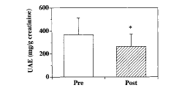
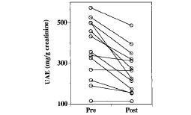
Effect of spironolactone on diabetic nephropathy
Effectiveness of Aldosterone Blockade in Patients With Diabetic Nephropathy
Atsuhisa Sato, Hypertension 2003

Slide 67
PLANET I: Summary of renal adverse events (%)
Adverse event | Rosuvastatin 10 mg/day (n = 116) | Rosuvastatin 40 mg/day (n = 123) | Atorvastatin 80 mg/day (n = 110) | p
Any renal adverse event | 7.8 | 9.8 | 4.5 | NS
Acute renal failure | 0.0 | 4.1 | 0.9 | <0.05
Serum creatinine doubling | 0.0 | 4.9 | 0.0 | <0.01
Serum creatinine doubling or acute renal failure | 0.0 | 7.3 | 0.9 | <0.01
de Zeeuw D. 2010European Renal Association-European Dialysis and Transplant Association Congress; June 27, 2010; Munich, Germany.

Slide 70
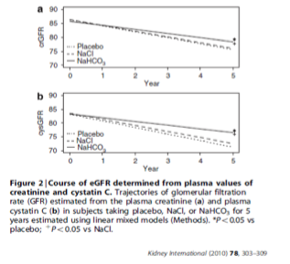
CKD and Bicarbonate Supplementation
Mahajan et al, 2010

Slide 73
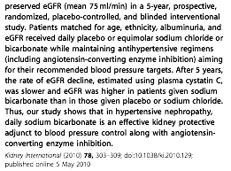

Slide 75
Original Article Bardoxolone Methyl (an oral antioxidant inflammation modulator) and Kidney Function in CKD with Type 2 Diabetes
Pablo E. Pergola, M.D., Ph.D., Philip Raskin, M.D., Robert D. Toto, M.D., Colin J. Meyer, M.D., J. Warren Huff, J.D., Eric B. Grossman, M.D., Melissa Krauth, M.B.A., Stacey Ruiz, Ph.D., Paul Audhya, M.D., Heidi Christ-Schmidt, M.S.E., Janet Wittes, Ph.D., David G. Warnock, M.D., for the BEAM Study Investigators
N Engl J Med
Volume 365(4):327-336
July 28, 2011

Slide 76
Study Overview
Adults with type 2 diabetes and CKD were assigned to receive bardoxolone methyl at a dose of 25 mg, 75 mg, or 150 mg once daily or placebo.
Drug treatment was associated with improved estimated GFR, a finding that persisted throughout the 52-week treatment period.

Slide 77
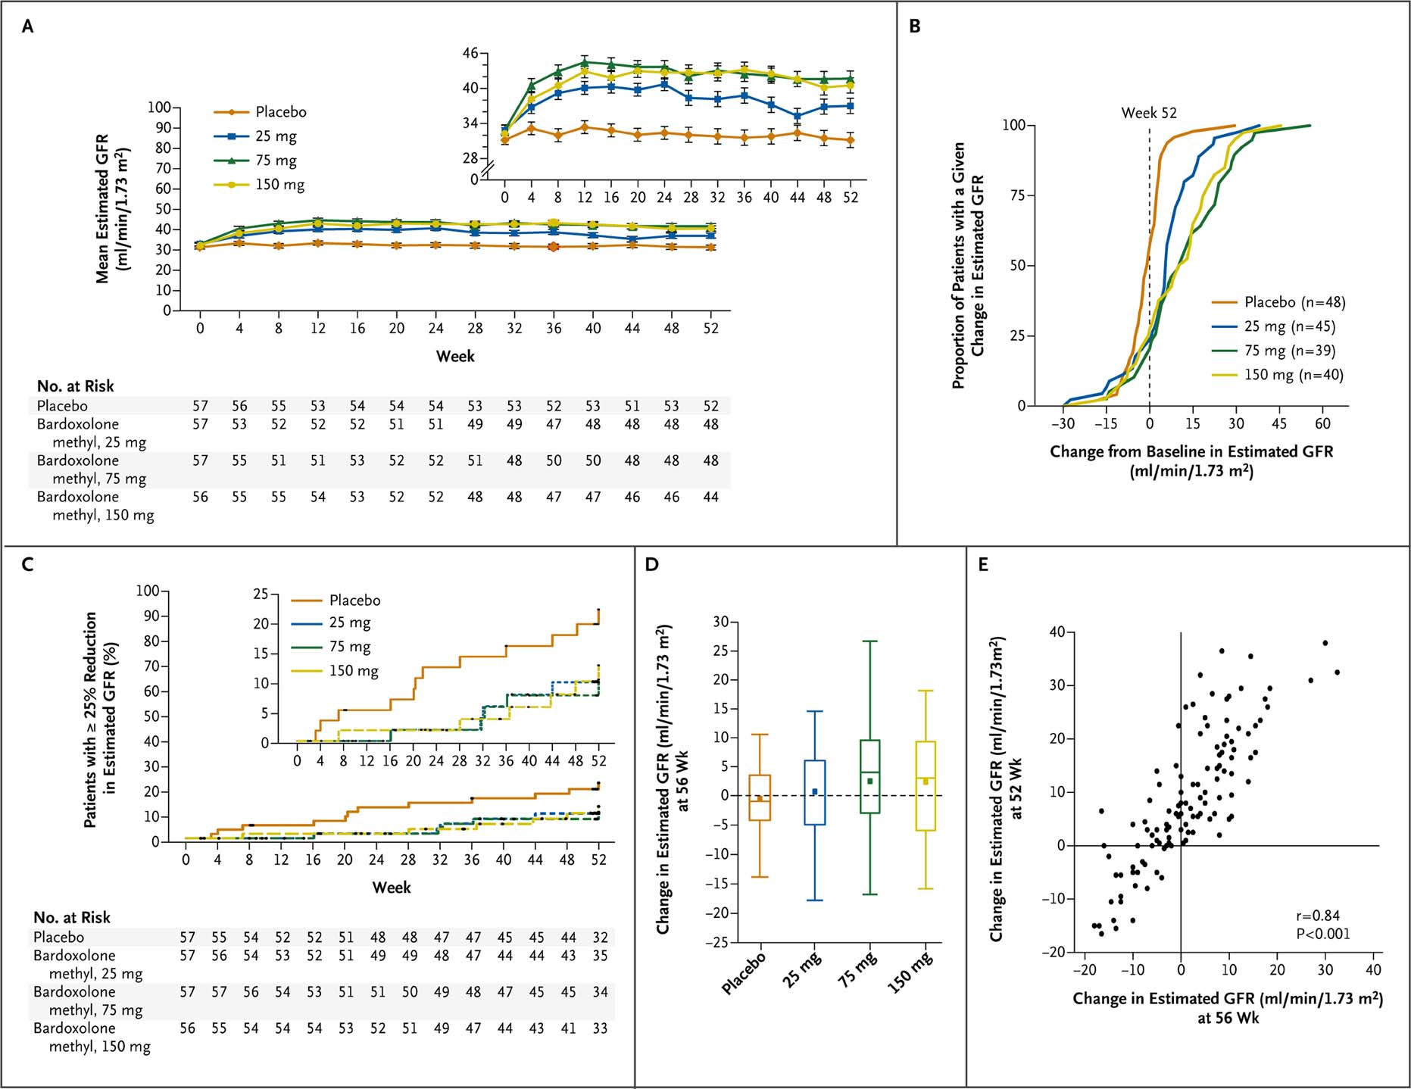
Effects of Bardoxolone Methyl on the Estimated Glomerular Filtration Rate (GFR).
Pergola PE et al. N Engl J Med 2011;365:327-336
Notes:
Figure 1 Effects of Bardoxolone Methyl on the Estimated Glomerular Filtration Rate (GFR). Panel A shows a repeated-measures model of the mean estimated GFR over time in the intention-to-treat population, with a limited range shown in the inset graph to highlight differences between groups. Significant differences in the change from baseline in the estimated GFR in each bardoxolone methyl group, as compared with the placebo group, were observed at 24 weeks (P<0.001 for all comparisons) and at 52 weeks (P=0.002 for the comparison with the 25-mg group and P<0.001 for the comparisons with the 75-mg and 150-mg groups). The I bars indicate standard errors. Panel B shows the cumulative distribution of changes in the estimated GFR at 52 weeks for patients who completed 52 weeks of study. Panel C shows the time to the first reduction in the estimated GFR of 25% or more through 52 weeks, with a limited range shown in the inset graph to highlight between-group differences. The numbers of patients at risk (i.e., patients who were still being followed and did not have a 25% decline in the estimated GFR) during each 4-week period are presented below the x axis. The difference between all 170 patients receiving bardoxolone methyl and the 57 patients receiving placebo had borderline significance (P=0.05 by the log-rank test); the differences between the dose-specific groups and the placebo group were not significant (25-mg group, P=0.13; 75-mg group, P=0.12; and 150-mg group, P=0.22). Points at which data were censored are indicated by solid circles. Panel D shows the distribution of the change from baseline in the mean estimated GFR at 56 weeks (4 weeks after study-drug discontinuation) for 48 patients in the placebo group, 45 patients in the 25-mg group, 39 patients in the 75-mg group, and 40 patients in the 150-mg group. The open box displays the interquartile range. The bar within the box is the median, and the solid square is the mean. The lower whisker indicates the smallest observed value that is at least 1.5 times the interquartile range below the 25th percentile. The upper whisker indicates the largest observed value that is at least 1.5 times the interquartile range above the 25th percentile. Panel E shows the correlation between the change in the estimated GFR at 52 weeks and the change at 56 weeks (r=0.84, P<0.001).

Slide 78
Conclusions
Bardoxolone methyl was associated with improvement in the estimated GFR in patients with advanced CKD and type 2 diabetes at 24 weeks.
The improvement persisted at 52 weeks, suggesting that bardoxolone methyl may have promise for the treatment of CKD.

Slide 79
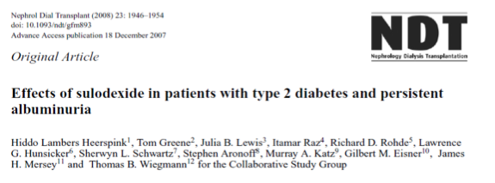

Slide 81
Original Article Glucose Control and Vascular Complications in Veterans with Type 2 Diabetes
William Duckworth, M.D., Carlos Abraira, M.D., Thomas Moritz, M.S., Domenic Reda, Ph.D., Nicholas Emanuele, M.D., Peter D. Reaven, M.D., Franklin J. Zieve, M.D., Ph.D., Jennifer Marks, M.D., Stephen N. Davis, M.D., Rodney Hayward, M.D., Stuart R. Warren, J.D., Pharm.D., Steven Goldman, M.D., Madeline McCarren, Ph.D., M.P.H., Mary Ellen Vitek, William G. Henderson, Ph.D., Grant D. Huang, M.P.H., Ph.D., for the VADT Investigators
N Engl J Med
Volume 360(2):129-139
January 8, 2009

Slide 83
Conclusion
Intensive glucose control in patients with poorly controlled type 2 diabetes had no significant effect on the rates of major cardiovascular events, death, or microvascular complications, with the exception of progression of albuminuria (P = 0.01)

Slide 84
Original Article Intensive Blood Glucose Control and Vascular Outcomes in Patients with Type 2 Diabetes
The ADVANCE Collaborative Group
N Engl J Med
Volume 358(24):2560-2572
June 12, 2008

Slide 85
Primary end-point Combined major macro or microvascular event
Intensive
Standard
Favours
Favours
Relative risk
Combined macro+mico
(n=5,571)
(n=5,569)
Intensive
Standard
reduction (95% CI)
1009
(18.1%)
1116
(20.0%)
10% (2 to 18)
*
Macrovascular
557
(10.0%)
590
(10.6%)
6% (-6 to 16)
Microvascular
526
(9.4%)
605
(10.9%)
14% (3 to 23)
**
0.5
1.0
2.0
Hazard ratio
*2P=0.013
**2P=0.014
ADVANCE collaborative group. NEJM, published on line June 6th
Notes:
ADVANCE, with more than 11 000 patients, is the largest ever prospective study carried out in type 2 diabetes for the prevention of vascular disease.

Slide 86
Major microvascular events
*
**
*2P=0.014
**2P=0.006
ADVANCE collaborative group. NEJM, published on line June 6th
Notes:
ADVANCE, with more than 11 000 patients, is the largest ever prospective study carried out in type 2 diabetes for the prevention of vascular disease.

Slide 87
Conclusion
A strategy of intensive glucose control, involving gliclazide (modified release) and other drugs as required, that lowered the glycated hemoglobin value to 6.5% yielded a 10% relative reduction in the combined outcome of major macrovascular and microvascular events, primarily as a consequence of a 21% relative reduction in nephropathy

Slide 89
DCCT

Slide 92
Diabetes: Tight Glucose vs Tight BP Control and CV Outcomes in UKPDS
Stroke
Any Diabetic
Endpoint
DM
Deaths
Microvascular
Complications
0
5%
10%
-10
12%
-20
24%
% Reduction In Relative Risk
*
-30
32%
32%
*
37%
*P <0.05 compared to tight glucose control
-40
*
44%
Tight Glucose Control
(Goal <6.0 mmol/l or 108 mg/dL)
Tight BP Control
(Average 144/82 mmHg)
*
-50
Bakris GL, et al. Am J Kidney Dis. 2000;36(3):646-661.

Slide 94
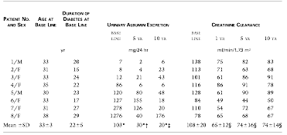

Slide 95
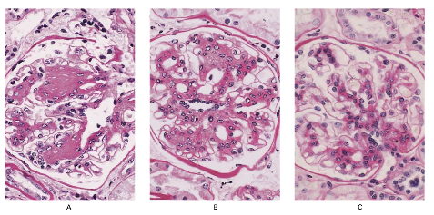

Slide 96
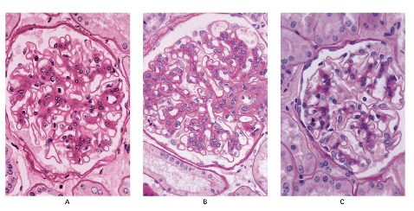

Slide 97
The optimal blood pressure target in patients with CKD is not clear

Slide 106
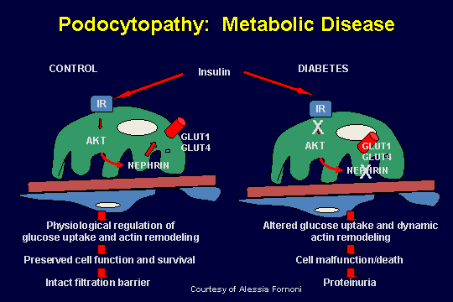

Slide 107
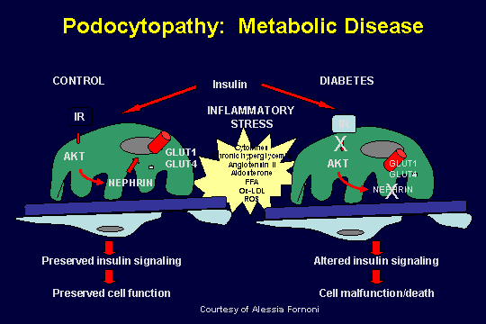

Slide 136
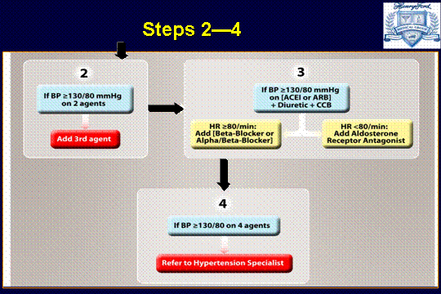

Slide 145
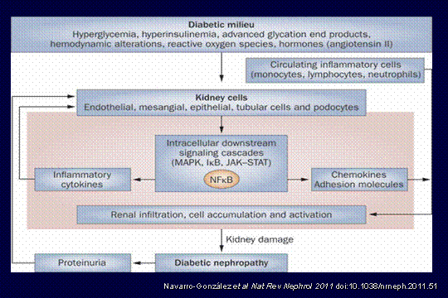

Slide 176
THANK YOU

