Slide 1
CNS Infections
Dr. Thomas Kwasa

Slide 2
Causative Agents
Prion Proteins-Slow “viral” diseases: Kuru, Scrapie, CJD, SSE, Mad cow disease etc.
Viruses-Acute and chronic, SSPE, HSE, CMV, HIV meningo-encephalitis, Transverse Myelitis, Rabies, Aseptic meningitis etc.
Bacteria-Pyogenic meningitis, TBM, Brain abscess, etc.
Fungi-Cryptococcal Meningitis etc.
Protozoa-Amoebic meningitis, Toxoplasmosis, cerebral malaria etc.

Slide 3
Clinical Presentation of CNS infections
Tends to produce meningoencephalitis or meningomyelitis.
Bacterial-MENINGOencephalitis.
Viral/toxo-meningoENCEPHALITIS/meningoMYELITIS (transverse myelitis).
TBM, Cryptococcoma,Toxo, e.t.c-ICSOL-focal neurological deficits+ raised ICP+ altered sensorium+Seizures.

Slide 4
Clinical Presentation of Meningitis
Headaches-frontal, occipital/nuchal, global.
Fever-very high temperatures in acute meningitis esp. bacterial. Less so in chronic cases and viral, fungal.
Vomiting-projectile without nausea esp. with increased ICP.
Neck stiffness, Positive Kernig’s, Brudzinski’s signs.
Dermopathy esp. in Meningococcal meningitis.
Photophobia.

Slide 5
Clinical Presentation of Encephalitis/ICSOL
Fever
Focal neurological deficits
Seizures
Mental confusion/disruption of cognitive function
Reduced sensorium/disorientation leading to coma.

Slide 6
Sources of Organisms causing Meningoencephalitis
Blood stream from a distant focus or septicaemia e.g. pneumonia, UTI, HS II, indwelling Foley’s, venous access sites.
Contiguous spread from chronic infective foci e.g. CSOM, retropharyngeal abscess, rhino-sinusitis, facial pimples.
Airborne from nasal secretions from a carrier-esp. in epidemic meningitis.
Following neurosurgical procedures and trauma breaching the subarachnoid space e.g. craniotomy or fracture of base of skull with CSF otorrhea, or rhinorrhea.

Slide 7
Sources of Organisms Causing Meningoencephalitis-II
5. Transfer through peripheral nerves- HSV I from the face, Rabies from inoculation site. These cause encephalitis rather than meningitis.
6. Environment/ contact e.g. nigleria(haemorrhagic CSF) , kuru(cannibalism), CJD(corneal transplant), consumption of meat from mad cow disease(US/European meat wars)-spongiform encephalitis with dementia and ataxia.
7.Through food e.g neurocysticercosis-Taenia solium.

Slide 8
Some Viral Infections of CNS
Rabies
Haemorrhagic encephalopathies-yellow fever, Ebola,
Poliomyelitis
Measles
Influenza
Varicella
Rubella
Mumps

Slide 9
Causes of Recurrent Meningitis
Anatomic communications-e.g. Para nasal sinuses, skin(congenital midline dermal sinus tracts, acne), incomplete fusion of neuro-tube structures.
Para meningeal foci- e.g. retropharyngeal abscess, spinal epidural abscess.
Immunologic defects-e.g. AIDS, hypogammaglobulinaemia, splenectomy, leukemia, lymphoma, SCD, compliment deficiencies.

Slide 10
Clinical Evaluation and Diagnosis-I
History- complaints with duration e.g. hdx lasting for years is unlikely to be due to CNS infection, h/o others with similar s/s in the locality.
P/E- s/s of meningeal irritation, s/s of increased ICP, fundoscopy, focal deficits(including CN palsies).
Blood counts(with differentials).
Blood cultures-gram positives & negatives.-50% pts with bacterial meningitis have positive B/C.

Slide 11
Clinical Evaluation and Diagnosis-II
5. LP-after fundoscopy and informed consent( If not sure, do brain CT scan to exclude mass lesion), gross appearance, let CSF stand for a while, biochemistry, bacteriology, immunochemistry.
6. Serologic studies-e.g. Latex agglutination or counter immunoelectrophoresis (CIE)for Strep pneumoniae, N. meningitidis, H. influenzae, L. monocytogenes.
7. Viral studies-HIV, Herpes, etc.
8. Imaging- CT Scans, MRI Scans of brain, spine etc., as determined from the clinical evaluation.

Slide 12
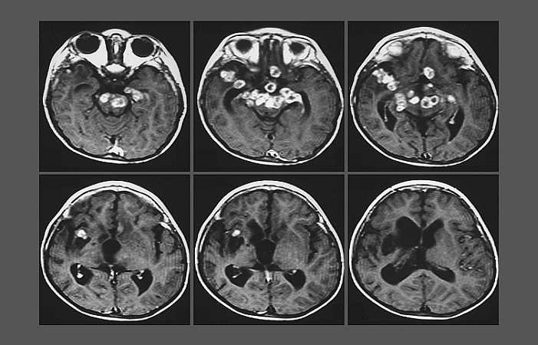
Multiple tuberculous abscesses

Slide 13
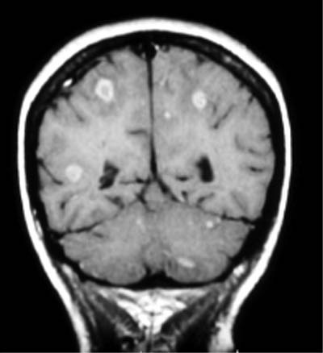
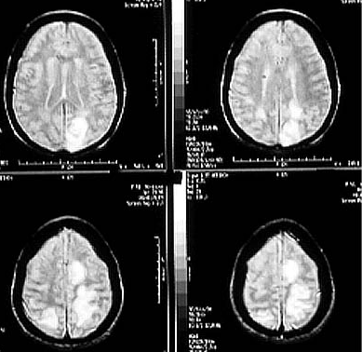
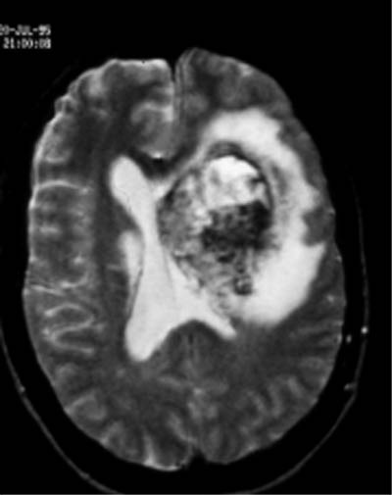
TOXOPLASMOSIS

Slide 14
CSF Findings-I
CSF sugar low in bacterial, cryptococcal, tuberculous, syphilitic- meningitis, neurosarcoidosis, and meningeal carcinomatosis.
2. CSF sugar is normal in viral meningitis.
CSF proteins high in bacterial meningitis, very high in TBM, only mildly elevated or normal in viral meningitis.
CSF WBC high in viral, bacterial meningitis( lymphocytic pleocytosis in viral meningitis and TBM).
Gram stain positive in gram-+ and Gram-- bacterial and negative in viral meningitis.

Slide 15
CSF Findings-II
6. AAFB +ve in TBM
7. India ink stain +ve in Crypto meningitis.
8. Crypto Antigen & Ab. +ve in crypto mening.
9. T. gondii bodies and amobae in CSF.
10. T. gondii ab.
11. CSF cultures positive even some hours after commencing antibiotics.
12. CSF is typically normal in prion diseases.

Slide 16
Treatment of CNS Infections 1
Prion diseases- no specific treatment-supportive.
HSV encephalitis- acyclovir/gancyclovir/famcyclovir/valacyclovir etc.
HIV- HAART- watch for IRIS especially when treating crypto. or TBM in HIV co-infection.
Steroid therapy may reduce chances and severity of post herpetic neuralgia in HZ eruptions(shingles)-adenine arabinoside for those with immunosuppression. Acyclovir also useful. Carbamazepine and other AEDs is useful in post herpetic pain.

Slide 17
Treatment of CNS Infections 2
5. Bacterial meningitis-antibiotics as per C/S profile,-IV.
6. Steroids useful in TBM, bacterial mening. in children
Steroids useless/contraindicated in Crypto mening., cerebral malaria
Repeated LP in Cryp mening. improves outcome and mortality.

Slide 18
Treatment of CNS infections 3
9. Cryp. Mening. Amphotericin B + Fluconazole= good BBB penetration.
10. Toxo-Sulfadiazine+Pyrimethamine combo.+ leucovorin to correct the antifolate effects of pyrimethamine.

