Slide 1
Investigation of the nervous system

Slide 2
Investigation in neurology
Where is it
Neurophysiology and neuroanatomy
What is it
history
Epidemiology

Slide 3
Investigation in neurology
Helps to answer the question which has been raised

Slide 4
Neurophysiological tests
EEG
Nerve conduction studies
EMG
Evoked potential
Visual
Somatosensory
auditory

Slide 5
EMG and Nerve Conduction Studies
An extension of the Physical Examination
Quantitates nerve and/or muscle injury
Provides Useful Data Regarding Nerve Injury
Site
Type
Severity
Duration
Prognosis

Slide 6
Importance of EDX Studies
Diagnosis
Localization of the problem
Further test
Prognosis

Slide 7
Structure of Nervous system
Central nervous system (CNS)
Brain
Cerebrum
Cerebellum
Brainstem
Spinal cord
Peripheral nervous system (PNS)
Nerves
Cranial nerve 12 pairs
Spinal nerve 31 pairs

Slide 8
From Kumar: Robbins and Cotran: Pathologic Basis of Disease, 7th ed.
Notes:
Two motor neurons red and green. Two motor units. Motor unit a few fibers to a few thousand.
Axonal degeneration of green neuron. Denervation atrophy – ie. angular atrophic myocytes. CMAP is reduced.
Reinnervation of green motor unit territory by red – larger motor unit action potential duration and amplitude
EMG reduced interference pattern as a result of denervation
EMG high amplitude and duration as result of reinnervation, reduced interference, high frequency
Segmental demyelination. Conduction block produces weakness. Motor units remain histologically the same. EMG reduced recruitment but motor units normal size and amplitude.

Slide 9
Goals of EDX Testing
Localization
Severity
Muscle
NMJ
Nerve
Anterior Horn
Fiber type
Pathology
Temporal course
Adapted from fig 1-2, Preston and Shapiro

Slide 10
When to order NCSs and EMG
Mononeuropathy
Mononeuropathy Multiplex
Radiculopathy
Plexopathy (Brachial or Lumbosacral)
Anterior Horn Cell Disorders
Diffuse neuropathies
Cranial neuropathies
Neuromuscular Junction Disorders
Myopathy

Slide 11
Motor NCS Parameters
Distal Latency
determined by conduction velocity of the nerve, neuromuscular junction & muscle
Amplitude
determined by number of muscle fibers activated
Proximal conduction velocity
determined by conduction velocity of the fastest fibers

Slide 12
Analysis of MNCV
Amplitude
Duration
12

Slide 13
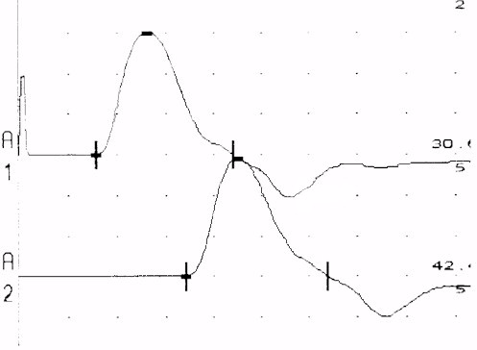
Normal Median Motor Study
DL CV Amp
(msec) (m/s) (mV)
Wrist-APB 3.2 15.0
Elbow-Wrist 55 14.8

Slide 14
Sensory NCS Parameters
Onset and peak latencies
Conduction velocity
determined by velocity of a very few fast fibers
Amplitude
determined by the number of large sensory fibers activated

Slide 15
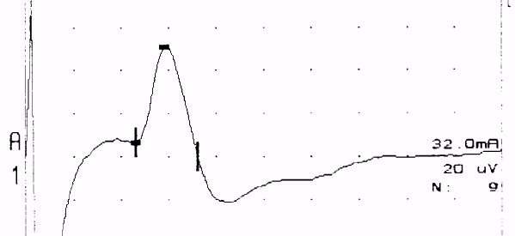
Normal Median Sensory Study
1 msec/div
Latency CV Amp
(msec) (m/s) (uV)
Wrist-D2 2.2 58 44.1

Slide 16
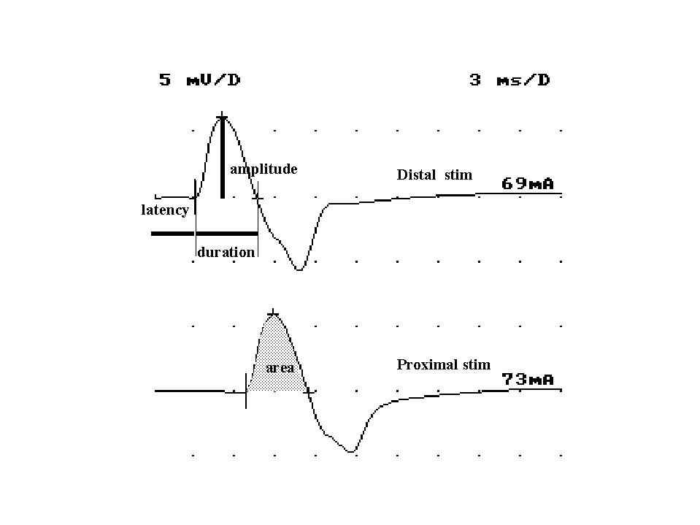
Motor Nerve Conductions
Vital part of EDX as this important for identifying demyelination, compression
Need to do proximal and distal studies to evaluate for conduction velocity, conduction block, temporal dispersion
Typical nerves: ulnar, median, peroneal, tibial.
Less common: radial, femoral, phrenic, spinal accessory, facial

Slide 17
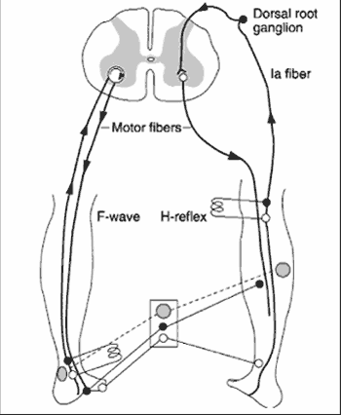
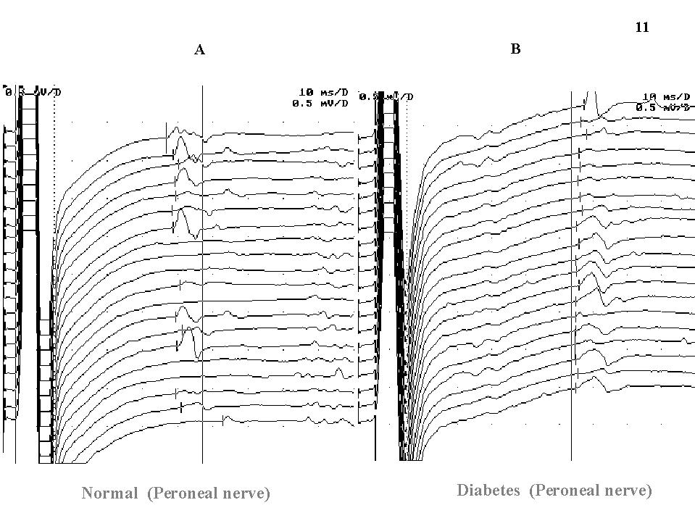
F-waves and H-reflex
Useful for identifying proximal segmental demyelination
Can only be done when motor amplitude is > 1 mV
Extremely height-dependent

Slide 18
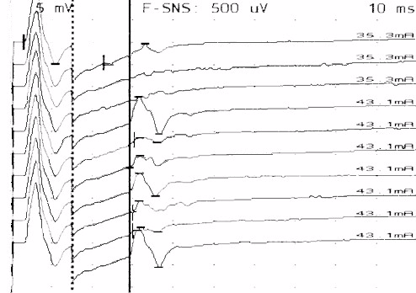
F Waves: Normal Median

Slide 19
Needle Electromyography: Techniques
Needle electrode is inserted into the muscle
Needle is disposable, single use
Multiple muscles are accessible for examination
Combination of muscles tested
Dependent upon clinical question
Level of discomfort is mild

Slide 20
Needle Electromyography: Data
Insertional Activity
Spontaneous Activity
Motor Unit Configuration
Motor Unit Recruitment
Interference Pattern

Slide 21
Needle Electromyography: Data
Motor Unit Configuration
Single motor unit: A motor axon and all its muscle fibers
Motor Unit Configuration: Amplitude, Duration, Morphology
Muscle is volitionally activated at different force levels
Needle recording properties enable assessment of single MUs
Motor Unit Recruitment
Pattern of motor unit activation with increasing volitional activation
Interference Patterns
Motor unit pattern with full voluntary activation

Slide 22
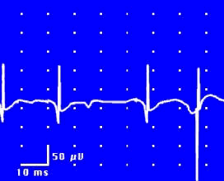
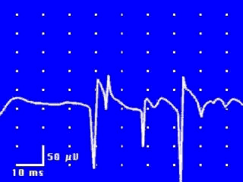
EMG: Spontaneous Activity
Fibrillation Potentials
Positive Sharp Waves

Slide 23
EMG: Spontaneous Activity
Fasciculation Potential

Slide 24
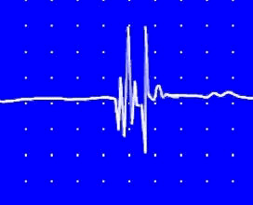
EMG: Neurogenic Motor Unit
10 msec/div, timebase
2MV/vertical segment

Slide 25
EMG Motor Unit Changes

Slide 26
Distance
d = 284 mm
Latency At elbow
L₁ = 8.5 ms
Latency At wrist
L₂ = 3.5 ms
26

Slide 27
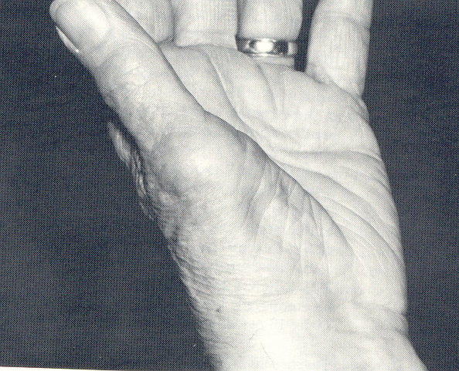
Carpal Tunnel Syndrome Atrophy of APB Muscle
Dawson,Hallett, Millender, 1990

Slide 28
Analysis of a motor unit potential (MUP)
MUP | NORMAL | NEUROGENIC | MYOPATHIC
Duration msec. | 3 – 15 msec | longer | Shorter
Amplitude | 300 – 5000 µV | Larger | Smaller
Phases | Biphasic / triphasic | Polyphasic | May be polyphasic
Resting Activity | Absent | Present | Present
Interference pattern | full | partial | Full
28

Slide 29
Guillain-Barre Syndrome Conduction Block

Slide 30
Model of Neuromuscular Junction

Slide 31
Myasthenia Gravis Repetitive Nerve Stimulation

Slide 32
Lambert-Eaton Syndrome Repetitive Nerve Stimulation

Slide 33
EEG
Record of spontaneous electrical activity generated in the cerebral; cortex
Record is a summation effects excitatory and inhibitory synaptic potentials.
Influenced by the thalamus and reticular activating system

Slide 34
EEG
Seizures
Sleep
Metabolic diseases
Specific encephalopathies
Brain death

Slide 35
Brain Waves: State of the Brain
Normal brain function involves continuous electrical activity
Patterns of neuronal electrical activity recorded are called brain waves

Slide 36
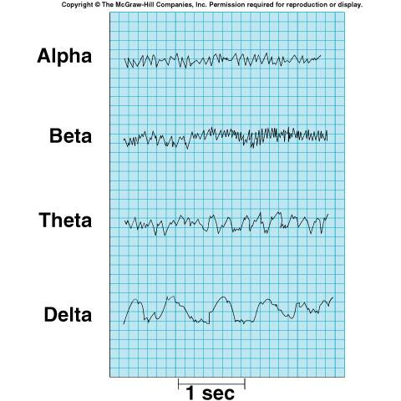
Electroencephalogram (EEG)

Slide 37
Brain waves change with age, sensory stimuli, brain disease, and the chemical state of the body
An electroencephalogram (EEG) records this activity
EEGs can be used to diagnose and localize brain lesions, tumors, infarcts, infections, abscesses, and epileptic lesions

Slide 38
Evoked potentials
Stimualtion opf sense organ or peripjheral nerve evokes corresponding cortical receptive areas

Slide 39
Visual evoked potential
Light waves in the retina intiatyes a discernible wave form over the occipital cortex
Occipital driving responses.
Best responses was by sudden change in a viewed checkerboard
Conduction delay disease of the optic nerve

Slide 40
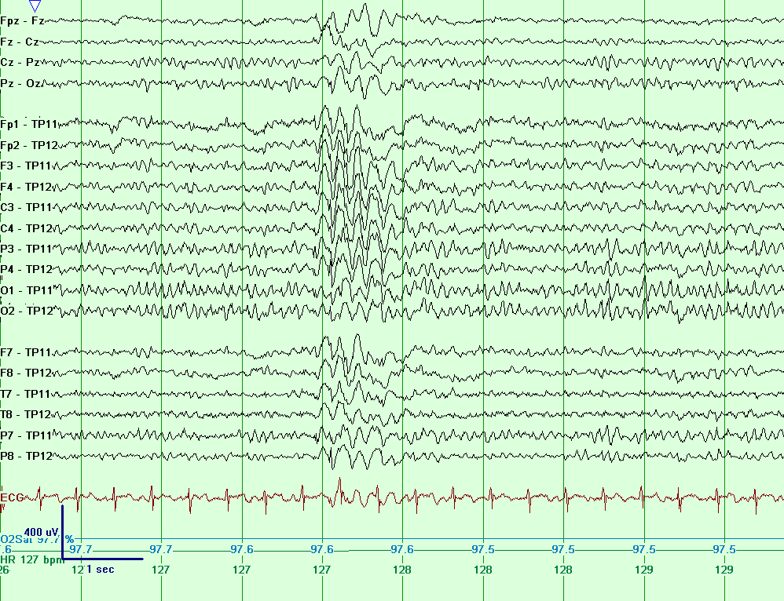
American Epilepsy Society 2015
E Slide 40
Notes:
Generalized atypical spike and wave, ipsilateral ear referential montage.
Copyright 2013. Mayo Foundation for Medical Education and Research. All rights reserved. Courtesy of Dr. Jeffrey W. Britton, MD.

Slide 41
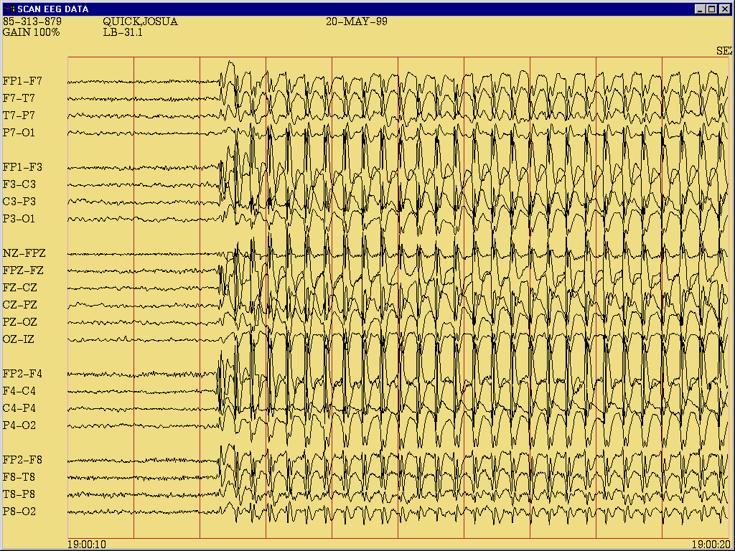
Notes:
Recorded absence seizure showing generalized 3.0-3.5 Hertz generalized spike and wave discharge, longitudinal bipolar montage.
Copyright 2013. Mayo Foundation for Medical Education and Research. All rights reserved. Courtesy of Dr. Jeffrey W. Britton, MD.

