Slide 1
BRONCHIECTASIS
LEVEL IV MEDICINE
BY: DR. J. O. MECHA
DATE: 16/9/2016

Slide 2
INTRODUCTION
Bronchiectasis and lung abscesses are referred to as suppurative lung diseases
Definition
Bronchiectasis is a chronic destructive lung disease characterized by:
  Abnormal and irreversible dilatation of the medium sized bronchi
  Persistent and variable inflammatory processes producing damage to the bronchial elastic and muscular elements
Clinically, bronchiectasis is characterized by a chronic cough and purulent sputum production.

Slide 3
EPIDEMIOLOGY
The burden of bronchiectasis has not been well characterized
Prevalence is influenced by:
  Access and uptake of childhood vaccination
  Prevalence of TB
  Treatment of respiratory tract infections
  Living conditions
  Availability of chest CT scan

Slide 4
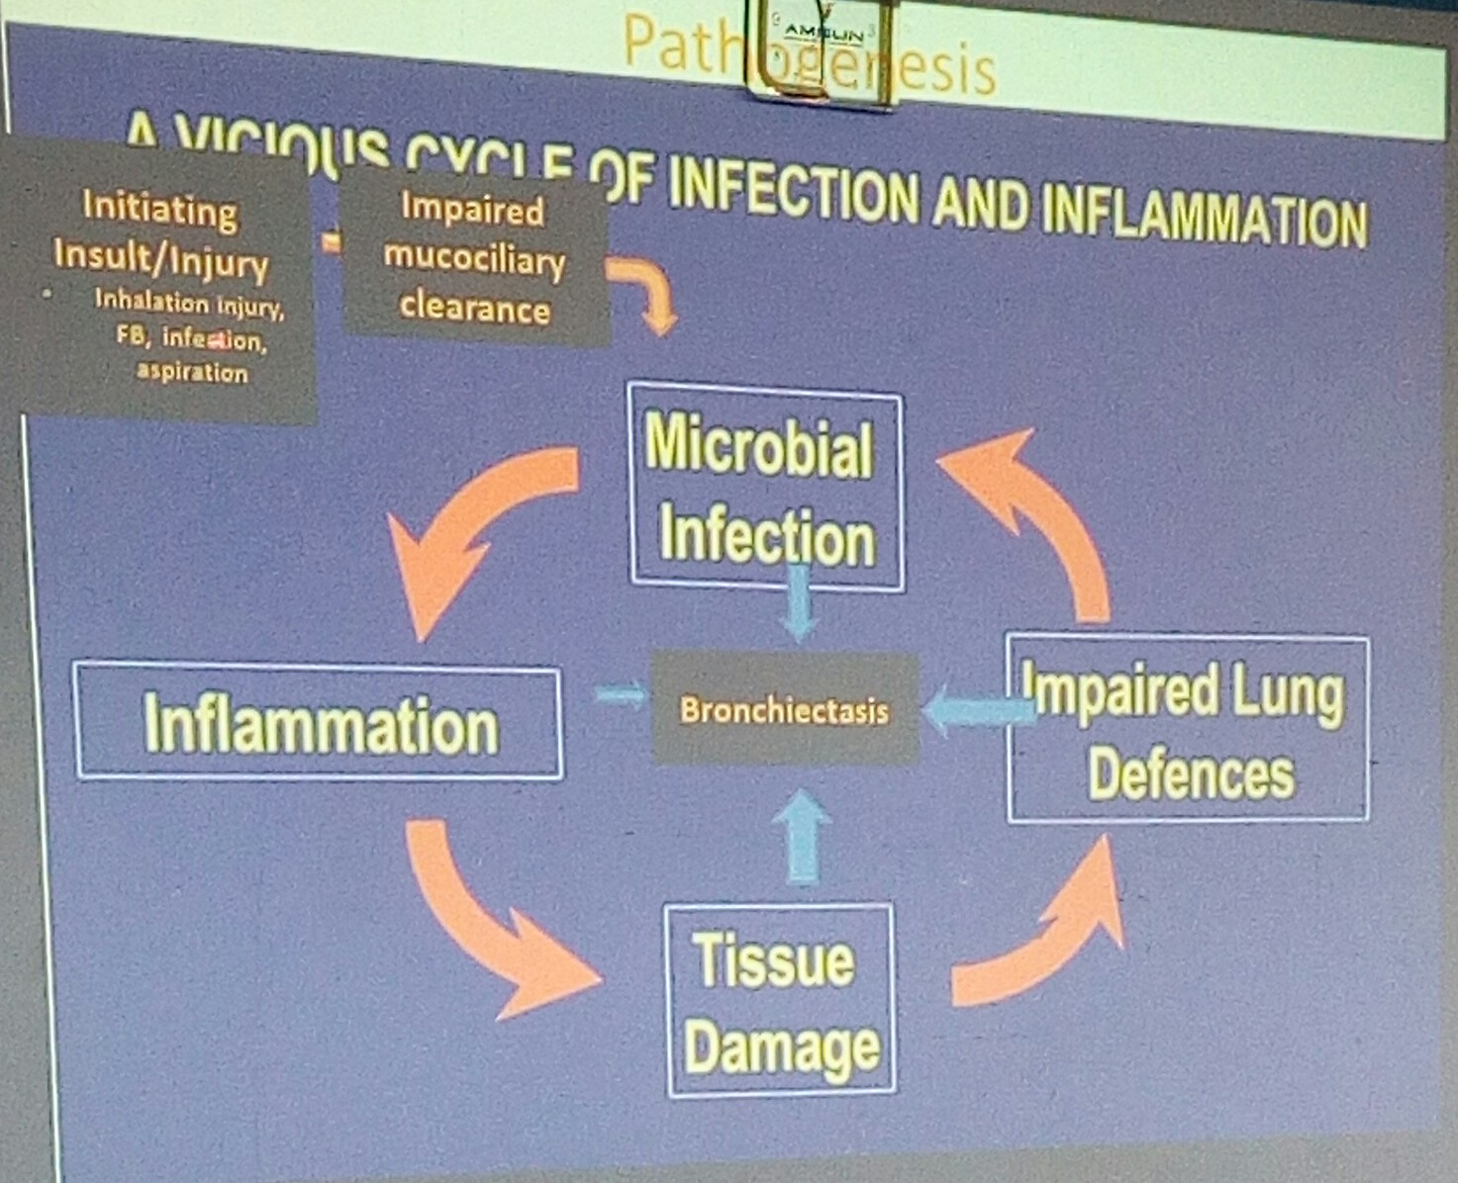
VICIOUS CYSLE OF INFECTION AND INFLAMMATION
RISKS OF ASPIRATION
During endotracheal intubation
Convulsing
Comatose patients

Slide 5
PATHOPHYSIOLOGY
Neutrophil proteases acute infection in a normal or compromised host →
Eepithelial injury (elastin, muscle and cartilage) + structural protein damage →
Damaged and dilated airway (+ fibrosis extending to the adjacent lung parenchyma) →
Mucus retention/chronic, recurrent infection →
Ongoing inflammation/tissue damage and repair/ chronic inflammation, lymphoid follicles and neutrophil sin the airway wall →
  Overproduction of viscid mucus
  Impaired mucociliary clearance
  Dilatation of airway
  Mucus stagnation
  Bacterial colonization

Slide 6
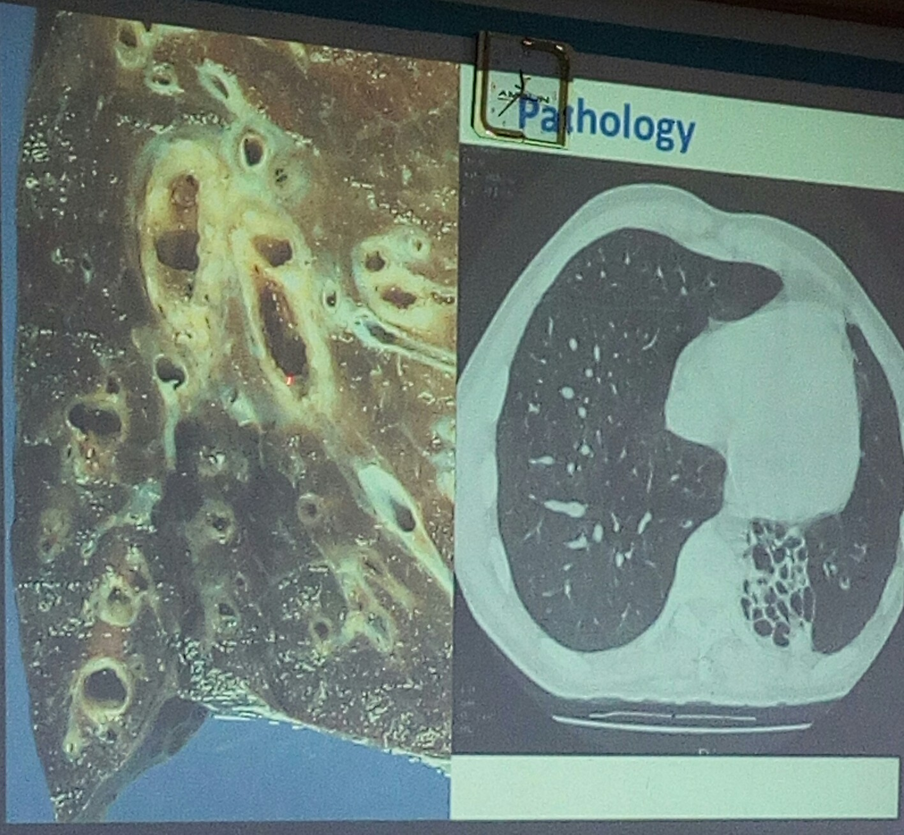

Slide 7
ETIOLOGY
Infection
  TB. Necrotising pneumonia (H. influenza, S. aureus, aspiration), Pertussis, Influenza, Measles
Systemic disease
  RA, Ulcerative colitis, SLE, Sjogren’s syndrome, ankylosing spondylosis, yellow nail syndrome
Bronchial obstruction
  Foreignbody, tumor e.g. carcinoid, mucoid impaction (can can be a complication of asthma), Allergic Bronchopulmonary aspergillosis (ABPA)
Congenital anatomical lung abnormality
Inherited disorders
  Ciliary dysfunction
  Cystic fibrosis
  Alpha – 1 AT deficiency
Undefined (29 – 49 %)
  Most of these due to congenital or acquired immunodeficiency disorders

Slide 8
EVALUATION
Take a good history
Role of investigations
  Underlying cause (especially those amenable to specific treatment)
  Prognosis

Slide 9
HISTORY
Symptoms
  Chronic cough, purulent sputum production
  Episodic exacerbations
    General malaise, joint pains, increasing breathlessness, hemoptysis
  Age of onset
  Associated upper airway disease e.g. sinusitis, recurrent otitis media
  H/O severe respiratory tract infection e.g. PTB
  Family history (including fertility)
  GERD
  Asthma features (suggestive of ABPA)
  Effect on quality of life.

Slide 10
EXAMIANTION
None – few
Clubing
Crackles

Slide 11
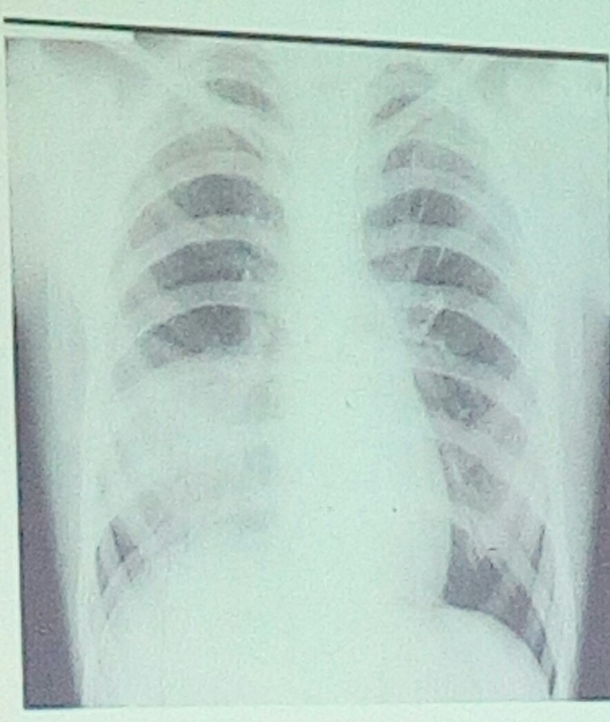
RADIOLOGY - CXR
Bronchiectasis
  Vessel crowding
  Loss of vessel markings
  Tramline/ring shadows
  Cystic lesions /air fluid levels
Poor
  Diagnostic sensitivity
  Monitoring progression

Slide 12
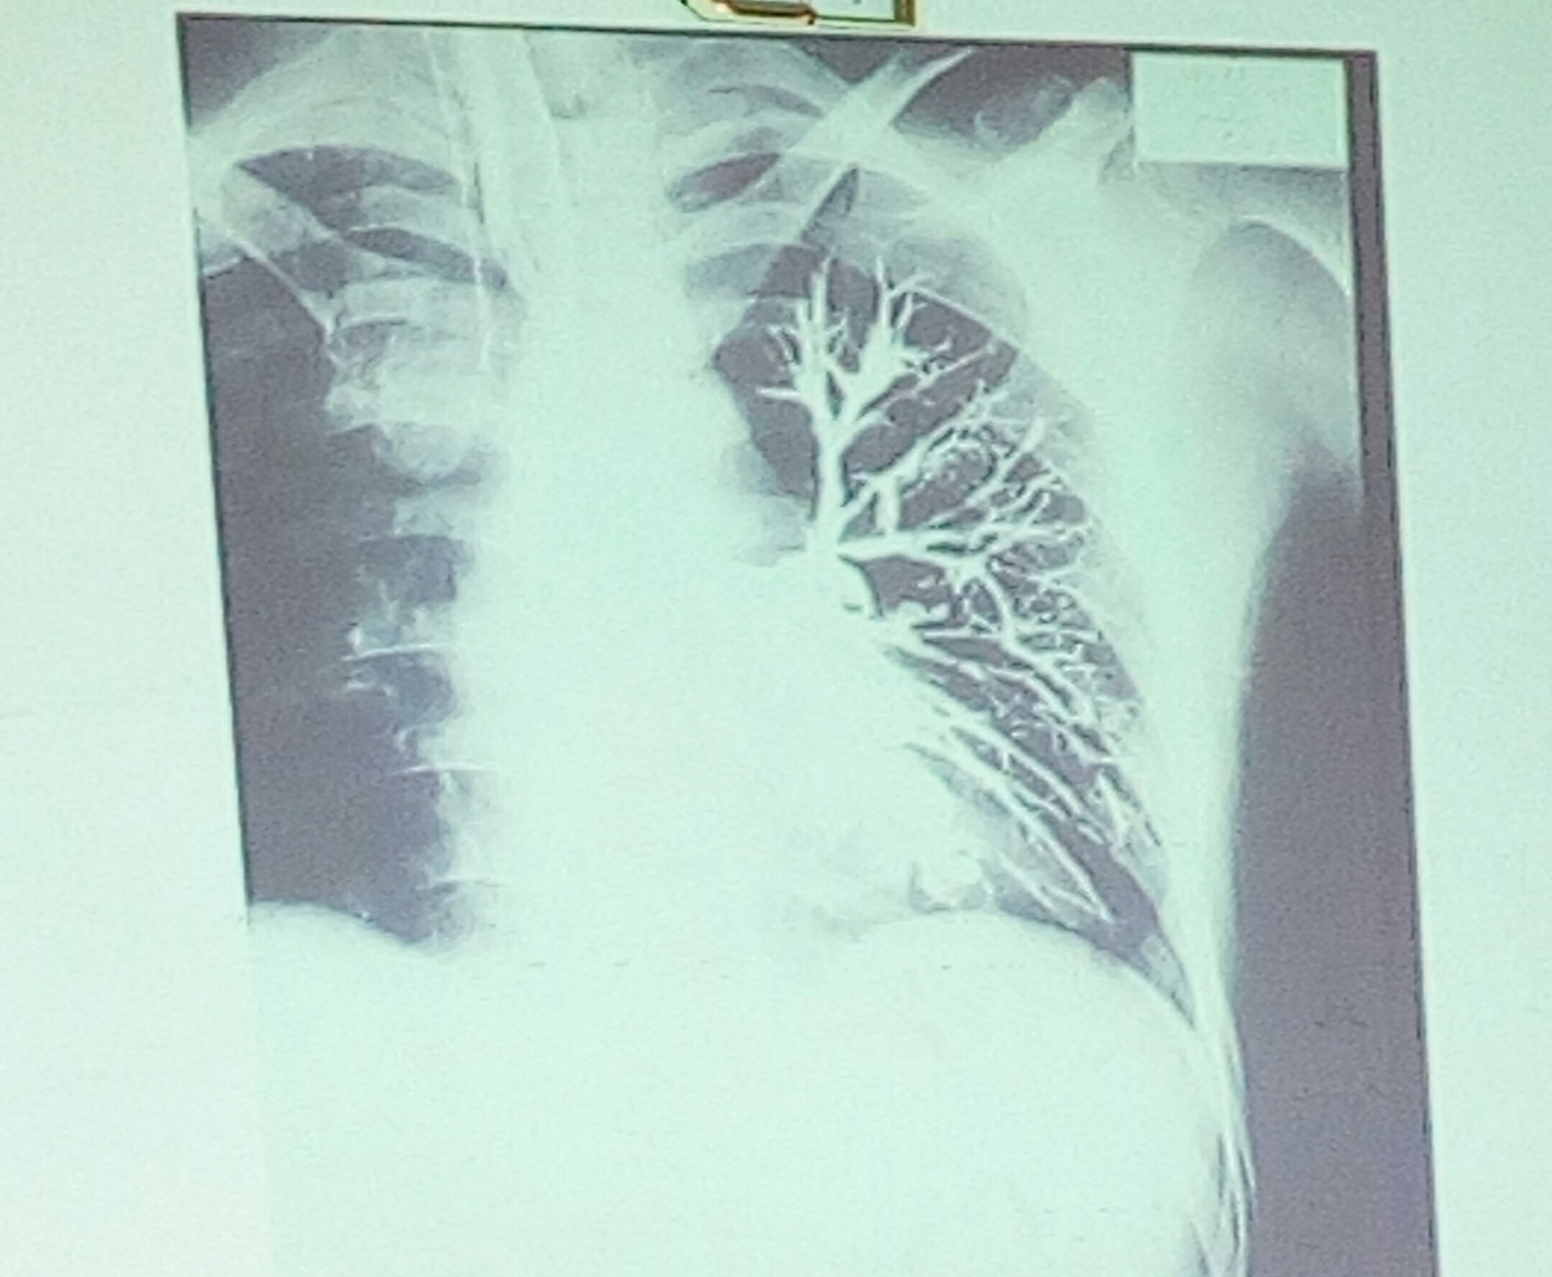
BRONCHOGRAM → NOT DONE ANYMORE
Contrast is put in airways

Slide 13
HRCT
Brochial dilatation
Brochial wall thickening
Classification (pathology)
Sensitivity 97% mire than CXR

Slide 14
OTHER INVESTIGATIONS
TBC
  Raised eosinophilia → ABPA
ESR/CRP
  Raised
Serum immunoglobulins
  Immunodeficiency e.g. hematologic malignancies
Aspergillus IgE (RAST) or IgG (precipitins)
Skin prick test for Aspergillus
Sputum microbiology
Esophageal studies
Ciliary studies
CF genotype/sweat test
Semen analysis
FOB (Fibre optic Brocnoscopy)
Lung function tests

Slide 15
BRONCHIECTASIS ECACERBATIONS IN BACERIOLOGY
Common
  H. influenza
  H. parainfluenza
  Pseudomonas aeruginosa
Less common
  S. pneumonia
  Moraxella catarrhalis
  S. aureus
  Stenotrophomonas maltophila

Slide 16
MANAGEMENT
Survival
Preserve lung function
Prevent frequent exacerbations
Reduce symptoms and improve quality of life.

Slide 17
MANAGEMENT PRINCIPLES
Patient education
Airway clearance
Reduced bacterial load
  Rx of exacerbations
  Antibiotic prophylaxis
Anti-inflammatory therapy (inhaled corticosteroids)
Vaccination
Airway clearance
  Postural drainage (percuss while you are at it to produce the sputum which is put in a sputum mug)

Slide 18
PULMONARY VASCULAR DISEASE:
PULMONARY EMBOLISM
BY: PROF. ELIJAH N. OGOLA
DATE: 16/9/2016

Slide 19
OUTLINE
VTE continuum
Risk factors
Pathophysiology
Clinical features
Investigations
Diagnosis
Treatment
  Immediate
  Long term
Prevention

Slide 20
VTE
DVT and PE are part of a continuum
PE almost invariably due to DVT
Same risk factors and similar management

Slide 21
PREAMBLE
Common problem → 3rd commonest cause of cardiovascular mortality
  1. ISCHEMIC HEART DISEASE
  2. STROKE
  3. VTE
Increasing incidence because of changing demographics and healthcare
Associated with specific risk factors therefore amenable to prevention

Slide 22
RISK FACTORS
Strong predisposing factors
Fracture (hip or leg)
Hip or knee replacement
Major general surgery
Major trauma
Spinal cord injury
Moderate predisposing factors
Arthroscopic knee surgery
Central venous lines
Chemotherapy
Chronic heart or respiratory failure
Hormone replacement therapy
Malignancy
Oral contraceptive therapy
Paralytic stroke
Pregnancy/post-partum
Previous VTE
Thrombophilia (inherited)

Slide 23
CONT.
Weak predisposing factors
Bed rest > 3 days
Immobility due to sitting (e.g. prolonged car or air travel)
Increasing age
Laparoscopic surgery e.g. cholecystectomy)
Obesity
Pregnancy/antepartum
Varicose veins

Slide 24
PRIMARY THROMBOPHILIAS
Anti-thrombin deficiency
Factor V Leiden
Protein C, S deficiency
Prothrombin 202120A mutation
Hyper-homocystinemia
Dys-fibrinogenemia
Anti-cardiolipin antibodies
Excessive PAI
Plasminogen deficiency
Thrombomodulin deficiency
Factor XII excess
Dysgammaglobulinemia

Slide 25
PATHOPHYSIOLOGY
Cardiac
  Obstruction to pulmonary blood flow
  Increased pulmonary vascular resistance
  Worsened by vasoconstrictors released
  RV dysfunction , ischemia
  Systemic circulation; impaired LV filling – hypotension, shock
Respiratory → hypoxia
  Low CO
  V/Q mismatch
  R-L shunting
  Atelectasis → lung compliance
  Decreased lung compliance (increased stiffness)
  Infarction

Slide 26
VIRCHOW’S TRIAD
Hyper-coagulable state
  Malignancy
  Pregnancy and post-partum period
  Estrogen therapy
  IBD
  Sepsis
  Thrombophilia
Circulatory stasis
  LV dysfunction
  Immobility or paralysis
  Venous insufficiency or varicose veins
  Venous obstruction from tumor, obesity or pregnancy
Endothelial injury
  Venous disorders
  Venous valvular damage
  Trauma or surgery
  Indwelling catheters

Slide 27
CLINICAL PRESENTATION
Non-specific hence high index of suspicion
Variable dependent on extent of thrombus and underlying cardio-respiratory status
Symptoms:
  Dyspnea. Chest pain, cough, hemoptysis, dizziness, syncope
Signs
  Tachypnea, tachycardia, hypotension, cyanosis
Features of DVT

Slide 28
INVESTIGATIONS
Aims:
  Establish diagnosis
  R/O competing diagnoses
  Look for risk factors
  Assess complications
  Risk stratification → prognosis

Slide 29
INVESTIGATIONS
D-dimer
  Assess possibility of intravascular coagulation
  Sensitive but not specific
  R/O intravascular coagulation
CXR
  Not diagnostic; helps in R/O competing diagnoses e.g. TB or pneumonia
  Find out features of CXR in PTE
ECG
  Seeing any evidence of RV function impairment
  R/O MI
Venous U/S
  Gold standard for diagnosis DVT
Cardiac biomarkers → BNP, Troponin
  Troponin is a marker of myocardial necrosis
  BNP is a marker of myocardial stretch
Echocardiography
  Predominantly in telling the consequences of the PTE to the RV
  Can provide indirect evidence of acute RV dysfunction
Lung scintigraphy (V/Q scan)
  Useful for diagnosis
  Used to be the gold standard but has been overtaken by CT pulmonary angiography
  Is therefore an alternative to CT
CT pulmonary angiogram
  Test of choice for PTE
  Contrast is used; injected into a peripheral vein
Pulmonary angiography
  Involves catheterizing the right heart and injecting dye straight into it
  Invasive; rarely done
Pulmonary Magnetic Resonance Angiography (MRA)
Blood gases

Slide 30
DIAGNOSTIC STRATEGIES
Is there hypotension or shock
If not, is the probability of PE high or low, using clinical parameters?

Slide 31
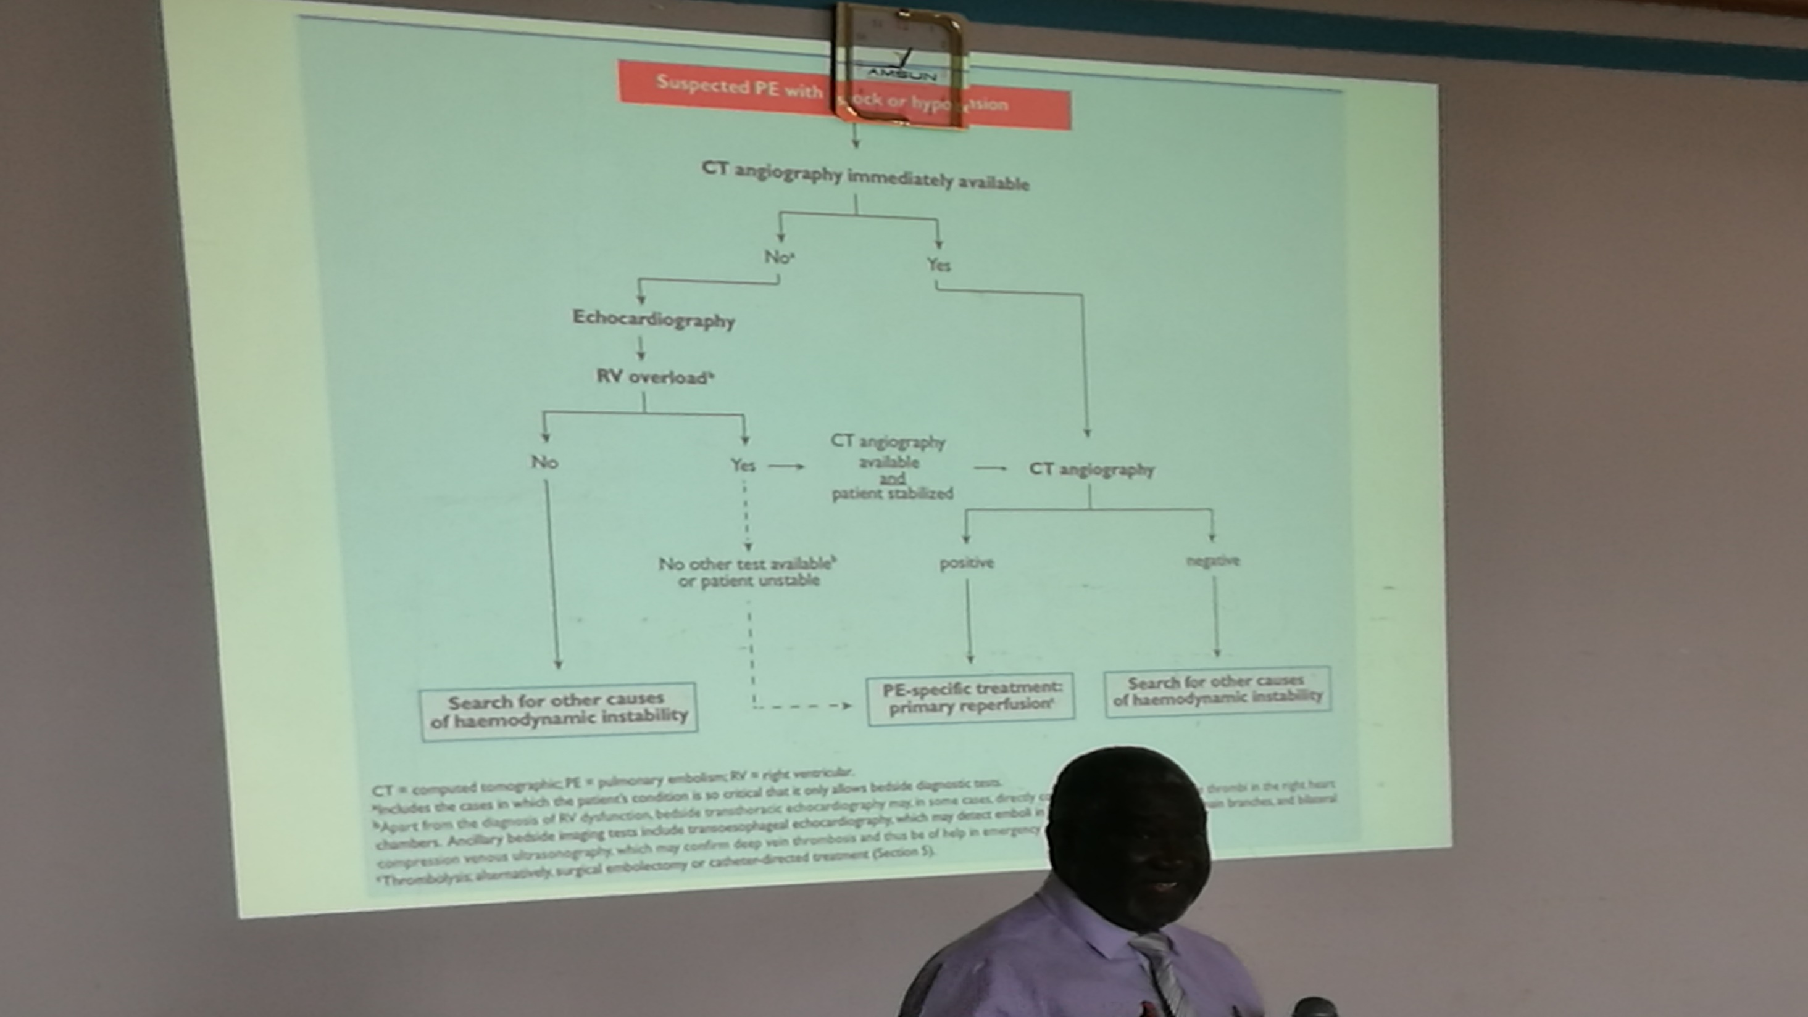

Slide 32
CRITERIA
If suspected PE with shock or hypotension →
  CT angiography immediately (if available) →
    Yes → (do CT angiography)
      Positive → PE – Specific treatment; primary reperfusion
      Negative → search for other causes of hemodynamic instability
    No →
      Echocardiography → RV overload
        No → search of other causes
        Yes
          CT angiography available and patient stabilized → (do CT angiography)
          No other test available or patient unstable → PE – Specific treatment; primary reperfusion

Slide 33
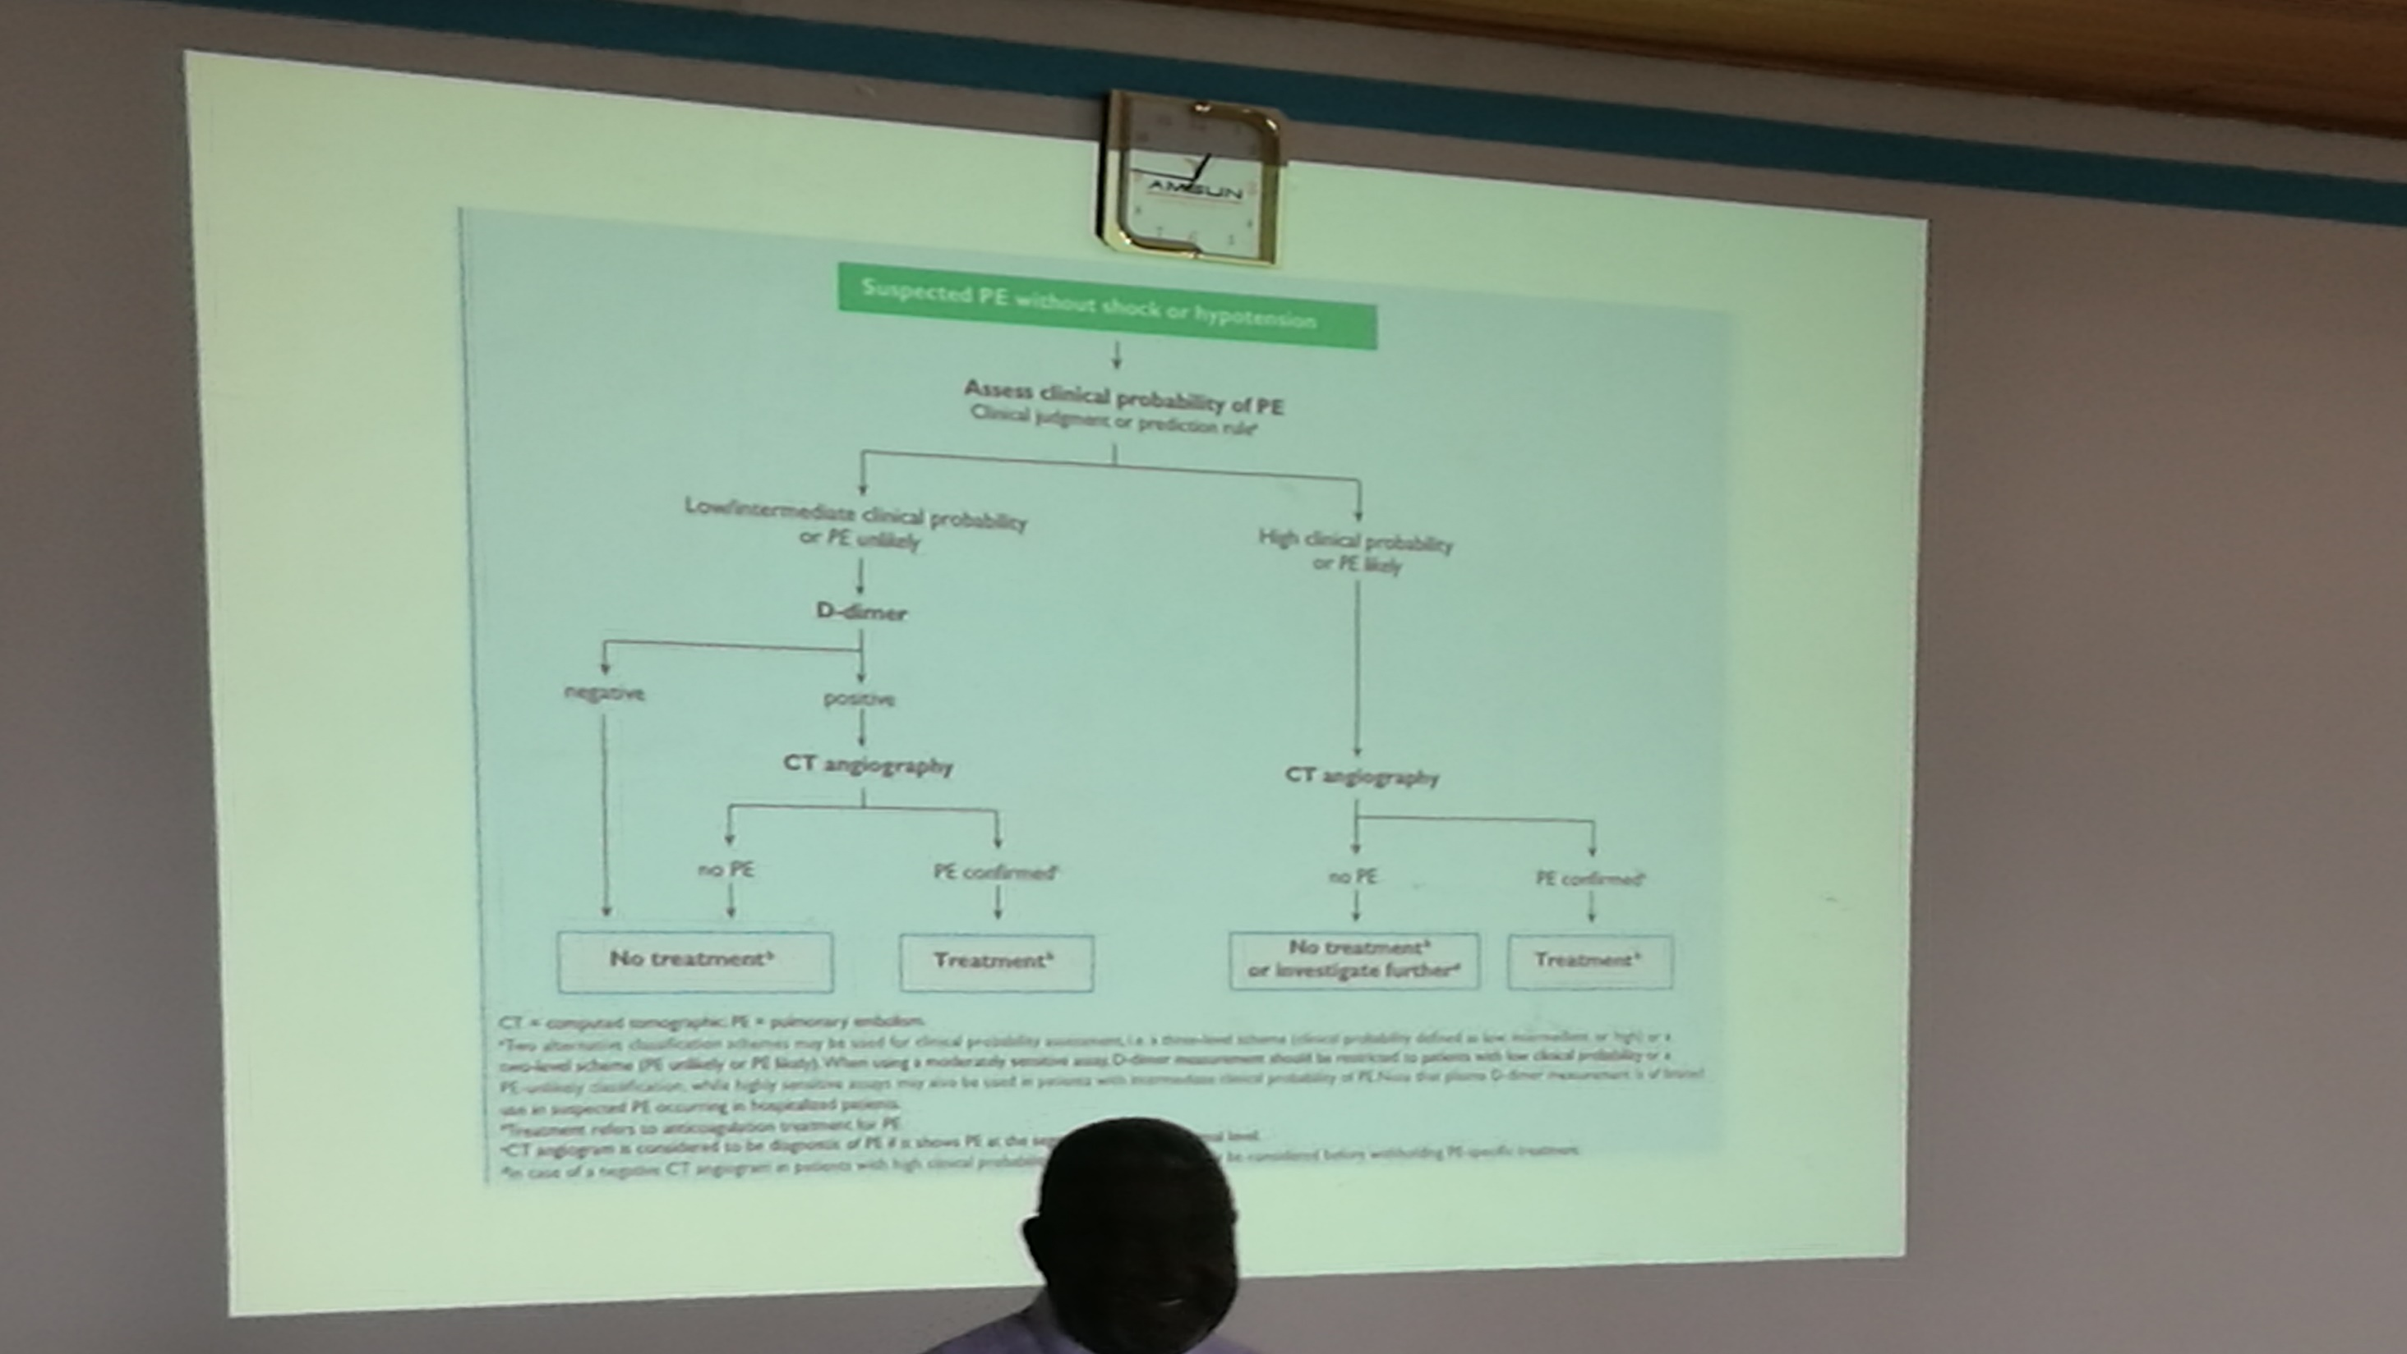

Slide 34
ALGORITHM
Suspected PE without shock →
  Assess clinical probability of PE (clinical judgment or prediction rule) →
    Low intermediate clinical probability or PE unlikely →
      D-dimer →
        Negative →
          No treatment
        Positive →
          CT angiography
            No PE → no treatment
            Confirmed → treatment
    High clinical probability or PE likely →
      CT angiography
        No PE
          No Rx or investigate further
        PE confirmed
          Treat

Slide 35
TREATMENT
Risk stratification of probability of death
  Hypotension/shock
  RV dysfunction
  Elevated BNP/Troponin
Hypotension/shock → thrombolytic therapy
None of the above → low risk. Anticoagulation, consider early discharge or home treatment
No hypotension with one or 2 of the above → intermediate risk. Anticoagulation and observe

Slide 36
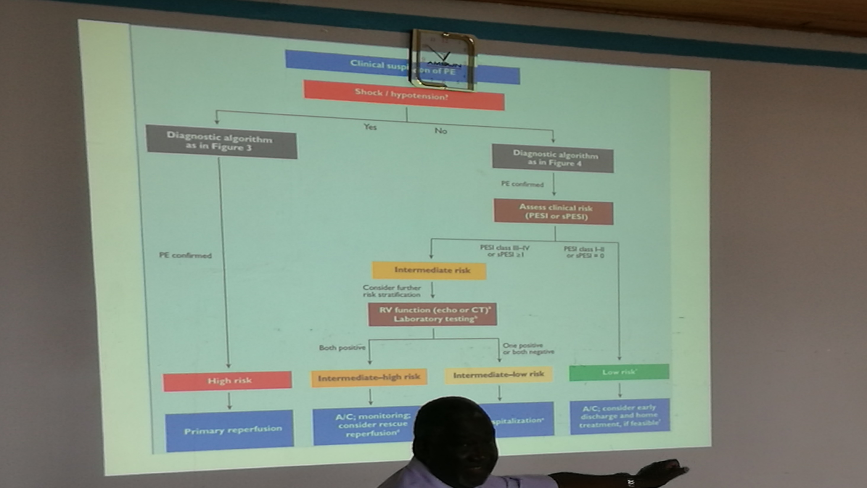

Slide 37
TARGETS FOR ANTICOAGULANTS
Oral
  VKAs (Warfarin) inhibit hepatic synthesis of functional coagulation factors
  Rivaroxaban, Apixaban, Edoxaban (FXa Inhibitors)
  Dabigtaran (FIIa inhibitors)
Parenteral
  Fondaparinux
  LMWH
  UFH

Slide 38
ANTICOAGULATION STRATEGIES
Initial parenteral therapy
  UFH – do frequent aPTT measurements; should be infused; can be used with any kidney function levels
  LMWH
  Fondaparinux – indirect FXa inhibitor; given OD
Followed by OAC
  VKA (warfarin)
  FXa inhibitors e.g. rivaroxaban, apixaban, edoxaban
  FII inhibitor - Dabigatran

Slide 39
CONT.
Initial parenteral therapy is for 5-10 days
Simultaneous initiation of OAC
In case of VKA overlap till INR is in therapeutic range (2-3) for 2 consecutive days
For rivaroxaban and apixaban → possibility of initiating oral therapy

Slide 40
DURATION OF THERAPY
1st provoked (transient risk factors) → 3 months
1st unprovoked → at least 3 months. Consider extended Rx depending on bleeding risk
Recurrence → indefinite
Same for continuous risk factors e.g. cancer

Slide 41
OTHER TREATMENT MODALITIES
Acute phase
  Surgical or catheter embolectomy
  Direct thrombolysis
Long term – venous filters
  High bleeding risk
  C/I to anticoagulation
  Recurrence despite adequate anticoagulation

Slide 42
PROPHYLAXIS
Indicated for moderate to high risk
Drugs:
  Parenterals; (N) OAC
Mechanical
  Passive exercises
  Compression stockings
  Ripple mattresses

Slide 43
TYPED BY EFFIE NAILA
MANY ARE THE AFFLICTIONS OF THE RIGHTEOUS BUT THE LORD DELIVERS HIM FROM THEM ALL

