Slide 1
Acute Respiratory Failure
Dr. Nduku Kiko
Lecture Fourth Years
Notes:
Respiratory failure is one of the most common reasons patients are admitted to the ICU. In some ICUs, 75% of patients require mechanical ventilation during their stay. Respiratory failure can be categorized mechanistically, based on pathophysiologic derangements in respiratory function. Accordingly, four different types of respiratory failure can be described, based on these pathophysiologic derangements
3.1 Anatomy and physiology of respiratory system.
One of the most important conditions of living is continuous gas exchange. Every day a human body consumes nearly 700 l of oxygen and produces 600 litersof carbon dioxide.
Oxygen is responsible for the mitochondrial and microsomal oxidation., peroxidation of unsaturated fatty acids and oxydase reactions. But the most significant role it plays when provides oxidative phosphorylation during energetic metabolism of the cell.
There are two types of breathing: external or lung respiration provides inflow of oxygen and carbon dioxide elimination; internal respiration is a complex process, which consists of haemoglobin transformation (connection and disconnection with oxygen), transportation of oxygenated haemoglobin trough circulatory system to the tissues and local cellular metabolism.
External breathing is being regulated by centres in medulla and pons. Increasing of carbon dioxide concentration, as well as acidosis of cerebrospinal fluid, stimulates inspiration. At the end of expiration inspiration centre is being stimulated automatically and thus respiratory act begins again. In addition receptors of aorta arch and carotid sinus are also involved into respiratory act regulation: they respond to the lowering of oxygen concentration in the arterial blood.
The act of ventilation itself is being done through contraction of chest muscles and diaphragm. Muscles, responsible for respiration, enlarge chest and thus create negative pressure inside of it, what makes air move through the airways to the alveoli. Expiration is usually passive: chest falls down to it previous position and “used” air gets back to the atmosphere.
Tidal volume (TV) is 450-800 ml for male and 400-700 for female. It can be measured by spirometer or volumeter. But not the whole air of one respiratory effort gets to the alveoli: part of it stays in oral cavity, nasal cavity, pharynx, trachea, bronchi and thus does not participate in the act of respiration itself. It is so called “dead space”- volume of airways which are ventilated, but are not involved in gas exchange. Dead space makes nearly 30% of the tidal volume (2,22 ml/kg of body weight).
Normal respiration rate (RR) is 14-20 per minute. Thus minute ventilation is calculated according to the formula:
Minute ventilation =Tidal volume* Respiratory rate (ml)
However the parameter, which helps to characterize the efficiency of breathing, is alveolar ventilation (AV): it shows the exact amount of the air which gets to the alveoli during the minute. The difference between minute ventilation and alveolar ventilation is the volume of dead space:
Alveolar ventilation= (Tidal volume-Dead space volume)* Respiratory rate (ml)
According to this formula breathing with lower frequency and higher tidal volume is more effective. In addition efficiency of breathing is increased through reduction of dead space volume. Thus endotracheal tube or tracheostomy make it two times less.
Oxygen gets to the arterial blood due to the difference of gas partial pressures. If the atmospheric pressure is 740-740 mm of Mercury and the amount of oxygen in the air is 20-21% partial pressure of Oxygen (pO₂) will be 160-150 mm of Mercury. In the airways air is being mixed with “used gases” and water steam, so the partial pressure of oxygen inside the alveoli is 95-85 mm of Mercury. With such values pO_{2a ,} 3 ml of oxygen will be dissolved in one liter of blood (plasma).
The main amount of oxygen in blood is being bound to the haemoglobin. One gram of haemoglobin bounds 1,34-1,39 ml of oxygen. In normal conditions haemoglobin of arterial blood (HbO_{2a})is saturated to the extent of 96%. So, with the concentration of haemoglobin 120-140 grams per liter, one liter of arterial blood contains 170-190 ml of oxygen (VO_{2a}).
From every litre of blood only one third of oxygen amount (nearly 50 ml) is being used for the needs of the tissues. Thus venous blood contains nearly 120-140 ml of oxygen (VO_{2v}) and it’s HbO_{2v} is 70-75% and pO_{2v} 45-55 mm of Mercury.
Partial pressure of carbon dioxide in the arterial blood (pCO_{2a}) is an important index of ventilation adequacy. Normally it is 36-46 mm of Mercury. Worsening of lung ventilation causes increasing of pCO_{2a} over 44 mm of Mercury – hypercapnia appears. Excessive ventilation, on the contrary, helps in elimination of carbon dioxide and appearance of hypocapnia: pCO_{2a} is lower than 35 mm of Mercury.
Respiratory insufficiency is a condition in which metabolic needs of the body can not be sutisfied with adequate oxygen admission, blood transportation, cellular consumption and carbon dioxide elimination.
Classification of respiratory insufficiency according to L. Usenko (1993):
A. Primary (caused by disorders of external respiration). Reasons:
1. airway patency disorders (obstruction with tongue, vomit, mucus, gastric contents, foreign bodies; laryngeal spasm, etc.)
2. central nervous system disorders (intoxication, brain injuries, haemorrhages, inflammations, etc.)
3. disorders of respiratory muscles activity (myasthenia, botulism, tetanus, muscle relaxants, etc.)
4. defects of chest structure or functional chest disorders ( chest injuries, limited diaphragm mobility – for example due to enteroparesis)
5. disorders of pulmonary compliance (pneumonia, bronchiolitis, atelectasis, “shock lung” syndrome, etc.)
6. disorders of ventilation-perfusion system (irregularity of ventilation and perfusion during artificial ventilation, pulmonary oedema, etc.)
B. Secondary (caused by inability of blood to contain enough oxygen for metabolic needs of tissues or disorders of transportation and cellular consumption).
Respiratory insufficiency is characterized with hypoxia (“lowering of the oxygen”). Hypoxia occurs in case of:
1. Inability of external respiration to provide arterial blood with enough amount of oxygen (hypoxic hypoxia)
2. Lowering of oxygen amount due to anaemia - decreased level of haemoglobin, red blood cells or appearance of their atypical forms (haemic hypoxia).
3. Inability of cardiovascular system to provide systemic and pulmonary circulation enough for metabolic needs of the body (circulatory hypoxia).
4. Disorders of oxidative phosphorylation on cellular level of different organs and systems (tissue hypoxia).
Hypoxia itself can be accompanied with hypercapnia and hypocapnia. In case of tissue hypoxia there is also a possibility of hyperoxia (excessive oxygen amount) as its background.
In clinical conditions we usually deal with mixed gas exchange disorders.
Clinical symptoms of acute respiratory insufficiency
There are two types of respiratory insufficiency according to its duration: acute and chronic. Acute respiratory insufficiency develops in minutes or hours, can be life-threatening and thus needs urgent intensive treatment.
Symptoms of acute respiratory failure are really various.
Central nervous system. Conscious patients can complain of breathlessness (feeling of the air-lack), difficult inspiration or expiration. Due to development of hypoxia patients become restless, anxious, and sometimes euphoric; they can not evaluate critically their condition or environment. Terminal stages of insufficiency show total CNS inhibition – comatose state (hypoxic or hypercapnic). Quite often, especially in children, convulsions appear.
Skin and mucosa are mirror of respiratory insufficiency: their changes are quite illustrative.
In case of external respiration disorders the amount of oxygenated haemoglobin is decreased and thus quantity of reduced haemoglobin. Arterial blood becomes “venous” (dark): skin and mucosa become cyanotic (blue, purple). First of all their colour change lips, nail plates, earlobes, afterwards face and other body parts. In case of anaemic patients with haemoglobin level 60 grams per litre and lower skin stays pale even in terminal stages of respiratory insufficiency. In case of cyanic and carbon monoxide intoxication skin, nail plates and mucosa turn bright pink, although patients are greatly suffering from hypoxia. Hydrosis is quite significant feature of hypercapnia. Terminal respiratory insufficiency is characterized with dark-grey color cold skin covered with clammy sweat.
Disorders of external respiration are the most obvious symptoms of respiratory insufficiency. Clinically in case of those patients next symptoms might be observed:
complete breathing arrest (apnea);
low respiratory rate – less than 12 per minute (bradypnea);
high respiratory rate – more than 20 per minute (tachypnea);
shallow breathing (respiratory volume less than 5 ml per kilogram of body weight);
respiratory “anarchy” (irregular breathing with pauses and uneven amplitude of respiratory movements);
pathological types of respiration:
a. Cheyne-Stokes breathing (periods of apnea, which are followed with chaotic frequent breathing);
b. Biot’s breathing (periods of apnea which are followed with breathing of equal amplitude);

Slide 2
Outine
Definition of acute respiratory failure.
Classification of acute respiratory failure
E tiology
Evaluation of patient with acute respiratory failure.
Management.

Slide 3
RESPIRATORY FAILURE
“inability of the lung to meet the metabolic demands of the body. This can be from failure of tissue oxygenation and/or failure of CO₂ homeostasis.”
Notes:
The primary function of the respiratory system is to oxygenate blood and eliminate carbon dioxide, which requires that blood come into virtual contact with fresh air to facilitate diffusion of respiratory gases between blood and gas. This process occurs in the lung alveoli, where blood flowing through alveolar wall capillaries is separated from alveolar gas by an extremely thin membrane of flattened endothelial and epithelial cells, across which respiratory gases diffuse and equilibrate. Blood flow through the lung is unidirectional via a continuous vascular path, along which venous blood absorbs oxygen from and loses CO₂ to inspired gas. The path for airflow, in contrast, reaches a dead end at the alveolar walls; as such, the alveolar space must be ventilated tidally, with inflow of fresh gas and outflow of alveolar gas alternating periodically at the respiratory rate (RR). To achieve an enormous alveolar surface area (typically 70 m²) for blood-gas diffusion within the modest volume of a thoracic cavity (typically 7 L), nature has distributed both blood flow and ventilation among millions of tiny alveoli through multigenerational branching of both pulmonary arteries and bronchial airways. As a consequence of variations in tube lengths and calibers along these pathways, and of the effects of gravity, tidal pressure fluctuations, and anatomic constraints from the chest wall, there is variation among alveoli in their relative ventilations and perfusions. Not surprisingly, for the lung to be most efficient in exchanging gas, the fresh gas ventilation of a given alveolus must be matched to its perfusion.
For the respiratory system to succeed in oxygenating blood and eliminating carbon dioxide, it must be able to ventilate the lung tidally to freshen alveolar gas; it must provide for perfusion of the individual alveolus in a manner proportional to its ventilation; and it must allow for adequate diffusion of respiratory gases between alveolar gas and capillary blood. Furthermore, it must be able to accommodate severalfold increases in the demand for oxygen uptake or CO₂ elimination imposed by metabolic needs or acid-base derangement. Given these multiple requirements for normal operation, it is not surprising that many diseases disturb respiratory function. Here, we consider in greater detail the physiologic determinants of lung ventilation and perfusion, and how their matching distributions and rapid gas diffusion allow for normal gas exchange

Slide 4
RESPIRATORY FAILURE
Definition Respiration is gas exchange between the organism and its environment. Function of respiratory system is to transfer O₂ from atmosphere to blood and remove CO₂ from blood.
Clinically Respiratory failure is defined as PaO₂ <60 mmHg while breathing air, or a PaCO₂ >55 mmHg.
Notes:
Due both to surface tension at the air-liquid interface between alveolar wall lining fluid and alveolar gas and to elastic recoil of the lung tissue itself, the lung requires a positive transmural pressure difference between alveolar gas and its pleural surface to stay inflated; this difference is called the elastic recoil pressure of the lung, and it increases with lung volume. Importantly, the lung becomes rather stiff at high lung volumes, so that relatively small volume changes are accompanied by large changes in transpulmonary pressure; in contrast, the lung is compliant at lower lung volumes, including those at which tidal breathing normally occurs. Note that at zero inflation pressure, even normal lungs retain some air in the alveoli. This occurs because the small peripheral airways of the lung are tethered open by radially outward pull from inflated lung parenchyma attached to adventitia; as the lung deflates during exhalation, those small airways are pulled open progressively less, and eventually they close, trapping some gas in the alveoli. This effect can be exaggerated with age and especially with obstructive airways diseases, resulting in gas trapping at quite large lung volumes

Slide 5
Type 1 Respiratory failure
-PaO2 low, PaCO2 normal or low.
Type II Respiratory Failure
PaO2 low, PaCO2 high.
Others(Type III and IV)
Notes:
This form of respiratory failure occurs as a result of lung atelectasis. Because atelectasis occurs so commonly in the perioperative period, this is also called perioperative respiratory failure. After general anesthesia, decreases in functional residual capacity lead to collapse of dependent lung units. Such atelectasis can be treated by frequent changes in position, chest physiotherapy, upright positioning, and aggressive control of incisional and/or abdominal pain. Noninvasive positive-pressure ventilation may also be used to reverse regional atelectasis.
Type IV Respiratory Failure
This form results from hypoperfusion of respiratory muscles in patients in shock. Normally, respiratory muscles consume <5% of the total cardiac output and O₂ delivery. Patients in shock often experience respiratory distress due to pulmonary edema (e.g., patients in cardiogenic shock), lactic acidosis, and anemia. In this setting, up to 40% of the cardiac output may be distributed to the respiratory muscles. Intubation and mechanical ventilation can allow redistribution of the cardiac output away from the respiratory muscles and back to vital organs while the shock is treated

Slide 6
Respiratory system includes:
CNS (medulla) Peripheral nervous system (phrenic nerve) Respiratory muscles Chest wall Lung Upper airway Bronchial tree Alveoli Pulmonary vasculature
Notes:
Respiratory center is divided into four major cliques
Inspiratory center (Dorsal respiratory group)[edit]
Location: Dorsal portion of medulla
Nucleus: Nucleus tractus solitarius
Expiratory center (Ventral respiratory group)[edit]
Location: Antero- lateral part of medulla, about 5 mm anterior and lateral to dorsal respiratory group
Nucleus: Nucleus ambiguous and nucleus retro ambiguous.
Function: It generally causes expiration but can cause either expiration or inspiration depending upon which neuron in the group is stimulated. It sends inhibitory impulse to the apneustic center.
Pneumotaxic center[edit]
Location: Pons(upper part )
Nucleus: Nucleus parabrachialis
Function: It controls both rate and pattern of breathing. Limit inspiration.
Apneustic center[edit]
Location: Pons(lower part)
Functions:
It discharges stimulatory impulse to the inspiratory center causing inspiration.
It receives inhibitory impulse from pneumotaxic center and from stretch receptor of lung.
It discharges inhibitory impulse to expiratory center.

Slide 7
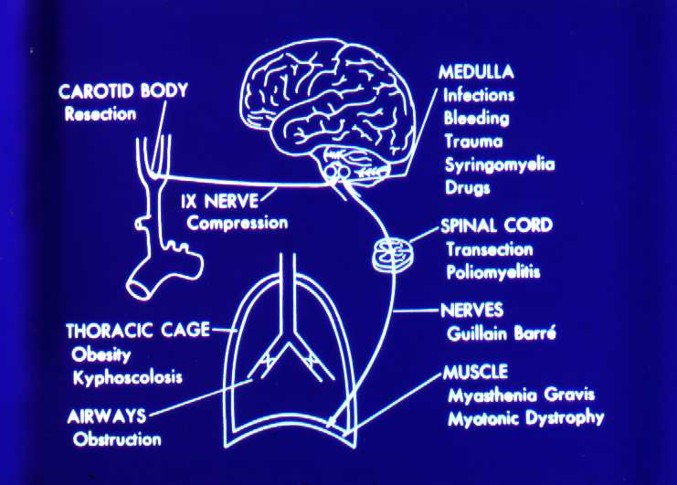
Potential causes of Respiratory Failure
Notes:
It is useful to think about the respiratory system as having three independently functioning components—the lung including its airways, the neuromuscular system, and the chest wall; the latter includes everything that is not lung or active neuromuscular system. As such, the mass of the respiratory muscles is part of the chest wall, while the force they generate is part of the neuromuscular system; the abdomen (especially an obese abdomen) and the heart (especially an enlarged heart) are, for these purposes, part of the chest wall. Each of these three components has mechanical properties that relate to its enclosed volume, or in the case of the neuromuscular system, the respiratory system volume at which it is operating, and to the rate of change of its volume (i.e., flow

Slide 8
HYPOXEMIC RESPIRATORY FAILURE(TYPE 1)
PaO₂ <60mmHg with normal or low PaCO₂ → normal or high pH
Most common form of respiratory failure
Lung disease is severe to interfere with pulmonary O₂ exchange, but over all ventilation is maintained
Physiologic causes: V/Q mismatch and Alveolar flooding- intrapulmonary shunt
Notes:
Type I, Acute Hypoxemic Respiratory Failure
This occurs when alveolar flooding and subsequent intrapulmonary shunt physiology occur. Alveolar flooding may be a consequence of pulmonary edema, pneumonia, or alveolar hemorrhage. Pulmonary edema can be further categorized as occurring due to elevated pulmonary microvascular pressures as seen in heart failure and intravascular volume overload or ARDS ("low-pressure pulmonary edema"; Chap. 268) and represents an extreme degree of lung injury. This syndrome is defined by diffuse bilateral airspace edema seen on chest radiography, the absence of left atrial hypertension, and profound shunt physiology (Fig. 267-5) in a clinical setting in which this syndrome is known to occur, including sepsis, gastric aspiration, pneumonia, near-drowning, multiple blood transfusions, and pancreatitis. The mortality rate of patients with ARDS was traditionally very high (50–70%), although recent changes in ventilator management strategy have led to reports of mortality rates closer to 30% (see below).

Slide 9
HYPOXEMIC RESPIRATORY FAILURE CAUSES OF ARTERIAL HYPOXEMIA
1. Low FiO₂
2. Hypoventilation
( Raised PaCO₂)
3. V/Q mismatch
4. Diffusion limitation
5. Intrapulmonary shunt - pneumonia - Atelectasis - CHF (high pressure pulmonary edema) - ARDS (low pressure pulmonary edema)
Notes:
The most common cause of respiratory hypoxia is ventilation-perfusion mismatch resulting from perfusion of poorly ventilated alveoli. Respiratory hypoxemia may also be caused by hypoventilation, in which case it is then associated with an elevation of PaCO ₂ (Chap. 252). These two forms of respiratory hypoxia are usually correctable by inspiring 100% O₂ for several minutes. A third cause of respiratory hypoxia is shunting of blood across the lung from the pulmonary arterial to the venous bed (intrapulmonary right-to-left shunting) by perfusion of nonventilated portions of the lung, as in pulmonary atelectasis or through pulmonary arteriovenous connections. The low PaO₂ in this situation is only partially corrected by an FiO₂ of 100%.
Although there is considerable variability in the relationships between the FEV₁ and other physiologic abnormalities in COPD, certain generalizations may be made. The Pa_{O2} usually remains near normal until the FEV₁ is decreased to ~50% of predicted, and even much lower FEV₁ values can be associated with a normal Pa_{O2}, at least at rest. An elevation of arterial level of carbon dioxide (Pa_{CO2}) is not expected until the FEV₁ is <25% of predicted and even then may not occur. Pulmonary hypertension severe enough to cause cor pulmonale and right ventricular failure due to COPD typically occurs in individuals who have marked decreases in FEV₁ (<25% of predicted) and chronic hypoxemia (Pa_{O2} <55 mmHg); however, recent evidence suggests that some patients will develop significant pulmonary hypertension independent of COPD severity (Chap. 250).
Nonuniform ventilation and ventilation-perfusion mismatching are characteristic of COPD, reflecting the heterogeneous nature of the disease process within the airways and lung parenchyma. Physiologic studies are consistent with multiple parenchymal compartments having different rates of ventilation due to regional differences in compliance and airway resistance. Ventilation-perfusion mismatching accounts for essentially all of the reduction in Pa_{O2} that occurs in COPD; shunting is minimal. This finding explains the effectiveness of modest elevations of inspired oxygen in treating hypoxemia due to COPD and therefore the need to consider problems other than COPD when hypoxemia is difficult to correct with modest levels of supplemental oxygen in the patient with COPD.
Two extreme examples are (1) ventilation of unperfused lung distal to a pulmonary embolus, in which ventilation of the physiologic dead space is "wasted" in the sense that it does not contribute to gas exchange; and (2) perfusion of nonventilated lung, a condition known as a "shunt." The latter allows venous blood to pass through the lung unaltered; when mixed with fully oxygenated blood leaving other well-ventilated lung units, shunted venous blood disproportionately lowers the mixed arterial Pa_{O2}, due to the nonlinear oxygen content versus the PO₂ relationship of hemoglobin (Fig. 252-5). Furthermore, the resulting arterial hypoxemia is refractory to supplemental inspired oxygen. This is because raising inspired FI_{O2} has no effect on alveolar gas tensions in nonventilated alveoli, and while raising inspired FI_{O2} does increase PA_{O2} in ventilated alveoli, the oxygen content of blood exiting ventilated units increases only slightly as hemoglobin will already have been nearly fully saturated and the solubility of oxygen in plasma is quite small.
In this circumstance, perfusion of relatively underventilated alveoli results in the incomplete oxygenation of exiting blood. When mixed with well-oxygenated blood leaving higher / regions, this partially preoxygenated blood disproportionately lowers arterial Pa_{O2}, although to a lower extent than does a similar perfusion fraction of blood leaving regions of pure shunt. In addition, in contrast to shunt regions, inhalation of supplemental oxygen does raise the PA_{O2} even in relatively underventilated low / regions, and so the arterial hypoxemia induced by / heterogeneity is typically responsive to oxygen therapy (Fig. 252-5).
In sum, arterial hypoxemia can be caused by substantial reduction of inspired oxygen tension, by severe alveolar hypoventilation, or by perfusion of relatively underventilated (low / ) or completely unventilated (shunt) lung regions, and, in unusual circumstances, by limitation of gas diffusion.
Small Airways
The major site of increased resistance in most individuals with COPD is in airways 2 mm diameter. Characteristic cellular changes include goblet cell metaplasia, with these mucus-secreting cells replacing surfactant-secreting Clara cells. Infiltration of mononuclear phagocytes is also prominent. Smooth-muscle hypertrophy may also be present. These abnormalities may cause luminal narrowing by fibrosis, excess mucus, edema, and cellular infiltration. Reduced surfactant may increase surface tension at the air-tissue interface, predisposing to airway narrowing or collapse. Respiratory bronchiolitis with mononuclear inflammatory cells collecting in distal airway tissues may cause proteolytic destruction of elastic fibers in the respiratory bronchioles and alveolar ducts where the fibers are concentrated as rings around alveolar entrances.
Because small airway patency is maintained by the surrounding lung parenchyma that provides radial traction on bronchioles at points of attachment to alveolar septa, loss of bronchiolar attachments as a result of extracellular matrix destruction may cause airway distortion and narrowing in COPD

Slide 10
Causes of Hypoxemic Respiratory failure
Etiology easier to assess by CXR abnormality:
- Normal Chest x-ray Cardiac shunt (right to left)
Asthma, COPD
Pulmonary embolism

Slide 11
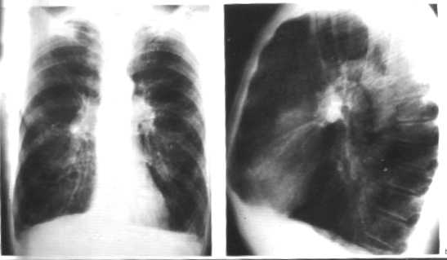
Hyperinflated Lungs : COPD
Notes:
Although there is considerable variability in the relationships between the FEV₁ and other physiologic abnormalities in COPD, certain generalizations may be made. The Pa_{O2} usually remains near normal until the FEV₁ is decreased to ~50% of predicted, and even much lower FEV₁ values can be associated with a normal Pa_{O2}, at least at rest. An elevation of arterial level of carbon dioxide (Pa_{CO2}) is not expected until the FEV₁ is <25% of predicted and even then may not occur. Pulmonary hypertension severe enough to cause cor pulmonale and right ventricular failure due to COPD typically occurs in individuals who have marked decreases in FEV₁ (<25% of predicted) and chronic hypoxemia (Pa_{O2} <55 mmHg); however, recent evidence suggests that some patients will develop significant pulmonary hypertension independent of COPD severity (Chap. 250).
Nonuniform ventilation and ventilation-perfusion mismatching are characteristic of COPD, reflecting the heterogeneous nature of the disease process within the airways and lung parenchyma. Physiologic studies are consistent with multiple parenchymal compartments having different rates of ventilation due to regional differences in compliance and airway resistance. Ventilation-perfusion mismatching accounts for essentially all of the reduction in Pa_{O2} that occurs in COPD; shunting is minimal. This finding explains the effectiveness of modest elevations of inspired oxygen in treating hypoxemia due to COPD and therefore the need to consider problems other than COPD when hypoxemia is difficult to correct with modest levels of supplemental oxygen in the patient with COPD.

Slide 12
Causes of Hypoxemic Respiratory failure (cont’d.)
Focal infiltrates on CXR
Atelectasis
Pneumonia

Slide 13
Causes of Hypoxemic Respiratory Failure (cont’d.)
Diffuse infiltrates on CXR
Cardiogenic Pulmonary Edema
Non cardiogenic pulmonary edema (ARDS)
Interstitial pneumonitis or fibrosis
Infections

Slide 14
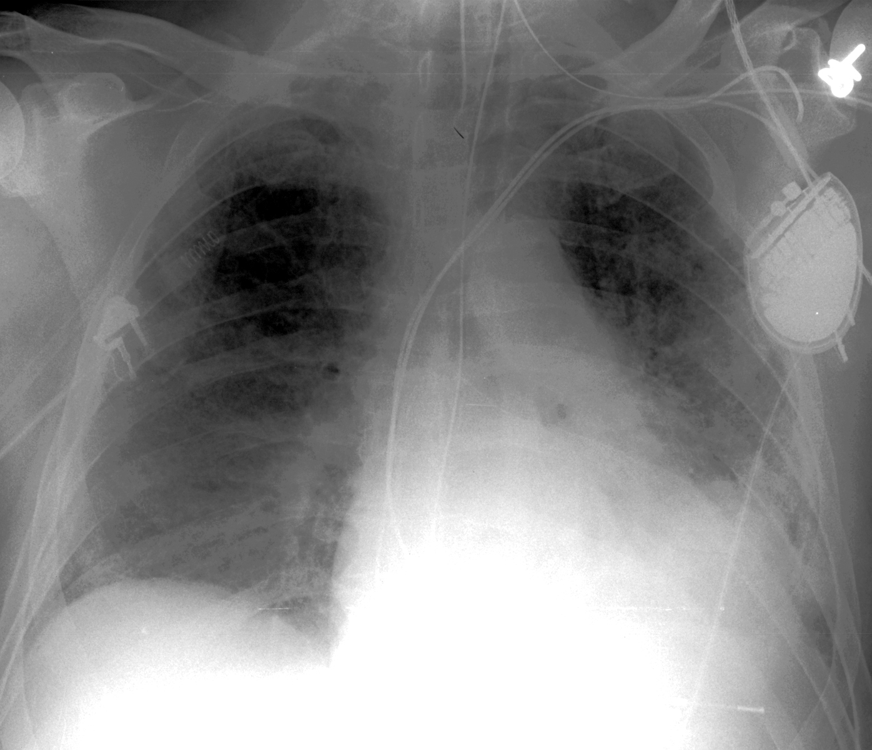
Diffuse pulmonary infiltrates

Slide 15
Acute Respiratory Distress Syndrome
Notes:
Acute respiratory distress syndrome (ARDS) is a clinical syndrome of severe dyspnea of rapid onset, hypoxemia, and diffuse pulmonary infiltrates leading to respiratory failure. ARDS is caused by diffuse lung injury from many underlying medical and surgical disorders. The lung injury may be direct, as occurs in toxic inhalation, or indirect, as occurs in sepsis (Table 268-1). The clinical features of ARDS are listed in Table 268-2. Acute lung injury (ALI) is a less severe disorder but has the potential to evolve into ARDS (Table 268-2). The arterial (a) PO₂ (in mmHg)/FIO₂ (inspiratory O₂ fraction) <200 mmHg is characteristic of ARDS, while a PaO₂/FIO₂ between 200 and 300 identifies patients with ALI who are likely to benefit from aggressive therapy

Slide 16
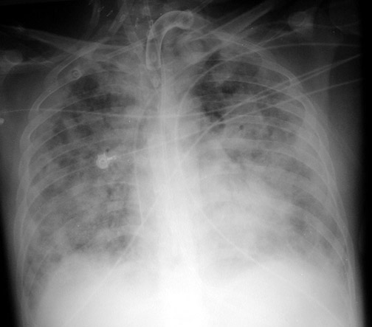
Bernard et al. AJRCCM 1994; 149:818
Rice et al. Chest 2007: 132: 410
Notes:
Non-cardiogenic pulmonary edema
Profound hypoxemia – difference between ali and ards.

Slide 18
Pneumonia
35%
ARDS network N Engl J Med 2000; 342:1301
Notes:
The exudative phase is notable for early alveolar edema and neutrophil-rich leukocytic infiltration of the lungs with subsequent formation of hyaline membranes from diffuse alveolar damage. Within 7 days, a proliferative phase ensues with prominent interstitial inflammation and early fibrotic changes. Approximately 3 weeks after the initial pulmonary injury, most patients recover. However, some patients enter the fibrotic phase, with substantial fibrosis and bullae formation.

Slide 19
CARDIOGENIC PULMONARY EDEMA
Pulmonary edema is an increase in extravascular lung water
Alveolar edema cause several gas exchange abnormalities
Movement of fluid is governed by Starling’s equation
QF = KF [(P_{IV} - P_{IS} ) + σ ( π_{IS} - π_{IV} )]
QF = rate of fluid movement KF = membrane permeability P_{IV} & P_{IS} are intra vascular and interstitial hydrostatic pressures π_{IS} and π_{IV} are interstitial and intravascular oncotic pressures
σ reflection coefficient
Lung edema is cleared by lymphatics

Slide 20
Hypercapnic Respiratory Failure (Type II)
PaCO₂ >55 mmHg
Hypoxemia is always present
pH depends on level of HCO₃
HCO₃ depends on duration of hypercapnia
Renal response occurs over days to weeks

Slide 21
Acute Hypercapnic Respiratory Failure (Type II)
-Acute
Arterial pH is low
Causes
- sedative drug over dose
- acute muscle weakness such as myasthenia gravis
- severe lung disease: alveolar ventilation can not be maintained (i.e. Asthma or
pneumonia)
-Acute on chronic:
This occurs in patients with chronic CO₂ retention who worsen and have rising CO₂ and low pH.
Mechanism: respiratory muscle fatigue
Notes:
This type of respiratory failure occurs as a result of alveolar hypoventilation and results in the inability to eliminate carbon dioxide effectively. Mechanisms by which this occurs are categorized by impaired central nervous system (CNS) drive to breathe, impaired strength with failure of neuromuscular function in the respiratory system, and increased load(s) on the respiratory system. Reasons for diminished CNS drive to breathe include drug overdose, brainstem injury, sleep-disordered breathing, and hypothyroidism. Reduced strength can be due to impaired neuromuscular transmission (e.g., myasthenia gravis, Guillain-Barré syndrome, amyotrophic lateral sclerosis, phrenic nerve injury) or respiratory muscle weakness (e.g., myopathy, electrolyte derangements, fatigue).
The overall load on the respiratory system can be subclassified into increased resistive loads (e.g., bronchospasm), loads due to reduced lung compliance [e.g., alveolar edema, atelectasis, intrinsic positive end-expiratory pressure (autoPEEP)—see below], loads due to reduced chest wall compliance (e.g., pneumothorax, pleural effusion, abdominal distention), and loads due to increased minute ventilation requirements (e.g., pulmonary embolus with increased dead space fraction, sepsis).
The mainstays of therapy for type II respiratory failure are treatments directed at reversing the underlying cause(s) of ventilatory failure. Noninvasive positive-pressure ventilation using a mechanical ventilator with a tight-fitting face or nasal mask that avoids endotracheal intubation often can stabilize these patients. This approach has been shown to be beneficial in treating patients with exacerbations of chronic obstructive pulmonary disease. Noninvasive ventilation has been tested less extensively in other types of type II respiratory failure but may be attempted nonetheless in the absence of contraindications (hemodynamic instability, inability to protect airway, respiratory arrest).

Slide 22
Causes of Hypercapnic Respiratory failure
Respiratory centre (medulla) dysfunction
Drug over dose, CVA, tumor, hypothyroidism,central hypoventilation
Neuromuscular disease-Guillain-Barre, Myasthenia Gravis, polio, spinal injuries
Chest wall/Pleural diseases,kyphoscoliosis, pneumothorax, massive pleural effusion
Upper airways obstruction-tumor, foreign body, laryngeal edema
Peripheral airway disorder-asthma, COPD
Notes:
Most commonly, acute or chronic obstructive lung disease presents with hypercarbia; however, many diseases of the respiratory system can cause hypercarbia if the resulting increase in work of breathing is greater than that which allows a patient to sustain an adequate minute ventilation.

Slide 23
Clinical Manifestation of Acute Resp. Failure
Asterexis,with warm peripheries, bounding pulses in severe hypercapnia
Airway obstruction-Intercostal indrawing, wheeze, pursing lips, tracheal tug
Cyanosis bluish color of mucous membranes/skin indicate
hypoxemia
- deoxygenated hemoglobin of 5g/dl.
Dyspnea - secondary to hypercapnia and hypoxemia
Confusion, somnolence and coma
Convulsions

Slide 24
ASSESSMENT OF PATIENT
Careful history
Physical Examination
Pulse oximetry
ABG analysis , calculation of an alveolar gas and arterial blood oxygen tension difference [(A-a)DO₂]. -classify RF and help with cause
Lung function tests
Chest Radiograph (AP/lat), CT chest, CTPA.
EKG
Notes:
The Alveolar–arterial gradient (A-aO₂,^{[1]} or A–a gradient), is a measure of the difference between the alveolar concentration (A) of oxygen and the arterial (a) concentration of oxygen. It is used in diagnosing the source of hypoxemia.^{[2]} It helps to assess the integrity of alveolar capillary unit. For example, in high altitude, the arterial oxygen [[PaO₂]] is low but only because the alveolar oxygen (PAO₂) is also low. However, in states of ventilation perfusion mismatch, such as pulmonary embolism or right-to-left shunt, oxygen is not effectively transferred from the alveoli to the blood which results in elevated A-a gradient
A normal A–a gradient for a young adult non-smoker breathing air, is between 5–10 mmHg. Normally, the A–a gradient increases with age. For every decade a person has lived, their A–a gradient is expected to increase by 1 mmHg. A conservative estimate of normal A–a gradient is less than [age in years/4] + 4. Thus, a 40-year-old should have an A–a gradient less than 14. A calculator that provides the predicted normal values for the A-a gradient based on age, sex, height and weight is available online.
An abnormally increased A–a gradient suggests a defect in diffusion, V/Q (ventilation/perfusion ratio) mismatch, or right-to-left shunt.^{[4]}
Because A–a gradient is approximated as: (150 − 5/4(pCO₂)) – Pa_{O2} at sea level and on room air (0.21x(760-47) = 149.7 mmHg for the alveolar oxygen partial pressure, after accounting for the water vapor), the direct mathematical cause of a large value is that the blood has a low P_{O2}, a low P_{CO2}, or both. CO2 is very easily exchanged in the lungs and low P_{CO2} directly correlates with high minute ventilation; therefore a low arterial P_{CO2} indicates that extra respiratory effort is being used to oxygenate the blood. A low Pa_{O2}indicates that at the patient's current minute ventilation (whether high or normal) is not enough to allow adequate oxygen diffusion into the blood. Therefore the A–a gradient essentially demonstrates a high respiratory effort (low arterial P_{CO2}) relative to the achieved level of oxygenation (arterial P_{O2}). A high A–a gradient could indicate a patient breathing hard to achieve normal oxygenation, a patient breathing normally and attaining low oxygenation, or a patient breathing hard and still failing to achieve normal oxygenation.
At the end of each tidal exhalation, the conducting airways are filled with alveolar gas that had not reached the mouth when expiratory flow stopped. During the ensuing inhalation, fresh gas immediately enters the airway tree at the mouth, but the gas first entering the alveoli at the start of inhalation is that same alveolar gas in the conducting airways that had just left the alveoli. As such, fresh gas does not enter the alveoli until the volume of the conducting airways has been inspired. This volume is called the anatomic dead space. Quiet breathing with tidal volumes smaller than the anatomic dead space introduces no fresh gas into the alveoli at all; only that part of the inspired tidal volume (V_{T}) that is greater than the dead space (V_{D}) introduces fresh gas into the alveoli. Importantly, the dead space can be further increased functionally if some of the inspired tidal volume is delivered to a part of the lung that receives no pulmonary blood flow, and, thus, cannot contribute to gas exchange, as can occur in the portion of the lung distal to a large pulmonary embolus. As such, exhaled minute ventilation (_{E} = V_{T} x RR) includes a component of dead space ventilation (_{D} = V_{D} x RR) and a component of fresh gas alveolar ventilation (_{A} = [V_{T} – V_{D}] x RR). Carbon dioxide elimination from the alveoli is equal to _{A} times the difference in CO₂ fraction between inspired air (essentially zero) and alveolar gas (typically 5.6%, after correcting for humidification of inspired air, corresponding to 40 mmHg). In the steady state, the alveolar fraction of CO₂ is equal to the metabolic CO₂ production divided by the alveolar ventilation. Because, as discussed below, alveolar and arterial CO₂ tensions are equal, and because the respiratory controller normally strives to maintain arterial P_{CO2} (Pa_{CO2}) at 40 mmHg, the adequacy of alveolar ventilation is reflected in Pa_{CO2}. If Pa_{CO2} falls much below 40 mmHg, alveolar hyperventilation is present, and if Pa_{CO2} exceeds 40 mmHg, then alveolar hypoventilation is present. Ventilatory failure is characterized by extreme alveolar hypoventilation.
As a consequence of oxygen uptake of alveolar gas into capillary blood, alveolar oxygen tension falls below that of inspired gas. The rate of oxygen uptake (determined by the body's metabolic oxygen consumption) is related to the average rate of metabolic carbon dioxide production and their ratio, called the "respiratory quotient" (R = CO₂/ O₂), depends largely on the fuel being metabolized. For a typical A merican diet, R is usually around 0.85, and more oxygen is absorbed than CO₂ is excreted. Together, these phenomena allow the estimation of alveolar oxygen tension, according to the following relationship, known as the alveolar gas equation:
Pa_{O2} = FI_{O2} x (P_{bar} – P_{H2O}) – Pa_{CO2}/R
The alveolar gas equation also highlights the influences of inspired oxygen fraction (FI_{O2}), barometric pressure (P_{bar}), and vapor pressure of water (P_{H2O} = 47 mmHg at 37°C) in addition to alveolar ventilation (which sets PA_{CO2}) in determining P_{A}O₂. An implication of the alveolar gas equation is that severe arterial hypoxemia rarely occurs as a pure consequence of alveolar hypoventilation at sea level while breathing air. The potential for alveolar hypoventilation to induce severe hypoxemia with otherwise normal lungs increases as P_{bar} falls with increasing altitude.
Ca_{O2} (mL/dL = 1.34 (mL/dL/g) x [hemoglobin](g) x%O₂Sat + 0.003 (mL/dL/mmHg) x Pa_{O2} (mmHg)
Instead, the oxygen saturation fraction of hemoglobin can be measured continuously using pulse oximetry, a tool that measures the absorbance by hemoglobin of several wavelengths of light transmitted across a finger, toe, or ear by a noninvasive probe. However, since oxygen content varies relatively little with Pa_{O2} at saturations above 90%, it is difficult to know the precise Pa_{O2} using this device. In addition, as noted above, Pa_{CO2} is needed to fully assess the mechanism of hypoxemia, a value that is not revealed by pulse oximetry.
It should also be noted that at times, most often due to abnormal hemoglobins or non-oxygen hemoglobin-ligand complexes, pulse oximetry can be misleading (such as observed with carboxyhemoglobin).
opacities of the parenchyma, blunting of the costophrenic angles, mass lesions, and volume loss, can be very helpful in determining an etiology. It should be noted that many diseases of the respiratory system, particularly those of the airways and pulmonary vasculature, are associated with a normal chest radiograph.
Subsequent computed tomography of the chest (CT scan) is often obtained. The CT scan allows better delineation of parenchymal processes, pleural disease, masses or nodules, and large airways. If administered with contrast, the pulmonary vasculature can be assessed with particular utility for determination of pulmonary emboli. Intravenous contrast also allows lymph nodes to be delineated in greater detail.

Slide 25
Management of Respiratory Failure Principles
Hypoxemia may cause death in RF
Primary objective is to reverse and prevent hypoxemia
Secondary objective is to control PaCO₂ and respiratory acidosis (usually tolerated till pH 7.2)
Treatment of underlying disease
Patient’s CNS and CVS must be monitored and treated

Slide 26
Oxygen Therapy
Supplemental O₂ therapy essential
titration based on SaO₂, PaO₂ levels and PaCO₂
Goal is to prevent tissue hypoxia
Goal:Increase arterial PaO₂ > 60 mmHg(at least to 54mmHg)(SaO₂ > 90%) or venous SaO₂ > 60%
O₂ dose either flow rate (L/min) or FiO₂ (%)
Start with FiO2 24% , increase depending on response(type II). Type I require high conc. (eg 60% , face mask)
Repeat ABG in 20 min.
Notes:
O₂ toxicity: - very high levels(>1000 mmHg) CNS toxicity and seizures - lower levels (FiO₂ > 60%) and longer exposure: - capillary damage, leak and pulmonary fibrosis - PaO₂ >150 can cause retrolental fibroplasia - FiO₂ 35 to 40% can be safely tolerated indefinitely
CO₂ narcosis: - PaCO₂ may increase severely to cause respiratory acidosis, somnolence and coma
- PaCO₂ increase secondary to combination of a) abolition of hypoxic drive to breathe b) increase in dead space
Although prolonged exposure to 100% inspired oxygen (FIO₂=1.0) has potential toxicity, there is insufficient evidence to indicate that this occurs during brief periods of adult CPR.^{3–5} Empirical use of 100% inspired oxygen during CPR optimizes arterial oxyhemoglobin content and in turn oxygen delivery; therefore, use of 100% inspired oxygen (FIO₂=1.0) as soon as it becomes available is reasonable during resuscitation from cardiac arrest

Slide 27
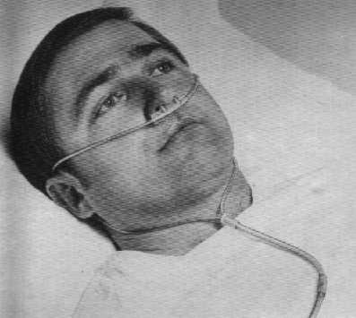
Notes:
First-Line Options
Standard nasal cannula The standard nasal cannula delivers an inspiratory oxygen fraction (FI,O₂) of 24-40% at supply flows ranging from 1-5 L·min-1. The formula is FI,O₂ = 20% + (4 × oxygen litre flow). The FI,O₂ is influenced by breath rate, tidal volume and pathophysiology. The slower the inspiratory flow the higher the FI,O₂ [6].
Venturi mask A Venturi mask mixes oxygen with room air, creating high-flow enriched oxygen of a settable concentration. It provides an accurate and constant FI,O₂. Typical FI,O₂ delivery settings are 24, 28, 31, 35 and 40% oxygen. The Venturi mask is often employed when the clinician has a concern about CO₂ retention [2].
Second-Line Options
Simple face mask The volume of the face mask is 100-300 mL. It delivers an FI,O₂ of 40-60% at 5-10 L·min⁻¹. The FI,O₂ is influenced by breath rate, tidal volume and pathology. The face mask is indicated in patients with nasal irritation or epistaxis. It is also useful for patients who are strictly mouth breathers. However, the face mask is obtrusive, uncomfortable and confining. It muffles communication, obstructs coughing and impedes eating [2].
Nonrebreathing face mask with reservoir and one-way valve The nonrebreathing face mask is indicated when an FI,O₂ >40% is required. It may deliver FI,O₂ up to 90% at high flow settings. Oxygen flows into the reservoir at 8-10 L·min⁻¹, washing the patient with a high concentration of oxygen. Its major drawback is that the mask must be tightly sealed on the face, which is uncomfortable. There is also a risk of CO₂ retention[2].
Reservoir cannulas Reservoir cannulas improve the efficiency of oxygen delivery. Hence, patients may be well oxygenated at lower flows. Litre flows of =8 L·min⁻¹ have been reported to adequately oxygenate patients with a high flow requirement [7, 8].
High-flow transtracheal catheters Transtracheal catheters deliver oxygen directly into the trachea. There are wash-out and storage effects that promote gas exchange as well as providing high-flow oxygen. High-flow transtracheal catheters may reduce the work of breathing and augment CO₂ removal. Patients who have been extubated may benefit from an interim of high-flow transtracheal oxygen to better ensure weaning success [9, 10].

Slide 28
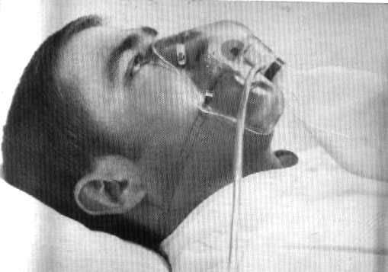

Slide 29
Estimating FiO₂

Slide 30
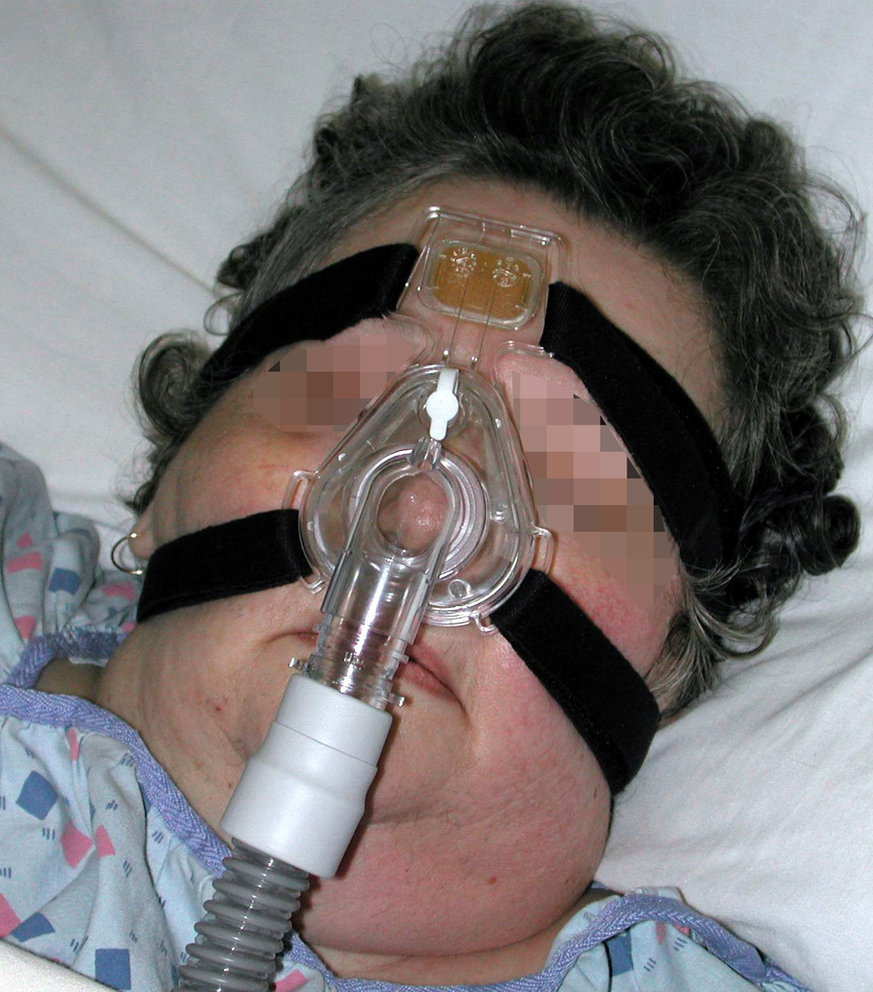
Noninvasive Ventilation
Notes:
The most important group of patients who benefit from a trial of NIV are those with acute exacerbations of chronic obstructive pulmonary disease (COPD) leading to respiratory acidosis (pH <7.35). Experience from several well-conducted randomized trials has shown that in patients with ventilatory failure characterized by blood pH levels between 7.25 and 7.35, NIV is associated with low failure rates (15–20%) and good outcomes (intubation rate, length of stay in intensive care, and in some series mortality rates). In more severely ill patients with pH <7.25, the rate of NIV failure is inversely related to the severity of respiratory acidosis, with greater failure as the pH decreases. In patients with milder acidosis (pH >7.35), NIV is not better than conventional therapy that includes controlled oxygen delivery and pharmacotherapy for exacerbations of COPD (systemic corticosteroids, bronchodilators, and, if needed, antibiotics).
Table 269–1. Contraindications for Noninvasive Ventilation
Cardiac or respiratory arrest Severe encephalopathy Severe gastrointestinal bleed Hemodynamic instability Unstable angina and myocardial infarction Facial surgery or trauma Upper airway obstruction High-risk aspiration and/or inability to protect airways Inability to clear secretions

Slide 31
Indications for Intubation
Inadequate oxygenation(decreased arterial PO2) that is not corrected by supplemental oxygen via mask/nasal.
Inadequate ventilation (increased arterial PCO2).
Need to control and remove pulmonary secretions.
Any patient in cardiac arrest.

Slide 32
Indications for Intubation
Any patient in deep coma who cannot protect his airway.(Gag reflex absent.).
Any patient in imminent danger of upper airway obstruction (e.g. Burns of the upper airways).
Any patient with decreased L.O.C, GCS <= 8.
Severe head and facial injuries with compromised airway.

Slide 33
MECHANICAL VENTILATION
Non invasive with a mask
Invasive with an endobronchial tube
MV can be volume or pressure cycled
For hypercapnia:
- MV increases alveolar ventilation and lowers
PaCO₂, corrects pH
- rests fatigues respiratory muscles
For hypoxemia: - O₂ therapy alone does not correct hypoxemia caused by shunt
- Most common cause of shunt is fluid filled or collapsed alveoli (Pulmonary edema)

Slide 34
POSITIVE END EXPIRATORY PRESSURE
PEEP increases the end expiratory lung volume (FRC)
PEEP recruits collapsed alveoli and prevents recollapse
FRC increases, therefore lung becomes more compliant
Reversal of atelectasis diminishes intrapulmonary shunt
Excessive PEEP has adverse effects - decreased cardiac output - barotrauma (pneumothorax, pneumomediastinum) - increased physiologic dead space - increased work of breathing

Slide 35
Other measures
Nebulised bronchodilators, Mg So4, Steroids if acute severe asthma; COPD.
Antibiotics
Diuretics
Thrombolytics, Anticoagulant

Slide 36
MANAGEMENT OF ARDS
Mechanical ventilation
Lung protective strategies-Low Tidal volume ventilation(6ml/kg)
Application of positive end expiratory pressure
Fluid conservative management
Mortality continues to be 50 to 60%
Extracorporal membrane oxygenation for severe reversible resp failure.
Notes:
led to a multicenter, randomized, prospective trial to compare traditional ventilator strategies for acute lung injury and ARDS (large tidal volume—12 mL/kg ideal body weight) to a low tidal volume (6 mL/kg ideal body weight). This study showed a dramatic reduction in mortality rate in the low tidal volume group (large tidal volume—39.8% mortality rate versus low tidal volume—31% mortality rate) and confirmed that ventilator management could affect outcomes in these patients. In addition, a "fluid conservative" management strategy [maintaining a relatively low central venous pressure (CVP) or pulmonary capillary wedge pressure (PCWP)] is associated with the need for fewer days of mechanical ventilation compared with a "fluid liberal" management strategy (maintaining a relatively high CVP or PCWP) in acute lung injury and ARDS.
Low tidal volume A Minimize left atrial filling pressures B High-PEEP or "open lung

Slide 37
Key messages
Etiology of hypoxemic (type 1) respiratory failure may be due to v/q mismatch; shunt; diffusion problem; hypoventilation or low Fio2
Acute respiratory distress syndrome-Diagnosis based on acute bilateral CXR infitrates, reduced Pa)2/Fio2<300 without heart failure or fluid overload.
Non invasive ventilation esps. If COPD/ heart failure;without contraindication.

Slide 38
Questions?

