Slide 1
RESPIRATORY MEDICINE
COMPILED BY EFFIE NAILA

Slide 2
1. OVERVIEW OF STRUCTURE AND FUNCTION OF THE RESPIRATORY MEDICINE – CLINICAL CORRELATIONS
DATE: 6/9/2016
BY: DR. J. O. MECHA

Slide 3
FUNCTIONS
PRIMARY FUNCTIONS
  Gas exchange
  Blood reservoir
  Host defense
  Metabolism (synthesis and catabolism)
  Heat exchange
SUPPORTIVE FUNCTIONS
Speech
Sleep

Slide 4
CONT.
Warming the air that is breathed in (thermoregulatory role)
Immunologic function
  Mechanical:
    Filtering out particulate matter from the air that is breathed
    Cough reflex
    Muco-ciliary function
  Functional role:
    Immune cells along the respiratory tract
Acid base balance
Gaseous exchange
BP regulation: Role in RAAS
Regulation of breathing
Role in sleep
REVIEW EMBRYOLOGY OF THE RESPIRATORY SYSTEM

Slide 5
CONGENITAL ANOMALIES
Esophageal atresia without fistula
Esophageal atresia with fistula
Esophageotracheal fistula
Tracheal stenosis
Sequestration
REVIEW HOW TO INSERT THE NG TUBE

Slide 6
TRACHEAL ANATOMY
Trachea: connects larynx to primary bronchi
In adults → 1.4 to 1.6 cm; diameter and 10-13 cm long
Begins immediately inferior to the cricoid cartilage
Bifurcates at T5

Slide 7
HISTOLOGY
Typically ciliated pseudo-stratified columnar
Failure of the mucociliary escalator motility
  Bronchiectasis
Cystic fibrosis
  Commonest genetic disease of the respiratory tract

Slide 8
TRACHEAL DISORDERS
Stenosis
  Tumors (malignant or benign)
  Prolonged endotracheal intubation
    Stridor (monophonic – upper airway obstruction, inspiratory), wheeze (polyphonic, generalized airway contraction, expiratory)

Slide 9
MAIN/PRIMARY BRONCHI
Similar structure to trachea
Originates at T4/t5
Right is shorter, wider in diameter and more vertical than the left.
Most aspirated foreign objects tend to go to the right
  Presentation:
    Recurrent pneumonia due to reduced draining of secretions beyond the object.
If complete obstruction
  Atelectasis due to alveolar collapse
Examination
  Rhonchi (unilateral)

Slide 10
ALVEOLI
Functional unit of the lung
Alveolar epithelium
  Alveolar type I cells
    Thin, flat, gaseous exchange
  Alveolar type II cells
    Secrete surfactant that increases pulmonary compliance by reducing surface tension
Pulmonary capillaries
Very thin interstitium
What could go wrong:
  Fibrosis e.g. interstitial lung disease
  Pulmonary edema in HF
    ARDS

Slide 11
RHYTHMIC NATURE OF BREATHING
Respiratory rhythm generator
  Located in medulla
REVIEW CENTRAL CONTROL AND MECHANISM OF INSPIRATION AND EXPIRATION.

Slide 12
CONTROL OF VENTILATION: Central and peripheral chemoreceptors
Peripheral
  In carotid and aortic bodies
  Stimulated by
    Increased PCO2
    Reduced PO2
    Reduced pH
Central
  In medulla (brain ISF)
  Stimulated by increased PCO2 via a decrease in pH
Response:
  Change in tidal volume
  Change in rhythm
What could go wrong:
  Head injury → Raised ICP, opiate toxicity,
  Presentation
    Bradypnea (below 12 breaths per minute)
  CO2 retention in COPD; reset set points due to persistent hyper-capnea

Slide 13
APPROACH TO THE PATIENT WITH RESPIRATORY DISEASE
Presentation
  COUGH
    Productive → inflammatory process (excessive productions of secretions)
      Infectious or non-infectious
    Associated wheeze, hemoptysis, chest pain etc.
      Wheeze is a sign of airflow obstruction and is polyphonic
    Sound characteristic of the cough
      Barking: Upper airway disorders
      Bovine: Paralysis of the vocal chords due to damage of the recurrent laryngeal nerve
    Cough reflex
      Recurrent laryngeal nerve
  SPUTUM PRODUCTION
    Huge amount of sputum, purulent: lung abscess, bronchiectasis

Slide 14
CONT.
CHEST PAIN
BREATHLESSNESS
EPISTAXIS
SNORING
  Esp. in patients with excessive day time sleepiness
  Sleep apnea

Slide 15
SURFACE LANDMARKS OF THE LUNGS
Boundaries of the normal lung
  Upper border: clavicle (dome of the lungs is just above the clavivle)
  Lower border: xyphi sternum
Others
  Suprasternal notchs
  Sternum
  Sternal angle
Anterior chest reference lines
  Mid-sternal
  Mid-clavicular
Posterior
  Vertebral line
  Scapula line
Laterally
  Posterior, mid, anterior axillary

Slide 16
REFERENCE RANGES
RR
  12 – 16 breaths per minute
  RR > 24 → critical illness esp. when associated with DIB
  Raised RR is a strong predictor of serious adverse events in both ambulatory and hospital settings
  CO2 retention → high volume pulse
Alveolar ventilation = TV X RR
  PaCO2 is the most important driver
  Body corrects changed in hypoxemia and hyper-carbia by increasing TV and/or RR

Slide 17
COMMUNITY ACQUIRED PNEUMONIA
MBChB V
08/09/2016
DR Marybeth C. Maritim

Slide 18
Lecture Objectives
Define community acquired pneumonia
Describe the etiologic agents (Microbiology)
Risk factors for (Epidemiology)
Clinical features (Imed + Pathology)
Investigations (Radiology, Microbiology, Haematology, )
Treatment (Pharmacology)
Complications (Imed)
Preventive measures of community acquired pneumonia (Imed)

Slide 19
Clinical Case
JK, 70 yr old male admitted with 3day Hx of cough, chest pain, fever and confusion
Has been living at Mji wa Furaha Old People’s home for the past 10 yrs. Hx of smoking, 5-pack years but stopped several yrs ago
O/E sick-looking, tachypnoeic, RR-40b/min, BP -100/50mmHg, features of consolidation RT middle lobe
What is your diagnosis?
What investigations would you do and why?

Slide 20
Pneumonia
Definition
Acute respiratory illness associated with recently developed radiological pulmonary shadowing which is either segmental or lobar
Pneumonia may be bacterial, viral, mycobacterial or fungal

Slide 21
Classification of Pneumonias
1) Community-acquired pneumonia
2) Hospital-acquired pneumonia
3) Aspiration pneumonia (including suppurative pneumonia)
4) Pneumonia in the immunocompromised host

Slide 22
Community-acquired Pneumonia (CAP)
Definition
Pneumonia acquired in the patient’s home or in the non-hospital environment such as a nursing home
Mainly spread by inhalational

Slide 23
CAP
Lobar pneumonia - radiological and pathological term referring to homogeneous opacification (red hepatisation) of one or more lung lobes often associated with pleural inflammation
Bronchopneumonia - patchy alveolar consolidation associated with bronchial and bronchiolar inflammation affecting both lower lobes

Slide 24
CAP
Etiologic Agents (Organisms)
Streptococcus pneumoniae 30%
Chlamydia pneumoniae 10%
Mycoplasma pneumoniae 9%
Legionella pneumophila 5%
Hemophilus influenza 3%

Slide 25
CAP
Etiologic Agents (Organisms)
Others – Staphylococcus aureus, Chlamydia psittaci, Coxiella burnetti, Klebsiella pneumoniae, Actinomyces israeli all <1%.
Viruses – Influenza virus 7-8% of CAP
- Parainfluenza
- Measles
- Respiratory syncytial virus (RSV) in infancy
- Varicella (chicken pox)

Slide 26
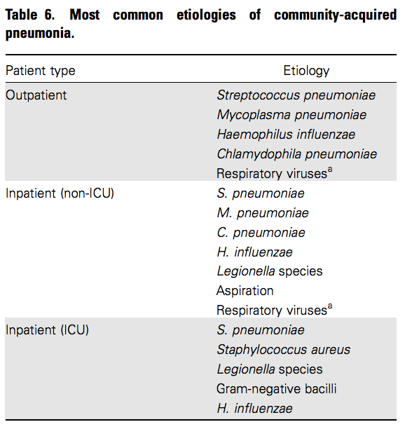

Slide 27
Risk Factors
Cigarette smoking
Alcohol intake
Corticosteroid therapy
Old age
Recent influenza infection
Preexisting lung disease
Contact with sick birds (Chlamydia psittaci)
Farm environments (Coxiella burnetti)

Slide 28
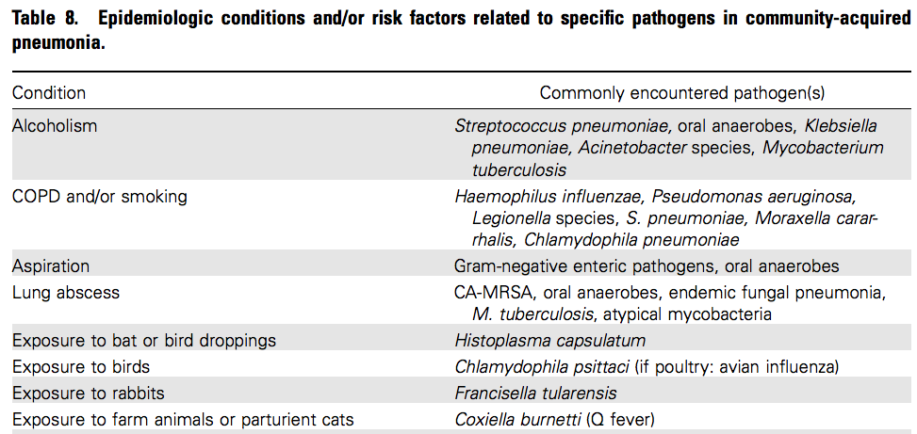

Slide 29
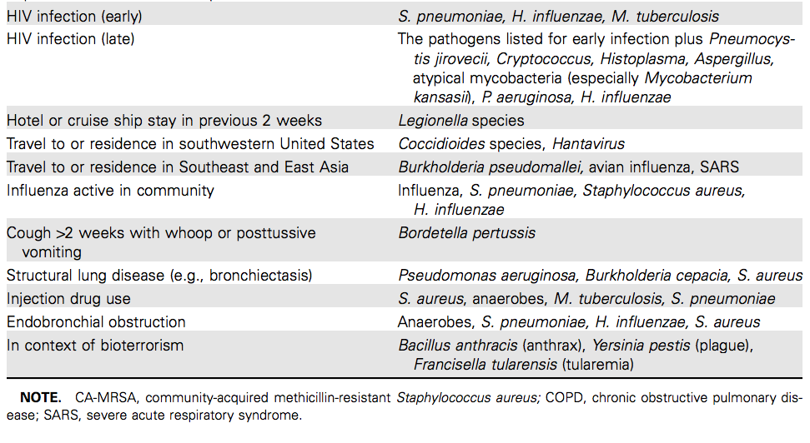

Slide 30
Clinical Features - Symptoms
Cough – productive of rust coloured sputum.
Fever
Malaise
Pleuritic chest pain
Headache
Confusion

Slide 31
Clinical Features - Signs
Fever
Tachycardia
Tachypnoea
Hypoxemia
Hypotension
Confusion
Pleural rub
Signs of consolidation – dull percussion note and bronchial breath sounds
Crepitations
Signs of a pleural effusion – stony dullness and absent or reduced breath sounds.

Slide 32
Investigations
1) Chest radiograph – homogenous opacity localised to the affected lobe or segment
Is useful in identifying pleural effusion, intrapulmonary abscess formation or when empyema is suspected
Hilar lymphadenopathy is seen in Mycoplasma pneumonia

Slide 33
Investigations 2
2)Microbiological Investigations
- sputum microscopy, culture and sensitivity
- aspiration of tracheal/ bronchial secretions during bronchoscopy for M/C/S
- Blood cultures and sensitivity patterns
3) Arterial blood gas measurement for assessment of disease severity

Slide 34
Investigations
4) Complete blood count
- Neutrophil leucocytosis suggests bacterial pneumonia
- Leucopenia suggests viral etiology

Slide 35
Assessment of Disease Severity
Clinical parameters
- Age of 60yrs or older
- Respiratory rate >30/min
- Diastolic blood pressure 60mmHg or less
- Confusion
- More than 1 lobe involved in CXR
- Presence of underlying disease

Slide 36
Assessment Of Disease Severity
Laboratory parameters
- Hypoxemia (PaO2 <8kPa)
- Leucopenia (<4000x10⁹/L)
- Leucocytosis (>20000x10⁹/L)
- Raised serum urea ≥7mmol/L
- Positive blood culture
- Hypoalbuminemia

Slide 37
Assessment Of Disease Severity
The 4 cardinal markers of severity are:-
- RR ≥30/ min
- Diastolic BP ≤60mmHg
- Serum BUN of ≥7mmol/L
- Presence of confusion
Patients with ≥2 of the 4 cardinal markers of severity have a 36-fold higher risk of dying compared with patients without these signs

Slide 38
Treatment
Supportive and specific treatment
Good response to antibiotic therapy
When there is delayed recovery suspect:-
- complications
- wrong diagnosis
- proximal bronchial obstruction
- recurrent aspirate

Slide 39
Supportive Treatment
Oxygen- for all hypoxemic patients. Use concentrations ≥35% in those without advanced COPD or hypercapnia
IV fluids
Physiotherapy
Pain relief with paracetamol or if severe then with pethidine or morphine.

Slide 40
Empiric Treatment
Pretreatment specimen samples (blood cultures and expectorated sputum) should be obtained for microbiological evaluation before starting empirical therapy
Combination empirical treatment is recommended

Slide 41
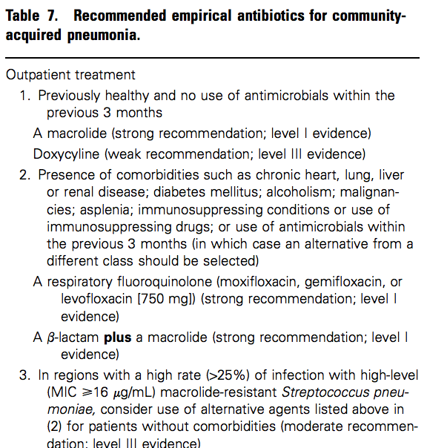

Slide 42
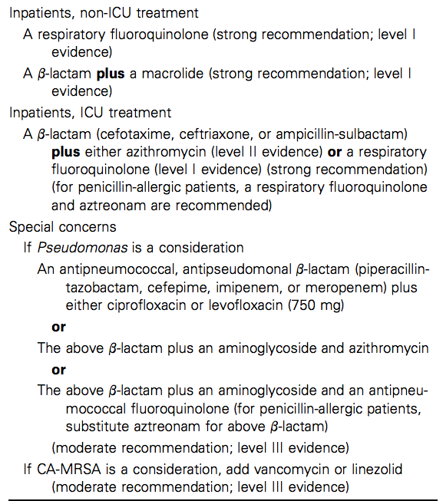

Slide 43
Specific Treatment
Antibiotic therapy – given after results of collected specimens have been
  Strep. pneumoniae – ceftriaxone
  Klebsiella pneumoniae - gentamicin and ceftazidime
  Chlamydia pneumoniae - erythromycin or tetracycline
  Chlamydia psittaci – tetracycline
  Actinomycosis – benzyl penicillin
  Varicella pneumonia – oral acyclovir

Slide 44
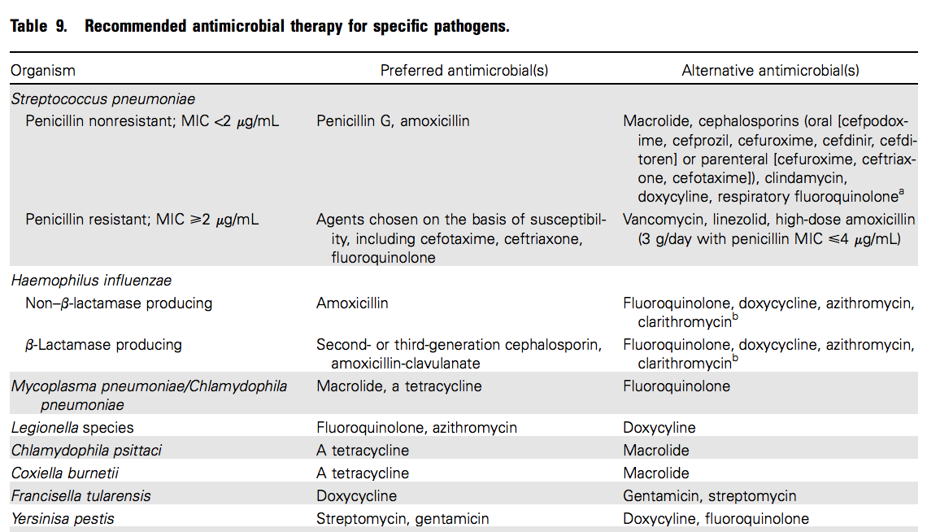

Slide 45
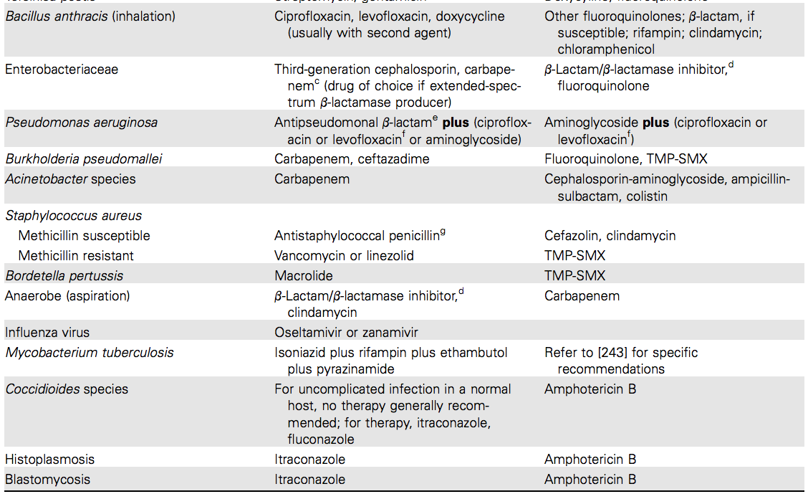

Slide 46
Complications
Parapneumonic effusions
Empyema
Sputum retention
Pneumothorax

Slide 47
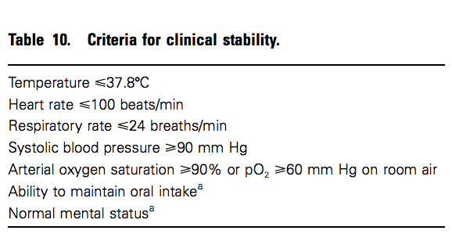

Slide 48
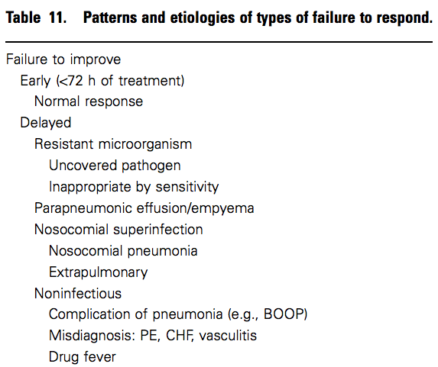

Slide 49
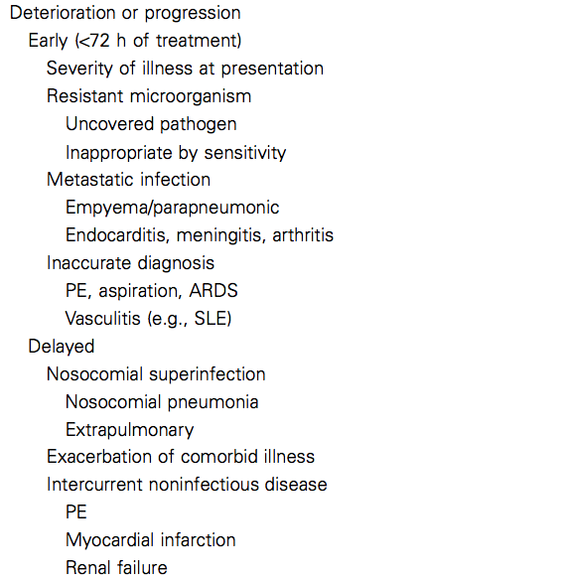

Slide 50
Prevention
Immunization with influenza A/B for all people >50yrs
Immunization with 23 polyvalent pneumococcal and H. influenza type B vaccines for all susceptible people e.g.
  elderly>65yrs
  co morbidities like diabetes, immunocompromised, sickle cell disease or asplenia.
Treatment of water sources to prevent Legionella pneumophila

Slide 51
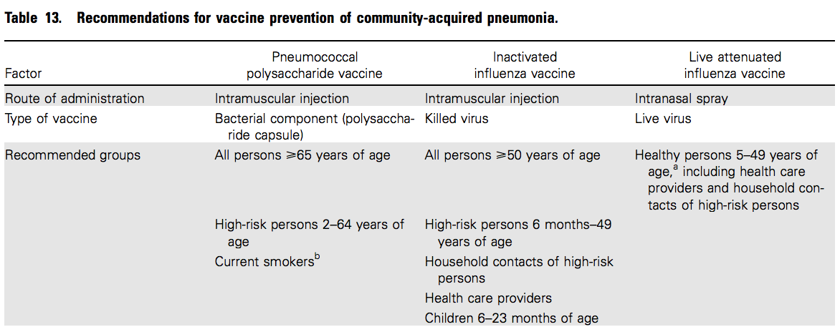

Slide 52
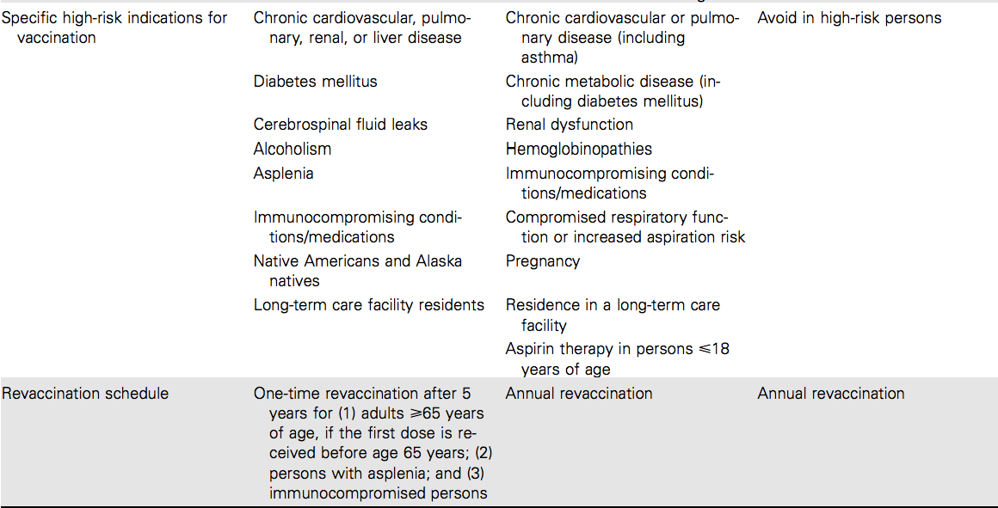

Slide 53
2. INTERSTITIAL LUNG DISEASE
BY: DR. MECHA
DATE: 13/9/2016

Slide 54
LECTURE OUTLINE
Definition
Clinical presentation and evaluation
Radiographic features
Classification
Treatment
Prognosis

Slide 55
PULMONARY INTERSITIUM
This is the space interposed between the air space epithelium (from the main bronchi to the alveoli, the vascular endothelium and the pleural mesothelium
The remnant of the splanchnopleuric mesenchymal bed into which the airway tubes and blood vessels have grown during lung morphogenesis
The gas exchange unit
  Capillary endothelium
  Alveolar epithelium
  Interstitial space

Slide 56
COMPONENTS OF THE ALVEOLAR/INTERSTITIAL SPACE
Fibroblasts
Myofibroblasts
Pericytes
Smooth muscle cells
Undifferentiated mesenchymal cels
Immune cells
Matrix
Basement membrane
Endothelium

Slide 57
DEFINITION
Few cells in the interstitium of the normal lung (pauci-cellular)
Injury to the basement membrane shared by epithelium and endothelium
Increased alveolar permeability and spillage of serum contents into the alveolar space and recruitment of fibroblasts
Collagen deposition
Also injury to small airways → respiratory bronchioles, alveolar ducts and terminal bronchioles

Slide 58
PATHOGENESIS
UNKNOWN
Some understanding of the mechanism of injury
Initiating injuries are likely multiple:
  Inhaled
  Sensitization to allergens
  Circulatory e.g. drugs like nitrofurantoin, amiodarone,
With continued injury, ‘repair’ process continues with additional fibro-proliferation that is unchecked.
There is an imbalance between injury and reparative processes.

Slide 59
IDIOPATHIC INTERSITIAL LUNG DISEASE (ILD) EPIDEMIOLOGY
81 in 100,000 prevalence in men
  Mostly due to occupational exposure in men to noxious substances
67 in 100, 000 in women
32.5 in 100,0000 incidence in men
26 in 100,000 in women
200 in 100,000 incidence in age > 75
30 – 40% of all ILD → IPF
Due to increasing numbers of cytotoxic drugs, increased detection of occupational lung diseases, and increasing life expectancy as well as better imaging and diagnostic testing e.g. high resolution CT scan, the incidence of these diseases is expected to rise.

Slide 60
CLINICAL CLASSIFICATION - ETIOLOGICAL
Connective tissue diseases → RA, SLE, Scleroderma
Drug induced → Nitrofurantoin, Amiodarone, Cytotoxic agents, Cocaine
Radiation
Primary unclassified → Sarcoidosis
Occupational → Organic dusts - hypersensitivity pneumonitis; inorganic dusts - silicosis
Idiopathic disorders → IPF, NSIF

Slide 61
EVALUATION OF ILD
Extensive history
  Longstanding cough (often)
  Dyspnea → progressive
  Weight loss
Age, gender, underlying comorbidities, drugs, smoking, occupational history, hobbies, pets, Family history
  Idiopathic pulmonary fibrosis (IPF) is a disease of the aged (> 60 years)
  Lymphangioleiomyomatosis (LAM) → young females in their reproductive age are at a higher risk
  Respiratory bronchiolitis, Desquamative Interstitial Pneumonitis (DIP) → largely diseases of smokers
Physical examination
  Wasting
  Fever
  Clubbing
  Tachypnoea
  Crackles
  Cyanosis
  Pulmonary HN and cor pulmonale

Slide 62
LABORATORY INVESTIGATIONS
Extensive: Depends on presentation and likely etiology

Slide 63
VIGNETTE
JKT is an 80 year old male diabetic and hypertensive for the last 24 years maintained on Mixtard 20/10, Metformin 850 mg 8 hourly and Losartan 50 mg daily.
He had presented 4 months ago with a history of cough and progressive dyspnea for 3 years
Cough brought on exertion, mostly dry, occasionally productive of clear, mucoid sputum, no hemoptysis
He’d experienced progressive decline in exercise tolerance

Slide 64
CONT.
He reported profuse night sweats often around 2:00 to 3:00am
He however had not lost weight and had normal appetite.
Lately he had been experiencing erratic glucose control and had therefore had his insulin dose increased.
On CXR →
  Peripheral, lower zone reticular opacification; that are symmetric, generalized & intersitital (opacification is in the form of lines) → extensive fibrosis
  Honey comb pattern & small lungs
  Prominent hilum (enlarged pulmonary vessels → pulmonary HTN)

Slide 65
CONT
The CXR was reported as a chronic interstitial pneumonitis, pulmonary TB should be excluded
An echocardiogram done previously showed normal biventricular function
Renal function was normal
Sputum collected was muco-salivary and negative for AFB
The ESR was 24 mm/hr

Slide 66
ON EXAMINATION
O/E, he was comfortable at rest
The GE was notable for grade 3 finger clubbing
SP0₂ was 97% at rest but dropped to 92 after climbing one flight of stairs or + 20 m on the flat.
Chest examination was notable for reduced lung expansion and fine end inspiratory bi-basal crackles.

Slide 67
INVESTIGATIONS
Lung function tests
  Spirometry
    Preserved FEV₁
      FEV₁:FVC ratio is usually either hyper-normal or preserved in Interstitial Lung disease
High resolution CT scan (HRCT)
  Confirms → symmetric, honey comb fibrosis
  Traction bronchiectasis – dilated airways in the peripheral 2/3 of the lung fields
  Relative sparing of apices
Lung biopsy
  Interlobular septal thickening
  Traction bronchiectasis and bronchiolectasis
  Fibroblastic foci
  Temporal and spatial heterogeneity

Slide 68
FURTHER INFORMATION
Risk factors
  Drug exposure
  Occupational exposure
  Systemic disease
  Smoking history

Slide 69
IDIOPATHIC INTERSITIAL PNEUMONIA CLASSIFICATION: ATS/ERS 2000
Idiopathic interstitial pneumonias (IIPs)
  Idiopathic Pulmonary Fibrosis (IPF – UIP)
  IIP other than IPF
    Desquamative Interstitial Pneumonia (DIP)
    Respiratory bronchiolitis interstitial lung disease (RB – ILD)
    Acute Interstitial Pneumonia (AIP)
    Cryptogenic organizing pneumonia (COP – OP)
    Non-specific Interstitial pneumonia (NSIP)
    Lymphoid Interstitial Pneumonia (LIP)
      Associated with HIV

Slide 70
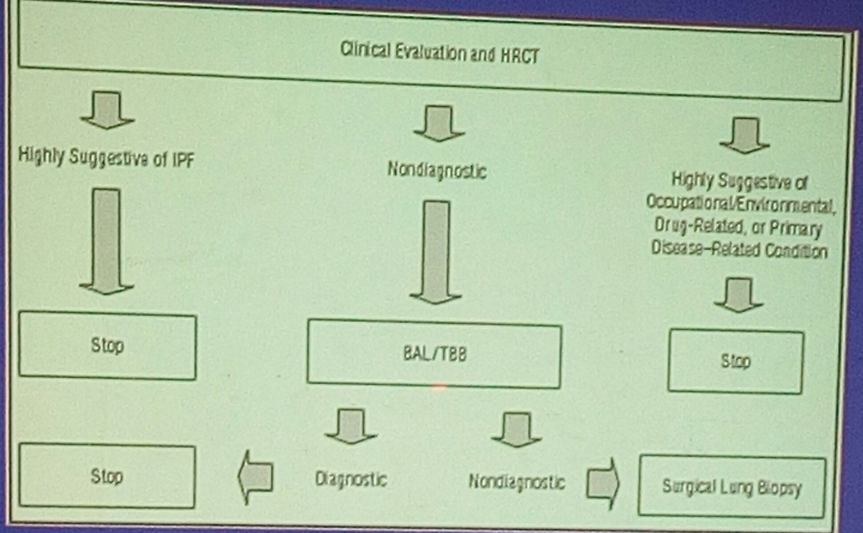
DIAGNOSTIC APPROACH TO THE PATIENT WITH SUSPECTED IIP

Slide 71
TREATMENT
 | THERAPY | PROGNOSIS
IPF-UIP | CORTICOSTEROIDS, AZATHIOPRINE, NAC, LUNG TRANSPLANTATION | Median survival 2.5 – 3.5 years
NSIP | CORTICOSTEROIDS, AZATHIPRINE | Recovery, stable disease, release
RB-ILD & DIP | SMOKING CESSATION CURATIVE | Good
AIP | RESPIRATORY SUPPORT, CORTICOSTEROIDS | 50% mortality

Slide 72
ASTHMA
BY: DR. MECHA
DATE: 13/9/2016

Slide 73
DEFINITION
Asthma is a chronic inflammatory disease of the airways characterized by airway hyper-responsiveness (AHR) to various triggers resulting in wide-spread airway narrowing and airflow limitation
Clinically, asthma presents as an episodic cough, wheeze and SOB which recovers spontaneously or with treatment.

Slide 74
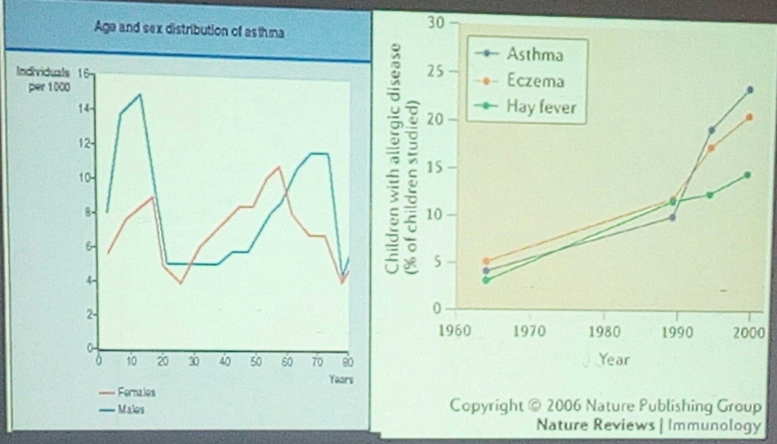
EPIDEMIOLOGY

Slide 75
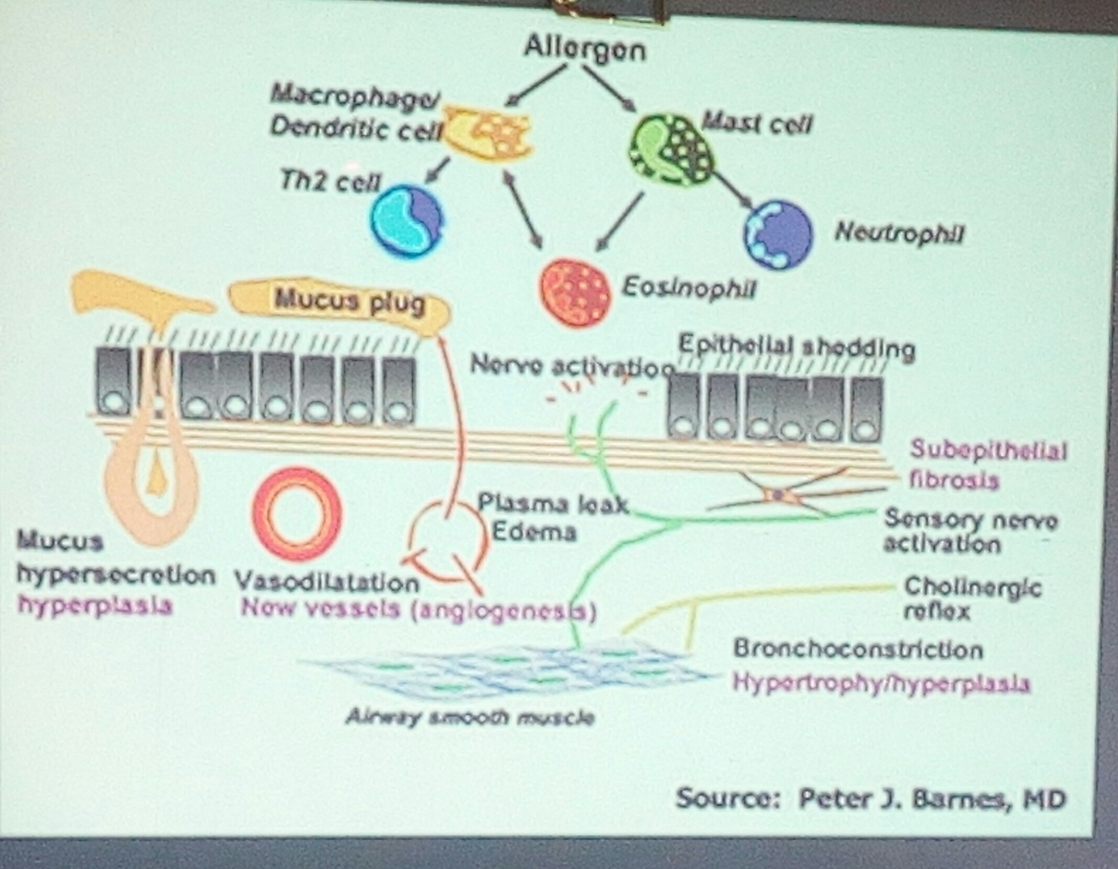
PATHOGENESIS:
There is an interaction between genetics and the environment (trigger factors)

Slide 76
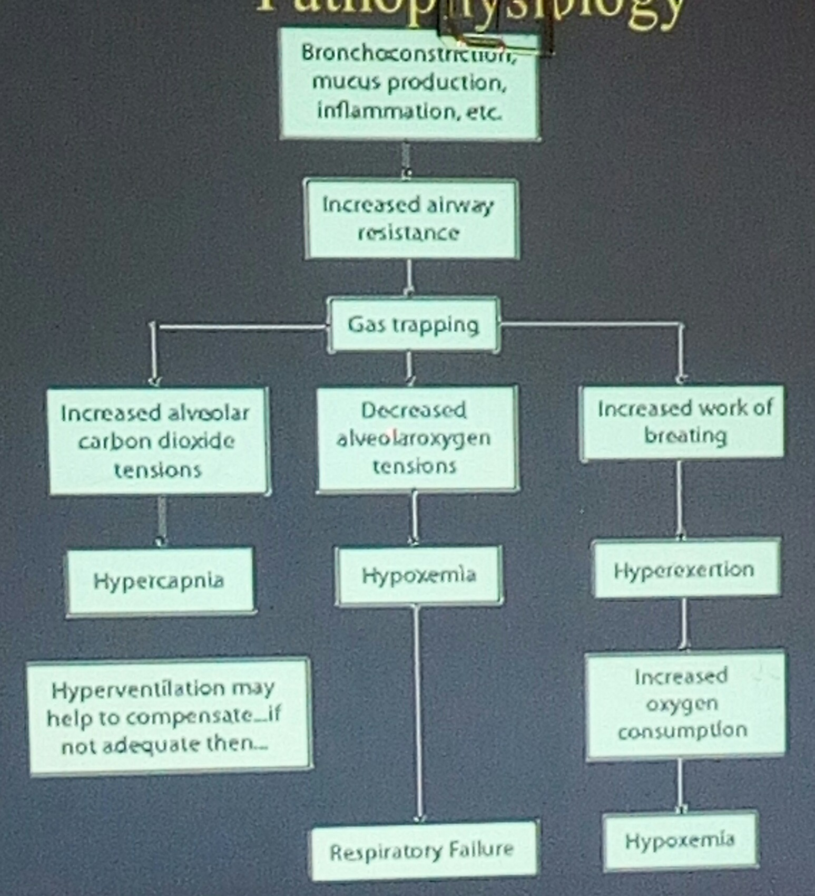
PATHOPHYSIOLOGY

Slide 77
CLINICAL PRESENTATION - HISTORY
Recurrent symptoms
  Wheeze, chest tightness, SOB, cough
Symptom variability
  Vary over time and from one episode to the next
  Tend to be nocturnal/or worse at night
Associated symptoms of atopy
  Allergic rhinitis or conjunctivitis or eczema
Ask the patient for any specific trigger factors.

Slide 78
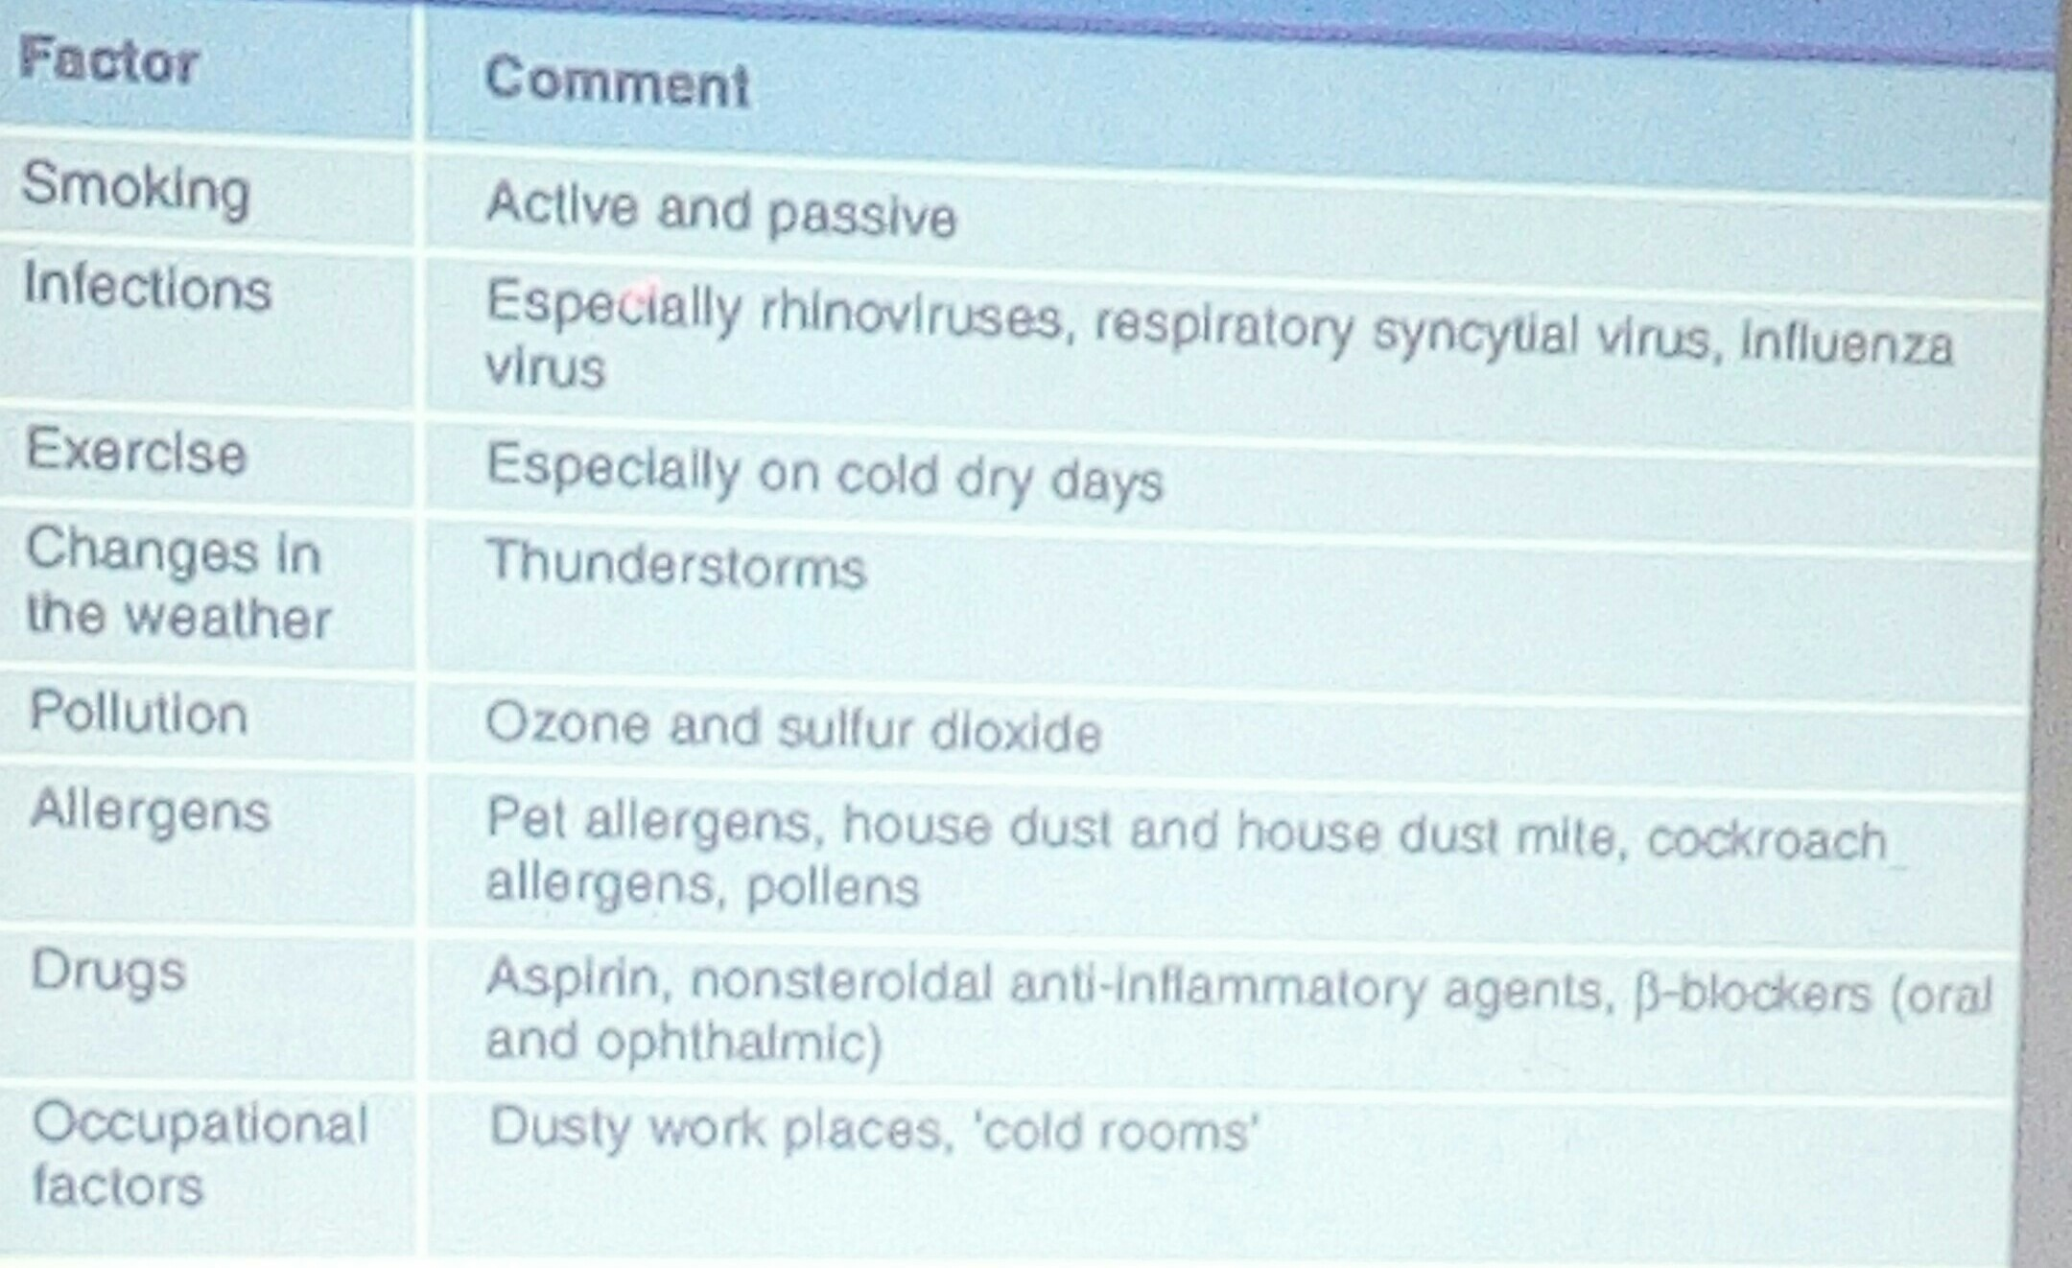
FACTORS THAT MAY EXARCERBATE ASTHMA (TRIGGER FACTORS)

Slide 79
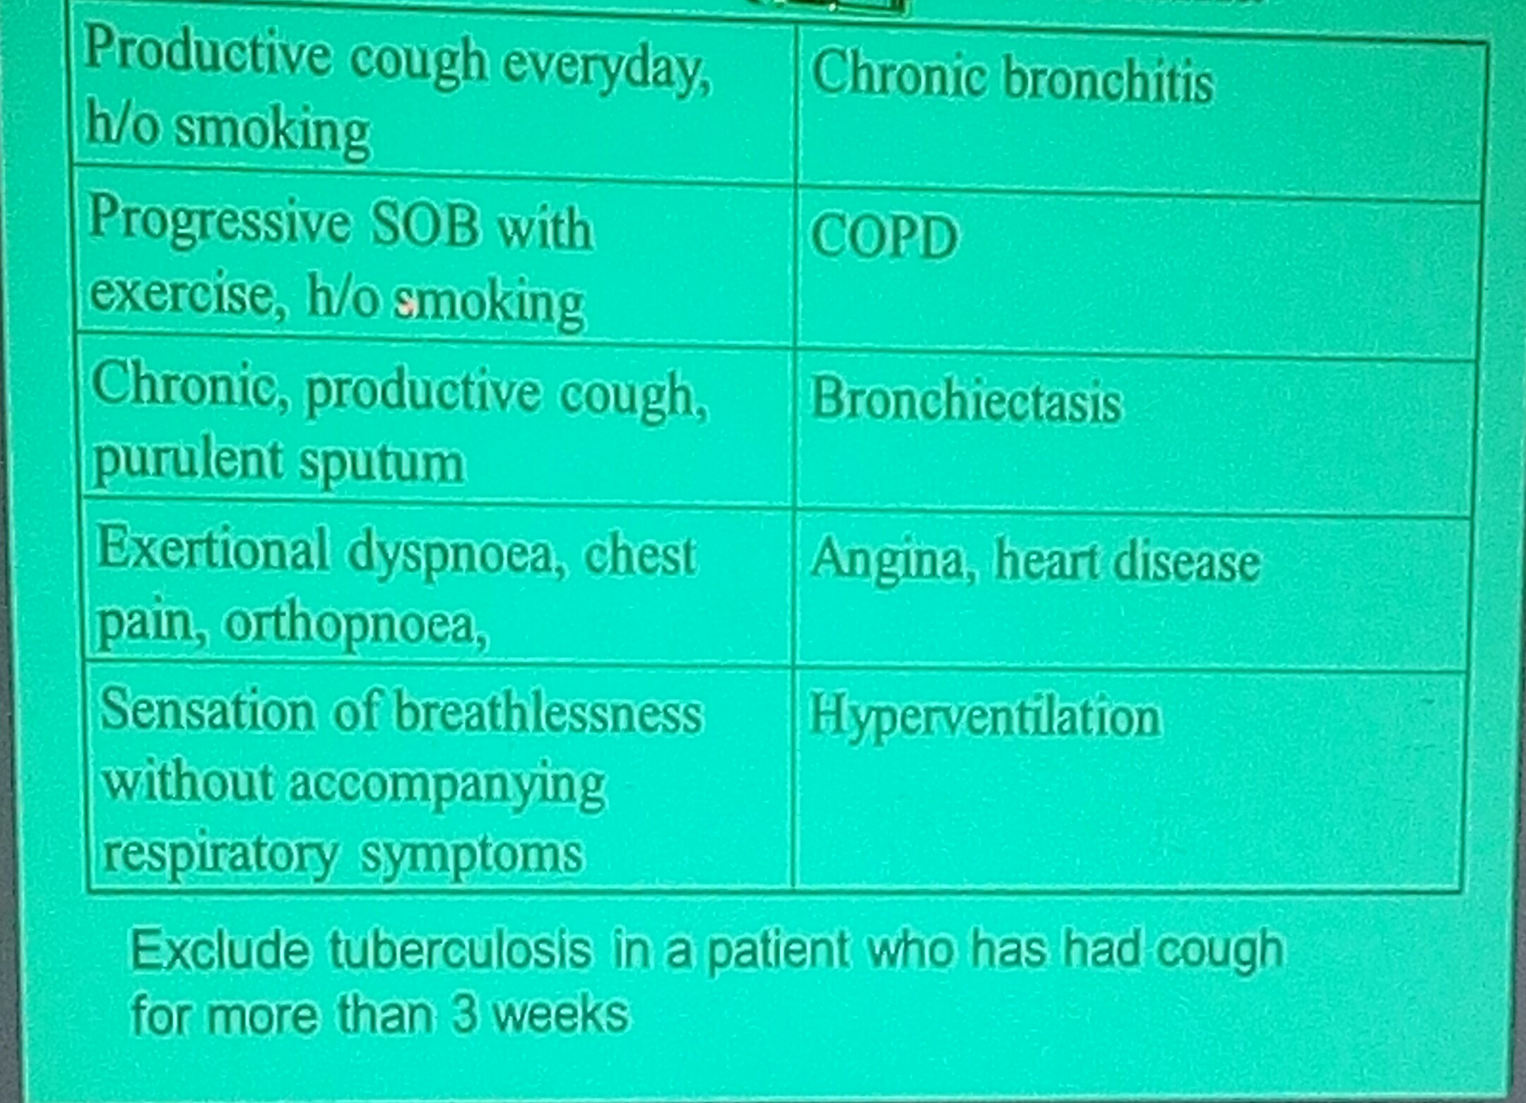
DIFFERENTIAL DIAGNOSIS OF ASTHMA

Slide 80
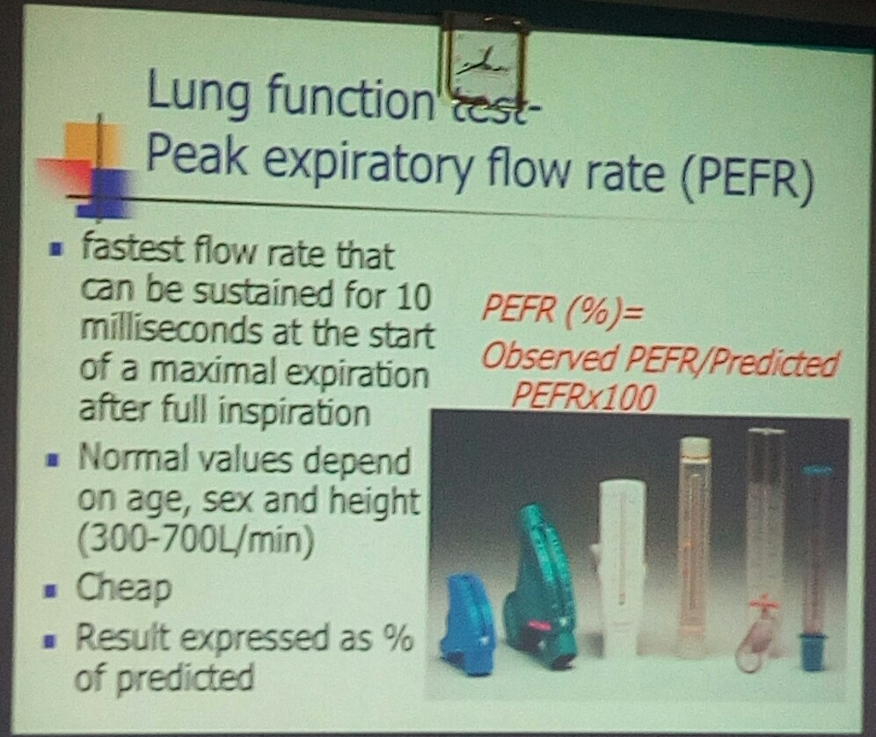
LUNG FUNCTION TESTS – PEAK EXPIRATORY FLOW RATE (PEFR)

Slide 81
OTHER TESTS
LUNG FUNCTION TESTS - SPIROMETRY

Slide 82
CLASSIFICATION
Etiological
  Atopic/allergic/extrinsic
  Intrinsic
  Exercise-induced
  Occupational
Severity (based on symptoms and PEFR)
  Acute asthma attack (mild → moderate → severe)
  Chronic asthma
    Intermittent
    Persistent: Mild → moderate → severe

Slide 83
PRINCIPLES OF MANAGEMNET
Non-pharmacological
  Allergen avoidance
  Patient education
Pharmacological
  The mainstay treatment → inhaler therapy depending on severity of the disease

Slide 84
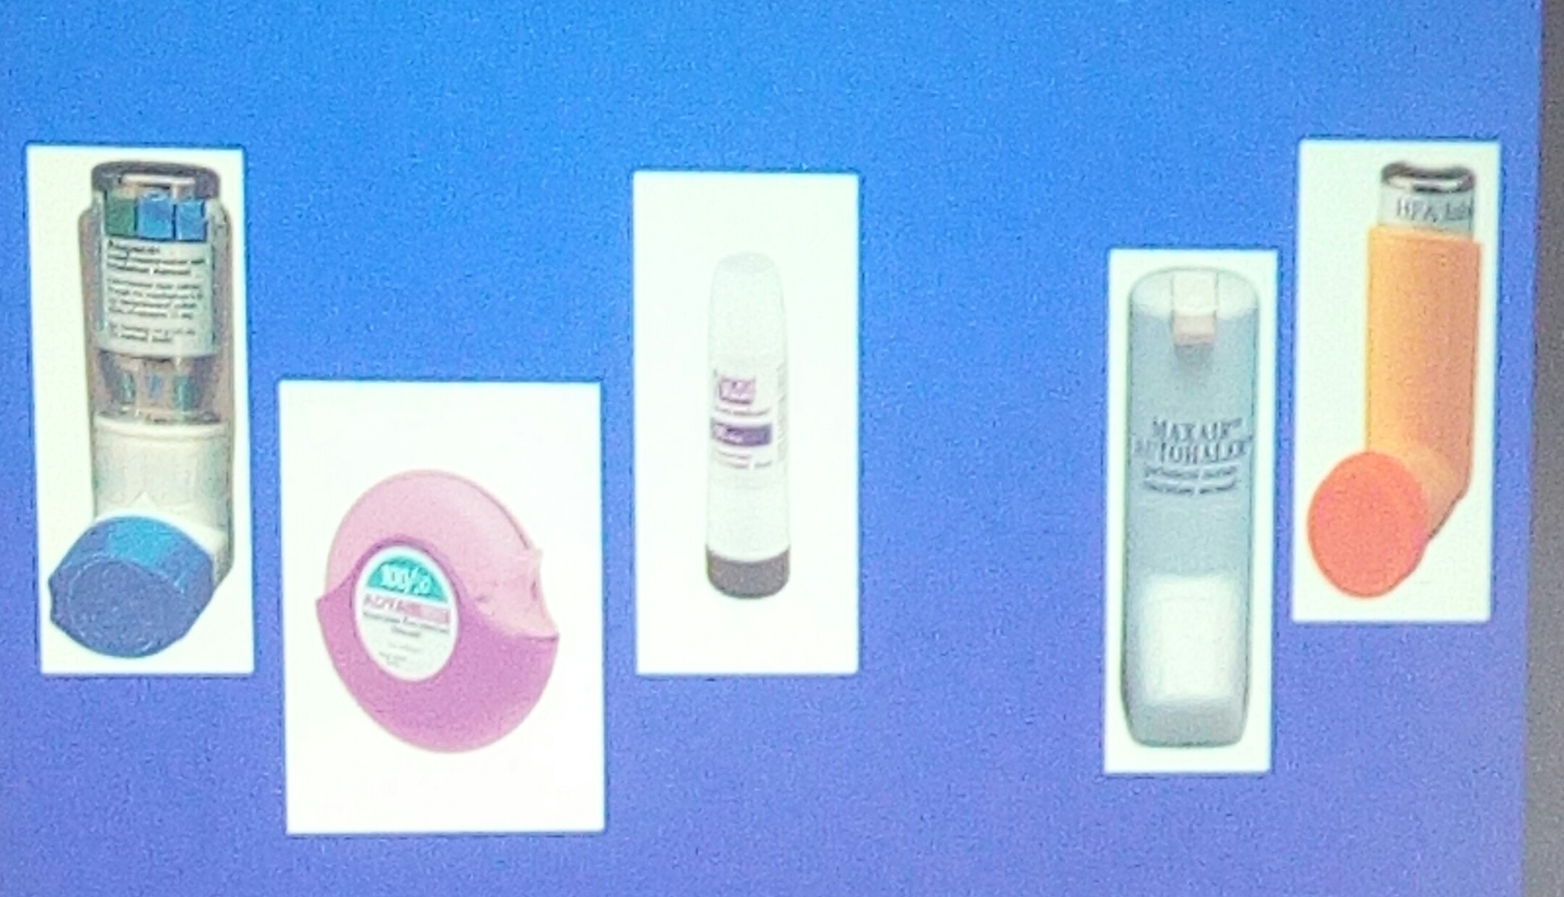
INHALERS

Slide 85
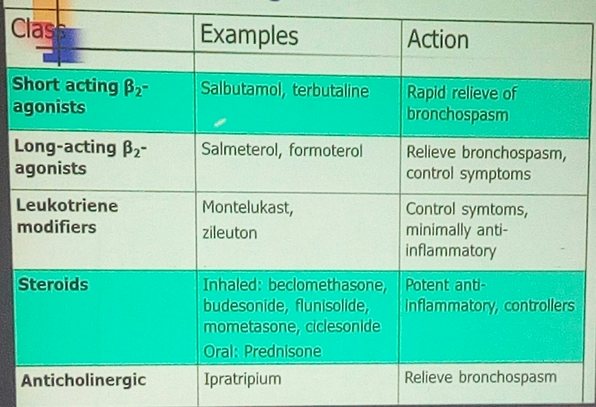
PHARMAOCLOGIC AGENTS COMMONLY USED IN ASTHMA MANAGEMENT

Slide 86
CONCLUSION
Asthma is one of the most commonest chronic respiratory disorders
The pathogenesis of asthma is multi-factorial involving genetic susceptibility and environmental factors
Patient education, avoidance of triggers and proper use of pharmacologic therapies will achieve disease control in a majority of patients.

Slide 87
TYPED BY EFFIE NAILA

