Slide 1
COMMUNITY ACQUIRED PNEUMONIA
MBChB V
08/09/2016
DR Marybeth C. Maritim

Slide 2
Lecture Objectives
Define community acquired pneumonia
Describe the etiologic agents (Microbiology)
Risk factors for (Epidemiology)
Clinical features (Imed + Pathology)
Investigations (Radiology, Microbiology, Haematology, )
Treatment (Pharmacology)
Complications (Imed)
Preventive measures of community acquired pneumonia (Imed)

Slide 3
Clinical Case
JK, 70 yr old male admitted with 3day Hx of cough, chest pain, fever and confusion
Has been living at Mji wa Furaha Old People’s home for the past 10 yrs. Hx of smoking, 5-pack years but stopped several yrs ago
O/E sick-looking, tachypnoeic, RR-40b/min, BP -100/50mmHg, features of consolidation RT middle lobe
What is your diagnosis?
What investigations would you do and why?

Slide 4
Pneumonia
Definition
Acute respiratory illness associated with recently developed radiological pulmonary shadowing which is either segmental or lobar
Pneumonia may be bacterial, viral, mycobacterial or fungal

Slide 5
Classification of Pneumonias
1) Community-acquired pneumonia
2) Hospital-acquired pneumonia
3) Aspiration pneumonia (including suppurative pneumonia)
4) Pneumonia in the immunocompromised host

Slide 6
Community-acquired Pneumonia (CAP)
Definition
Pneumonia acquired in the patient’s home or in the non-hospital environment such as a nursing home
Mainly spread by inhalational

Slide 7
CAP
Lobar pneumonia - radiological and pathological term referring to homogeneous opacification (red hepatisation) of one or more lung lobes often associated with pleural inflammation
Bronchopneumonia - patchy alveolar consolidation associated with bronchial and bronchiolar inflammation affecting both lower lobes

Slide 8
CAP
Etiologic Agents (Organisms)
Streptococcus pneumoniae 30%
Chlamydia pneumoniae 10%
Mycoplasma pneumoniae 9%
Legionella pneumophila 5%
Hemophilus influenza 3%

Slide 9
CAP
Etiologic Agents (Organisms)
Others – Staphylococcus aureus, Chlamydia psittaci, Coxiella burnetti, Klebsiella pneumoniae, Actinomyces israeli all <1%.
Viruses – Influenza virus 7-8% of CAP
- Parainfluenza
- Measles
- Respiratory syncytial virus (RSV) in infancy
- Varicella (chicken pox)

Slide 10
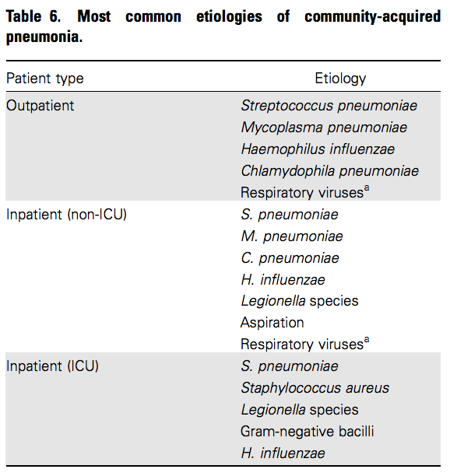

Slide 11
Risk Factors
Cigarette smoking
Alcohol intake
Corticosteroid therapy
Old age
Recent influenza infection
Preexisting lung disease
Contact with sick birds (Chlamydia psittaci)
Farm environments (Coxiella burnetti)

Slide 12
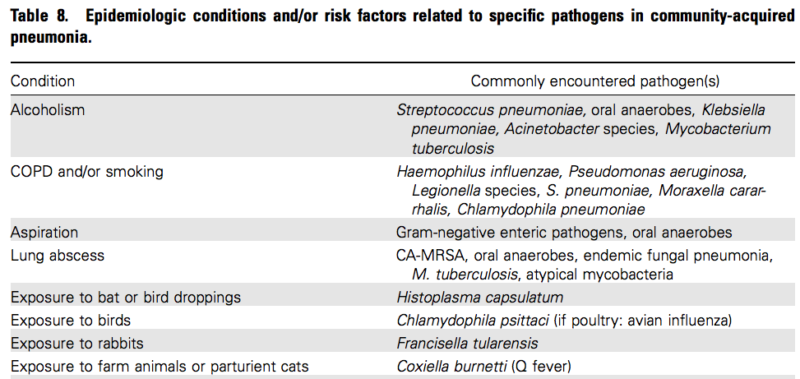

Slide 13
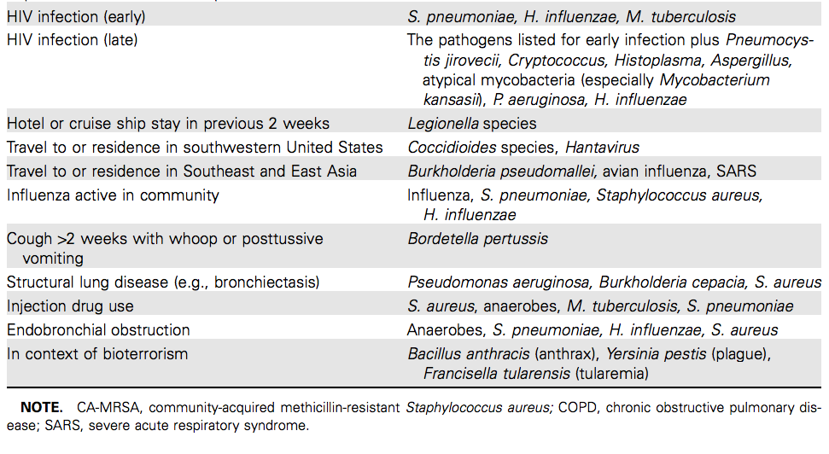

Slide 14
Clinical Features - Symptoms
Cough – productive of rust coloured sputum.
Fever
Malaise
Pleuritic chest pain
Headache
Confusion

Slide 15
Clinical Features - Signs
Fever
Tachycardia
Tachypnoea
Hypoxemia
Hypotension
Confusion
Pleural rub
Signs of consolidation – dull percussion note and bronchial breath sounds
Crepitations
Signs of a pleural effusion – stony dullness and absent or reduced breath sounds.

Slide 16
Investigations
1) Chest radiograph – homogenous opacity localised to the affected lobe or segment
Is useful in identifying pleural effusion, intrapulmonary abscess formation or when empyema is suspected
Hilar lymphadenopathy is seen in Mycoplasma pneumonia

Slide 17
Investigations 2
2)Microbiological Investigations
- sputum microscopy, culture and sensitivity
- aspiration of tracheal/ bronchial secretions during bronchoscopy for M/C/S
- Blood cultures and sensitivity patterns
3) Arterial blood gas measurement for assessment of disease severity

Slide 18
Investigations
4) Complete blood count
- Neutrophil leucocytosis suggests bacterial pneumonia
- Leucopenia suggests viral etiology

Slide 19
Assessment of Disease Severity
Clinical parameters
- Age of 60yrs or older
- Respiratory rate >30/min
- Diastolic blood pressure 60mmHg or less
- Confusion
- More than 1 lobe involved in CXR
- Presence of underlying disease

Slide 20
Assessment Of Disease Severity
Laboratory parameters
- Hypoxemia (PaO2 <8kPa)
- Leucopenia (<4000x10⁹/L)
- Leucocytosis (>20000x10⁹/L)
- Raised serum urea ≥7mmol/L
- Positive blood culture
- Hypoalbuminemia

Slide 21
Assessment Of Disease Severity
The 4 cardinal markers of severity are:-
- RR ≥30/ min
- Diastolic BP ≤60mmHg
- Serum BUN of ≥7mmol/L
- Presence of confusion
Patients with ≥2 of the 4 cardinal markers of severity have a 36-fold higher risk of dying compared with patients without these signs

Slide 22
Treatment
Supportive and specific treatment
Good response to antibiotic therapy
When there is delayed recovery suspect:-
- complications
- wrong diagnosis
- proximal bronchial obstruction
- recurrent aspirate

Slide 23
Supportive Treatment
Oxygen- for all hypoxemic patients. Use concentrations ≥35% in those without advanced COPD or hypercapnia
IV fluids
Physiotherapy
Pain relief with paracetamol or if severe then with pethidine or morphine.

Slide 24
Empiric Treatment
Pretreatment specimen samples (blood cultures and expectorated sputum) should be obtained for microbiological evaluation before starting empirical therapy
Combination empirical treatment is recommended

Slide 25
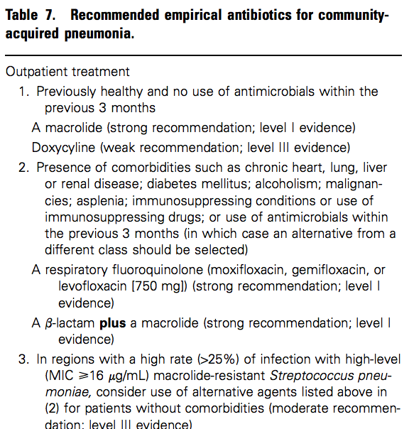

Slide 26
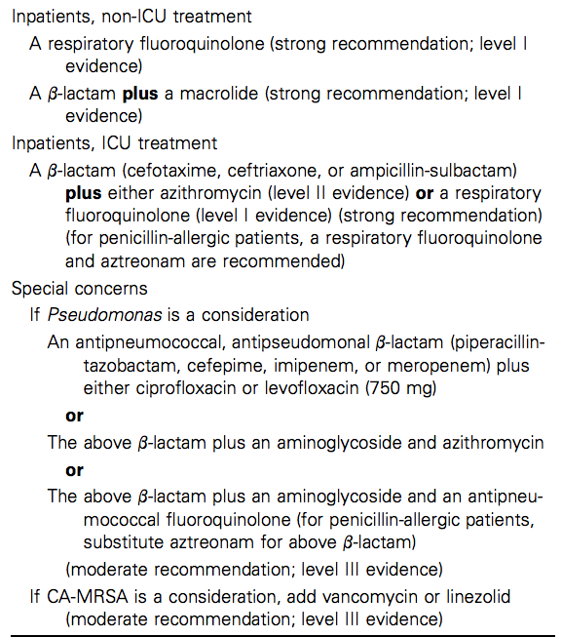

Slide 27
Specific Treatment
Antibiotic therapy – given after results of collected specimens have been
  Strep. pneumoniae – ceftriaxone
  Klebsiella pneumoniae - gentamicin and ceftazidime
  Chlamydia pneumoniae - erythromycin or tetracycline
  Chlamydia psittaci – tetracycline
  Actinomycosis – benzyl penicillin
  Varicella pneumonia – oral acyclovir

Slide 28
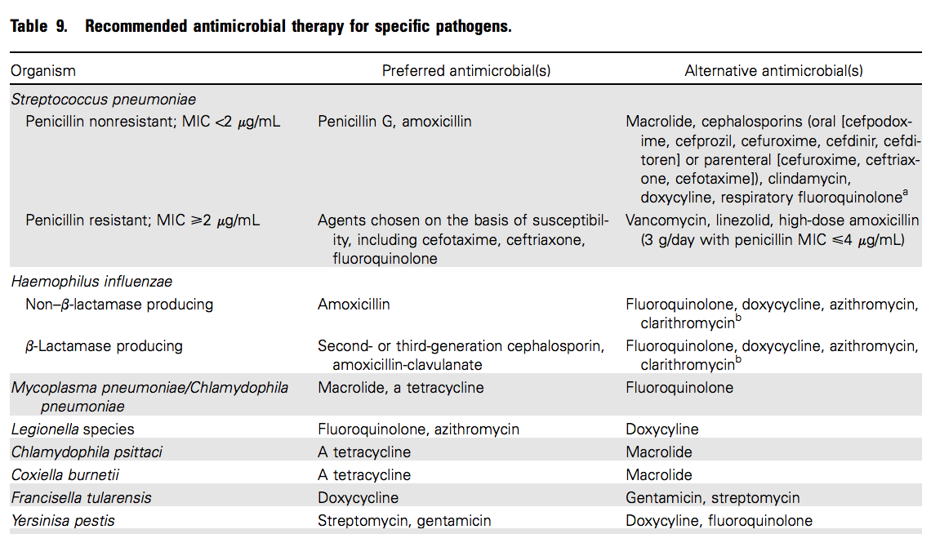

Slide 29
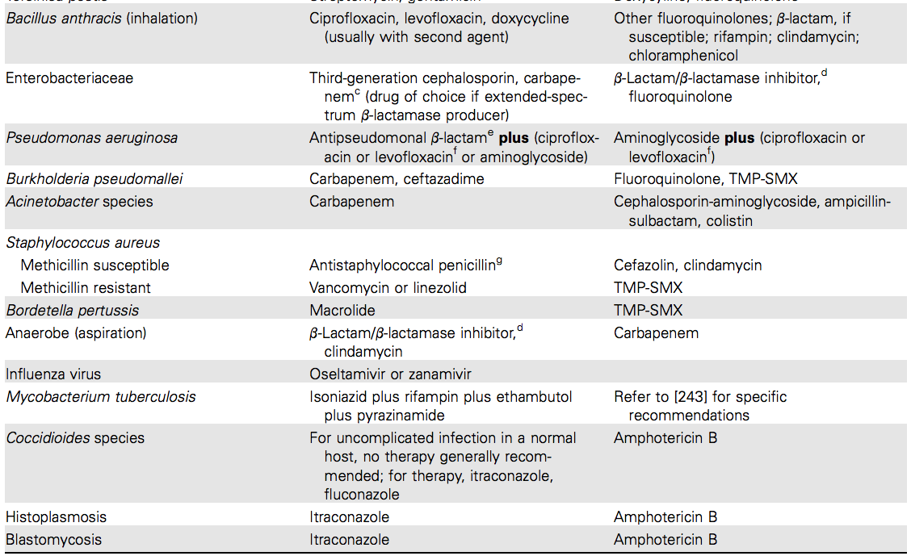

Slide 30
Complications
Parapneumonic effusions
Empyema
Sputum retention
Pneumothorax

Slide 31
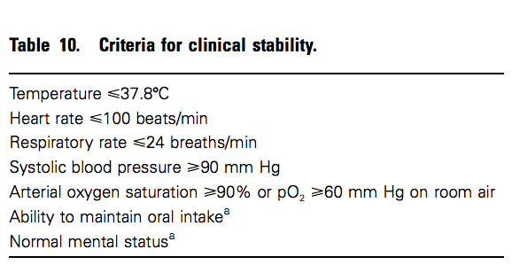

Slide 32
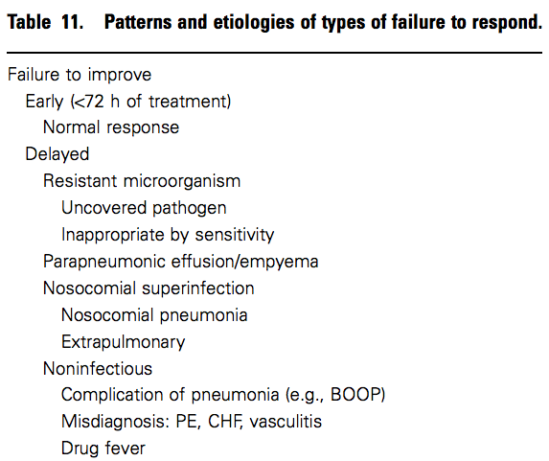

Slide 33
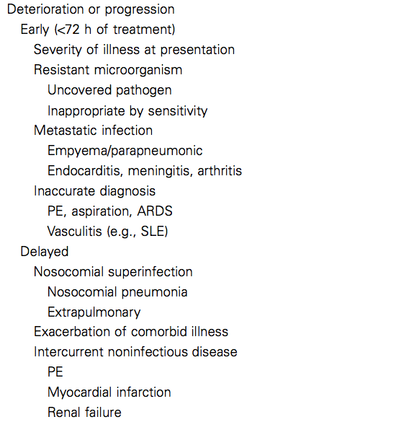

Slide 34
Prevention
Immunization with influenza A/B for all people >50yrs
Immunization with 23 polyvalent pneumococcal and H. influenza type B vaccines for all susceptible people e.g.
  elderly>65yrs
  co morbidities like diabetes, immunocompromised, sickle cell disease or asplenia.
Treatment of water sources to prevent Legionella pneumophila

Slide 35
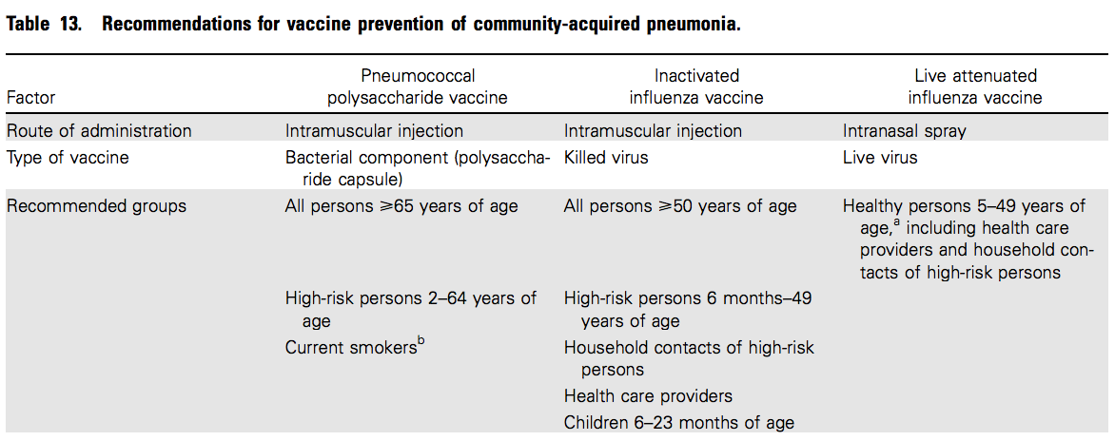

Slide 36
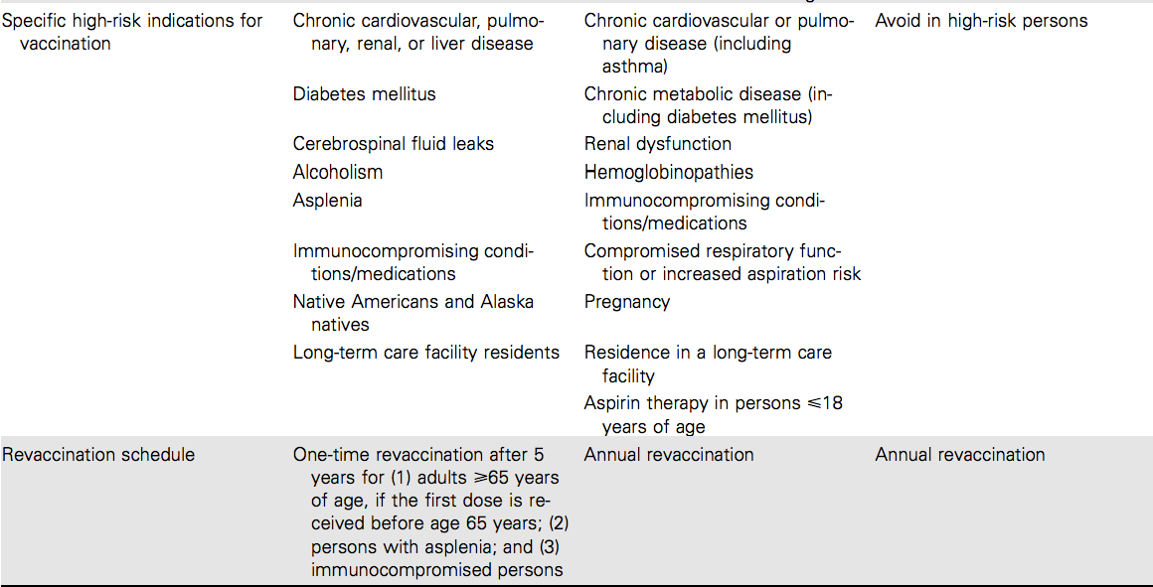

Slide 37
References
Davidson’
IDSA guidelines for Community acquired pneumonia

Slide 38
THANK YOU !

