Slide 1
Approach to Community Acquired Pneumonia
Dr Eugene Kalman Genga
Department of clinical medicine and therapeutics
UON

Slide 2
Mr. Congestion
Mr. C is a 70 year old male who presents to the primary care clinic where you work. He is accompanied by his daughter. Mr. C’s daughter states that Mr. C has a fever, bad cold with a cough and that he has been confused. He fell as he was getting dressed this morning.

Slide 3
On physical examination, he appears flushed but otherwise alert and oriented. He is 5-11, 90kg and has a blood pressure of 90/60 mmHg, a heart rate of 90 beats per minute, a respiratory rate of 34 breaths per minute, and a body temperature of 39 ºC.
respiratory exam reveal reduced chest expansion, increased tactile phremitus and dullness in right base. On auscultation there was bronchial breathe sounds and coarse crepitations especially over the right lower lung. Apart from the confusion the rest of his exam is normal.

Slide 4
Based on your history and physical exam what is your diagnosis

Slide 5
Diagnosis of Pneumonia
Signs and symptoms
Fever or hypothermia, cough with or without sputum, dyspnea, chest discomfort, sweats, or rigors
Atypical pneumonia associated with headaches, diarrhea, non-exudative pharyngitis, myalgias
Physical exam may reveal fever, tachypnea, tachycardia.
Lung exam; increased tactile fremitus, dullness to percussion, decreased breath sounds, presence of rales or crackles

Slide 6
Alphabet Soup for Pneumonia
HAP: Hospital-acquired pneumonia
  ≥ 48 h from admission
VAP: Ventilator-associated pneumonia
  ≥ 48 h from endotracheal intubation
HCAP: Healthcare-associated pneumonia
  Long-term care facility (NH), hemodialysis, outpatient chemo, wound care, etc.
CAP: Community-acquired pneumonia
  Outside of hospital or extended-care facility
Notes:
6

Slide 7
CAP - Why do we care about it?
5.6 million cases annually
1.1 million require hospitalization
Mortality rate =12% in-hospital; near 40% in ICU patients
Am J Respir Crit Care Med 163:1730-54, 2001

Slide 8
MCQ 1
What is the most likely pathogenic mechanism in this patient's pneumonia?
Direct inoculation
Aspiration of oropharyngeal contents
Hematogenous deposition
Reactivation
Inhalation of infectious particles

Slide 9
Pathogenetic mechanisms in Pneumonia
Inhalation of infectious particles Common
Aspiration of oropharyngeal or gastric content Common
Hematogenous deposition Uncommon
Invasion from infection in contiguous structures Rare
Direct inoculation Less common
Reactivation More common in Immunocompromised hosts

Slide 10
Key Bacterial Pathogens in CAP
S. pneumoniae is the primary recognized bacterial cause of respiratory infections
16%
Atypical
Pathogens:
23%
40%
S. pneumoniae
6%
M. catarrhalis
H. influenzae
Legionella spp.
10%
M. pneumoniae
C. pneumoniae
Others
7%
1%
20%
Reimer and Carroll: Clin Infect Dis 26:742-748, 1998.
Marrie: Infect Dis Clin North Am 12:723-740,1998.
Bartlett et al: Clin Infect Dis 26:811-838, 1998

Slide 11
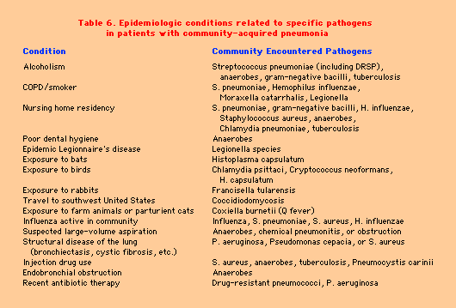
CAP – Modifying Factors
Am J Respir Crit Care Med 163:1730-54, 2001

Slide 12
Four Stages of Pathologic Process of Pneumococcal Pneumonia
Edema: Build up of fluid containing protein and bacteria accumulates in the air sacs of the lungs
Red Hepatization: An excess of fluid in the capillaries of the air sacs causes an influx of many white and red blood cells
Gray Hepatization: Macrophages come to the rescue engulfing the white blood cells, red blood cells and other cellular debris
Resolution: Alveolar exudate is then removed and the lung gradually returns to normal
(Porth 2009)

Slide 13
Factors that Interfere with Respiratory Defense Mechanisms
Mechanisms | Function | Factors That Impair
Nose and throat defenses | IgA protects again the multiplying of bacteria Sneezing removes bacteria from respiratory tract | Decreased IgA Nasal inflammation caused by allergies Common cold Trauma to the nose
Cough reflexes | Protect against aspiration | Reduced cough reflex r/t stroke neuromuscular diseases sedation anesthesia
Muociliary clearance system | Cilia remove bacteria from respiratory passages | Smoking Viruses Cold, dry air
Alveolar macrophage | Removes bacteria from alveoli | Cold, dry air Alcohol use Smoking Obstruction
IgG and IgM | Help to remove bacteria from the blood | IgG deficiency IgM deficiency
(Porth 2009)

Slide 14
Back to Mr. C
Past Medical History:
20 year smoking history
Coronary Artery Disease
Recovering alcoholic
History of asthma (currently tapering off corticosteroids for recent exacerbation)

Slide 15
Quick Review: Why is Mr. C at increased risk for developing CAP?
History of Smoking
Yes, smoking reduces the ability to remove bacteria
Corticosteroids
Yes, immune system is compromised with steroid use
History of Alcoholism
Yes, decreases ability to remove bacteria from alveoli

Slide 16
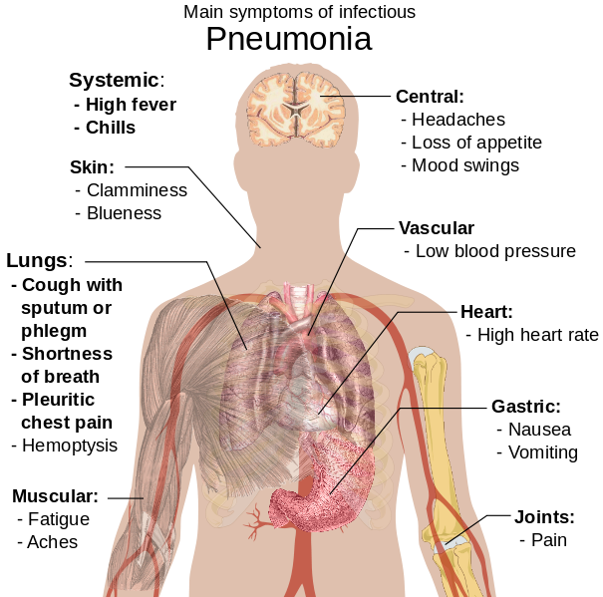
(Wikipedia 2012)

Slide 17
MCQ 2
What is the next most important step in this patient's care?
Empiric therapy with a fluoroquinolone
Chest x-ray
Sputum culture
Hospitalization
CBC, glucose, BUN, Na tests

Slide 18
Diagnosis: Radiography
CXR (PA and Lateral):
  American Thoracic Society (ATS) guidelines, “all patients with suspected CAP should have a chest radiograph to establish the diagnosis and identify complications (pleural effusions, multilobar disease)”
  Lobar consolidation – more common in typical pneumonia
  Bilateral, diffuse infiltrates – commonly seen in atypical pneumonia
    However, radiologists cannot reliably differentiate bacterial from nonbacterial pneumonia on the basis of the radiographic appearance
  If performed early in the course of the disease, may be negative
    The sensitivity of chest radiography depends greatly on pretest probability

Slide 19
Infiltrate Patterns
Pattern | Possible Diagnosis
Lobar | S. pneumo, Kleb, H. flu, GN
Patchy | Atypicals, viral, Legionella
Interstitial | Viral, PCP, Legionella
Cavitary | Anaerobes, Kleb, TB, S. aureus, fungi
Large effusion | Staph, anaerobes, Kleb

Slide 20
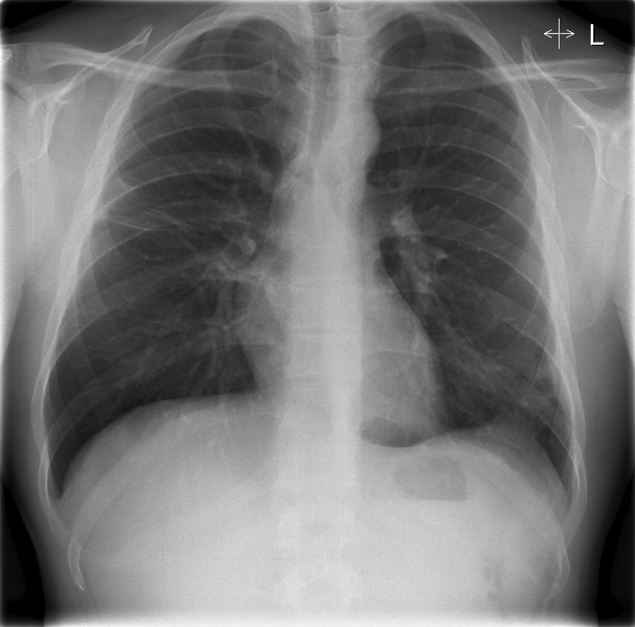
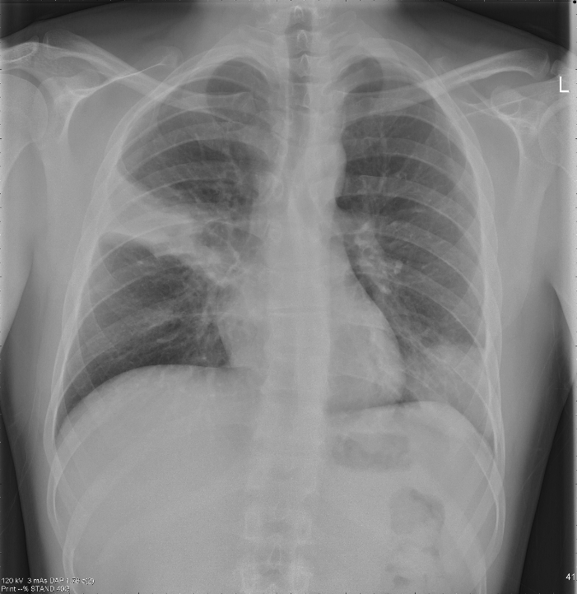
Chest Radiograph
May show hyper-expansion, atelectasis or infiltrates
Normal
Pneumonia
(Wikipedia 2012)

Slide 21
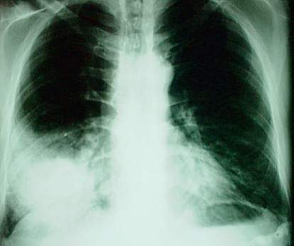

Slide 22
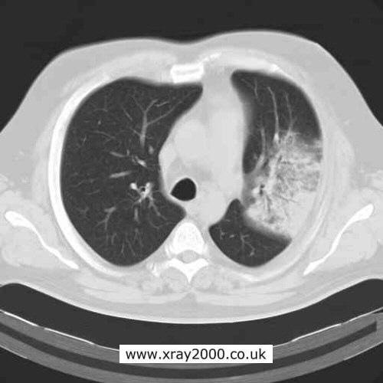

Slide 23
CAP – Testing
CXR
Sputum Gram Stain and culture
Pulse oximetry
Routine lab testing – CBC,ESR,CRP,U/E/C, LFTs
ABG
Thoracentesis if pleural effusion present
Am J Respir Crit Care Med 163:1730-54, 2001

Slide 24

Laboratory Tests
WBC-(leukocyte count) increases with the presence of infection
BUN-measures the level of nitrogen in the blood derived from urea. An elevated BUN can indicate dehydration or impaired kidney function
Sputum M/C/S-identifies causative bacteria to determine antibiotic therapy required to treat CAP
(Microsoft Images)

Slide 25
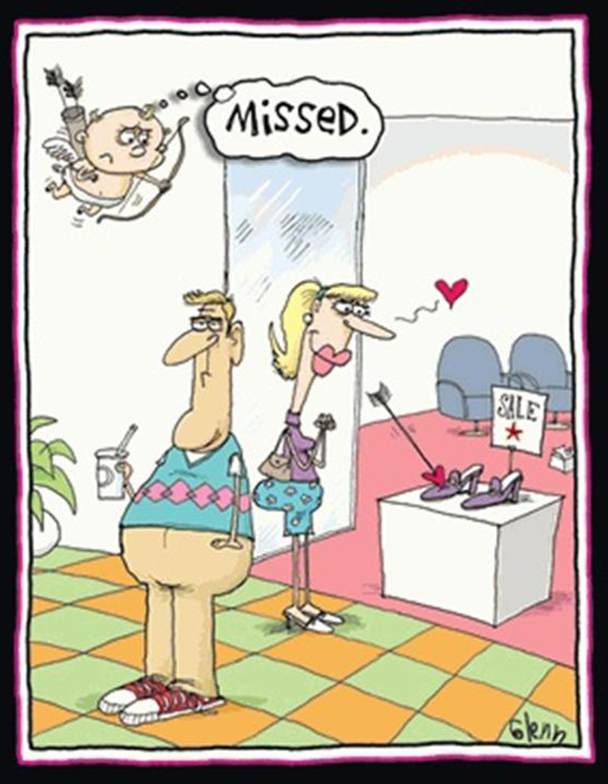
Commercial break

Slide 26
Mr. Congestion
Mr. C is a 70 year old male who presents to the primary care clinic where you work. He is accompanied by his daughter. Mr. C’s daughter states that Mr. C has a fever,bad cold with a cough and that he has been confused. He fell as he was getting dressed this morning.

Slide 27
On physical examination, he appears flushed but otherwise alert and oriented. He is 5-11, 90kg and has a blood pressure of 90/60 mmHg, a heart rate of 90 beats per minute, a respiratory rate of 34 breaths per minute, and a body temperature of 39 ºC.
respiratory exam reveal reduced chest expansion, increased tactile phremitus and dullness in right base. On auscultation there was bronchial breathe sounds and coarse crepitations especially over the right lower lung. Apart from confusion the rest of his exam is normal.

Slide 28
Should this patient be admitted?

Slide 29
To Admit or Not?
Pneumonia Severity & Deciding Site of Care
Using objective criteria to risk stratify & assist in decision re outpatient vs inpatient management
PSI
CURB-65
Caveats
  Other reasons to admit apart from risk of death
  Not validated for ward vs ICU
  Labs/vitals dynamic
Notes:
29

Slide 30
CURB-65
Prediction Rule to Assist in Determining Site of Care
Confusion (disorientation to person, place or time)
Urea (BUN > 7 mmol/L)
Respiratory Rate (RR > 30 breaths/minute)
Blood Pressure (systolic< 90 mmHg-diastolic< 60 mm Hg)
65 (years of age or greater)
  One point for each prognostic variable
  0-1 treat as outpatient, 2 general inpatient admission,
  3-5 intensive care admission
(Uptodate 2012)

Slide 31
Use the CURB-65 Scale to determine where Mr. C’s pneumonia will be managed
Outpatient
Sorry! Mr. C has 3 out of 5 predictive indicators which means that he should be admitted to the intensive care unit
Hospitalize on General Inpatient Floor
Almost Correct! Yes, Mr. C should be admitted. 3/5 predictive indicators shows that intensive care observation is needed
Hospitalize in the Intensive Care Unit
Yes! Mr. C has 3 out of 5 predictive indicators which would guide us to admit him for care in the intensive care unit

Slide 32
CAP – Criteria for ICU Admission
Major criteria
Invasive mechanical ventilation required
Septic shock with the need of vasopressors
Minor criteria (least 3)
Confusion/disorientation
Blood urea nitrogen ≥ 20 mg%
Respiratory rate ≥ 30 / min; Core temperature < 36ºC
Severe hypotension; PaO2/FiO2 ratio ≤ 250
Multi-lobar infiltrates
WBC < 4000 cells; Platelets <100,000

Slide 33
How would you treat this patient?

Slide 34
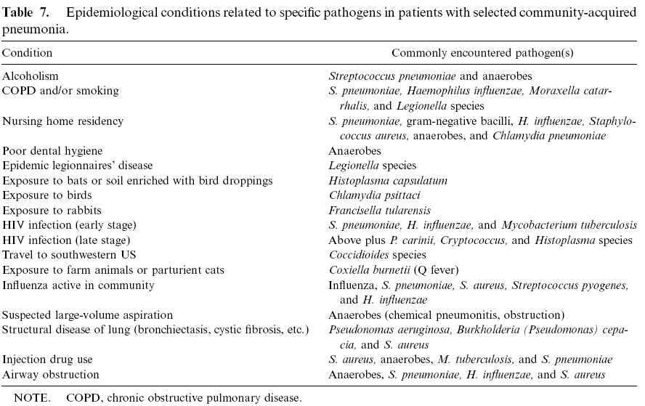

Slide 35
Empirical Antibiotic Treatment of CAP

Slide 36
Duration of Therapy
? ? ? ? ? ?
5 -7 days - outpatients
7-10 days – inpatients, S. pneumoniae
10-14 days – Mycoplasma, Chlamydia, Legionella
14+ days - chronic steroid users
Am J Respir Crit Care Med 163:1730-54, 2001

Slide 37
CAP -The Switch to Oral Antibiotics
Switch if patient meets the following:
  Improved cough and dyspnea
  Afebrile on 2 occasions 8 hours apart
    If otherwise improving way waive this criteria
  Decreasing WBC count
  Functional GI tract with adequate PO intake
Am J Respir Crit Care Med 163:1730-54, 2001

Slide 38
Complications
common complications of severe CAP include:
“respiratory failure “shock “multiorgan failure “bleeding diatheses “complicated pleural effusion “exacerbation of comorbid illnesses “lung abscess “metastatic infection
Lung abscess may occur in association with aspiration or with infection caused by a single CAP pathogen(CA-MRSA, P. aeruginosa,(rarely) S. Pneumoniae)
Aspiration pneumonia is typically a mixed polymicrobial infection involving both aerobes and anaerobes
In either scenario, drainage should be established
A significant pleural effusion should be tapped for both diagnostic and therapeutic purposes
If the fluid has a pH of <7, a glucose level of <2.2 mmol/L, and a LDH concentration of >1000 U/L or if bacteria are seen or cultured, then the fluid should be drained; a chest tube is usually required.

Slide 39
Discharge Criteria
Candidates for discharge should have no more than one of the following poor prognostic indicators:
Temperature > 37.8 degrees Celsius
Pulse > 100 beats per minute
Respiratory rate > 24 per minute
Systolic blood pressure < 90 mmHg
Oxygen saturation < 90 percent
Inability to maintain oral intake

Slide 40

We are concluding…..

Slide 41
Current Guidelines for Medical Management
You decide to admit Mr. C to the hospital for IV antibiotics, oxygen therapy and monitoring
You add a blood culture X 2 to the orders per guidelines for patient with CAP admitted to ICU
Empiric treatment is based on presumptive diagnosis of pneumococcal pneumonia
    Combination therapy of Beta-lactam and macrolide (eg. ceftriaxone and ampicillin)
Oxygen is administered to maintain pulse ox > 93%
(Mandell et al 2007)

Slide 42
In less than 72 hours Mr. C is off his oxygen, on a general care inpatient unit and is changed to oral antibiotics. His discharge planning will include:
Smoking cessation
Yearly influenza vaccination
Pneumococcal vaccination with booster in 5 years
Importance of fluid intake

Slide 43
Let’s Review
Community Acquired Pneumonia CAP is one of the leading cause of infectious death worldwide.
Streptococcus pneumoniae is the most common cause of CAP
Compromised defense mechanisms put individuals at risk for developing CAP
Empiric therapy is based on presumptive cause of CAP
Age and co-morbid disease increase risk and morbidity of infection from pneumonia
Prevention education should be included in anticipatory guidance during clinic visits

Slide 44
Key Points
In all patients in whom pneumonia is suspected, a chest x-ray should be ordered to provide diagnostic evidence with which to distinguish different patterns of infiltrates.
The need for in-patient care can be determined by professional judgment, based on the patient's signs and symptoms; however, a risk factor calculation can be helpful in determining those with high predicted mortality.
Obtaining blood cultures within 24 hours of admission and starting antibiotics within 4 hours of admission have been shown to reduce 30-day mortality and are considered quality indicators.

Slide 45
Key Points
Because 30% to 50% of patients with community-acquired pneumonia never have a pathogen identified, it is recommended that empiric therapy selection be based on presumed organisms and their sensitivities, history of exposure, other comorbid health conditions, and x-ray findings.
Aggressive testing including cultures, serology testing, and other rapid assays to determine the causative pathogen are appropriate for most inpatients. More invasive testing, including bronchoscopy, should be reserved for deteriorating patients in whom no etiology has been determined.

Slide 46

Thanx for your time

