Slide 1
2. INTERSTITIAL LUNG DISEASE
BY: DR. MECHA
DATE: 13/9/2016

Slide 2
LECTURE OUTLINE
Definition
Clinical presentation and evaluation
Radiographic features
Classification
Treatment
Prognosis

Slide 3
PULMONARY INTERSITIUM
This is the space interposed between the air space epithelium (from the main bronchi to the alveoli, the vascular endothelium and the pleural mesothelium
The remnant of the splanchnopleuric mesenchymal bed into which the airway tubes and blood vessels have grown during lung morphogenesis
The gas exchange unit
  Capillary endothelium
  Alveolar epithelium
  Interstitial space

Slide 4
COMPONENTS OF THE ALVEOLAR/INTERSTITIAL SPACE
Fibroblasts
Myofibroblasts
Pericytes
Smooth muscle cells
Undifferentiated mesenchymal cels
Immune cells
Matrix
Basement membrane
Endothelium

Slide 5
DEFINITION
Few cells in the interstitium of the normal lung (pauci-cellular)
Injury to the basement membrane shared by epithelium and endothelium
Increased alveolar permeability and spillage of serum contents into the alveolar space and recruitment of fibroblasts
Collagen deposition
Also injury to small airways → respiratory bronchioles, alveolar ducts and terminal bronchioles

Slide 6
PATHOGENESIS
UNKNOWN
Some understanding of the mechanism of injury
Initiating injuries are likely multiple:
  Inhaled
  Sensitization to allergens
  Circulatory e.g. drugs like nitrofurantoin, amiodarone,
With continued injury, ‘repair’ process continues with additional fibro-proliferation that is unchecked.
There is an imbalance between injury and reparative processes.

Slide 7
IDIOPATHIC INTERSITIAL LUNG DISEASE (ILD) EPIDEMIOLOGY
81 in 100,000 prevalence in men
  Mostly due to occupational exposure in men to noxious substances
67 in 100, 000 in women
32.5 in 100,0000 incidence in men
26 in 100,000 in women
200 in 100,000 incidence in age > 75
30 – 40% of all ILD → IPF
Due to increasing numbers of cytotoxic drugs, increased detection of occupational lung diseases, and increasing life expectancy as well as better imaging and diagnostic testing e.g. high resolution CT scan, the incidence of these diseases is expected to rise.

Slide 8
CLINICAL CLASSIFICATION - ETIOLOGICAL
Connective tissue diseases → RA, SLE, Scleroderma
Drug induced → Nitrofurantoin, Amiodarone, Cytotoxic agents, Cocaine
Radiation
Primary unclassified → Sarcoidosis
Occupational → Organic dusts - hypersensitivity pneumonitis; inorganic dusts - silicosis
Idiopathic disorders → IPF, NSIF

Slide 9
EVALUATION OF ILD
Extensive history
  Longstanding cough (often)
  Dyspnea → progressive
  Weight loss
Age, gender, underlying comorbidities, drugs, smoking, occupational history, hobbies, pets, Family history
  Idiopathic pulmonary fibrosis (IPF) is a disease of the aged (> 60 years)
  Lymphangioleiomyomatosis (LAM) → young females in their reproductive age are at a higher risk
  Respiratory bronchiolitis, Desquamative Interstitial Pneumonitis (DIP) → largely diseases of smokers
Physical examination
  Wasting
  Fever
  Clubbing
  Tachypnoea
  Crackles
  Cyanosis
  Pulmonary HN and cor pulmonale

Slide 10
LABORATORY INVESTIGATIONS
Extensive: Depends on presentation and likely etiology

Slide 11
VIGNETTE
JKT is an 80 year old male diabetic and hypertensive for the last 24 years maintained on Mixtard 20/10, Metformin 850 mg 8 hourly and Losartan 50 mg daily.
He had presented 4 months ago with a history of cough and progressive dyspnea for 3 years
Cough brought on exertion, mostly dry, occasionally productive of clear, mucoid sputum, no hemoptysis
He’d experienced progressive decline in exercise tolerance

Slide 12
CONT.
He reported profuse night sweats often around 2:00 to 3:00am
He however had not lost weight and had normal appetite.
Lately he had been experiencing erratic glucose control and had therefore had his insulin dose increased.
On CXR →
  Peripheral, lower zone reticular opacification; that are symmetric, generalized & intersitital (opacification is in the form of lines) → extensive fibrosis
  Honey comb pattern & small lungs
  Prominent hilum (enlarged pulmonary vessels → pulmonary HTN)

Slide 13
CONT
The CXR was reported as a chronic interstitial pneumonitis, pulmonary TB should be excluded
An echocardiogram done previously showed normal biventricular function
Renal function was normal
Sputum collected was muco-salivary and negative for AFB
The ESR was 24 mm/hr

Slide 14
ON EXAMINATION
O/E, he was comfortable at rest
The GE was notable for grade 3 finger clubbing
SP0₂ was 97% at rest but dropped to 92 after climbing one flight of stairs or + 20 m on the flat.
Chest examination was notable for reduced lung expansion and fine end inspiratory bi-basal crackles.

Slide 15
INVESTIGATIONS
Lung function tests
  Spirometry
    Preserved FEV₁
      FEV₁:FVC ratio is usually either hyper-normal or preserved in Interstitial Lung disease
High resolution CT scan (HRCT)
  Confirms → symmetric, honey comb fibrosis
  Traction bronchiectasis – dilated airways in the peripheral 2/3 of the lung fields
  Relative sparing of apices
Lung biopsy
  Interlobular septal thickening
  Traction bronchiectasis and bronchiolectasis
  Fibroblastic foci
  Temporal and spatial heterogeneity

Slide 16
FURTHER INFORMATION
Risk factors
  Drug exposure
  Occupational exposure
  Systemic disease
  Smoking history

Slide 17
IDIOPATHIC INTERSITIAL PNEUMONIA CLASSIFICATION: ATS/ERS 2000
Idiopathic interstitial pneumonias (IIPs)
  Idiopathic Pulmonary Fibrosis (IPF – UIP)
  IIP other than IPF
    Desquamative Interstitial Pneumonia (DIP)
    Respiratory bronchiolitis interstitial lung disease (RB – ILD)
    Acute Interstitial Pneumonia (AIP)
    Cryptogenic organizing pneumonia (COP – OP)
    Non-specific Interstitial pneumonia (NSIP)
    Lymphoid Interstitial Pneumonia (LIP)
      Associated with HIV

Slide 18
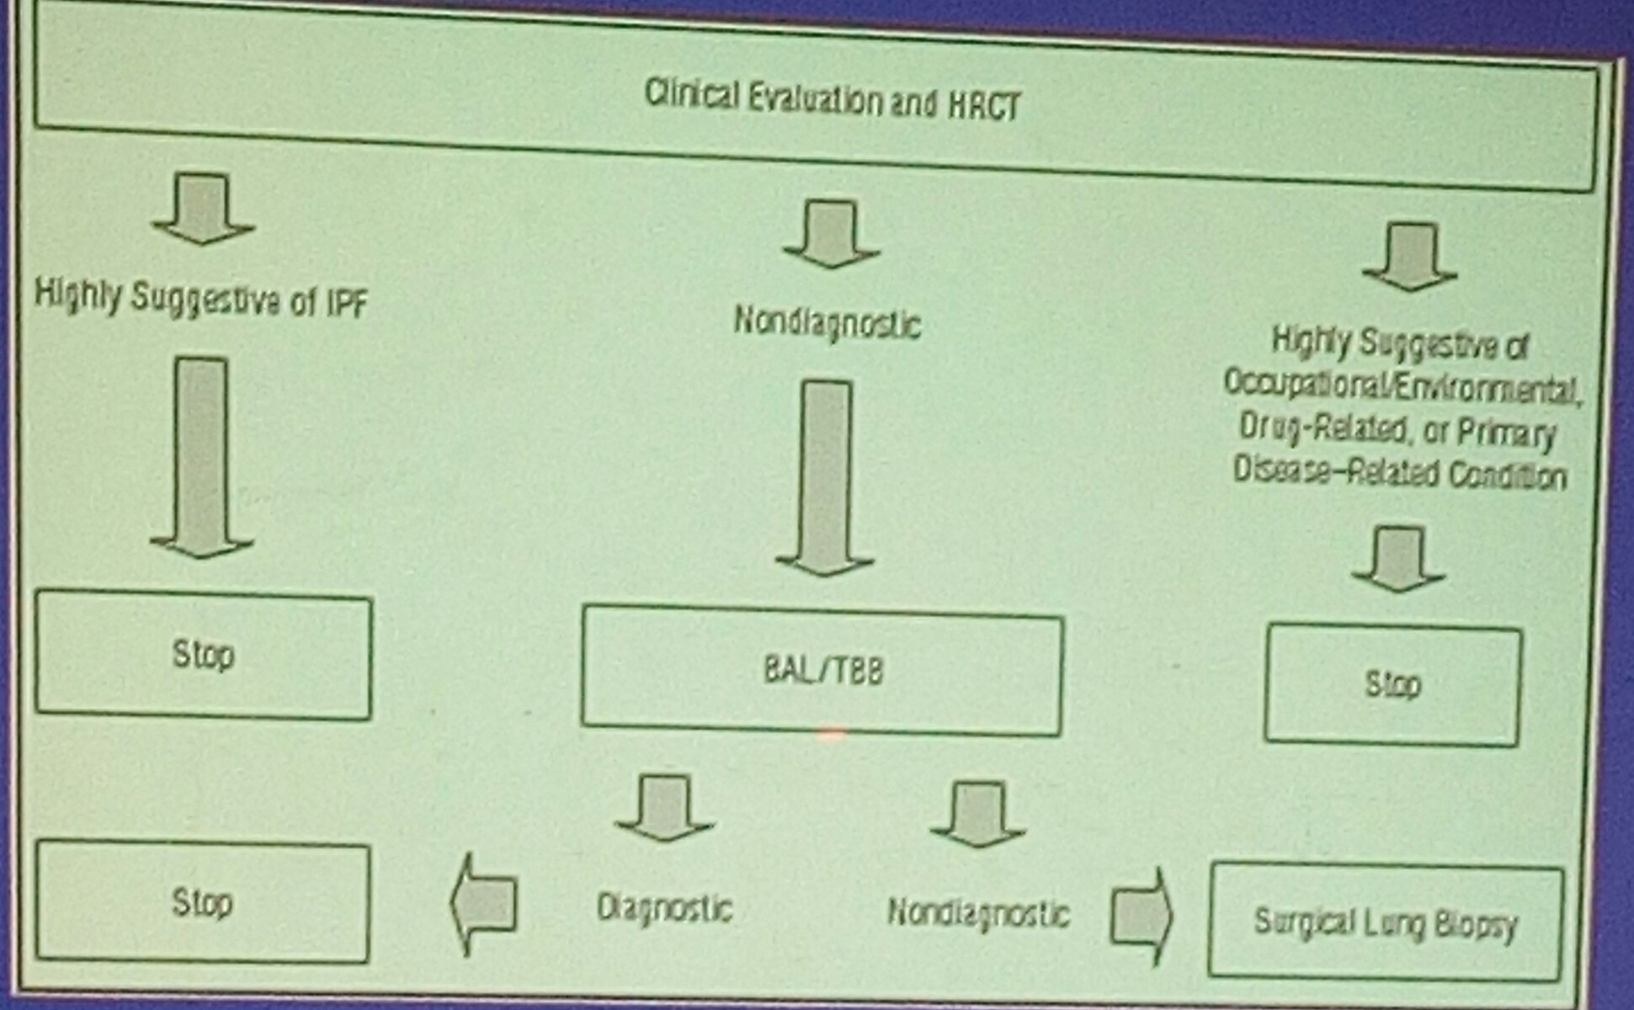
DIAGNOSTIC APPROACH TO THE PATIENT WITH SUSPECTED IIP

Slide 19
TREATMENT
 | THERAPY | PROGNOSIS
IPF-UIP | CORTICOSTEROIDS, AZATHIOPRINE, NAC, LUNG TRANSPLANTATION | Median survival 2.5 – 3.5 years
NSIP | CORTICOSTEROIDS, AZATHIPRINE | Recovery, stable disease, release
RB-ILD & DIP | SMOKING CESSATION CURATIVE | Good
AIP | RESPIRATORY SUPPORT, CORTICOSTEROIDS | 50% mortality

Slide 20
ASTHMA
BY: DR. MECHA
DATE: 13/9/2016

Slide 21
DEFINITION
Asthma is a chronic inflammatory disease of the airways characterized by airway hyper-responsiveness (AHR) to various triggers resulting in wide-spread airway narrowing and airflow limitation
Clinically, asthma presents as an episodic cough, wheeze and SOB which recovers spontaneously or with treatment.

Slide 22
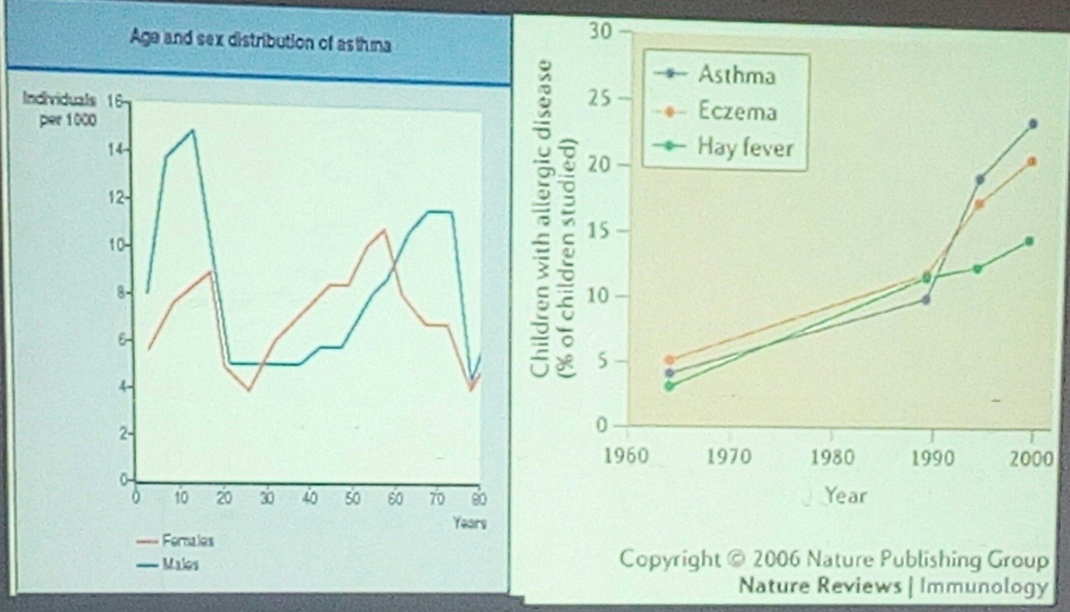
EPIDEMIOLOGY

Slide 23
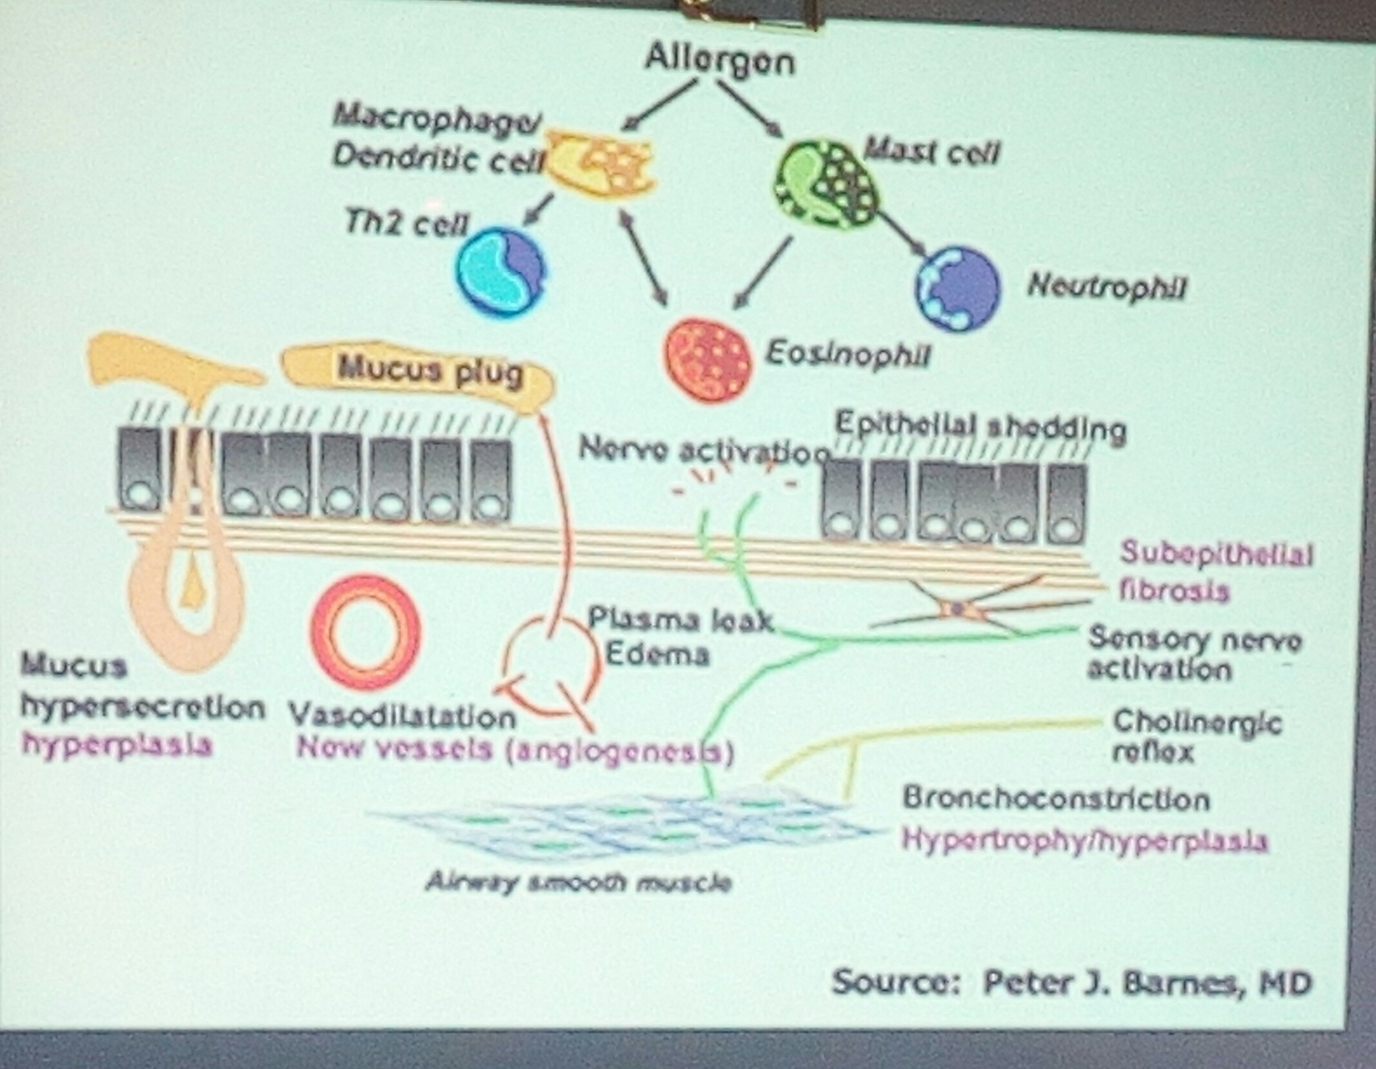
PATHOGENESIS:
There is an interaction between genetics and the environment (trigger factors)

Slide 24
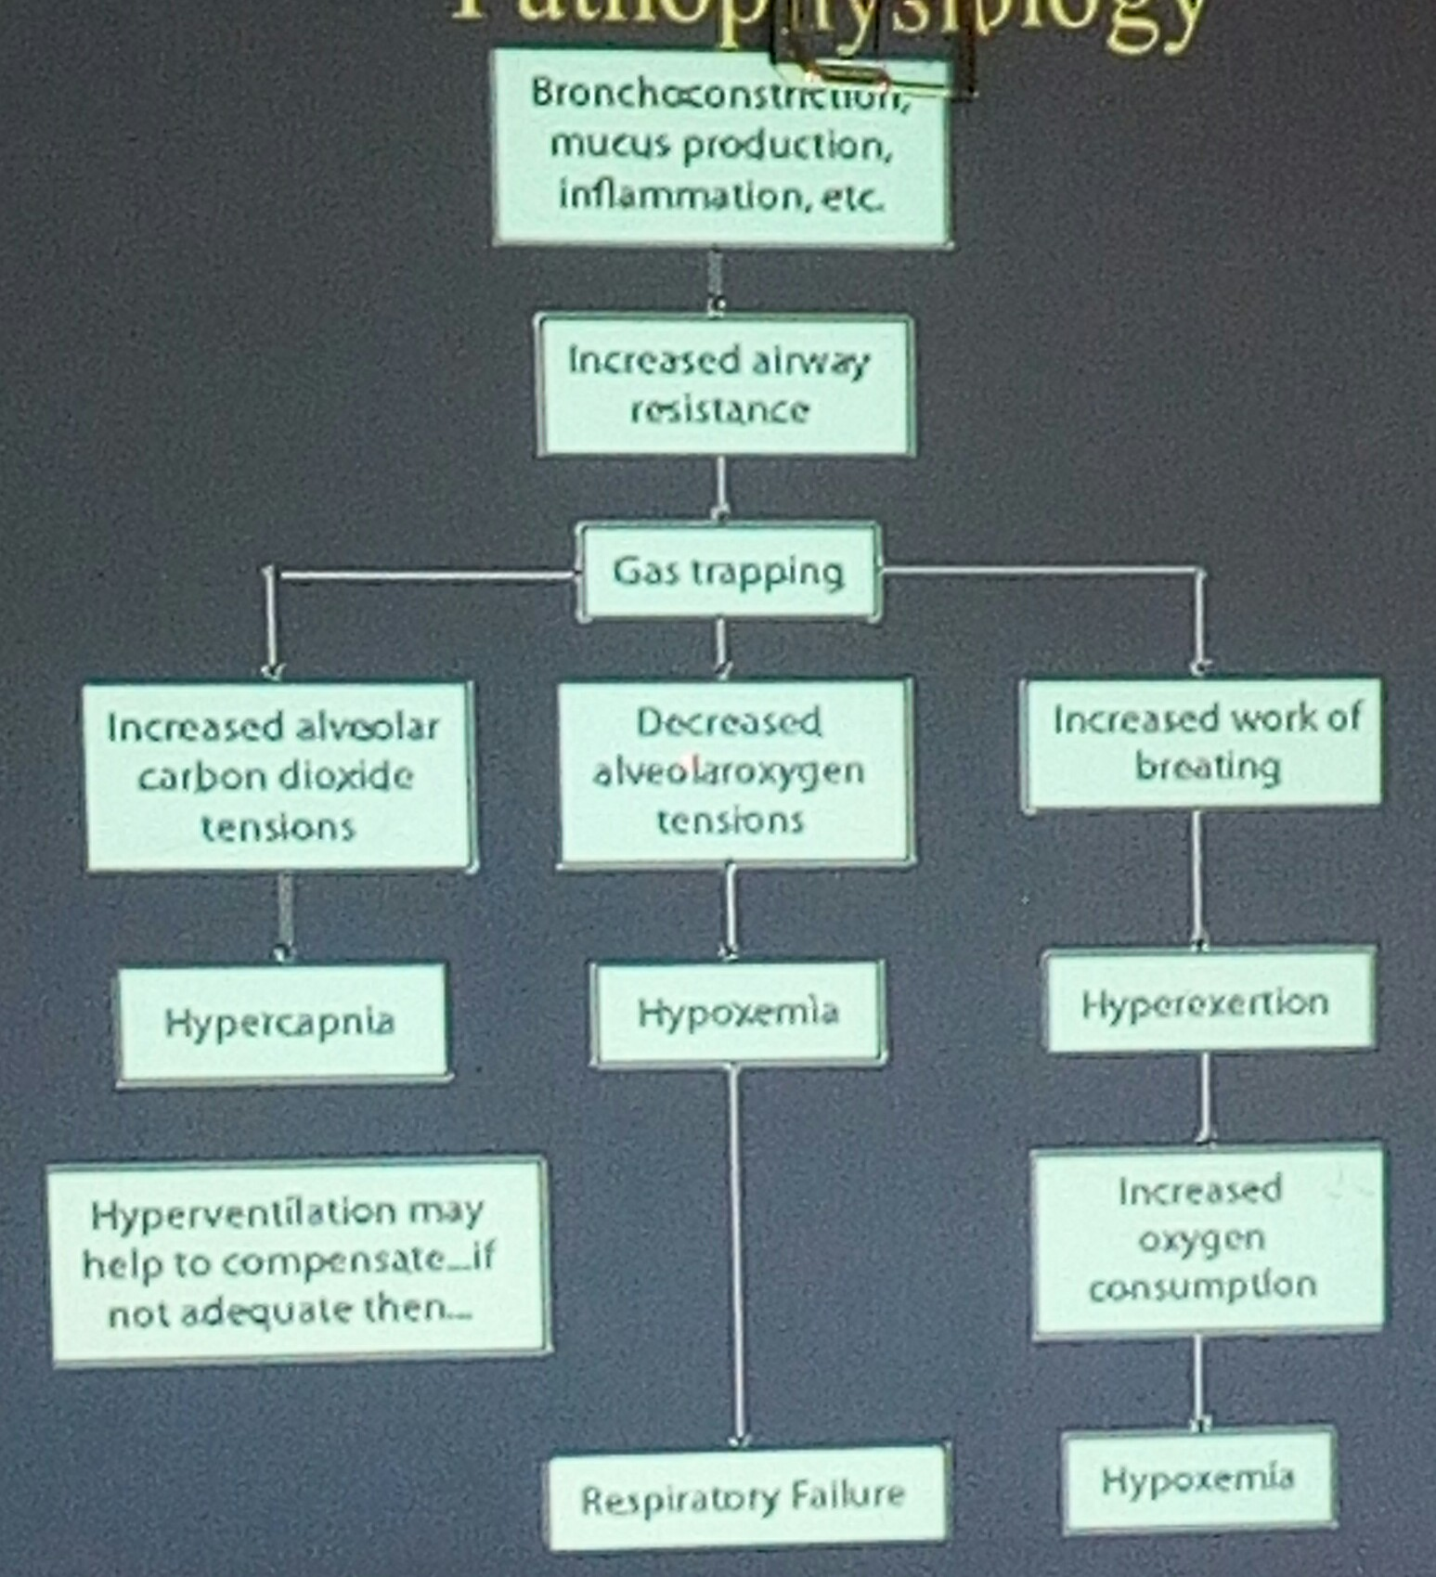
PATHOPHYSIOLOGY

Slide 25
CLINICAL PRESENTATION - HISTORY
Recurrent symptoms
  Wheeze, chest tightness, SOB, cough
Symptom variability
  Vary over time and from one episode to the next
  Tend to be nocturnal/or worse at night
Associated symptoms of atopy
  Allergic rhinitis or conjunctivitis or eczema
Ask the patient for any specific trigger factors.

Slide 26
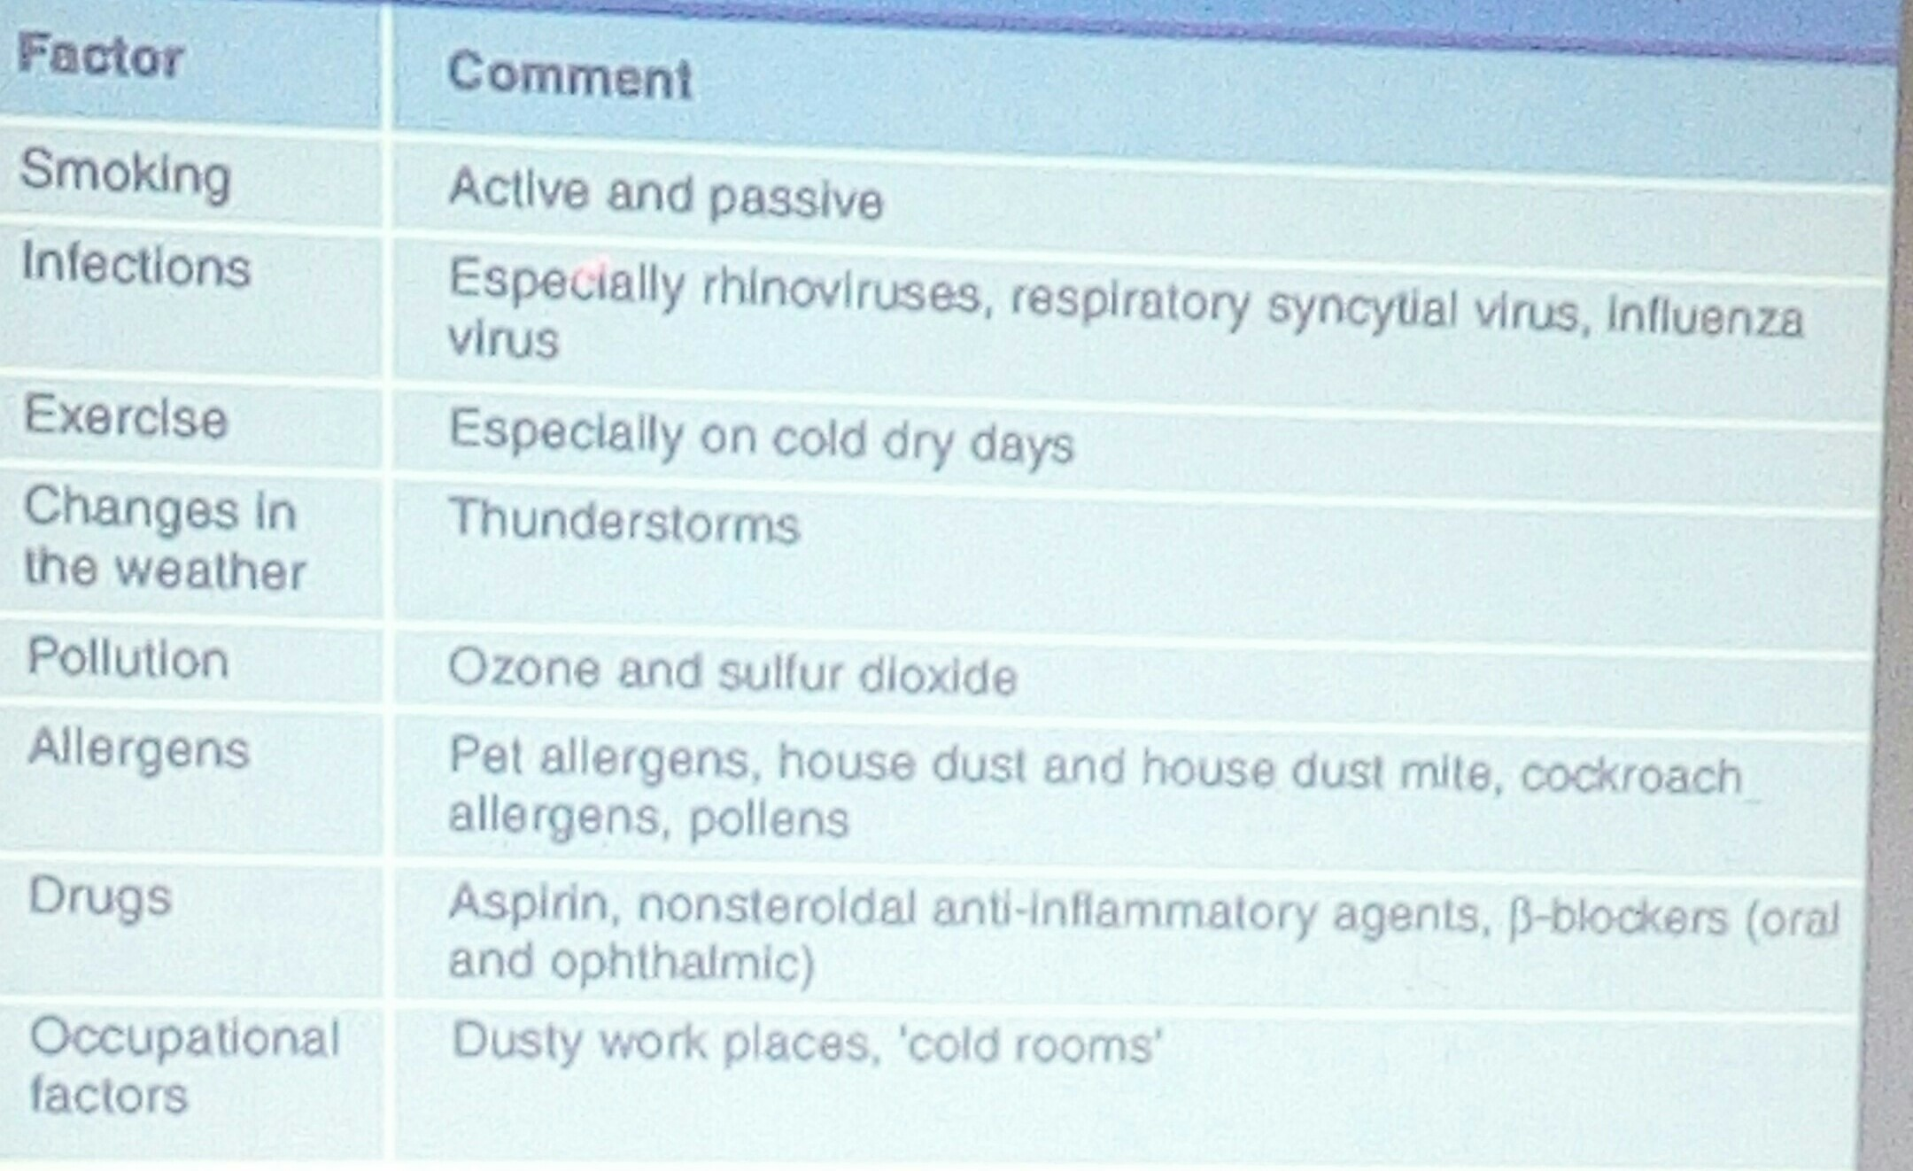
FACTORS THAT MAY EXARCERBATE ASTHMA (TRIGGER FACTORS)

Slide 27
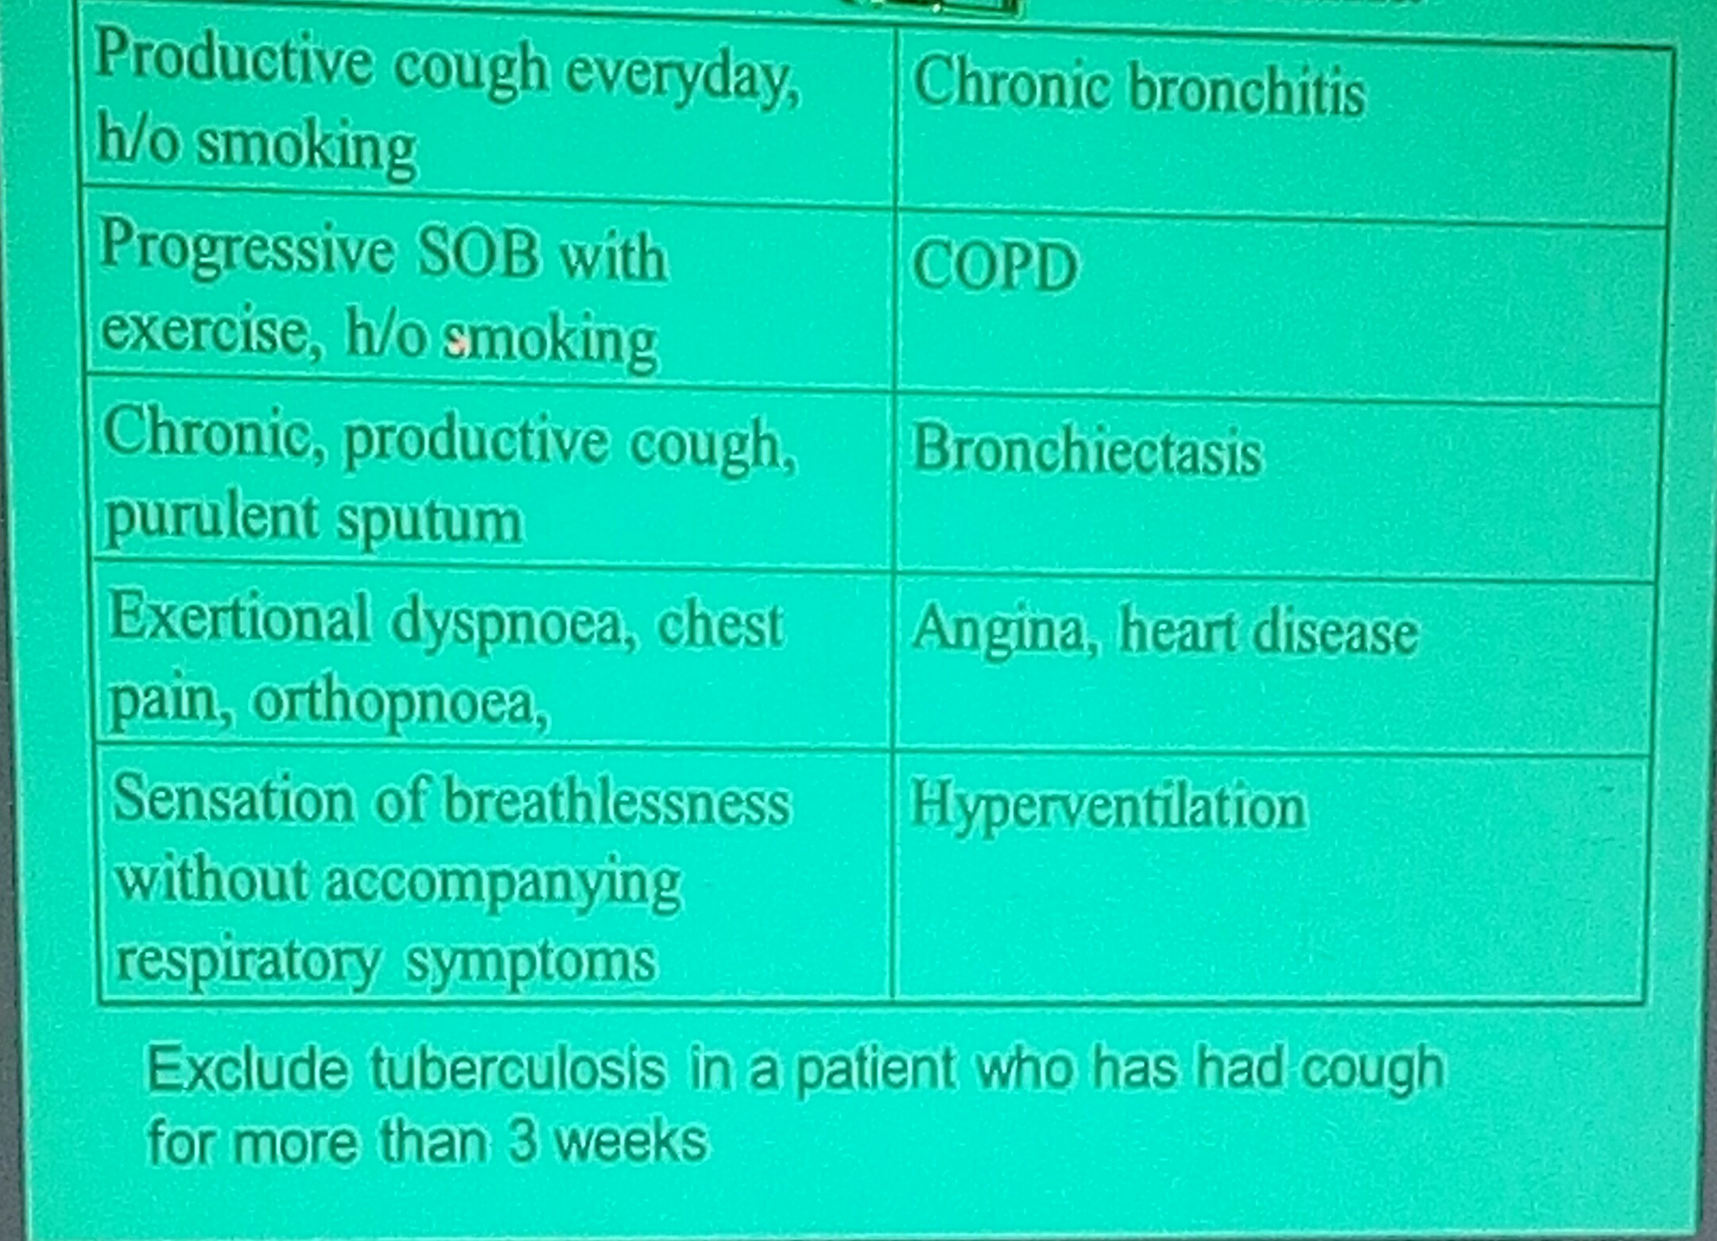
DIFFERENTIAL DIAGNOSIS OF ASTHMA

Slide 28
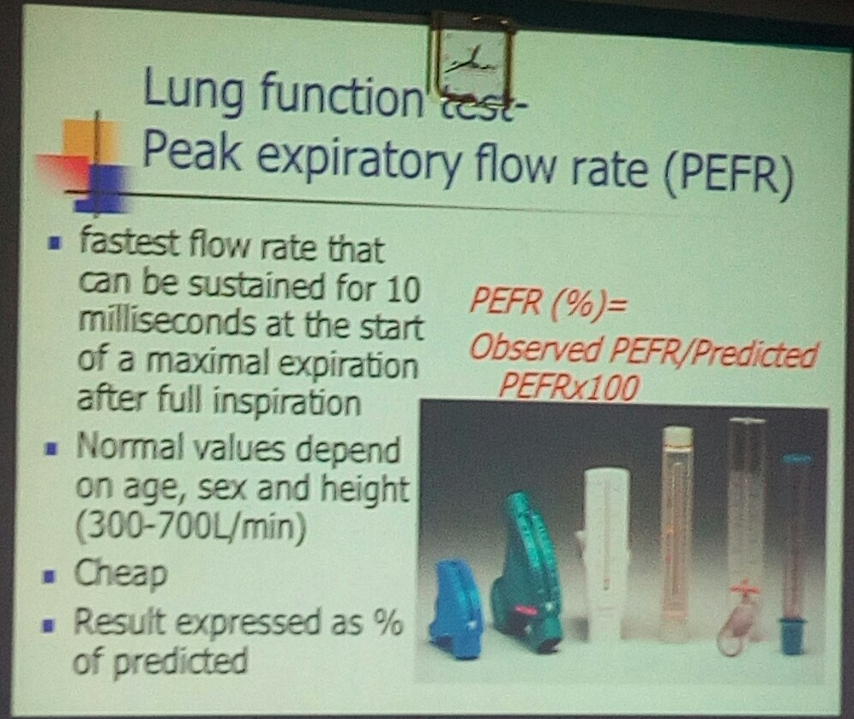
LUNG FUNCTION TESTS – PEAK EXPIRATORY FLOW RATE (PEFR)

Slide 29
OTHER TESTS
LUNG FUNCTION TESTS - SPIROMETRY

Slide 30
CLASSIFICATION
Etiological
  Atopic/allergic/extrinsic
  Intrinsic
  Exercise-induced
  Occupational
Severity (based on symptoms and PEFR)
  Acute asthma attack (mild → moderate → severe)
  Chronic asthma
    Intermittent
    Persistent: Mild → moderate → severe

Slide 31
PRINCIPLES OF MANAGEMNET
Non-pharmacological
  Allergen avoidance
  Patient education
Pharmacological
  The mainstay treatment → inhaler therapy depending on severity of the disease

Slide 32
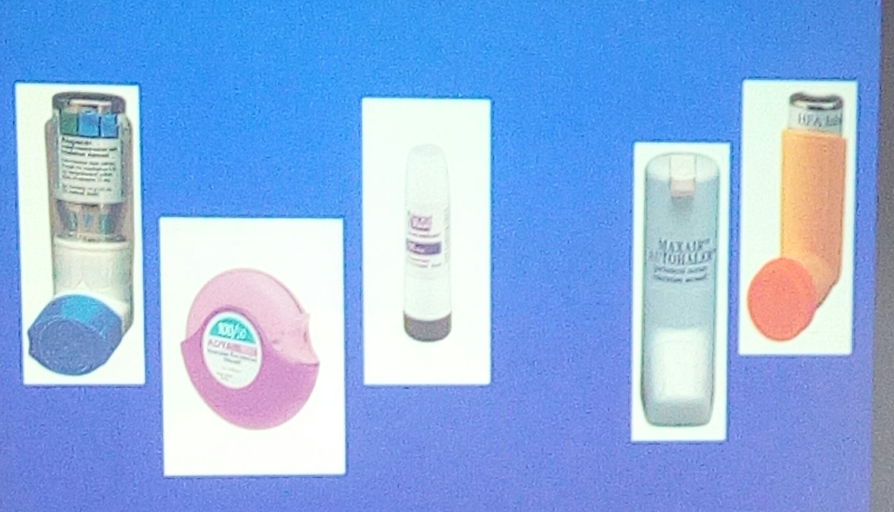
INHALERS

Slide 33
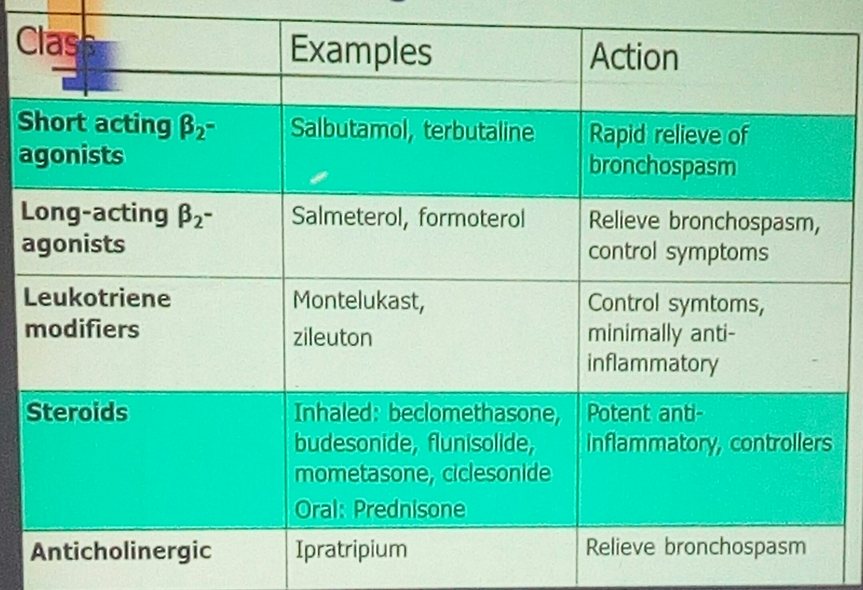
PHARMAOCLOGIC AGENTS COMMONLY USED IN ASTHMA MANAGEMENT

Slide 34
CONCLUSION
Asthma is one of the most commonest chronic respiratory disorders
The pathogenesis of asthma is multi-factorial involving genetic susceptibility and environmental factors
Patient education, avoidance of triggers and proper use of pharmacologic therapies will achieve disease control in a majority of patients.

Slide 35
TYPED BY EFFIE NAILA

