Slide 1
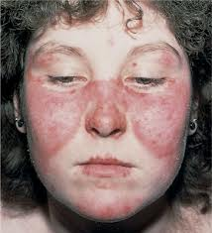
SYSTEMIC LUPUS ERYTHEMATOSUS (SLE)
Syokau Ilovi
Department of Clinical Medicine & Therapeutics
Tel: 0722233157
Email: csilovi@uonbi. ac.ke

Slide 2
Outline
Introduction/ Definition
Epidemiology
Pathophysiology
Clinical Manifestation
Treatment

Slide 3
Definition
Systemic lupus erythematosus (SLE/ Lupus) is an autoimmune chronic inflammatory disease that can affect various parts of the body.

Slide 4
Epidemiology
SLE is a multigenic disease.
In most genetically susceptible individuals, normal alleles of multiple normal genes each contribute a small amount to abnormal immune responses; if enough variations accumulate, disease results.
The frequency of SLE varies by race and ethnicity-higher rates reported in blacks and Hispanics.
The incidence of SLE in black women is 4 times higher than that in white women.
Female sex is permissive for SLE- females make higher antibody responses than males.
Women exposed to estrogen-containing oral contraceptives or hormone replacement have an increased risk of developing SLE >90% of SLE occur in women, starting in child bearing age.
M:F- 1:11 ( during child bearing years)

Slide 5
Pathophysiology (1)
SLE is an autoimmune disorder characterized by multisystem inflammation with the generation of autoantibodies.
Although the specific cause of SLE is unknown, multiple factors are associated with the development of the disease-genetic, epigenetic, ethnic, immunoregulatory, hormonal, and environmental factors.
Many immune disturbances, both innate and acquired, occur in SLE

Slide 6
Pathophysiology (2)
Several environmental stimuli may influence SLE
Exposure to ultraviolet light causes flares of SLE in approximately 70% of patients.
Most SLE patients have autoantibodies for 3 years or more before the first symptoms of disease, suggesting that regulation controls the degree of autoimmunity for years before quantities and qualities of autoantibodies and pathogenic B and T cells actually cause clinical disease.
EBV may be one infectious agent that can trigger SLE in susceptible individuals.

Slide 7
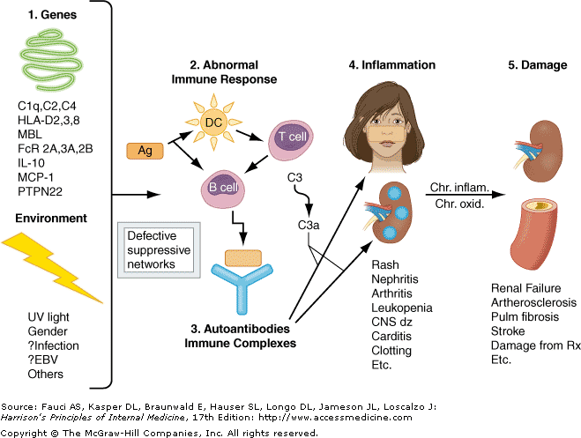

Slide 8
Clinical Manifestations
SLE is a chronic autoimmune disease that can affect almost any organ system.
Its presentation and course are highly variable, ranging from indolent to fulminant.

Slide 10
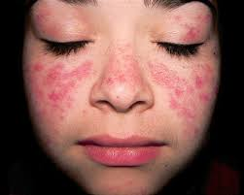
Malar Rash

Slide 11
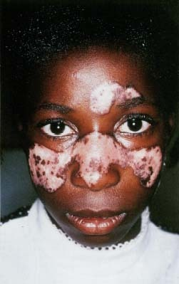
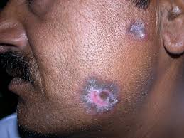
Discoid Rash
Discoid lesions are roughly circular with slightly raised, scaly hyperpigmented erythematous rims and depigmented, atrophic centers in which all dermal appendages are permanently destroyed.
Lesions can be disfiguring, particularly on the face and scalp. Treatment consists primarily of topical or locally injected glucocorticoids and systemic antimalarials.

Slide 12
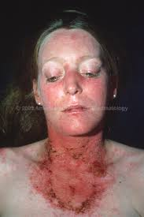
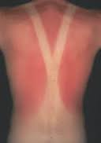
Photosensitivity
Photosensitivity rash-slightly raised erythema, occasionally scaly, on the face (particularly the cheeks and nose—the "butterfly" rash), ears, chin, V region of the neck, upper back, and extensor surfaces of the arms

Slide 16
Renal Manifestations
Nephritis is usually the most serious manifestation of SLE.
Since nephritis is asymptomatic in most lupus patients, urinalysis should be ordered in any person suspected of having SLE.
The classification of lupus nephritis is primarily histologic
Renal biopsy is useful in planning current and near-future therapies.
Patients with dangerous proliferative forms of glomerular damage (ISN III and IV) usually have microscopic hematuria and proteinuria (>500 mg per 24 h); approximately one-half develop nephrotic syndrome, and most develop hypertension.
If diffuse proliferative glomerulonephritis (DPGN) is untreated, virtually all patients develop ESRD within 2 years of diagnosis.
Therefore, aggressive immunosuppression is indicated (usually systemic glucocorticoids plus a cytotoxic drug), unless damage is irreversible.
Overall in the United States, ~20% of individuals with lupus DPGN die or develop ESRD within 10 years of diagnosis.
For most people with lupus nephritis, accelerated atherosclerosis becomes important after several years of disease; attention must be given to control of blood pressure, hyperlipidemia, and hyperglycemia.

Slide 17
Nervous System Manifestations
The most common manifestation of diffuse CNS lupus is cognitive dysfunction, including difficulties with memory and reasoning.
Headaches are also common.
Seizures of any type may be caused by lupus; treatment often requires both antiseizure and immunosuppressive therapies.
Psychosis can be the dominant manifestation of SLE; it must be distinguished from glucocorticoid-induced psychosis. The latter usually occurs in the first weeks of glucocorticoid therapy, at daily doses of 40 mg of prednisone or equivalent; psychosis resolves over several days after glucocorticoids are decreased or stopped.
Myelopathy is not rare and is often disabling; rapid immunosuppressive therapy starting with glucocorticoids is standard of care.

Slide 18
Vascular Occlusions
The prevalence of transient ischemic attacks, strokes, and myocardial infarctions is increased in patients with SLE.
These vascular events are increased in, but not exclusive to, SLE patients with antibodies to phospholipids (aPL).
Antiphospholipid antibodies are associated with hypercoagulability and acute thrombotic events, whereas chronic disease is associated with accelerated atherosclerosis.
Ischemia in the brain can be caused by focal occlusion (either noninflammatory or associated with vasculitis)
In SLE, myocardial infarctions are primarily manifestations of accelerated atherosclerosis.

Slide 19
Pulmonary Manifestations
The most common pulmonary manifestation of SLE is pleuritis with or without pleural effusion.
Pulmonary infiltrates also occur as a manifestation of active SLE and are difficult to distinguish from infection on imaging studies.
Life-threatening pulmonary manifestations include interstitial inflammation leading to fibrosis, shrinking lung syndrome, and intraalveolar hemorrhage; all of these probably require early aggressive immunosuppressive therapy as well as supportive care.

Slide 20
Cardiac Manifestations
Pericarditis is the most frequent cardiac manifestation; it usually responds to anti-inflammatory therapy and infrequently leads to tamponade.
More serious cardiac manifestations are myocarditis and fibrinous endocarditis of Libman-Sacks.
The endocardial involvement can lead to valvular insufficiencies, most commonly of the mitral or aortic valves, or to embolic events.
Patients with SLE are at increased risk for myocardial infarction, usually due to accelerated atherosclerosis, which probably results from chronic inflammation and/or chronic oxidative damage to lipids and to organs.

Slide 21
Hematologic Manifestations
The most frequent hematologic manifestation of SLE is anemia, usually normochromic normocytic, reflecting chronic illness.
Also present with haemolysis
Leukopenia is also common and almost always consists of lymphopenia, not granulocytopenia; this rarely predisposes to infections and by itself usually does not require therapy.
Thrombocytopenia may be a recurring problem.

Slide 22
Gastrointestinal Manifestations
Nausea, sometimes with vomiting, and diarrhea can be manifestations of an SLE flare,
Autoimmune peritonitis and/or intestinal vasculitis.
Increases in serum aspartate aminotransferase (AST) and alanine aminotransferase (ALT) are common when SLE is active.

Slide 23
Ocular Manifestations
Sicca syndrome- Dry eye, dry mouth
Nonspecific conjunctivitis
Sight threatening complications-retinal vasculitis and optic neuritis.
Complications of glucocorticoid therapy-cataracts & glaucoma.

Slide 24
Investigations
ANA- 98% prevalence- Repeated negative tests make SLE unlikely
Anti-dsDNA- 70%- Specific for SLE
TBC
U/E/C, Urinalysis
LFTs
CXR, ECG, Lipids

Slide 25
Treatment Modalities
Management of SLE often depends on disease severity and disease manifestations, although hydroxychloroquine has a central role for long-term treatment in all SLE patients.
In general, cutaneous manifestations, musculoskeletal manifestations, and serositis represent milder disease, which may wax and wane with disease activity. These are often controlled with nonsteroidal anti-inflammatory drugs (NSAIDS) or low-potency immunosuppression medications beyond hydroxychloroquine and/or short courses of corticosteroids
Consider immunosuppressive agents (eg, azathioprine, mycophenolate mofetil, methotrexate) in refractory cases or when steroid doses cannot be reduced to levels for long-term use.

Slide 26
Antiphospholipid Antibody Syndrome(APS)
Patients with SLE who have venous or arterial clotting, and/or repeated fetal losses, and at least two positive tests for aPL( antiphospholipid antibodies).
APS should be managed with long-term anticoagulation.
A target international normalized ratio (INR) of 2.0–2.5 is recommended for patients with one episode of venous clotting;
INR of 3.0–3.5 is recommended for patients with recurring clots or arterial clotting, particularly in the central nervous system.

Slide 27
Drug Induced Lupus
In predisposed individuals
Common drugs- Isoniazid, Hydralazine, Procainamide
Auto-antibodies- anti-Histone Abs positive

