Slide 1
PRINCIPLES OF RHEUMATOLOGY DIAGNOSIS
Dr Eugene Kalman Genga
Department of Clinical Medicine and Therapeutics
University Of Nairobi

Slide 2
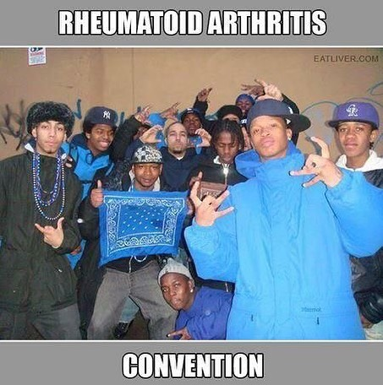
Definition:
Rheumatologic (or Rheumatic) Disease:
diseases characterized by pain and inflammation
in joints and connective tissues, often referred to
as “collagen-vascular diseases”.

Slide 3



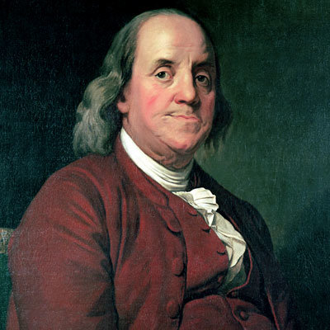



Slide 4
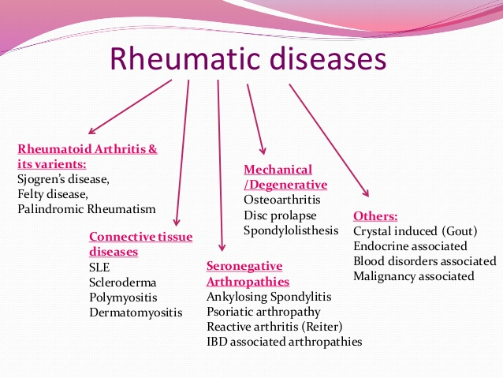

Slide 5
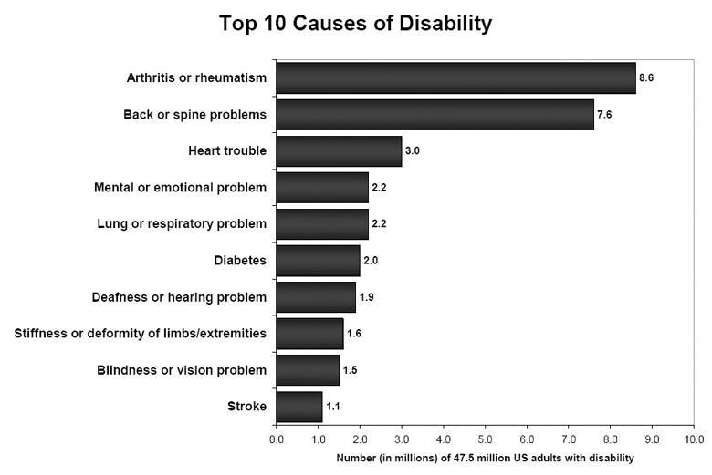

CDC: Census Bureau 2004

Slide 6

OUTLINE
• Introduction
Approach to the patient with a musculoskeletal complaint
Approach to the patient with a connective tissue disease
Take home message

Slide 7

Descriptive Terms
Synovitis
Bursitis
Arthralgia
Arthritis
Monoarthritis
Oligo/pauci-arthritis
Polyarthritis
Tendonitis/Tendinosis
Tenosynovitis
Enthesitis
Myalgia
Myositis
Osteoporosis
Early morning stiffness

Slide 8
Small vs large joint involvement
Symmetrical vs asymmetrical disease
Axial disease vs peripheral joint involvement
Juvenile arthritis: onset < 16 years

Slide 9

MUSCULOSKELETAL COMPLAINT EVALUATION OF PATIENTS WITH MUSCULOSKELETAL COMPLAINTS
Goals
Accurate diagnosis
Timely provision of therapy
Avoidance of unnecessary diagnostic testing

Slide 10
Case 1
CC: Arthralgia in hands and feet HPI: 50 yr WW presents with 6 weeks of arthralgia in hands and feet. Swelling over MCP’s, PIP’s. Has tried naproxen with partial relief ROS, PMH, PSH, Social HX: Negative FH: mother with rheumatoid arthritis
Exam: Tenderness & synovitis of wrists, R MCP 2-4 and B PIP 3

Slide 11
History.. Age
<30= Systemic lupus erythromatosus, Ankylosis spodylitis, Reactive Arthritis, JIA.
30-50= Rheumatoid arthritis, Systemic sclerosis, Gout.
>50= OA, Pseudogout, Polymyalgia rheumatica
Any Age group= Psoriatic arthritis, Enteropathic arthritis

Slide 12
History.. Sex
>Female:
SLE, RA, OA, Systemic sclerosis, Ankylosis spodylitis, PMR.
Male=Female:
Psoriatic arthritis, Enteropathic arthritis Pseudogout.
>Male:
Gout, Reactive Arthritis

Slide 13
SITE...
Symmetrical= RA, SLE, Systemic sclerosis
Asymmetrical=OA
Large joints=OA
DIP= OA, Psoriatic arthritis
MCP, PIP= RA, SLE
1st MTP= Gout, OA
Spine= OA, Ankylosis spodylitis, Psoriatic arthritis, Reactive arthritis
Shoulder= PMR

Slide 14
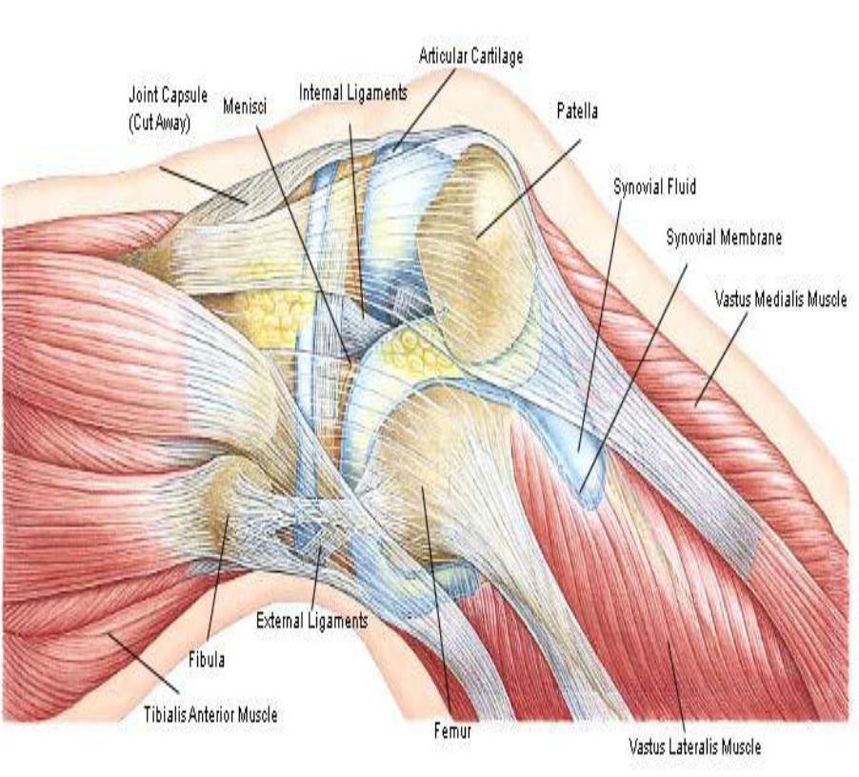
DIAGNOSTIC APPROACH Articular Vs. Non Articular

Slide 15
History and physical exam pearls:
Articular: Pain is diffuse and deep
Pain with active and passive range of motion
Swelling
Crepitation, locking, instability or deformity

Slide 16
History and physical exam pearls:
Non articular: Pain with active but not passive ROM Tenderness in adjacent structures Other physical findings in remote areas

Slide 17
Evaluation
I - History
Symptoms of joint disease
Pain
  Inflammatory joint disease
    present both at rest and with motion.
    It is worse at the beginning than at the end of usage.
  Non-inflammatory joint disease(ie, degenerative, traumatic, or mechanical)
    Occurs mainly or only during motion
    Improves quickly with rest.
    Patients with advanced degenerative disease of the hips, spine, or knees may also have pain at rest and at night.
  Pain that arises from small peripheral joints tends to be more accurately localized than pain arising from larger proximal joints. For example, pain arising from the hip joint may be felt in the groin or buttocks, in the anterior portion of the thigh, or in the knee.

Slide 18
Acute Vs. Insidious onset

Slide 19
Persistent Vs. Episodic
Rheumatoid arthritis
Ankylosing spondylitis
Disease activity

Slide 20
Number of joints involved
Monoarticular: 1 joint involved
Oligoarticular: 2-4 joints involved
Polyarticular: >4 joints involved
Symmetry of joint involvement
Symmetric arthritis is characterized by involvement of the same joints on each side of the body. This symmetry is typical of RA and SLE.
Asymmetric arthritis is characteristic of psoriatic arthritis, reactive arthritis (Reiter syndrome), and Lyme arthritis.

Slide 21
Monoarticular
Polyarticular Infection
crystal disease
RA, psoriatic arthritis

Slide 22
Distribution of affected joints
  The distal interphalangeal joints of the fingers are usually involved in psoriatic arthritis, gout, or osteoarthritis but are usually spared in RA.
  Joints of the lumbar spine are typically involved in ankylosing spondylitis but are spared in RA.
Distinctive types of musculoskeletal involvement
  Spondyloarthropathy involves entheses, leading to heel pain (inflammation at the insertions of the Achilles tendon and/or plantar fascia), dactylitis (sausage digits), tendonitis, and back pain (sacroiliitis and vertebral disc insertions).
  Gout commonly involves tendon sheaths and bursae, resulting in superficial inflammation.

Slide 23
I - History
Symptoms of joint disease
Stiffness
  Stiffness is a perceived sensation of tightness when attempting to move joints after a period of inactivity. It typically subsides over time. Its duration may serve to distinguish inflammatory from non-inflammatory forms of joint disease.
  With inflammatory arthritis, the stiffness is present upon waking and typically lasts 30-60 minutes or longer.
  With noninflammatory arthritis, stiffness is experienced briefly (eg, 15 min) upon waking in the morning or following periods of inactivity.

Slide 24
I - History
Symptoms of joint disease
Stiffness
  Stiffness is a perceived sensation of tightness when attempting to move joints after a period of inactivity. It typically subsides over time. Its duration may serve to distinguish inflammatory from non-inflammatory forms of joint disease.
  With inflammatory arthritis, the stiffness is present upon waking and typically lasts 30-60 minutes or longer.
  With noninflammatory arthritis, stiffness is experienced briefly (eg, 15 min) upon waking in the morning or following periods of inactivity.

Slide 25
I - History
Symptoms of joint disease
Swelling
  With inflammatory arthritis, joint swelling is related to synovial hypertrophy, synovial effusion, and/or inflammation of periarticular structures. The degree of swelling often varies over time.
  With noninflammatory arthritis, the formation of osteophytes leads to bony swelling. Patients may report gnarled fingers or knobby knees. Mild degrees of soft tissue swelling do occur and are related to synovial cysts, thickening, or effusions.

Slide 26
History
Limitation of motion
    Loss of joint motion may be due to structural damage, inflammation, or contracture of surrounding soft tissues.
    Patients may report restrictions on their activities of daily living, such as fastening a bra, cutting toenails, climbing stairs, or combing hair.
Weakness
    Muscle strength is often diminished around an arthritic joint as a result of disuse atrophy.
    Weakness with pain suggests a musculoskeletal cause (eg, arthritis, tendonitis) rather than a pure myopathic or neurogenic cause.
    Manifestations include decreased grip strength, difficulty rising from a chair or climbing stairs, and the sensation that a leg is "giving way."

Slide 27
MUSCULOSKELETAL COMPLAINT
Systemic Vs. Localized
RA, SLE Osteoarthritis

Slide 28
History
Extra-articular symptoms
  Fatigue
    Fatigue is usually synonymous with exhaustion and depletion of energy in patients with arthritis.
    With inflammatory polyarthritis, the fatigue is usually noted in the afternoon or early evening.
    With psychogenic disorders, the fatigue is often noted upon arising in the morning and is related to anxiety, muscle tension, and poor sleep.

Slide 29
    Constitutional symptoms suggest an underlying systemic disorder and are not expected in patients with degenerative joint disease. These may include fatigue, malaise, and weight loss.
    Skin lesions may be present. Physical examination of the skin, but not the joints, may indicate the specific diagnosis of a number of rheumatic diseases. Examples include SLE, dermatomyositis, scleroderma, Lyme disease, psoriasis, Henoch-Schönlein purpura, and erythema nodosum.
    Ocular symptoms or signs are also possible. Episcleritis and scleritis may be associated with RA or Wegener granulomatosis, anterior uveitis with ankylosing spondylitis, and iridocyclitis with juvenile RA. Conjunctivitis may be caused by reactive arthritis

Slide 30
History and Physical exam Pearls
Inflammatory
Non-Inflammatory
Erythema
Warmth Pain
Swelling
Tenosynovitis
Stiffness after prolonged rest Fatigue
Pain without swelling
Gel phenomenon
Pain is aggravated with activity

Slide 31

Physical Examination
General
  general condition, fever, pulse, BP
Articular or extra-articular
Joint Inflammation
  swollen, red, , tender, hot
Functional impairment
  passive and active movement
  Crepitus during active or passive range of motion
  Instability
  Joint Deformity (flexion, subluxation, dislocation)

Slide 32
Know It When You See It
Soft synovial swelling
Synovitis and volar subluxation at the MCP joints
Synovitis of the wrists
Synovitis of the PIP joints with early swan neck deformities
Rheumatoid arthritis
Notes:
4

Slide 33
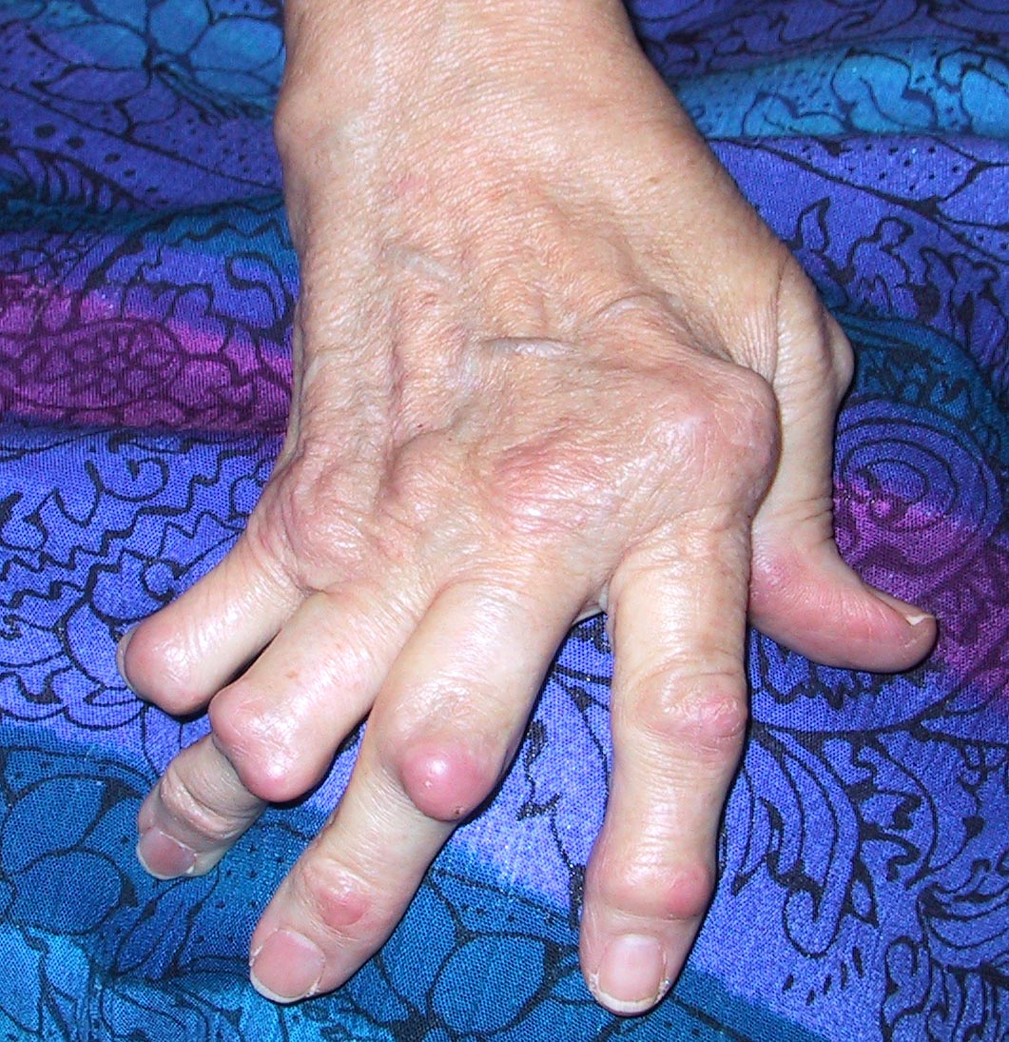
Rheumatoid Arthritis: Late Stages
Deformities
Nodules
Tendon Rupture
Notes:
5
Associated deformities: Zeta thumb, swan neck, buttonierres, subluxation, ulnar deviation

Slide 34
Know It When You See It
Often associated with:
  Inflammatory eye disease
  Balanitis, oral ulceration, or keratoderma
  Enthesopathy
  Sacroiliitis
Seronegative asymmetric arthritis
Notes:
10

Slide 35
Know It When You See It
Inflammation of the DIP joints
Sausage fingers
Joint involvement shows radial pattern
Nail changes
Psoriatic patches
Arthritis may start before the skin
Psoriatic arthritis
Notes:
7

Slide 36
Know It When You See It
Hard bony enlargements
Heberden’s nodes at
the DIP joints
Bouchard’s nodes at
the PIP joints
Often have “squared” first CMC joint due to osteophytes at that joint
Osteoarthritis
Notes:
3

Slide 37
Know It When You See It
Tap if joint/bursa infection suspected
Do not tap through cellulitis
Infection
Notes:
28

Slide 38
Know It When You See It
A true connective-tissue disease
Left: Hypermobility of joints. Can touch thumb to volar surface of forearm
Right: Hyperelasticity of skin
Associated with vascular abnormalities
Ehlers-Danlos syndrome
Notes:
33

Slide 39

Physical exam:
Look for clues in other organs that may lead to a diagnosis

Slide 40
Rheumatoid arthritis

Slide 41
Psoriasis

Slide 42
Gonoccocal arthritis

Slide 43
Gout

Slide 44
DIAGNOSTIC APPROACH
Laboratories:
CBC: Anemia, thrombocytosis Inflammation Neutropenia, thrombocytopenia Felty’s syndrome Hemolysis, thrombocytopenia SLE
Elevated ESR, CRP inflammation
CCP antibodies: Positive in 40% of RF negative RA, CCP is far more specific for RA than RF is, but a negative result does not exclude the diagnosis of RA
Van Venrooij WJ, Autoimmun Rev 2006; 6(1):37-41

Slide 46
Synovial fluid analysis
condition Appearance WBC count PMN% Other
Normal Clear/straw < 200 < 25%
Trauma Clear/bloody < 2000 < 25%
OA Clear/slightly cloudy < 2000 < 25% Occasional cartilage fragments
Infection Cloudy/purulent > 50000 > 80% Organisms on gram stain
RA Cloudy/light yellow < 10000 75% Occasional cholesterol crystals
Gout Cloudy/white or yellow > 10000 75% MSU crystals
Pseudogout Cloudy/white or yellow > 10000 75% CPPD crystals

Slide 48

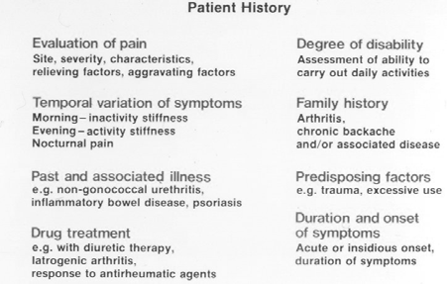

Slide 49
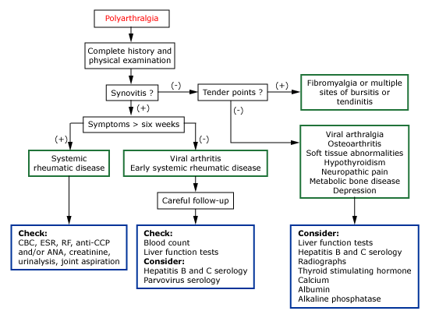
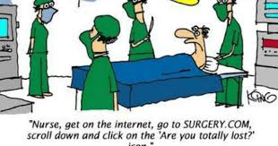
Summary…

Slide 50
CONNECTIVE TISSUE DISEASE
Diagnostic approach:
CC: Arthralgia and muscle weakness
HPI: 46 yr African lady who presents with 6 months of arthralgia in shoulders, hands, knees and feet. Swelling wrists, and PIP’s. She also has difficulty getting up from a chair, and combing her hair.
ROS: Easy bruisability, Raynaud’s phenomenon, hair loss
PMH, PSH, social history and family history: NC
PE: Diffuse hair loss, TJC 26, SJC 9. Weakness in proximal arms, legs and neck flexors Labs: Leukopenia, elevated AST, CPK 1000, aldolase 12, UA: nl, ANA 1:640, RNP pos, C3 120, C4 8

Slide 51
History pearls:
Multisystem organ involvement is common
Constitutional: Fatigue, fever, weight loss
Eyes: Sicca(dryness), redness, pain
ENT: Sicca, oral/nasal ulcers, dysphagia, sore throat
Heart: Chest pain, orthopnea, PND
Lungs: Pleuritic pain, dyspnea, cough
Abdomen: GERD, bowel changes, GIB
Joints: Pain, swelling, stiffness

Slide 52
Skin: Photosensitivity, hair loss, rashes, Raynaud’s, nail changes
Neurological: Neuropathy, muscle weakness, mental status changes, headache, seizures
Psychiatric: Depression, psychosis
GU: genital ulcers

Slide 53
Physical exam pearls:
Head to toe examination

Slide 54
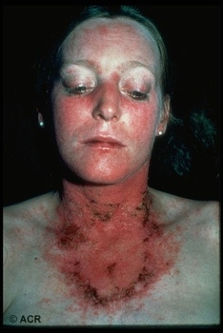
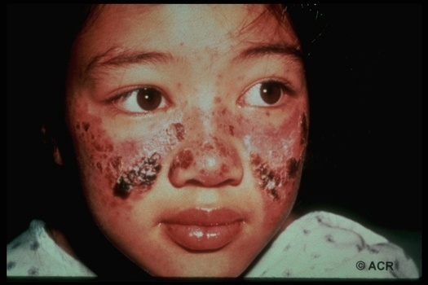
Know It When You See It
“Butterfly”/Malar rash
Involves cheeks, spares nasolabial fold
Systemic lupus erythematosus
Notes:
12

Slide 55
Know It When You See It
Appears in a broad- based interrupted pattern in systemic vasculitis, including SLE
May occur as a fine, connected, lacy pattern in normals
Livedo reticularis
Notes:
19

Slide 56
Systemic sclerosis

Slide 57
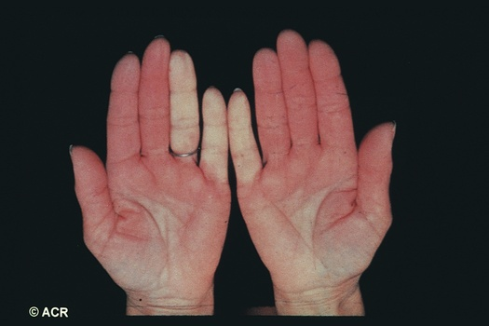
Know It When You See It
Can be 1º or 2º
Stress/cold can trigger
Keep extremities and body warm
Raynaud’s phenomenon
Notes:
19

Slide 58
Systemic sclerosis, SLE

Slide 59
Dermatomyositis

Slide 60
Know It When You See It
Characteristic of dermal vasculitis
Palpable purpura
Notes:
20

Slide 61
CONNECTIVE TISSUE DISEASE
Goldblatt F. Lancet 2013; 382: 797–808

Slide 62
CONNECTIVE TISSUE DISEASE
Diagnostic approach
Laboratories:
CBC: Hemolysis, thrombocytopenia, leukopenia, lymphopenia
CMP: Renal insufficiency, elevated LFT’s, hypokalemia
Urinalysis: Hematuria, proteinuria, active sediment, inability to acidify the urine

Slide 63
Laboratories:
ANA: Antibodies against nuclear specificities (e.g. DNA, snRNP)
ANA can be seen in the normal population:
≥ 1:40: 20-30%
≥ 1:80: 10-12%
≥ 1:160: 5%
≥ 1:320: 3%
In clinical use, ANA is insufficient to establish or refute a diagnoses
ANA results add weight to diagnoses that throughout the evaluation should rely heavily on other clinical information
Kelley’s Rheumatology Textbook- 8th Ed. (2009)

Slide 64
CT disease Diagnostic approach: Laboratories:

Slide 65
Imaging studies:
Systemic sclerosis

Slide 66
Imaging studies: SLE

Slide 67
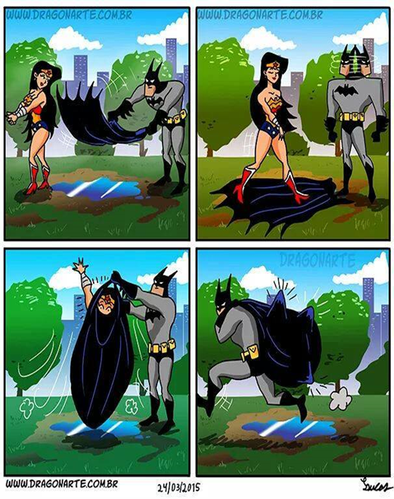
TAKE HOME MESSAGES
• A full history and physical exam can lead to a diagnosis 80-90% of the time
• In patients with a musculoskeletal symptom characterize the pain: Is it articular?, how many joints are involved?, is it inflammatory?, is it a systemic process?, What is the duration of symptoms?
• ANAs and rheumatoid factor can be positive in multiple conditions and even in the normal population. Think of the pre-test probability for a connective tissue disease before ordering it

Slide 68


