Slide 1
SPONDYLOARTHROPATHIES/
SPONDYLOARTHRITIDES
Syokau Ilovi
Department of Clinical Medicine & Therapeutics
2/6/2021

Slide 2
Outline
Introduction
Ankylosing Spondylitis
Reactive arthritis
Psoriatic arthritis

Slide 3
Introduction
The spondyloarthritides are a group of disorders that share certain clinical features and genetic associations.
  ankylosing spondylitis
  reactive arthritis
  psoriatic arthritis and spondylitis
  enteropathic arthritis and spondylitis
  juvenile-onset spondyloarthritis
  undifferentiated spondyloarthritis.
The similarities in clinical manifestations and genetic predisposition (HLA-B27) suggest that these disorders share pathogenic mechanisms.
Asymmetrical distal arthritis

Slide 4
Ankylosing Spondylitis
Ankylosing spondylitis (AS) is an inflammatory disorder of unknown cause that primarily affects the axial skeleton.
Peripheral joints and extraarticular structures are also frequently involved.
Male to female prevalence is between 2:1 and 3:1.
AS strongly associated with HLA-B27 ( occurs in 90% of patients).

Slide 5
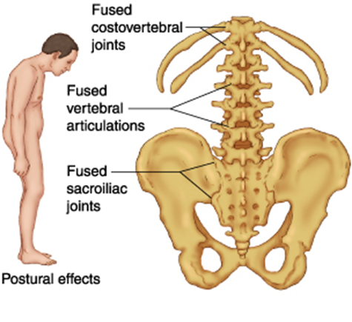
Pathogenesis of AS
The pathogenesis of AS is almost certainly immune-mediated.
A unifying concept is that the AS disease process begins at sites where articular cartilage, ligaments, and other structures attach to bone.

Slide 6
Laboratory Findings of AS
No laboratory test is diagnostic of AS.
HLA B27 is present in approximately 90% of patients.
ESR and CRP are often elevated.

Slide 7
Clinical Manifestations of AS
The initial symptom is usually dull pain, insidious in onset, felt deep in the lower lumbar or gluteal region, accompanied by low-back morning stiffness of up to a few hours' duration that improves with activity and returns following periods of inactivity.
Within a few months of onset, the pain has usually become persistent and bilateral.
Common sites include the costosternal junctions, spinous processes, iliac crests, greater trochanters, ischial tuberosities, tibial tubercles, and heels.
Arthritis of peripheral joints other than the hips and shoulders, usually asymmetric.
Neck pain and stiffness from involvement of the cervical spine are usually relatively late manifestations.
The most specific findings involve loss of spinal mobility, with limitation of anterior and lateral flexion and extension of the lumbar spine and of chest expansion.
Pain in the sacroiliac joints may be elicited either with direct pressure or with maneuvers that stress the joints.

Slide 8
Schober Test (1)
Measures lumbar spine flexion.
The patient stands erect, with heels together, and marks are made directly over the spine 5 cm below and 10 cm above the lumbosacral junction.
The patient then bends forward maximally, and the distance between the two marks is measured.
The distance between the two marks increases by 5 cm in the case of normal mobility and by <4 cm in the case of decreased mobility.
*Chest expansion is also reduced in AS

Slide 9
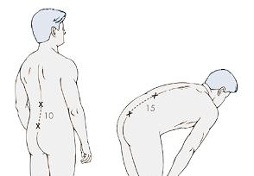
Schober Test (2)

Slide 10
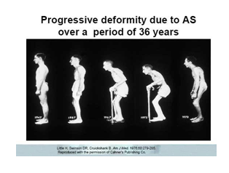
Complications of AS (1)
Fusion of the spine
The patient's posture undergoes characteristic changes, with obliterated lumbar lordosis, buttock atrophy, and accentuated thoracic kyphosis. There may be a forward stoop of the neck or flexion contractures at the hips, compensated by flexion at the knees

Slide 11
Complications of AS (2)
The most serious complication of the spinal disease is spinal fracture, which can occur with even minor trauma to the rigid, osteoporotic spine.
Extra-articular manifestation- anterior uveitis, inflammation in the colon or ileum of frank Inflammatory Bowel Disease (IBD)

Slide 12
Treatment of AS
Exercise program designed to maintain posture and range of motion.
NSAIDs reduce pain and tenderness and increase mobility in many patients with AS.
Anti-TNF- therapy have revolutionised AS - rapid, profound, and sustained reductions in all clinical and laboratory measures of disease activity.

Slide 13
Reactive Arthritis
Reactive arthritis (ReA) refers to acute nonpurulent arthritis complicating an infection elsewhere in the body.
Usually follow enteric or urogenital infections.
The identification of bacterial species capable of triggering the clinical syndrome and the finding that many patients possess the B27 antigen have led to the unifying concept of ReA as a clinical syndrome triggered by specific etiologic agents in a genetically susceptible host.
Presents with triad of arthritis, urethritis, and conjunctivitis.

Slide 14
Aetiological Agents
Enteric infection with any of several Shigella, Salmonella, Yersinia, and Campylobacter species.
Genital infection with Chlamydia trachomatis
Others- Clostridium difficile, Campylobacter coli, certain toxigenic E. coli, Ureaplasma urealyticum & Mycoplasma genitalium.
  Respiratory infection with Chlamydia pneumoniae
*Patients with clinical features of ReA who lack evidence of an antecedent infection will be considered to have undifferentiated spondyloarthritis.

Slide 15
Epidemiology of ReA
Prevalence of HLA B27- 50%.
Enteric ReA- M:F 1:1
Venereal ReA occurs predominantly in men.
In Africans- Associated with HIV, without association to B27- WHO Stage 1
In caucasians- HIV- HLA B27 positive- occurs with advancing Hiv disease

Slide 16
Clinical Features of ReA (1)
Antecedent infection 1–4 weeks before onset of symptoms of the reactive disease.
However, in a sizable minority, no clinical or laboratory evidence of an antecedent infection can be found.
Constitutional symptoms are common, including fatigue, malaise, fever, and weight loss.
The musculoskeletal symptoms are usually acute in onset.
Arthritis is usually asymmetric and additive, with involvement of new joints occurring over a period of a few days to 1–2 weeks.
The joints of the lower extremities, especially the knee, ankle, and subtalar, metatarsophalangeal, and toe interphalangeal joints, are the most common sites of involvement, but the wrist and fingers can be involved as well. The arthritis is usually quite painful, and tense joint effusions are not uncommon, especially in the knee.

Slide 17
Clinical Features of ReA (2)
Urogenital lesions may occur throughout the course of the disease.
In males, urethritis may be marked or relatively asymptomatic and may be either an accompaniment of the triggering infection or a result of the reactive phase of the disease. Prostatitis is also common.
In females, cervicitis or salpingitis may be caused either by the infectious trigger or by the sterile reactive process.
Ocular disease is common, ranging from transient, asymptomatic conjunctivitis to an aggressive anterior uveitis that occasionally proves refractory to treatment and may result in blindness.
Arthritis typically persists 3–5 months, but courses up to 1 year can occur.
HLA-B27–positive patients have shown a worse outcome than B27-negative patients.

Slide 18
Laboratory and Radiographic Findings of ReA
ESR is usually elevated during the acute phase of the disease.
Synovial fluid shows nonspecifically inflammatory.
HLA B27 positive- 50% of patients
Serologic evidence of a recent infection may be present, such as a marked elevation of antibodies to Yersinia, Salmonella, or Chlamydia.
In early or mild disease, radiographic changes may be absent or confined to juxtaarticular osteoporosis.
With long-standing persistent disease, marginal erosions and loss of joint space can be seen in affected joints.
Periostitis with reactive new bone formation is characteristic of the disease, as it is with all the spondyloarthritides.
Spurs at the insertion of the plantar fascia are common.
Sacroiliitis and spondylitis may be seen as late sequelae.

Slide 19
Diagnosis of ReA
ReA is a clinical diagnosis with no definitively diagnostic laboratory test or radiographic finding.
The diagnosis should be entertained in any patient with an acute inflammatory, asymmetric, additive arthritis or tendinitis.
The evaluation should include questioning regarding possible triggering events such as an episode of diarrhea or dysuria.
On physical examination, attention must be paid to the distribution of the joint and tendon involvement and to possible sites of extraarticular involvement, such as the eyes, mucous membranes, skin, nails, and genitalia.
Synovial fluid analysis may be helpful in excluding septic or crystal-induced arthritis.
Culture, serology, or molecular methods may help to identify a triggering infection.
Although typing for B27 is not needed to secure the diagnosis in clear-cut cases, it may have prognostic significance in terms of severity, chronicity, and the propensity for spondylitis and uveitis.
HIV testing .
It is important to differentiate ReA from disseminated gonococcal disease both of which can be venereally acquired and associated with urethritis.
Unlike ReA, gonococcal arthritis and tenosynovitis tend to involve both upper and lower extremities equally, to lack back symptoms, and to be associated with characteristic vesicular skin lesions.
  Occasionally, only a therapeutic trial of antibiotics can distinguish the two.

Slide 20
Treatment of ReA
Most patients with ReA benefit from NSAIDs
Prompt, appropriate antibiotic treatment of acute chlamydial urethritis or enteric infection may prevent the emergence of ReA.
No benefit for antibiotic therapy that is initiated after onset of arthritis.
Athritis- sulfasalazine, azathioprine, anti-TNF-
Tendinitis and other enthesitic lesions may benefit from intralesional glucocorticoids.
Uveitis may require aggressive treatment with glucocorticoids to prevent serious sequelae.

Slide 21
Psoriatic Arthritis
Psoriatic arthritis (PsA) refers to an inflammatory arthritis that characteristically occurs in individuals with psoriasis.

Slide 22
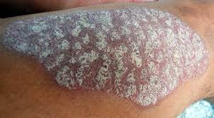
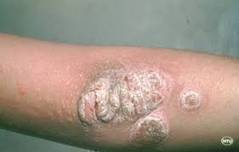
Psoriasis

Slide 23
Epidemiology of PsA
Prevalence of PsA among individuals with psoriasis-5% - 30%.
Associated with HLA-B27

Slide 24
Pathogenesis of PsA
PsA is almost certainly immune-mediated and probably shares pathogenic mechanisms with psoriasis.

Slide 25
Clinical Features of PsA (1)
60–70%- psoriasis precedes joint disease.
15–20%- the two manifestations appear within 1 year of each other.
15–20% - the arthritis precedes the onset of psoriasis and can present a diagnostic challenge.
The frequency in men and women is almost equal.
The spectrum of arthropathy:
  (1) arthritis of the DIP joints
  (2) asymmetric oligoarthritis
  (3) symmetric polyarthritis similar to RA
  (4) axial involvement (spine and sacroiliac joints)
  (5) arthritis mutilans, a highly destructive form of disease.

Slide 26
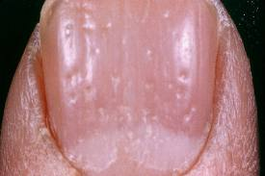
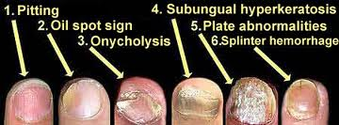
Clinical Features of PsA (2)
Nail changes in the fingers or toes occur in 90% of patients with PsA, compared with 40% of psoriatic patients without arthritis.
6 Nail Changes- pitting, horizontal ridging, onycholysis, yellowish discoloration of the nail margins, dystrophic hyperkeratosis,

Slide 27

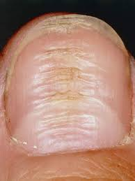

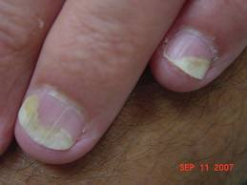
Nail Changes
Hyperkeratosis
Yellow nails
Horizontal Ridging
Onycholysis

Slide 28
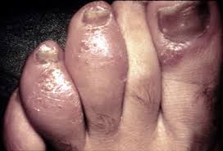
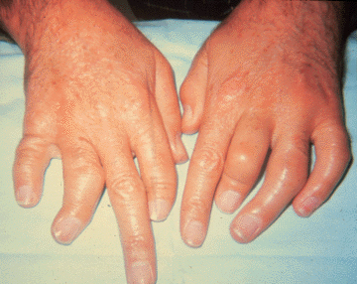
Clinical Features of PsA (3)
Dactilitis
Arthritis mutilans

Slide 29
Psoriasis & HIV
The psoriasis and PsA seen with HIV infection both tend to be severe and can occur in populations with very little psoriasis in noninfected individuals.
Severe enthesopathy, dactylitis, and rapidly progressive joint destruction are seen, but axial involvement is very rare.
This condition is prevented by or responds well to ART.

Slide 30
Laboratory of PsA
The diagnosis of PsA is primarily clinical, based on the presence of psoriasis and characteristic peripheral or spinal joint symptoms, signs, and imaging
There are no diagnostic laboratory tests for PsA.
ESR and CRP are often elevated.

Slide 31
Treatment of PsA
Therapy is directed at both the skin and joints in PsA.
MTX,
Anti-TNF- agents- Prompt and dramatic resolution of both arthritis and skin lesions

Slide 32
COVID-19 & PsA
Covid has been associated with Reactive Arthritis
COVID – Multisystemic Inflammatory Syndrome in Children (MIS-C)- 2-4 weeks after infection- Inflammation, Kawasaki’s, conjunctivitis, rash, dactylitis
Biologics used in PsA worsen COVID outcomes
Patients on Biologics can take COVID Vaccination

