Slide 1
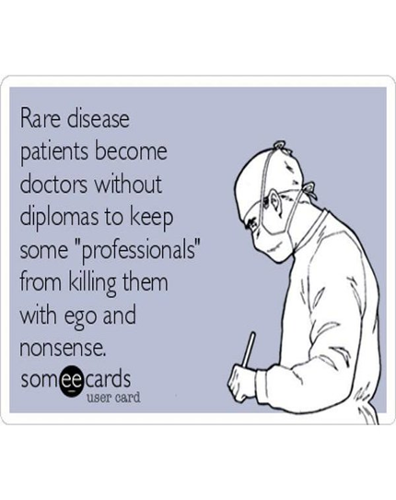
Basics on Inflammatory muscle disease for the Medical student
Dr Eugene kalman Genga

Slide 3
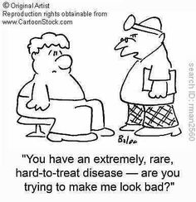
Inflammatory myopathies
Rare heterogeneous group of acquired diseases characterized by inflammatory infiltrate of skeletal muscle.
Incidence of about 2-10 per 1 million people per year in the United States.
Potentially treatable.

Slide 4
Idiopathic inflammatory myopathies
Polymyositis
Dermatomyositis
Juvenile dermatomyositis
Inclusion body myositis
Myositis associated with collagen vascular disease
Myositis associated with malignancy

Slide 5
Idiopathic inflammatory myopathies
Polymyositis
Dermatomyositis
Juvenile dermatomyositis
Inclusion body myositis
Myositis associated with collagen vascular disease
Myositis associated with malignancy

Slide 6
Polymyositis/Dermatomyositis
Occur sporadically or in association with other systemic autoimmune disease
More common in women than men.
DM common than PM.
DM can clinically manifest with heliotrope rash, Grotton’s papules, shawl rash, erythematous nailfolds, dermatomyositis sine myositis.

Slide 7
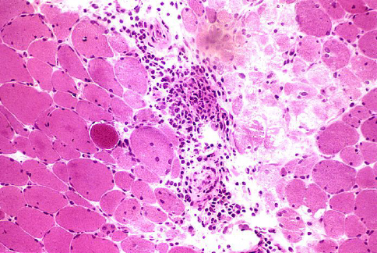
Dermatomyositis
Inflammatory myopathy
Prevalence: 1:100,000 in general population
Female to male prevalence of 2:1
peak incidence ages 40-50
Immune complex deposition in the vessels considered to be part of a complement-mediated vasculopathy
Hematoxylin and eosin stain (20x) of a muscle biopsy from a patient with dermatomyositis showing perivascular and perimysial inflammation, as well as perifascicular necrosis.

Slide 8
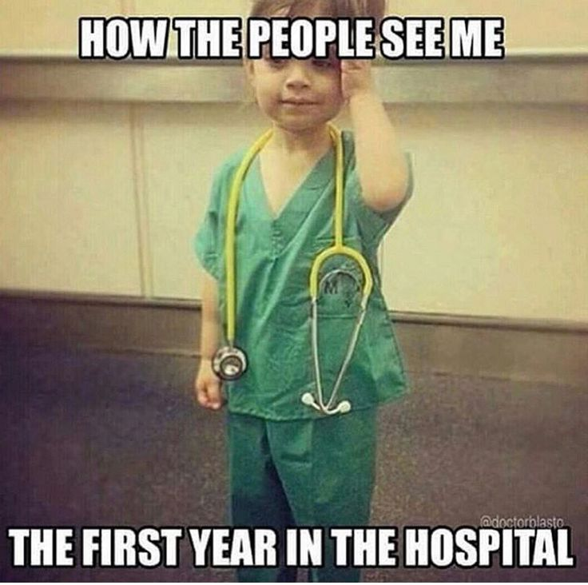
Case 1
40 yr old lady has come to the hospital with c/o difficulty in using all 4 limbs-last 7 months
Blackish discoloration face and hands-6 months
Difficulty in swallowing 2 months
Pain over the both great toes 1month

Slide 9
History
She was apparently normal 7 months ago when developed pain over the both thighs followed by fever, she took treatment, fever subsided in 3 days but she noticed weakness of both legs, mainly in the proximal region, which is insidious in onset and slowly progressive in nature

Slide 10
History
She was apparently normal 7 months ago when developed pain over the both thighs followed by fever, she took treatment, fever subsided in 3 days but she noticed weakness of both legs, mainly in the proximal region, which is insidious in onset and slowly progressive in nature
h/o difficulty in getting up from squatting and lying posture, climbing the stairs -7months
Difficulty in lifting the hand above the head, combing the hair and bringing the food to mouth-6 months
h/o difficulty in lifting the head from the pillow-4 months
Difficulty in mixing the food- 2 months
h/o dysphagia .-last 2 months , started with solid food now even for liquid, progressive,mainly during initiation of swallowing and associated with throat pain

Slide 11
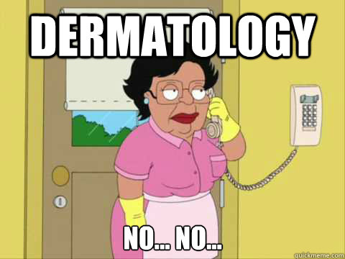
h/o hyper pigmentation over the face, chest and neck-6 months, non itchy
h/o excessive hair loss +

Slide 12
MALAR RASH& V sign

Slide 13
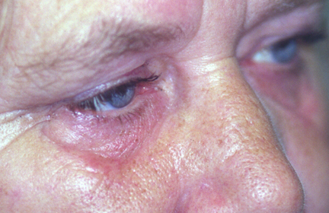
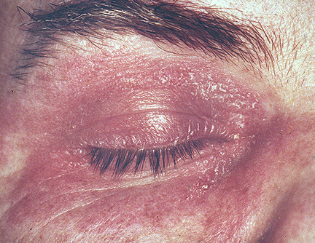
Signs and Symptoms
Heliotrope rash:
A reddish-purple eruption on the upper eyelid
accompanied by swelling of the eyelid
Most specific rash in DM
Only present in a minority of patients.

Slide 14
SHAWL SIGN

Slide 15
GOTTRON`S PAPULES

Slide 16
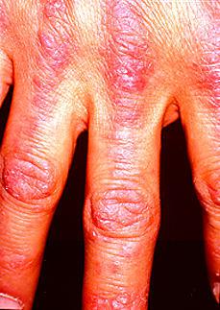
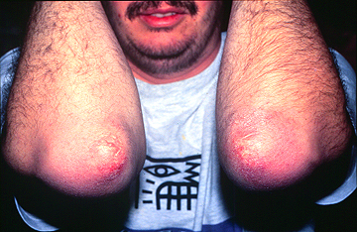
Signs and Symptoms
Grotton’s Sign:
An erythematous, scaly eruption over the extensor surfaces of the metacarpophalangeal joints and digits
can mimic psoriasis

Slide 17
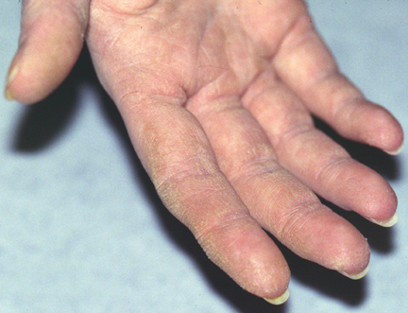
“Mechanic’s Hands”
roughened, cracked skin at tips and lateral aspects of the fingers resulting in irregular, dirty-appearing lines

Slide 18
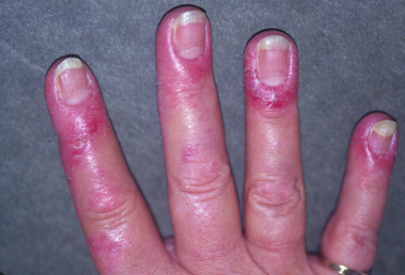
Nail Changes
Periungual Erythema

Slide 19
Tone - normal on both side
Power - shoulder 2/5 both side
Elbow 3/5 both side
wrist 4/5 both side
hand grip good
hip 2/5 ,knee 3/5, ankle 4/5
DTR preserved
Plantar b/l flexor , other superficial reflexes normal
Sensory system normal
No cerebellor sign
No involuntory movements
No fasiculation
Gait- waddling gait

Slide 20
Dermatomyositis - histology

Slide 21
Diagnostic Criteria
Bohan and Peter Criteria:
Symmetric proximal muscle weakness
most common symptom
typical rash
elevated serum muscle enzymes
myopathic changes on EMG
characteristic muscle biopsy abnormalities and absence of histopathologic signs of other myopathies

Slide 23
Immunopathogenesis
Humorally-mediated disorder with cellular infiltrate focused around blood vessels
Proinflammatory cytokines contribute to muscle weakness
IL-1 and TNF-alpha are increased in muscle tissue
Upregulation of MHC class I molecules on myocytes lead to disturbed muscle function

Slide 24
Complications
Interstitial lung disease
10% of cases
respiratory failure may result from diaphragmatic and chest muscle weakness
can result in rapid respiratory failure and death
Esophageal disease
weakness of the striated muscle of the upper 1/3 of the esophagus and/or oropharyngeal muscles
can lead to nasal regurgitation, dysphagia, aspiration
More common in elderly patients
leads to increased incidence of bacterial pneumonia
Myocarditis
Malignancy

Slide 25
Outcome Predictors
Worse outcomes if:
delay in initial treatment of >6 months after symptom onset
greater weakness at presentation
presence of dysphagia
respiratory muscle weakness
interstitial lung disease
associated malignancy
cardiac involvement
advanced age

Slide 26
Malignancy in DM Patients
Incidence: of patients with DM, 48% over age 65 v. 9% under age 65 were found to have a malignancy
Risk factors:
Evidence of capillary damage on muscle biopsy
DM complicated by cutaneous necrosis on the trunk
Cutaneous leukocytoclastic vasculitis
Older age at diagnosis
Pathophysiology: paraneoplastic process
Regenerating cells in myositis muscle, but not in normal muscle, express high levels of myositis-specific autoantigens. Same antigens are expressed at high levels in several cancers
Types of cancer: adenocarcinoma of the cervix, lung, ovaries, pancreas, bladder and stomach make up about 70% of associated cancers

Slide 27
Cancer Screening in DM Patients
Thorough medical history and physical exam
Age appropriate cancer screening (mammogram and colonoscopy)
CT of chest, abdomen and pelvis recommended only if significantly increased risk
Pelvic US and transvaginal US for women
Serum CA 125 and CA 19-9
PSA
UA for blood

Slide 28
Case 2….
Patient ABC ,30 years old house wife
admitted with following complaints
Muscle pains-------- 2 months
Gen. body weakness----- 1 month
Difficulty in swallowing ----- 10 days

Slide 29
Muscle aches
Usual state of health 2 months back
Gradual in onset
From lower limbs, then upper limbs then whole body
Aggravated on trying to move limb and pressing the muscles
Progressive
There is also history of associated B/L knee joint pain but no inflammation associated with it

Slide 30
Weakness
Gradual in onset
Unable to rise up from sitting position, climbing stairs
Then unable to move lower limbs
and also difficulty in combing hair then even moving her upper limbs
Didn’t c/o any difficulty in breathing or neck movements
There is no history of any morning stiffness.

Slide 31
Difficulty in swallowing
For last 10 days difficulty in swallowing
Difficulty is more for solids than liquids
No h/o regurgitation, vomiting.

Slide 32
History
There is no history of any associated fever, respiratory tract or GIT infection in past few weeks, palpitation, heat or cold intolerance, any change in urine color, cough, sputum.
There is also no history of use of any drugs for a long period, also no history of any homeo or herbal medicine.
There is no h/o mouth ulcers alopecia, sun burns, change in color of finger tips in cold.

Slide 33
Examination
A middle aged ill looking female lying comfortably in the bed with I/V cannula at right arm, well cooperative during examination with following vitals
B.P 110/70 mmHg
Pulse 82/min
R.R 20/min
Temp. 98`F

Slide 34
General Physical Examination
No significant finding on GPE
No erythematous rash at face
Shawl sign -ve
Gottron sign -ve
Heliotrope rash –ve
No mechanic’s hands
No signs of cushing’s disease
No skin changes
No signs of hyper/hypothyroidism

Slide 35
Musculoskeletal & Nervous system
Well oriented in time place and person
GCS 15/15
Mild tenderness in muscles of lower thigh
Plantars B/L down going
Power 1/5 at proximal muscles, 3/5 at distal muscles of lower limbs
2/5 in proximal muscles of upper limb and 4/5 in lower limbs

Slide 36
Musculoskeletal & Nervous system
Bulk of muscles bilateral equal and normal
Tone was normal in all limbs
Reflexes are normal
All sensations intact
All cranial nerves intact (no neurological dysphagia)

Slide 37
Other Systemic Examination
Respiratory system:
Normal in shape, bilateral chest movements equal, and bilateral air entry equal. On auscultation normal vesicular breathing with few bibasal inspiratory crackles not changing character with cough.
CVS
Apex beat in 5th intercostal space just lateral to mid clavicular line non taping, non heaving with S1+S2+0

Slide 38
Abdomen
Scaphoid, with umbilicus normal in shape and position, flanks not filled and no visible veins or stria
soft, non tender, no visceromegaly
No shifting dullness
Bowel sounds 3/min

Slide 39
investigations
CBC
Hb 10.7 g/dl
WBC 10800
PLT count 191000
Neut. 88%
Poly. 10%
Eosin.1%
ESR 100 mm/1st hr
Urine C/E
Albumin nil
Pus cells rare
RBC 9-10
Crystals uric acid+
Blood ++
pH 7.0
sp. Gravity 1010
Casts nil
Serum electrolytes
Na 139
K 4.4
Cl 102
RFTS
Urea 60
Creatinine 1.2
LFTs
ALT 370 IU
AST 490 IU
S. bilirubin 0.7 (0.4D)
Alk. PO4 204

Slide 40
CPK 7047
LDH 2785

Slide 41
NCS Normal
EMG showed
Increased insertional activity with fibrillation and +ve sharp waves especially in proximal muscles. There is early recruitment of motor units and interference pattern is early and full especially in lower limbs and proximal muscles. Motor unit size and duration is decreased
Impression: this study is in favour of inflammatory myopathy(polymyositis)

Slide 42
Biopsy of Skeletal muscle sent
CA 125 sent

Slide 44
Inclusion body myositis (IBM)
Most common inflammatory myopathy after age 50 yrs
Insidious onset, slowly progressive proximal leg and distal arm weakness
Delayed diagnosis with average duration of symptoms prior to diagnosis is 6-7 yrs
Male are affected more than female
Hallmark: weakness and atrophy (2/3rd of the pts)
Legs: knee extensors, ankle dorsiflexors
Arms: wrist and finger flexors
Upto 82% of patients have marked asymmetry
Sparing of thenar and hypothenar muscles helps distinguish IBM from ALS
Dysphagia occurs on 70% patients
Mild to moderate facial weakness

Slide 45
IBM
marked difficulty in flexing the fingers of the left hand as compared to the right
Quadriceps atrophy
Notes:
Wash U – quadriceps atrophy
Book – this pt has marked difficulty in flexing the fingers of the left hand as compared to the right.

Slide 46
IBM – work up
Serum CK may be normal or elevated up to 10 times normal
ANA positive in 20% patients
Nerve conduction studies - mild sensory axonal peripheral polyneuropathy in up to 30% of patients with IBM
Needle examination - evidence of muscle irritation (increased insertional activity, positive sharp waves, polyphasic potentials)
Skeletal muscle MRI scans – atrophy and signal abnormalities in affected muscle groups

Slide 47
 | PM | DM | IBM
Age at onset | >18yrs | Adulthood, childhood | >50yrs
sex | M=F | F>M | M>F
Weakness | proximal | proximal | Proximal, early distal involvement
Familial association | No | No | Yes, in some cases /familial inflammatory myopathies /
Response to treatment | good | better | poor
CTDs | yes | yes | Yes, in up to 20%
malignacy | No | yes, in up to 15% of cases | No
Rash | Absent | Present | Absent
Biopsy | “primary” inflammation with the CD8/MHC-I complex & vacuoles | Perifascicular, perymysial, or privascular infiltrates, perifascicular atrophy | Primary inflammation with CD8/MHC-I complex; vacuolated fibers with b-amyloid deposits , cytochrome oxygenase-negative fibers ; signs of chronic myopathy

Slide 48
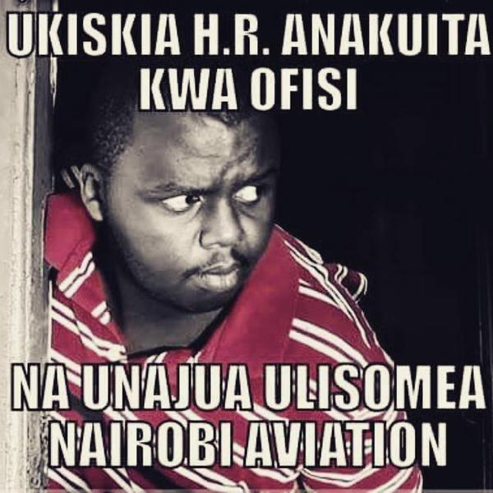
IIM - Evaluation
Careful history and physical examination to define:
The time\tempo of symptom onset and progression.
The exact nature of the problems and associated factors.
Medical and family history.
Muscle bulk/strength, rashes, cardiac, pulmonary, GI findings.
Environmental exposures temporally associated.

Slide 49
IIM – Systemic manifestations
General manifestations: fatigue, fever, weight loss.
Musculoskeletal: myalgia, muscle tenderness and weakness. Arthralgia, arthritis, contractures.
Dermatologic: Photosensitive rashes and edema. Vasculitis with infarcts and ulceration. Subcutaneous inflammation (panniculitis) and calcification.

Slide 50
IIM – Systemic manifestations
Gastrointestinal: oropharyngeal involvement with tongue weakness and voice changes; dysphagia and reflux.
Pulmonary:Atelectasis, cough. Interstitial lung disease. Aspiration.
Cardiovascular:Tachyrhythmias and other conduction abnormalities. Congestive heart failure from myocarditis or cor pulmonale. Raynaud.

Slide 51
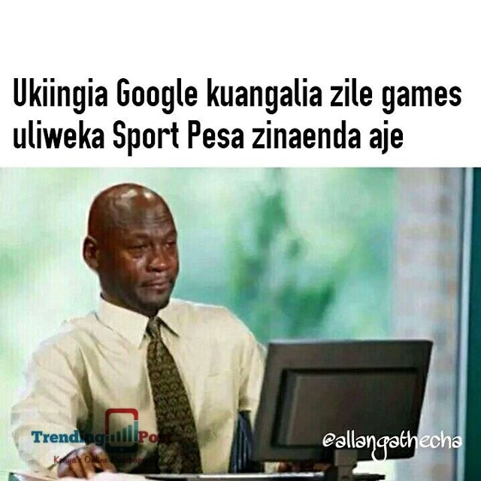
IIM - Evaluation
Laboratory evaluation directed by the above:
Muscle enzymes, serologies, tests to R/O other diseases.
Radiographic studies, muscle MRI.
EMG, biopsies of skin, muscle, possibly other tissues.
Special serologic or genetic studies depending upon results from the above.

Slide 52
IIM – Laboratory abnormalities
Sarcoplasmic enzymes (CPK, LDH, ALT, AST, aldolase) – useful in assessing myositis activity.
CPK MB fraction – correlates with diseases activity and is not usually indicative of cardiac involvement unless the ratio of CK-MB/total CK rapidly increases.
ESR/CRP – elevated in <30% of pts.
ANA – positive in 60-90% of pts; best single lab discriminator of IIM from other myopathies.

Slide 53
Causes of elevated serum CPK enzyme activity
Physical trauma or muscle stress.
Any muscle trauma – falls, EMG studies, surgery, muscle biopsy, IM injection.
Strenuous, prolonged exercise-marathon running, forced marching.
Drug effects
On muscle itself – clofibrate, ethanol, amphetamines, heroin.
On CK metabolism/clearance-phenobarbital, morphine, diazepam.

Slide 54
Causes of elevated serum CPK enzyme activity
Diseases
Directly affecting muscle-non inflammatory myopathies of all kinds, MI, malignant hyperthermia, infectious myopathies, IIM.
Affecting blood supply to muscle-emboli to muscle, vasculitis,prolonged immobilization.
Affecting the CNS-cerebral ischemia, trauma,infections.
Possible familial cases in African-Americans.

Slide 55
Myositis specific antibodies

Slide 56
Treatment Immunosuppressive therapy is the mainstay of treatment
First line
Prednisone
IV Methylprednisone
Second line
Methotrexate
Azathioprine
Third line/ Emerging drugs
Cyclosporine
Intravenous Immunoglobulins
Mycophenolate
Tacrolimus
Rituximab
Etanercept
Cyclophosphamide

Slide 57
Prognosis
The prognosis of the idiopathic inflammatory myopathies is generally favorable
Overall, drug-free remissions are rare except in JDM
Poor prognostic factors
old age
male gender
non-Caucasian ethnicity
longer symptom duration
ILD, cardiac involvement
associated malignancy
dysphagia
serum MSA (anti Jo-1 antibodies, anti SRP antibodies)
Mortality remains two- to three fold higher than the general population; with cancer, lung, cardiac complications, and infections being the most common causes of death

Slide 58
We are done……

