Slide 1
SYSTEMIC SCLEROSIS
Syokau Ilovi
Department of Clinical Medicine & Therapeutics
Tel: 0722233157
Email: csilovi@uonbi. ac.ke

Slide 2
Overview
Definition
Epidemiology
Pathophysiology
Clinical Variants
Clinical Presentation
Complications
Treatment

Slide 3
Definition
Also known as scleroderma/ SSc
Is an autoimmune disease of unknown aetiology characterized by characterized by thickening of the skin (scleroderma) and internal organ fibrosis internal organs (eg lungs, GIT, heart, &kidneys)
Also presents with vaculopathy ( Raynaud’s phenomenon) and autoantibody formation.

Slide 4
Epidemiology
Usually affects women aged 30- 40 years
F:M ratio 3-6:1
No racial preponderance
* Local data

Slide 5
Pathophysiology

Slide 6
Vasculopathy
Raynaud's phenomenon, an early manifestation, is characterized by an altered blood-flow response to cold challenge.
This is initially reversible vascular abnormality is associated with alterations in the autonomic and peripheral nervous systems.
Progressive luminal occlusion culminates in the striking absence of blood vessels seen on angiograms of the hands and kidneys of patients with late-stage disease.

Slide 7
Cellular and Humoral Autoimmunity
Circulating autoantibodies occur in virtually all patients with SSc.
Include Antinuclear antibodies (ANA)
May also have autoantibodies specific to SSc

Slide 8
Fibrosis
Fibrosis characteristically follows and is thought to be a consequence of autoimmunity and vascular damage.
Characterized by progressive replacement of normal tissue architecture with dense connective tissue.
Hallmark of SSc

Slide 9
Clinical Variants (1)
The hallmark of the disease is the skin fibrosis (scleroderma)
Also has internal organ fibrosis of different magnitudes
These determine the type of disease that develops

Slide 10
Clinical Variants(2)
Diffuse Cutaneous Systemic Sclerosis
Limited Cutaneous Systemic Sclerosis
Morphea
Systemic Sclerosis Sine Scleroderma

Slide 11
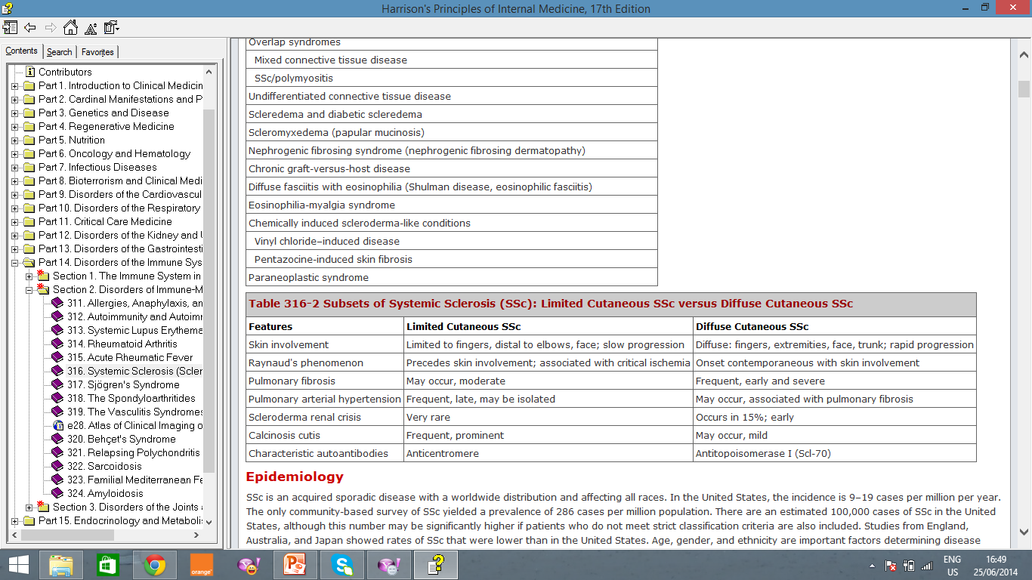
Clinical Variants(3)

Slide 12
Clinical Presentation(1)
Systemic sclerosis can affect virtually every organ.
Commonly affects skin, lungs, GIT, kidneys, heart.

Slide 13
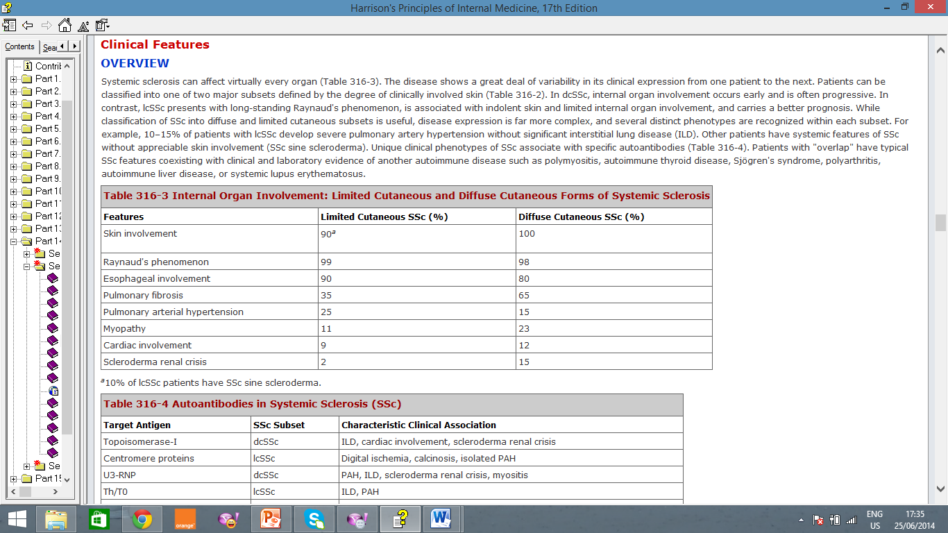
Clinical Presentation(2)

Slide 14
Raynaud's Phenomenon(1)
3–5% of the general population has Raynaud's phenomenon, and it is more frequent in women. ( Primary Raynaud’s)
  Represents an exaggerated response to cold
Secondary Raynaud's phenomenon occurs as a complication of SSc and other connective tissue diseases.
In SSC, Raynaud's phenomenon, defined as episodic vasoconstriction in the fingers and toes, develops in virtually every patient.
May also affect the tip of the nose and earlobes.
Attacks are triggered by exposure to cold, a decrease in temperature, emotional stress, and vibration.
Typical attacks start with pallor, followed by cyanosis of variable duration. Eventually erythema develops spontaneously or with rewarming of the digit.
The progression of the three colour phases reflects the underlying pathogenic mechanisms of vasoconstriction, ischemia, and reperfusion.

Slide 15
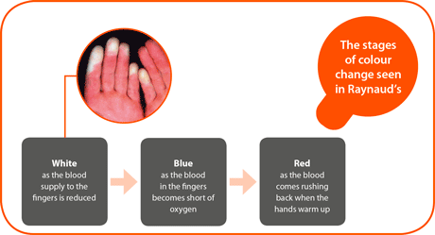
Raynaud's Phenomenon(2)

Slide 16
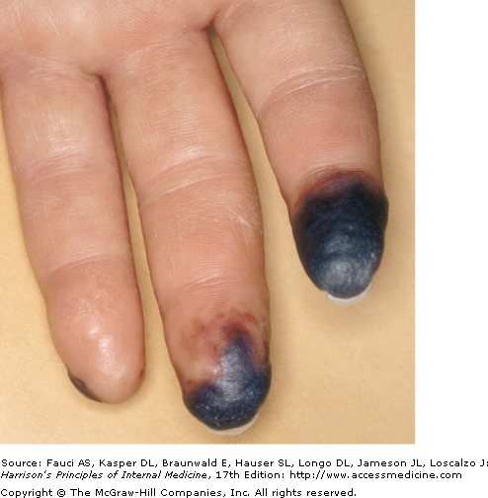
Raynaud's Phenomenon(3)-Gangrene

Slide 17
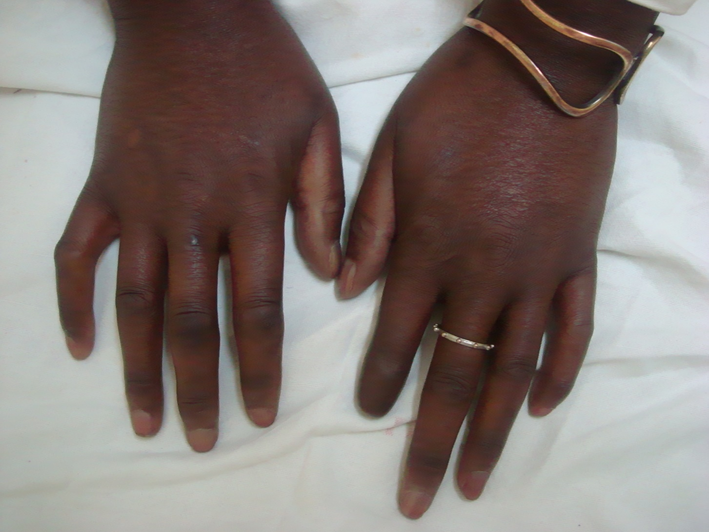
Raynaud's Phenomenon(4)- Auto amputation

Slide 18
Skin Features(1)
Skin thickening is the hallmark of SSc that distinguishes it from other connective tissue diseases.
The distribution of skin thickening is invariably symmetrical and bilateral.
In the affected areas, the skin is firm, coarse, and thickened

Slide 19
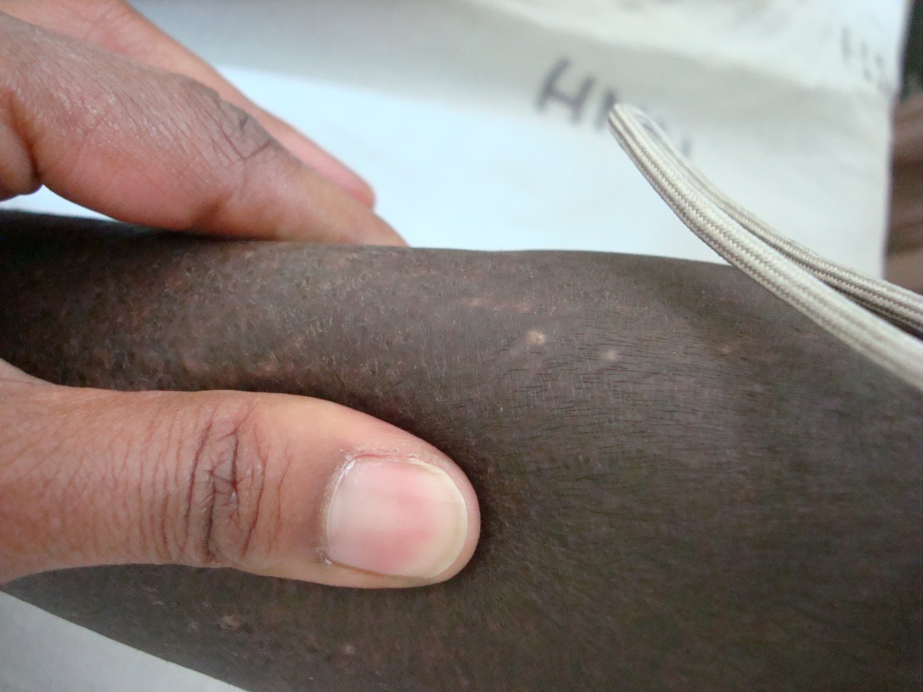
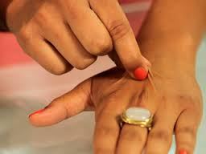
Skin Features(2)

Slide 20
Skin Features(3)
Skin thickening in combination with fibrosis of the subjacent tendons accounts for contractures of the wrists, elbows, and knees.
The face assumes a characteristic "mauskopf" appearance with taut and shiny skin, loss of wrinkles, and occasionally an expressionless facies due to reduced mobility of the eyelids, cheeks, and mouth.
Thinning of the lips with accentuation of the central incisor teeth and fine wrinkles (radial furrowing) around the mouth complete the picture.
The oral aperture may be dramatically reduced(microstomia).
The nose assumes a pinched, beak-like appearance.

Slide 21
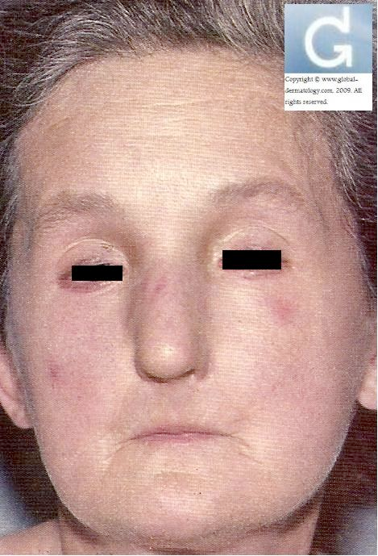
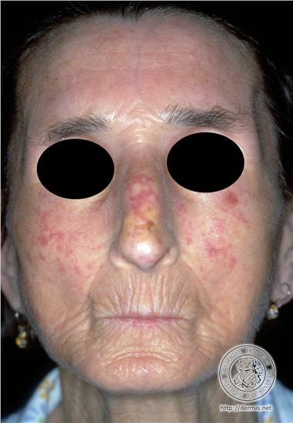
Skin Features(4)- Mauskopf

Slide 22
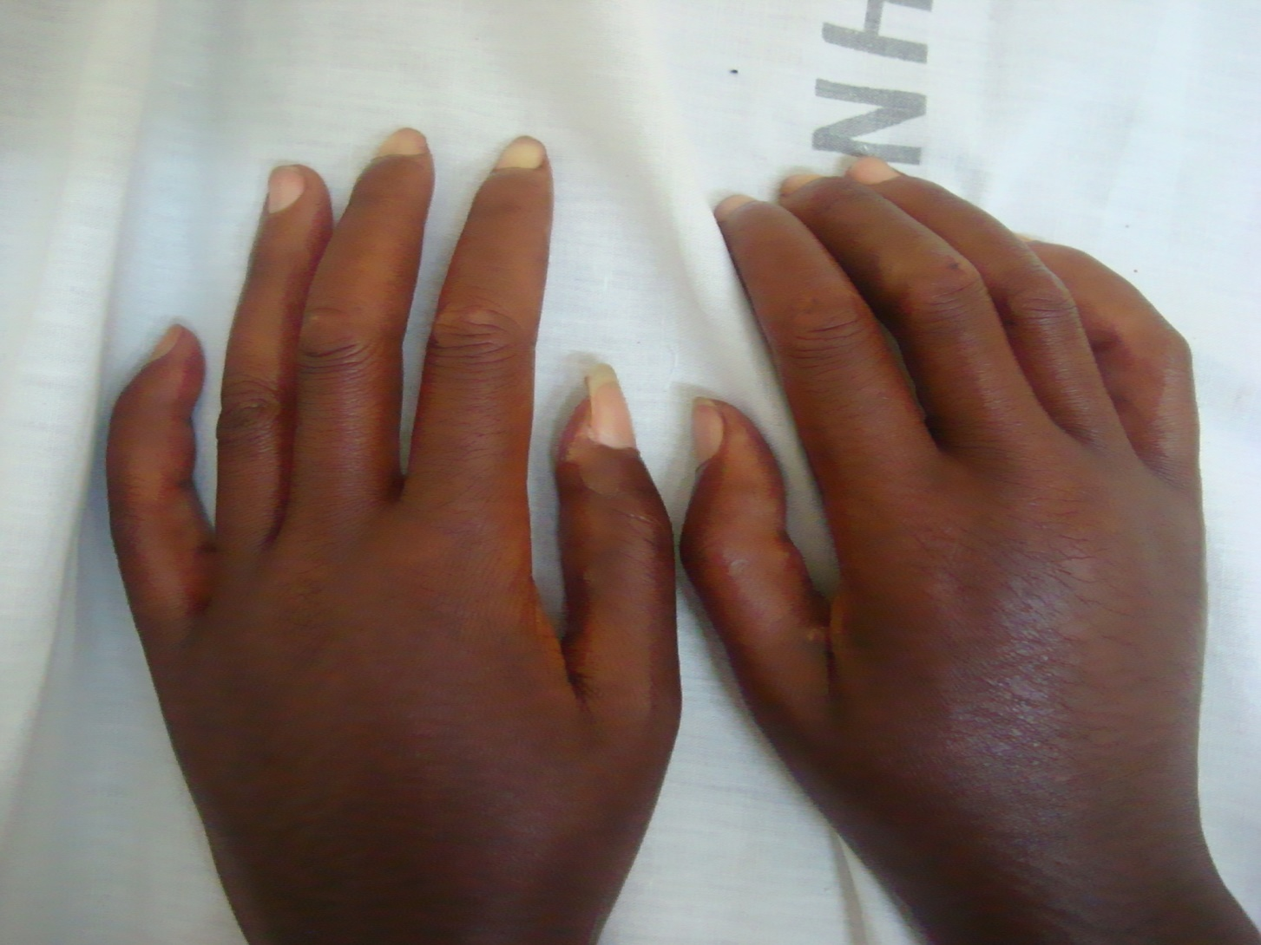
Skin Features(5)- Sclerodactyl

Slide 23
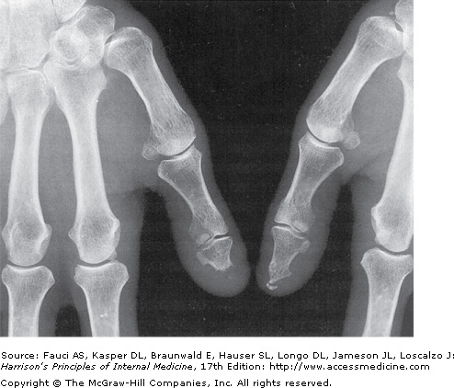
Acro-osteolysis

Slide 24
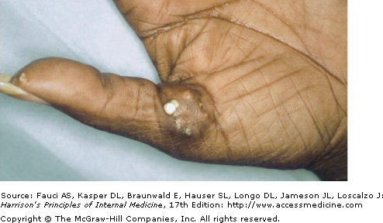
Calcinosis Cutis

Slide 25
Pulmonary Features
Pulmonary involvement can be documented in most patients with SSc and is now the leading cause of death
Two main entities- Pulmonary fibrosis and Pulmonary arterial hypertension

Slide 26
Gastrointestinal Involvement
The gastrointestinal tract is affected in up to 90% of patients.
Most patients have heartburn, regurgitation, and dysphagia

Slide 27
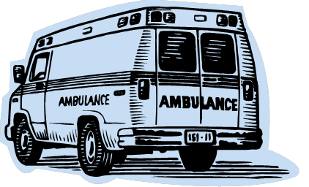

Renal Involvement
Patients present with malignant hypertension
Is an emergency
Treatment is by use of ACE Inhibitors

Slide 28
Cardiac Involvement
Cardiac involvement is manifested by myocardial and pericardial disease and conduction system abnormalities.
Cardiac involvement can also occur secondary to PAH and scleroderma renal crisis.

Slide 29
Other Complications
Carpal tunnel syndrome occurs frequently and may be a presenting manifestation of SSc.
Generalized arthralgia and stiffness are prominent in early disease
Dry eyes and dry mouth (sicca complex)
Hypothyroidism is common and generally due to fibrosis of the thyroid gland

Slide 30
Diagnosis
The diagnosis of SSc is made primarily on clinical grounds and is generally straightforward in patients with established disease.
The presence of skin induration, with a characteristic symmetrical distribution pattern associated with typical visceral organ manifestations, establishes the diagnosis with a high degree of certainty
Barium Swallow- GERD
ECG- Conduction abnormalities
Auto-antibodies

Slide 31
SSc In Kenya
Study of 50 patients
M:F 1:4
Mean age of presentation was 41.7 years with a range of 4 years to 70 years.
Majority of the patients (82%) presented with diffuse cutaneos systemic sclerosis.
Skin manifestation was the commonest presentation (100%), followed by Raynaud’s phenomenon (64%), pulmonary disease (56%) and esophageal disease (54%).
Antinuclear antibodies were present in 67% of the patients tested.
Ilovi CS, Oyoo GO.Characteristics Of Patients With Systemic Sclerosis In Nairobi, Kenya: A Retrospective Study . Africa Journal of Rheumatology. Vol 1; Jan 2013: Page 23-27

Slide 32
Management
To date, no therapy has been shown to significantly alter the natural history of SSc
Raynauds- Warmth, Calcium channel blockers
SSc renal crisis- ACEI
GERD- PPI
Lung disease- Cyclophosphamide

