Slide 1

The Doctor’s nightmare: Fibromyalgia
Dr Eugene Kalman Genga
Dept. of clinical Medicine and Therapeutics
University of Nairobi

Slide 2
QUIZ

Slide 3
Somatisation is more common in
Women
People with higher socioeconomic status
Patients from larger families
People who have had early life difficulties
People who have experienced stressful life events

Slide 4
Somatisation is more common in
Women
People with higher socioeconomic status
Patients from larger families
People who have had early life difficulties
People who have experienced stressful life events

Slide 5
What % of MUS persist beyond a year?
5%
25%
50%
85%

Slide 6
What % of MUS persist beyond a year?
5%
25%
50%
85?

Slide 7
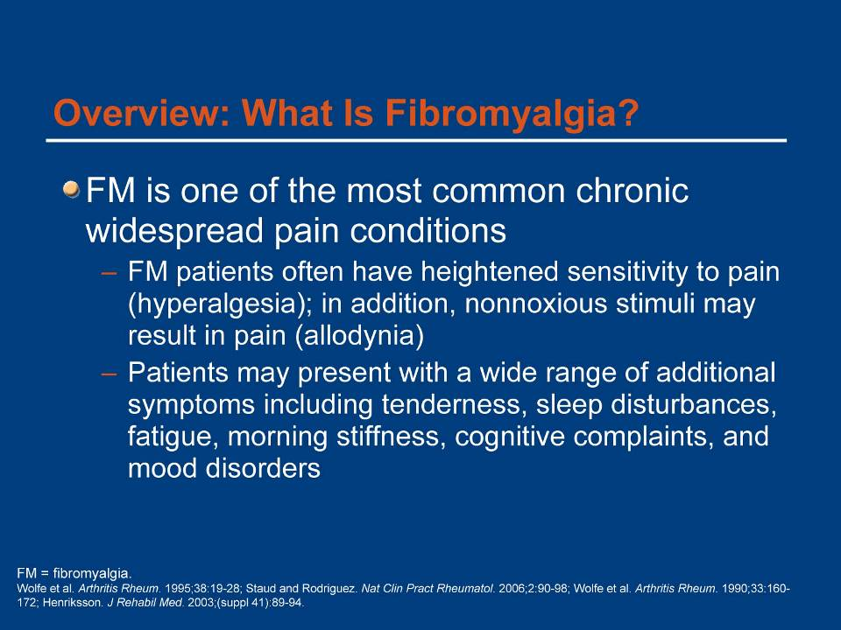

Slide 8

Primary Care and Functional Illnesses
Account for 30-50% of office visits
Medical classification: FM, IBS, irritable bladder, vulvodynia, non-cardiac chest pain, TMJ, multiple chemical sensitivity, tension headaches
Psychiatric classification: Somatization disorder, hypochondriasis, conversion disorder, PTSD
Commonest primary care problem
Specialty referral based on most distressing syndrome

Slide 9
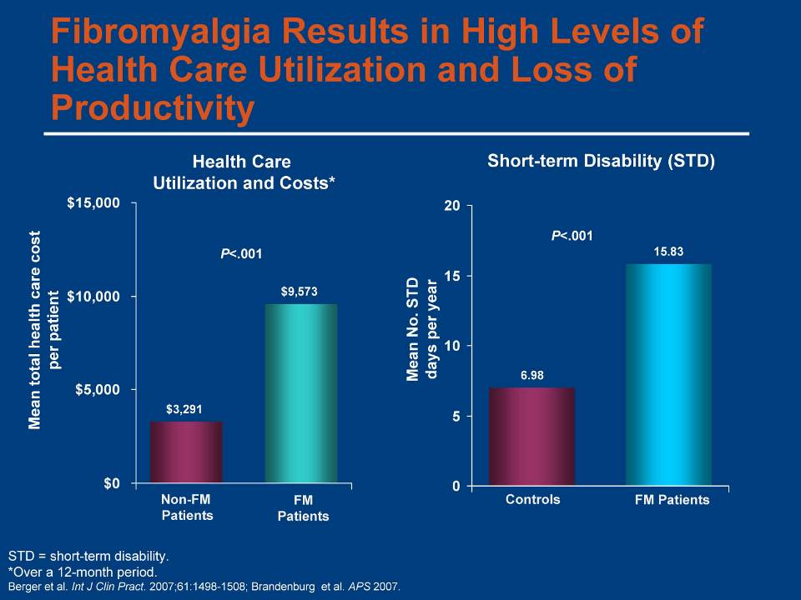

Slide 10
Case Presentation
A 35-year-old woman presents to your office complaining of diffuse “joint pain” for the past several months. On further questioning, she states that the pain is all over her body, in her muscles and joints. It is there throughout the day, and worsened by exercise.
She gets minimal relief with acetaminophen.

Slide 11
Who Gets Fibromyalgia?
No concurrent medical illness
  Any age, but peak age 40-60
  60-90% female in clinic, although less gender difference in population-based studies
Concurrent medical illness (e.g., SLE, RA, OA, hypothyroidism, hepatitis). Important to consider in patients with rheumatic or chronic pain disorders
Prior medical illness (e.g., Lyme disease,
viral illness)
Medications (steroid taper)
Notes:
Table 1.1. Who Gets Fibromyalgia?

Slide 12
Case Cont’d
ROS: Positive for daytime fatigue, constipation, and occasional palpitations.
PMH: None.
Meds: Acetaminophen prn
FH: Mother has RA, sister has hypothyroidism.

Slide 13
Medically Unexplained Illnesses Concurrent With Fibromyalgia
Chronic fatigue syndrome
Irritable bowel syndrome
Muscle, migraine headaches
Irritable bladder syndrome
Mood disturbances
Vulvodynia
Temporomandibular joint (TMJ) disorder
IN EACH OF THESE: Diagnosis dependent on:
Exclusion of disease
Symptoms rather than signs
No reproducible laboratory findings
Gold standard is “expert opinion”
Notes:
THOUGHT LEADER SLIDE
No reference needed per Don Goldenberg (he created)

Slide 14
Case Cont’d
Physical Exam T 36.5; BP 125/78; P 65
Genl: WNWD, thin woman, NAD, slightly flat affect
Neck: No thyromegaly, no LAD.
CV: RRR, no murmur
Lungs: Clear
Abd: Soft, slightly tender throughout, ND
MSK: No joint swelling nor erythema. Normal range of motion in all joints. 8/18 tender points positive
Skin: No rashes.

Slide 15

Case Cont’d
What is your differential diagnosis?
What further work-up does she need?

Slide 16
Differential Diagnosis
Polyarticular arthritis
  Rheumatoid arthritis
  SLE
  Polymyalgia rheumatica
Endocrine disorders
  Hypothyroidism
  Hyperparathyroidism (hypercalcemia)
Myopathies
  Polymyositis
  Rhabdomyolysis

Slide 17
Differential Diagnosis
Neuropathies
Depression
Chronic fatigue syndrome
Myofascial pain syndrome
Anemia

Slide 18

Case Cont’d
What further work-up does our patient need?

Slide 19
Diagnostic Evaluation
Careful history and physical
  This is the most important component and often leads to the diagnosis
Labs to evaluate for:
  Causes of fatigue (CBC, TSH)
  Causes of myalgias (CK, ? Chemistry panel)
  Evidence of inflammation (ESR)

Slide 20
Diagnostic Evaluation
Generally NOT recommended
  ANA, Rheumatoid factor

Slide 21
Diagnostic Evaluation
Differentiating FM from other disorders
RA | Elevated RF, ? ESR, joint swelling/deformity, systemic symptoms
SLE | Systemic symptoms, ESR
PMR | Stiffness, ESR. Usually older patients.
Myositis/Rhabdo | Weakness, elevated CK
Depression | Tender points negative
Myofascial pain syndrome | Localized pain
Chronic fatigue syndrome | Fatigue > pain

Slide 22
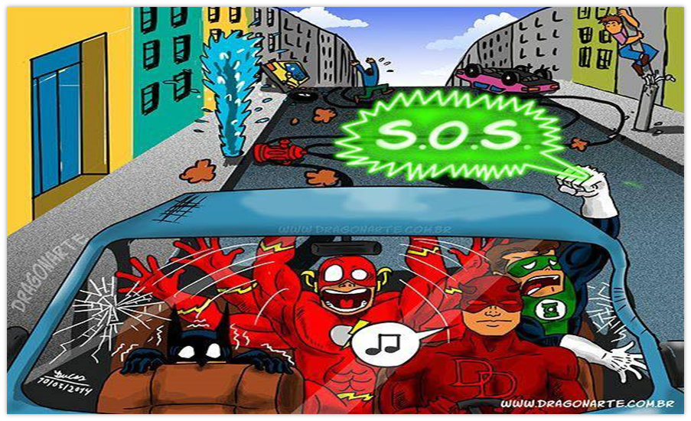
Case Cont’d
Your patient’s CBC, Chem 7, TSH, and ESR are normal. She returns to clinic for a follow-up visit to review her labs. You are about to begin explaining her diagnosis of fibromyalgia

Slide 23

Case Cont’d
You inform your patient that you believe she has fibromyalgia. She becomes tearful and says that she has read about this disease on the internet and it is clearly not a real illness. Furthermore, she has read that fibromyalgia is strongly associated with depression, and she adamantly states that she is not depressed. She would love to get back to the activities she used to enjoy, if only she did not have so much pain. She demands a referral to a rheumatologist for further evaluation.

Slide 24
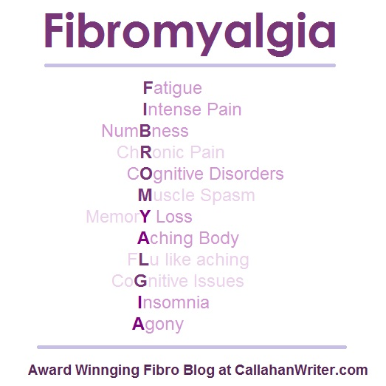

Slide 25
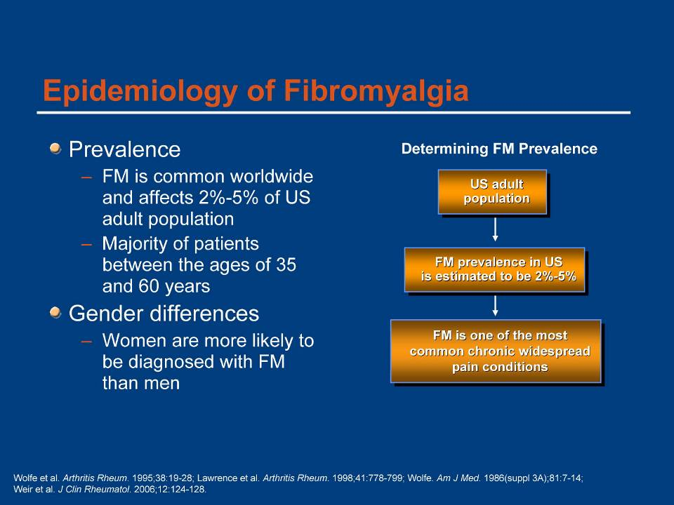
Nguyen at western Kenya area had 20%, Dokwe at KNH rheumatology clinic had 13%, Malombe at KNH CCC had 17.9%,

Slide 26
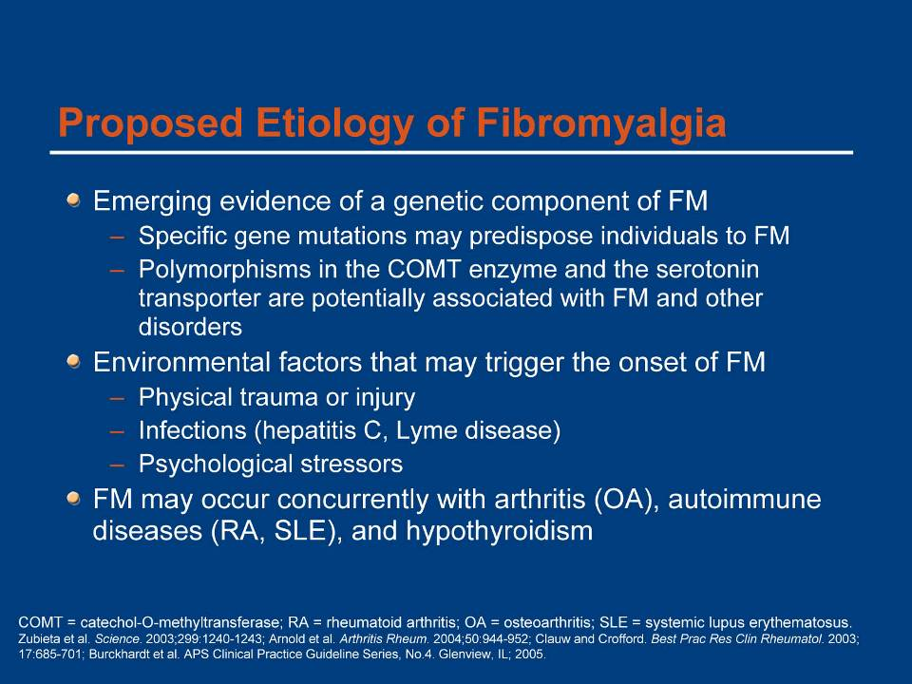

Slide 27
Fibromyalgia
Pathophysiology
Mechanism | Description
Central sensitization | Amplification of pain in the spinal cord via spontaneous nerve activity, expanded receptive fields, and augmented stimulus responses
Abnormalities of descending inhibitory pain pathways | Dysfunction in brain centers (or the pathways from these centers) that normally downregulate pain signaling in the spinal cord
Neurotransmitter abnormalities | Decreased serotonin in the central nervous system may lead to aberrant pain signaling, which may be due to serotonin transporter polymorphism Decreased dopamine transmission in the brain may lead to chronic pain through unclear mechanisms
Neurohumoral abnormalities | Dysfunction in the hypothalamic—pituitary—adrenal axis, including blunted cortisol responses and lack of cortisol diurnal variation, is associated with (but is not specific for) fibromyalgia
Psychiatric comorbid conditions | Patients with fibromyalgia have increased rates of psychiatric comorbid conditions, including depression, anxiety, posttraumatic stress, and somatization; these may predispose to the development of fibromyalgia
Abeles AM, et al. Ann Intern Med. 2007;146:726-734.

Slide 28
Structured Interview for Fibromyalgia
A. Widespread pain (axial + upper and lower + L and R sides)
B. 11 of 18 reproducible tender points
C. At least 4 of: generalized fatigue, headache, sleep disturbance, neuropsych complaints, numbness/tingling, IBS
OR
Explained by no other condition
Fibromyalgia
A. Generalized, chronic pain (≥ 3 months) affecting the axial, plus upper and lower segments, plus left and right sides of the body
C. At least 4 of the following symptoms
1. Generalized fatigue
2. Headaches
3. Sleep disturbance
4. Neuropsychiatric complaints
5. Numbness, tingling sensations
6. Irritable bowel symptoms
Pope HG Jr, Hudson JI. Int J Psychiatry Med 1991;21(3):205-232

Slide 29
FM Diagnosis is Very “Physician Dependent”
History of chronic,
widespread pain for ≥3 months
History of chronic,
widespread pain for ≥3 months
Rule out other conditions that may present with chronic widespread pain
Depending on physician: Mental health evaluation, sleep evaluation
Rule out other conditions that may present with chronic widespread pain (“Operator dependent”)
General physical exam, neurologic exam, selected laboratory testing (ESR, thyroid tests; avoid screening serologic tests)
General physical exam, neurologic exam, selected laboratory testing (ESR, thyroid tests; avoid screening serologic tests)
Confirm presence of tender points
(Fibromyalgia may be present, even if <11 of 18)
Confirm presence of tender points
(Fibromyalgia may be present, even if <11 of 18)
Confirm diagnosis
of fibromyalgia
Confirm diagnosis
of fibromyalgia
29
Modified from Goldenberg JAMA 2004
Notes:
29
References:
1. Goldenberg DL, Burckhardt C, Crofford L. Management of fibromyalgia syndrome. JAMA. 2004;292:2388-2395.
2. Wolfe F, Smythe HA, Yunus MB et al. The American College of Rheumatology 1990 criteria for the classification of fibromyalgia. Report of the Multicenter Criteria Committee. Arthritis Rheum. 1990;33:160-172.
3. Jain AK, Carruthers BM, van de Sande MI et al. Fibromyalgia syndrome: Canadian clinical working case definition, diagnostic and treatment protocols – a consensus document. J Musculoskelet Pain. 2003;11:3-107.
4. Burckhardt CS, Goldenberg D, Crofford L, et al. Guideline for the Management of Fibromyalgia Syndrome Pain in Adults and Children. APS Clinical Practice Guidelines Series, No.4. Glenview, Ill: American Pain Society; 2005.

Slide 30
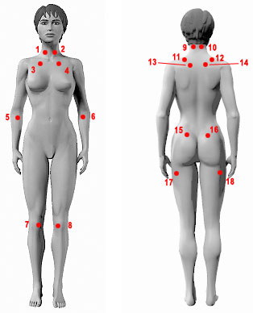
Fibromyalgia
ACR Diagnostic Criteria
History (≥3 months) of widespread pain
  Above and below the waist
  Bilateral
  In the axial skeleton
Manual tender
point examination
  Pain in ≥11 of 18 specific
  fibromyalgia tender points on digital palpation
  ~ palpation force: 4 kg/1.4 cm²
Okifuji A, et al. J Rheumatol. 1997;24:377-383.
Wolfe F, et al. Arthritis Rheum. 1990;33:160-172.
http://www.fibromyalgia-symptoms.org/fibromyalgia_diagnosis.html. Accessed August 1, 2008.
Notes:
The fibromyalgia tender points are areas of tenderness in muscles, muscle-tendon junctions, or fat pads.
The palpation examination should be performed with an approximate force of 4 kg/1.4 cm² , which is approximately the pressure required to partially blanch the blood from under the fingernail. Palpation can be delivered with a calibrated dolorimeter to ensure reliability and validity between examiners. Palpation must be “painful” rather than “tender.”
Fibromyalgia can be diagnosed even if the ACR’s tender point criteria are not met, provided the patient history is highly suggestive.
Am Fam Physician. 2007;76:247-54.

Slide 31
Fibromyalgia
Differential Diagnosis
Rheumatic illness
  Systemic CTD (RA, myositis, SLE, PMR)
    False + ANA “pitfalls”
    Seronegative spondyloarthropathies
Other chronic pain disorder (OA, spinal stenosis, neuropathy)
Infectious disease
  Lyme disease
  Viral (hepatitis C, HIV, “EBV”)
Hypothyroidism
Consider concurrent systemic illness and primary sleep and mood disorders
CTD=connective tissue disease. RA=rheumatoid arthritis. SLE=systemic lupus erythematosus; PMR=polymyalgia rheumatica; ANA=antinuclear antibodies; HIV=human immunodeficiency virus; EBV=Epstein-Barr virus.
http://www.medscape.com/viewprogram/17278_pnt. FPO
Notes:
Except for ethnicity, marital status, and education, patients with survey-diagnosed fibromyalgia differed in all diagnostic and clinical characteristics from patients without survey-diagnosed fibromyalgia.

Slide 32
Fibromyalgia
Interventions
Patient Education
Explain what the condition is
and what it is not
Physical Therapy
Exercise programs
CAM
Cognitive-
behavioral,
alternative therapies
Multimodal Therapeutic
Strategies for Fibromyalgia
Psychological
Support
Psychotherapy,
support groups
Pharmacotherapy
SNRIs, TCAs,
anticonvulsants, tramadol
Address Comorbidities
Sleep dysfunction,
depression, anxiety
CAM, complementary and alternative medicine; SNRI, serotonin–norepinephrine reuptake inhibitor;
TCA, tricyclic antidepressant.
Burckhardt CS, et al. Guideline for the Management of Fibromyalgia Syndrome Pain in Adults and Children.
Glenville, Ill: American Pain Society; 2005.

Slide 33
Treatment of Fibromyalgia
Patient Education
Patients generally have fewer symptoms if they are told their diagnosis
Group sessions (6-17 sessions), lectures, written materials seem to improve quality-of-life, pain, sleep, energy levels³; improvements lasted 3-12 months
One 1.5-day educational session improved energy, stiffness, pain severity, and depression⁴

Slide 34
Fibromyalgia
Nonpharmacologic Therapies
Strong evidence
  Education
  Aerobic exercise
  Cognitive-behavioral therapy
Modest evidence
  Strength training
  Hypnotherapy, biofeedback, balneotherapy
Weak evidence
  Acupuncture
  Chiropractic, manual, and massage therapy
  Electrotherapy
  Ultrasound
No evidence
  Tender point injections
  Flexibility exercise
Burckhardt CS, et al. Guideline for the Management of Fibromyalgia Syndrome Pain in Adults and Children.
Glenville, Ill: American Pain Society; 2005; Goldenberg DL, et al. JAMA. 2004;292:2388-2395.

Slide 35




Fibromyalgia
Aerobic Exercise
Exercise
Control
a
Benefits first reported 30 years ago
  Nearly universally beneficial
Tolerance, compliance,
and adherence are
biggest hurdles
Programs should be individualized
  Begin several months after pharmacologic therapy
  Begin with low-impact exercises
30
25
20
a
15
Mean Change
in Parameter, %
10
5
0
-5
-10
Aerobic
Mean Tender
Performance
Point Pain
Pain Intensity
Threshold
ª P<0.001; meta-analysis of 4 independent studies.
Busch AJ, et al. Cochrane Database Syst Rev. 2002, Issue 2. Art. No. CD003786. doi:10.1002/14651858.CD003786.
McCain GA, et al. Arthritis Rheum. 1988;31:1135-1141.

Slide 36
Fibromyalgia
Cognitive-Behavioral Therapy
Thoughts
Longitudinal trials show
reduced pain severity and improved function
Systematic reviews demonstrate reduced pain and fatigue, improved mood and function
Improvements also seen with meditation, relaxation, stress management
Effects depend heavily
on therapist and program
Physical
Response
Feelings
Behavior
Goldenberg DL, et al. JAMA. 2004;292:2388-2395.
Hadhazy V, et al. J Rheumatol. 2000;27:2911-2918.
Williams DA. Best Pract Res Clin Rheumatol. 2003;17:649-665.

Slide 37
Fibromyalgia
Overlap With Related Syndromes
Fibromyalgia
2%-4% of population;
defined by widespread
pain and tenderness
CFS
1% of population;
fatigue and 4 of 8
“minor criteria”
Pain and/or
sensory
amplification
Psychiatric
disorders
MDD, OCD,
bipolar, PTSD,
GAD, panic attack
Regional pain
syndromes
(eg, tension headache,
TMD, idiopathic LBP)
Somatoform disorders
4% of population; multiple unexplained symptoms,
no “organic” findings
CFS, chronic fatigue syndrome; GAD, generalized anxiety disorder; LBP, low back pain; MDD, major depressive disorder;
OCD, obsessive-compulsive disorder; PTSD, post-traumatic stress disorder; TMD, temporomandibular disorders.
Clauw DJ, et al. Neuroimmunomodulation. 1997;4:134-153.

Slide 38

Medications in FMS
Strong evidence for efficacy
  Amitriptyline, 25-50 mg at bedtime
  Cyclobenzaprine, 10-30 mgs at bedtime
  Pregabalin, 300-450 mg/day
  Gabepentin, 1600-2400 mg/day
  Duloxetine, 60-120 mg/day
  Milnacipran, 100-200 mg/day
Modest evidence for efficacy
  Tramadol, 200-300 mg/day
  SSRIs (fluoxetine, sertraline)
Weak evidence for efficacy: pramipexole, gamma hydroxybutyrate, growth hormone, 5-hydroxytryptamine, tropisetron, s-adenosyl-methionine
No evidence: opioids, NSAIDS, benzodiazepene and nonbenzodiazepene hypnotics, melatonin, magnesium, DHEA, thyroid hormone, OTC including guaifenesin
Modified from Goldenberg, et al: Management of fibromyalgia syndrome. JAMA 2004; 292:2388-95.

Slide 39
Rationale for the Use of Central Nervous System Active Medications in FM
No evidence for muscle pathology
Current research supports role of augmented central pain mechanisms
  Genetic predisposition
    5-HT_{2A} receptor polymorphism
    ↑ Pain severity in FM patients with T/T genotype
    ↑ Frequency of S/S genotype in FM patients compared with healthy controls
    ↑ Incidence of COMT polymorphism in FM patients
  Substance P increased in CSF
  5-HT and NE serum levels decreased in some studies
  Imaging studies
Elevated lifetime rates of mood disorders in patients with FM
Elevated rates of mood disorders in first-degree relatives of FM patients
Sleep disturbances
Russell IJ et al. Arthritis Rheum. 1992;35:550-556 Bondy B et al. Neurobiol Dis. 1999;6:433-439; Offenbaecher M et al. Arthritis Rheum. 1999;42:2482-2488. Arnold LM, et al. Arthritis Rheum. 2004;50:944-52. Moldofsky H. Adv Neuroimmunol. 1995;5:39-56. Buskila D, Sarzi-Puttini P. Arthritis Res Ther. 2006;8(5):218 Harris RE, et al. Arthritis Rheum. 2008;58:903-907.
.
Notes:
Sleep abnl thought to be mediated by by abnormality of central serotonergic neurotransmission. So the tertiary TCA’s with higher serotonin/norepinephrine reuptake inhibition than secondary agents became the initial candidates
This talk will focus on psychopharmacologic treatment of fibromyalgia

Slide 40
Natural history of fibromyalgia
Patients should be reassured that fibromyalgia is not life-threatening.
Most patients have waxing and waning symptoms throughout life, but generally remain very functional.
Most patients report that they are able to work full-time.
Patients should be encouraged to take an active role in disease management.

Slide 41
Case Study
Introducing Katherine
54-year-old financial consultant
Presents to PCP for evaluation of pain that started 4 months ago in her shoulders and spread recently to
her hips, arms, and back
  Pain levels vary, 5-8/10
  She can’t work as efficiently as before
History of symptoms consistent with IBS for the last 3 years, and recent depression, poor sleep and
chronic fatigue
Differentials??
What formal diagnostic, laboratory, and imaging tests may be helpful when diagnosing Katherine?
  Does she have any fibromyalgia predisposing factors?
IBS, irritable bowel syndrome; PCP, primary care physician; RA rheumatoid arthritis; SLE, systemic lupus erythematosus.

Slide 42
Fibromyalgia
Comprehensive Assessment
Detailed history focusing on illness that may mimic, complicate, or occur concurrently with fibromyalgia
Evaluate the severity of other fibromyalgia symptoms:
fatigue, sleep disturbance, mood/cognitive disturbance
Clinical diagnosis of fibromyalgia based on 1990 ACR criteria
Patient with probable fibromyalgia
Assess functional status at initial and subsequent visits
Characterize pain type,
location, source, intensity, duration, effects on QoL
Analyze complete blood count, ESR, muscle enzymes,
liver function, thyroid function
ACR, American College of Rheumatology; ESR, erythrocyte sedimentation rate; QoL, quality of life.
Burckhardt CS, et al. Guideline for the Management of Fibromyalgia Syndrome Pain in Adults and Children.
Glenville, Ill: American Pain Society; 2005.

Slide 43
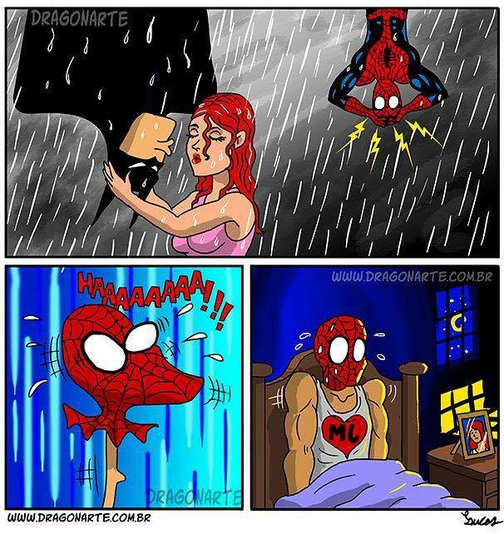
Fibromyalgia: take-home points
Defined as diffuse pain and 11/18 positive tender points, though some patients will not strictly meet criteria
Check CBC, ESR, TSH, CK depending on symptoms
Most effective treatments: Patient education; aerobic exercise; CBT; TCAs
Most patients will continue to have some pain but will function relatively normally

